Slide 1
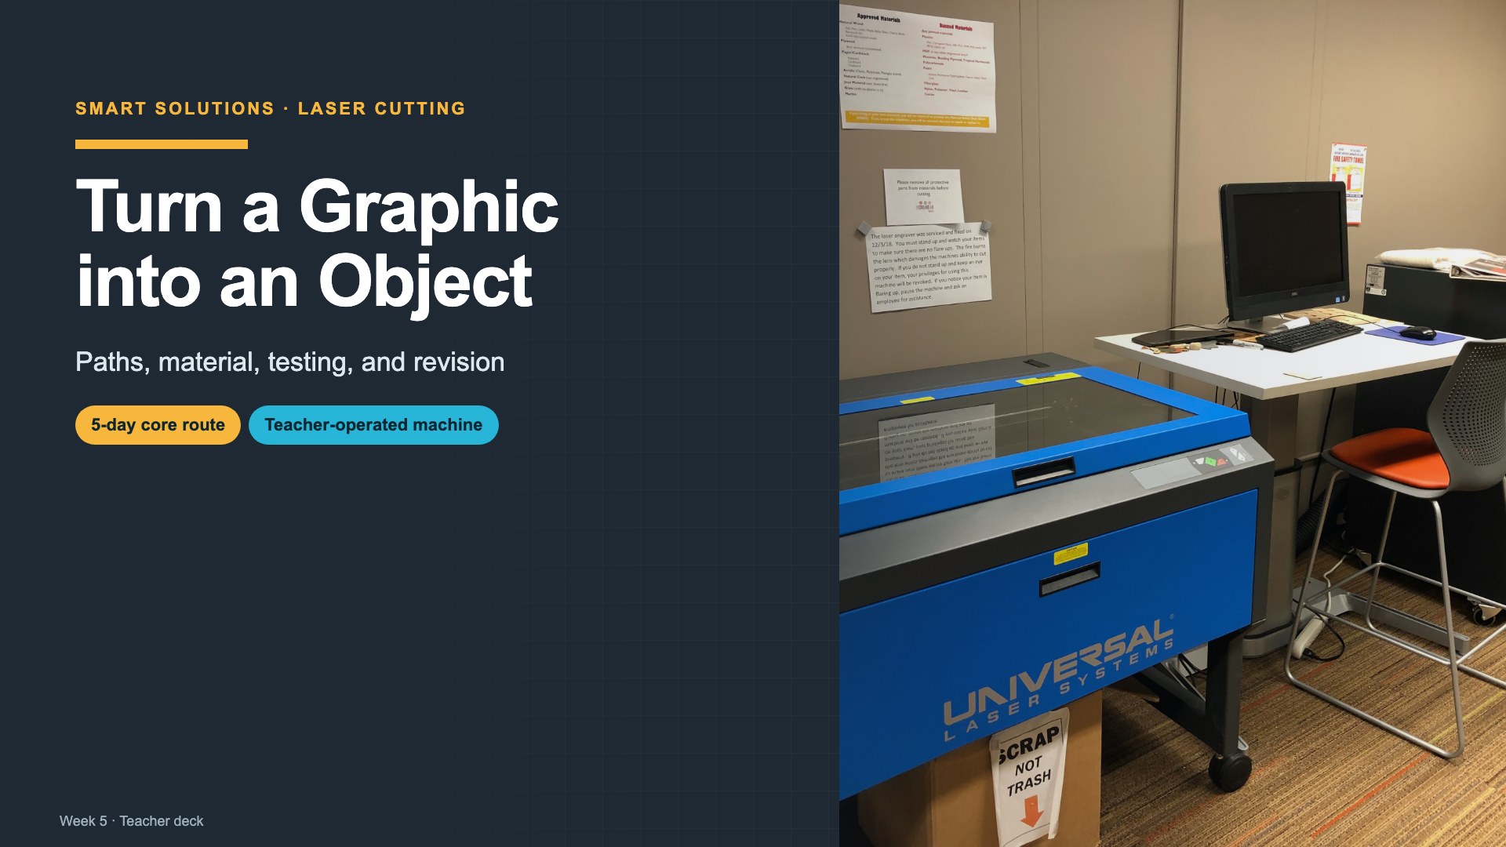
Notes:
Introduce the week as a fabrication problem, not a machine tour. Students will learn how file structure, material, and testing control the physical result.
[Sources]
- https://commons.wikimedia.org/wiki/File:Library_laser_cutter.jpg
- https://support.glowforge.com/hc/en-us/articles/360033633314-safety-glowforge-performance-series

Slide 2
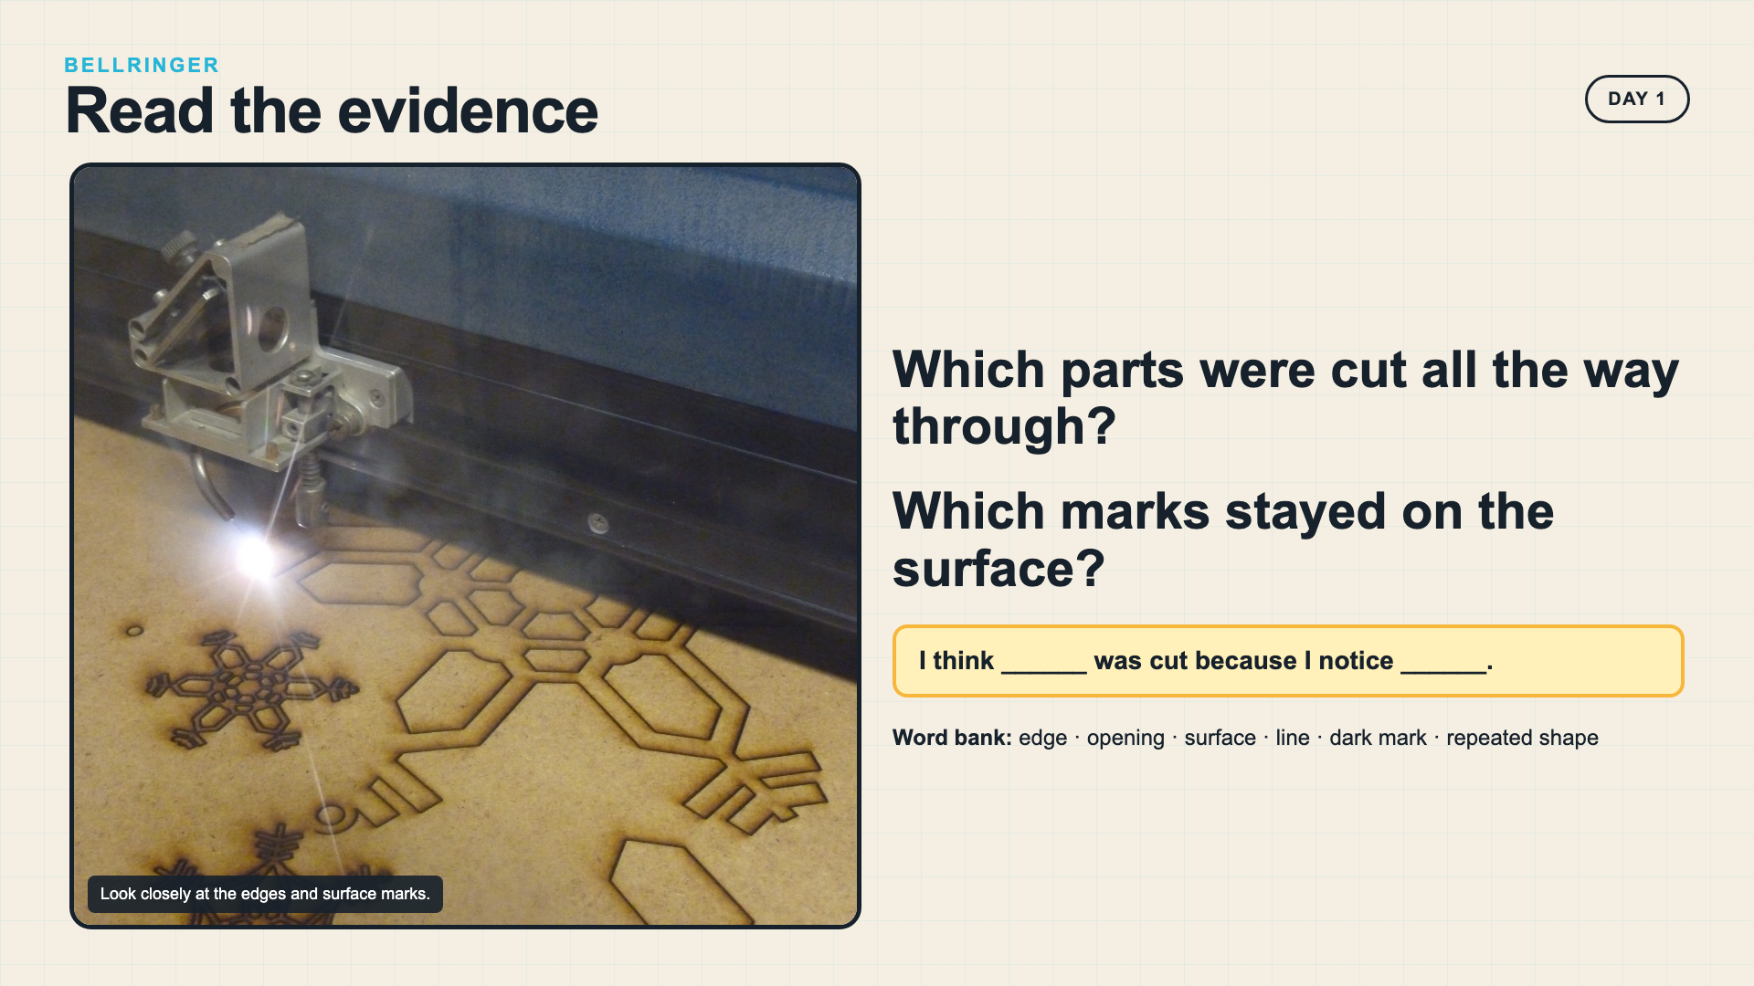
Notes:
Give students quiet looking time before they talk. Ask them to point to evidence in the photo rather than guess how a laser works.
[Sources]
- https://commons.wikimedia.org/wiki/File:Laser_cutting_snowflakes.jpg

Slide 3
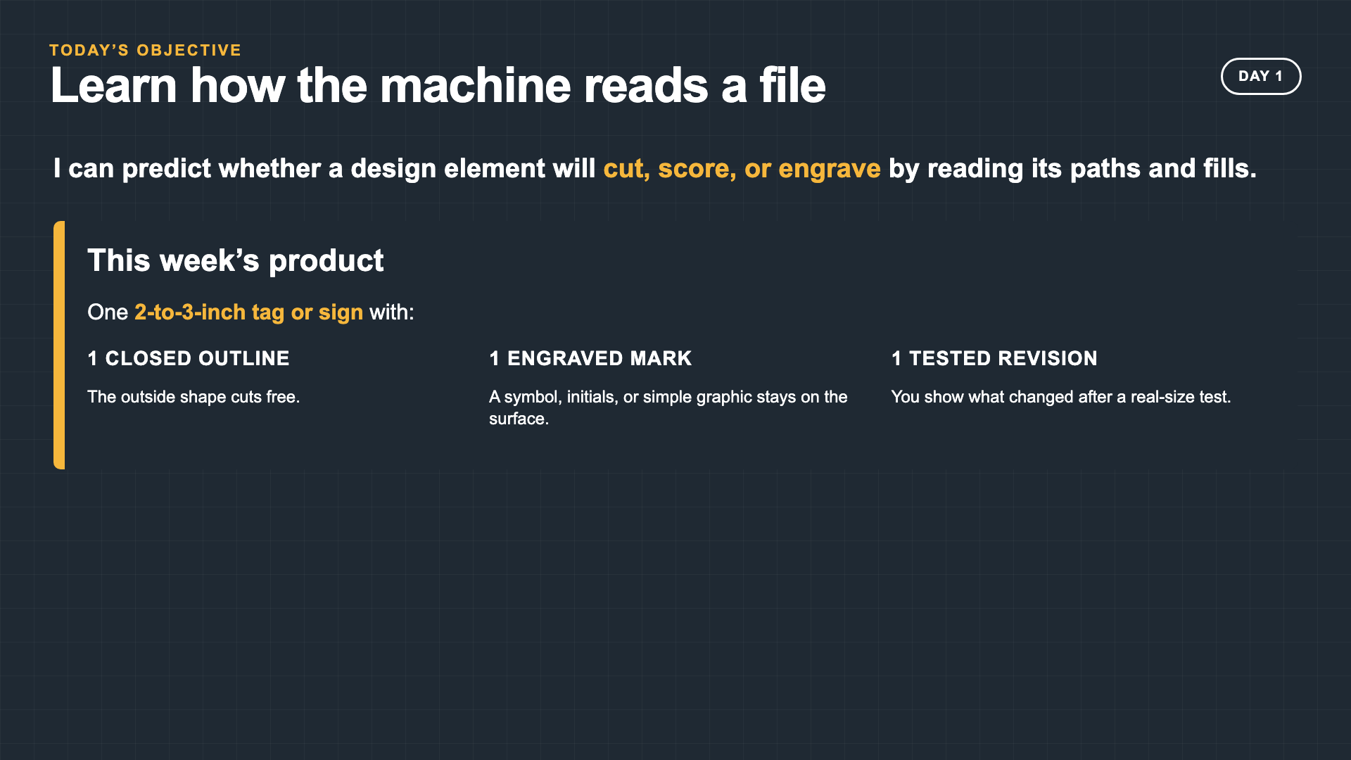
Notes:
The product is intentionally small so every student can complete one full test-and-revise cycle within the compressed week.
[Sources]
- Owner course source: Lesson Outline Intro Laser Cut Mini-Project + Catch-Up.docx

Slide 4
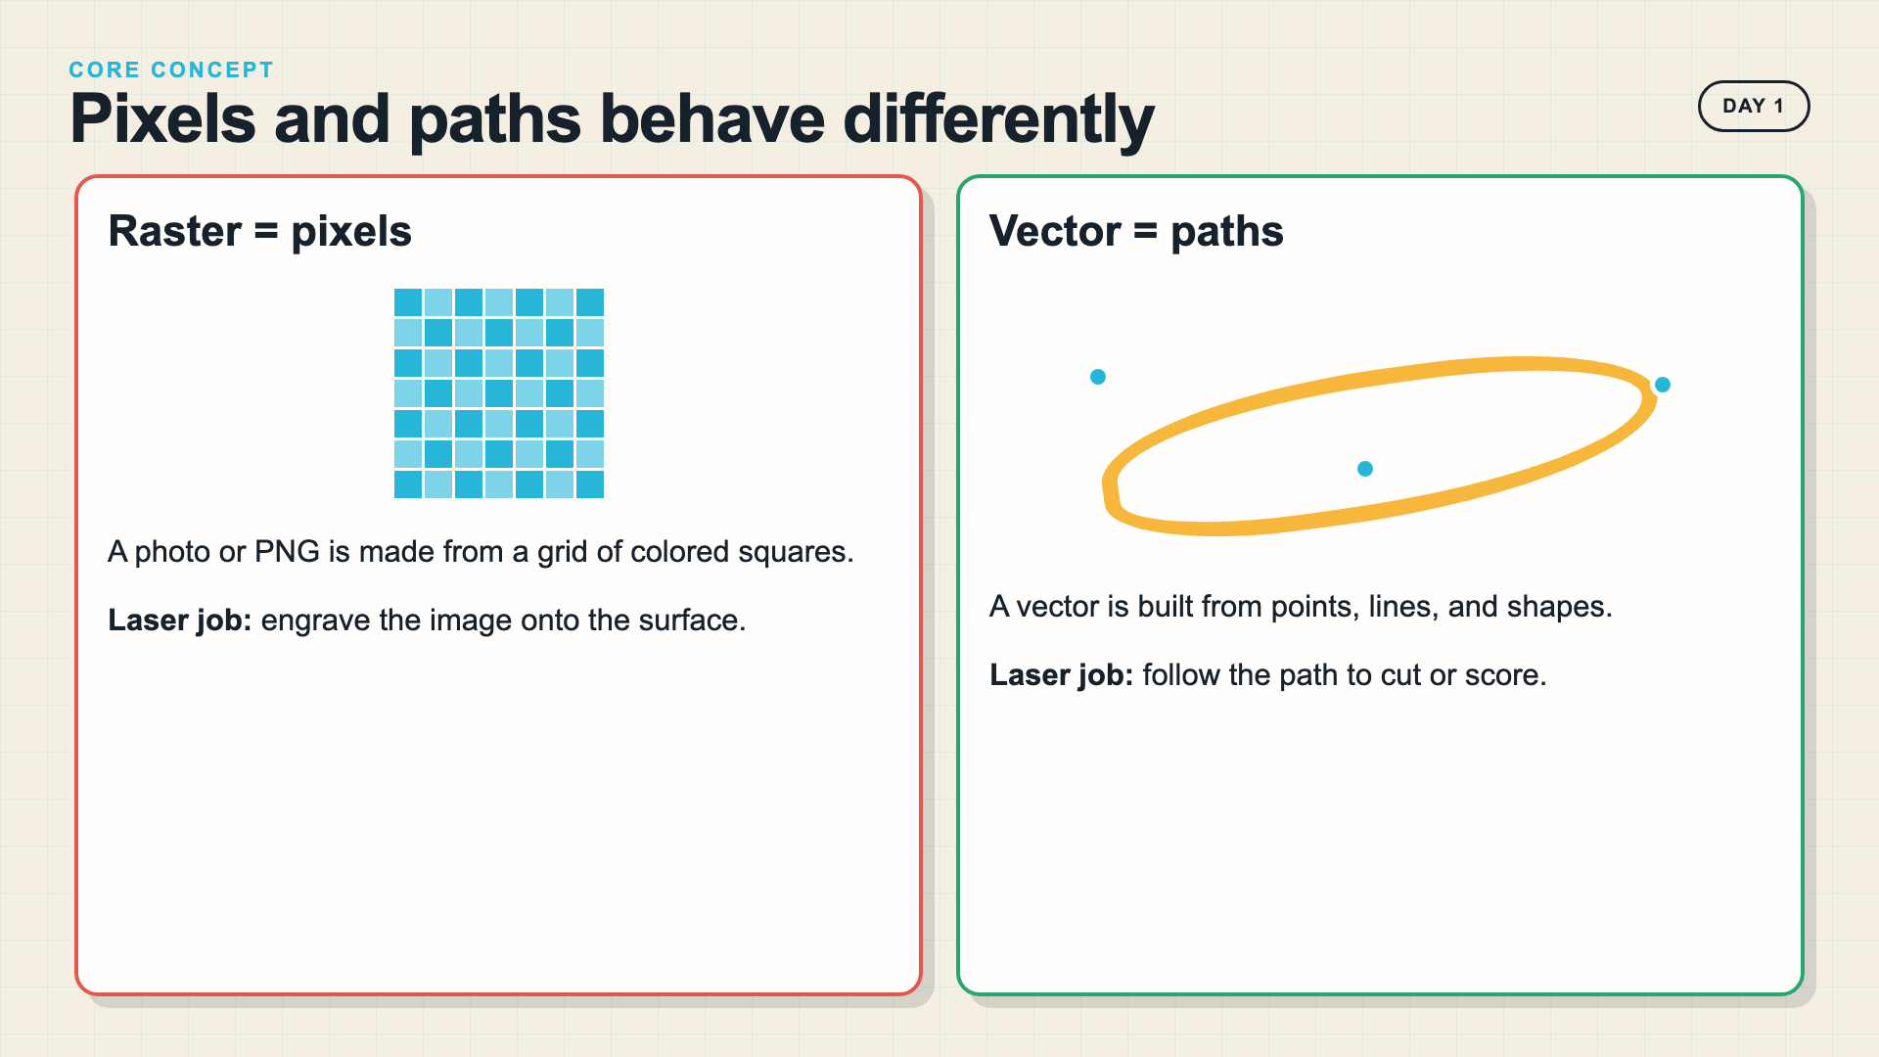
Notes:
Raster and vector describe how a graphic is stored. Keep the explanation at this functional level today.
[Sources]
- https://support.glowforge.com/hc/en-us/articles/20546129150747-Rasterize-Objects-Convert-Vector-Design-to-Bitmap
- https://support.glowforge.com/hc/en-us/articles/360034142453-Upload-Your-Own-Design-File

Slide 5
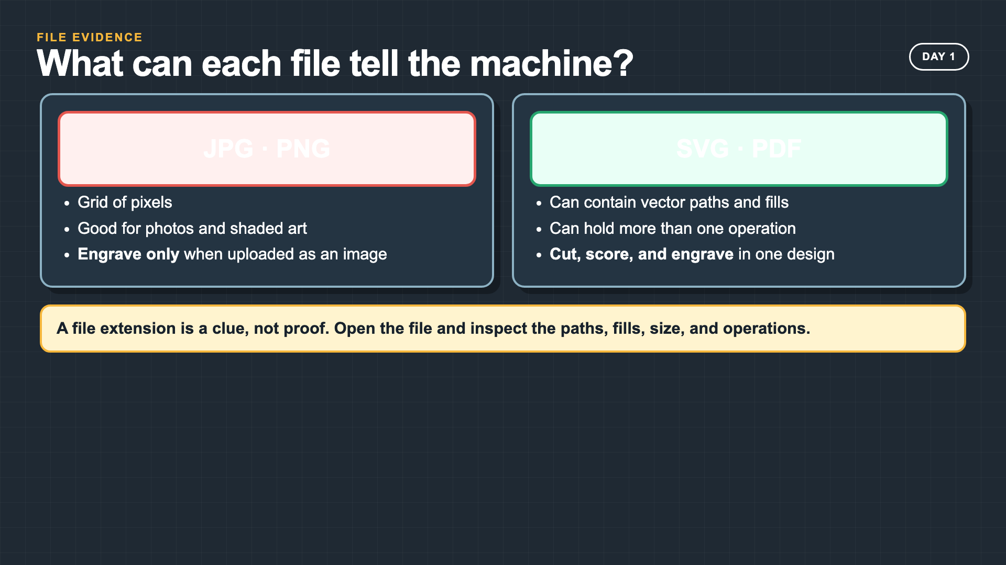
Notes:
A PDF can contain raster or vector content, so the extension alone is not proof. Model opening and inspecting the file.
[Sources]
- https://support.glowforge.com/hc/en-us/articles/360034142453-Upload-Your-Own-Design-File

Slide 6
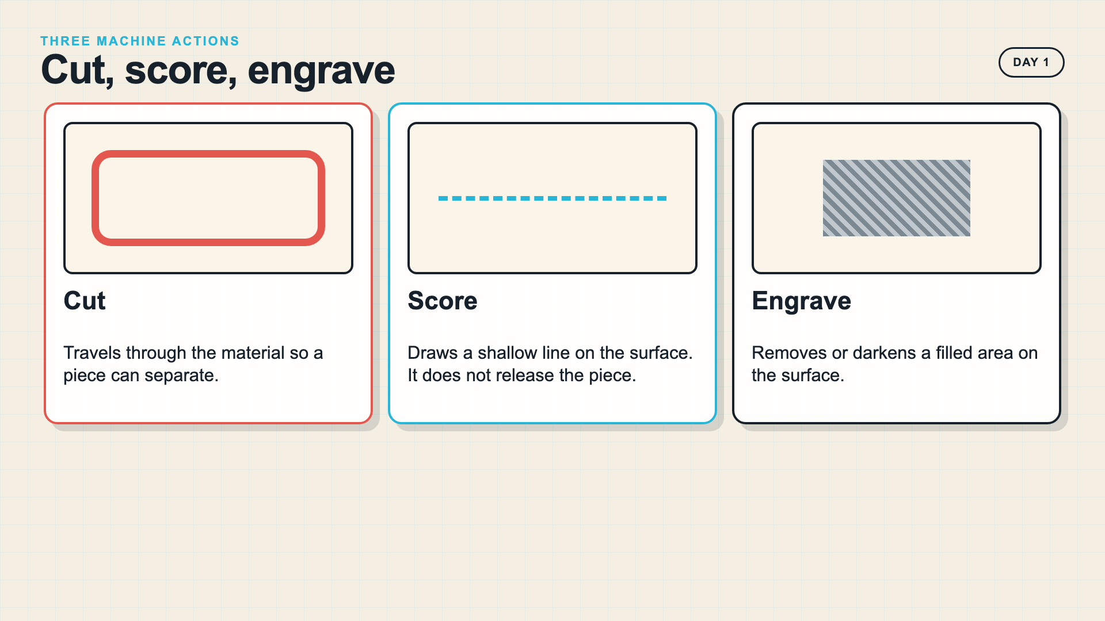
Notes:
If your machine uses different operation names, translate the terms while preserving the distinction between through-cut, surface line, and filled engraving.
[Sources]
- https://support.glowforge.com/hc/en-us/articles/360034142453-Upload-Your-Own-Design-File
- https://support.glowforge.com/hc/en-us/articles/20545971062683-Simplify-Strokes

Slide 7
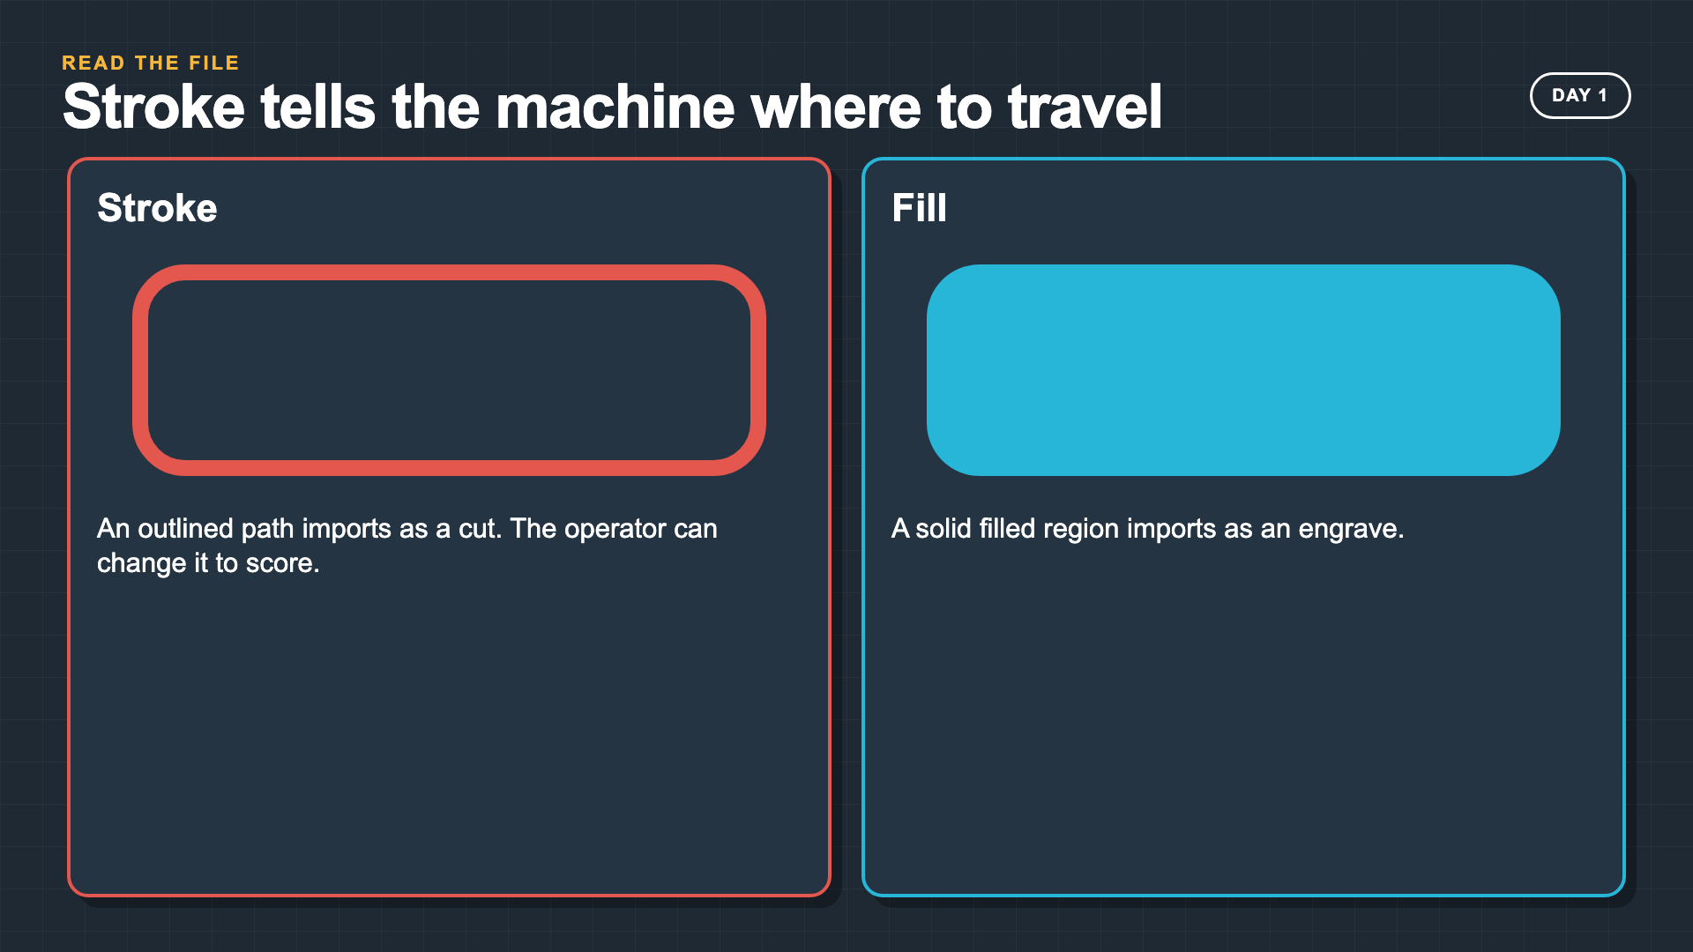
Notes:
Glowforge imports strokes as cuts and fills as engraves. The operator can change an imported stroke to score.
[Sources]
- https://support.glowforge.com/hc/en-us/articles/20545971062683-Simplify-Strokes

Slide 8
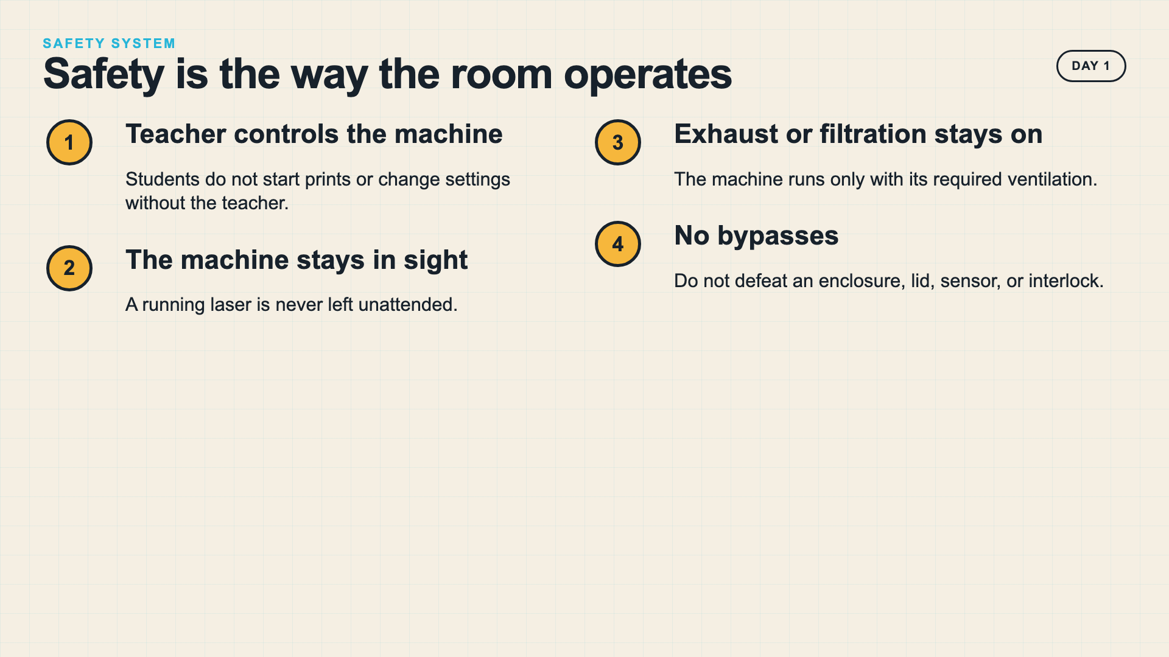
Notes:
Teach the room system before the machine demo. These are operating conditions, not optional reminders.
[Sources]
- https://support.glowforge.com/hc/en-us/articles/360033633314-safety-glowforge-performance-series

Slide 9
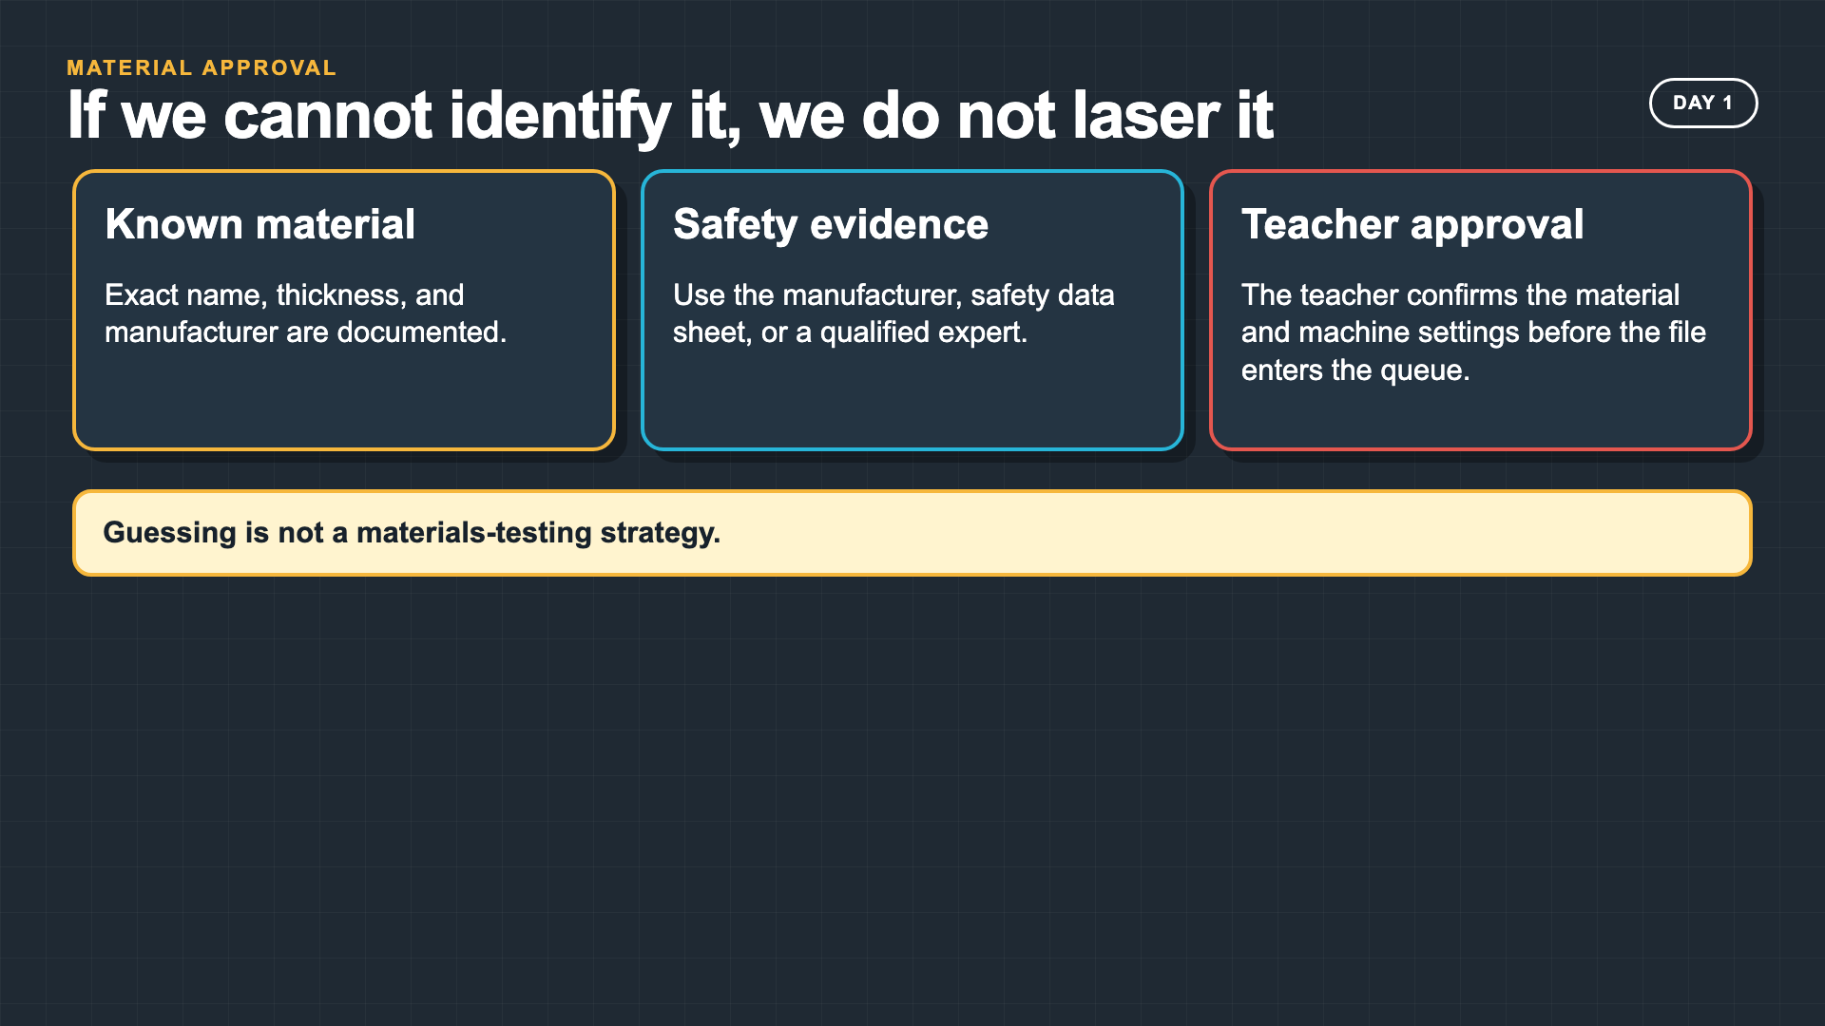
Notes:
Do not rely on appearance or a student report to identify a material. If you cannot confirm compatibility, do not run it.
[Sources]
- https://support.glowforge.com/hc/en-us/articles/4605593296027-Non-Proofgrade-Materials-FAQ

Slide 10
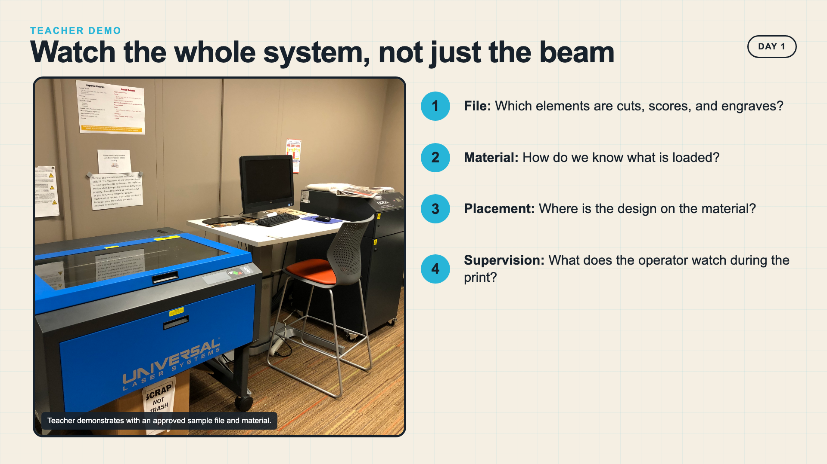
Notes:
Use an approved sample file and material. Narrate file, material, placement, and supervision as one system.
[Sources]
- https://commons.wikimedia.org/wiki/File:Library_laser_cutter.jpg
- https://support.glowforge.com/hc/en-us/articles/360033633314-safety-glowforge-performance-series

Slide 11
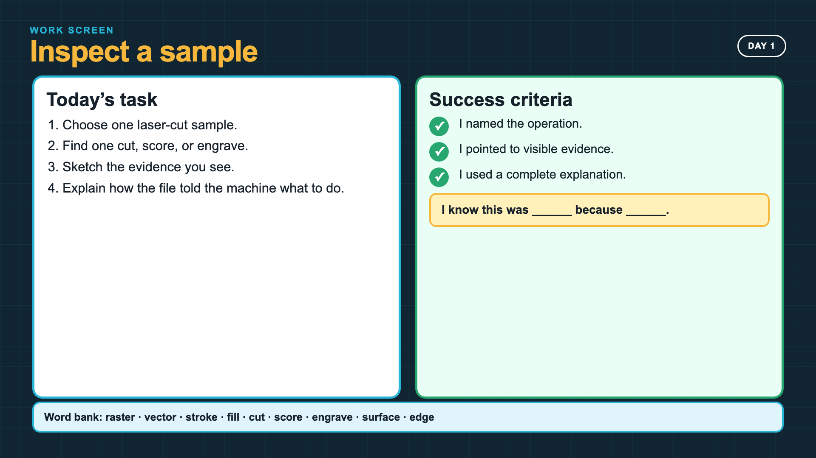
Notes:
Leave this slide projected during the formative First Look. Students need a physical sample or a clear photograph.
[Sources]
- Owner course source: Lesson Outline Intro Laser Cut Mini-Project + Catch-Up.docx

Slide 12
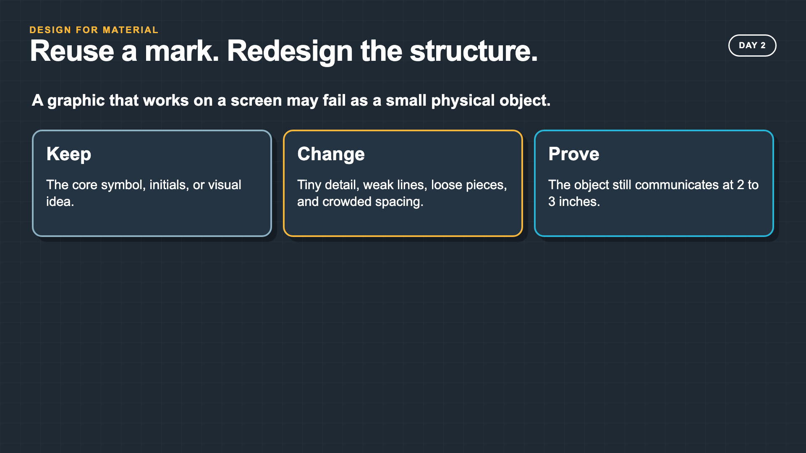
Notes:
The lesson reuses a prior visual idea so students can focus on adapting it for material and scale rather than starting a new brand project.
[Sources]
- Owner course source: Gulf Coast Marine Rescue graphics

Slide 13
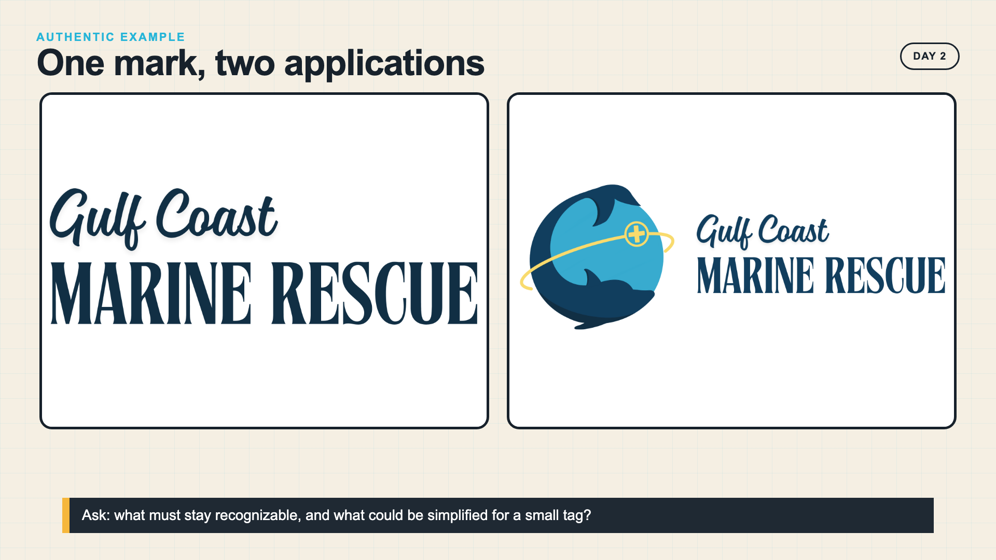
Notes:
The two owner-created graphics show one identity moving into a physical application. Ask students to identify the visual core before discussing simplification.
[Sources]
- Owner-created Gulf Coast Marine Rescue graphics supplied by the course author

Slide 14
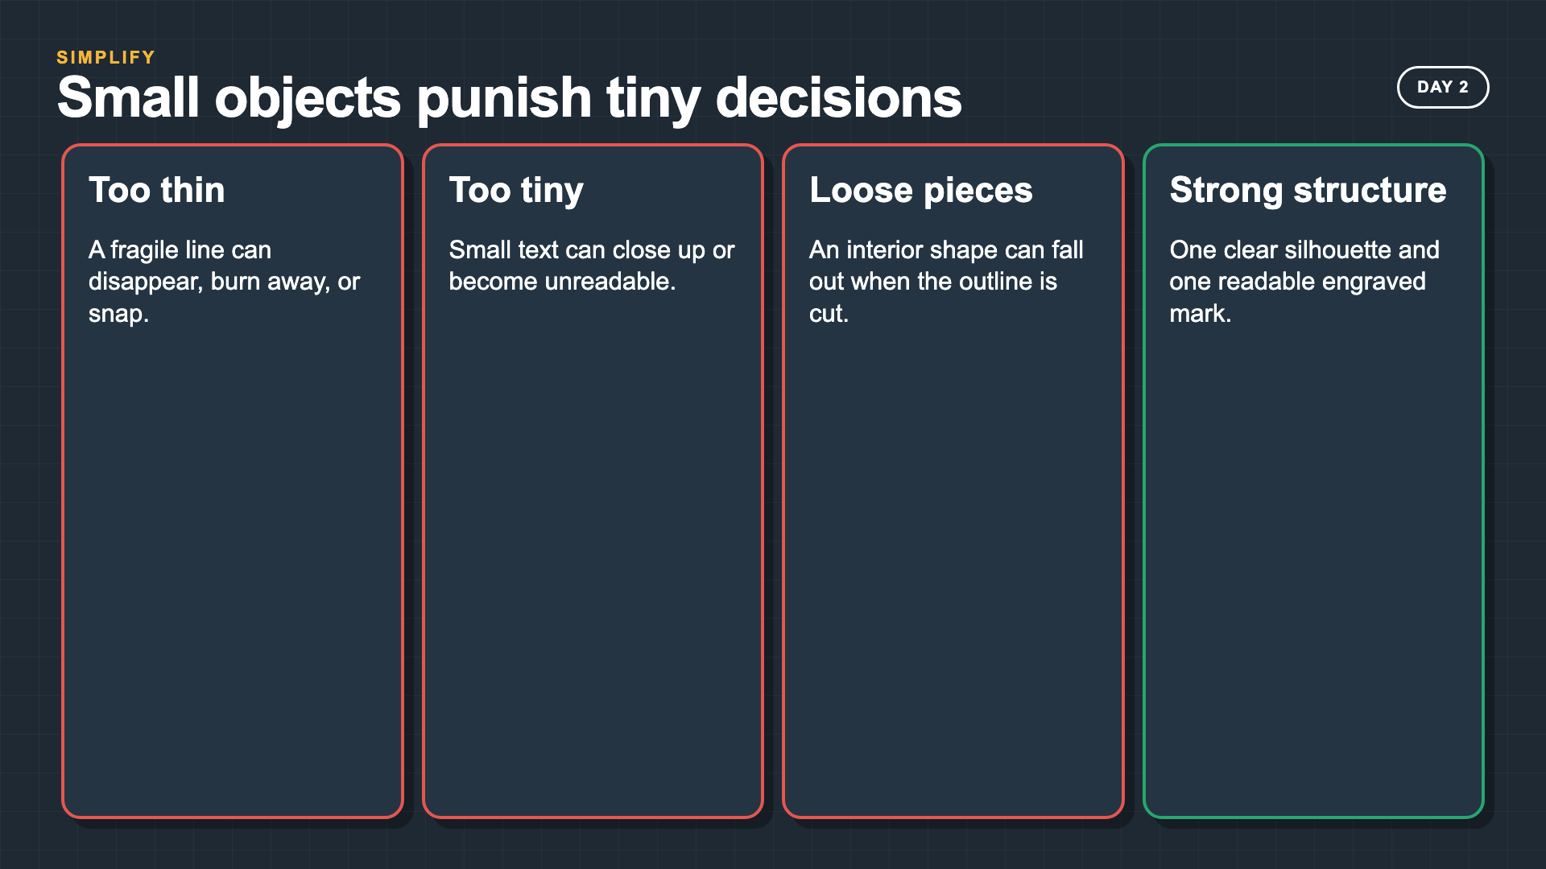
Notes:
Connect simplification to fabrication risk: too many nodes, tiny details, narrow bridges, and loose pieces all create failure points.
[Sources]
- https://support.glowforge.com/hc/en-us/articles/20545971062683-Simplify-Strokes

Slide 15
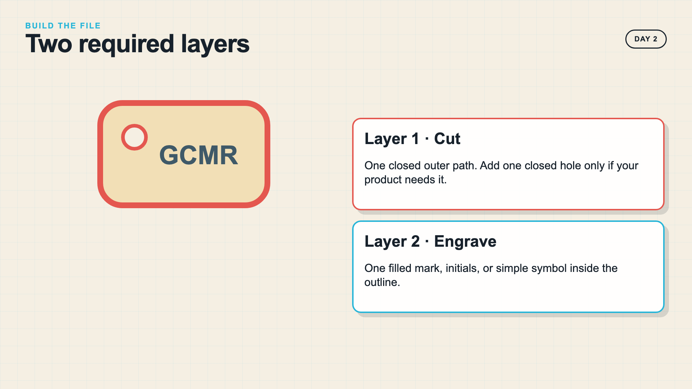
Notes:
Model the file as an operation map. The red outline and gray mark are conceptual colors; students should follow your machine's layer/color conventions.
[Sources]
- https://support.glowforge.com/hc/en-us/articles/20545971062683-Simplify-Strokes

Slide 16
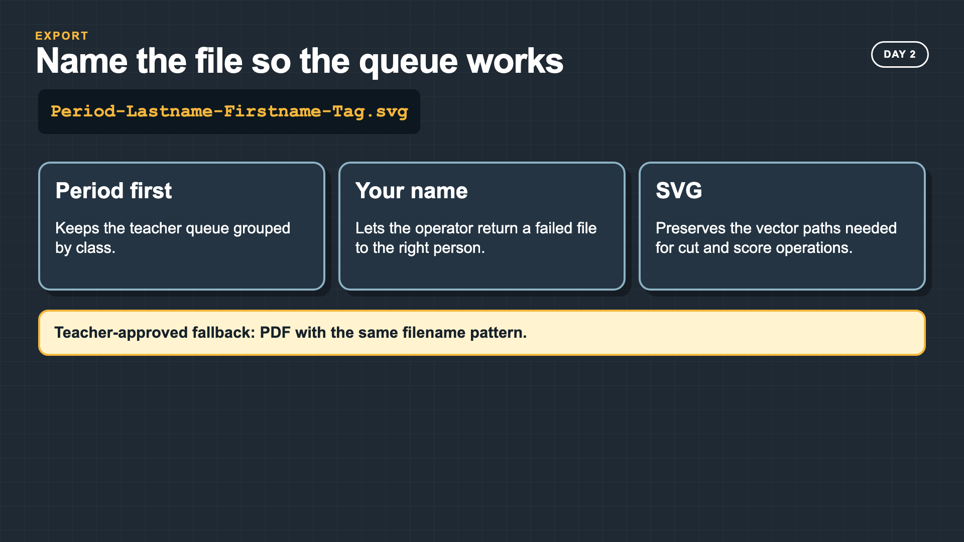
Notes:
Use a separate queue folder for each period. If your workflow uses PDF, keep the same base filename.
[Sources]
- Owner course source: Lesson Outline Intro Laser Cut Mini-Project + Catch-Up.docx

Slide 17
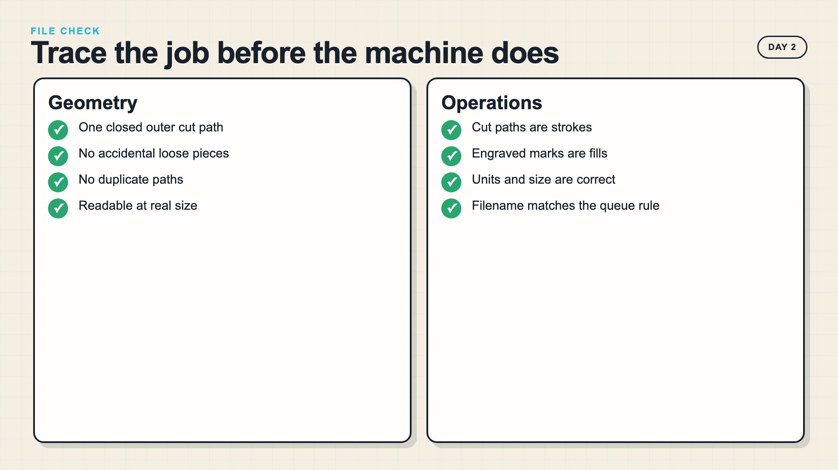
Notes:
Trace every path at presentation scale. Duplicate paths can cause a laser to repeat an operation and closed-path failures can change the cut result.
[Sources]
- https://support.glowforge.com/hc/en-us/articles/20545971062683-Simplify-Strokes

Slide 18
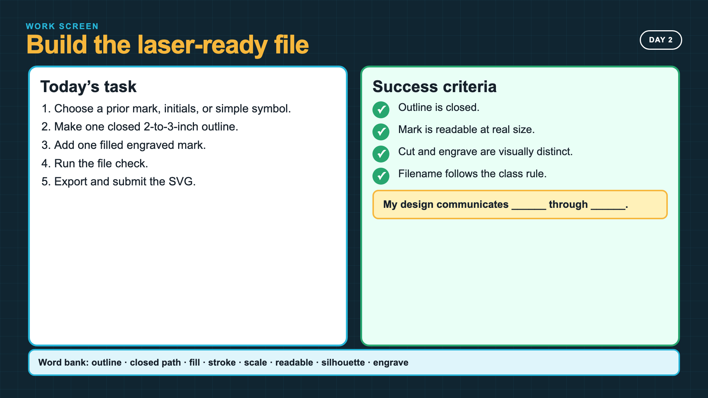
Notes:
Leave this slide projected during file-building time. The sentence stem is part of the submission evidence, not an extra reflection.
[Sources]
- Owner course source: Lesson Outline Intro Laser Cut Mini-Project + Catch-Up.docx

Slide 19
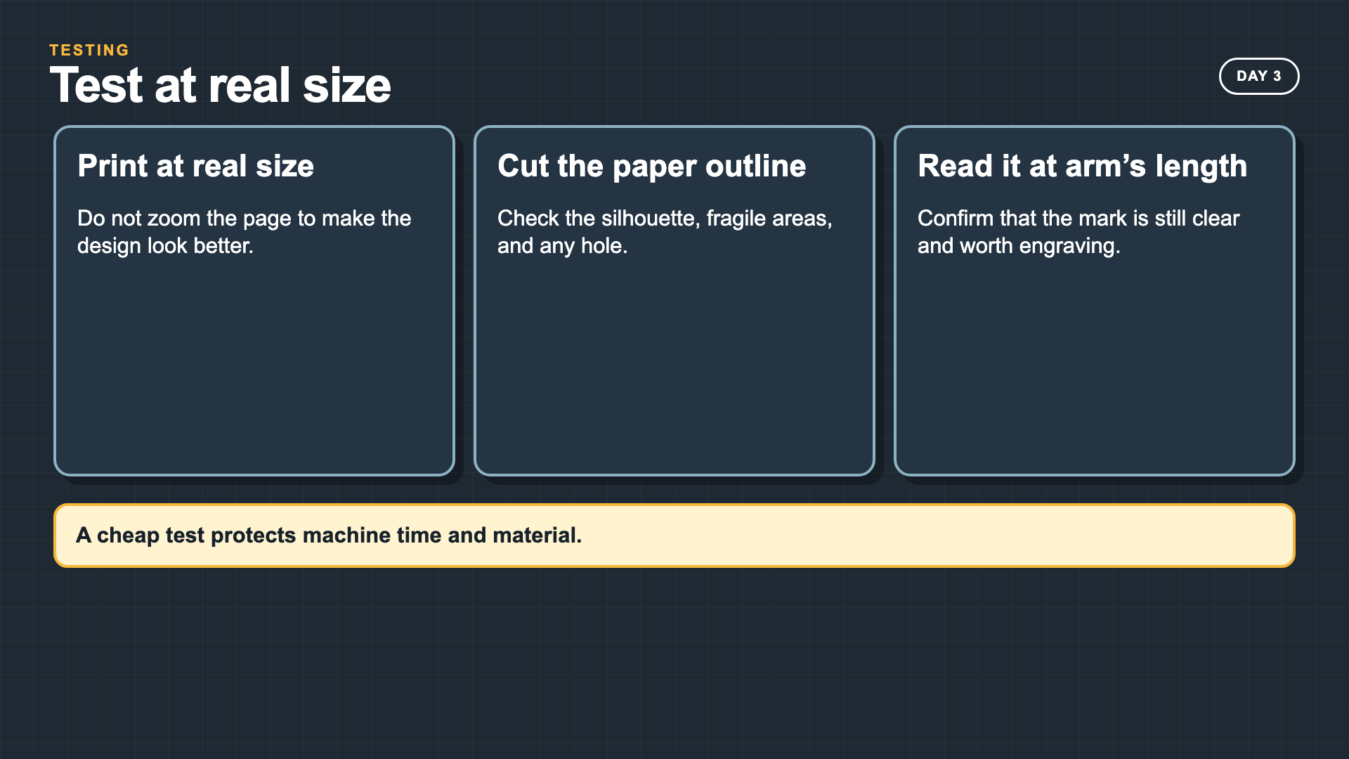
Notes:
A real-size paper test protects both machine time and material. Students should see testing as design work, not a punishment for a weak file.
[Sources]
- Owner course source: Lesson Outline Intro Laser Cut Mini-Project + Catch-Up.docx

Slide 20
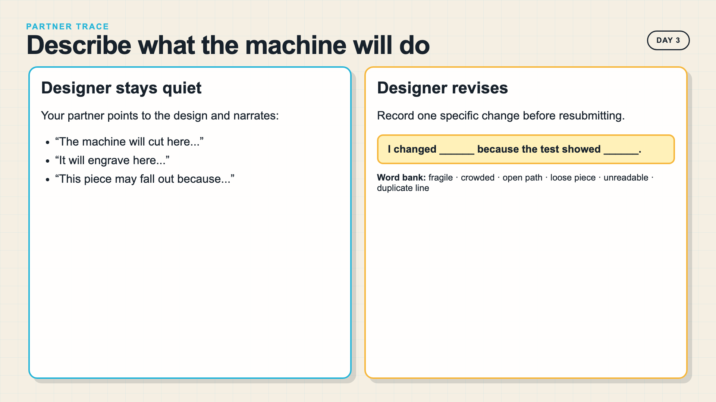
Notes:
The partner narrates the machine route while the designer stays quiet. If the partner cannot predict the operations, the file is not ready.
[Sources]
- Owner course source: Lesson Outline Intro Laser Cut Mini-Project + Catch-Up.docx

Slide 21
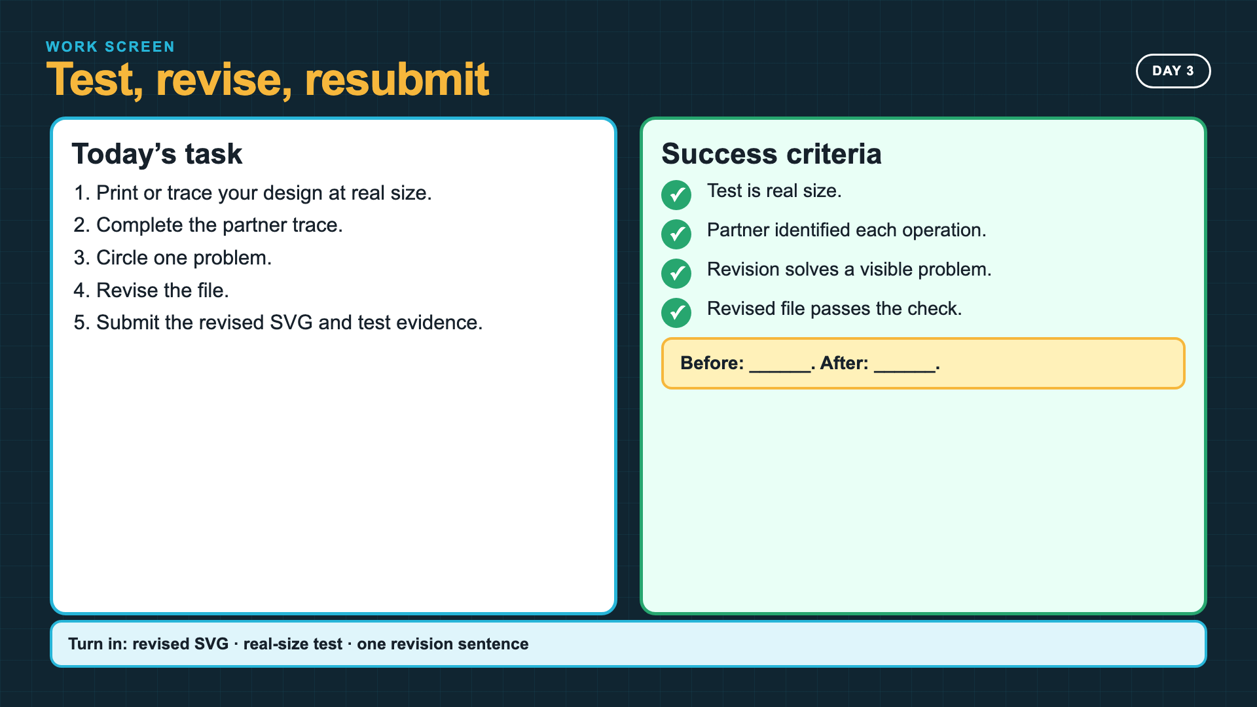
Notes:
Leave this slide projected for Day 3. Require a visible before-and-after change, even when the first design was close.
[Sources]
- Owner course source: Lesson Outline Intro Laser Cut Mini-Project + Catch-Up.docx

Slide 22
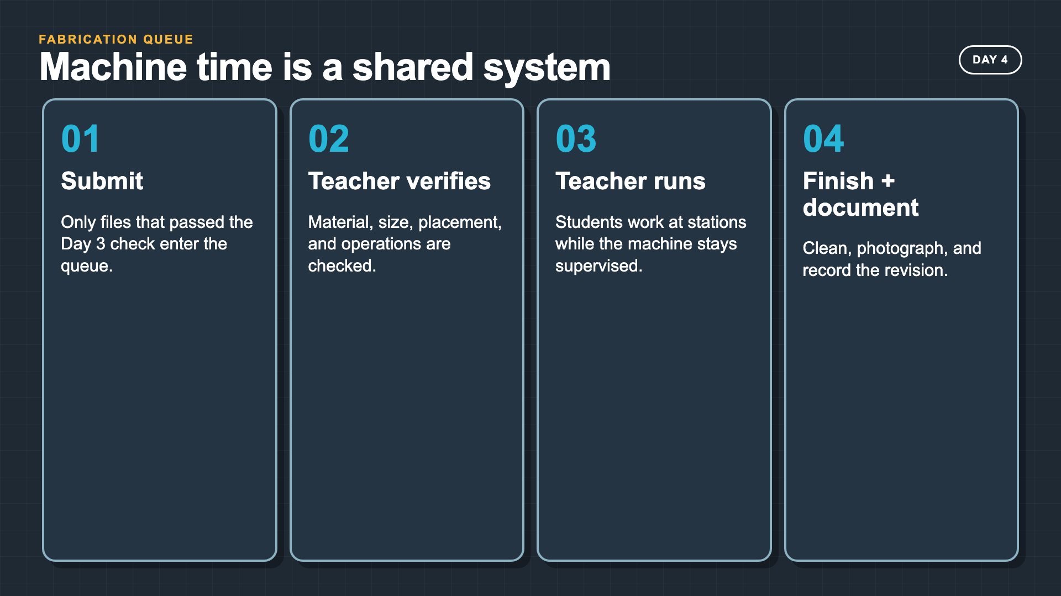
Notes:
Students should not cluster around the machine. The queue, finishing station, documentation station, and revision loop keep everyone working.
[Sources]
- https://support.glowforge.com/hc/en-us/articles/360033633314-safety-glowforge-performance-series
- Owner course source: Lesson Outline Intro Laser Cut Mini-Project + Catch-Up.docx

Slide 23
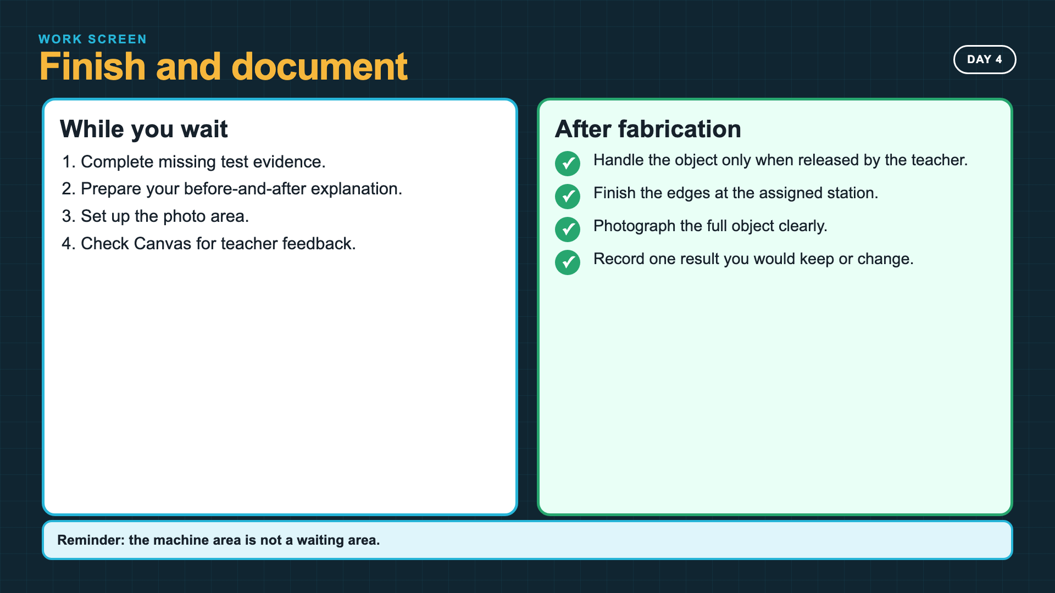
Notes:
Leave this slide projected during fabrication. Release finished pieces according to your machine and material cooldown requirements.
[Sources]
- https://support.glowforge.com/hc/en-us/articles/360033633314-safety-glowforge-performance-series

Slide 24
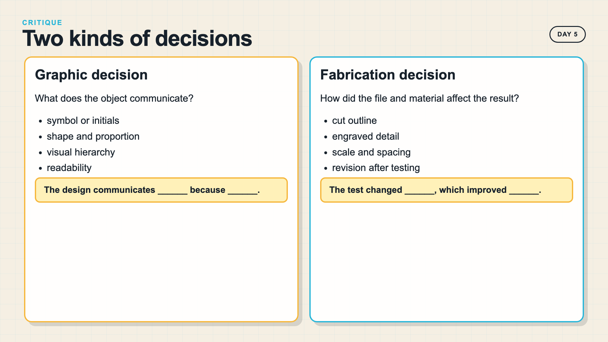
Notes:
Keep the critique specific. A strong graphic decision can still be paired with a weak fabrication decision, and vice versa.
[Sources]
- Owner course source: Lesson Outline Intro Laser Cut Mini-Project + Catch-Up.docx

Slide 25
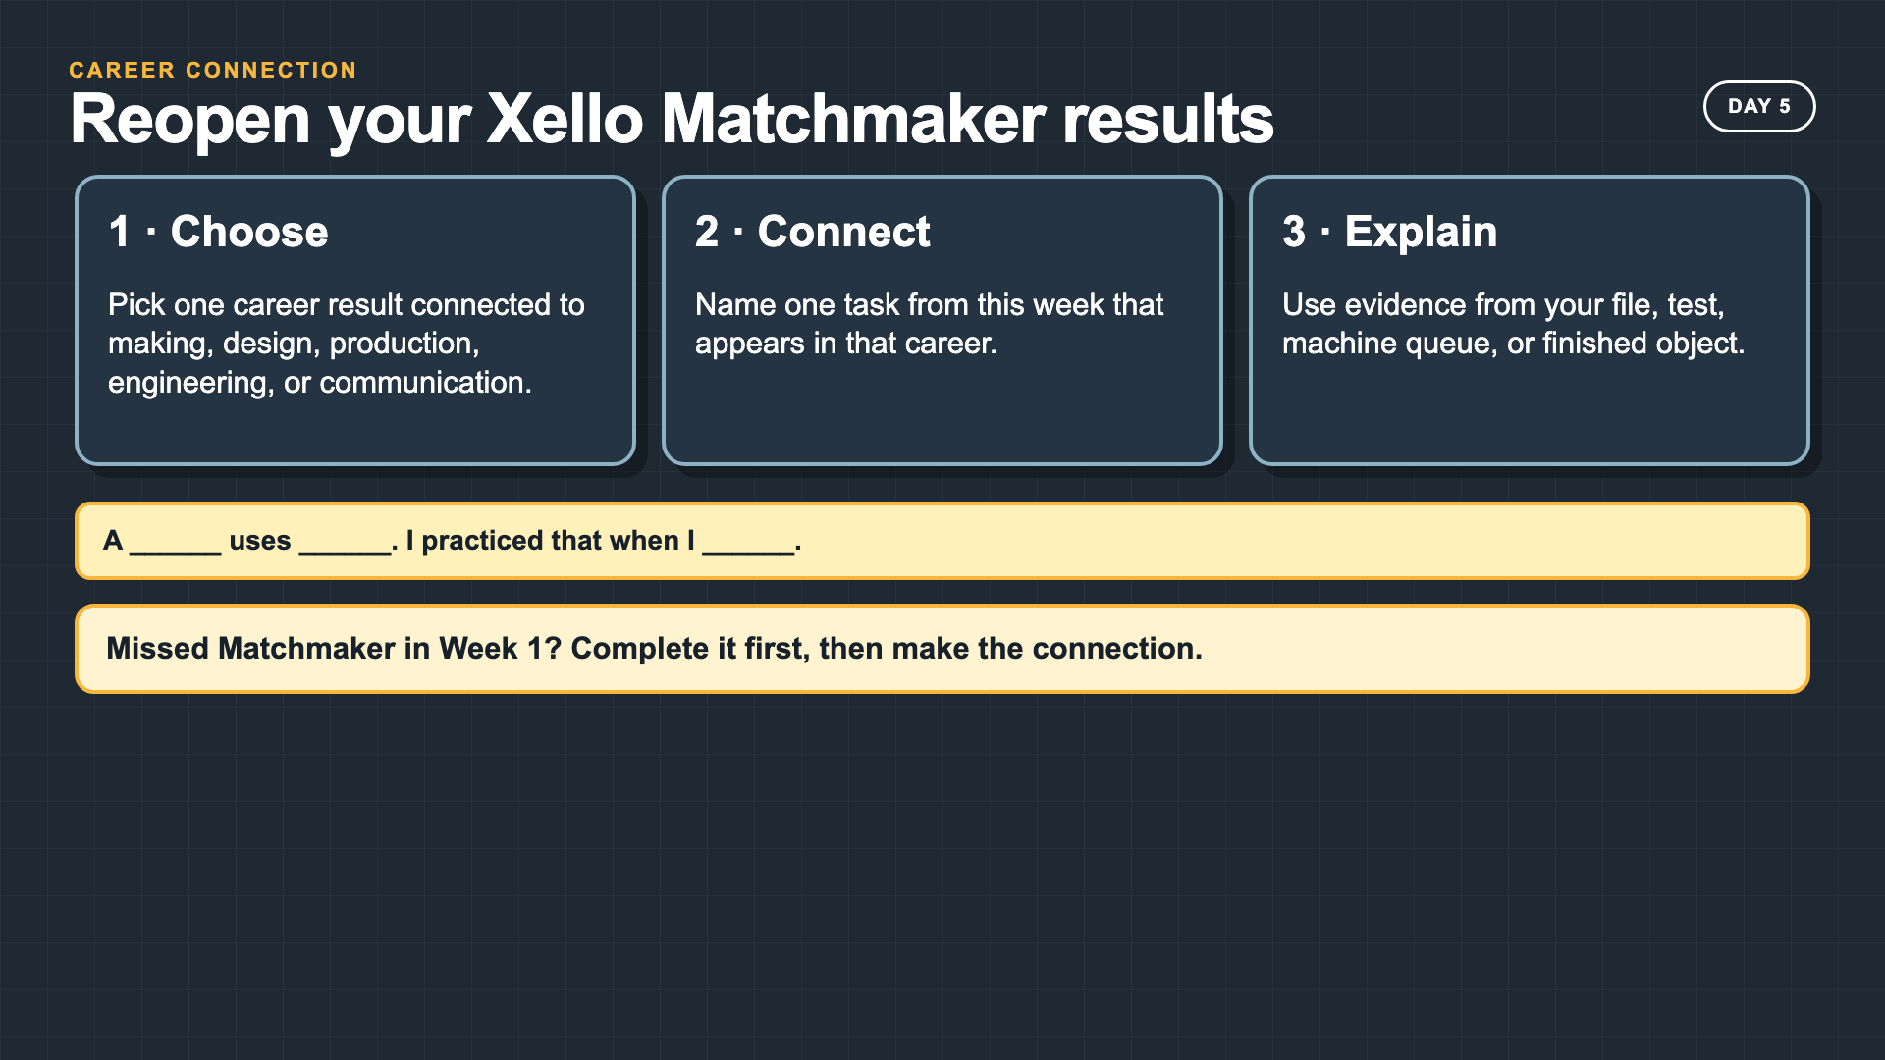
Notes:
Students who completed Matchmaker in Week 1 reopen their results. This is a career-connection check, not a second Matchmaker launch.
[Sources]
- Smart Solutions Scope and Sequence, Week 5
- Owner course source: Lesson Outline Intro Laser Cut Mini-Project + Catch-Up.docx

Slide 26
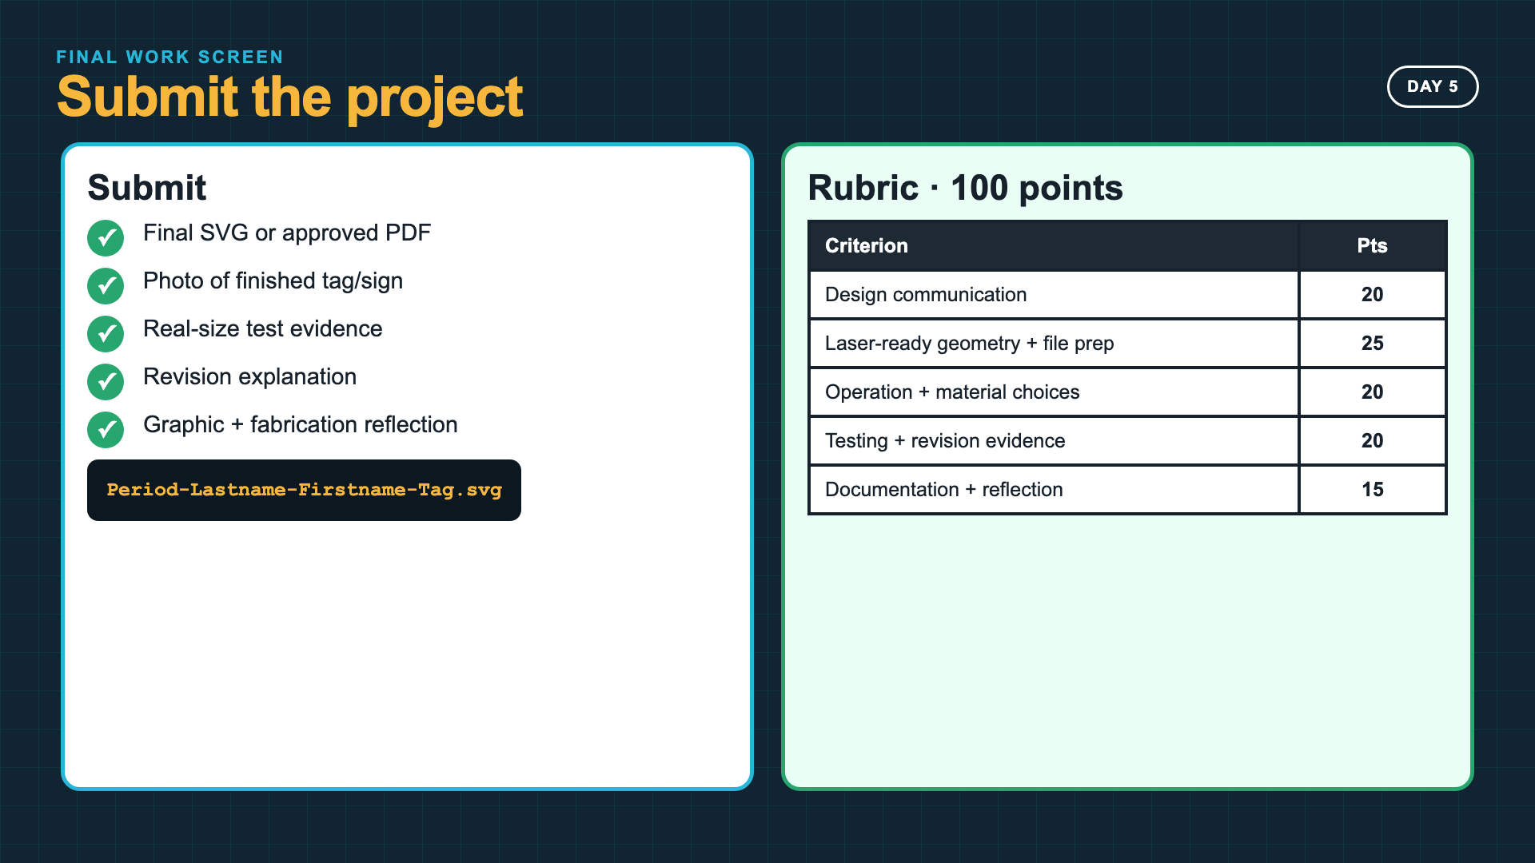
Notes:
Leave this slide projected during final submission. Read the five rubric rows before students submit so they can locate each piece of evidence.
[Sources]
- Owner-approved staged rubric for the 2027 compressed Laser-Ready Tag project

Slide 27
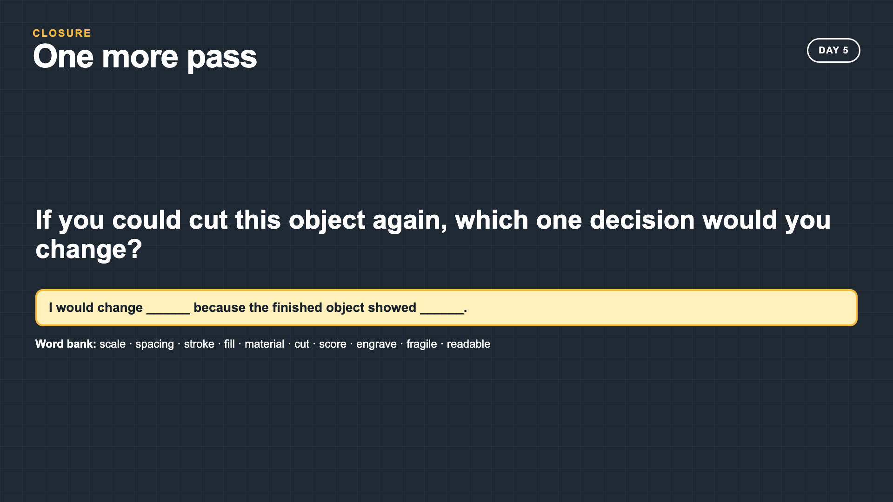
Notes:
Collect the response as a quick exit, submission comment, or table discussion. The answer should name evidence from the physical result.
[Sources]
- Owner course source: Lesson Outline Intro Laser Cut Mini-Project + Catch-Up.docx

