Slide 1
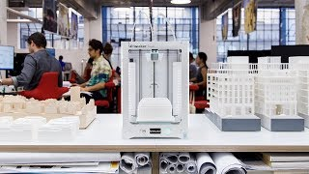
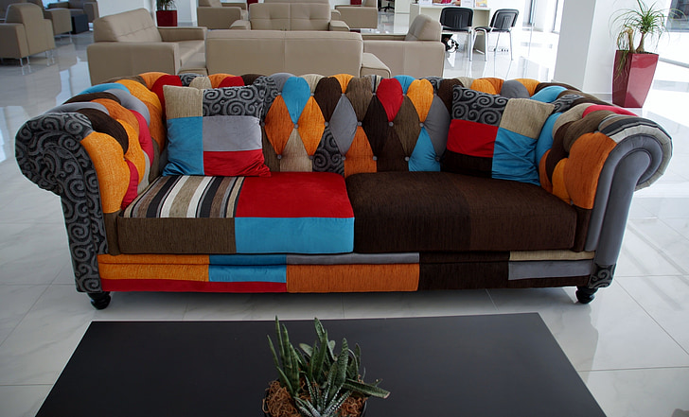
3D MODELING | DREAM ROOM | DAY 2
Dream Room: What is Scale?
How architects shrink buildings — and how you will shrink your room.
Real architects use 3D modeling and 3D printing to create scale models

Slide 2
What does 1:100 scale mean?
1:100
=
100 mm
1 mm
TinkerCAD
Everything is 100 times smaller
Real Life
1 millimeter in TinkerCAD = 100 millimeters in real life
Think of it like a shrink ray — everything in your room gets smaller by the same amount. The couch, the TV, the walls. That is what we are doing with math.

Slide 3
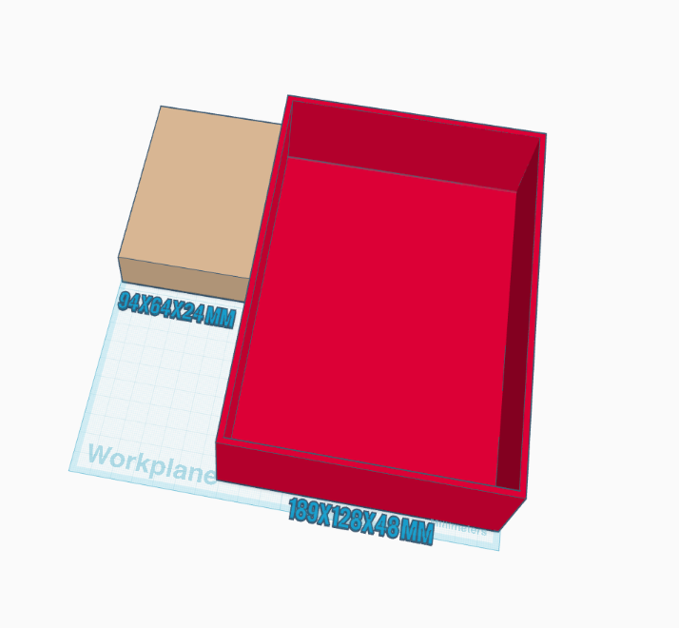
The Room Scale Template
Your Room Shell
94 x 64 x 24 mm
OR
189 x 128 x 48 mm
But what size room does this represent in real life? We need to figure that out!

Slide 4
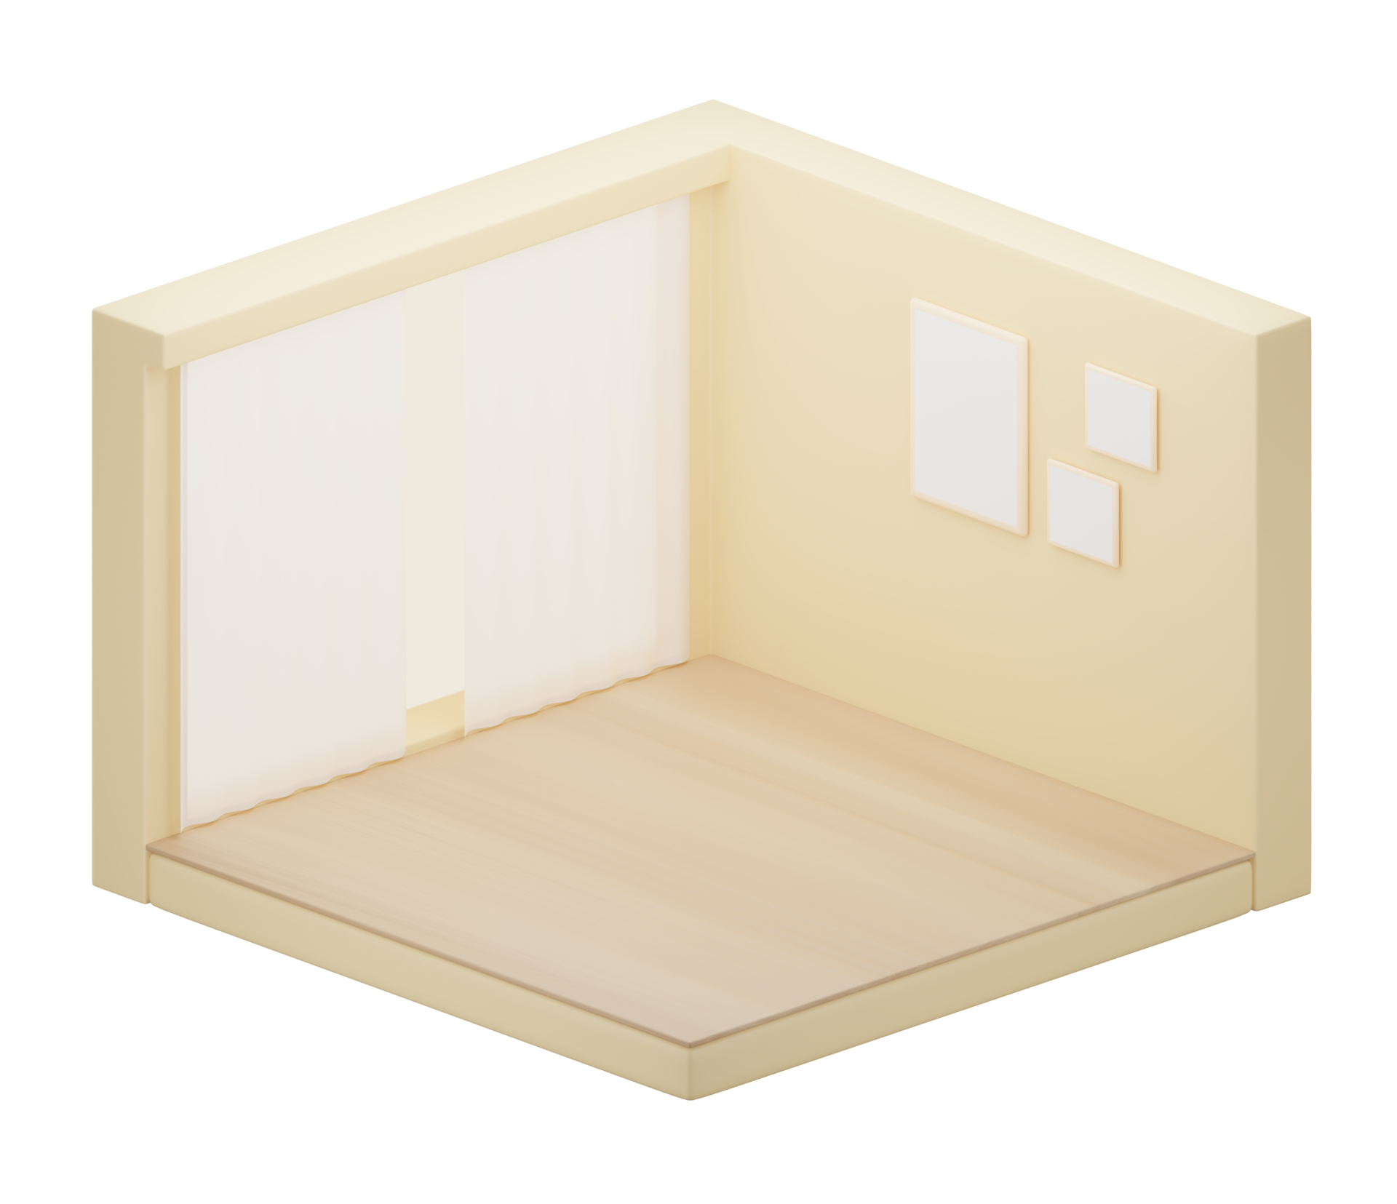
The Problem: US vs. TinkerCAD
31ft x 21ft x 8ft
How are things usually measured in the U.S.?
8ft
TinkerCAD (and the rest of the world) uses Metres / Millimetres!
31ft
21ft

Slide 5
3 Steps: Real Life to TinkerCAD
STEP A
STEP B
STEP C
Feet to Meters
Meters to Millimeters
Scale Down to 1:100
Feet x 0.305
Meters x 1,000
Millimeters / 100
= Meters
= Millimeters
= TinkerCAD
31 ft x 0.305 = 9.5 m
9.5 m x 1,000 = 9,500 mm
9,500 / 100 = 95 mm
Steps A & B = unit conversion. Step C = the actual scaling.

Slide 6
Worked Example: Room Conversion
Room: 31 ft x 21 ft x 8 ft
Life-Size | x 0.305 | Meters | x 1,000 | Millimeters | / 100 | TinkerCAD
31 ft | 31x.305 | 9.5 m | 9.5x1000 | 9,500 mm | 9500/100 | 95 mm
21 ft | 21x.305 | 6.4 m | ??????? | 6,400 mm | 6400/100 | ???????
8 ft | 8x.305 | ??????? | ??????? | ??????? | ??????? | ???????

Slide 7
Worked Example: Room Conversion
Room: 31 ft x 21 ft x 8 ft
Life-Size | x 0.305 | Meters | x 1,000 | Millimeters | / 100 | TinkerCAD
31 ft | 31x.305 | 9.5 m | 9.5x1000 | 9,500 mm | 9500/100 | 95 mm
21 ft | 21x.305 | 6.4 m | 6.4x1000 | 6,400 mm | 6400/100 | 64 mm
8 ft | 8x.305 | ??????? | ??????? | ??????? | ??????? | ???????

Slide 8
Worked Example: Room Conversion
Room: 31 ft x 21 ft x 8 ft
Life-Size | x 0.305 | Meters | x 1,000 | Millimeters | / 100 | TinkerCAD
31 ft | 31x.305 | 9.5 m | 9.5x1000 | 9,500 mm | 9500/100 | 95 mm
21 ft | 21x.305 | 6.4 m | 6.4x1000 | 6,400 mm | 6400/100 | 64 mm
8 ft | 8x.305 | ??????? | ??????? | ??????? | ??????? | ???????
YOUR TURN
The height is 8 feet.
Do all 3 steps. Pause the video!

Slide 9
Answer: All Rows Complete
Room: 31 ft x 21 ft x 8 ft
Life-Size | x 0.305 | Meters | x 1,000 | Millimeters | / 100 | TinkerCAD
31 ft | 31x.305 | 9.5 m | 9.5x1000 | 9,500 mm | 9500/100 | 95 mm
21 ft | 21x.305 | 6.4 m | 6.4x1000 | 6,400 mm | 6400/100 | 64 mm
8 ft | 8x.305 | 2.4 m | 2.4x1000 | 2,400 mm | 2400/100 | 24 mm
Your model: 95 x 64 x 24 mm

Slide 10
Your Room in TinkerCAD
31ft x 21ft x 8ft
>>>
95 x 64 x 24 mm
24 mm
95 mm
64 mm
Same proportions, just 100x smaller. That is scale.

Slide 11
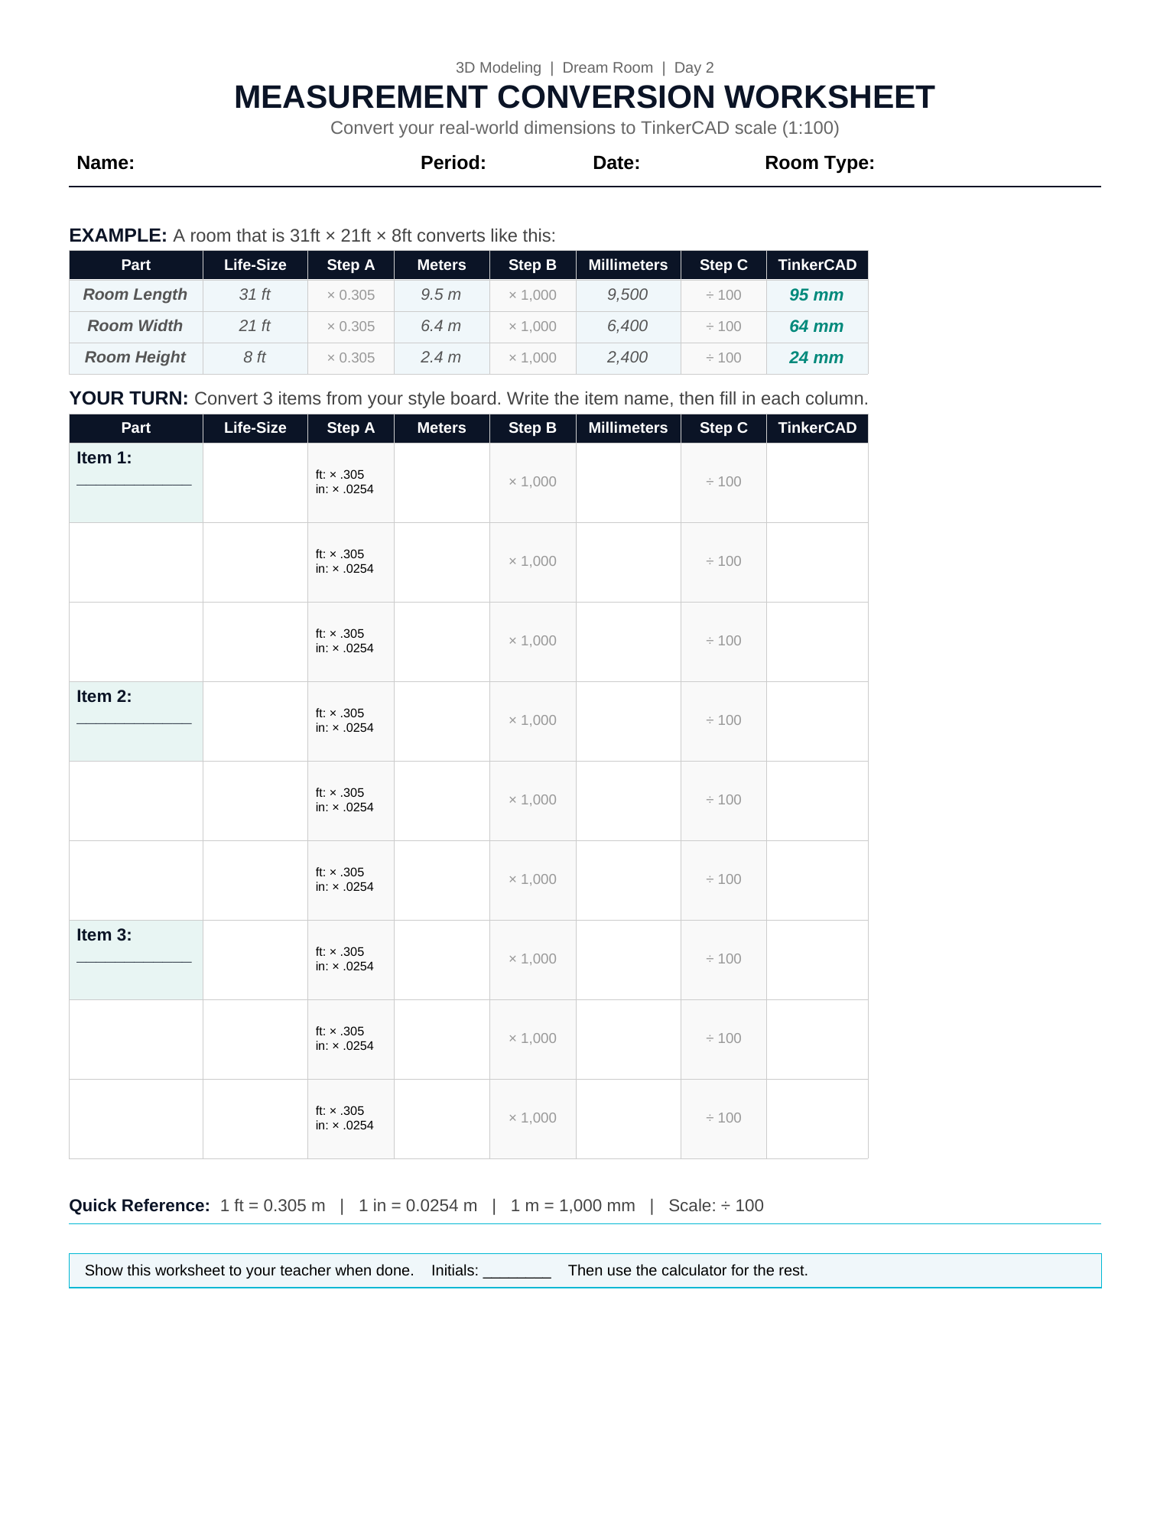
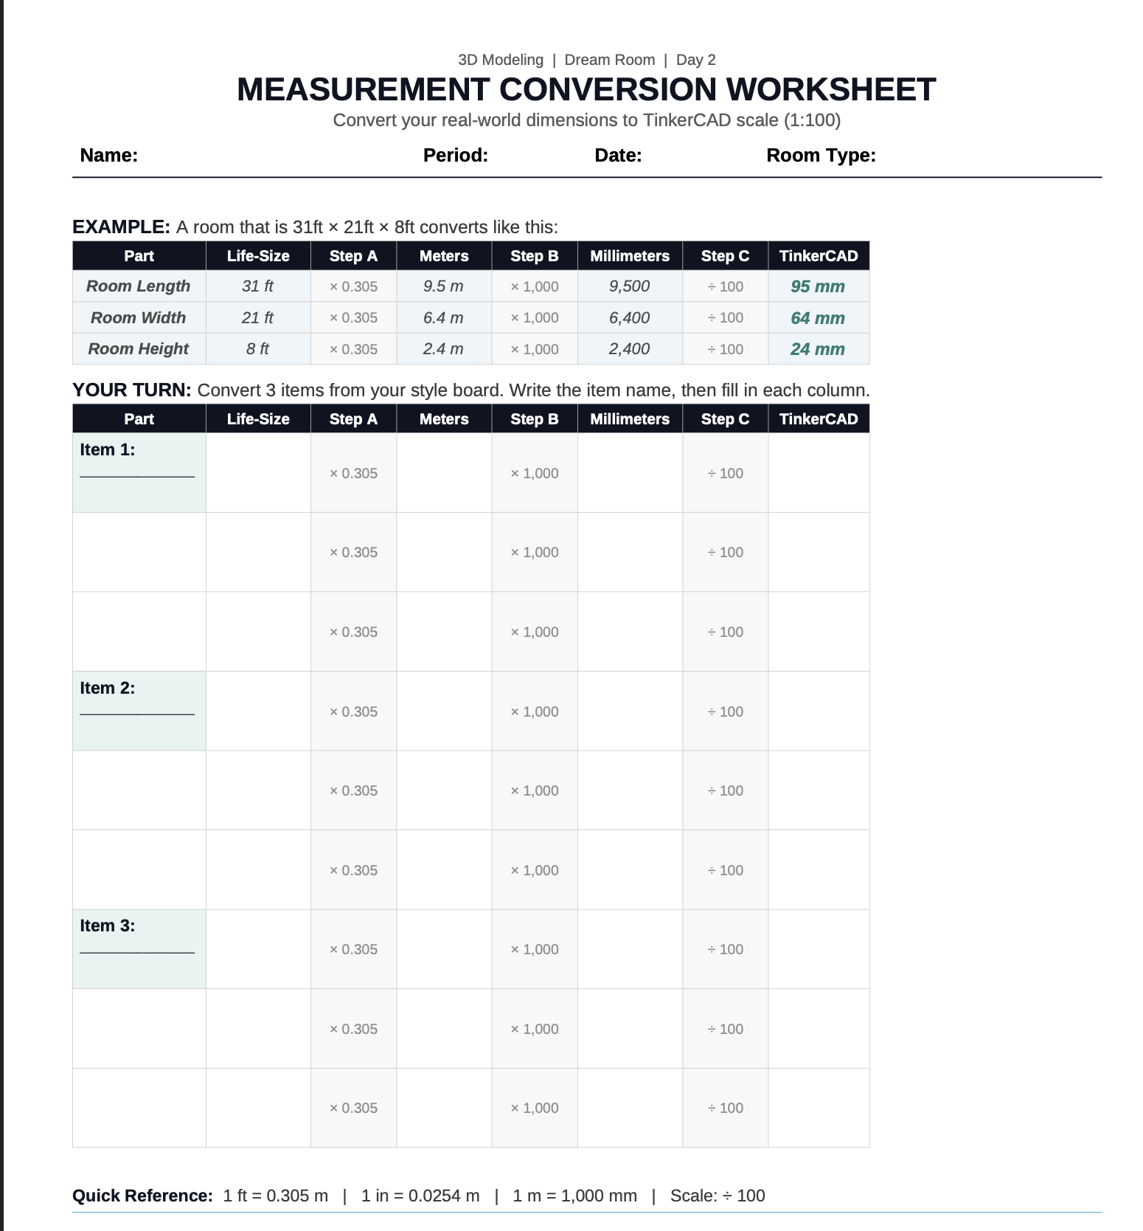
Your Turn: Convert + Build
1
Convert your room + 3 furniture items by hand using the worksheet
2
Show your teacher your worksheet to get it checked
3
Use the Google Sheet calculator for your remaining items
4
Open TinkerCAD → Dream Room activity → Copy and Tinker the Room Scale Template
5
Start building! Days 3 to 5 are build, test, and revision days.

