Slide 1
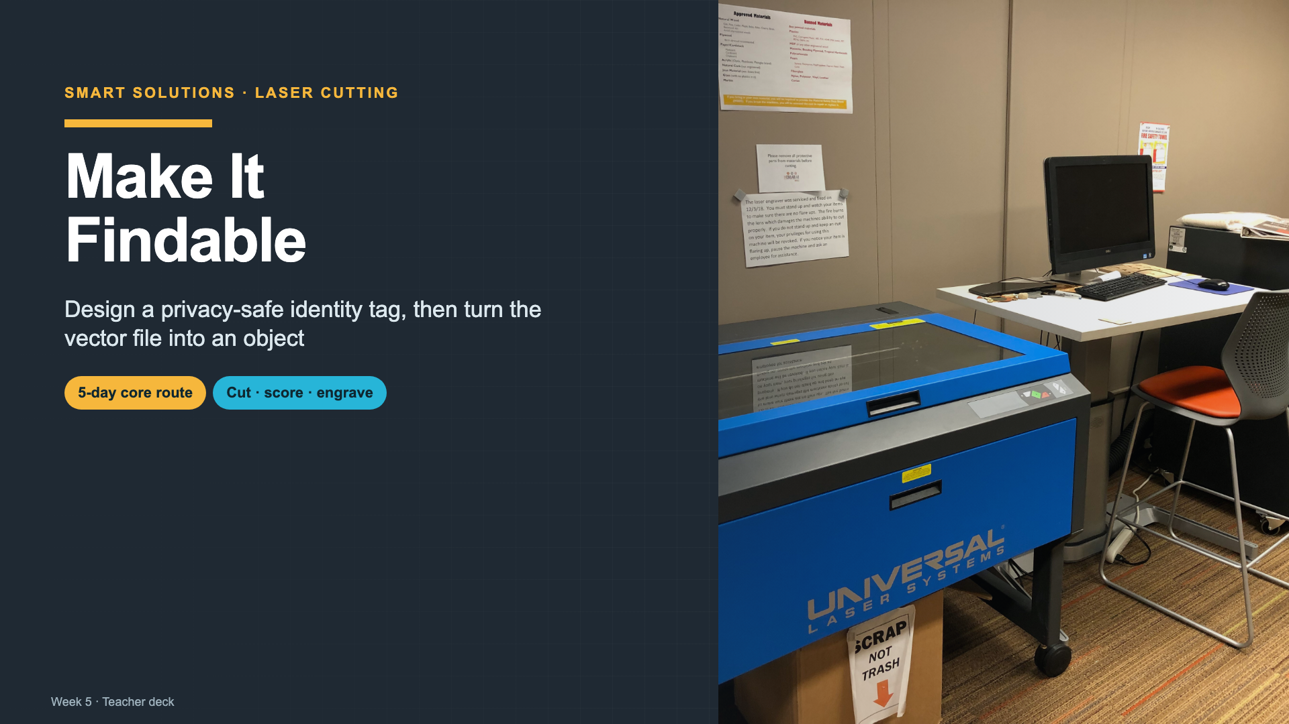
Notes:
Introduce the week through the lost-item problem, then explain that the laser is one tool in the design process.
[Sources]
- https://commons.wikimedia.org/wiki/File:Library_laser_cutter.jpg
- Smart Solutions 2027 Laser Cutting lesson plan

Slide 2
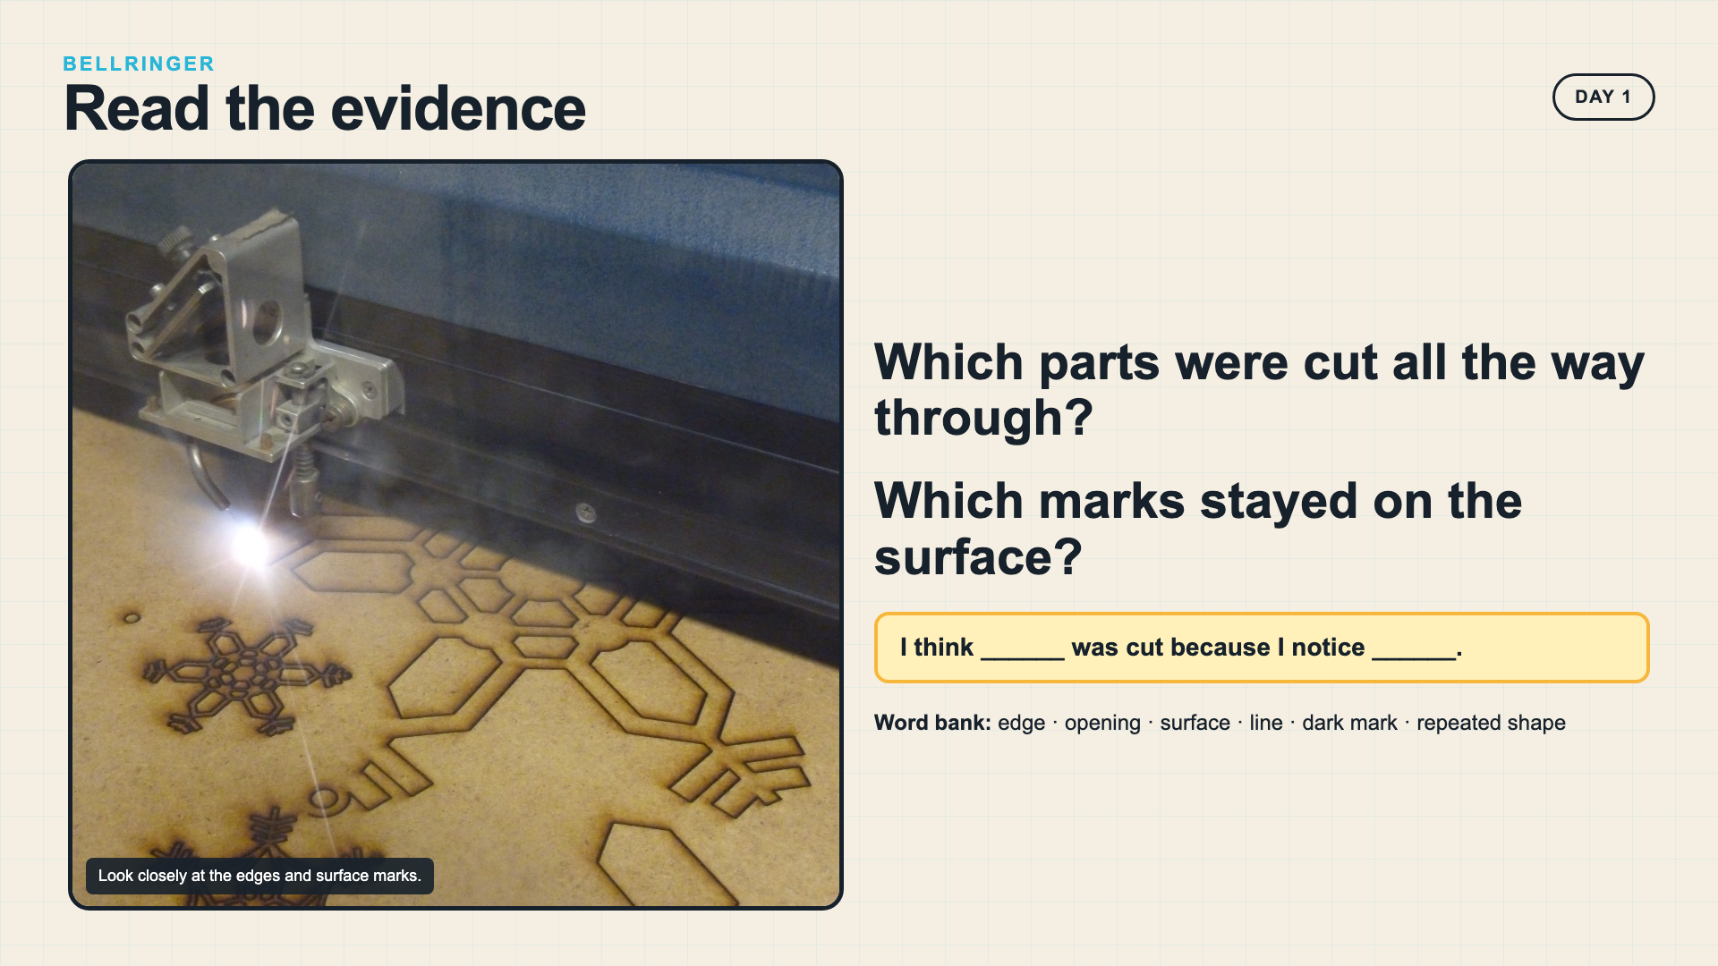
Notes:
Give students quiet looking time. Ask them to point to visible evidence instead of guessing how the machine works.
[Sources]
- https://commons.wikimedia.org/wiki/File:Laser_cutting_snowflakes.jpg

Slide 3
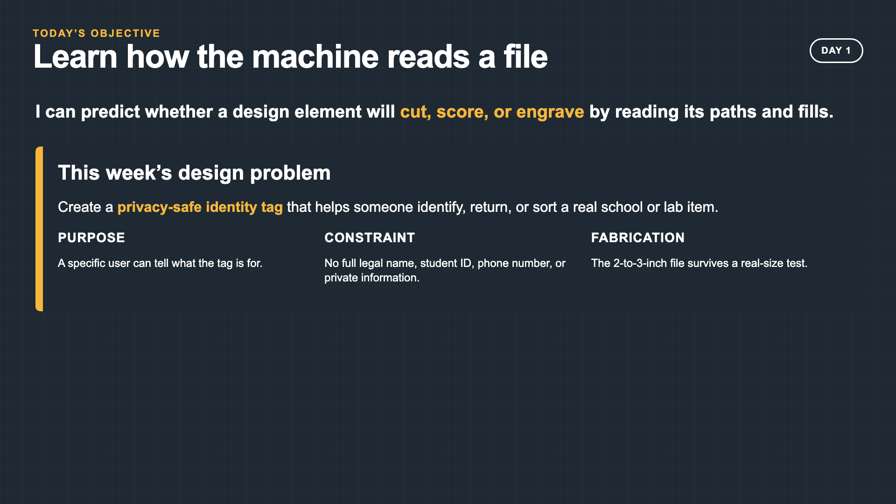
Notes:
Connect today's file-reading objective to the weeklong identity-tag problem. Purpose and privacy are assessed alongside fabrication.
[Sources]
- Smart Solutions 2027 Laser Cutting lesson plan

Slide 4
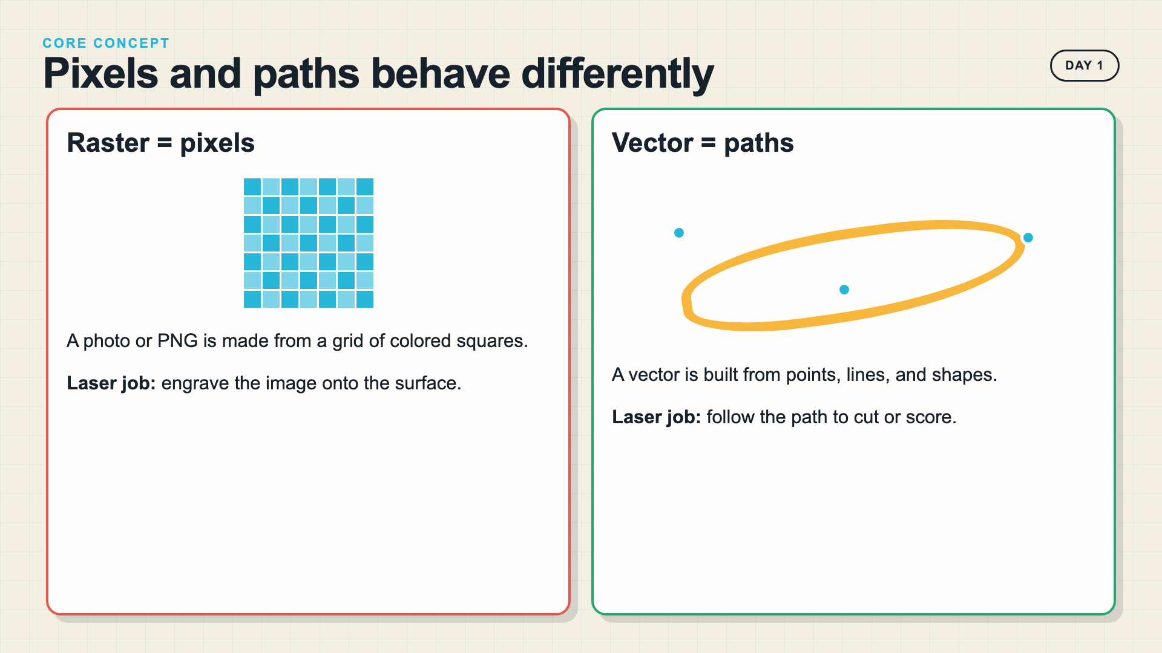
Notes:
Keep raster and vector at a functional level: pixels describe an image; vector paths describe geometry that can scale and control operations.
[Sources]
- https://support.glowforge.com/hc/en-us/articles/20546129150747-Rasterize-Objects-Convert-Vector-Design-to-Bitmap
- https://support.xtool.com/article/544

Slide 5
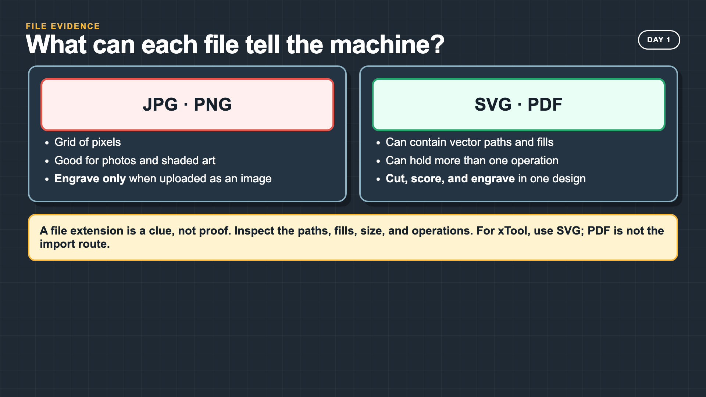
Notes:
A PDF may contain raster or vector content, so the extension alone is not proof. Model opening and inspecting the file. For xTool Creative Space, use SVG rather than PDF.
[Sources]
- https://support.glowforge.com/hc/en-us/articles/360034142453-Upload-Your-Own-Design-File
- https://support.xtool.com/article/544

Slide 6
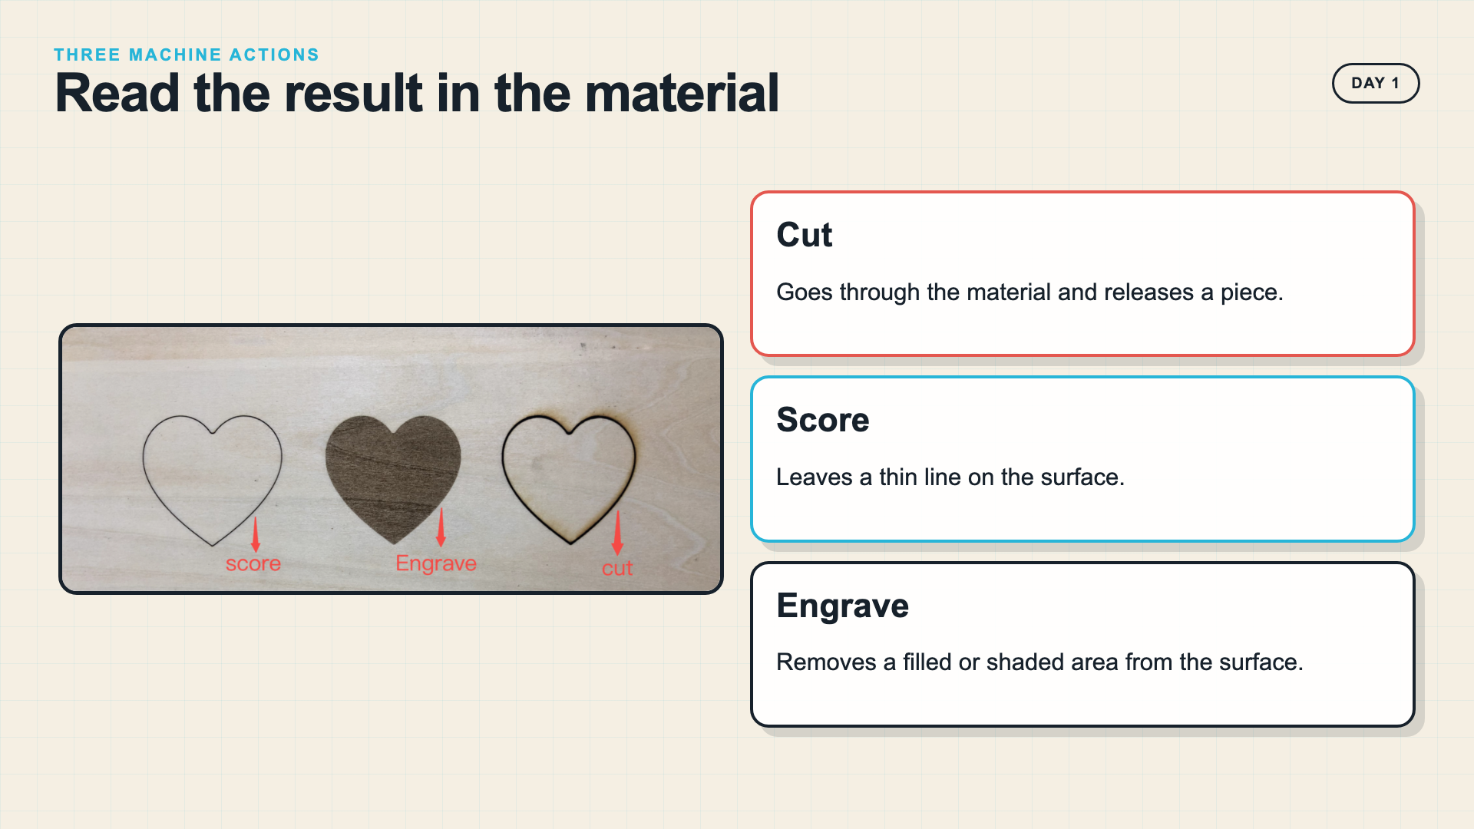
Notes:
Use the real material comparison to separate the three operations. Ask students to describe the evidence before you reveal the labels.
[Sources]
- https://support.xtool.com/article/565

Slide 7
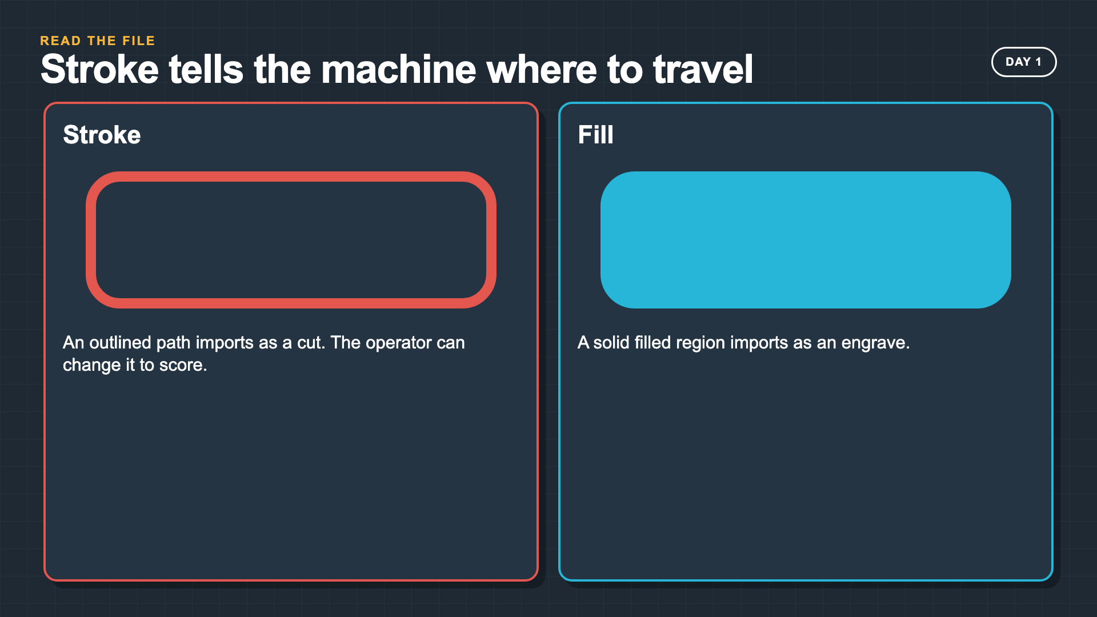
Notes:
The common concept is operation mapping. Glowforge and xTool use different interfaces, but both let an operator assign vector paths and filled or raster areas to machine actions.
[Sources]
- https://support.glowforge.com/hc/en-us/articles/20545971062683-Simplify-Strokes
- https://support.xtool.com/article/565

Slide 8
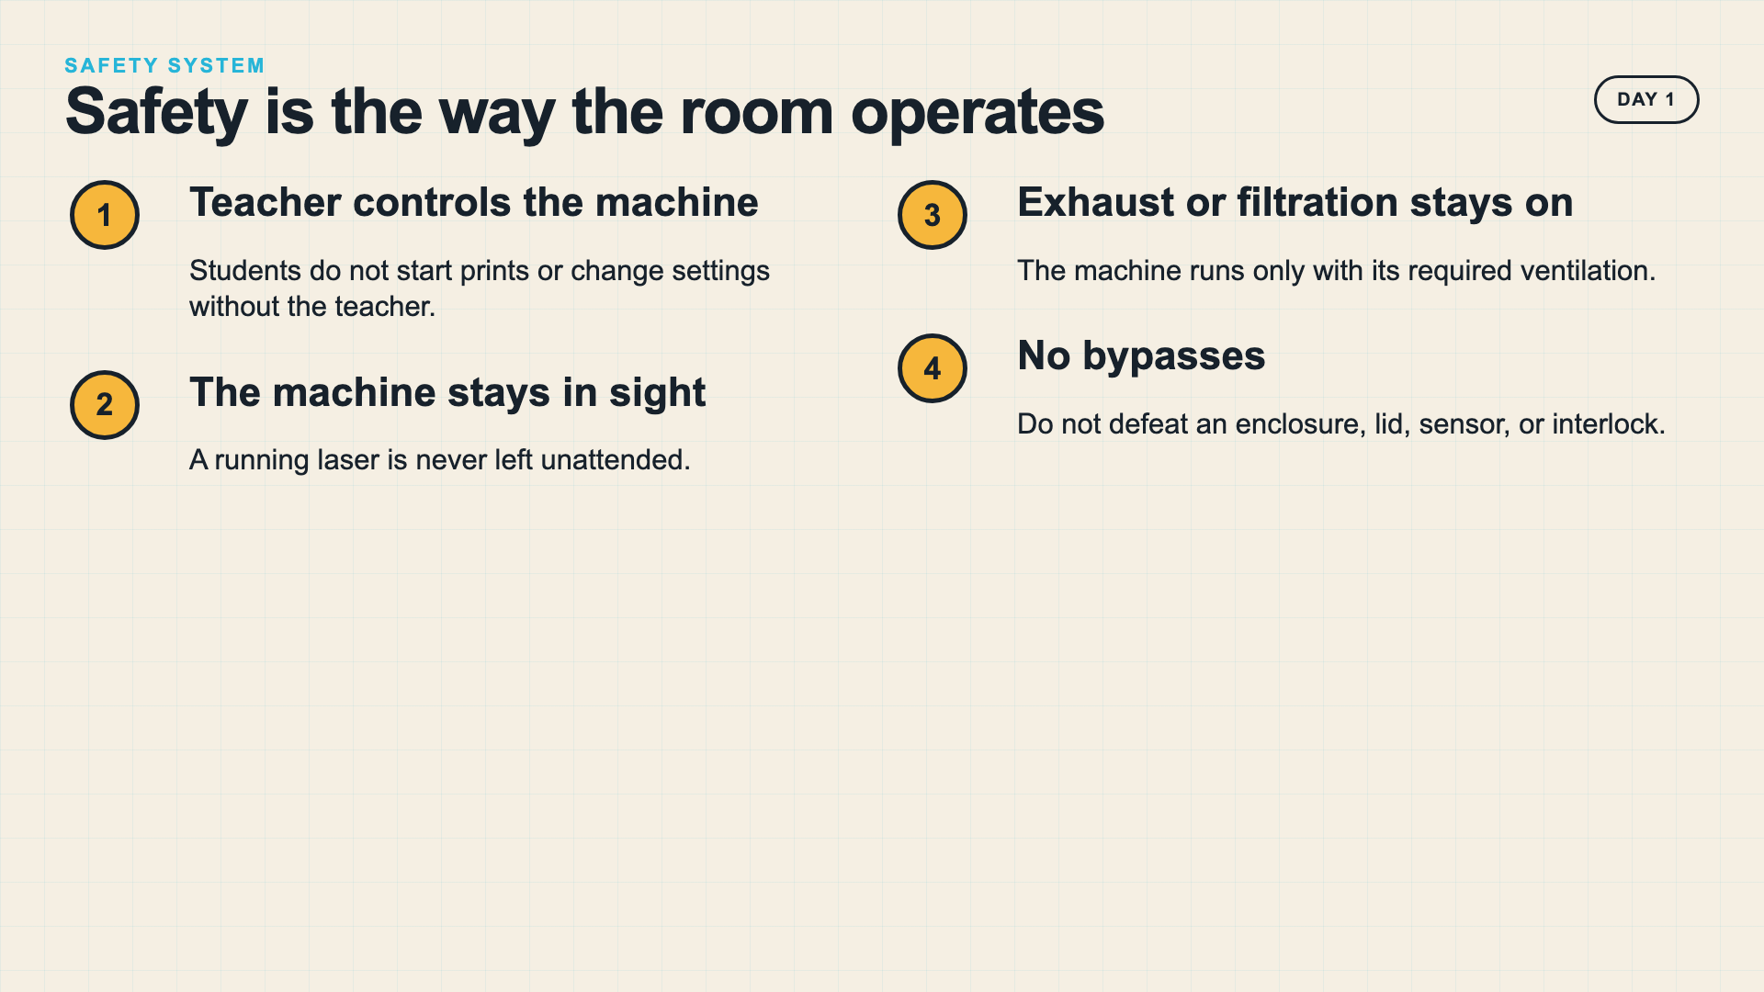
Notes:
Teach the room system before the machine demonstration. These are operating conditions, not optional reminders.
[Sources]
- https://support.glowforge.com/hc/en-us/articles/360033633314-safety-glowforge-performance-series
- https://support.xtool.com/academy/course?id=4

Slide 9
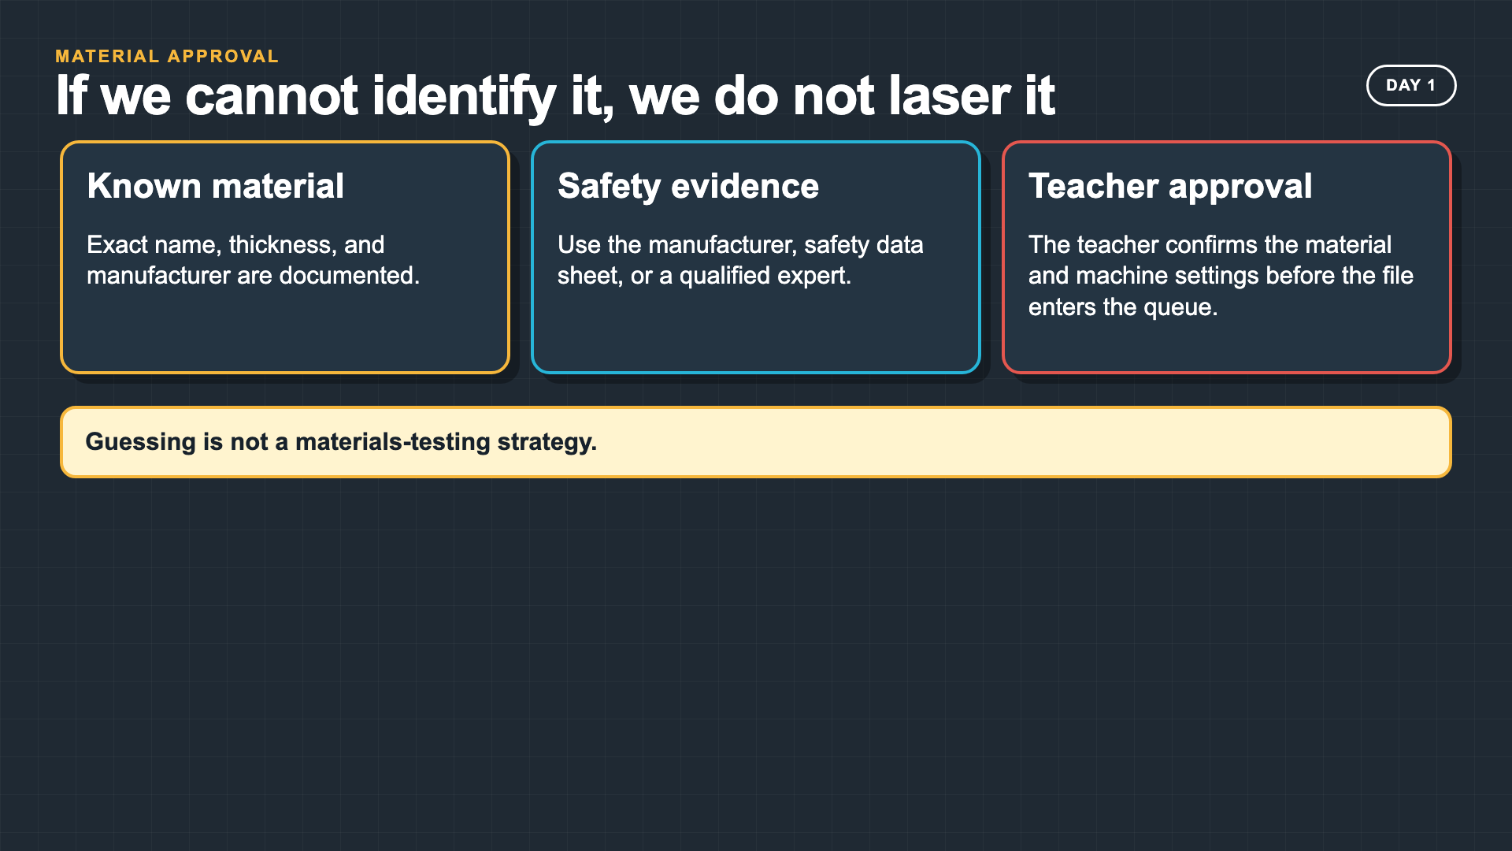
Notes:
Do not identify material by appearance or a student report. If compatibility cannot be confirmed for the exact machine, do not run it.
[Sources]
- https://support.glowforge.com/hc/en-us/articles/4605593296027-Non-Proofgrade-Materials-FAQ
- https://support.xtool.com/academy/course?id=4

Slide 10
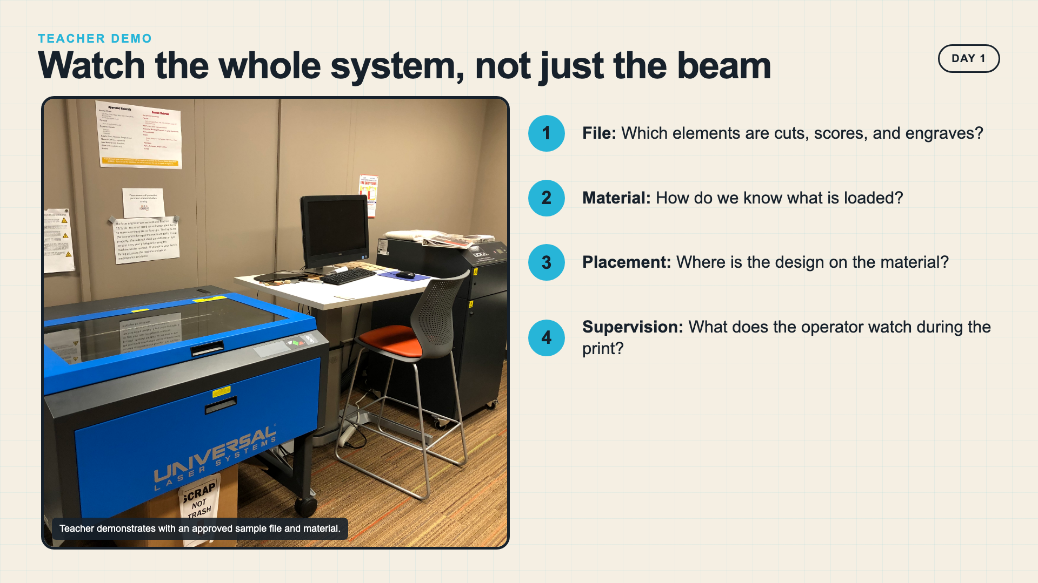
Notes:
Use an approved sample file and material. Narrate file, material, placement, ventilation, and supervision as one system.
[Sources]
- https://commons.wikimedia.org/wiki/File:Library_laser_cutter.jpg
- https://support.glowforge.com/hc/en-us/articles/360033633314-safety-glowforge-performance-series

Slide 11
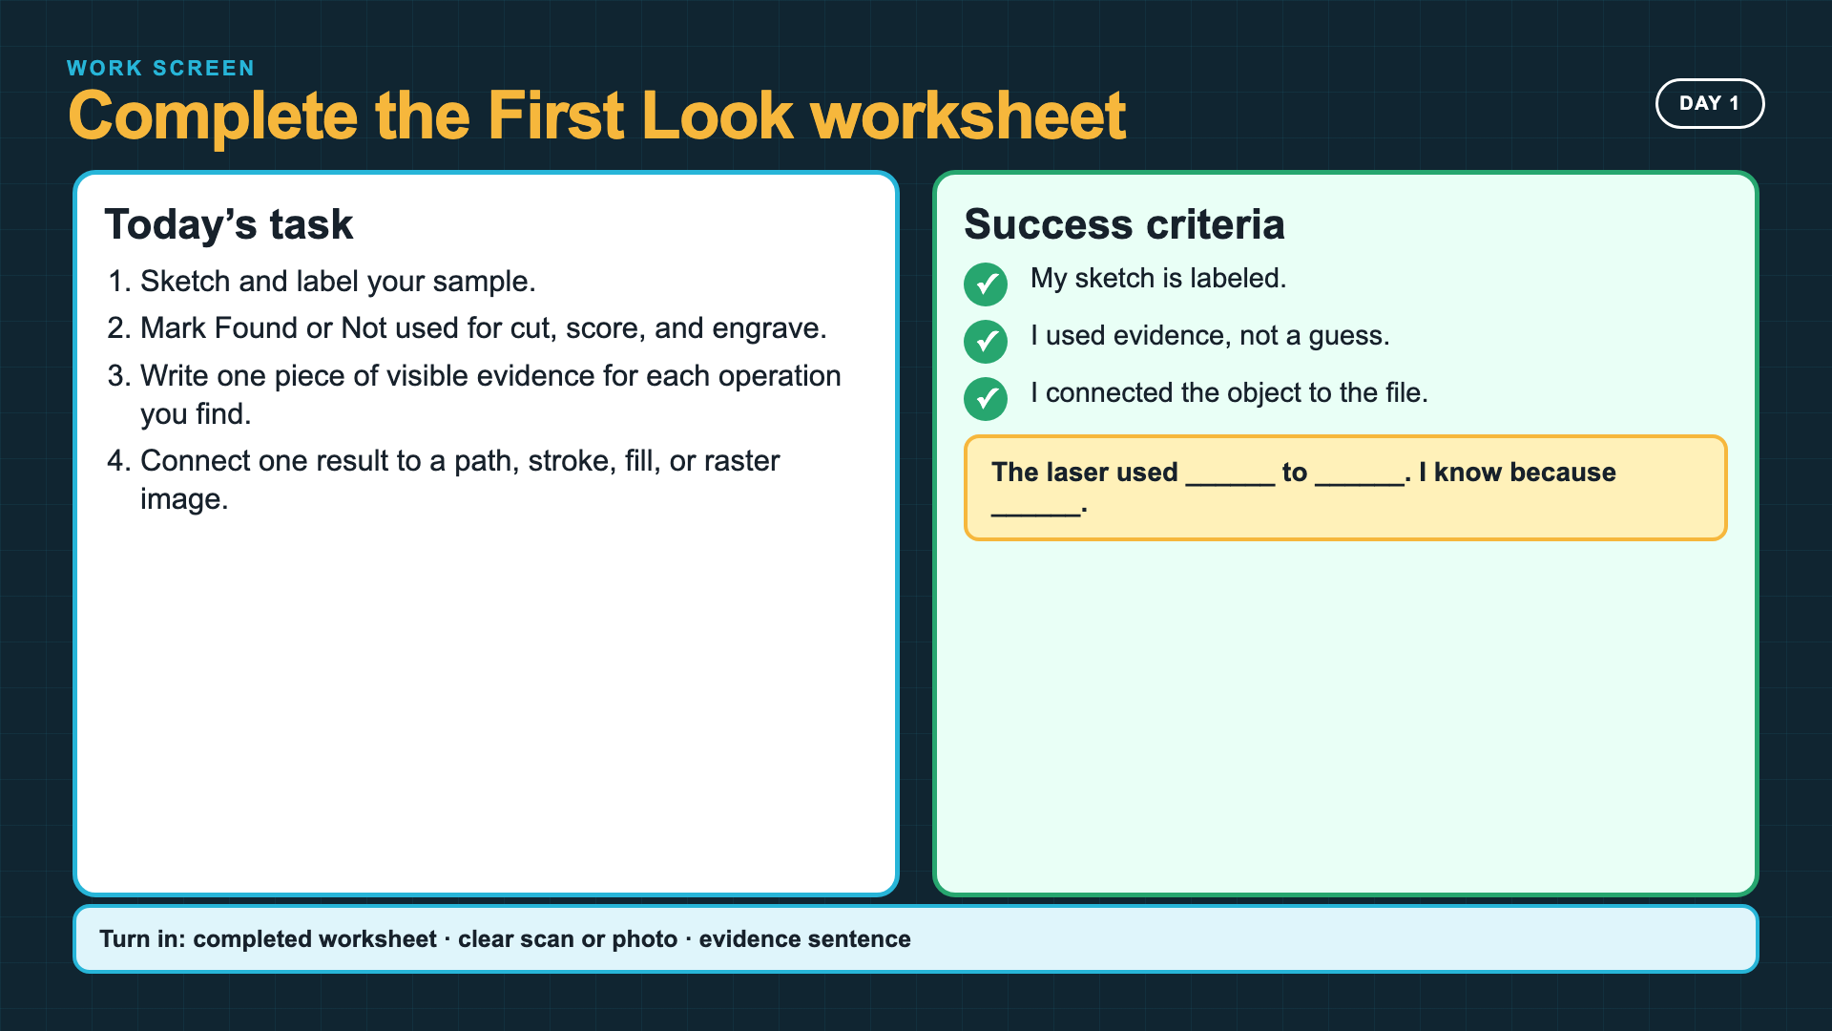
Notes:
Leave this slide projected while students complete the First Look worksheet. A physical sample is preferred; the sourced operation photo is the fallback.
[Sources]
- Smart Solutions 2027 Laser First Look worksheet
- https://support.xtool.com/article/565

Slide 12
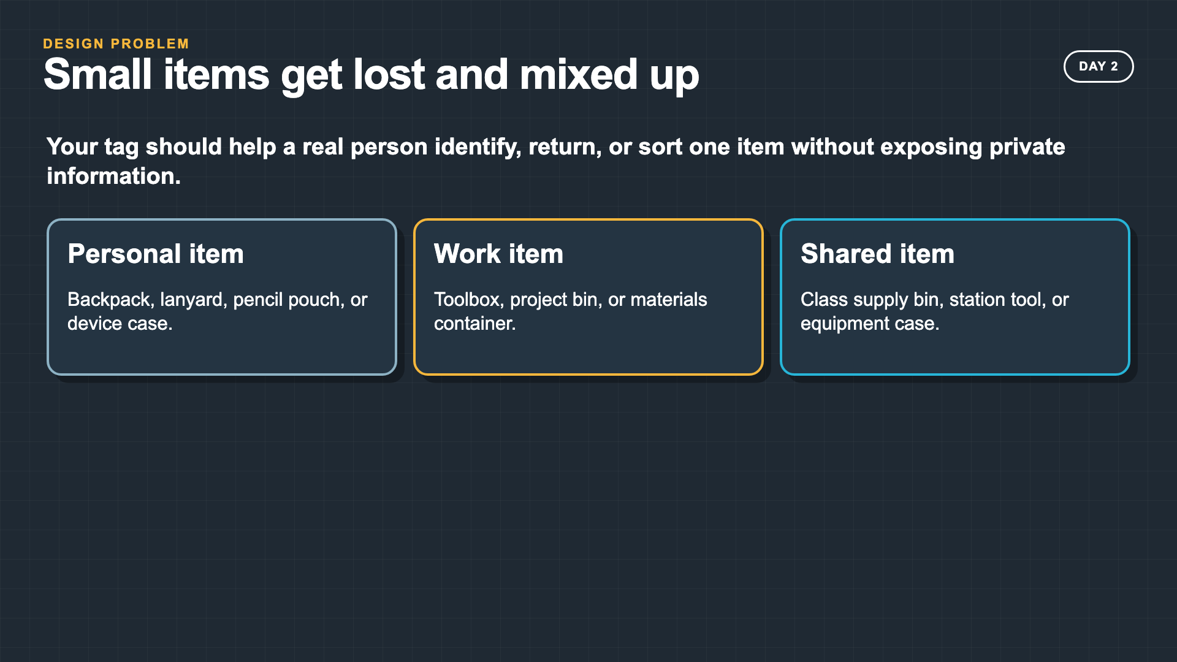
Notes:
Frame the tag as a small real problem: items get lost or mixed up. Students must help a user without exposing private information.
[Sources]
- Smart Solutions 2027 Laser Cutting lesson plan

Slide 13
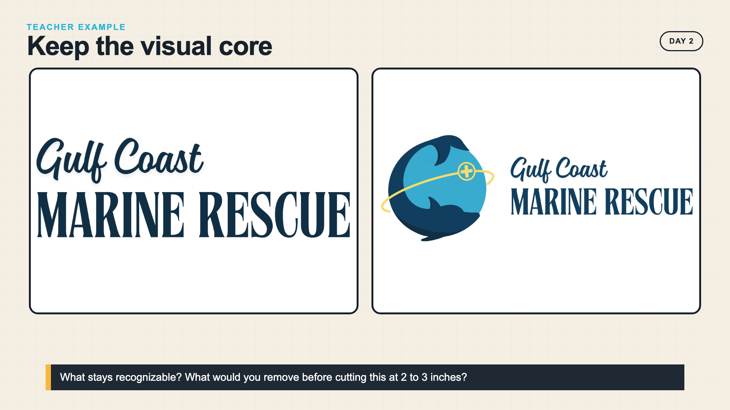
Notes:
This teacher example shows one visual identity adapted for a small object. It is not the student brief; use it only to discuss what stays recognizable.
[Sources]
- Course-provided Gulf Coast Marine Rescue graphics

Slide 14
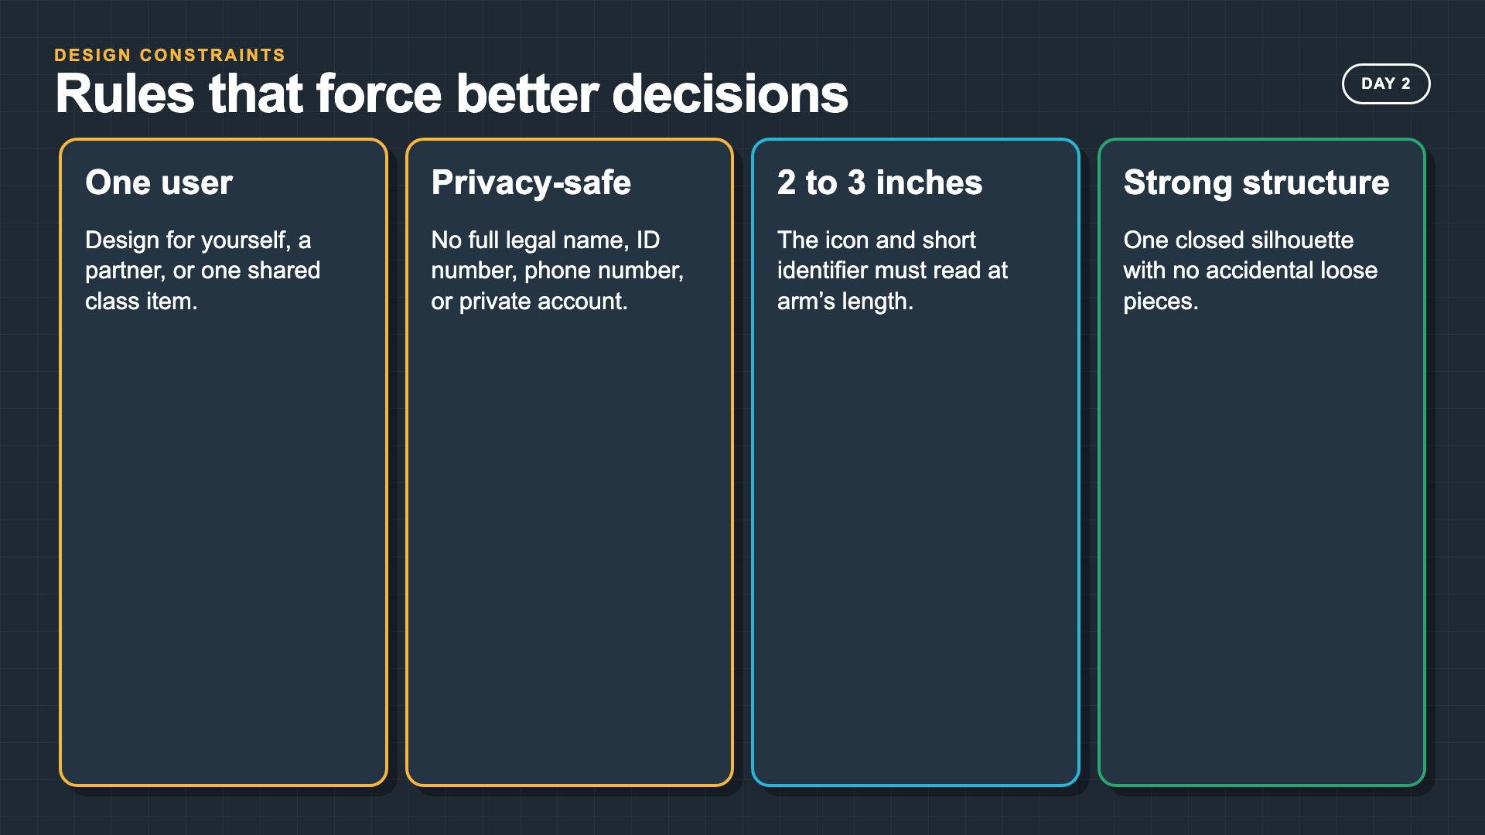
Notes:
Do not remove the constraints to make the task easier. The constraints create the design problem students must solve.
[Sources]
- Smart Solutions 2027 Laser Cutting lesson plan

Slide 15
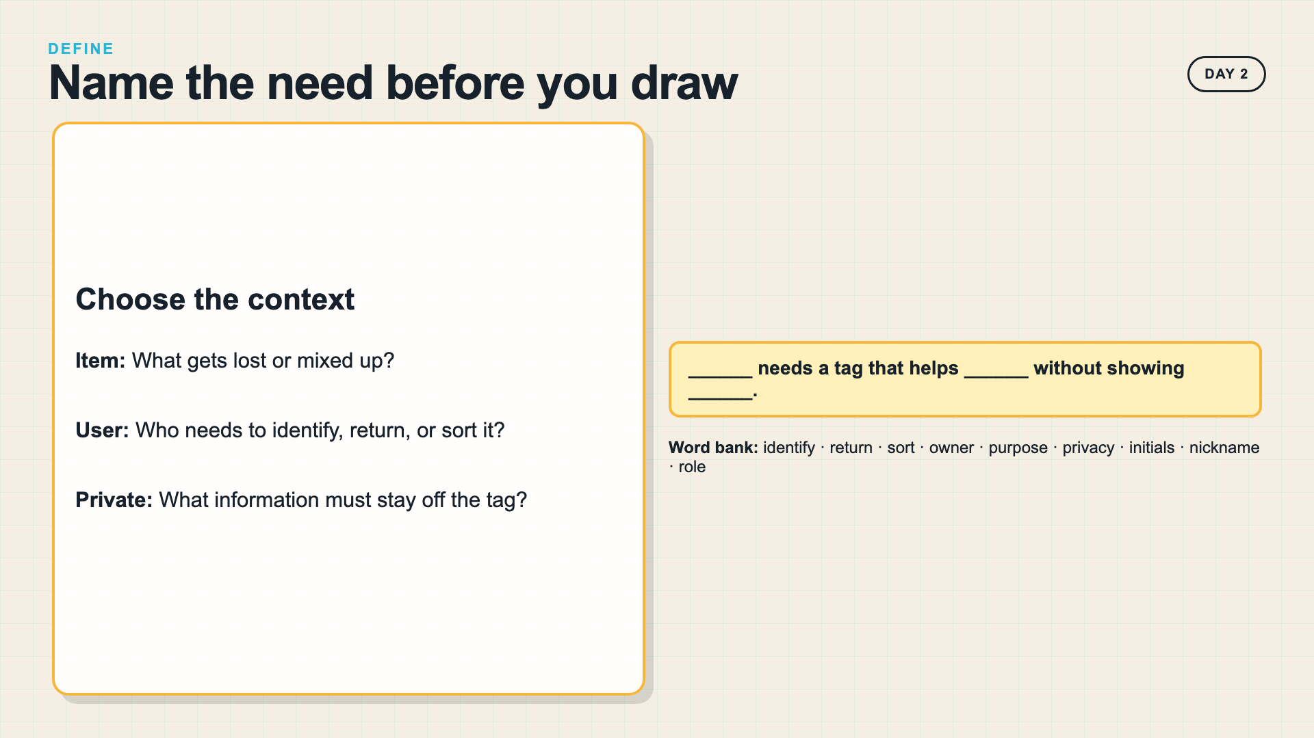
Notes:
Model one complete define statement. Accept personal or shared-class contexts as long as the user, item, purpose, and privacy boundary are specific.
[Sources]
- Smart Solutions 2027 Laser Cutting lesson plan

Slide 16
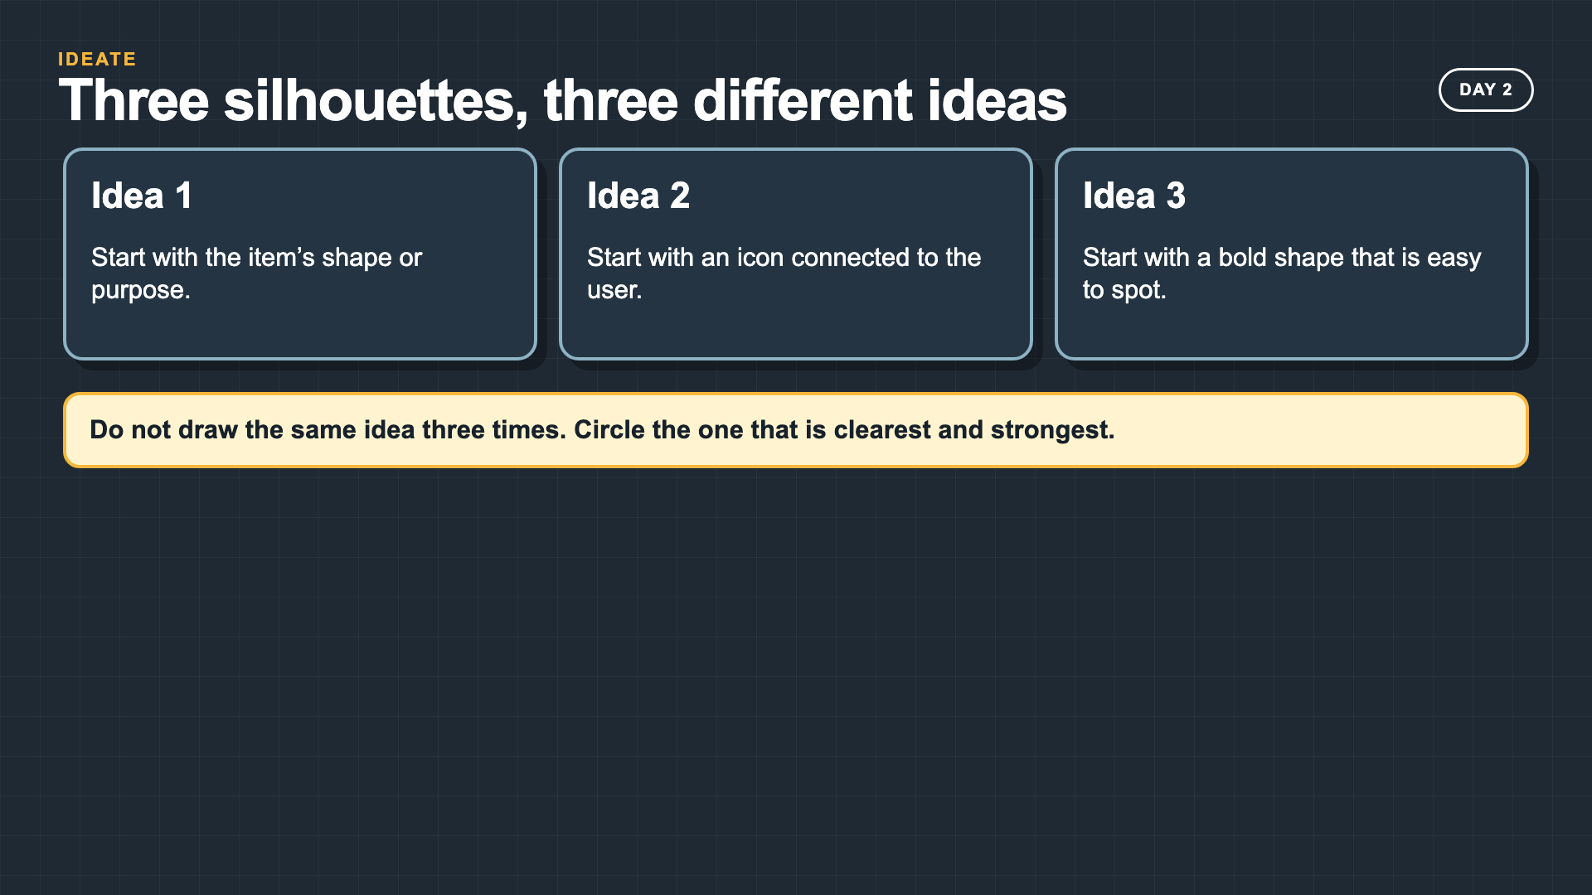
Notes:
Require three meaningfully different silhouettes. If students only change decoration, send them back to the item's purpose or the user's need.
[Sources]
- Smart Solutions 2027 Laser Cutting lesson plan

Slide 17
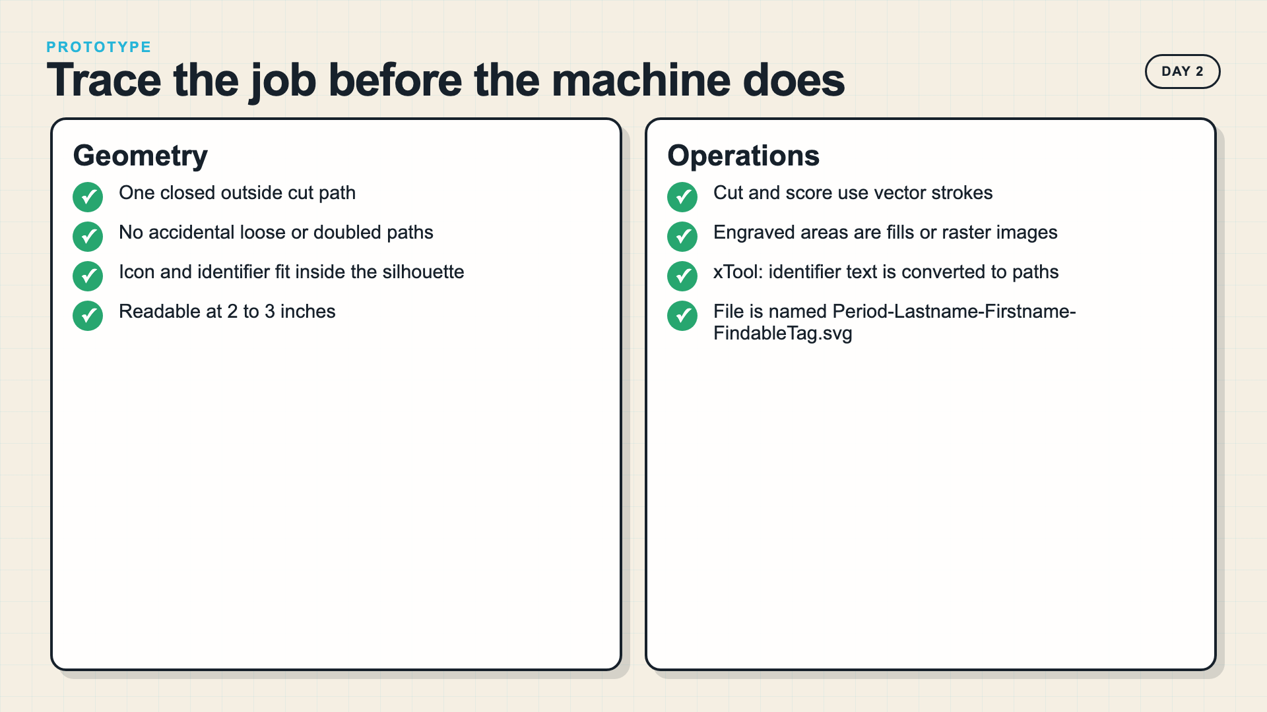
Notes:
Trace the file at presentation scale. Duplicate paths can repeat an operation; open paths and loose interior pieces can change the physical result. On the xTool route, convert identifier text to paths before SVG export because XCS does not display live SVG text.
[Sources]
- https://support.glowforge.com/hc/en-us/articles/20545971062683-Simplify-Strokes
- https://support.xtool.com/article/1883
- https://support.xtool.com/article/544

Slide 18
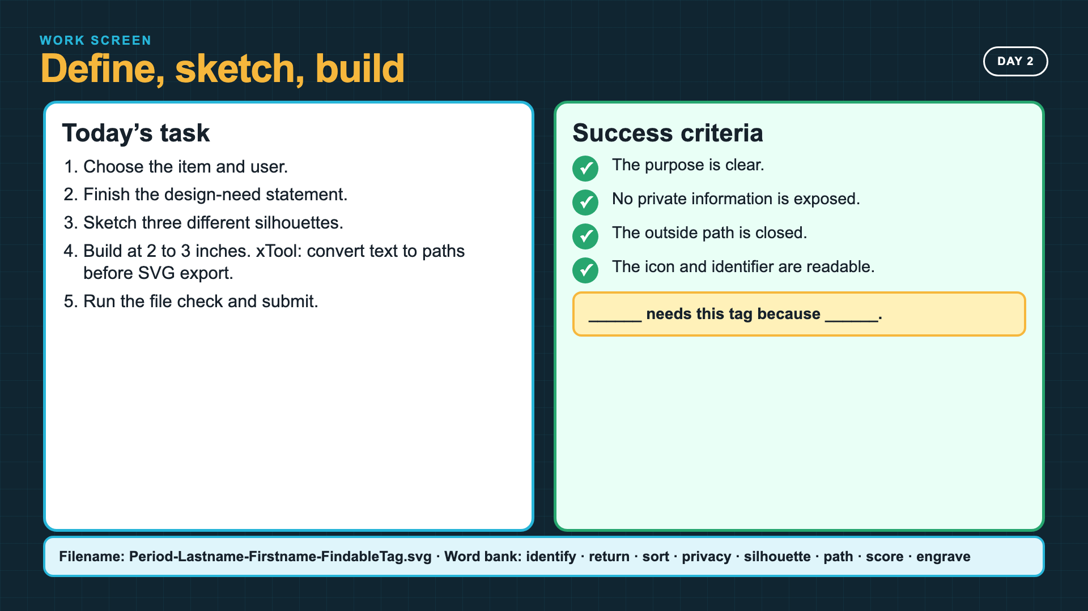
Notes:
Leave this slide projected during Day 2. Students should have the need statement and three sketches before the vector file becomes the focus. Point xTool classes to the text-to-paths step before export.
[Sources]
- Smart Solutions 2027 Laser Cutting lesson plan
- https://support.xtool.com/article/544

Slide 19
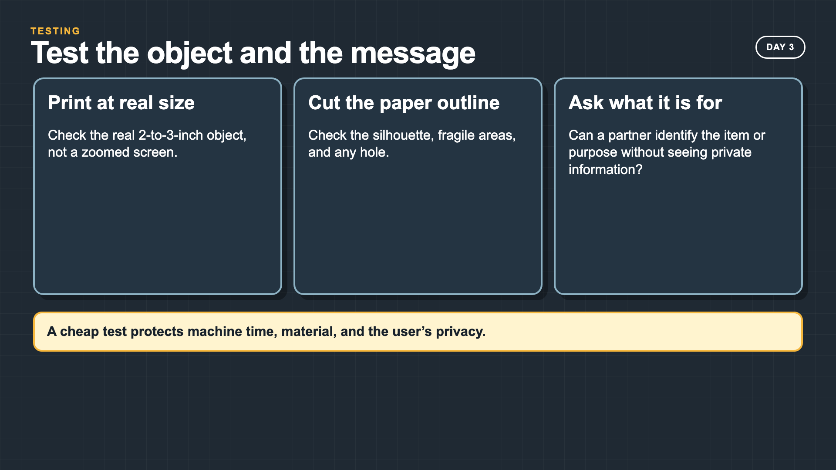
Notes:
A real-size paper test checks both fabrication and communication. The tag must work at the size that will be cut.
[Sources]
- Smart Solutions 2027 Laser Cutting lesson plan

Slide 20
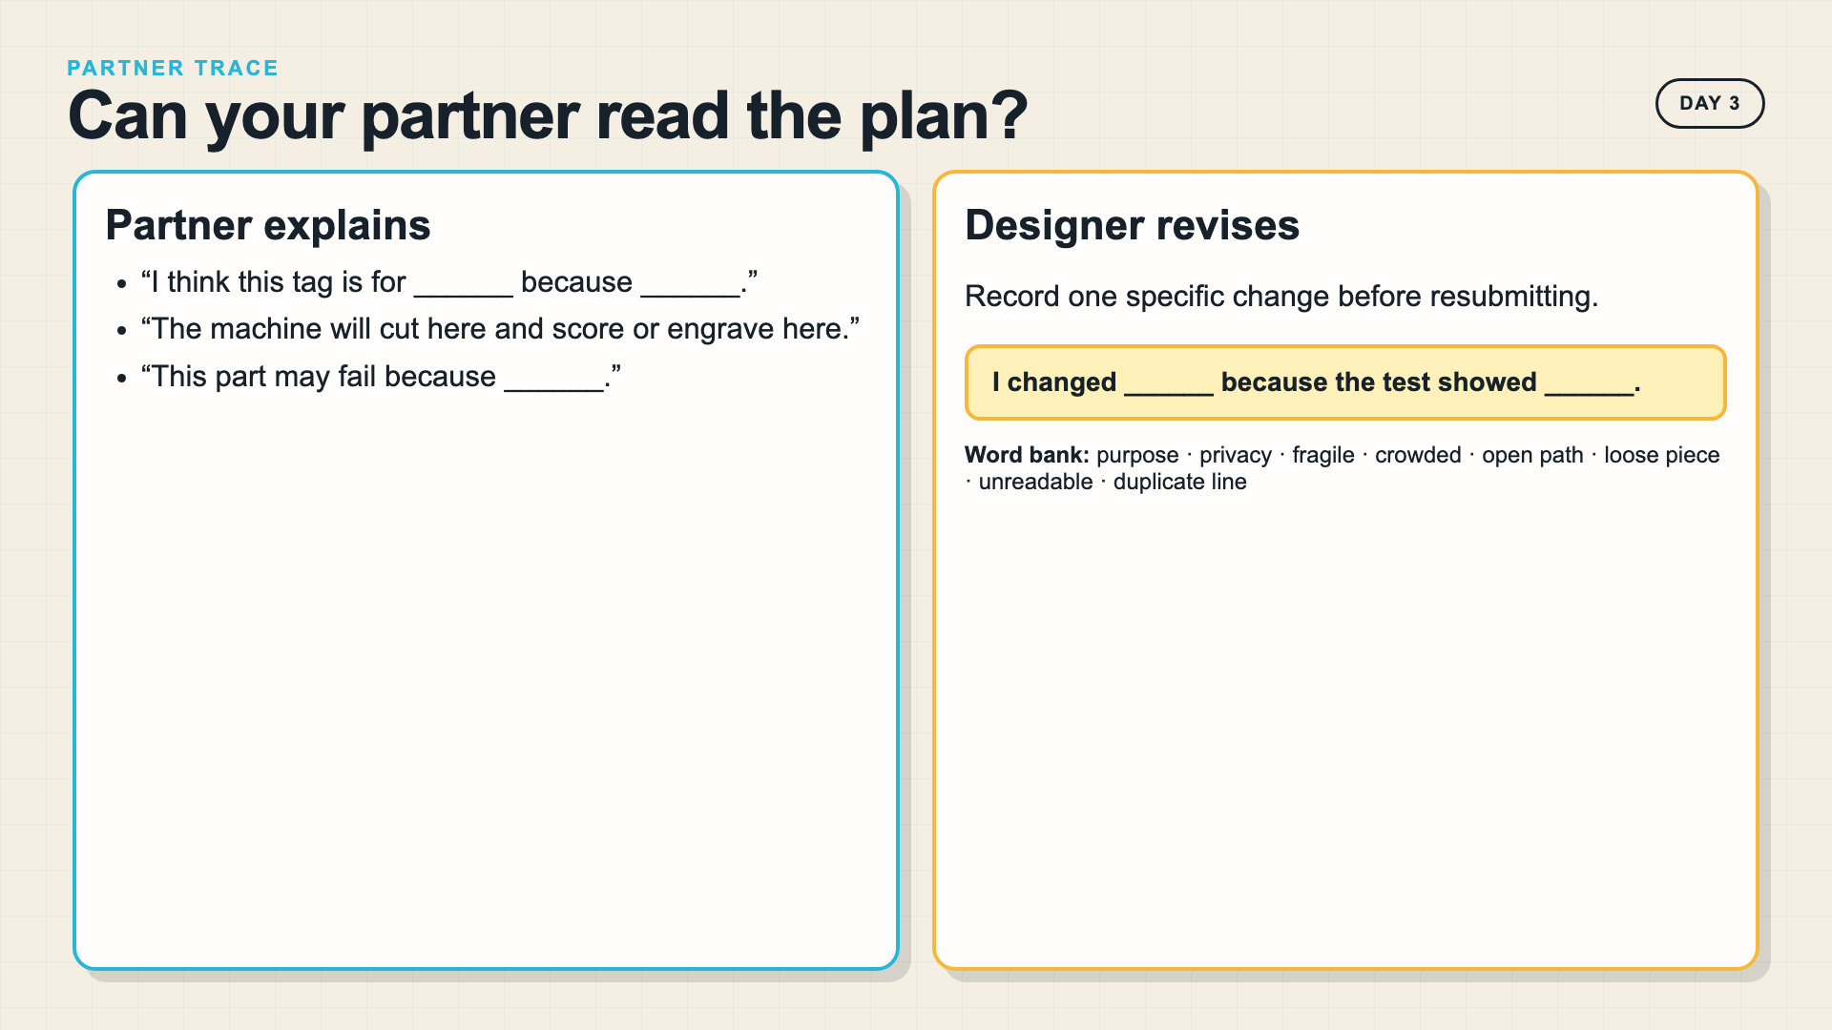
Notes:
The partner first identifies the tag's purpose, then narrates the operation route. The designer listens before revising.
[Sources]
- Smart Solutions 2027 Laser Cutting lesson plan

Slide 21
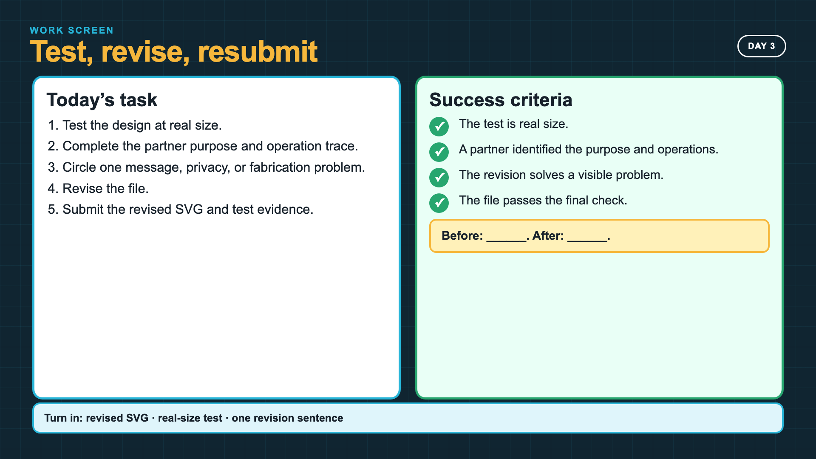
Notes:
Leave this slide projected for Day 3. Require a visible before-and-after change, even when the first design was close.
[Sources]
- Smart Solutions 2027 Laser Cutting lesson plan

Slide 22
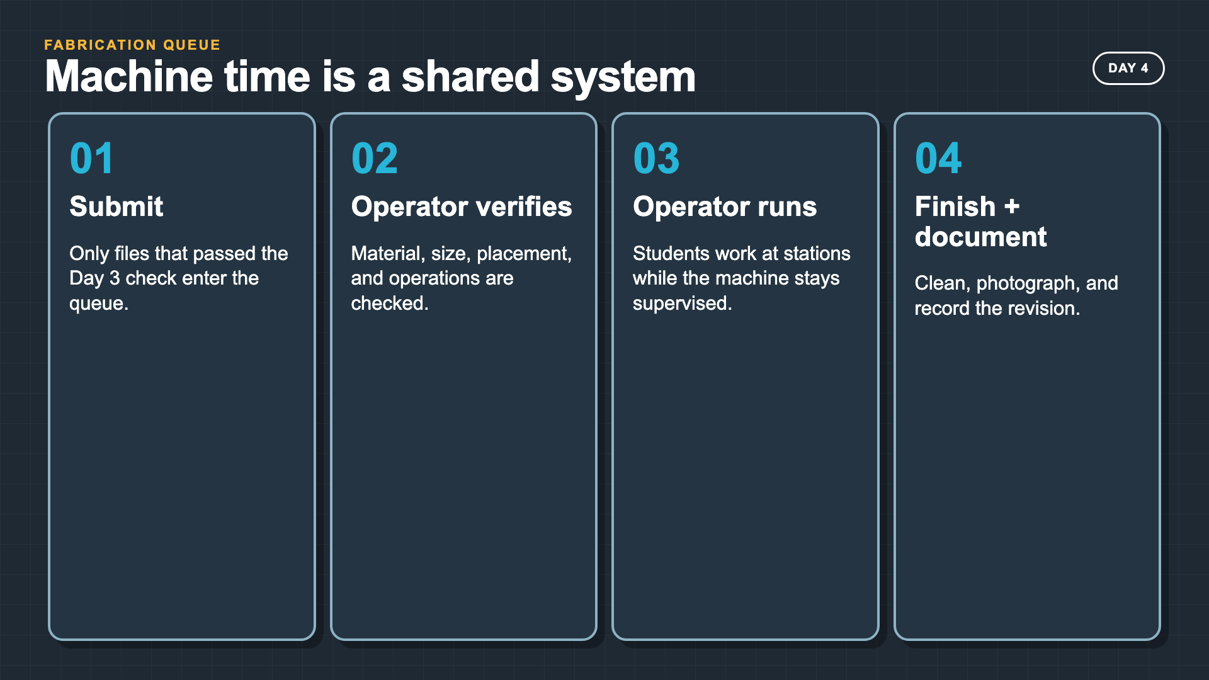
Notes:
Students should not cluster around the machine. The queue, finishing station, documentation station, and revision loop keep everyone working.
[Sources]
- https://support.glowforge.com/hc/en-us/articles/360033633314-safety-glowforge-performance-series
- https://support.xtool.com/academy/course?id=4

Slide 23
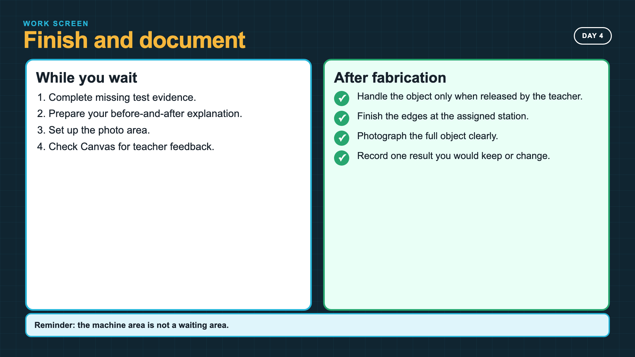
Notes:
Leave this slide projected during fabrication. Release finished pieces according to the exact machine and material procedure.
[Sources]
- https://support.glowforge.com/hc/en-us/articles/360033633314-safety-glowforge-performance-series
- https://support.xtool.com/academy/course?id=4

Slide 24
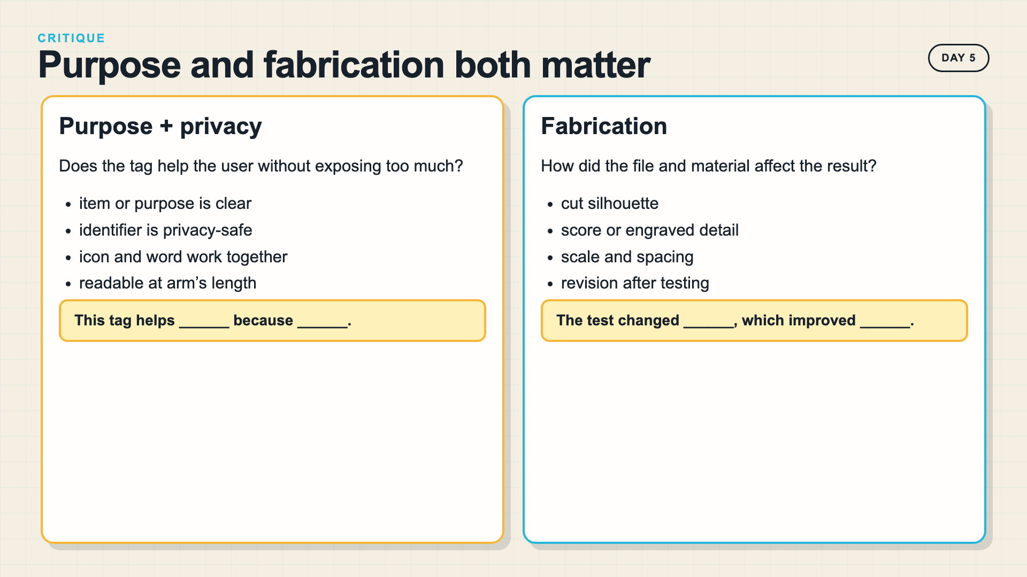
Notes:
Keep the critique specific. A tag can be laser-ready and still fail its user, or communicate clearly and still have weak fabrication geometry.
[Sources]
- Smart Solutions 2027 Laser Cutting project rubric

Slide 25
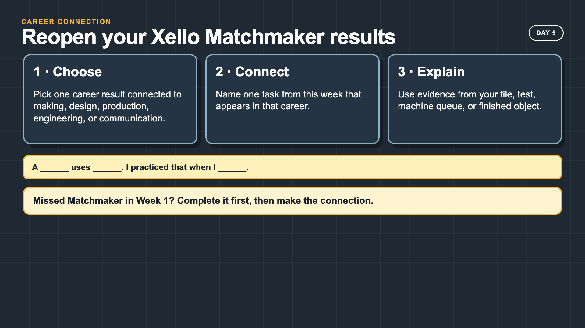
Notes:
Students who completed Matchmaker in Week 1 reopen their results. This is a career-connection check, not a second Matchmaker launch.
[Sources]
- Smart Solutions Scope and Sequence, Week 5

Slide 26
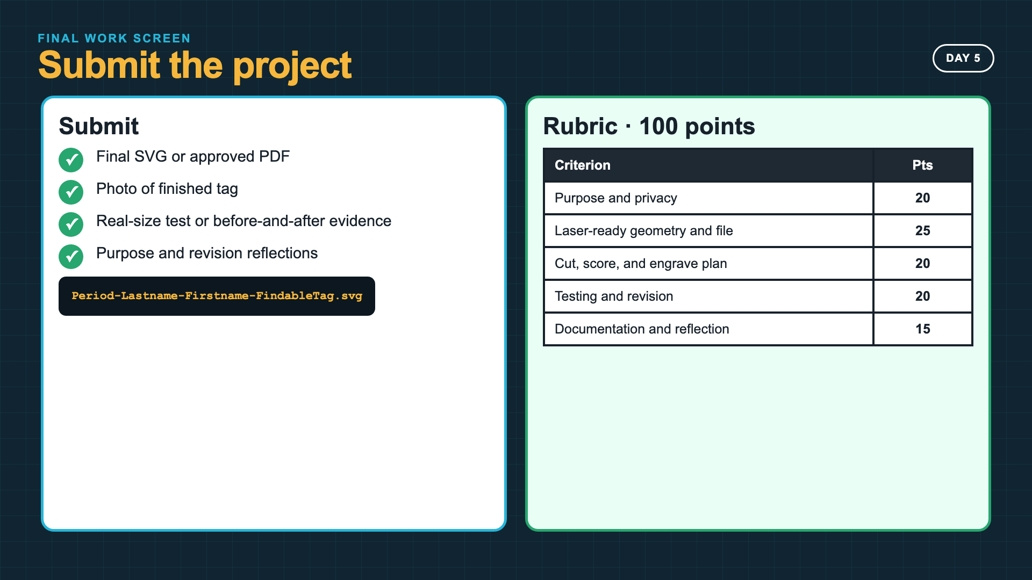
Notes:
Leave this slide projected during submission. Read the five rubric rows aloud so students can locate each piece of evidence.
[Sources]
- Smart Solutions 2027 Laser Cutting project rubric

Slide 27
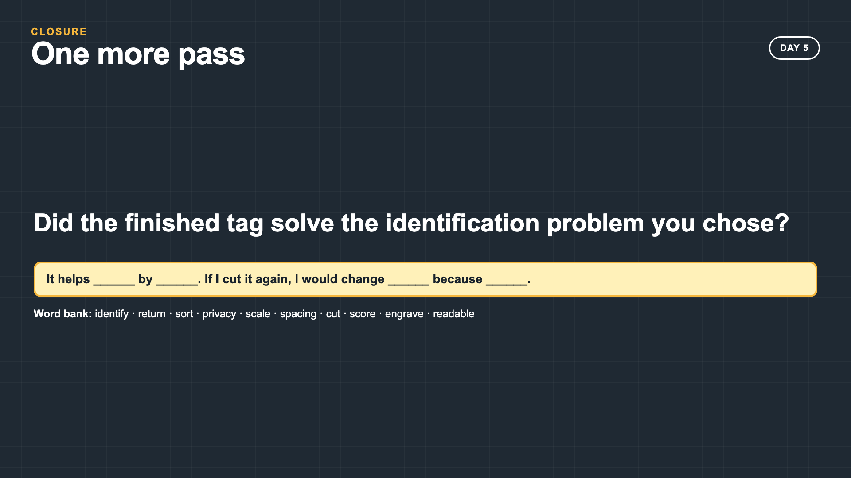
Notes:
Collect the response as a quick exit, submission comment, or table discussion. The answer should name the user, result, and one revision.
[Sources]
- Smart Solutions 2027 Laser Cutting lesson plan

