Slide 1
THINGLINK:
WELCOME MISSION
Guide a First-Time Visitor
One visitor. Three stops. One useful interactive map.
Arrive. Find. Get help or continue.
PART 1: INTERACTIVE MEDIA
Notes:
Introduce the Welcome Mission as a two-day design sprint. Students will guide one first-time visitor through arrive, find, and get help or continue.
[Sources]
- Elisha Lucero, ThingLink place-mapping lesson materials (2025).

Slide 2





WHAT YOU WILL LEARN AND MAKE
By the end, you can:
YOU WILL MAKE:
Explain how backgrounds and tags guide a first-time visitor
DAY 1: PLAN
Choose one visitor and plan arrive, find, and get help or continue.
Plan a three-stop visit for one named audience
DAY 2: BUILD + TEST
Build, test, and revise one Welcome Mission map
Upload the map, add purposeful tags, ask a partner to test it, and revise one thing.
ThingLink: Welcome Mission
LESSON 1.1: WELCOME MISSION
Notes:
Keep the standards in the facilitator guide. Project this slide to name the learning and the product in plain language.
[Sources]
- Elisha Lucero, ThingLink place-mapping lesson materials (2025).

Slide 3

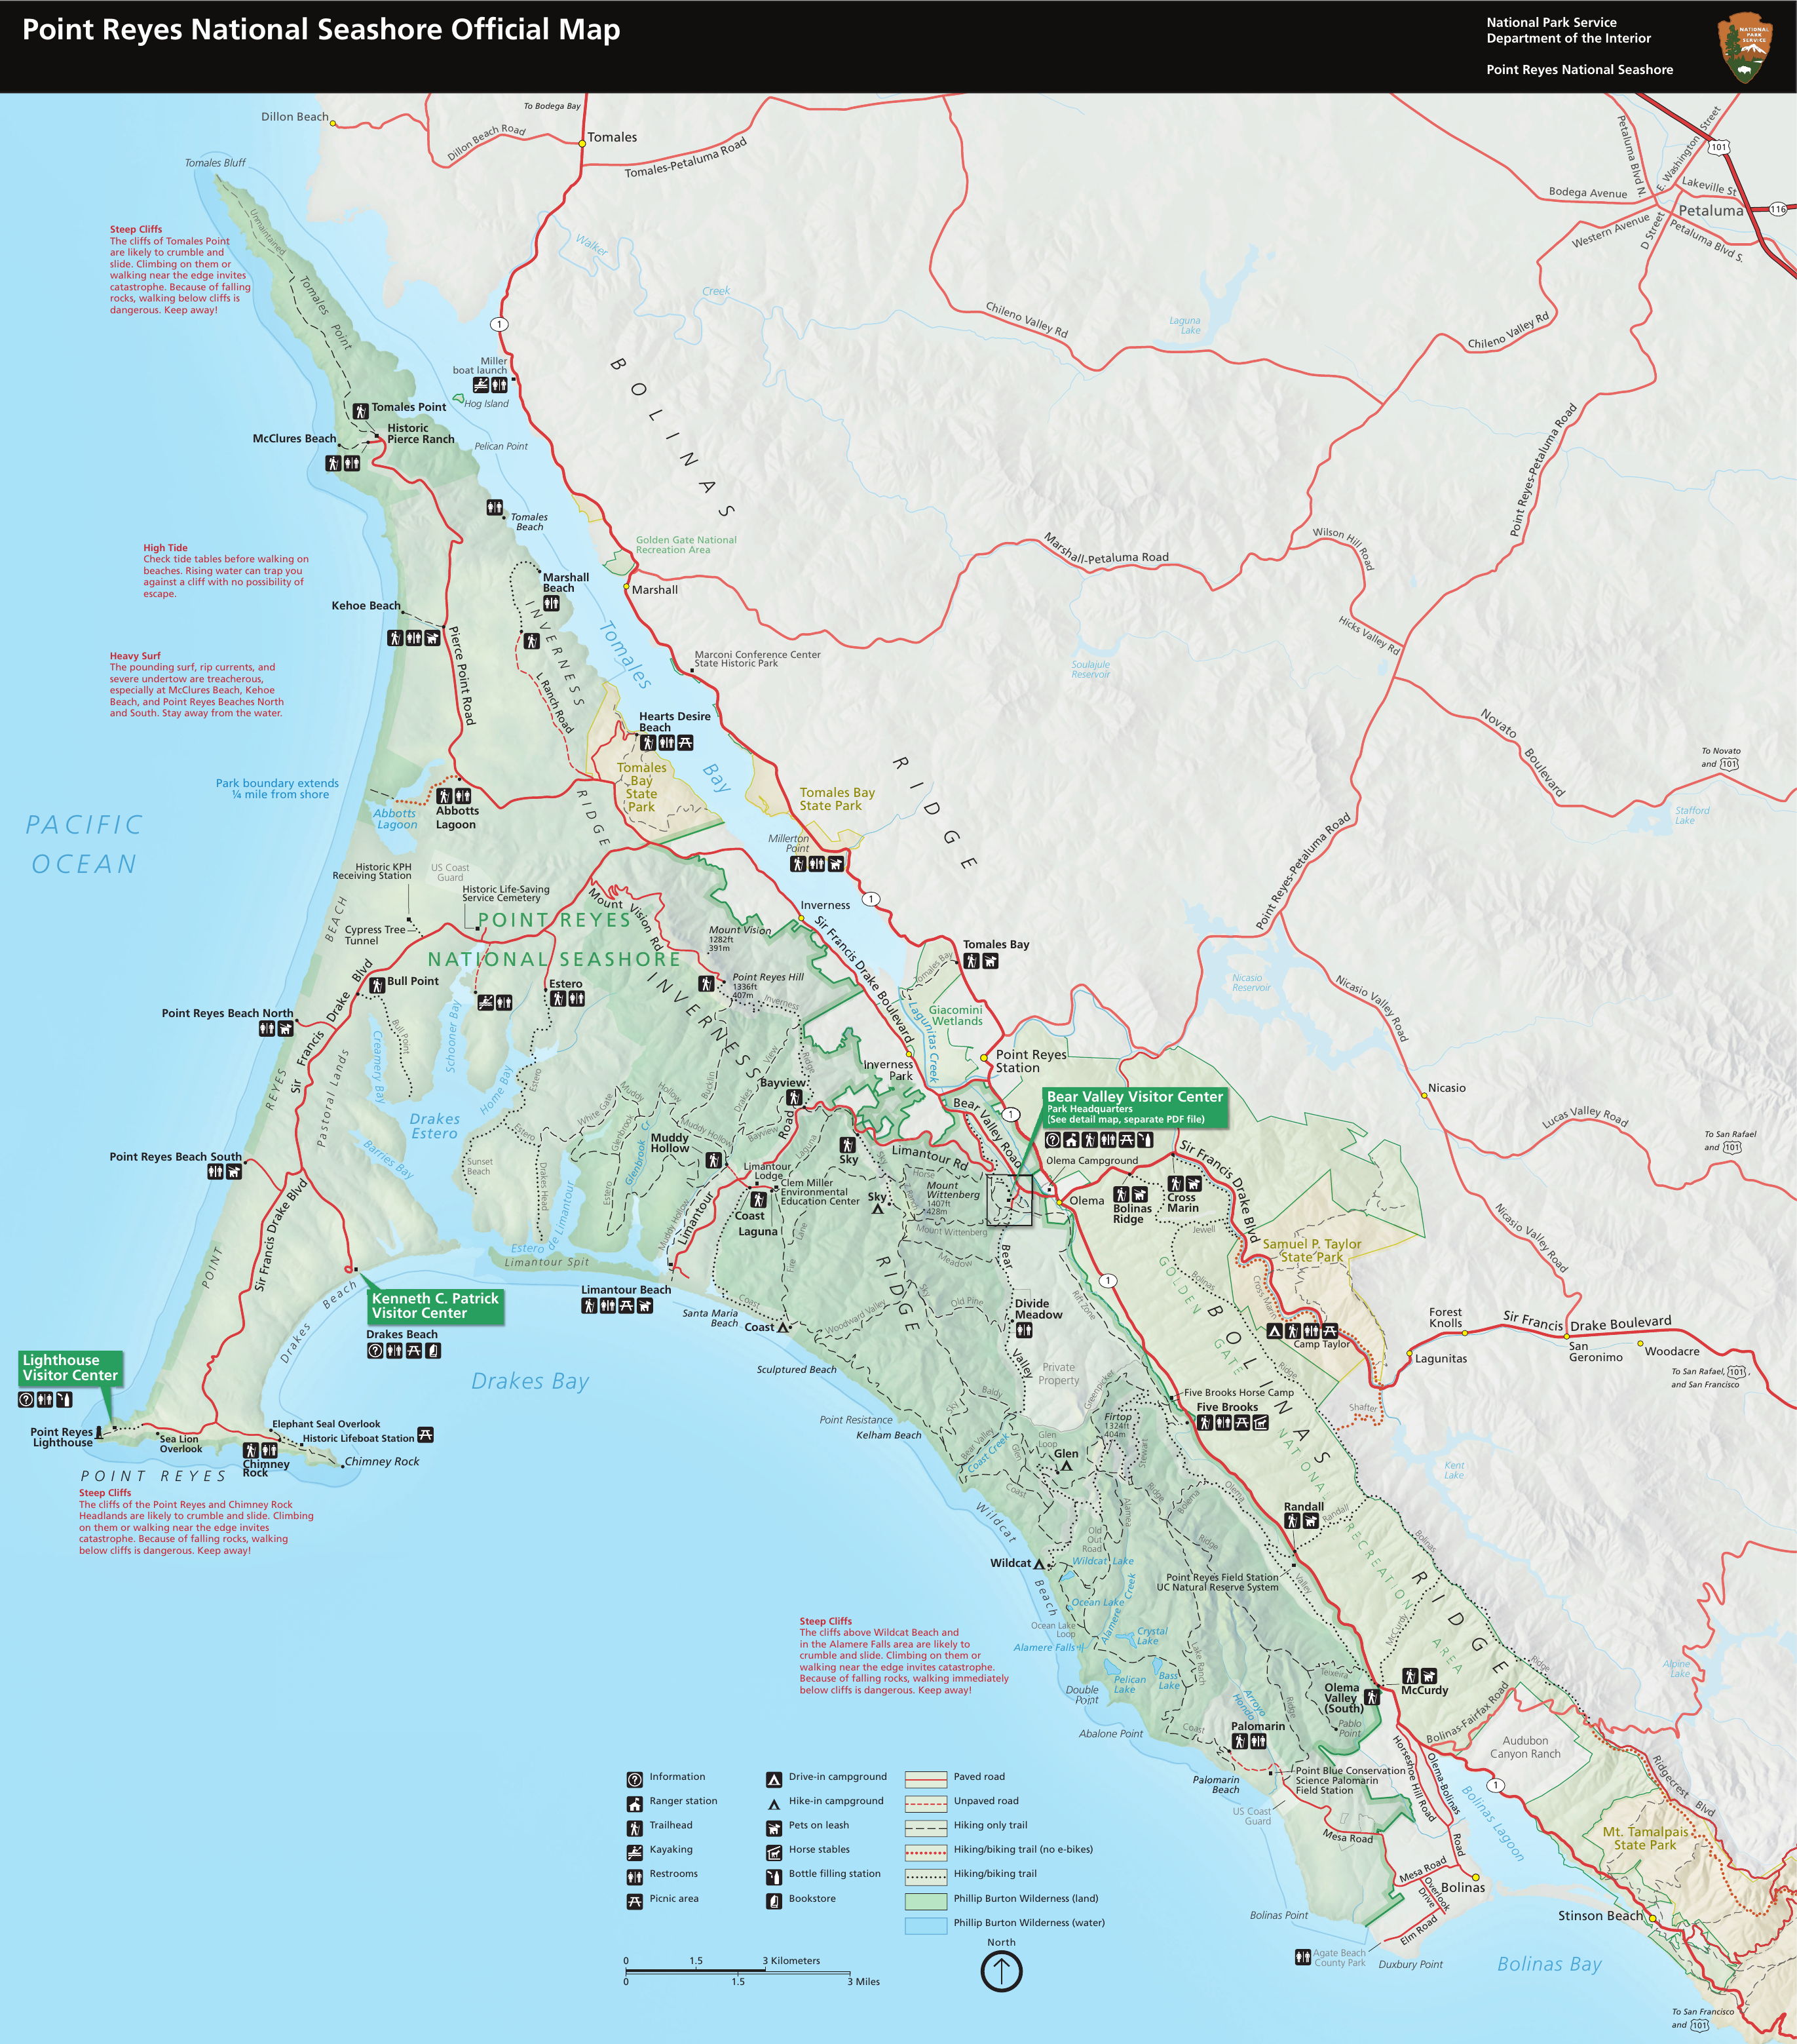
DO NOW: REMEMBER A FIRST VISIT
WARMUP
Think of the first time you entered a place and did not know where to go. What did you need to find?
Three stops I needed:
1
2
What information would have helped you move without asking someone to guide you?
3
Think about:
A useful guide answers:
Where did you enter?
Where do I enter?
What did you come to find?
What should I notice first?
What sign or landmark helped?
Where can I get help?
Where could you ask for help?
What could confuse me?
QUICK SKETCH
WELCOME MISSION: DAY 1
Notes:
Give students quiet thinking time, then ask two or three students to describe a first visit that felt confusing and name the information they needed.
[Sources]
- Elisha Lucero, ThingLink place-mapping lesson materials (2025).
- National Park Service, Point Reyes National Seashore park map: https://www.nps.gov/pore/planyourvisit/upload/map_park.pdf (accessed August 11, 2026).
- Smithsonian National Museum of Natural History, museum map: https://naturalhistory.si.edu/visit/map (accessed August 11, 2026).
- Dallas Area Rapid Transit, DART Rail System Map effective May 13, 2026: https://dartorgcmsblob.dart.org/prod/docs/default-source/dart-maps/dart_rail_map.pdf?sfvrsn=2aafae30_11 (accessed August 11, 2026).

Slide 4

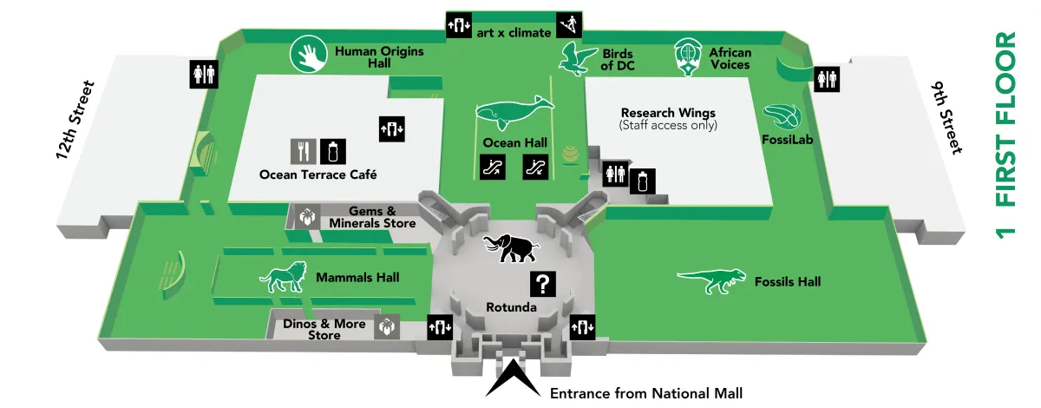
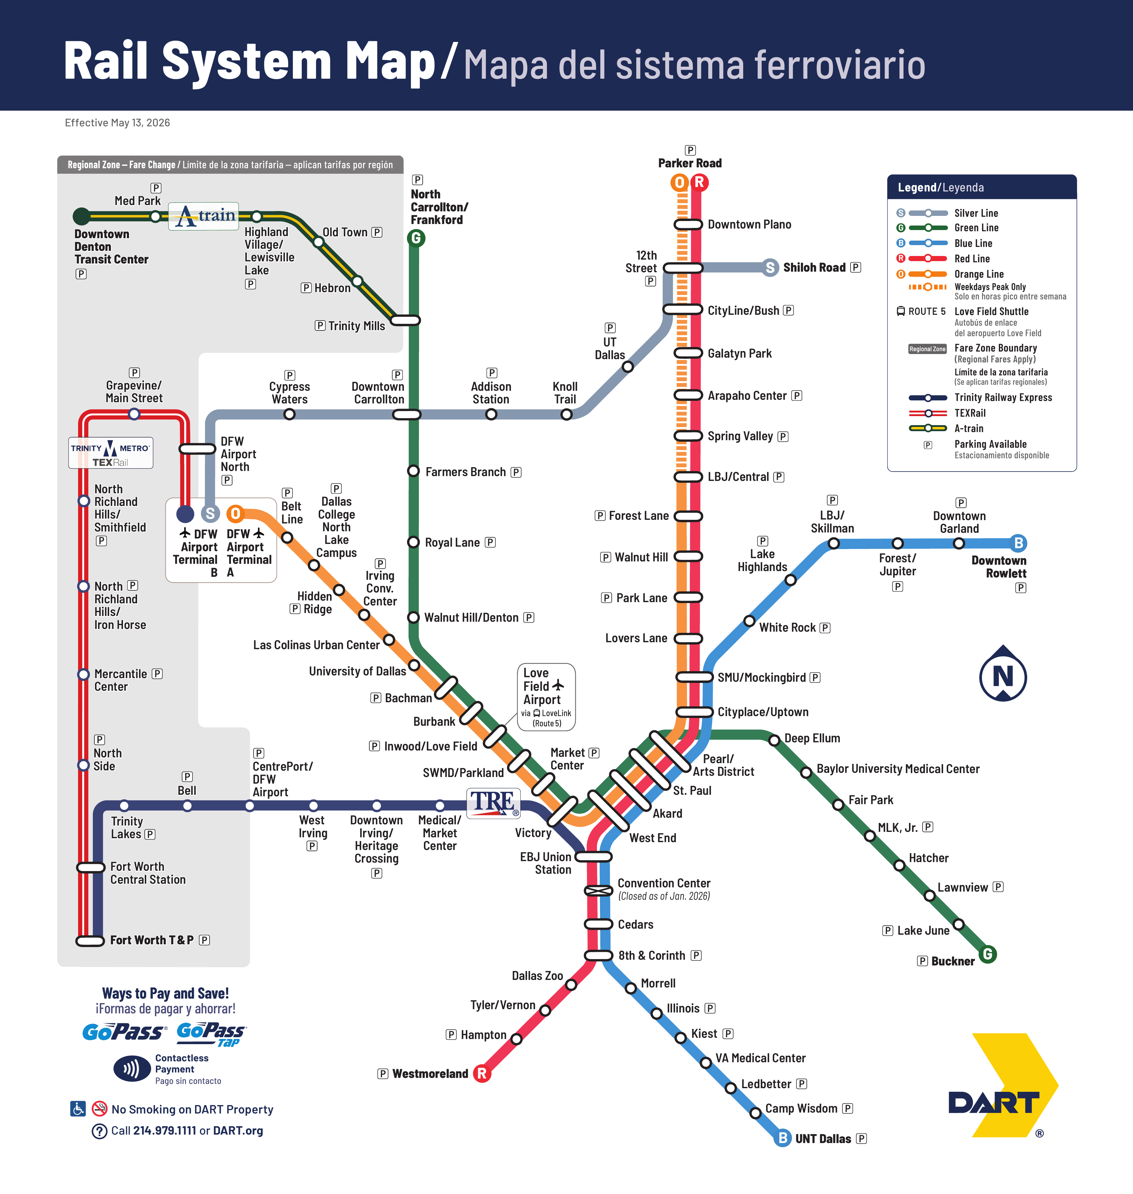
WHAT MAKES A MAP USEFUL?
A map has a job
A useful map helps a specific person do something: arrive safely, find a destination, or choose a route.
Notice what each map includes and what it leaves out.
POINT REYES
SMITHSONIAN
DART RAIL
PARK
MUSEUM
TRANSIT
Job: plan a safe visit. Visitors need roads, trails, services, and warnings.
Job: find one exhibit. Visitors need floors, landmarks, and amenities.
Job: choose a route. Riders need lines, stops, and transfer points.
Look for:
Clear labels
Useful landmarks
Paths or connections
Warnings and services
A readable visual hierarchy
Turn and talk: Who is each map for? What is the first useful thing your eye finds?
Notes:
Use the three maps to teach audience and purpose. Ask what each map helps someone do and what information would be distracting in that context.
[Sources]
- Elisha Lucero, ThingLink place-mapping lesson materials (2025).
- National Park Service, Point Reyes National Seashore park map: https://www.nps.gov/pore/planyourvisit/upload/map_park.pdf (accessed August 11, 2026).
- Smithsonian National Museum of Natural History, museum map: https://naturalhistory.si.edu/visit/map (accessed August 11, 2026).
- Dallas Area Rapid Transit, DART Rail System Map effective May 13, 2026: https://dartorgcmsblob.dart.org/prod/docs/default-source/dart-maps/dart_rail_map.pdf?sfvrsn=2aafae30_11 (accessed August 11, 2026).

Slide 5







WHY MAKE A MAP INTERACTIVE?
Layer information
Show evidence
Explain a location
A background image gives the viewer the big picture. Tags add details only where the viewer needs them.
Use a photo, short video, or audio clip when it adds something the map cannot show.
Name what the visitor found and why it matters.
The viewer chooses what to open, so placement and labels matter.
Connect a resource
Test with a viewer
Link a menu, schedule, directions, or another useful source.
Share the map with someone who was not part of your planning.
ThingLink Editor
Save
Publish
A tag earns its spot when it helps
A visitor finds something
Your place map
A viewer understands a choice
A user avoids confusion
An audience takes the next step
Background = the big picture. Tag = the detail a viewer opens on purpose.
Notes:
Teach the background-and-tag relationship. A tag is useful when it gives the viewer information at the moment they need it.
[Sources]
- Elisha Lucero, ThingLink place-mapping lesson materials (2025).
- ThingLink Support, How to create an interactive image: https://support.thinglink.com/hc/en-us/articles/360021500733-How-to-create-an-interactive-image (accessed August 11, 2026).
- ThingLink Support, Tag Types: https://support.thinglink.com/hc/en-us/articles/360021312294-Tag-Types (accessed August 11, 2026).
- ThingLink Support, Creating accessible content: https://support.thinglink.com/hc/en-us/articles/24782995017239-Creating-accessible-content (accessed August 11, 2026).

Slide 6

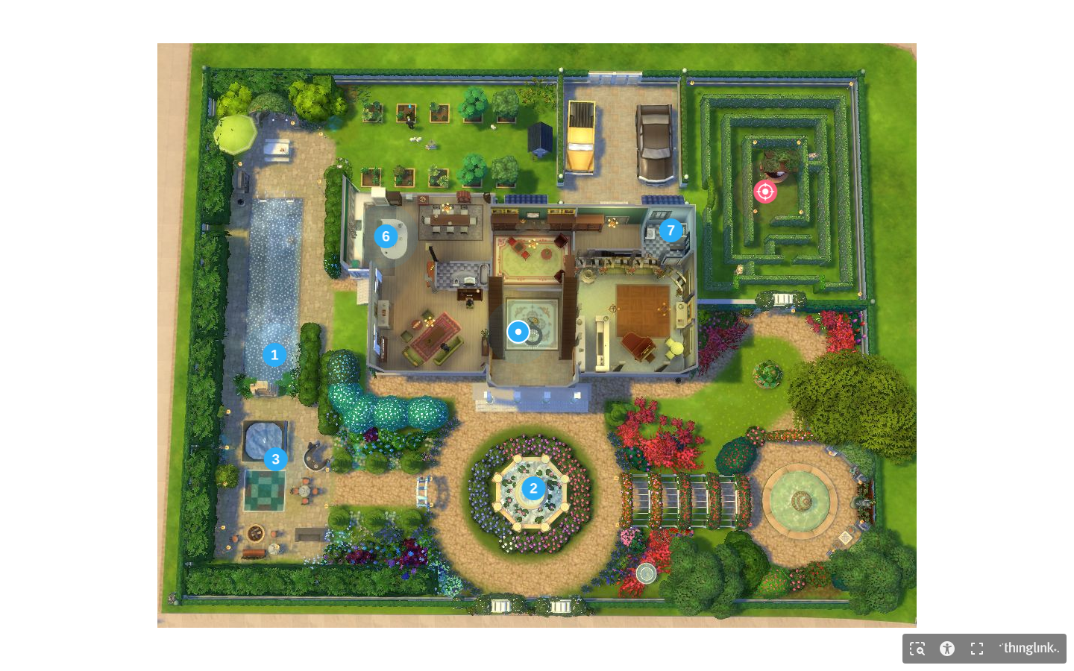
THINGLINK IN ACTION: READ THE TAGS
Study one real example
The background shows the whole place. Numbered tags tell the viewer where to choose.
A strong tag sits near the thing it explains and gives the viewer a reason to open it.
As we open tags, notice:
Placement
Short, specific labels
Explore the class example: https://www.thinglink.com/view/scene/2023915701714027173
Useful media
A clear audience
A next step
Turn and talk: Which tag is easiest to understand before opening it? What makes it clear?
Notes:
Open the live class example if the network allows. Do not explain every tag first. Let students predict what each tag will reveal from its placement and label.
[Sources]
- Elisha Lucero, ThingLink place-mapping lesson materials (2025).
- Interactive place map class example: https://www.thinglink.com/view/scene/2023915701714027173 (accessed August 11, 2026).

Slide 7











TWO-DAY ROUTE: PLAN, BUILD, TEST
DAY 1: LEARN + PLAN
DAY 2: BUILD + TEST
Learning + work:
Learning + work:
Compare real maps and identify their job
Upload the place map to ThingLink
Analyze what makes a tag useful
Add at least three purposeful tags
Choose one visitor and one mission
Check labels and any media, links, or sources
Plan arrive, find, and get help or continue
Ask a partner to test the map
Revise one thing, then submit the link
You need:
You need:
Planning paper
Map image or sketch
Computer
Class code or group
Source notes if needed
A named audience
Map image
Outside-media sources
Notes:
Preview the two-day route before students plan. Keep the three-stop mission visible: arrive, find, and get help or continue.
[Sources]
- Elisha Lucero, ThingLink place-mapping lesson materials (2025).

Slide 8






PLAN YOUR WELCOME MISSION
One visitor. One mission. Three required stops.
Plan how the visitor will arrive, find what they need, and get help or continue.
Before you sketch, name:
Required stops:
ARRIVE
FIND
GET HELP OR CONTINUE
Purpose
Audience
OPTIONAL FOURTH STOP: Add one only if it helps the same visitor.
What did the visitor come to do?
Who is visiting for the first time?
Mission:
My map helps a first-time ___ complete ___.
Check your plan:
Tag plan
Does each stop move the same visitor forward?
What will each tag help the visitor do?
Can the visitor arrive without coaching?
What title tells the visitor what they found?
Is the place safe to share?
Notes:
Conference on the visitor and mission before students choose media. Approve one clear three-stop route before production.
[Sources]
- Elisha Lucero, ThingLink place-mapping lesson materials (2025).

Slide 9

DAY 1: BUILD THE VISITOR ROUTE
Sketch one place map
Map before tags
Show where the visitor begins and how the three stops connect. Tags will add the details later.
Show the whole place
Label landmarks
Choose one starting point:
Give the viewer a clear boundary and orientation.
Use short labels for the places a visitor must find.
Hand-drawn map photographed or scanned
Digital floor plan or diagram
Mark the three stops
Keep paths clear
A public, composite, fictional, or teacher-approved place image
Label arrive, find, and get help or continue.
Do not cover labels or routes with tag icons.
Notes:
Require a readable background before tags. Students may draw, build digitally, or use a public, composite, fictional, or teacher-approved image with a legal reuse route.
[Sources]
- Elisha Lucero, ThingLink place-mapping lesson materials (2025).

Slide 10





DAY 1 CHECK: READY TO BUILD?
Your plan is ready when:
Bring for Day 2:
Plan check:
Save or collect:
One first-time visitor and mission are named
1
Final map image
The background can be read without tags
Arrive, find, and help or next step are planned
2
Three tag ideas
3
Media or link sources
Partner check:
Can my partner tell what this place is?
Next: build and test
Can my partner name the visitor and mission?
Use your class code or group. Do not create a personal class outside the teacher's setup.
Can the visitor complete all three stops?
Is the map readable at a glance?
ThingLink: Welcome Mission
WELCOME MISSION: DAY 1
Notes:
Use this as the Day 1 leave-up check. A partner should be able to identify the visitor, mission, and three stops from the plan alone.
[Sources]
- Elisha Lucero, ThingLink place-mapping lesson materials (2025).

Slide 11






DAY 2: MAKE THE VISIT INTERACTIVE
BEFORE YOU OPEN THINGLINK
TODAY'S BUILD CHECK:
Have the background and tag sources ready so tool setup does not interrupt the design work.
Upload one place map
Add three purposeful tags
Your map image: JPG or PNG
Your teacher's ThingLink group or class code
Arrive, find, and help or next-step tag plans
Source links and attribution notes
Credit media and links
Test, revise, and submit
Build for the viewer, not for the tool. Every tag should help the audience do or understand something.
ThingLink: Welcome Mission
LESSON 1.1: WELCOME MISSION
Notes:
Confirm every student can enter the teacher's ThingLink group before work begins. Avoid asking students to create personal classes.
[Sources]
- Elisha Lucero, ThingLink place-mapping lesson materials (2025).

Slide 12







THINGLINK: BUILD THE WELCOME ROUTE
1
Upload the background
ThingLink
My Place Map
Save
Publish
Open your teacher's ThingLink group. Click Create, then choose Image.
Upload the approved JPG or PNG background from your device.
Arrive
Find
2
Add one useful tag
Place the tag beside its location. Keep labels and routes clear.
Lab
Choose the format that fits the information:
Get Help
Text and media: explain or show
Embed: add supported video or media
Link: connect a useful source
Editing tag: Arrive
Text
Media
Link
3
Check before moving on
Add a short, clear title.
Preview the tag. Fix broken media, unclear labels, or missing credit.
Save Tag
Notes:
Model one tag from start to preview. ThingLink's interface may change, so narrate the design decisions rather than memorizing button locations.
[Sources]
- Elisha Lucero, ThingLink place-mapping lesson materials (2025).
- ThingLink Support, How to create an interactive image: https://support.thinglink.com/hc/en-us/articles/360021500733-How-to-create-an-interactive-image (accessed August 11, 2026).
- ThingLink Support, Tag Types: https://support.thinglink.com/hc/en-us/articles/360021312294-Tag-Types (accessed August 11, 2026).
- ThingLink Support, Creating accessible content: https://support.thinglink.com/hc/en-us/articles/24782995017239-Creating-accessible-content (accessed August 11, 2026).

Slide 13






WORK TIME: BUILD YOUR WELCOME MISSION
Example tag layout
In Progress
Today's task
Use text, media, or links where they help the visitor complete the route.
• Text: explain a location and why it matters
Location label
What the viewer finds here
• Media: show a detail the background cannot show
Useful source
A
Schedule, menu, or directions
• Link: connect a schedule, menu, directions, or other useful source
Media evidence
A short clip that adds information
A
Success criteria
Explain
Show
Connect
All three stops are easy to follow. Tags are clear. Media or links work when used. Outside information is credited. Private details stay out.
Short, useful text
Image, video, or audio
A working source link
Word bank: arrive · find · help · landmark · route · label · tag · revise Stem: This tag helps the visitor ___ because ___.
Notes:
Leave this slide visible during production. Redirect decorative tags toward the visitor's three-stop mission.
[Sources]
- Elisha Lucero, ThingLink place-mapping lesson materials (2025).
- ThingLink Support, How to create an interactive image: https://support.thinglink.com/hc/en-us/articles/360021500733-How-to-create-an-interactive-image (accessed August 11, 2026).
- ThingLink Support, Tag Types: https://support.thinglink.com/hc/en-us/articles/360021312294-Tag-Types (accessed August 11, 2026).
- ThingLink Support, Creating accessible content: https://support.thinglink.com/hc/en-us/articles/24782995017239-Creating-accessible-content (accessed August 11, 2026).

Slide 14



TEST, REVISE, AND SUBMIT
Use a fresh viewer
Before you submit:
Submission route:
1 Preview the map and test every tag
Your place map has:
One readable background for one first-time visitor
Arrive, find, and help or next-step tags
2 Copy the share link and submit it in Canvas
Working media or links with source credit
One revision based on a viewer's test
Viewer test
Ask a partner to open the map without coaching them:
I found ___ quickly.
I got stuck when ___.
ThingLink: Welcome Mission
WELCOME MISSION: SUBMIT
Notes:
The tester should receive no coaching. The tester tries to arrive, find the destination, and get help or continue. Students revise one hesitation.
[Sources]
- Elisha Lucero, ThingLink place-mapping lesson materials (2025).
- ThingLink Support, How to create an interactive image: https://support.thinglink.com/hc/en-us/articles/360021500733-How-to-create-an-interactive-image (accessed August 11, 2026).
- ThingLink Support, Tag Types: https://support.thinglink.com/hc/en-us/articles/360021312294-Tag-Types (accessed August 11, 2026).
- ThingLink Support, Creating accessible content: https://support.thinglink.com/hc/en-us/articles/24782995017239-Creating-accessible-content (accessed August 11, 2026).

Slide 15



NEXT: WELCOME MISSION IN 360°
What changes in 360°?
Next project: guide a visitor through a 360° scene
Same design questions:
You will:
Who is visiting for the first time?
Use a 2:1 panoramic image, add accessible tags, test navigation, and revise one confusing moment.
What should they notice first?
This map work carries forward:
Where should tags sit?
Audience choices
Tag placement
Testing + revision
How will a viewer know where to go next?
ThingLink: Welcome Mission
NEXT: 360° PLACE GUIDE
Notes:
Use this as a short bridge only. The 360 project has its own guide, image specifications, and accessibility checks.
[Sources]
- Elisha Lucero, ThingLink place-mapping lesson materials (2025).
- ThingLink Support, Tagging 360 Images: https://support.thinglink.com/hc/en-us/articles/360021315274-Tagging-360-Images (accessed August 11, 2026).

