Slide 1
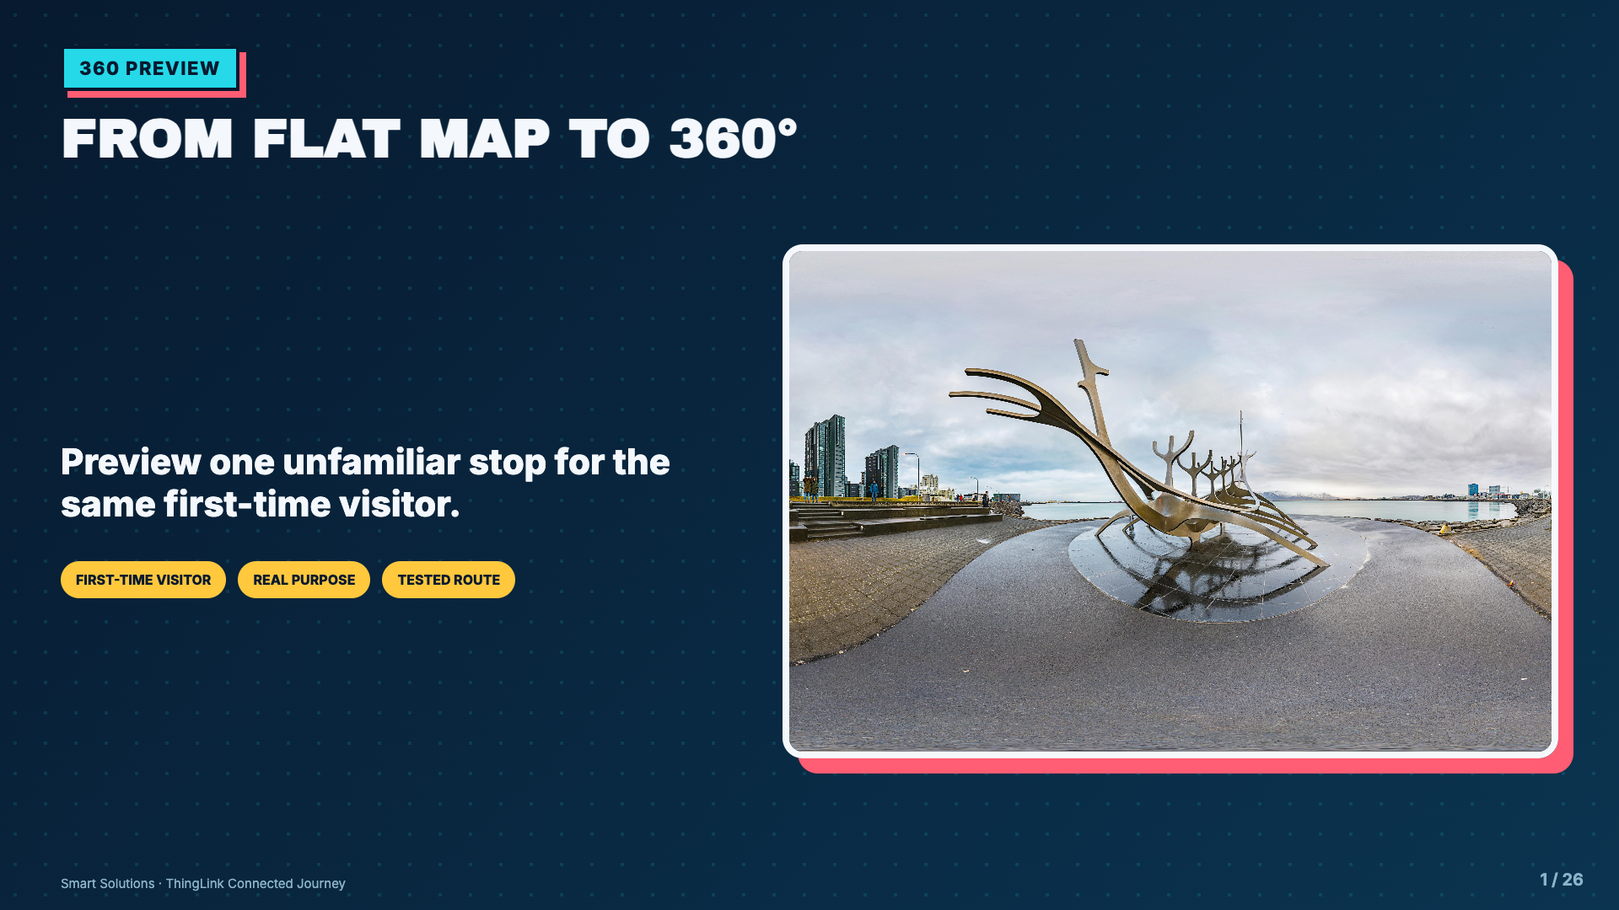
Notes:
Open by reconnecting to Welcome Mission. Students are not choosing a new random topic. They are moving closer to one stop where looking around helps.
[Sources]
- Elisha Lucero, Smart Solutions ThingLink lesson materials and Welcome Mission project sequence.
- ThingLink Support, Sample 360 image - Reykjavik.jpg: https://support.thinglink.com/hc/en-us/article_attachments/360041251134
- ThingLink Support, Tagging 360 Images: https://support.thinglink.com/hc/en-us/articles/360021315274-Tagging-360-Images

Slide 2
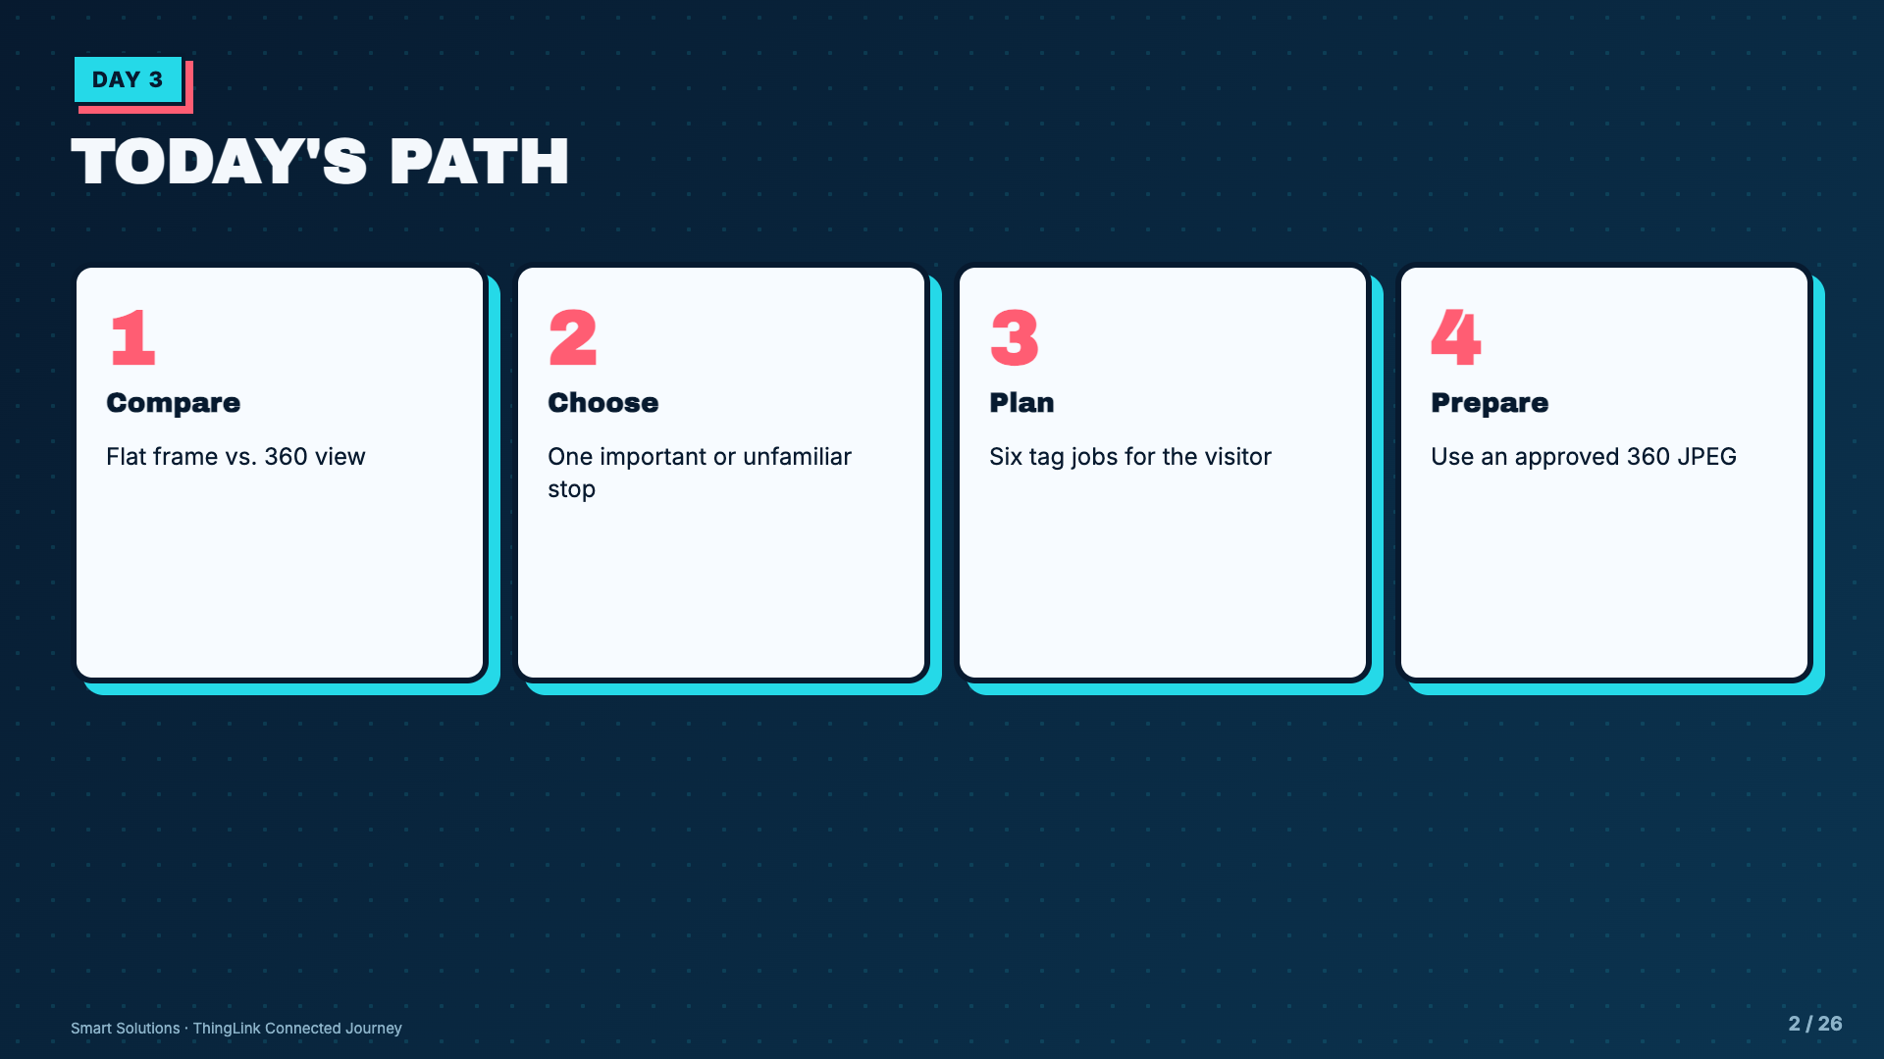
Notes:
Name the entire learning-to-project flow before the video. Students should know why they are comparing media.
[Sources]
- Elisha Lucero, Smart Solutions ThingLink lesson materials and Welcome Mission project sequence.
- ThingLink Support, Tagging 360 Images: https://support.thinglink.com/hc/en-us/articles/360021315274-Tagging-360-Images

Slide 3
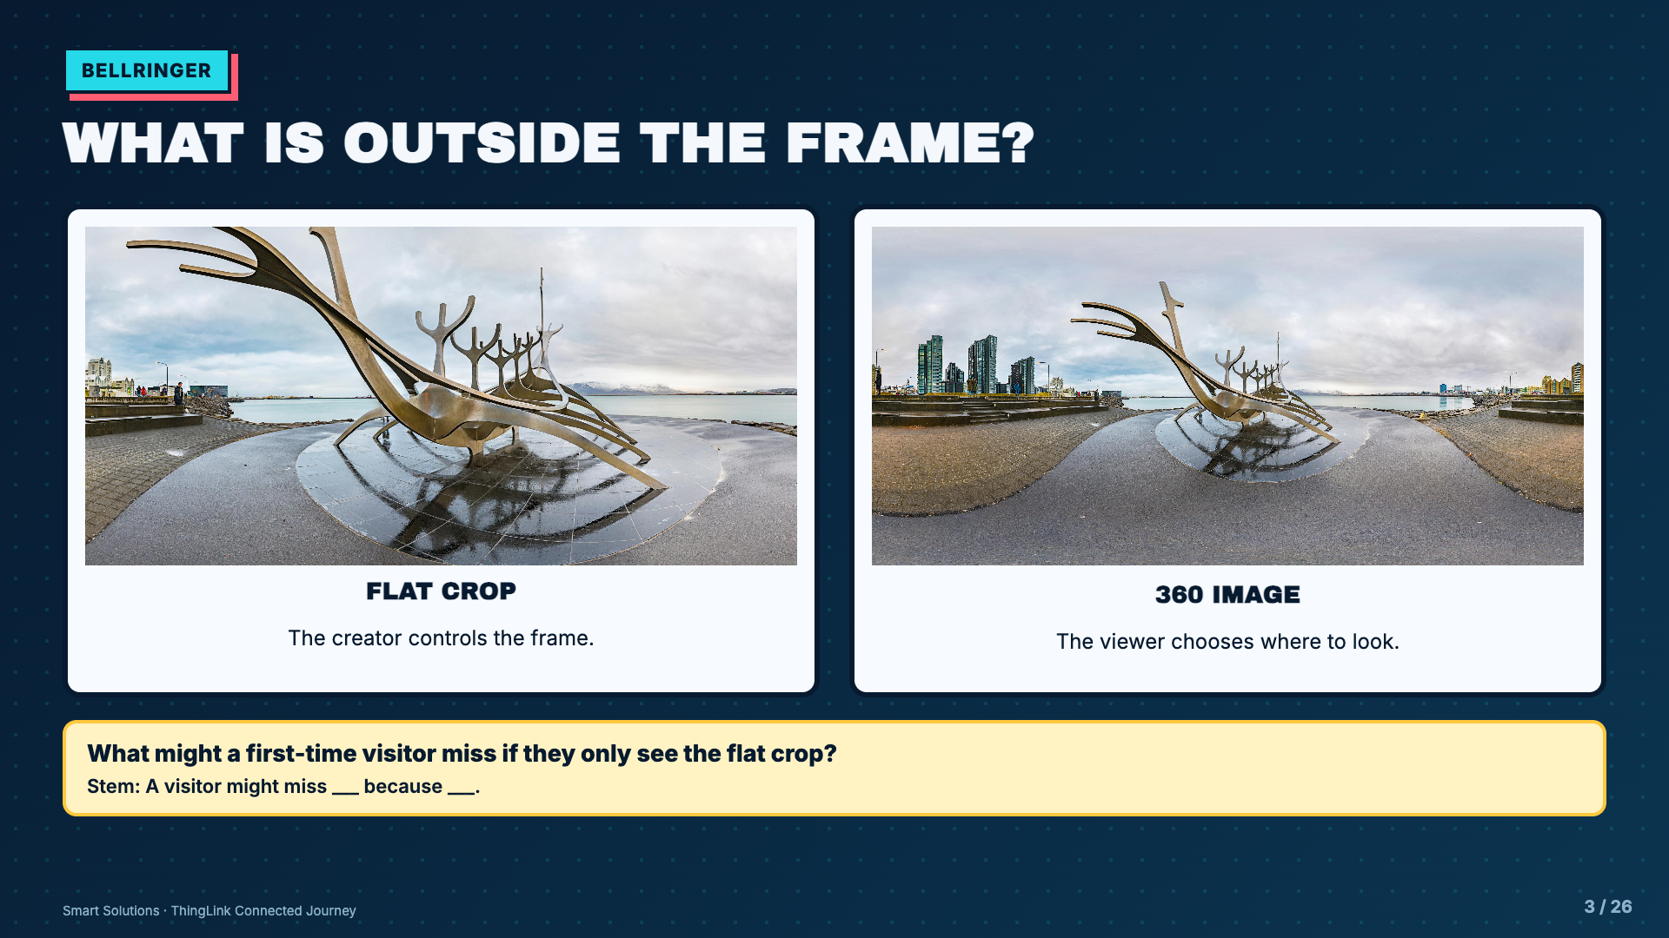
Notes:
Give students 45 seconds to look before speaking. The two panels use the same official ThingLink sample so the media difference, not the location, drives the comparison.
[Sources]
- ThingLink Support, Sample 360 image - Reykjavik.jpg: https://support.thinglink.com/hc/en-us/article_attachments/360041251134
- ThingLink Support, Tagging 360 Images: https://support.thinglink.com/hc/en-us/articles/360021315274-Tagging-360-Images

Slide 4
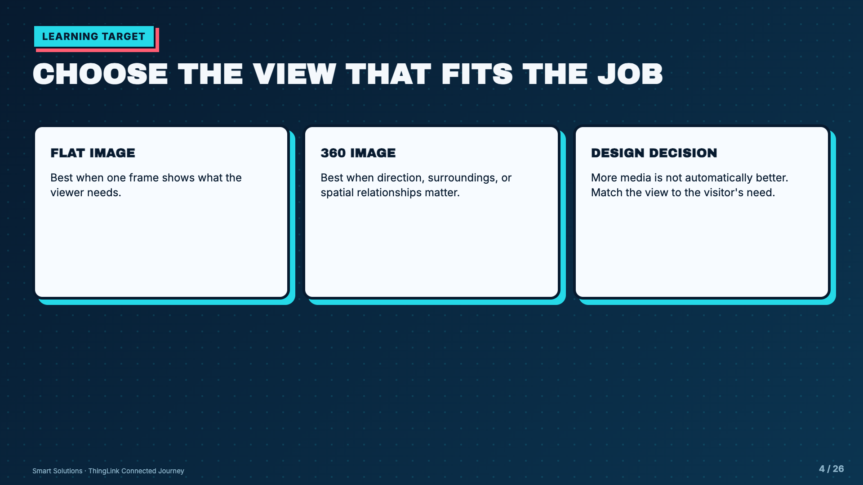
Notes:
Push against novelty. A 360 image is useful only when looking around changes understanding or action.
[Sources]
- Elisha Lucero, Smart Solutions ThingLink lesson materials and Welcome Mission project sequence.
- ThingLink Support, Tagging 360 Images: https://support.thinglink.com/hc/en-us/articles/360021315274-Tagging-360-Images

Slide 5
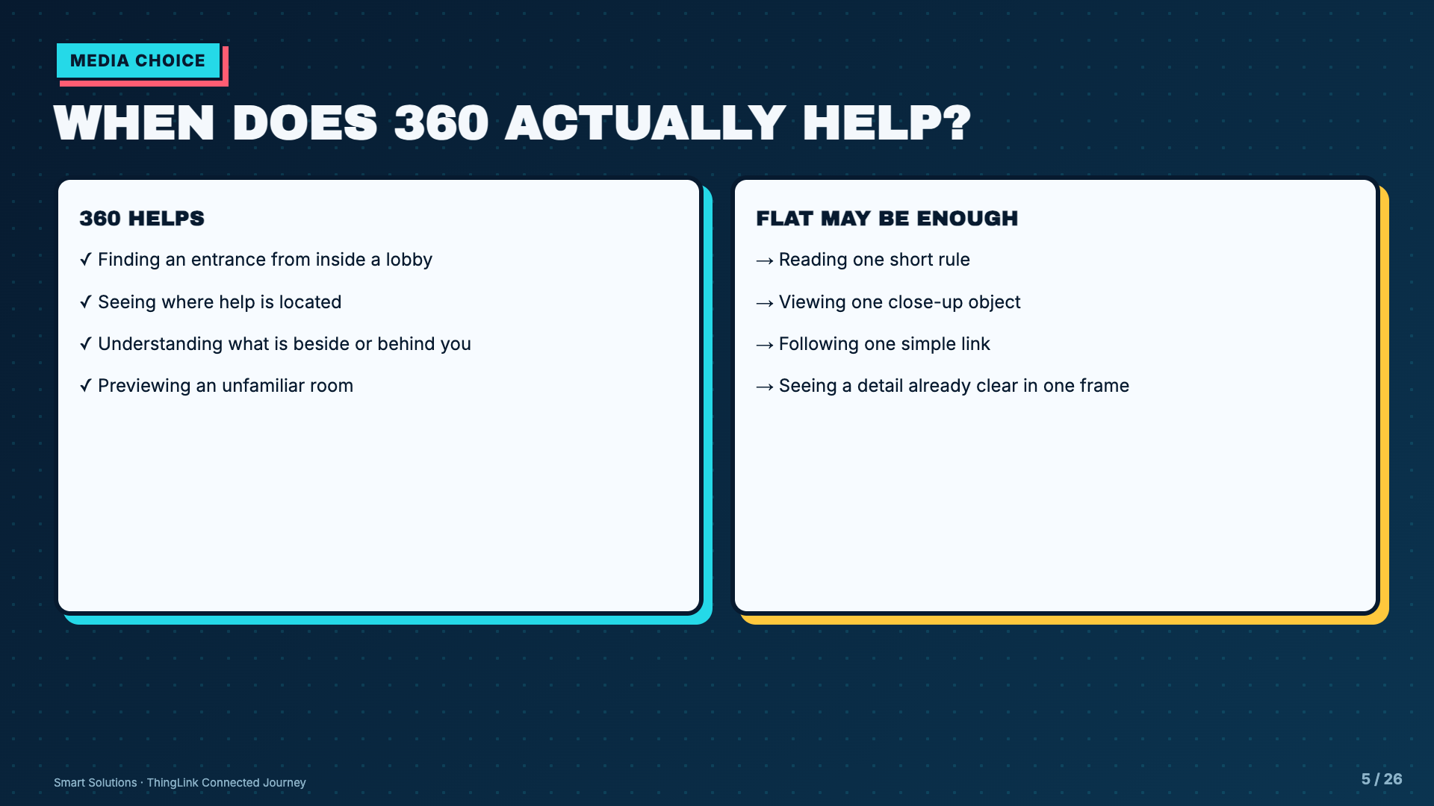
Notes:
Ask students to justify one item on each side. Accept disagreement when they can connect the choice to an audience need.
[Sources]
- Elisha Lucero, Smart Solutions ThingLink lesson materials and Welcome Mission project sequence.
- ThingLink Support, Tagging 360 Images: https://support.thinglink.com/hc/en-us/articles/360021315274-Tagging-360-Images

Slide 6
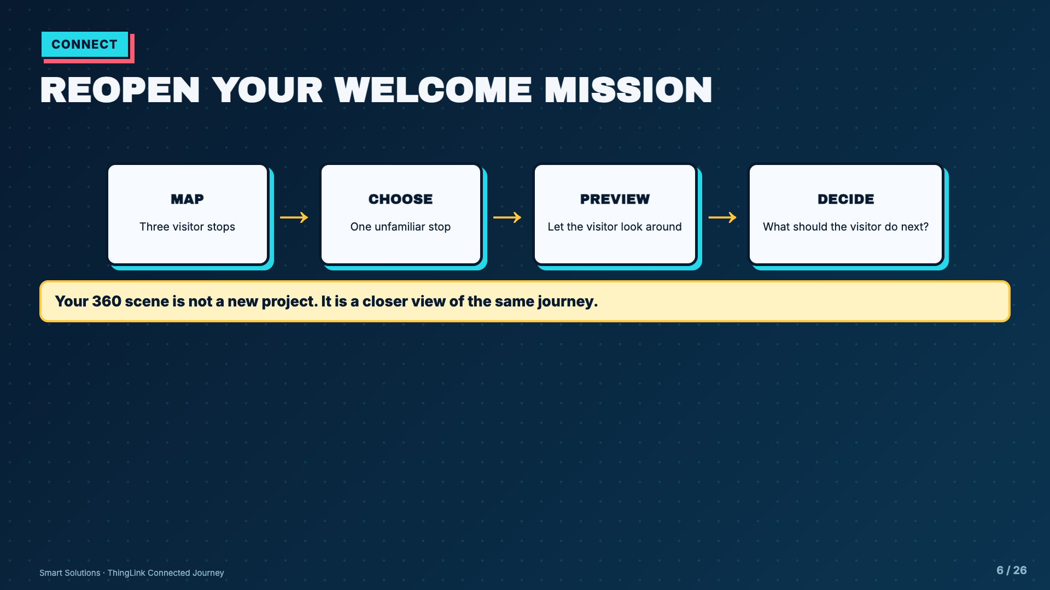
Notes:
Have students physically reopen their prior submission. If Welcome Mission was skipped, assign one shared visitor and place before students continue.
[Sources]
- Elisha Lucero, Smart Solutions ThingLink lesson materials and Welcome Mission project sequence.

Slide 7
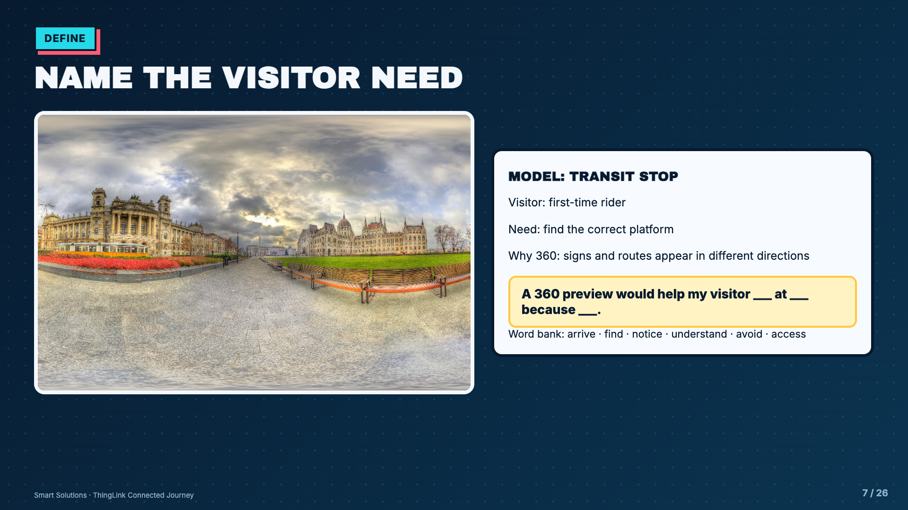
Notes:
Model a complete need statement before students browse images. The visitor need should drive the tags.
[Sources]
- ThingLink Support, Sample 360 image - Budapest.jpg: https://support.thinglink.com/hc/en-us/article_attachments/360041251154
- Elisha Lucero, Smart Solutions ThingLink lesson materials and Welcome Mission project sequence.

Slide 8
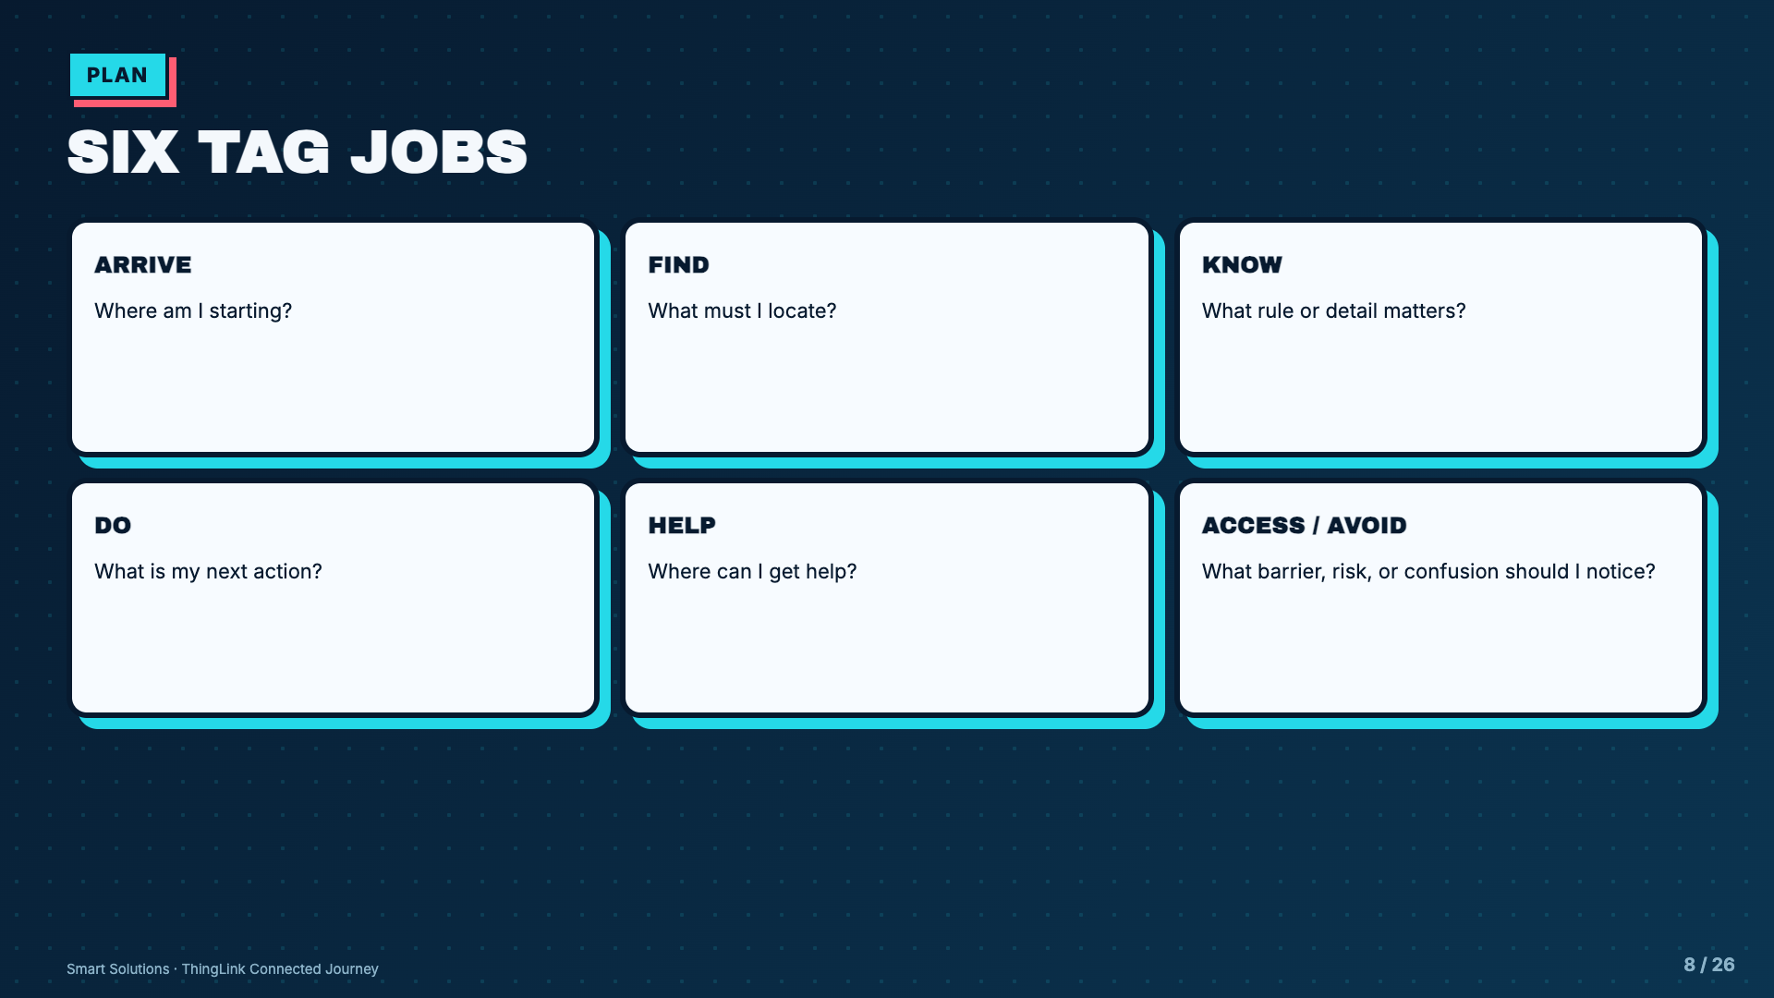
Notes:
These jobs are the creative constraint. Students decide how to fulfill each job; they are not filling the scene with six unrelated facts.
[Sources]
- Elisha Lucero, Smart Solutions ThingLink lesson materials and Welcome Mission project sequence.
- ThingLink Support, Tag Types: https://support.thinglink.com/hc/en-us/articles/360021312294-Tag-Types

Slide 9
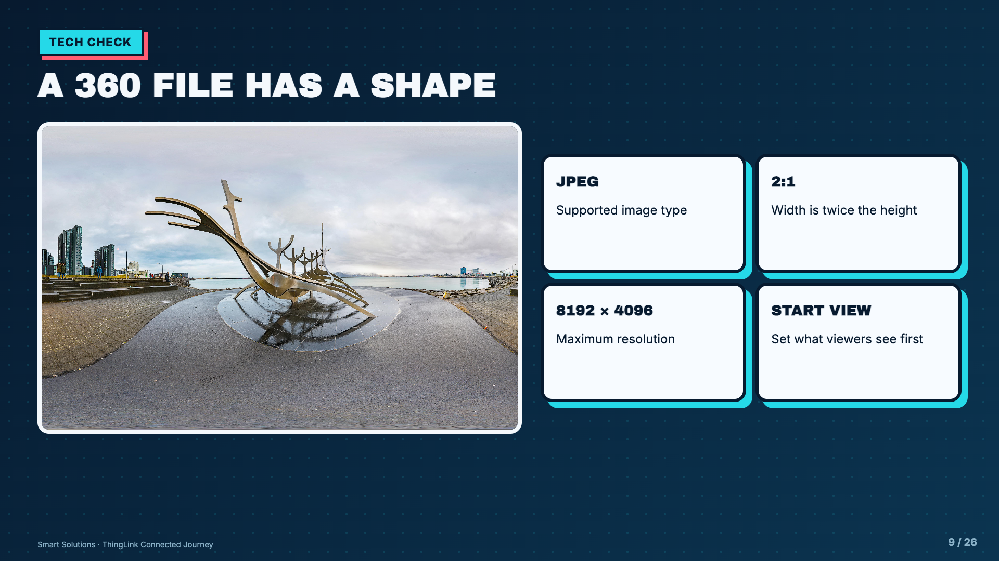
Notes:
Use the sample panorama to show the 2:1 rectangle. Do not teach an unsupported 25 MB limit. ThingLink determines the content type from the file.
[Sources]
- ThingLink Support, Sample 360 image - Reykjavik.jpg: https://support.thinglink.com/hc/en-us/article_attachments/360041251134
- ThingLink Support, Tagging 360 Images: https://support.thinglink.com/hc/en-us/articles/360021315274-Tagging-360-Images

Slide 10
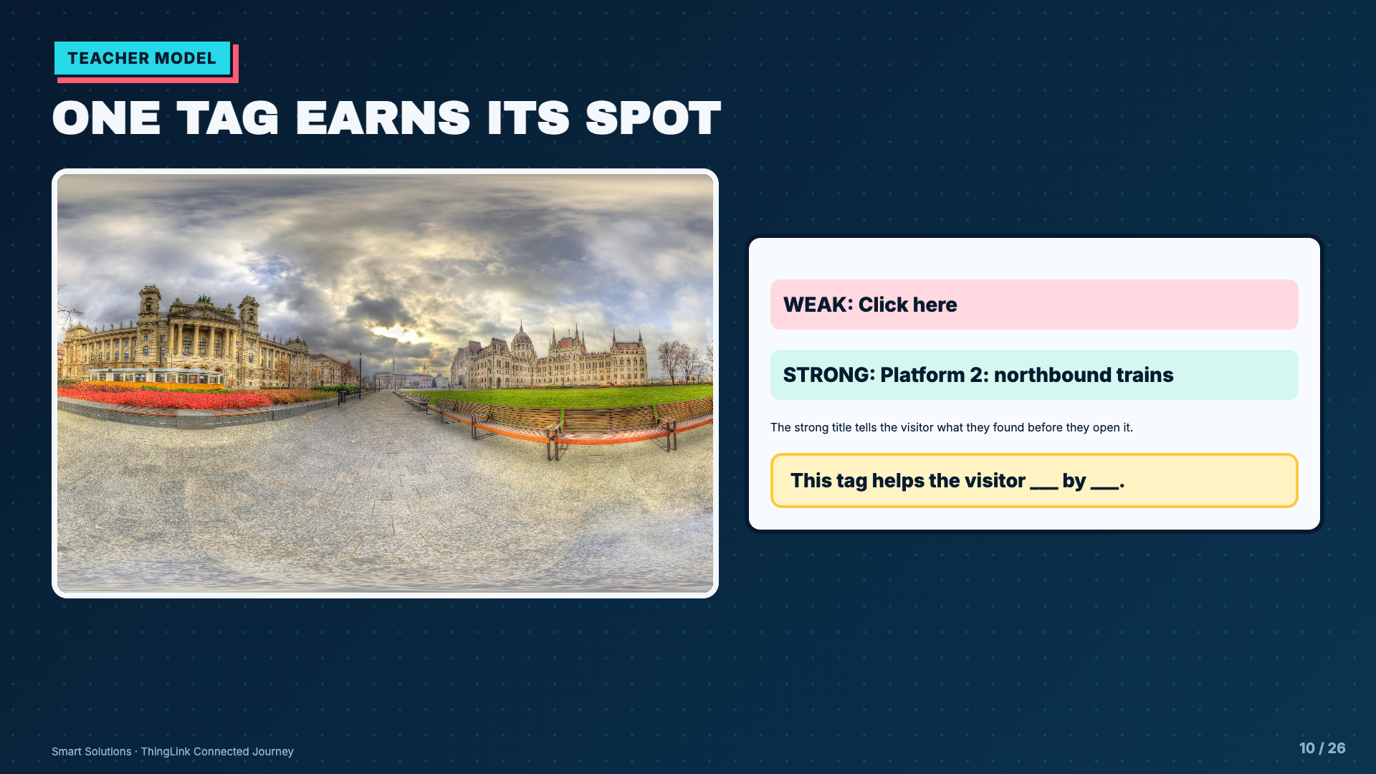
Notes:
Model one label revision. Students should see that accessibility and usefulness begin with the tag title, not after the design is finished.
[Sources]
- ThingLink Support, Sample 360 image - Budapest.jpg: https://support.thinglink.com/hc/en-us/article_attachments/360041251154
- Elisha Lucero, Smart Solutions ThingLink lesson materials and Welcome Mission project sequence.
- ThingLink Support, Tag Types: https://support.thinglink.com/hc/en-us/articles/360021312294-Tag-Types

Slide 11
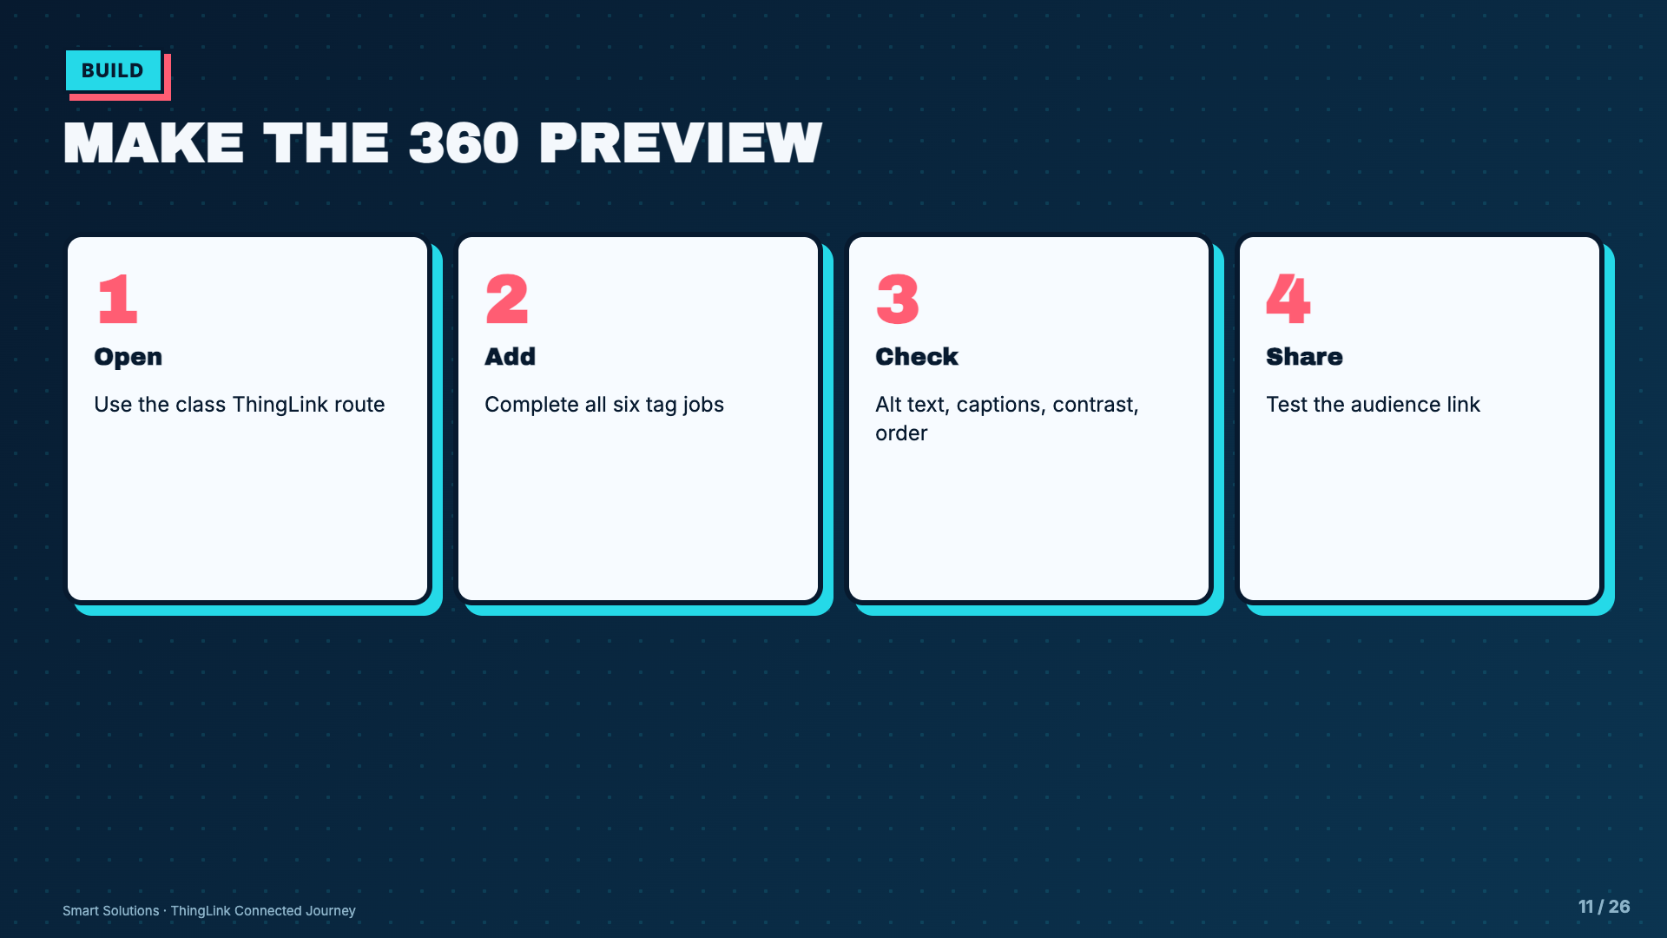
Notes:
Narrate decisions rather than memorizing interface positions. ThingLink may move controls, but the design contract stays stable.
[Sources]
- Elisha Lucero, Smart Solutions ThingLink lesson materials and Welcome Mission project sequence.
- ThingLink Support, Tag Types: https://support.thinglink.com/hc/en-us/articles/360021312294-Tag-Types
- ThingLink Support, Tagging 360 Images: https://support.thinglink.com/hc/en-us/articles/360021315274-Tagging-360-Images

Slide 12
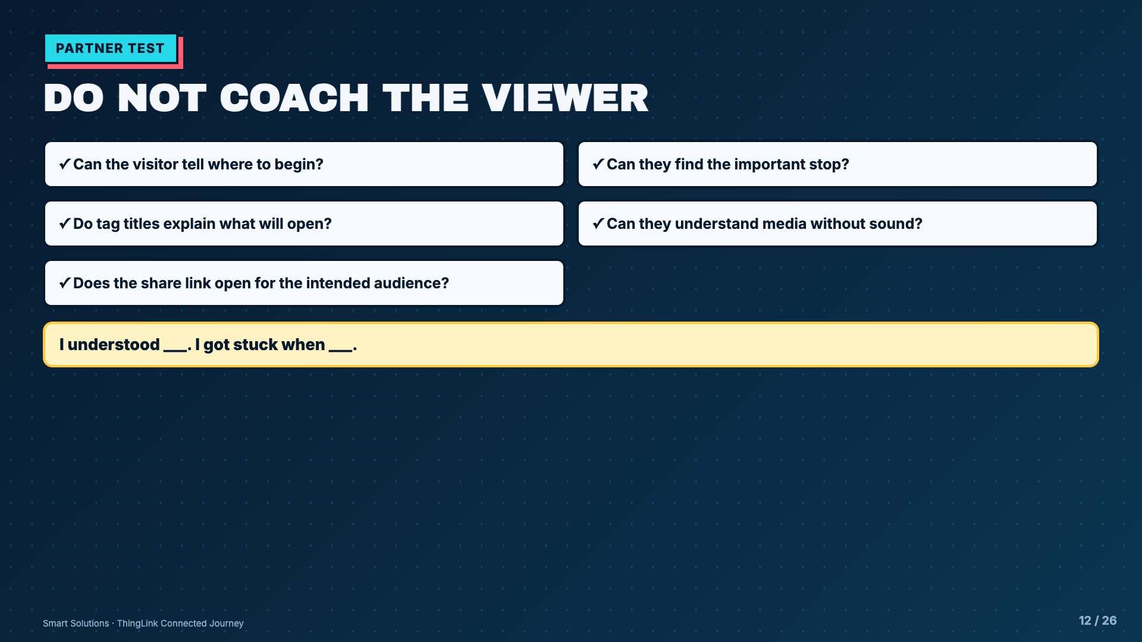
Notes:
The creator stays quiet while the partner navigates. Confusion is useful evidence, not a failure to hide.
[Sources]
- Elisha Lucero, Smart Solutions ThingLink lesson materials and Welcome Mission project sequence.

Slide 13
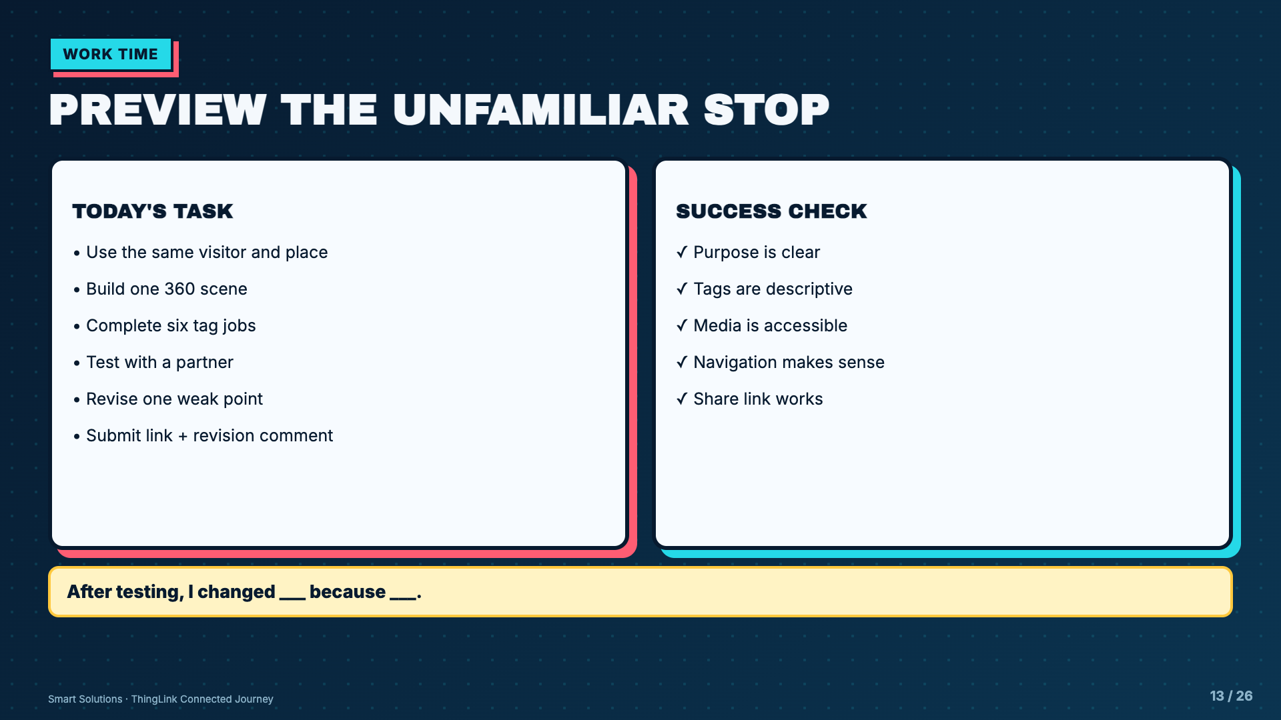
Notes:
Leave this projected for Days 4 and 5. Conference first on visitor need, then on technical polish.
[Sources]
- Elisha Lucero, Smart Solutions ThingLink lesson materials and Welcome Mission project sequence.
- ThingLink Support, Tagging 360 Images: https://support.thinglink.com/hc/en-us/articles/360021315274-Tagging-360-Images
- ThingLink Support, Tag Types: https://support.thinglink.com/hc/en-us/articles/360021312294-Tag-Types

Slide 14
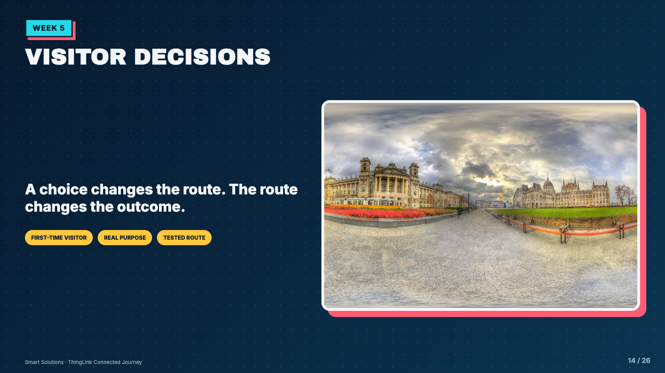
Notes:
Shift from information design to cause and effect. The visitor is now inside the place and must decide what to do next.
[Sources]
- Elisha Lucero, Smart Solutions ThingLink lesson materials and Welcome Mission project sequence.
- ThingLink Support, Sample 360 image - Budapest.jpg: https://support.thinglink.com/hc/en-us/article_attachments/360041251154
- ThingLink Support, Branching block: https://support.thinglink.com/hc/en-us/articles/36619634243607-Branching-block

Slide 15
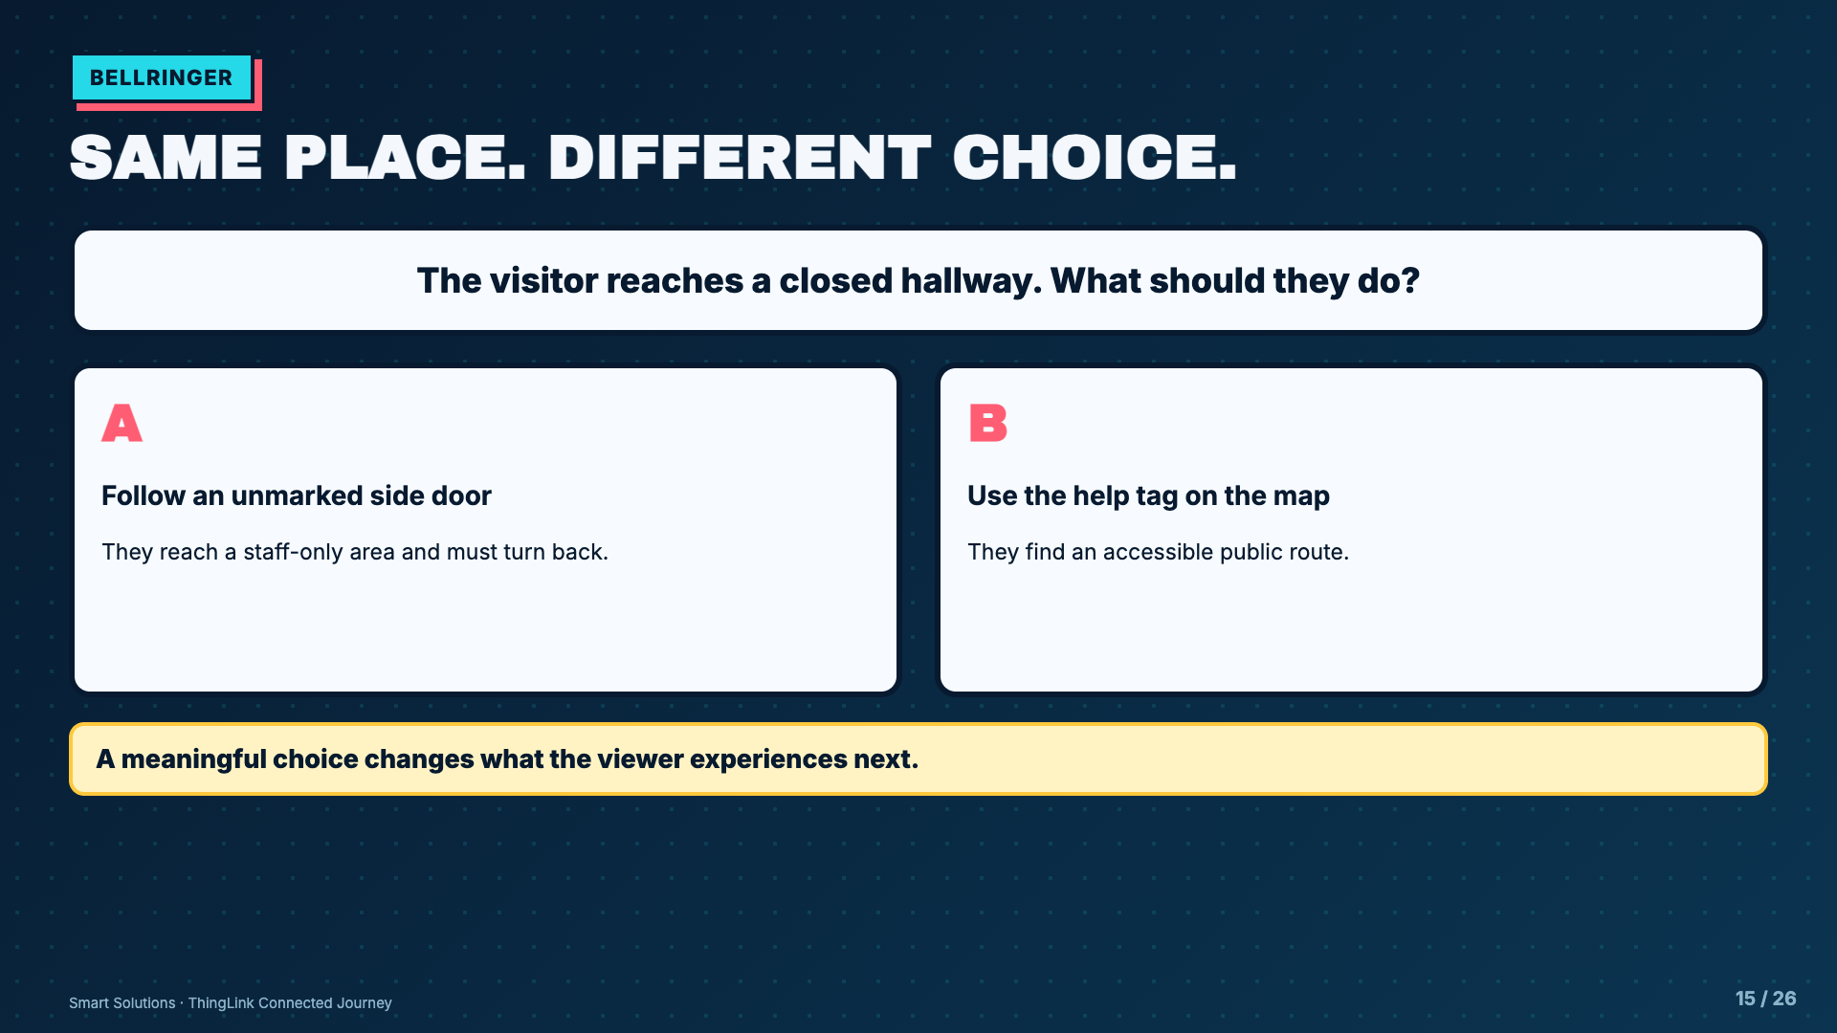
Notes:
Do not frame one choice as morally good and the other as foolish. The point is to show consequence and recovery.
[Sources]
- Elisha Lucero, Smart Solutions ThingLink lesson materials and Welcome Mission project sequence.
- ThingLink Support, Branching block: https://support.thinglink.com/hc/en-us/articles/36619634243607-Branching-block

Slide 16
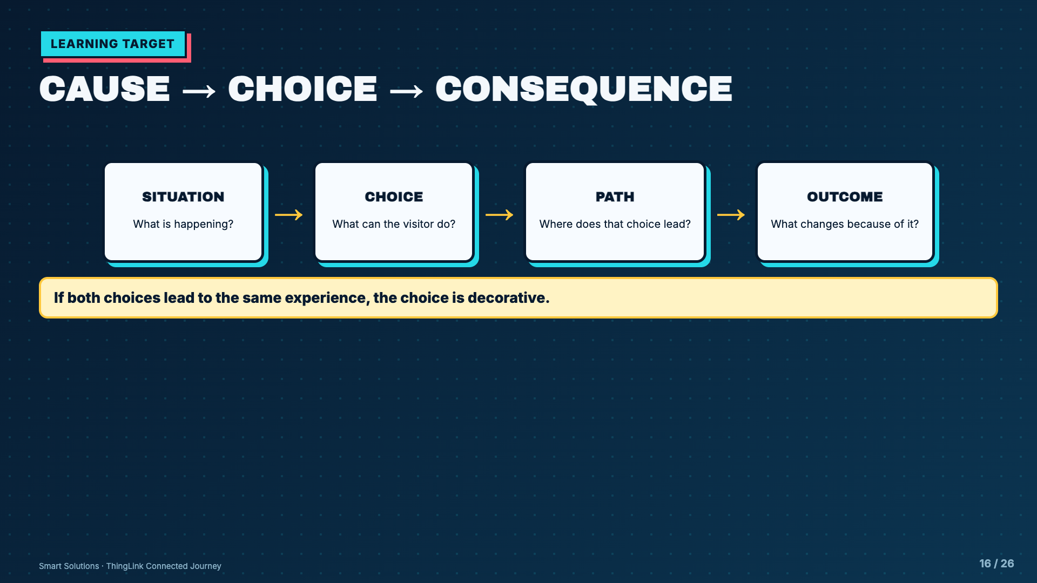
Notes:
Use the word consequence neutrally. A consequence is what follows from a choice, not automatically a punishment.
[Sources]
- Elisha Lucero, Smart Solutions ThingLink lesson materials and Welcome Mission project sequence.
- ThingLink Support, Branching block: https://support.thinglink.com/hc/en-us/articles/36619634243607-Branching-block

Slide 17
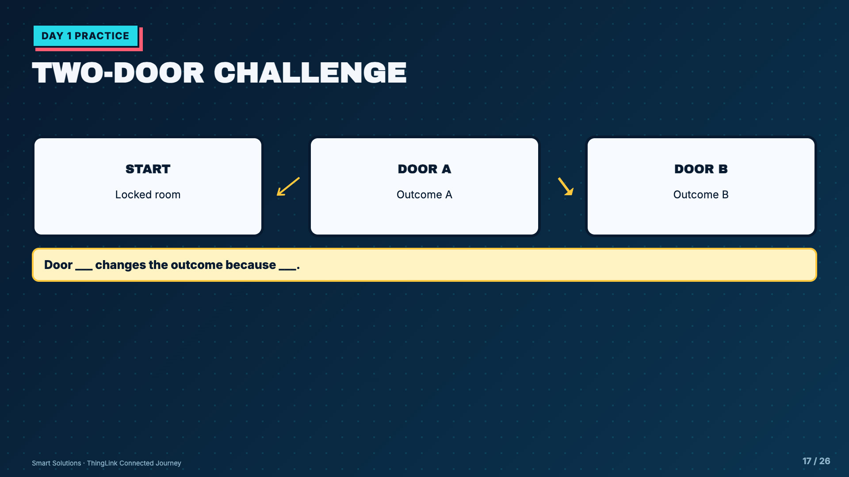
Notes:
Keep the practice tiny. Students need one start and two visibly different outcomes before they plan a larger scenario.
[Sources]
- Elisha Lucero, Smart Solutions ThingLink lesson materials and Welcome Mission project sequence.

Slide 18
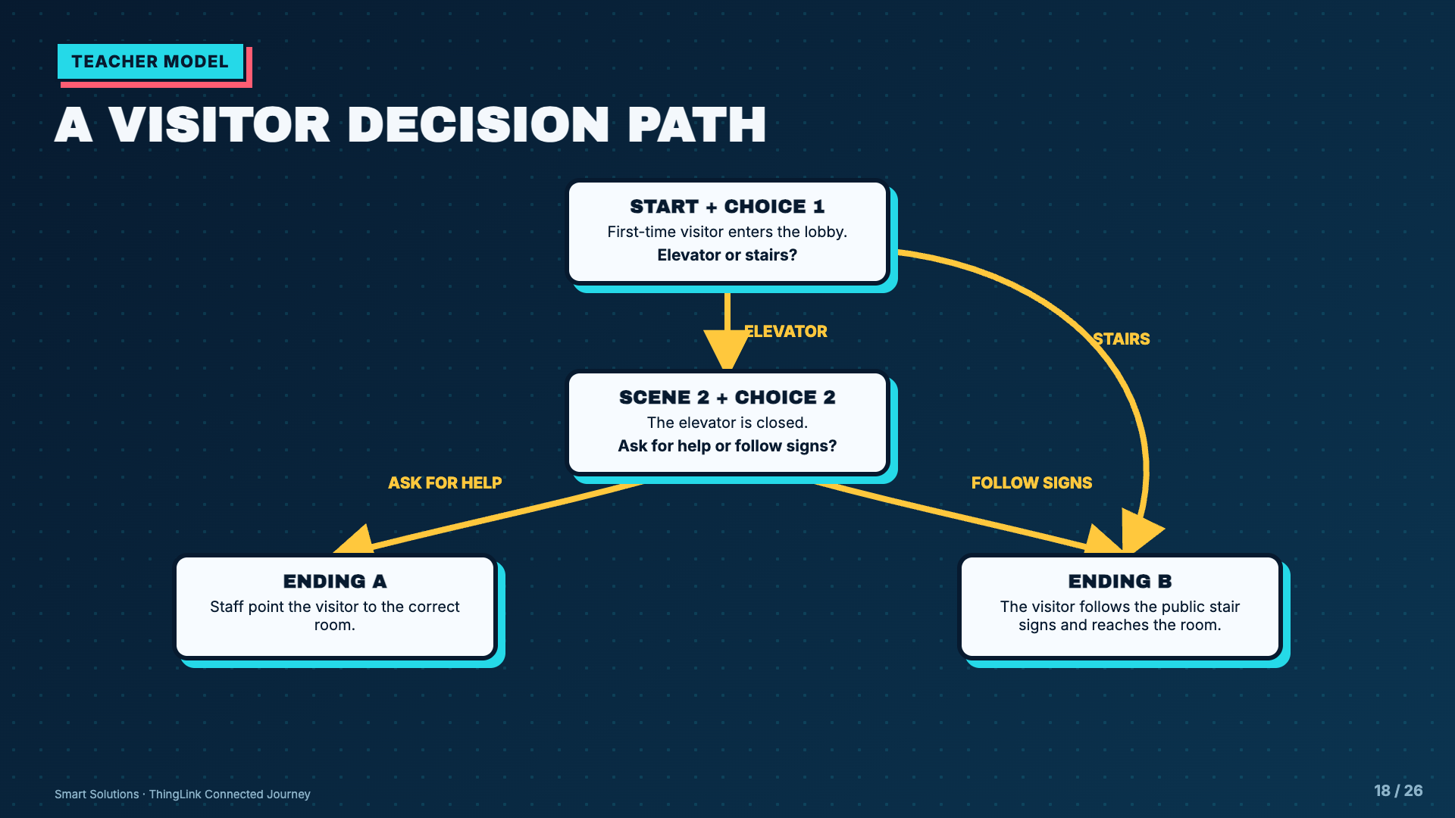
Notes:
Trace all four labeled arrows out loud. Choice 1 sends the visitor either to a second decision or directly to Ending B. Choice 2 sends the visitor to Ending A or Ending B. Both choices visibly change the next step or outcome.
[Sources]
- Elisha Lucero, Smart Solutions ThingLink lesson materials and Welcome Mission project sequence.
- ThingLink Support, Branching block: https://support.thinglink.com/hc/en-us/articles/36619634243607-Branching-block

Slide 19
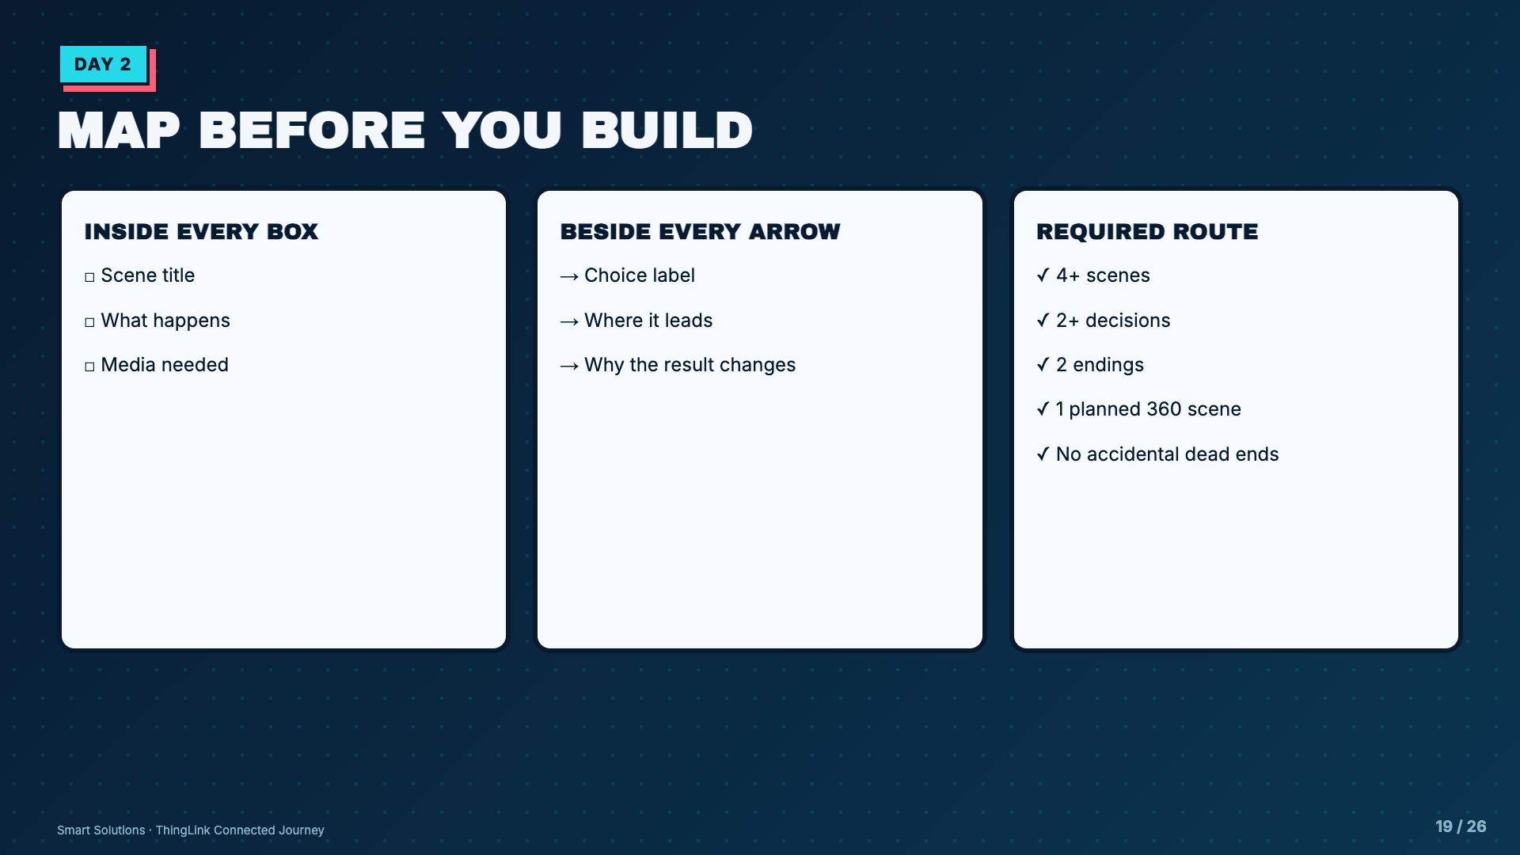
Notes:
Require teacher approval at the paper map. Digital branching is expensive to repair after media is built.
[Sources]
- Elisha Lucero, Smart Solutions ThingLink lesson materials and Welcome Mission project sequence.
- ThingLink Support, Scenario Builder editor overview: https://support.thinglink.com/hc/en-us/articles/26320071153303-Scenario-Builder-editor-overview
- ThingLink Support, Branching block: https://support.thinglink.com/hc/en-us/articles/36619634243607-Branching-block

Slide 20
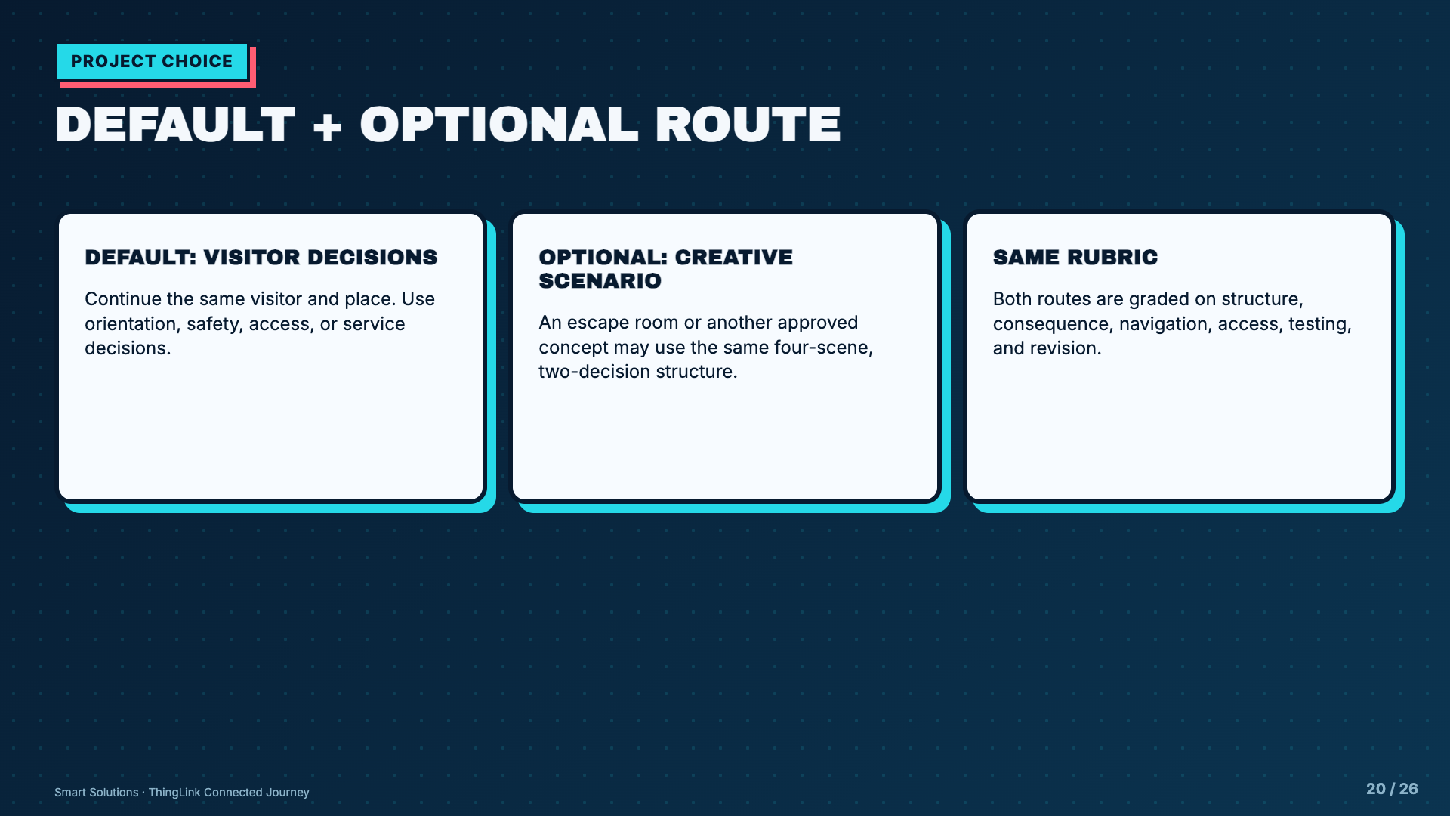
Notes:
Keep the visitor route as the default curriculum spine. Do not make students invent a second unrelated world unless they deliberately choose the optional route.
[Sources]
- Elisha Lucero, Smart Solutions ThingLink lesson materials and Welcome Mission project sequence.

Slide 21
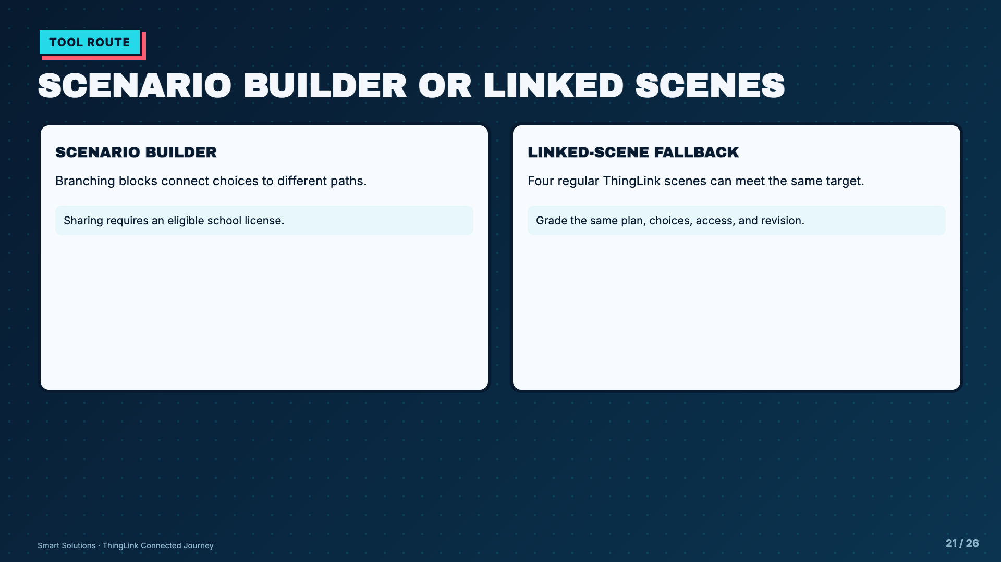
Notes:
Test the school license before announcing the route. Scenario editing is available broadly, but K-12 sharing requires Enhanced or Staff Training. Use linked scenes if sharing is unavailable.
[Sources]
- ThingLink Support, Scenario Builder editor overview: https://support.thinglink.com/hc/en-us/articles/26320071153303-Scenario-Builder-editor-overview
- ThingLink Support, Sharing and viewing scenarios: https://support.thinglink.com/hc/en-us/articles/36621419836951-Sharing-and-viewing-scenarios
- ThingLink Support, Branching block: https://support.thinglink.com/hc/en-us/articles/36619634243607-Branching-block

Slide 22
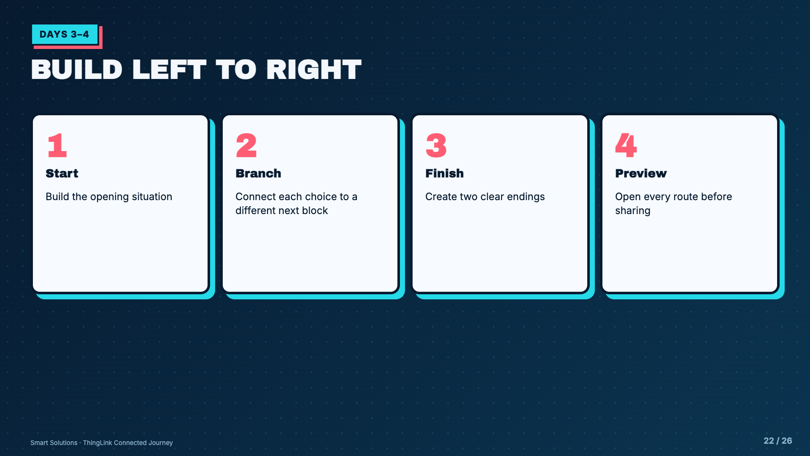
Notes:
ThingLink scenarios flow left to right. Unconnected blocks are not shown to viewers, so require frequent preview checks.
[Sources]
- ThingLink Support, Scenario Builder editor overview: https://support.thinglink.com/hc/en-us/articles/26320071153303-Scenario-Builder-editor-overview
- ThingLink Support, Branching block: https://support.thinglink.com/hc/en-us/articles/36619634243607-Branching-block

Slide 23
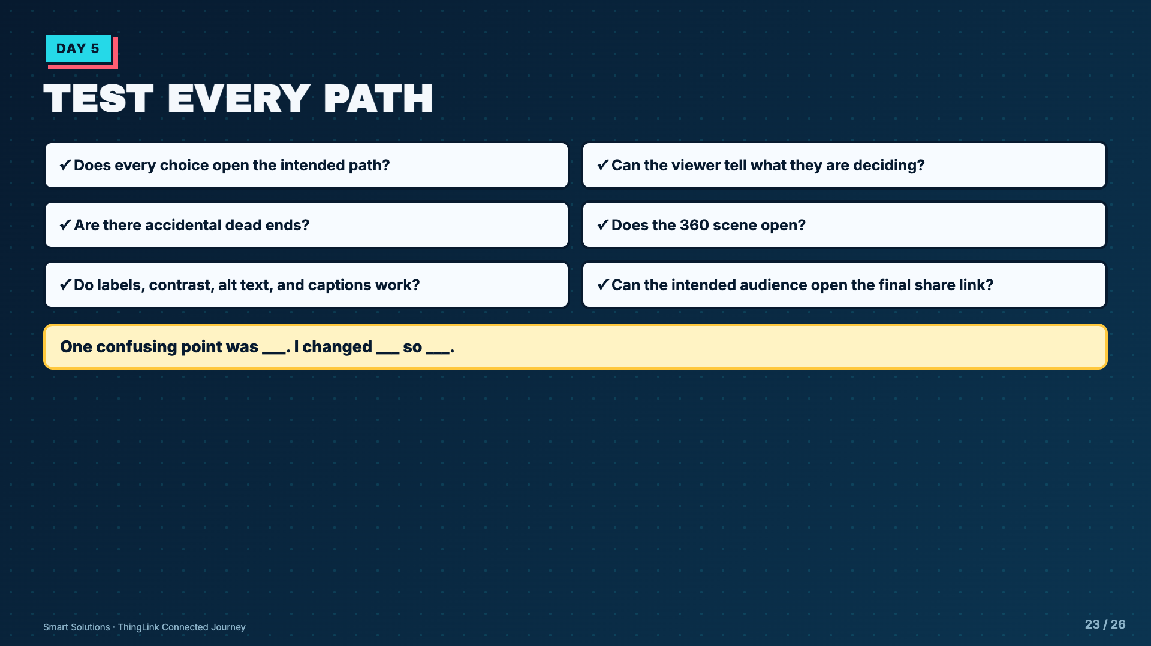
Notes:
Give testers the story map and the live project. They should confirm both structural fidelity and audience clarity.
[Sources]
- Elisha Lucero, Smart Solutions ThingLink lesson materials and Welcome Mission project sequence.
- ThingLink Support, Sharing and viewing scenarios: https://support.thinglink.com/hc/en-us/articles/36621419836951-Sharing-and-viewing-scenarios

Slide 24
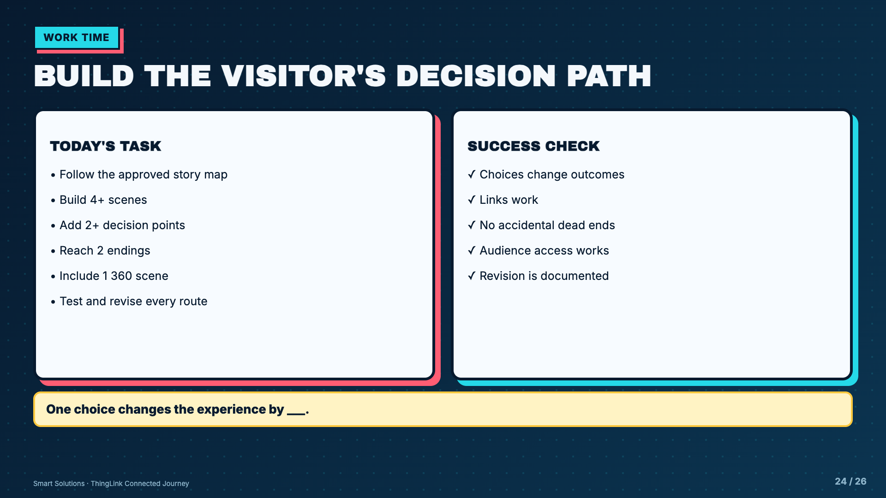
Notes:
Leave this projected on build days. Redirect students to the approved story map before helping them add more media.
[Sources]
- Elisha Lucero, Smart Solutions ThingLink lesson materials and Welcome Mission project sequence.
- ThingLink Support, Branching block: https://support.thinglink.com/hc/en-us/articles/36619634243607-Branching-block
- ThingLink Support, Sharing and viewing scenarios: https://support.thinglink.com/hc/en-us/articles/36621419836951-Sharing-and-viewing-scenarios

Slide 25
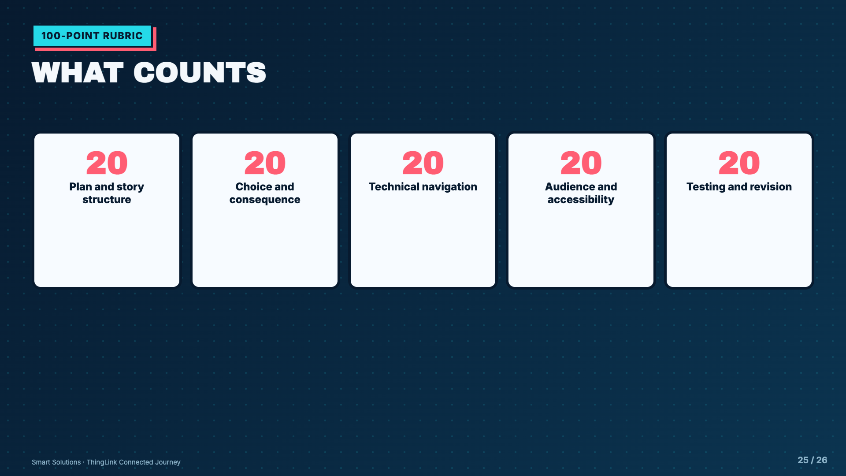
Notes:
Read the exact five Canvas rubric labels before students submit. Each row is worth 20 points.
[Sources]
- Elisha Lucero, Smart Solutions ThingLink lesson materials and Welcome Mission project sequence.

Slide 26
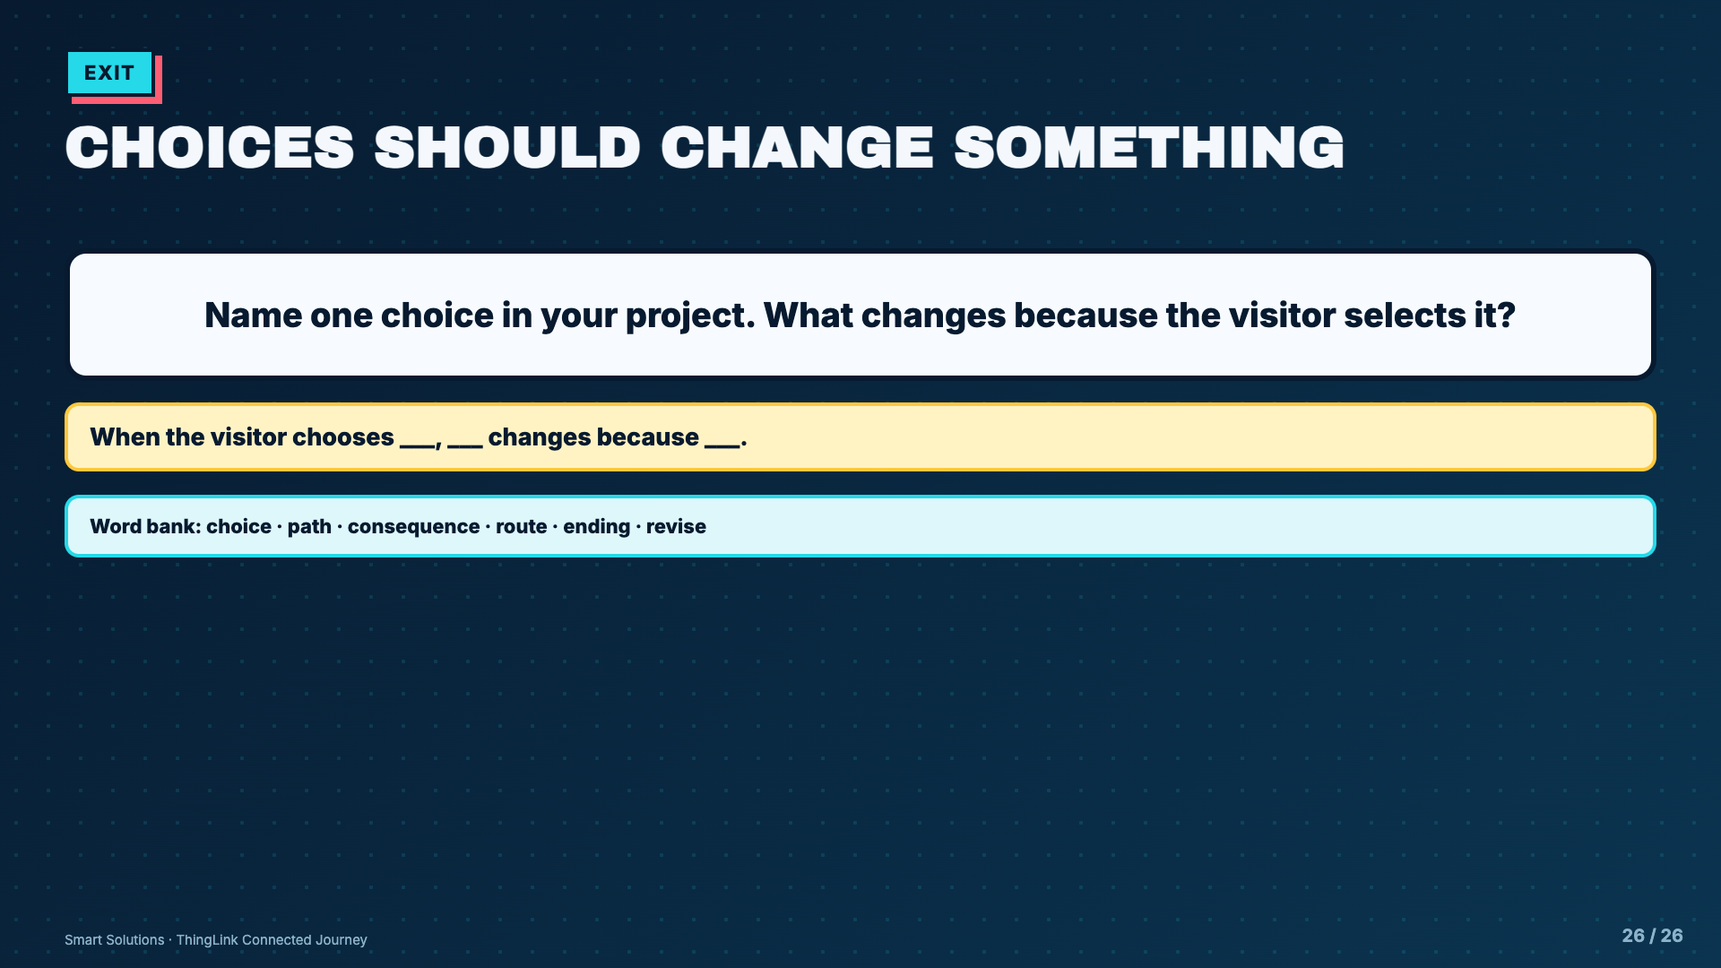
Notes:
Collect this as a Canvas comment, paper exit, or table share. A strong answer names a visible difference in path or outcome.
[Sources]
- Elisha Lucero, Smart Solutions ThingLink lesson materials and Welcome Mission project sequence.
- ThingLink Support, Branching block: https://support.thinglink.com/hc/en-us/articles/36619634243607-Branching-block

