Slide 1
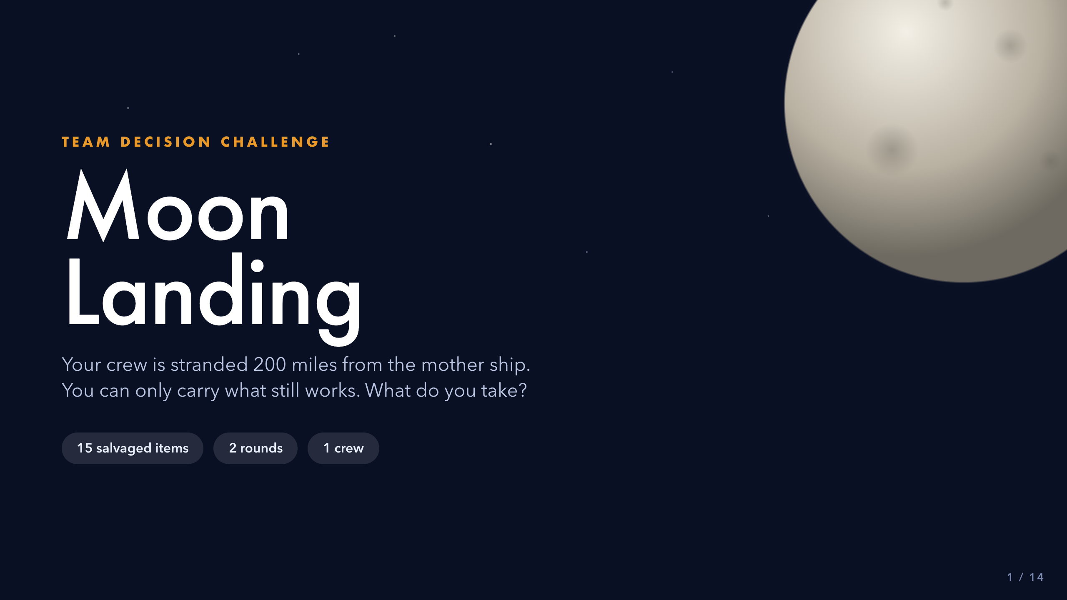
Notes:
Open cold. Read the subtitle aloud and let the premise sit for a moment before explaining anything. Tell students two things only: they will decide alone first, then as a crew, and the crew's answer does not have to match anyone's.
Do NOT hand out the ranking chart yet -- that comes at slide 4.
Whole activity runs 45-55 minutes.
[Sources]
- Activity source: 'Moon Landing', Grahame Knox, insight.typepad.co.uk, CC BY-NC-ND 3.0 (teacher-supplied PDF).
Rankings and reasoning: NASA 'Survival on the Moon' exercise (US Government, public domain).
- Visuals: original CSS/SVG built for this deck. No third-party image assets.

Slide 2
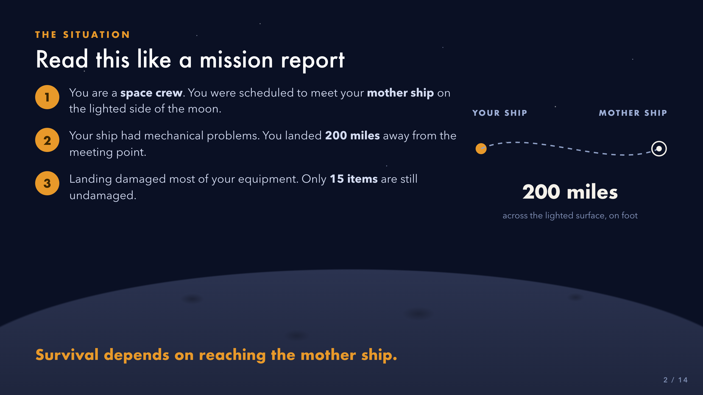
Notes:
Read the three numbered beats aloud, or have three students each read one.
Check comprehension before moving on:
- Where are you trying to get to?
- How far away is it?
- What still works?
Stress 'the lighted side of the moon.' It is the reason the heating unit ranks 13 and the water ranks 2, and students who catch it now score better later.
[Sources]
- Activity source: 'Moon Landing', Grahame Knox, insight.typepad.co.uk, CC BY-NC-ND 3.0 (teacher-supplied PDF).
Rankings and reasoning: NASA 'Survival on the Moon' exercise (US Government, public domain).
- Visuals: original CSS/SVG built for this deck. No third-party image assets.

Slide 3
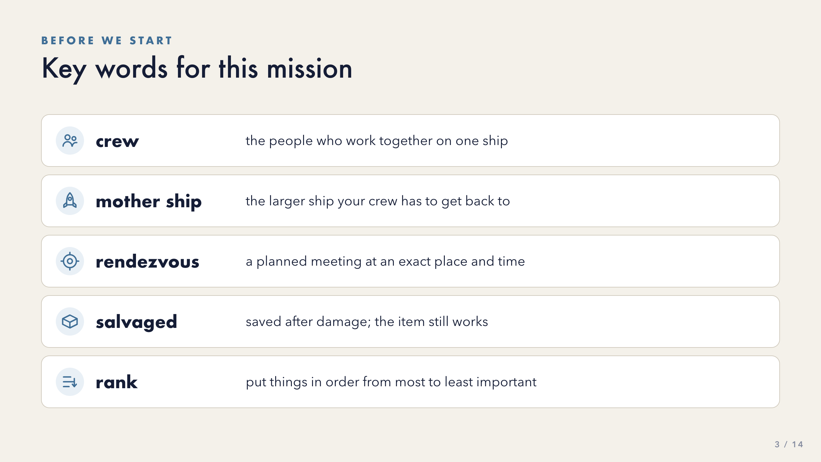
Notes:
Pre-teach all five before students see the worksheet. About 30-45 seconds each.
'Rendezvous' is the hardest -- say it, have the class say it back, then move on. Do not drill it.
These five are recognition vocabulary, not a spelling list. Point back to this slide whenever a word resurfaces during the activity.
[Sources]
- Activity source: 'Moon Landing', Grahame Knox, insight.typepad.co.uk, CC BY-NC-ND 3.0 (teacher-supplied PDF).
Rankings and reasoning: NASA 'Survival on the Moon' exercise (US Government, public domain).
- Visuals: original CSS/SVG built for this deck. No third-party image assets.

Slide 4
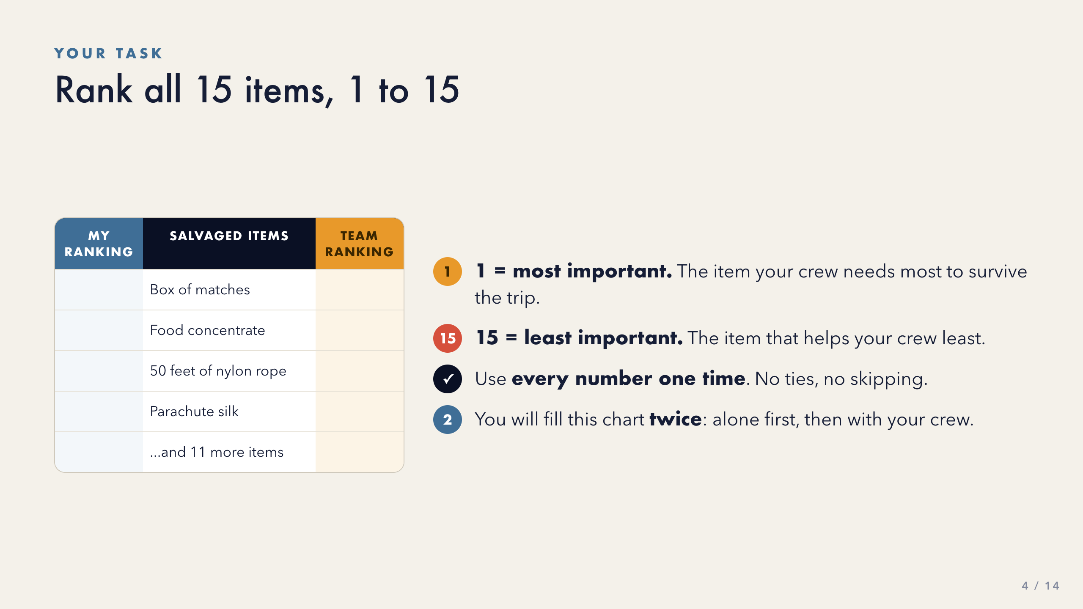
Notes:
Hand out the Moon Landing Ranking Chart now.
Point to the physical columns as you explain them: left column first, right column later. Students fill the SAME chart twice.
The most common error is reusing a number. Say the rule out loud and consider writing '1-15, each number once' on the board where it stays visible.
[Sources]
- Activity source: 'Moon Landing', Grahame Knox, insight.typepad.co.uk, CC BY-NC-ND 3.0 (teacher-supplied PDF).
Rankings and reasoning: NASA 'Survival on the Moon' exercise (US Government, public domain).
- Visuals: original CSS/SVG built for this deck. No third-party image assets.

Slide 5
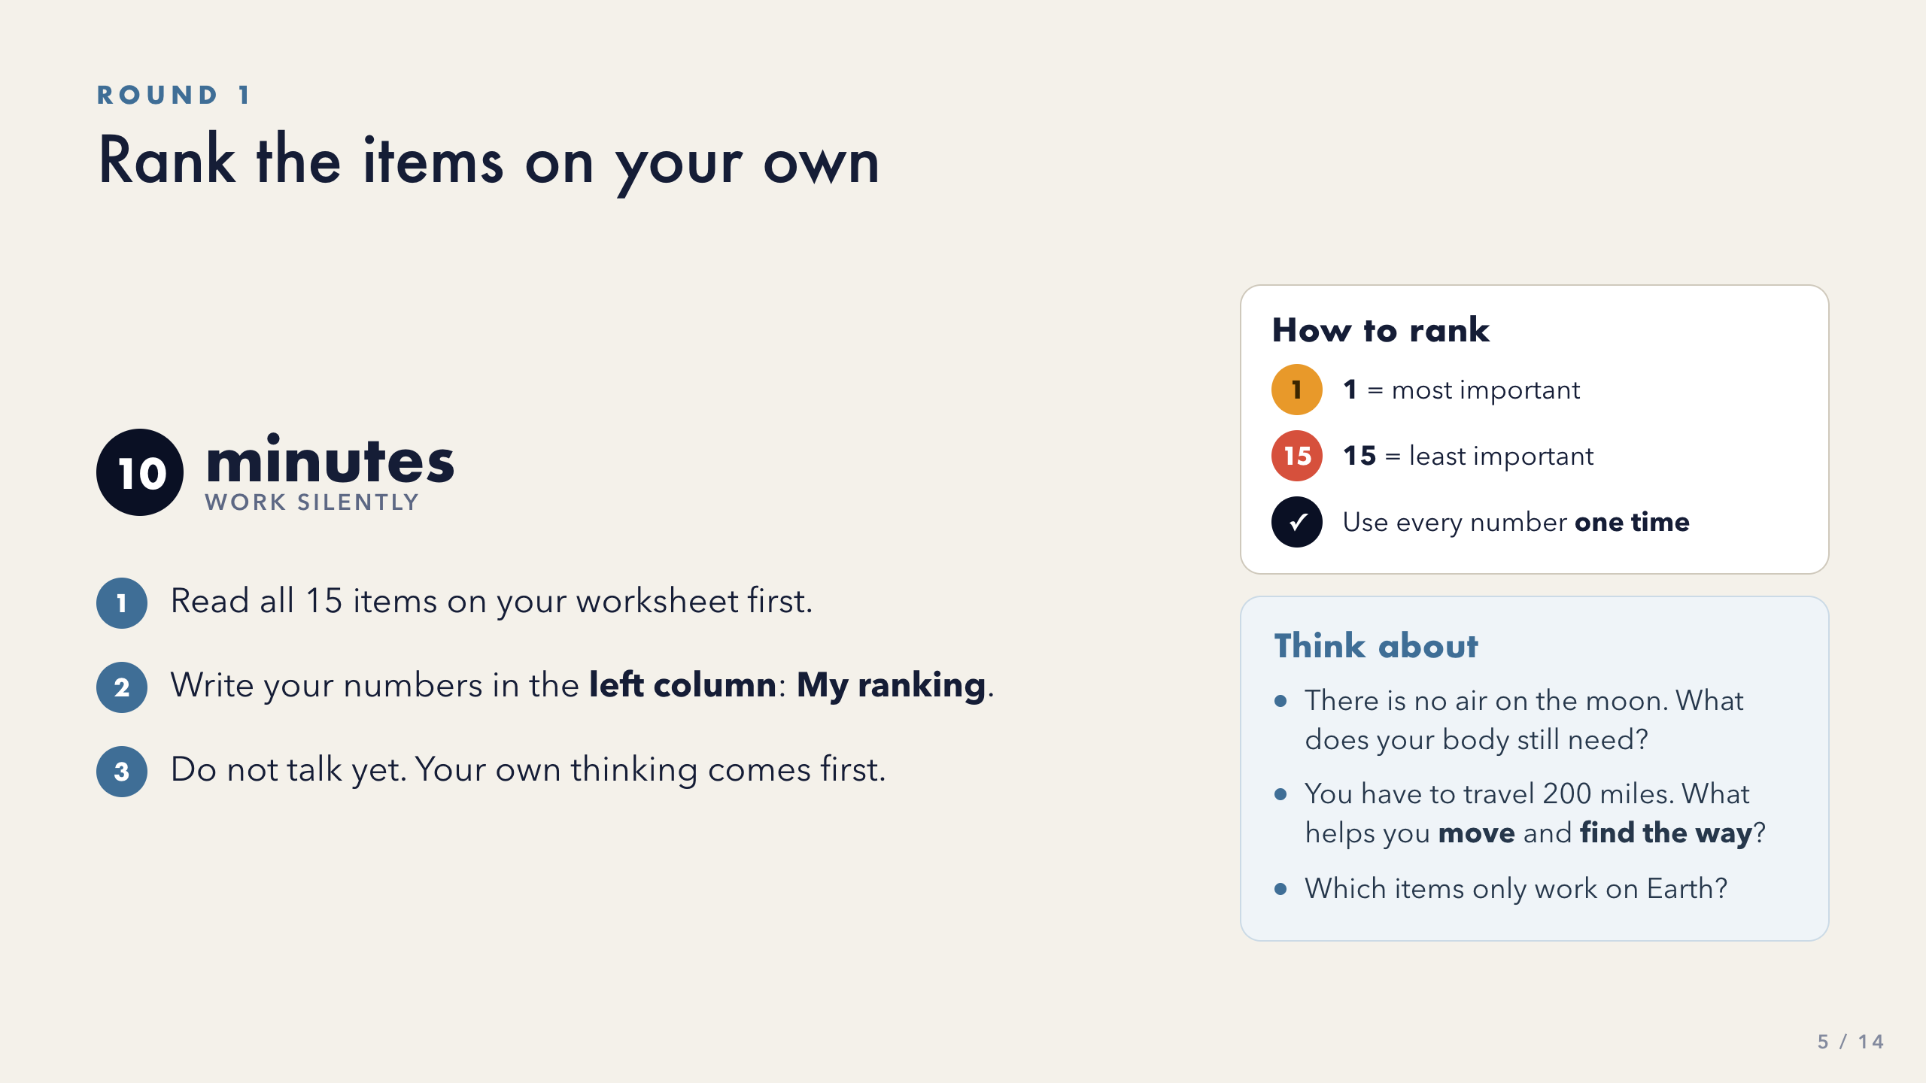
Notes:
Ten minutes, silent, independent. Set a visible timer.
Circulate, but do not give opinions. When a student asks 'do matches work up there?', redirect with a question: 'What does fire need?'
The How to rank panel repeats the three rules from slide 4 on purpose -- stay on this slide for the whole round. Point at it for students who missed the explanation or forgot; you should not have to flip back.
The Think about box is for students who stall -- point to it rather than explaining it.
If most of the room finishes early, close at 8 minutes. Momentum matters more than the full ten.
[Sources]
- Activity source: 'Moon Landing', Grahame Knox, insight.typepad.co.uk, CC BY-NC-ND 3.0 (teacher-supplied PDF).
Rankings and reasoning: NASA 'Survival on the Moon' exercise (US Government, public domain).
- Visuals: original CSS/SVG built for this deck. No third-party image assets.

Slide 6
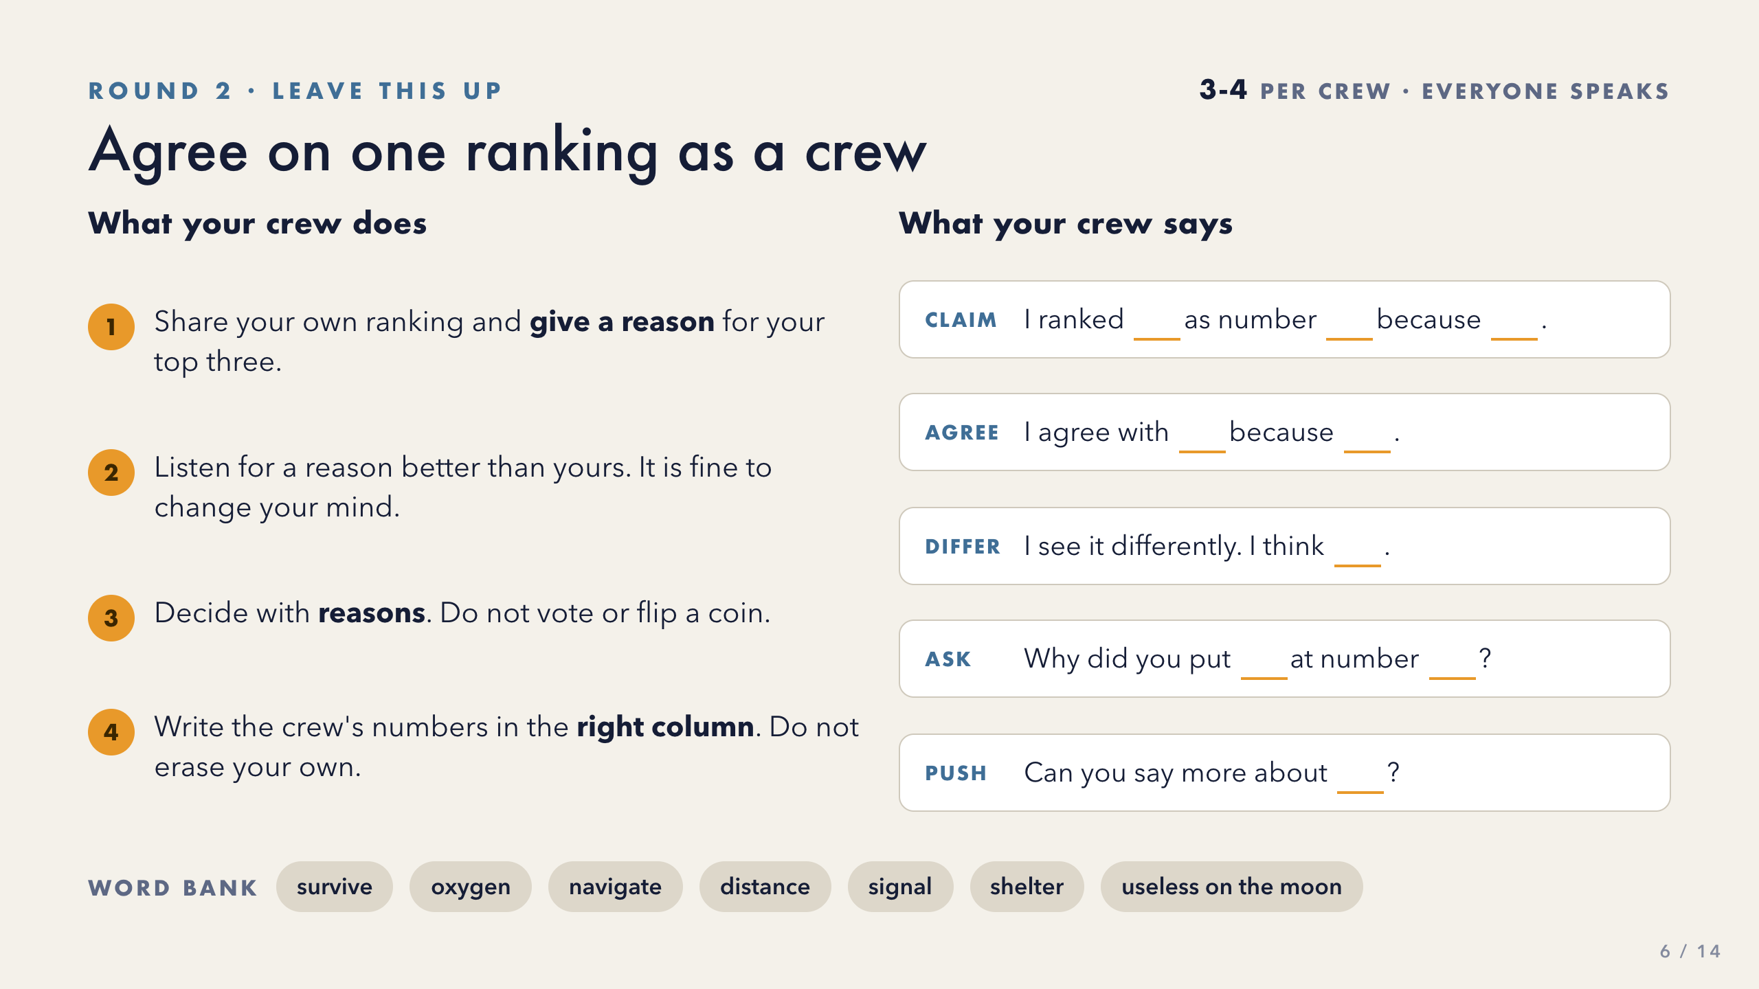
Notes:
Groups of 3-4. Allow 12-15 minutes. This slide stays up for the whole round -- the crew directions and the sentence stems are both on it, so you should not need to flip away.
Direction 3 carries the whole lesson: decide with REASONS, not by voting or averaging. If you hear 'let's just split the difference', stop the group and ask for a reason.
Give every crew member at least one stem to use out loud. For newcomer and early-stage emergent bilingual students, Ask and Push are the safest entry points -- they let a student participate fully without having to defend a ranking. The word bank is reference, not a required list; do not grade its use.
Listen for students who change their mind and quietly note their names -- you will call on them by name in the debrief at slide 13.
Watch for crews erasing their individual column. They need both to score.
[Sources]
- Activity source: 'Moon Landing', Grahame Knox, insight.typepad.co.uk, CC BY-NC-ND 3.0 (teacher-supplied PDF).
Rankings and reasoning: NASA 'Survival on the Moon' exercise (US Government, public domain).
- Visuals: original CSS/SVG built for this deck. No third-party image assets.

Slide 7
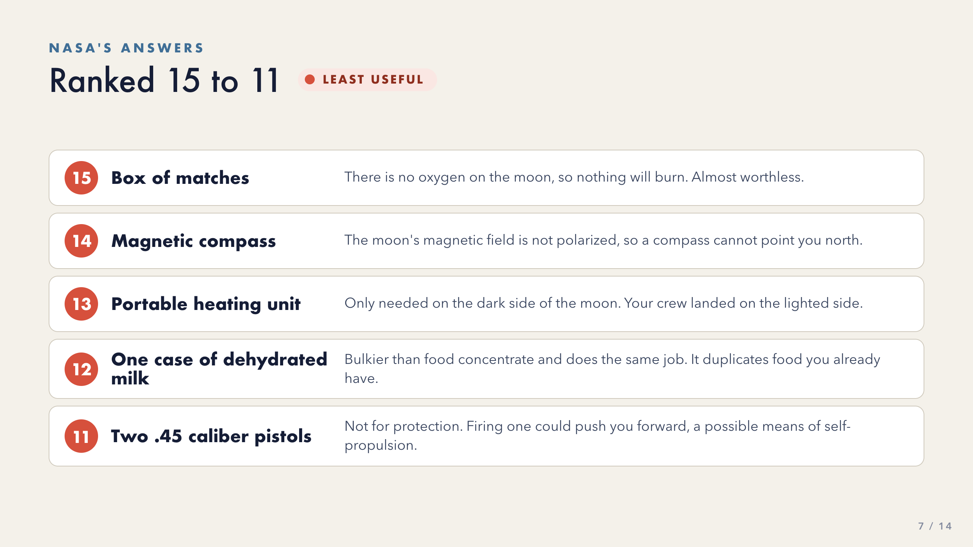
Notes:
Reveal one tier at a time, and keep slide 11 hidden until scoring.
Pause after each item and ask: 'Did anyone have this one close?' Celebrate near-misses -- the reasoning is the point, not the number.
Item 11 is the one that surprises them. Say it plainly: NASA ranks the pistols for PROPULSION, not protection. Naming that up front keeps the conversation from drifting.
[Sources]
- Activity source: 'Moon Landing', Grahame Knox, insight.typepad.co.uk, CC BY-NC-ND 3.0 (teacher-supplied PDF).
Rankings and reasoning: NASA 'Survival on the Moon' exercise (US Government, public domain).
- Visuals: original CSS/SVG built for this deck. No third-party image assets.

Slide 8
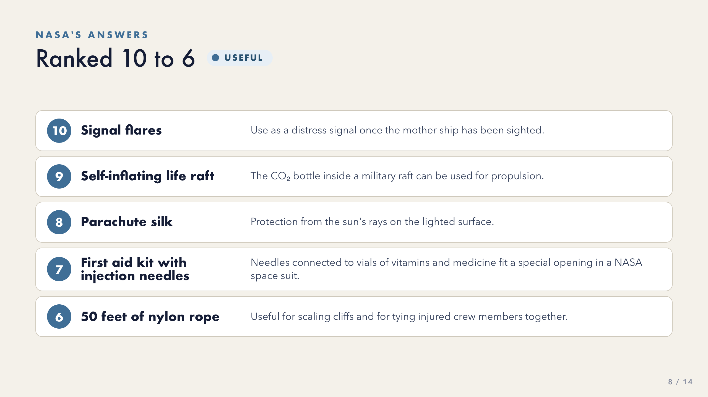
Notes:
Middle tier -- these are the items crews argue about most.
Worth pausing on the life raft (9): the value is the CO2 bottle inside it, not the raft. Ask students what else on the list works for a reason other than its obvious one.
The first aid kit (7) tends to be ranked too low by students who assume nobody is injured.
[Sources]
- Activity source: 'Moon Landing', Grahame Knox, insight.typepad.co.uk, CC BY-NC-ND 3.0 (teacher-supplied PDF).
Rankings and reasoning: NASA 'Survival on the Moon' exercise (US Government, public domain).
- Visuals: original CSS/SVG built for this deck. No third-party image assets.

Slide 9
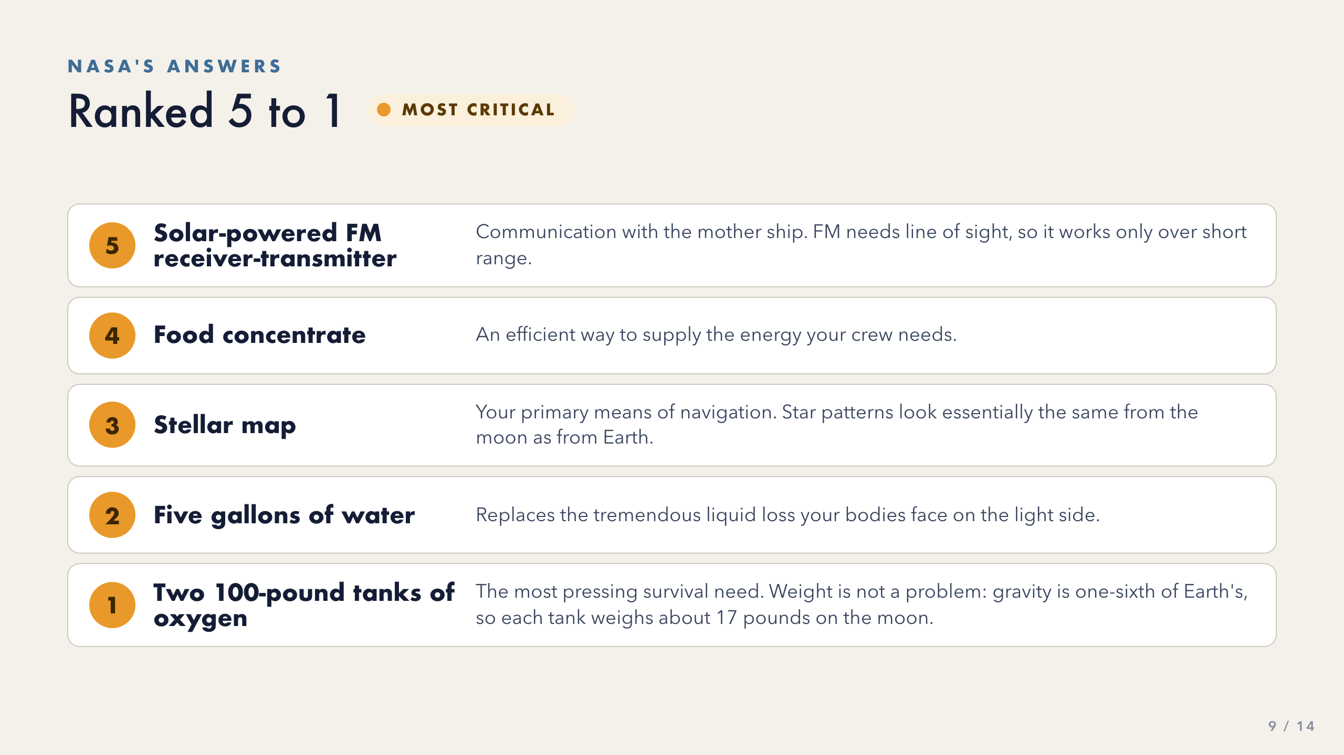
Notes:
Slow down here. This is the payoff.
Before revealing #1, ask the room: 'Two hundred pounds of oxygen tanks -- how do you carry that 200 miles?' Let them wrestle with it, then reveal the one-sixth gravity answer: about 17 pounds each on the moon.
That single fact reframes the whole exercise -- weight reasoning from Earth does not transfer.
[Sources]
- Activity source: 'Moon Landing', Grahame Knox, insight.typepad.co.uk, CC BY-NC-ND 3.0 (teacher-supplied PDF).
Rankings and reasoning: NASA 'Survival on the Moon' exercise (US Government, public domain).
- Visuals: original CSS/SVG built for this deck. No third-party image assets.

Slide 10
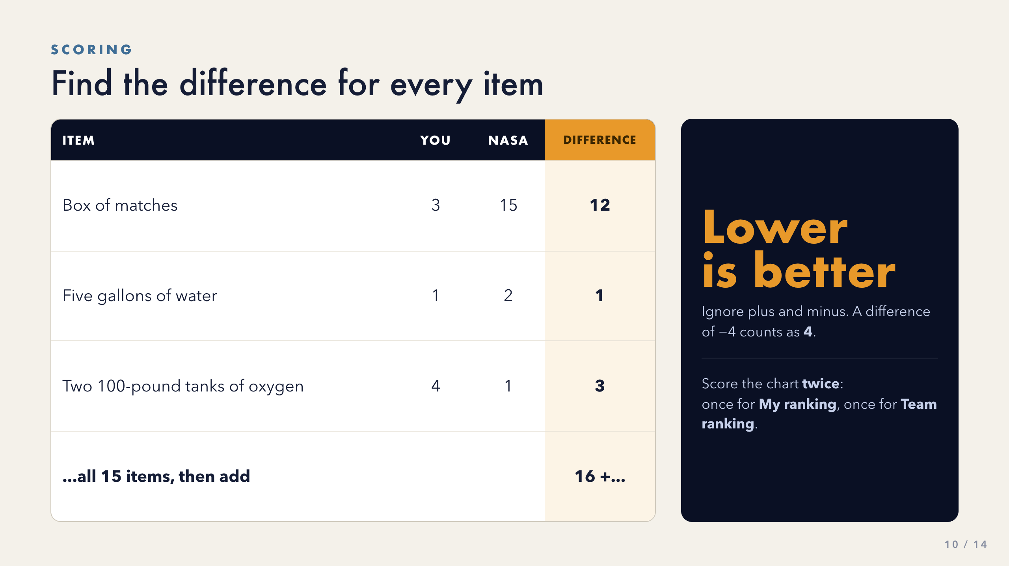
Notes:
Model the first row on the board using a real number from a student in the room.
Two errors to head off:
- Keeping the minus sign. A difference of -4 counts as 4.
- Scoring only one column. They need My score AND Team score.
Say 'lower is better' at least twice. It runs against every scoring instinct students have, so once will not land.
[Sources]
- Activity source: 'Moon Landing', Grahame Knox, insight.typepad.co.uk, CC BY-NC-ND 3.0 (teacher-supplied PDF).
Rankings and reasoning: NASA 'Survival on the Moon' exercise (US Government, public domain).
- Visuals: original CSS/SVG built for this deck. No third-party image assets.

Slide 11
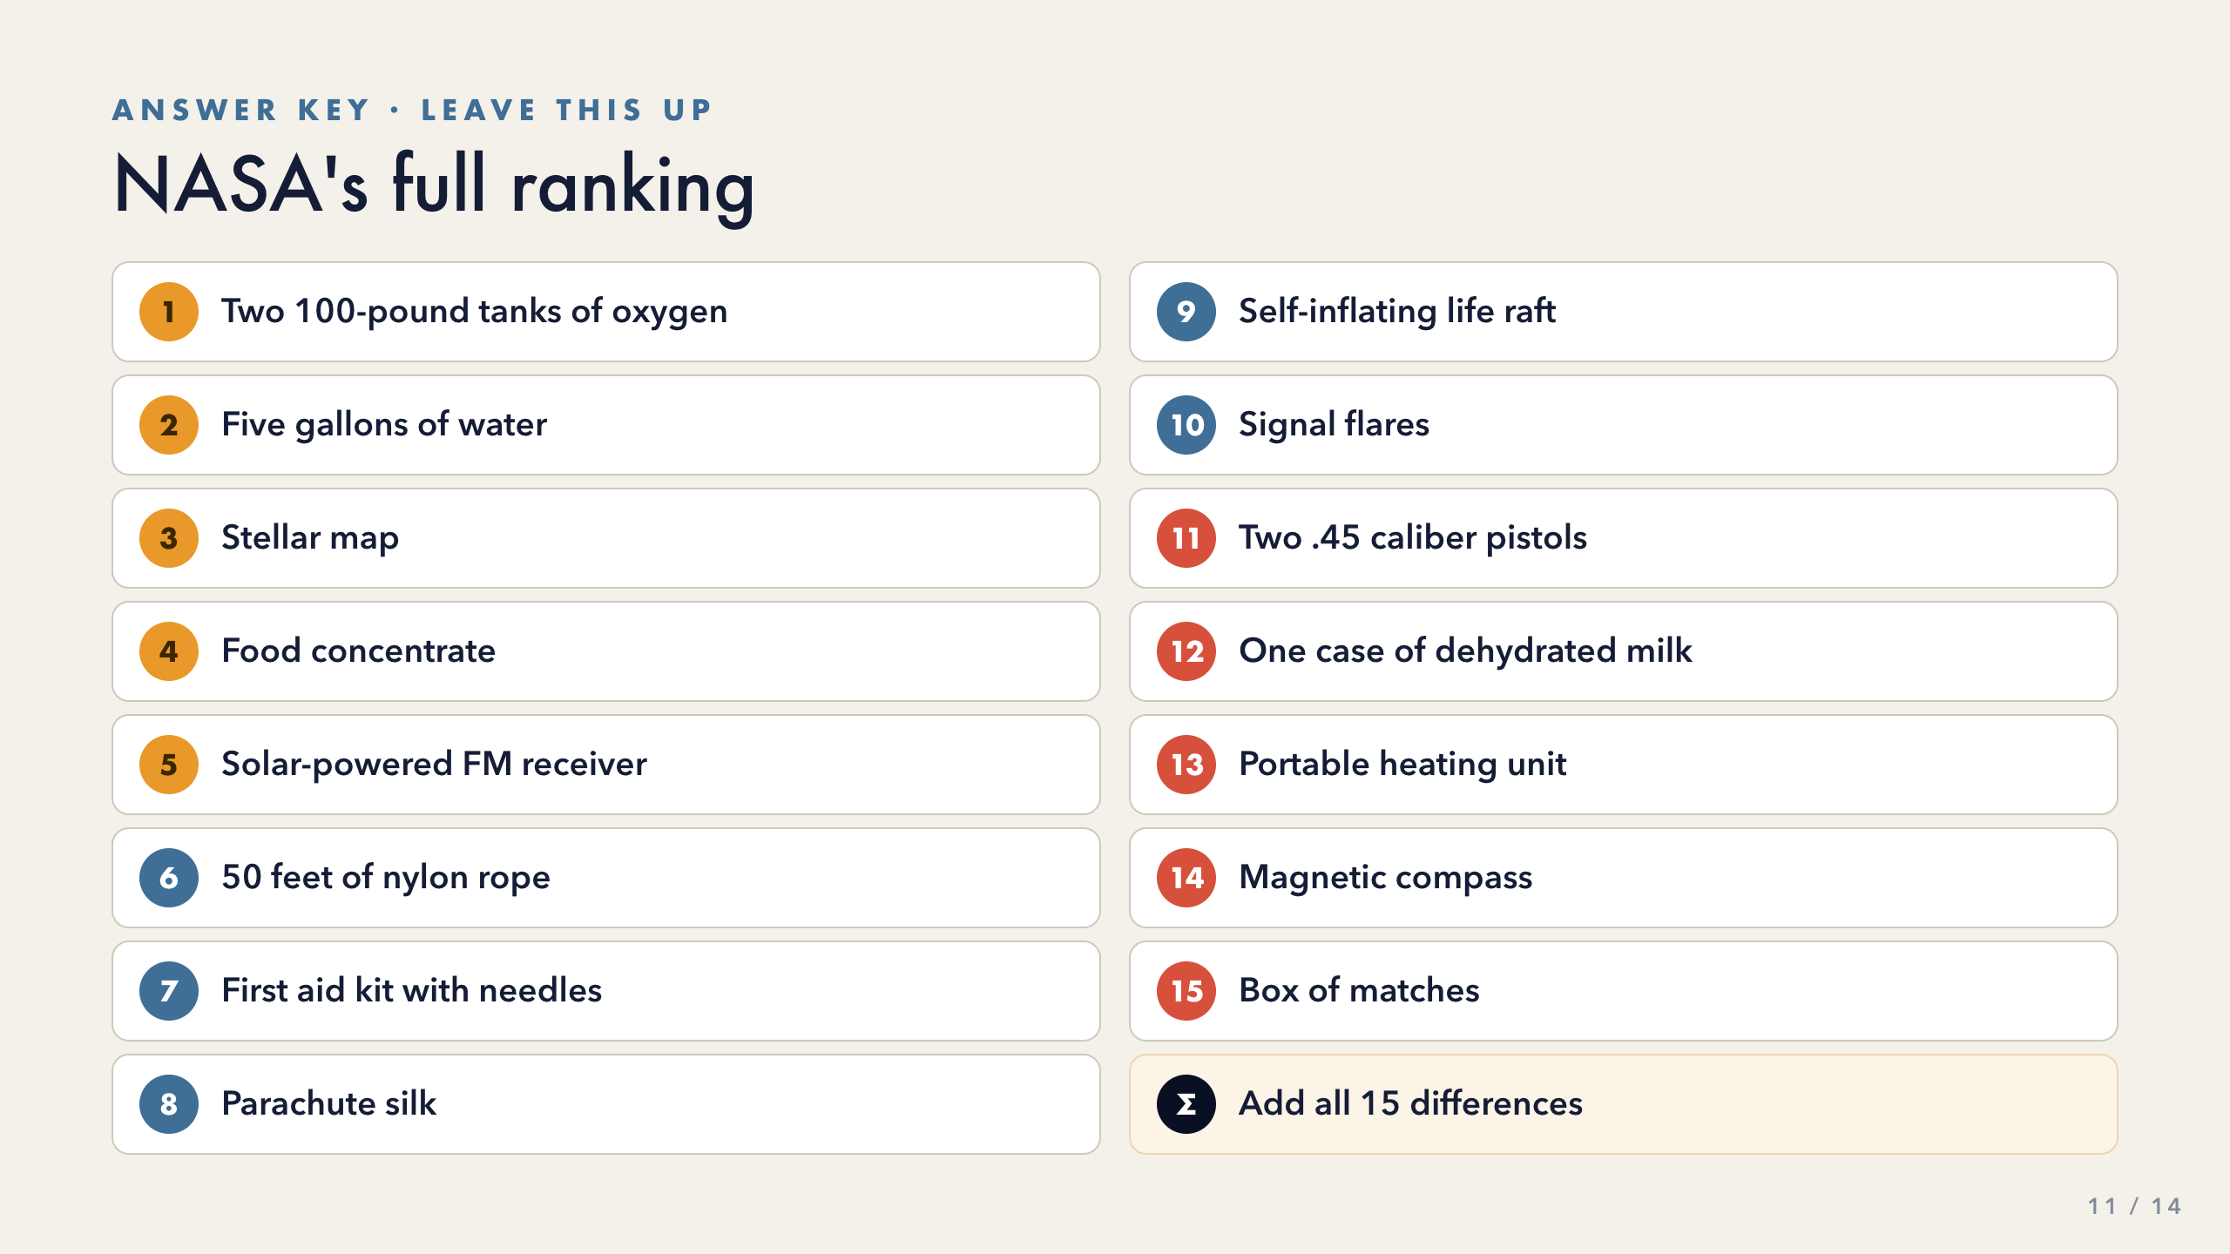
Notes:
Leave this slide up while crews score. Expect 5-8 minutes.
Circulate and spot-check the arithmetic -- the totals drive the debrief, so a wrong sum weakens the payoff.
Have each crew write both totals somewhere you can see them.
[Sources]
- Activity source: 'Moon Landing', Grahame Knox, insight.typepad.co.uk, CC BY-NC-ND 3.0 (teacher-supplied PDF).
Rankings and reasoning: NASA 'Survival on the Moon' exercise (US Government, public domain).
- Visuals: original CSS/SVG built for this deck. No third-party image assets.

Slide 12
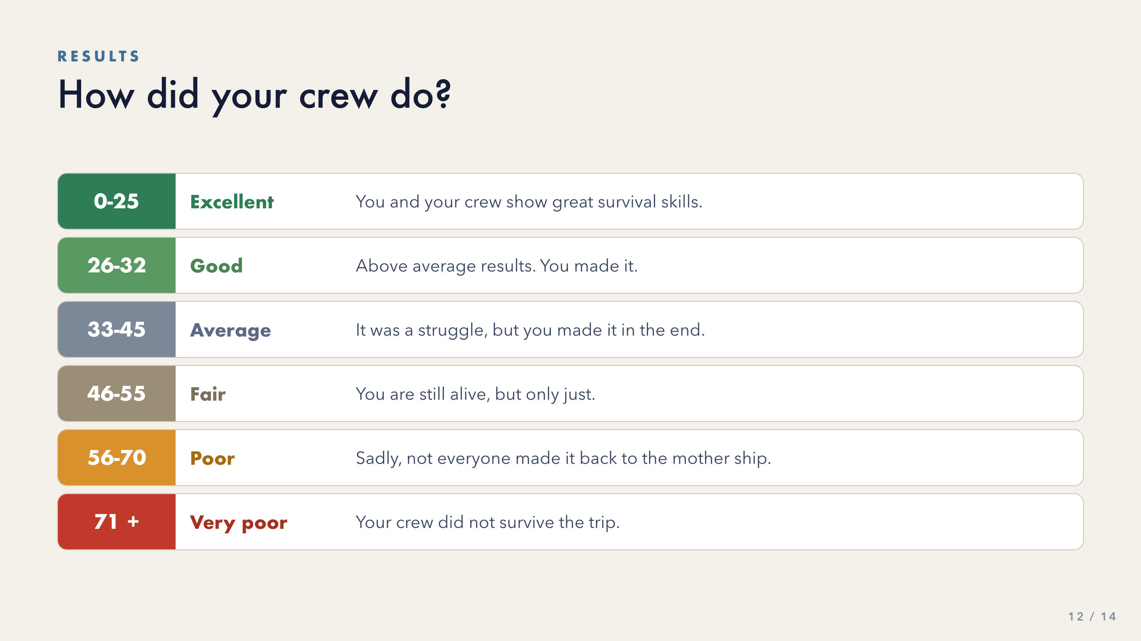
Notes:
Have crews report both scores aloud.
Then take a show of hands: whose TEAM score was lower than their OWN score? In most classes it is the clear majority. That show of hands is the evidence for slide 14 -- do not skip it.
Keep the tone light on the bottom two bands. The scenario is fictional and the joke is part of the original activity.
[Sources]
- Activity source: 'Moon Landing', Grahame Knox, insight.typepad.co.uk, CC BY-NC-ND 3.0 (teacher-supplied PDF).
Rankings and reasoning: NASA 'Survival on the Moon' exercise (US Government, public domain).
- Visuals: original CSS/SVG built for this deck. No third-party image assets.

Slide 13
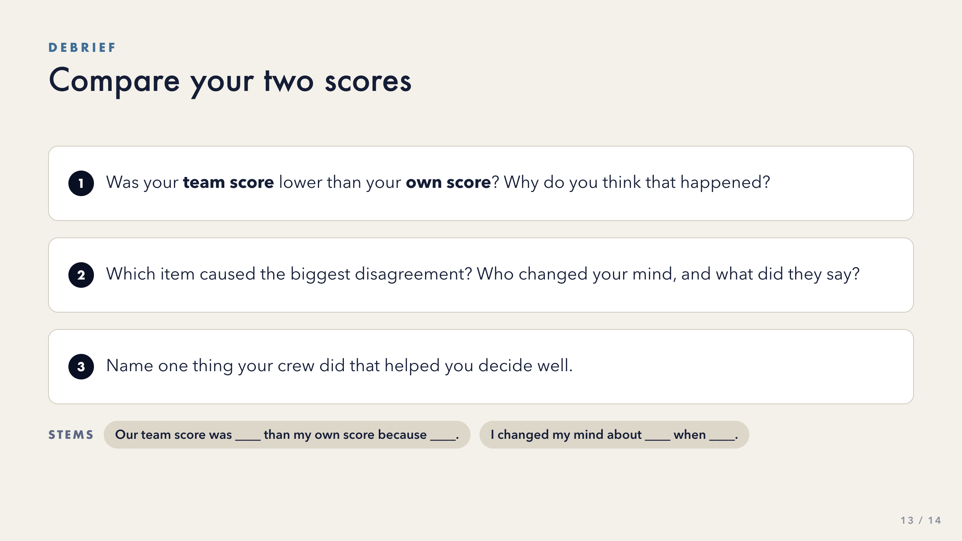
Notes:
This is the lesson. Do not rush it because the scoring felt like the ending.
Question 2 is the highest-value one -- call on the students you noticed changing their mind during Round 2. Naming a specific person's reasoning makes the abstraction concrete.
Give 30 seconds of silent think time before taking any answers, and point students to the stems at the bottom.
If a crew scored WORSE together, that is a genuine finding, not a failure -- ask what happened in their conversation.
[Sources]
- Activity source: 'Moon Landing', Grahame Knox, insight.typepad.co.uk, CC BY-NC-ND 3.0 (teacher-supplied PDF).
Rankings and reasoning: NASA 'Survival on the Moon' exercise (US Government, public domain).
- Visuals: original CSS/SVG built for this deck. No third-party image assets.

Slide 14
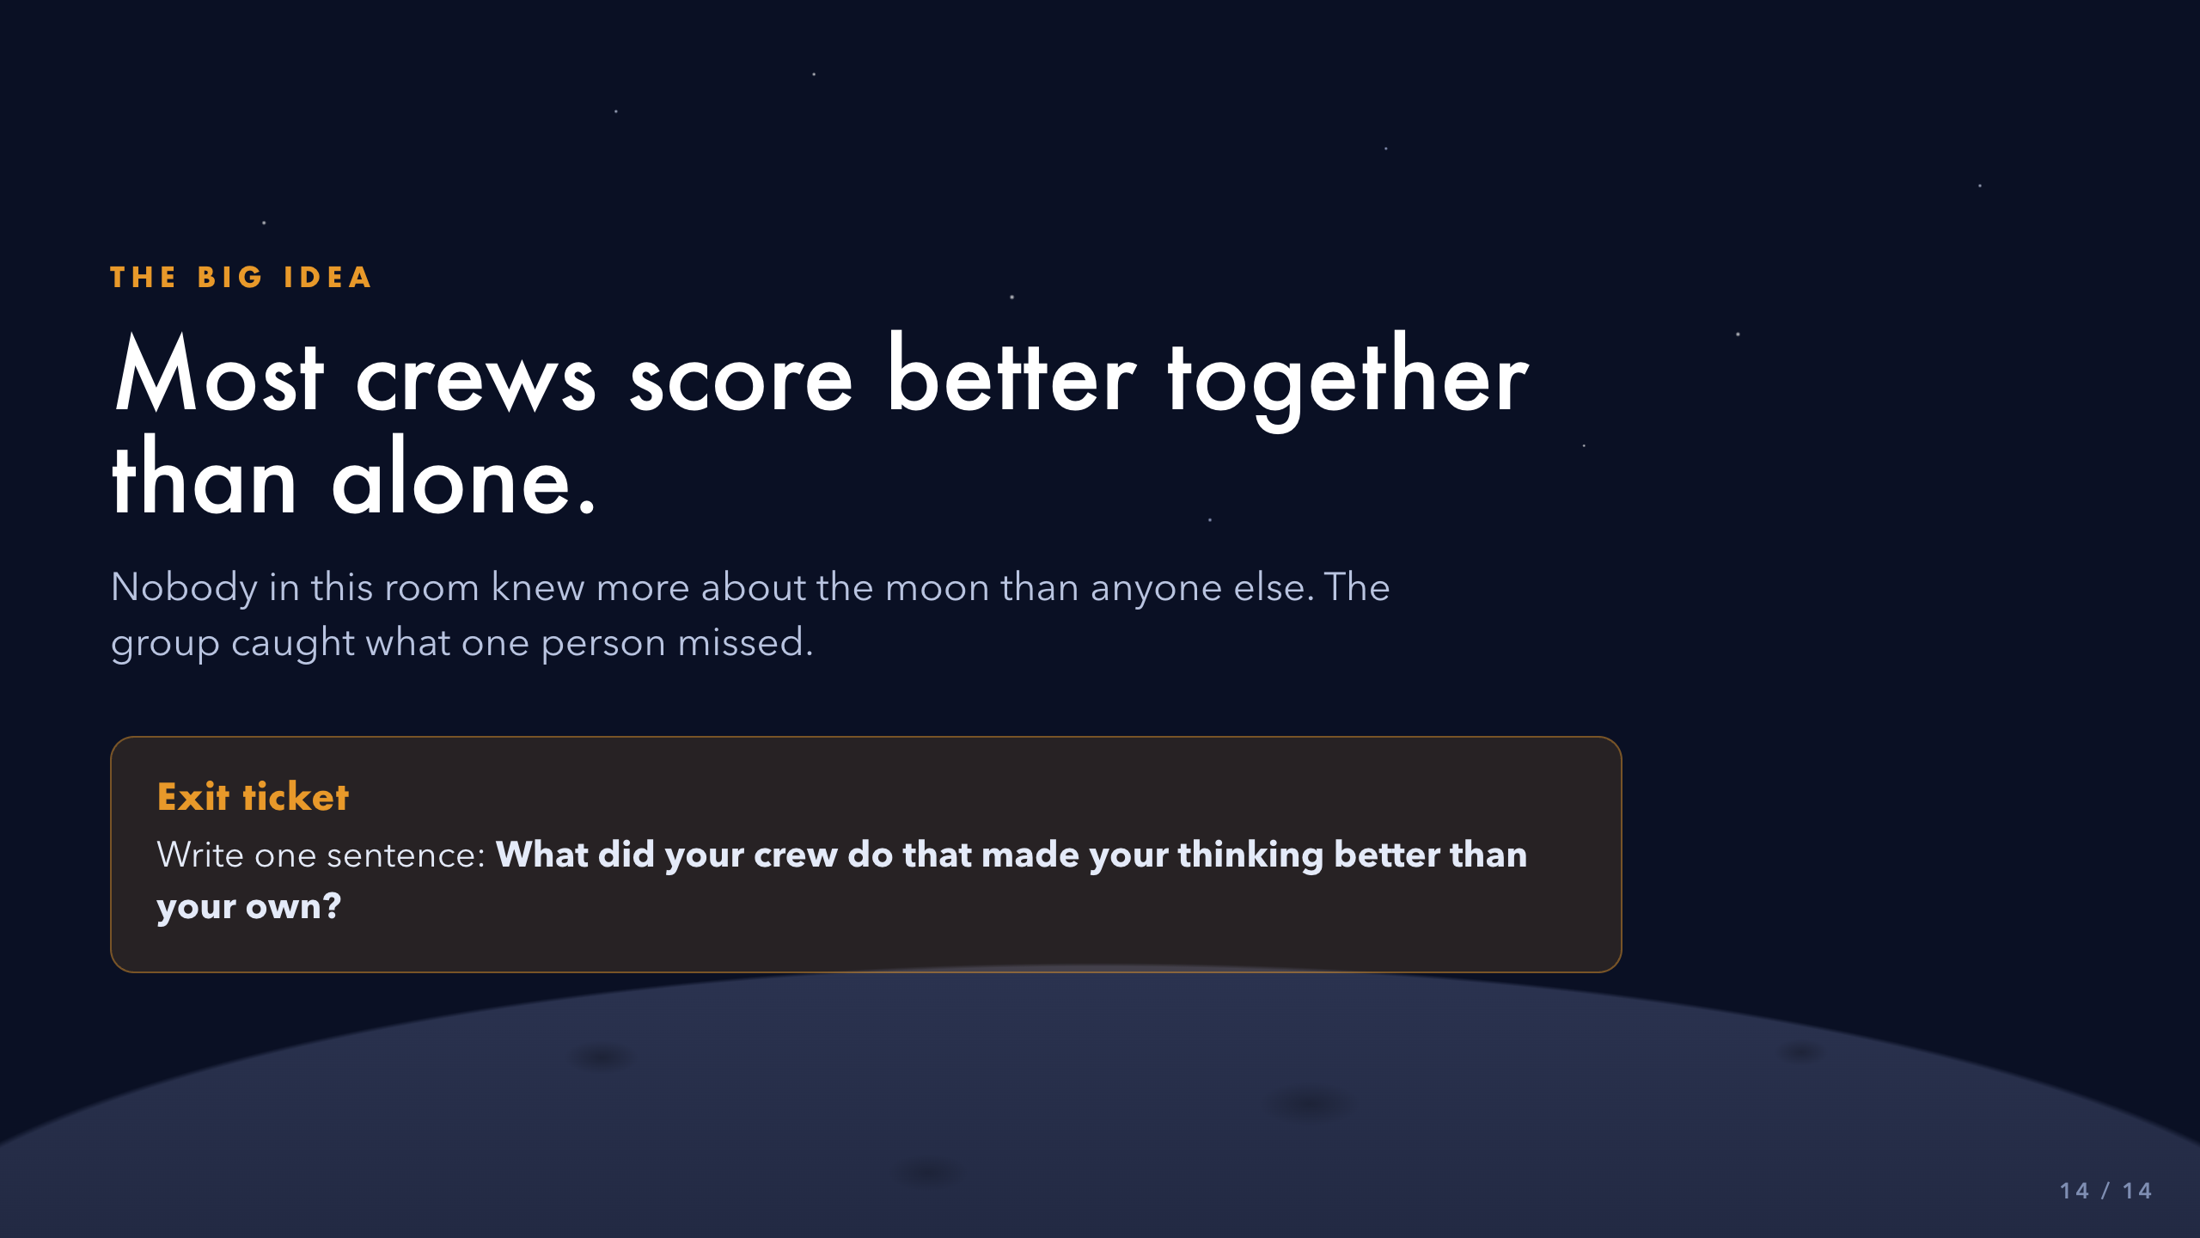
Notes:
Say the big idea explicitly. Students rarely extract it on their own.
The mechanism is worth naming. No one in the room was a NASA engineer. The crew scored better because more reasons got checked.
Collect the exit ticket on paper or in Canvas. One sentence is enough.
[Sources]
- Activity source: 'Moon Landing', Grahame Knox, insight.typepad.co.uk, CC BY-NC-ND 3.0 (teacher-supplied PDF).
Rankings and reasoning: NASA 'Survival on the Moon' exercise (US Government, public domain).
- Visuals: original CSS/SVG built for this deck. No third-party image assets.

