Slide 1
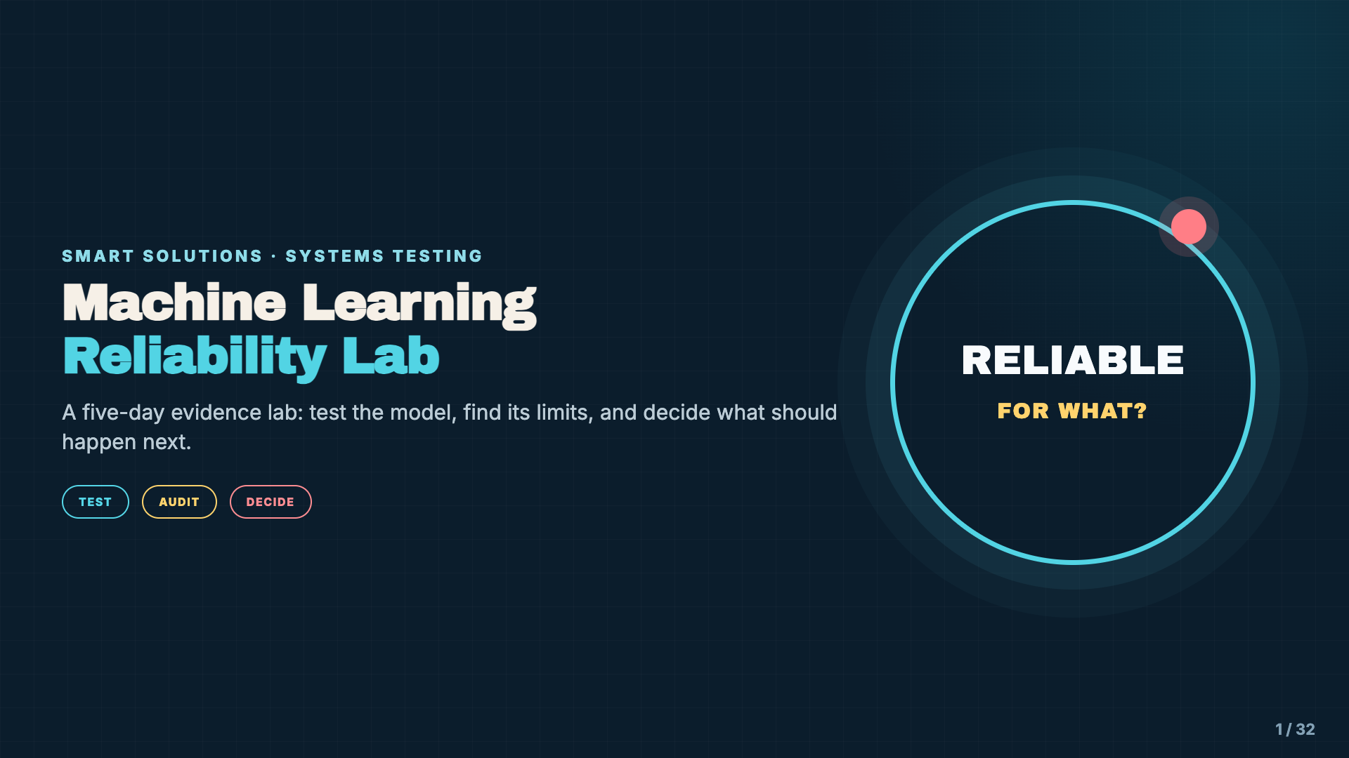
Notes:
Open by framing students as a model testing team. This is not another week of learning what machine learning is or training a first model. Students will investigate whether an existing model is reliable enough for a particular use.
[Sources]
- Instructional examples and Model Reliability Case File supplied with this lesson.

Slide 2
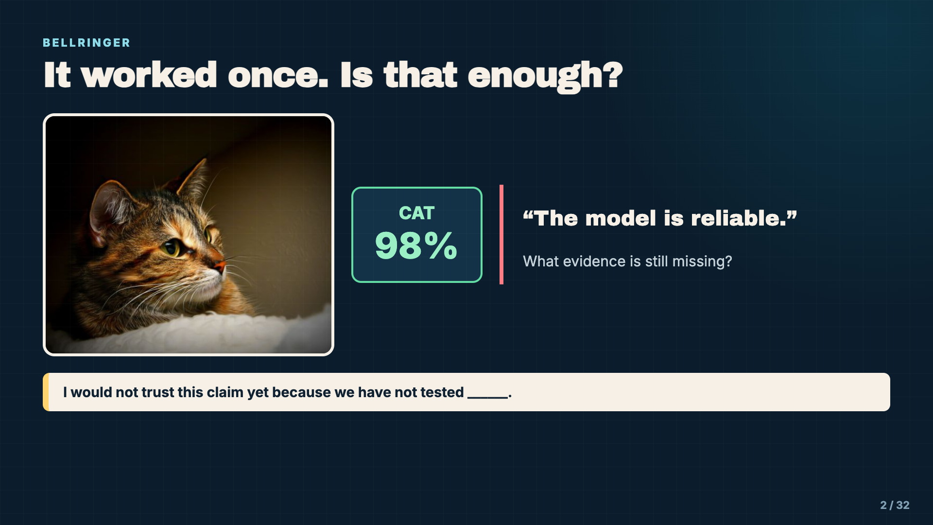
Notes:
Give students 45 seconds to write, then turn and talk. Listen for conditions, other examples, new backgrounds, and repeated tests. Do not correct yet; collect the class’s definition of “enough evidence.”
[Sources]
- Photo: COLORED PENCIL magazine, CC BY 2.0, https://www.flickr.com/photos/61446950@N06/12175509725
- https://airc.nist.gov/airmf-resources/airmf/3-sec-characteristics/

Slide 3
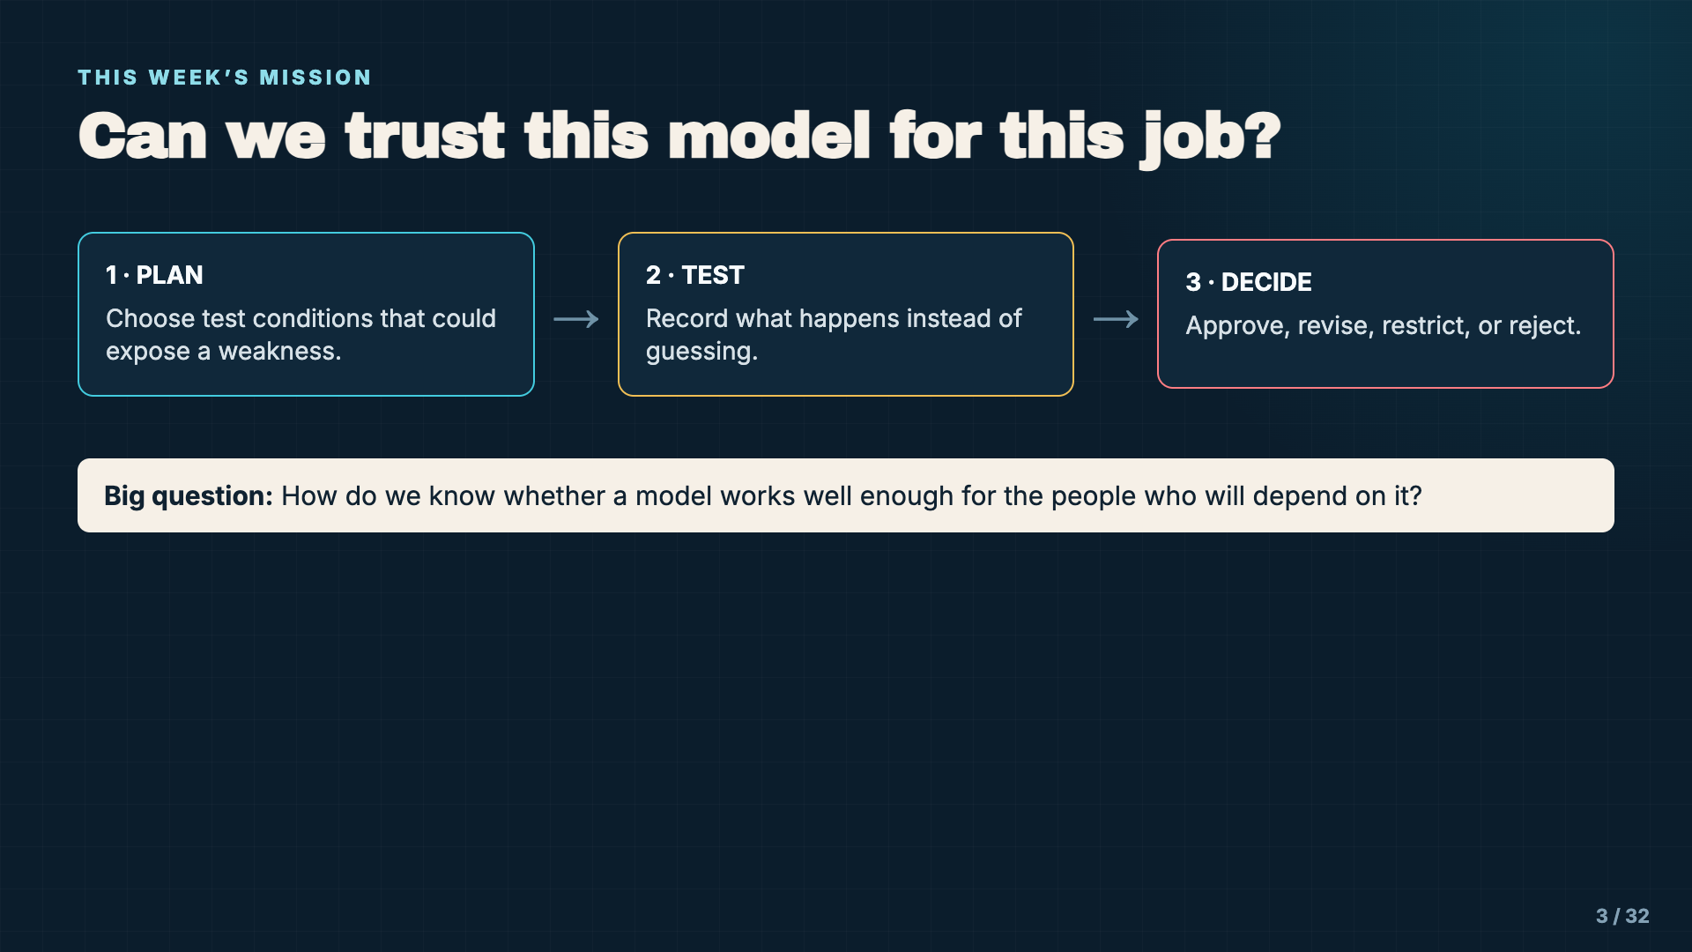
Notes:
Read the big question aloud. Explain that “reliable” never means perfect. It means the evidence is strong enough for the intended use and the known limits are visible.
[Sources]
- Instructional examples and Model Reliability Case File supplied with this lesson.

Slide 4
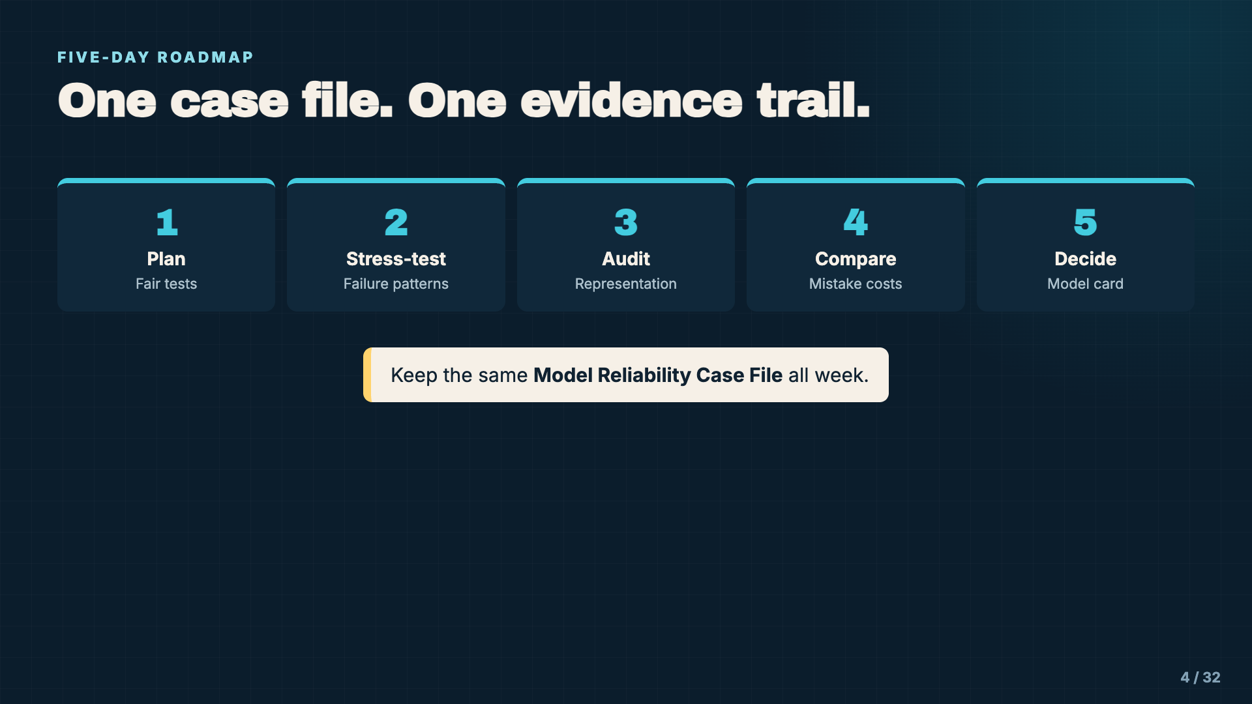
Notes:
Show students the cumulative case file. If students cannot reopen their Picture This model, use the teacher-provided backup model or run the test as a whole-class demonstration. No student should lose the investigation because a saved model link is missing.
[Sources]
- Instructional examples and Model Reliability Case File supplied with this lesson.

Slide 5
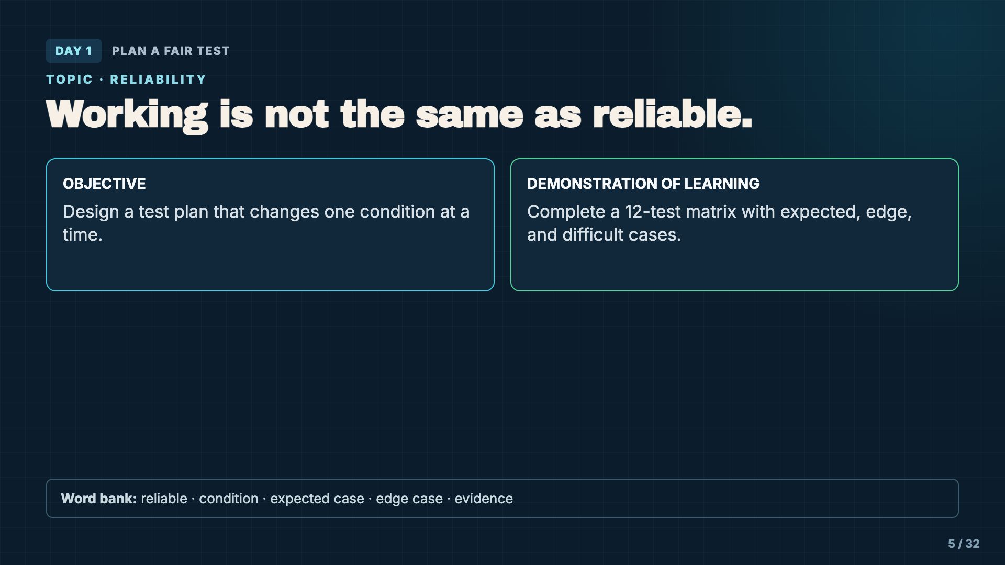
Notes:
State the objective and demonstration of learning. Students are designing the test today, not running all 12 tests. A strong plan anticipates conditions the model may not handle.
[Sources]
- Instructional examples and Model Reliability Case File supplied with this lesson.

Slide 6
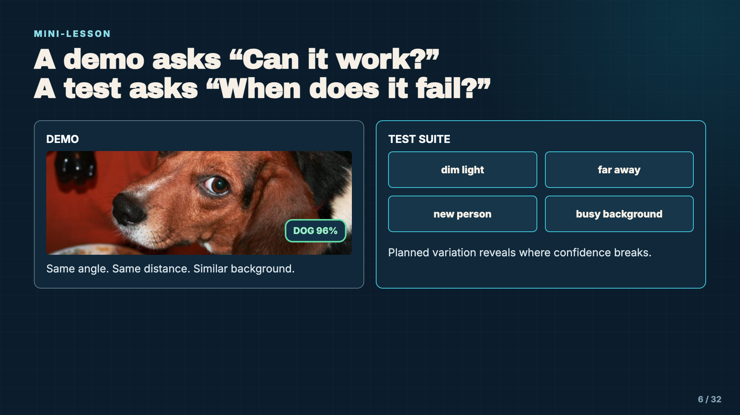
Notes:
Contrast a polished demonstration with a useful test. A successful demo can be real and still be weak evidence. Reliability requires testing conditions that differ from training.
[Sources]
- Photo: foxypar4, CC BY 2.0, https://www.flickr.com/photos/43145783@N00/1318449097
- https://airc.nist.gov/airmf-resources/airmf/3-sec-characteristics/
- https://developers.google.com/machine-learning/crash-course/overfitting/dividing-datasets

Slide 7
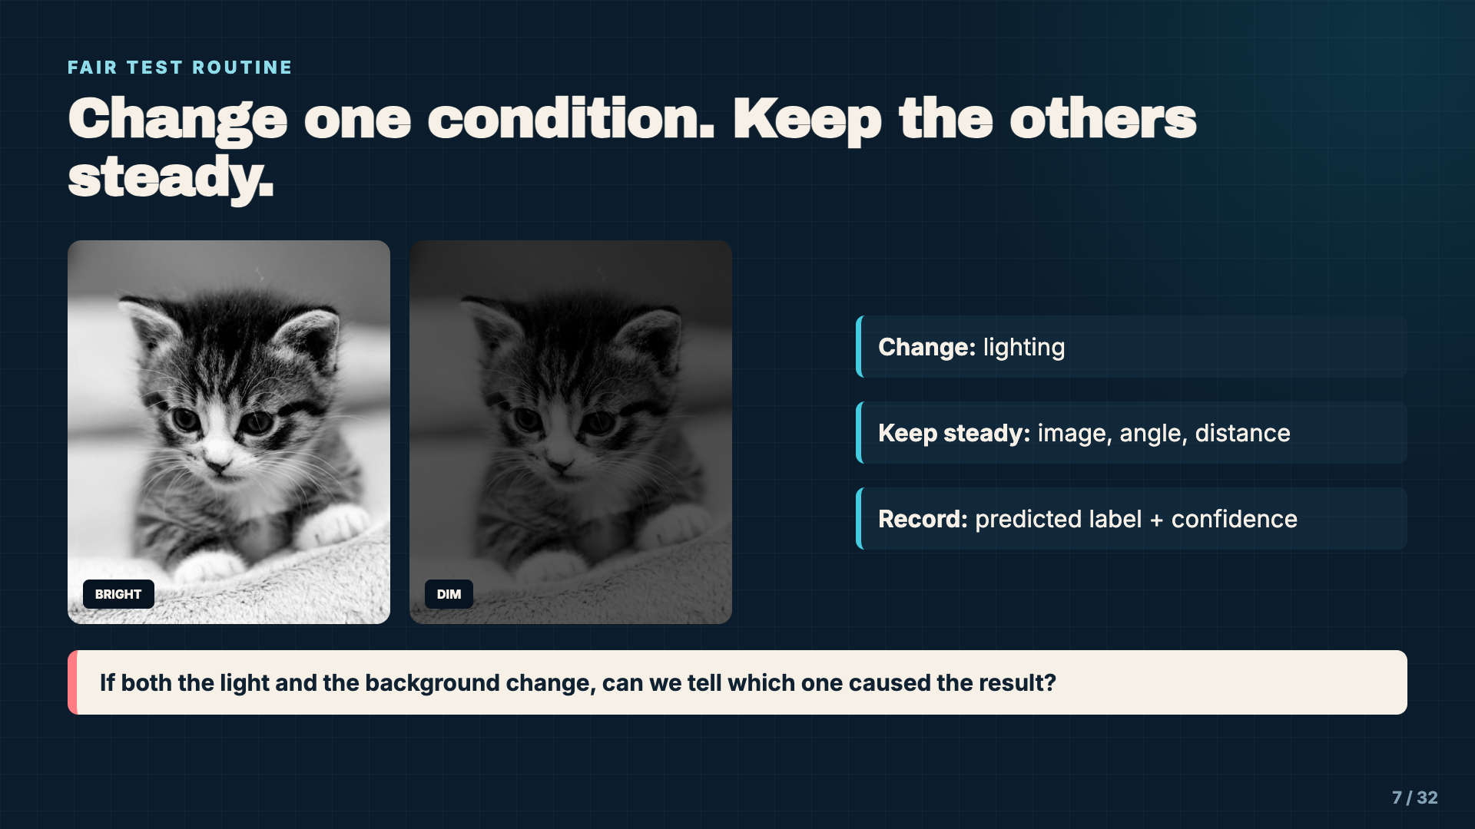
Notes:
Model the logic of a controlled comparison. Students will not always be able to control every variable perfectly, but they should name what changed and avoid changing everything at once.
[Sources]
- Photo: Kit4na, CC BY 2.0, https://www.flickr.com/photos/44843078@N03/7604210572
- https://developers.google.com/machine-learning/crash-course/overfitting/data-characteristics

Slide 8
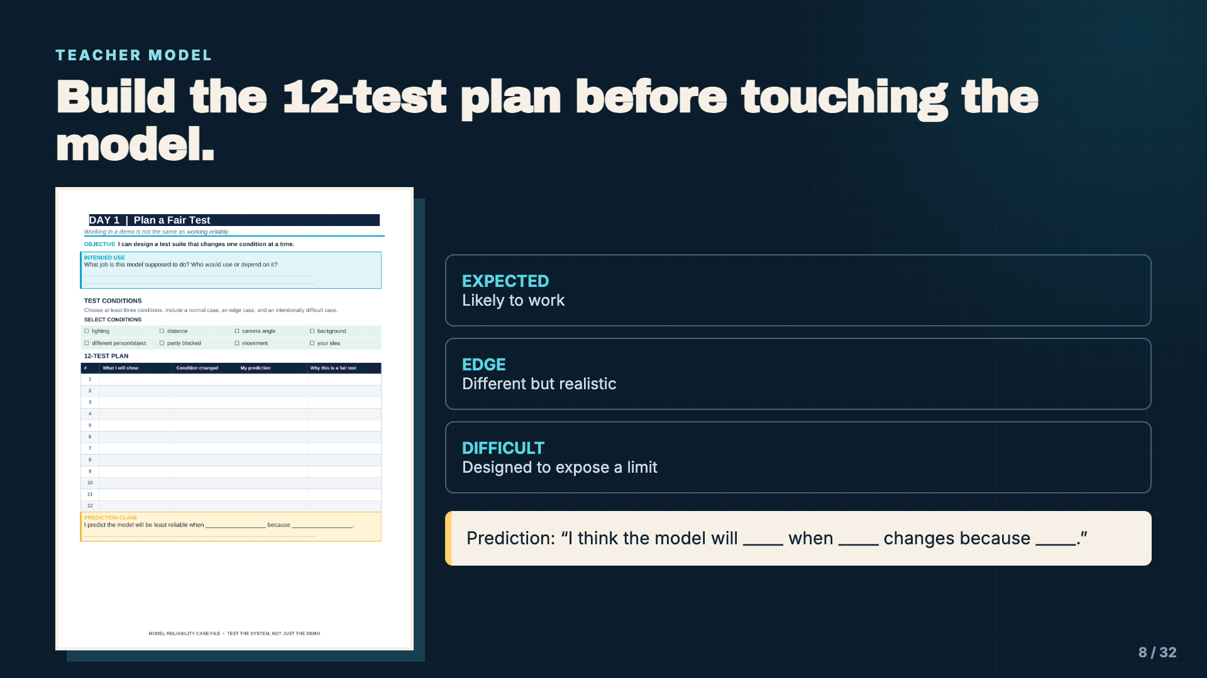
Notes:
Project the case-file page and complete one row aloud. Require a reason for the prediction. A condition such as “different background” is stronger than “hard picture” because it can be reproduced.
[Sources]
- Instructional examples and Model Reliability Case File supplied with this lesson.

Slide 9
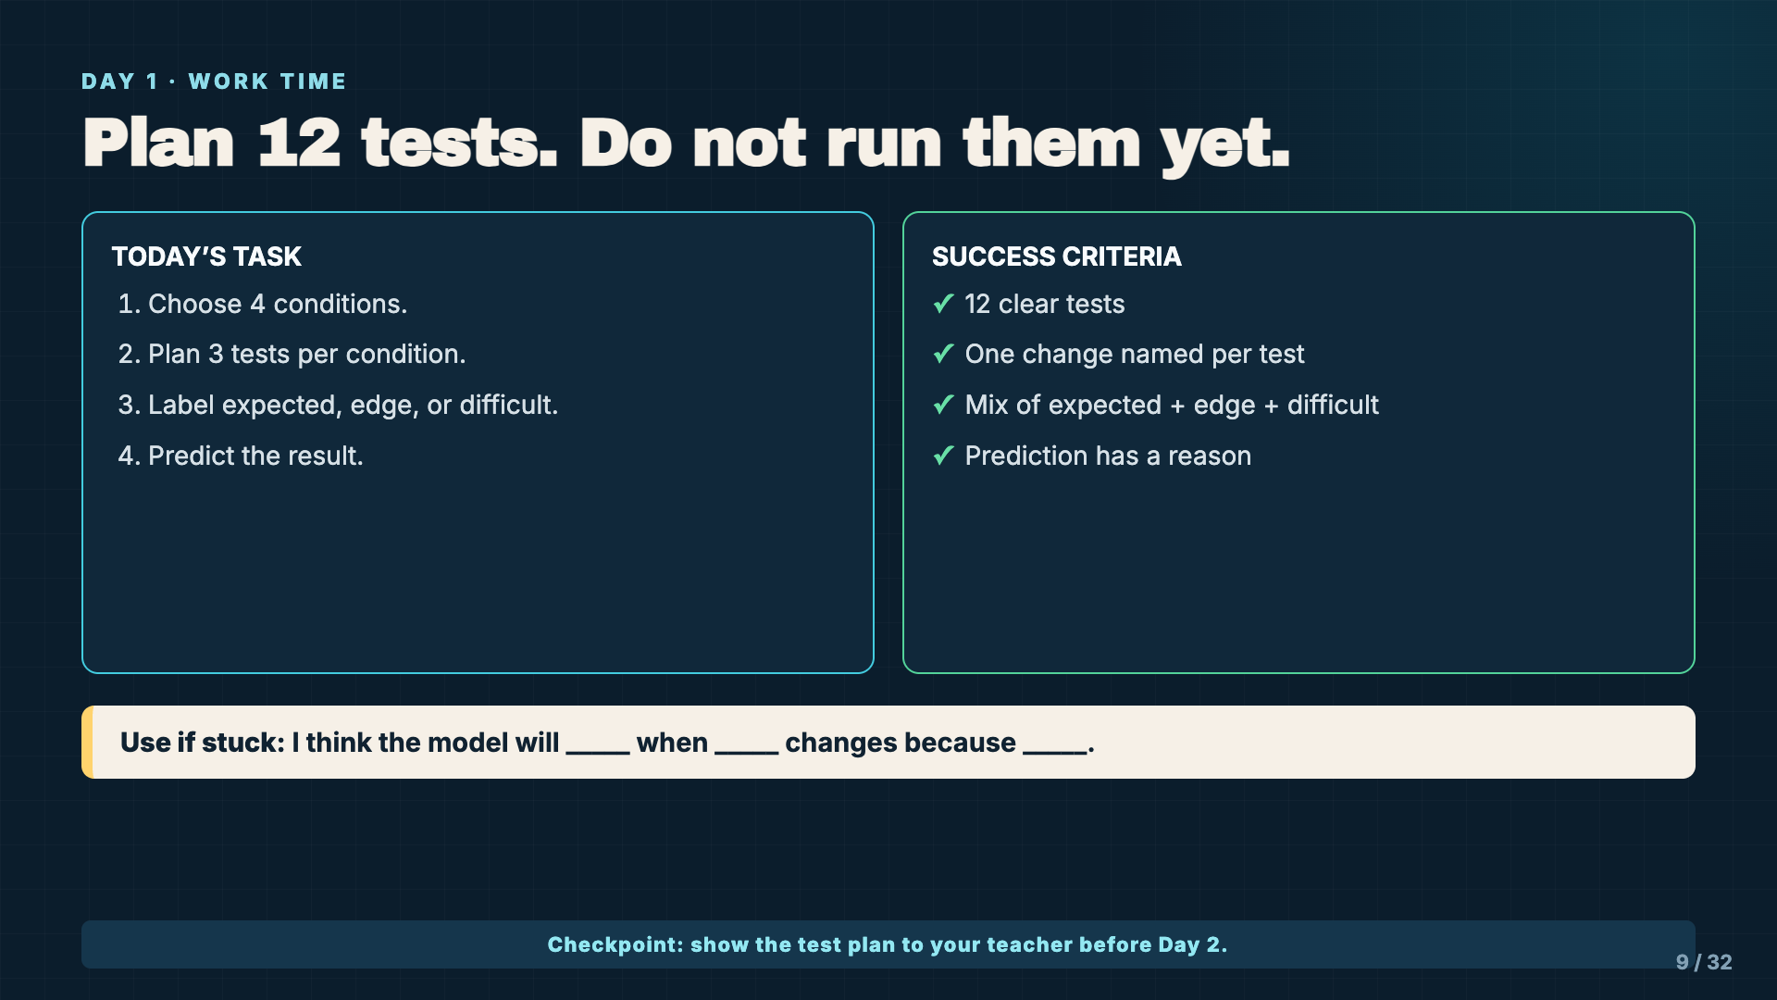
Notes:
Leave this slide projected. Circulate for vague conditions, repeated copies of the same test, or plans that change several variables at once. The checkpoint prevents students from wasting Day 2 on an unusable test plan.
[Sources]
- Instructional examples and Model Reliability Case File supplied with this lesson.

Slide 10
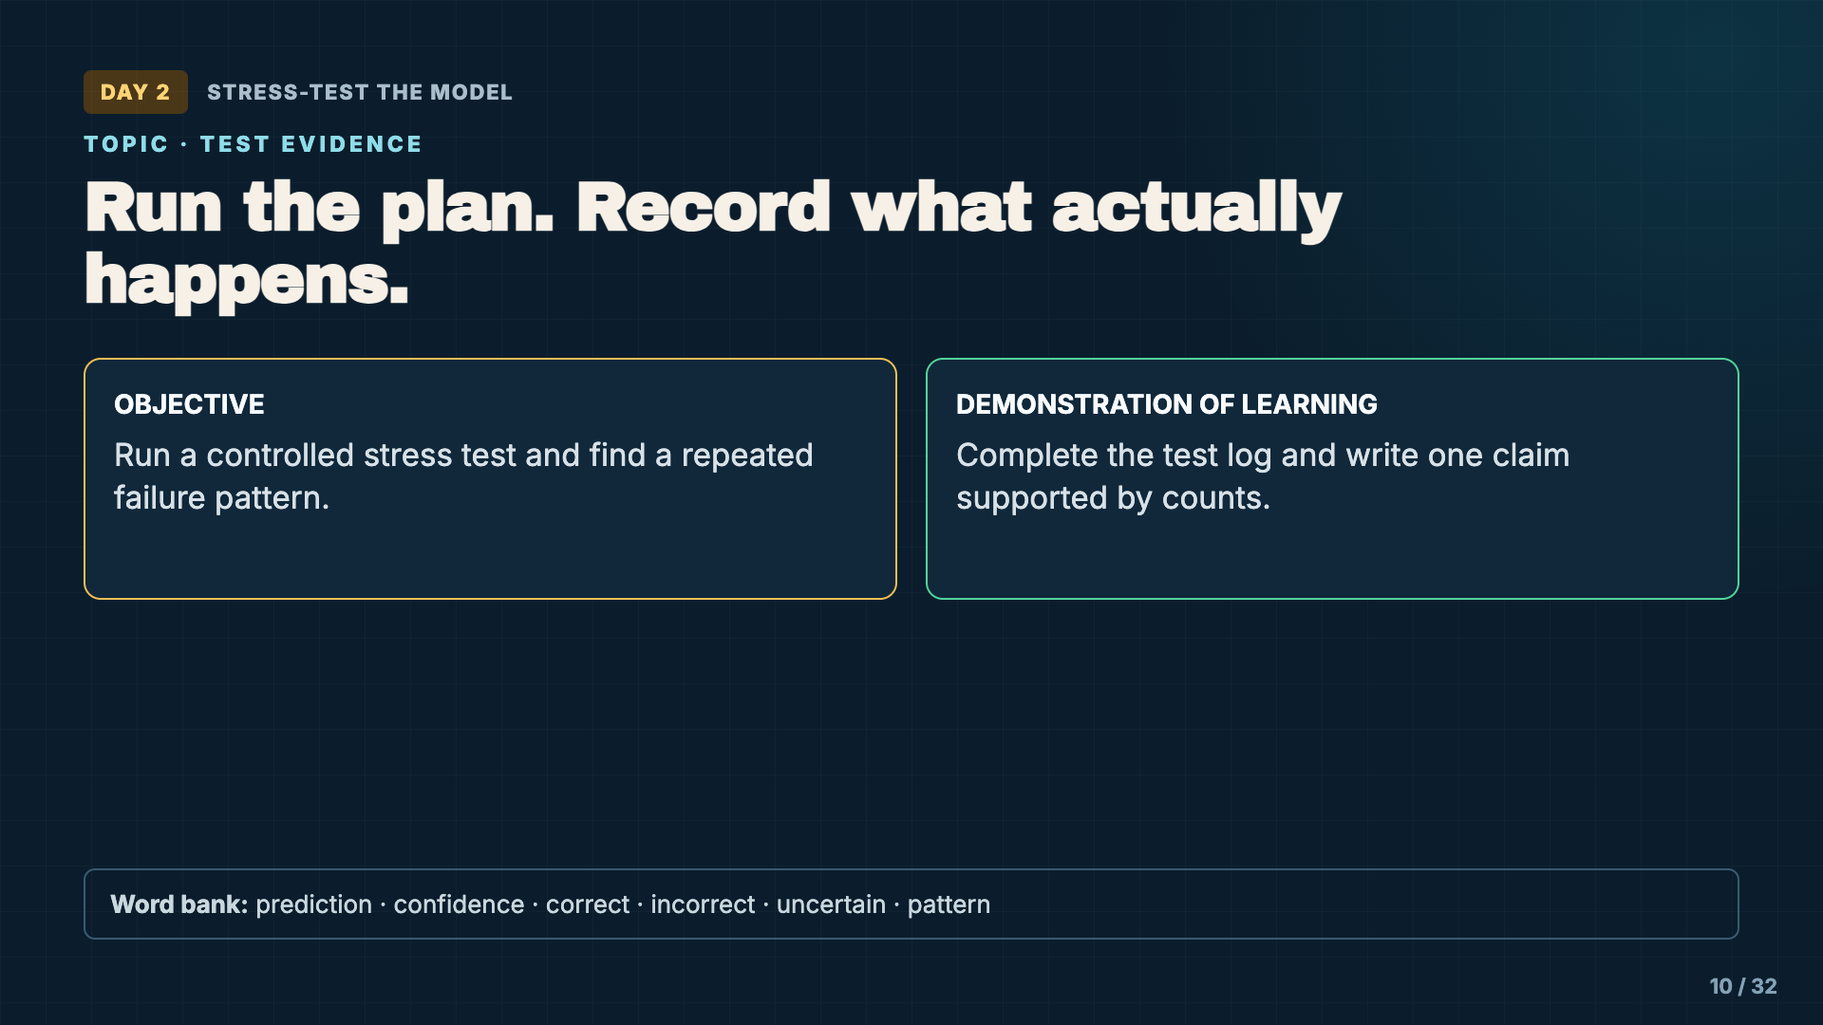
Notes:
Review that students are gathering evidence, not trying to make the model look good. Incorrect and uncertain results are valuable because they reveal a boundary.
[Sources]
- Instructional examples and Model Reliability Case File supplied with this lesson.

Slide 11
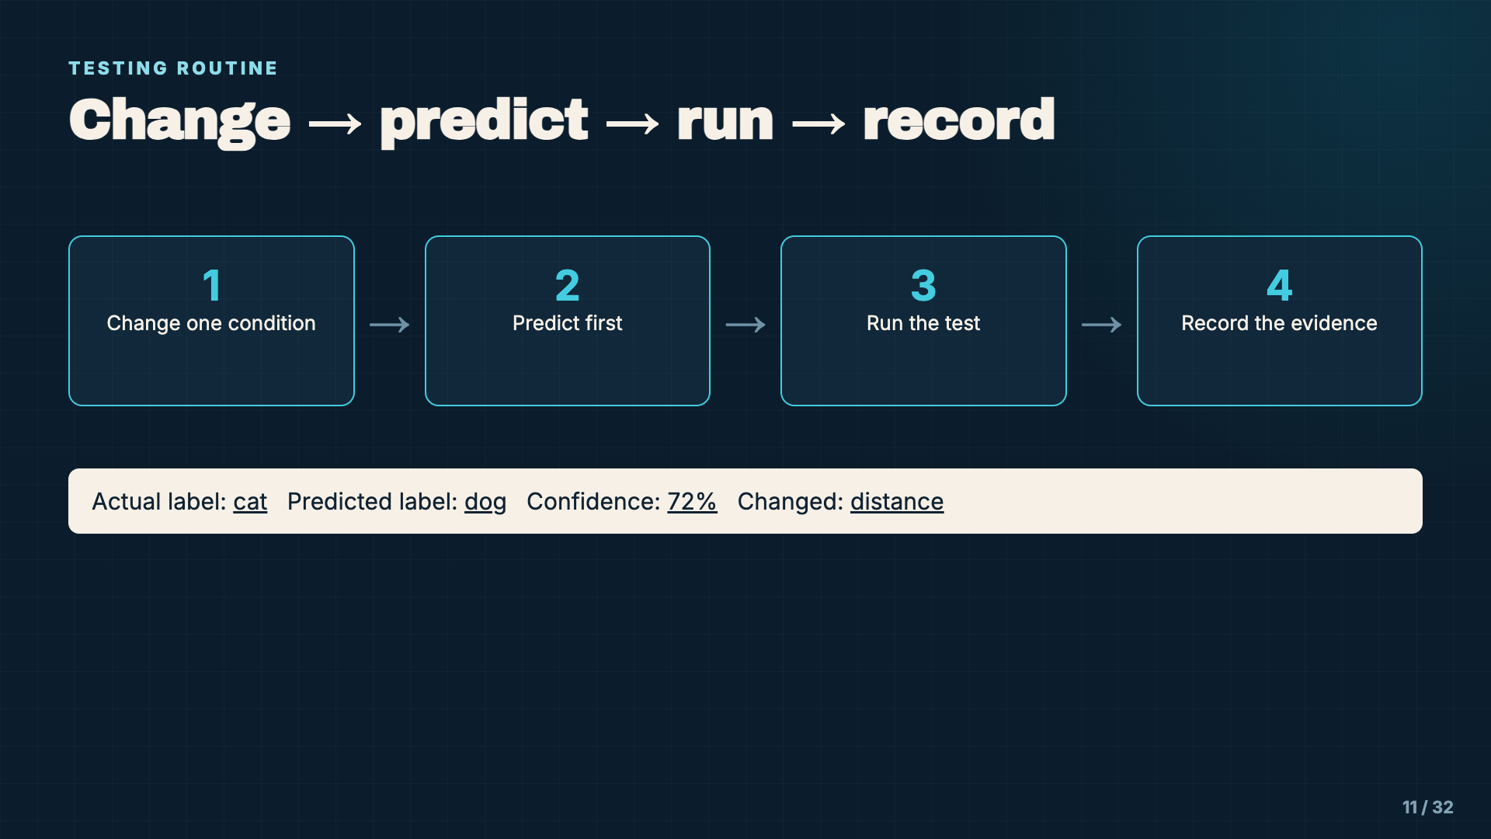
Notes:
Run one test in front of students. Narrate the sequence and record the result even if it is surprising. The log needs actual and predicted labels so a high-confidence wrong answer is not mistaken for success.
[Sources]
- Instructional examples and Model Reliability Case File supplied with this lesson.

Slide 12
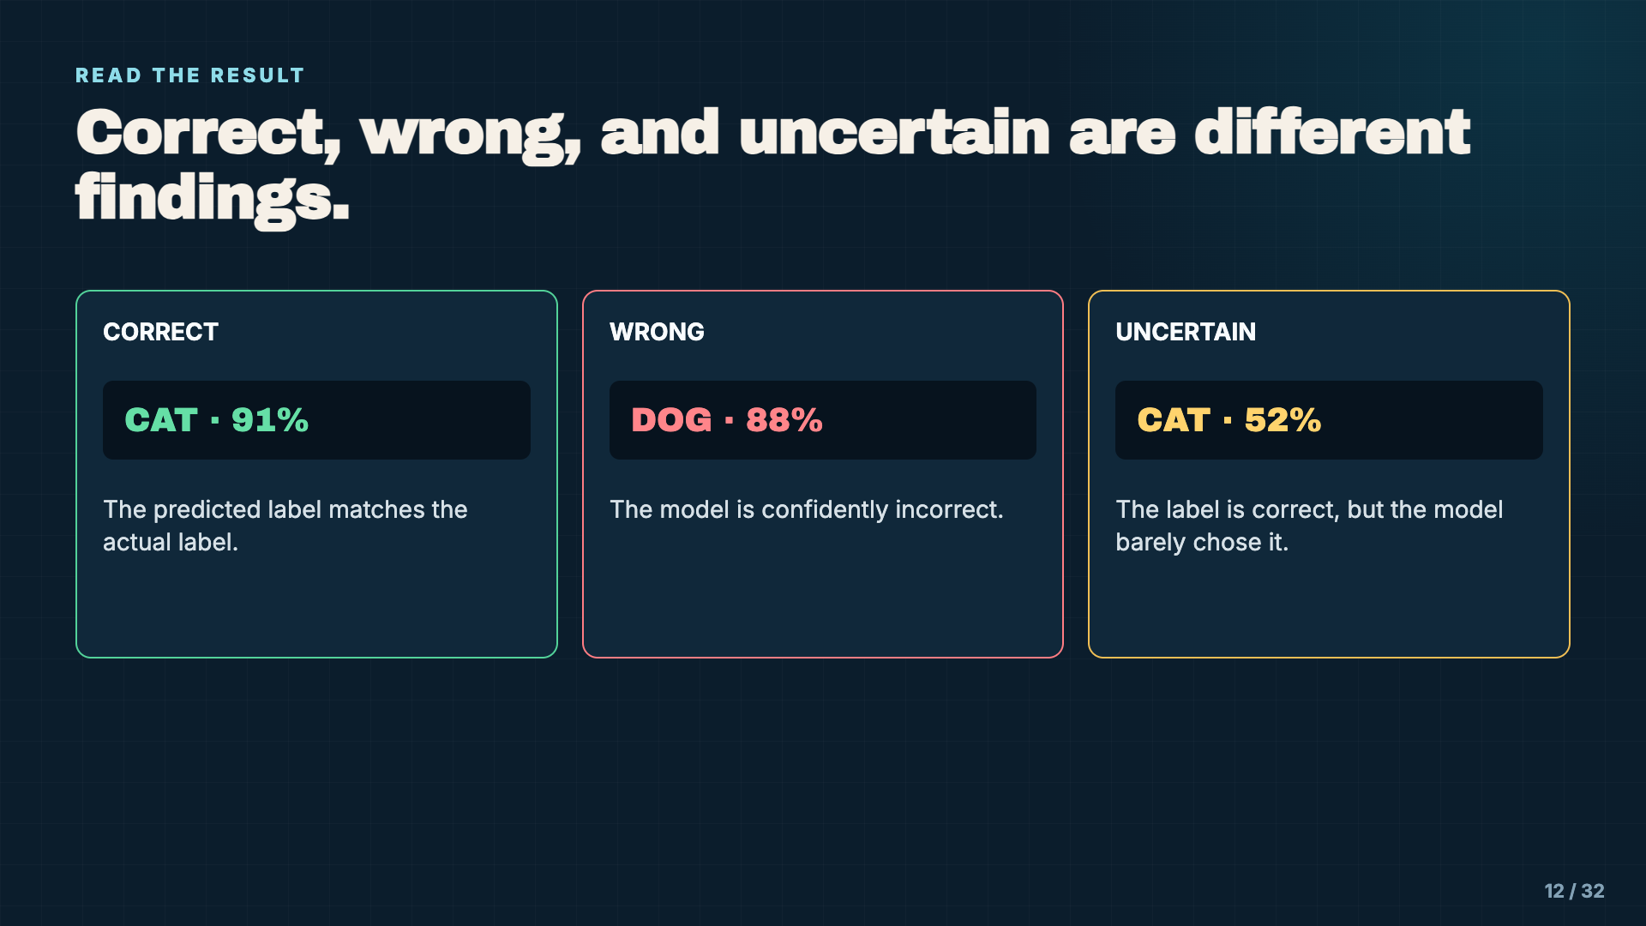
Notes:
Ask which result worries students most and why. There is no universal answer without knowing the use. A confidently wrong result and an uncertain correct result are both evidence, but they suggest different problems.
[Sources]
- https://developers.google.com/machine-learning/crash-course/classification/accuracy-precision-recall

Slide 13
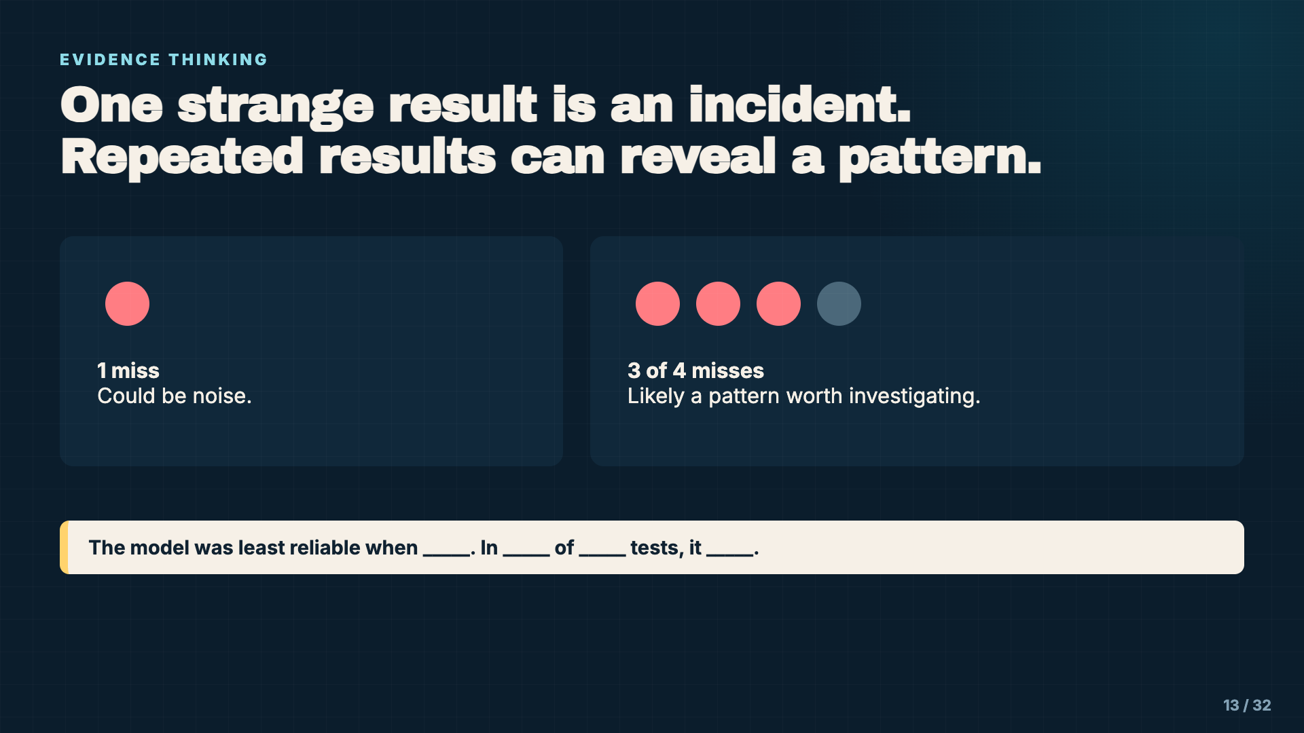
Notes:
Emphasize counts. Students should not claim “the model cannot handle dark images” after one result. A claim becomes stronger when several tests under the same condition show a similar outcome.
[Sources]
- Instructional examples and Model Reliability Case File supplied with this lesson.

Slide 14
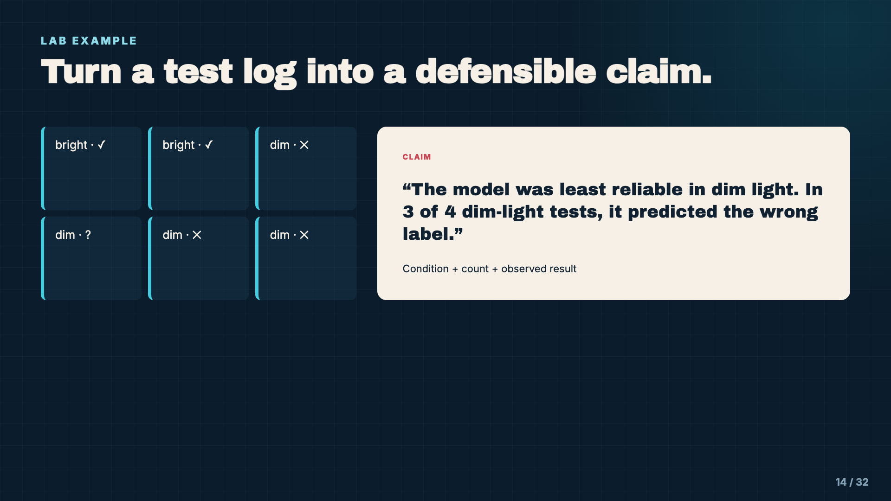
Notes:
Compare a weak claim such as “the model hates darkness” with the evidence-based claim shown. Require students to name only what the evidence supports; causes remain hypotheses unless tested.
[Sources]
- Instructional examples and Model Reliability Case File supplied with this lesson.

Slide 15
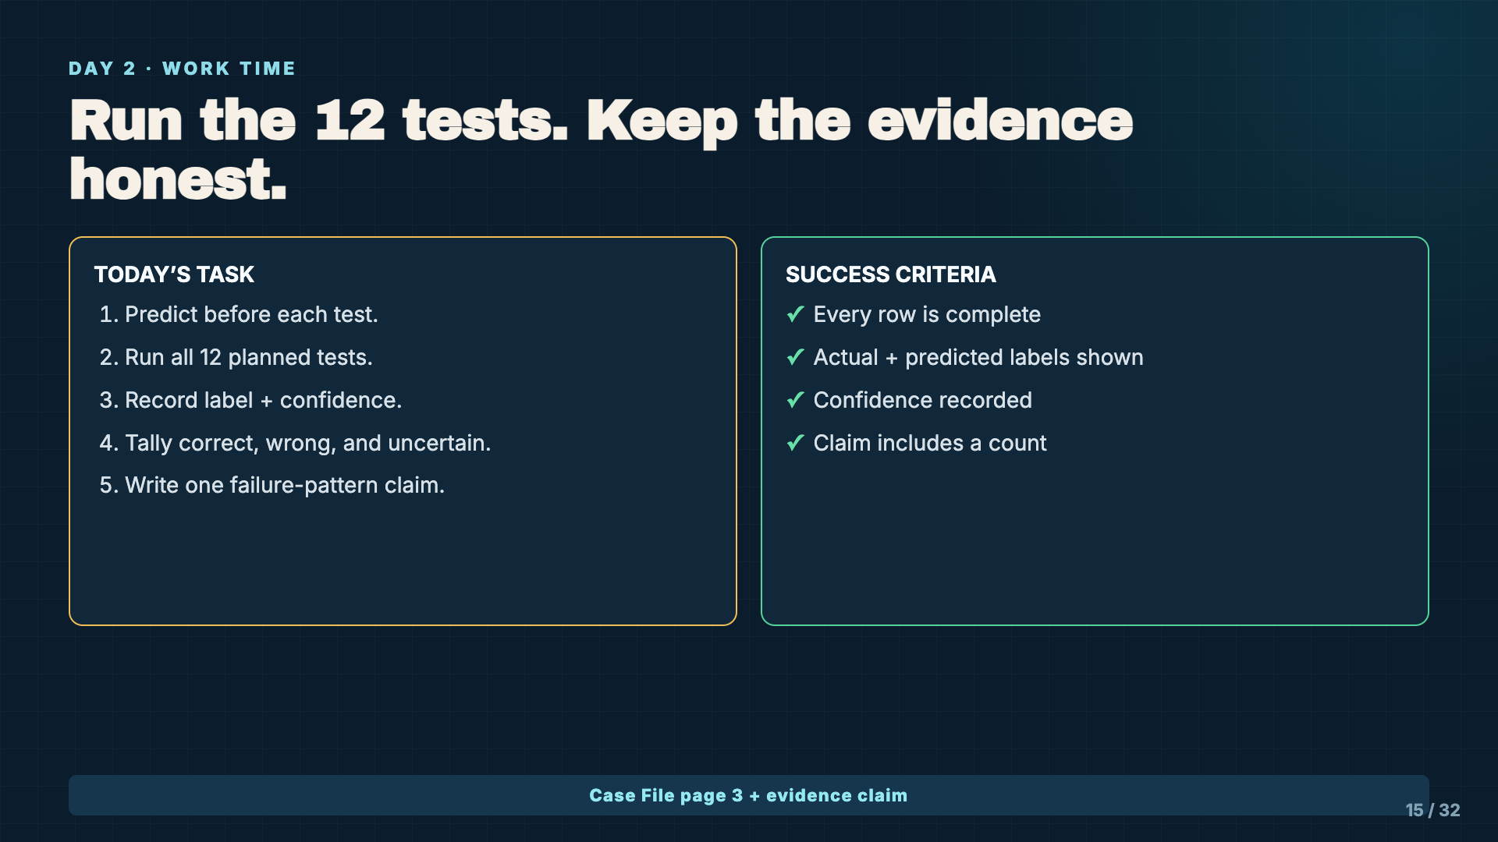
Notes:
Leave this slide projected. Watch for students rerunning a test until they get the answer they want. Repeats are allowed only when the repeat is recorded as another data point.
[Sources]
- Instructional examples and Model Reliability Case File supplied with this lesson.

Slide 16
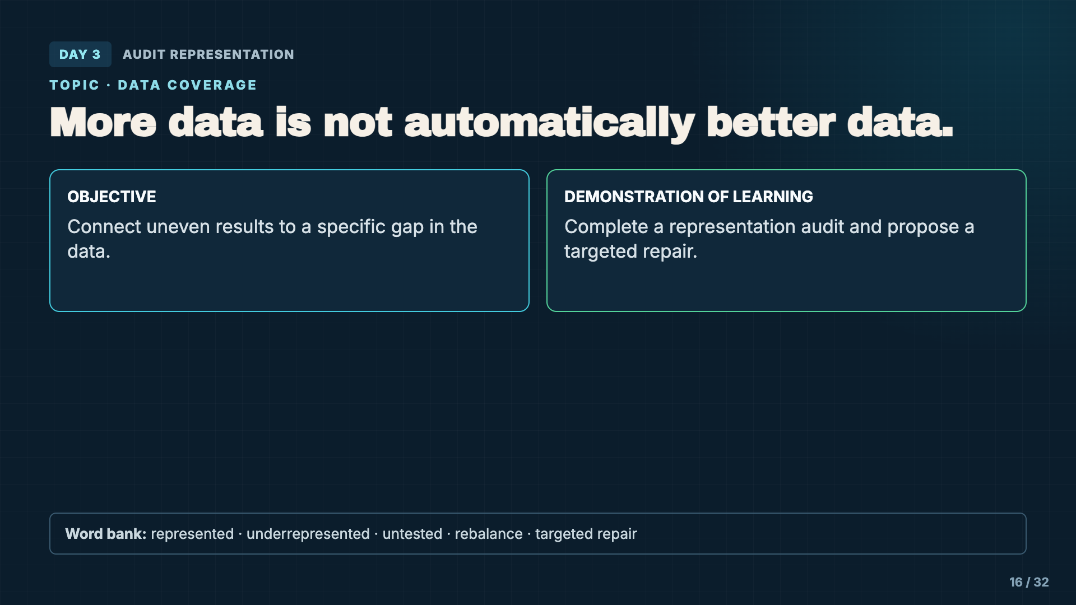
Notes:
Introduce representation as coverage: what examples and conditions are well represented, weakly represented, or missing. Keep the language tied to observable evidence.
[Sources]
- Instructional examples and Model Reliability Case File supplied with this lesson.

Slide 17
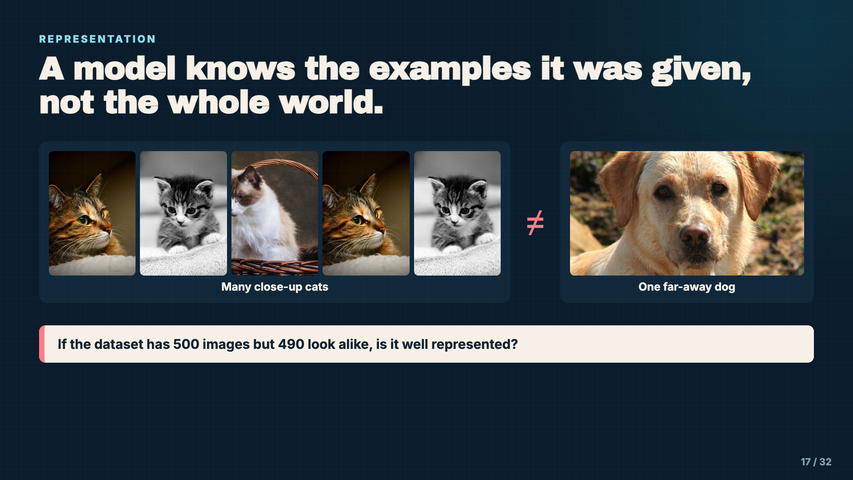
Notes:
Use this exaggerated example to distinguish quantity from coverage. Students should notice that a large dataset can still have a narrow point of view.
[Sources]
- Cat photos: https://www.flickr.com/photos/61446950@N06/12175509725; https://www.flickr.com/photos/44843078@N03/7604210572; https://www.flickr.com/photos/38621030@N07/12474422135 (CC BY 2.0)
- Dog photo: faith goble, CC BY 2.0, https://www.flickr.com/photos/24420613@N08/3506250273
- https://developers.google.com/machine-learning/crash-course/overfitting/data-characteristics

Slide 18
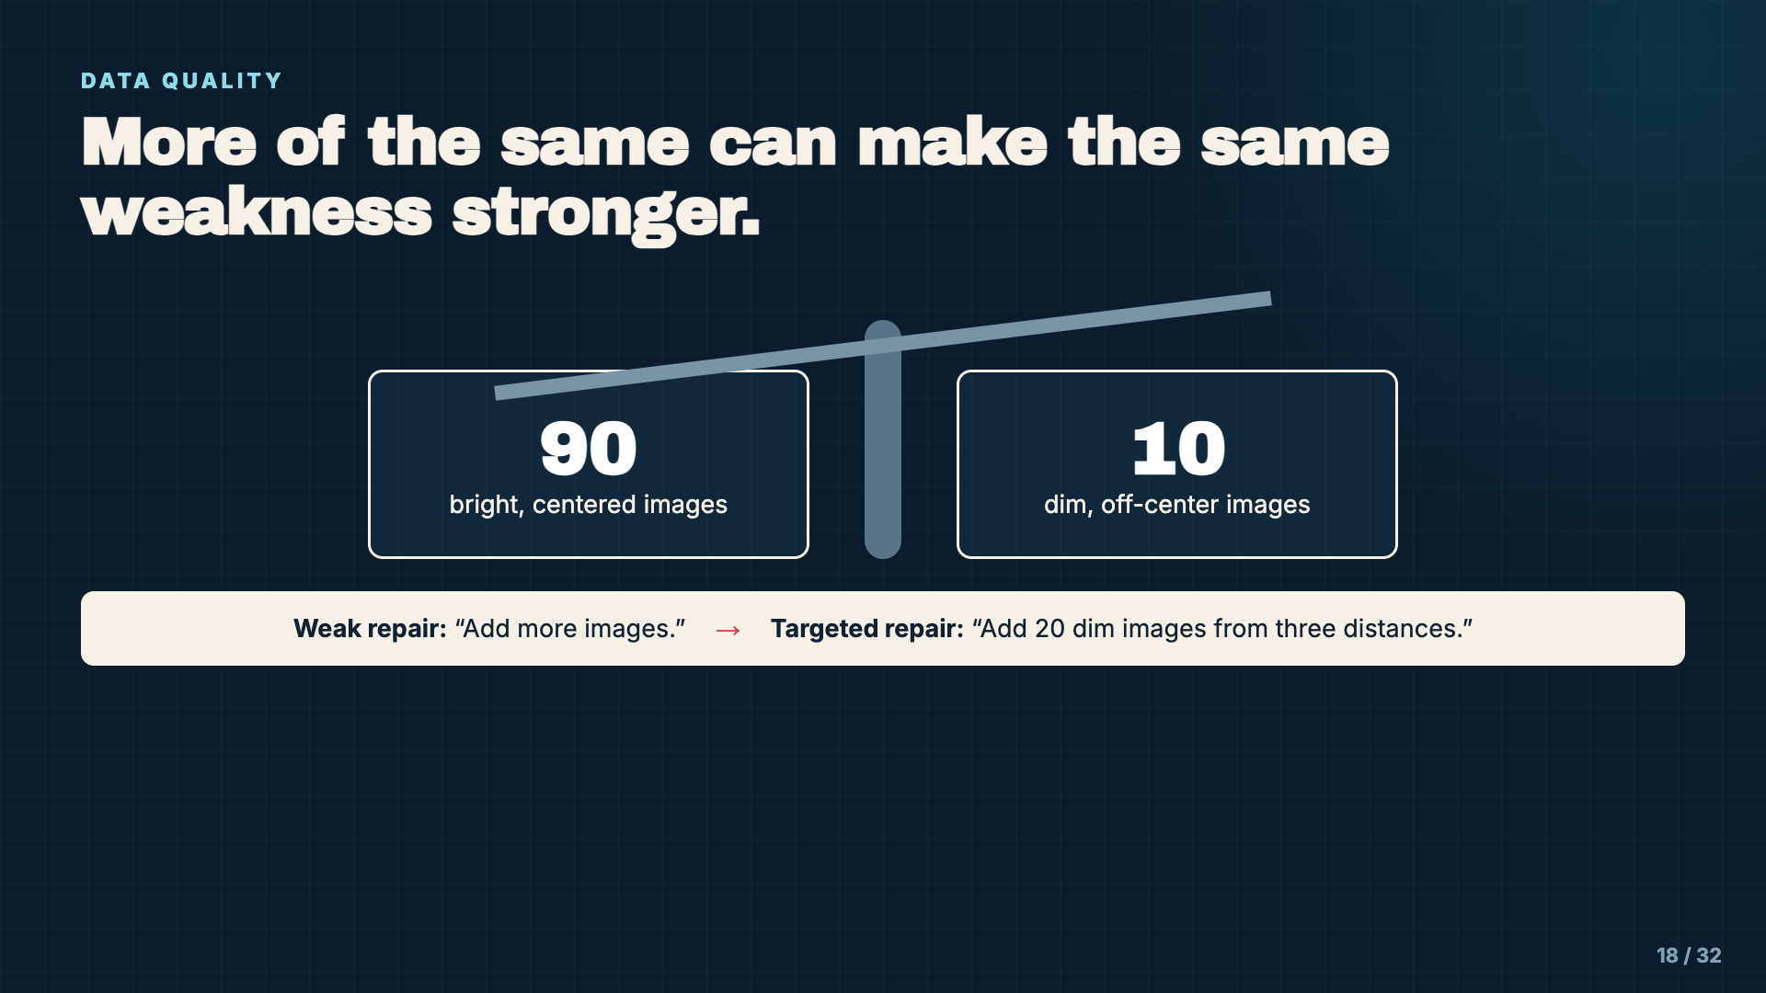
Notes:
Require repairs to name the missing or weakly represented condition. “Add more data” is not yet an actionable engineering decision.
[Sources]
- https://developers.google.com/machine-learning/crash-course/overfitting/data-characteristics

Slide 19
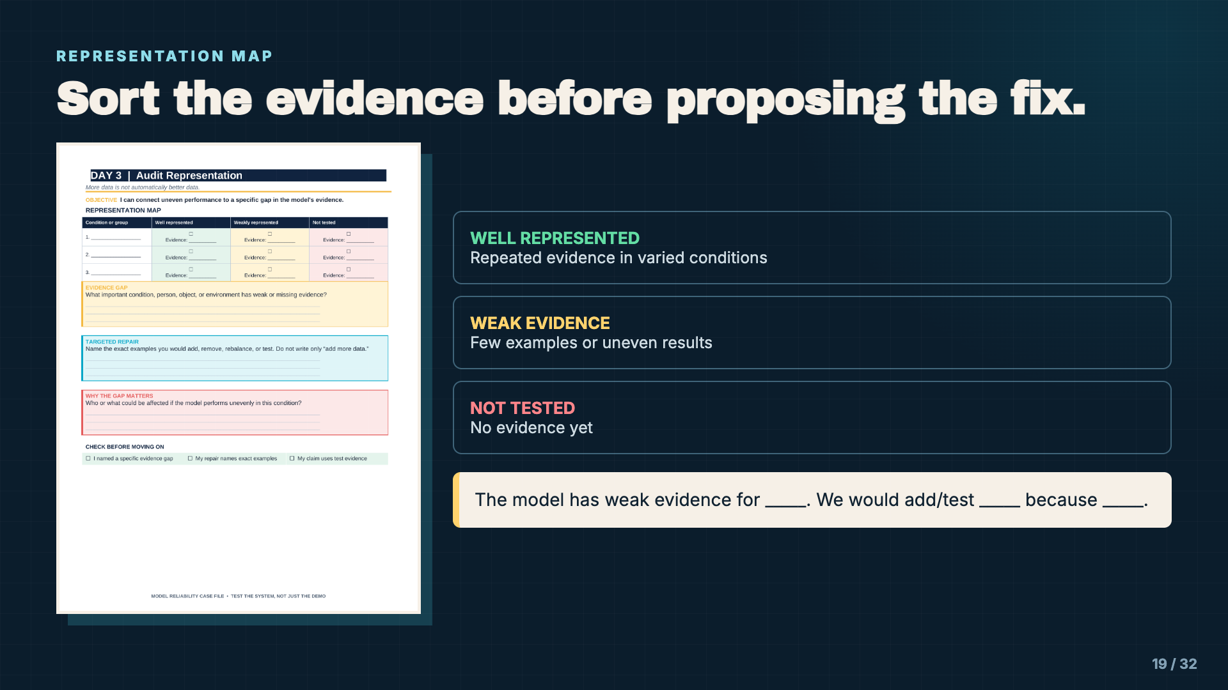
Notes:
Model one condition in each category. “Not tested” is not the same as “fails.” It means the team cannot responsibly make a claim yet.
[Sources]
- Instructional examples and Model Reliability Case File supplied with this lesson.

Slide 20
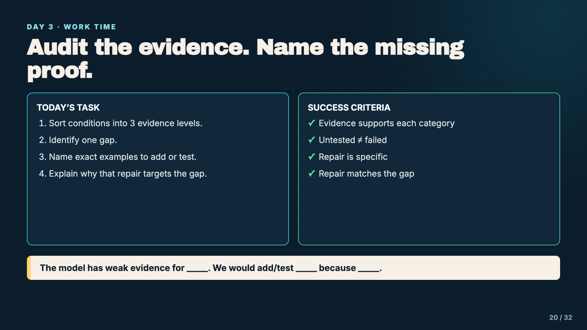
Notes:
Leave this slide projected. Push students away from generic fixes. A strong response names number, type, and condition of the examples they would add or test.
[Sources]
- Instructional examples and Model Reliability Case File supplied with this lesson.

Slide 21
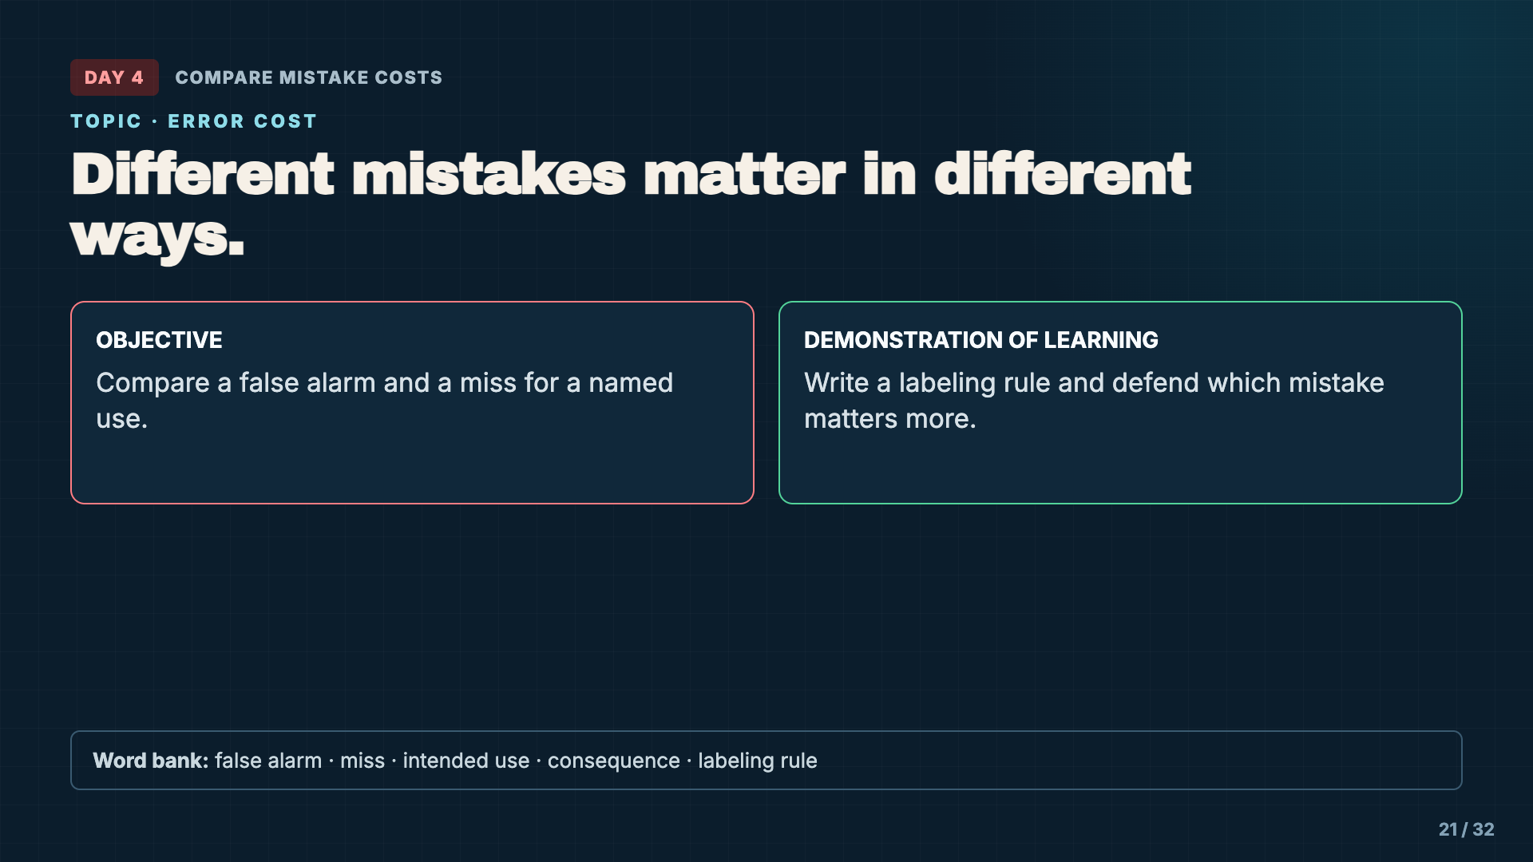
Notes:
Tell students today’s question is not simply “How accurate is it?” The intended use changes which errors matter and whether the model is acceptable.
[Sources]
- Instructional examples and Model Reliability Case File supplied with this lesson.

Slide 22
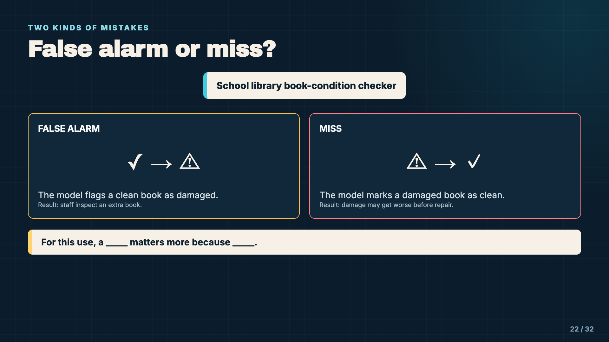
Notes:
Use the library example because both mistakes have understandable but different consequences. Do not imply that one error type is always worse. Change the intended use and the answer may change.
[Sources]
- https://developers.google.com/machine-learning/crash-course/classification/accuracy-precision-recall

Slide 23
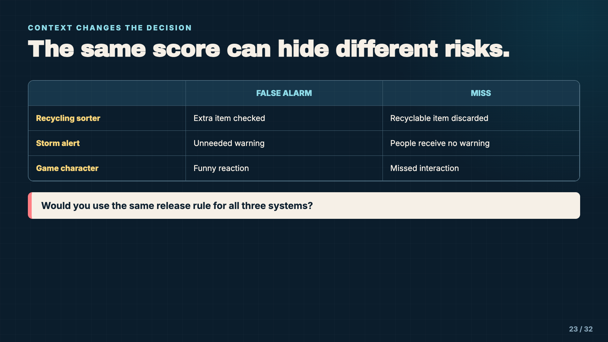
Notes:
Have pairs select one row and explain which error is more serious. Ask what evidence would be needed before release. This prepares students for restrict versus approve decisions.
[Sources]
- https://developers.google.com/machine-learning/crash-course/classification/accuracy-precision-recall
- https://airc.nist.gov/airmf-resources/airmf/3-sec-characteristics/

Slide 24
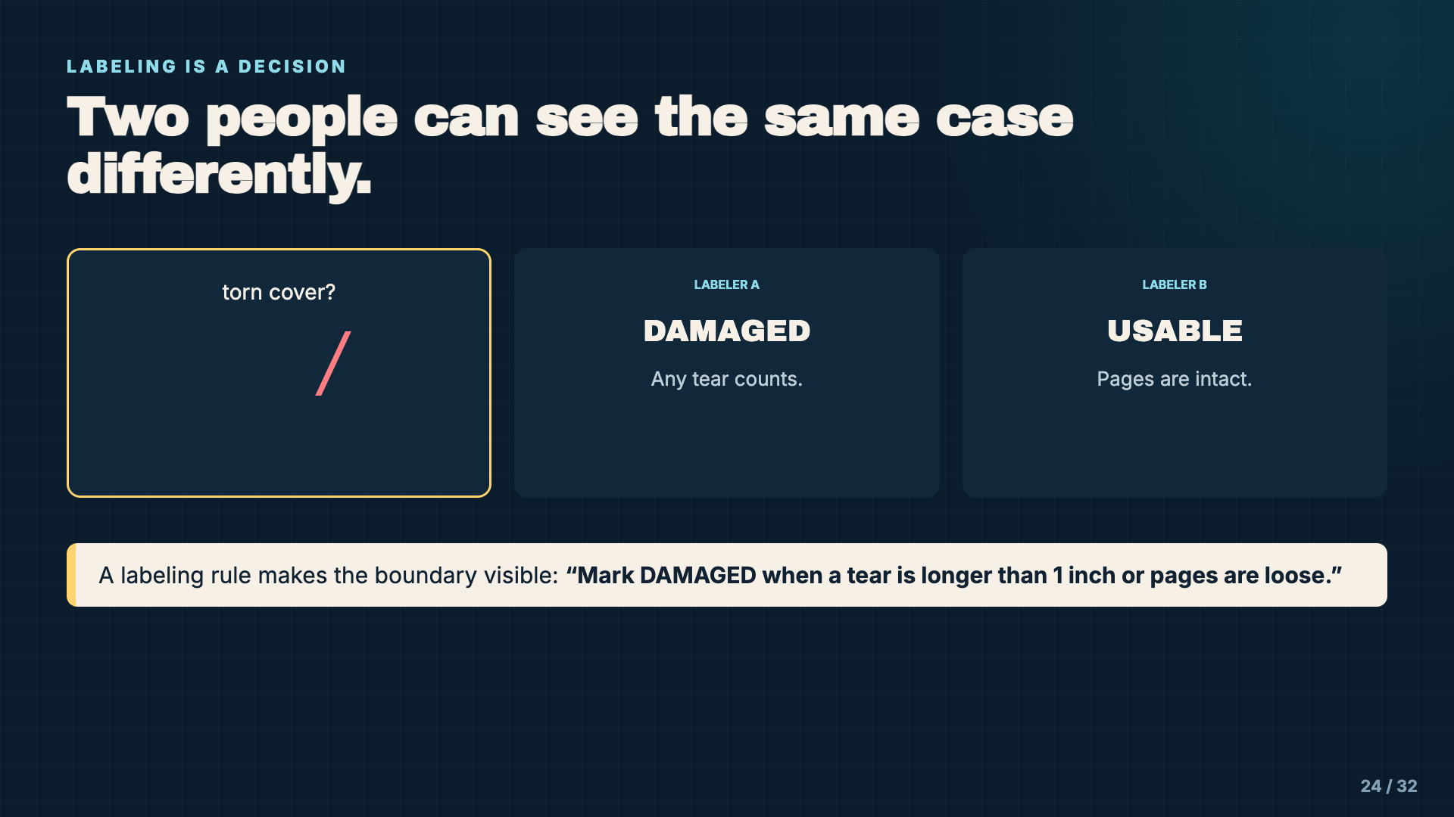
Notes:
Explain that labels are not magically objective. A clear policy reduces disagreement and makes later results easier to interpret. Students should write a rule another person could follow.
[Sources]
- https://developers.google.com/machine-learning/crash-course/overfitting/data-characteristics

Slide 25
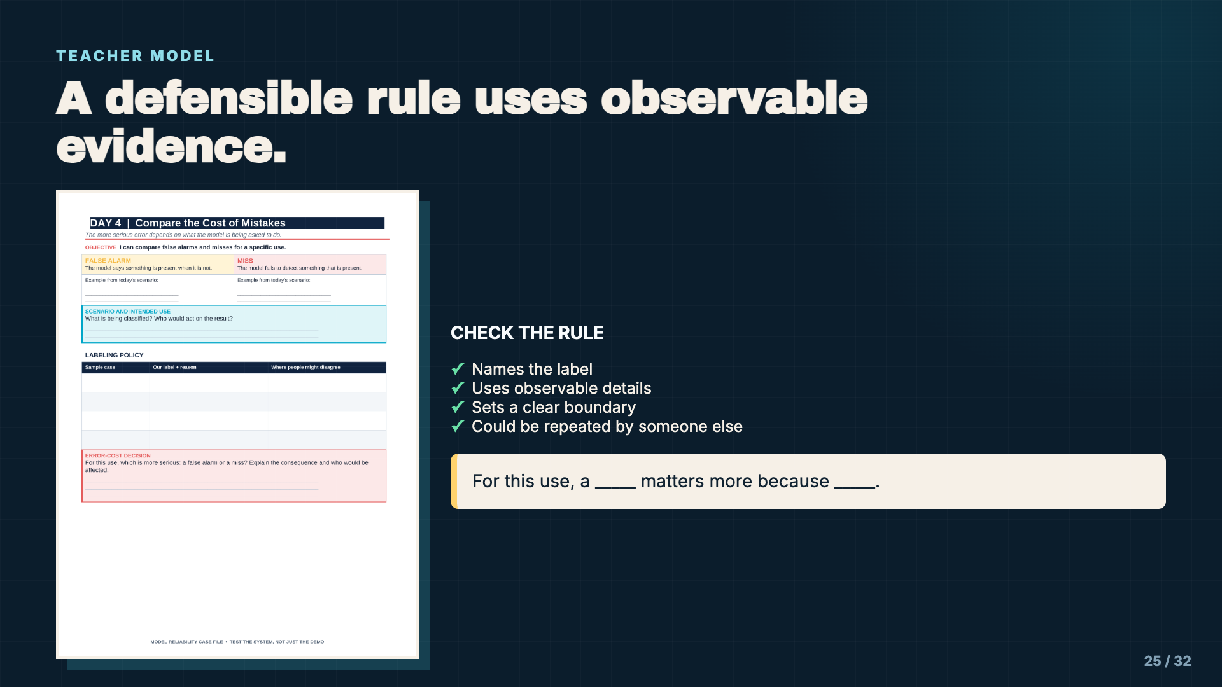
Notes:
Complete a sample policy and error-cost statement. If students use only feelings such as “it seems bad,” ask them to name the real consequence for a user.
[Sources]
- Instructional examples and Model Reliability Case File supplied with this lesson.

Slide 26
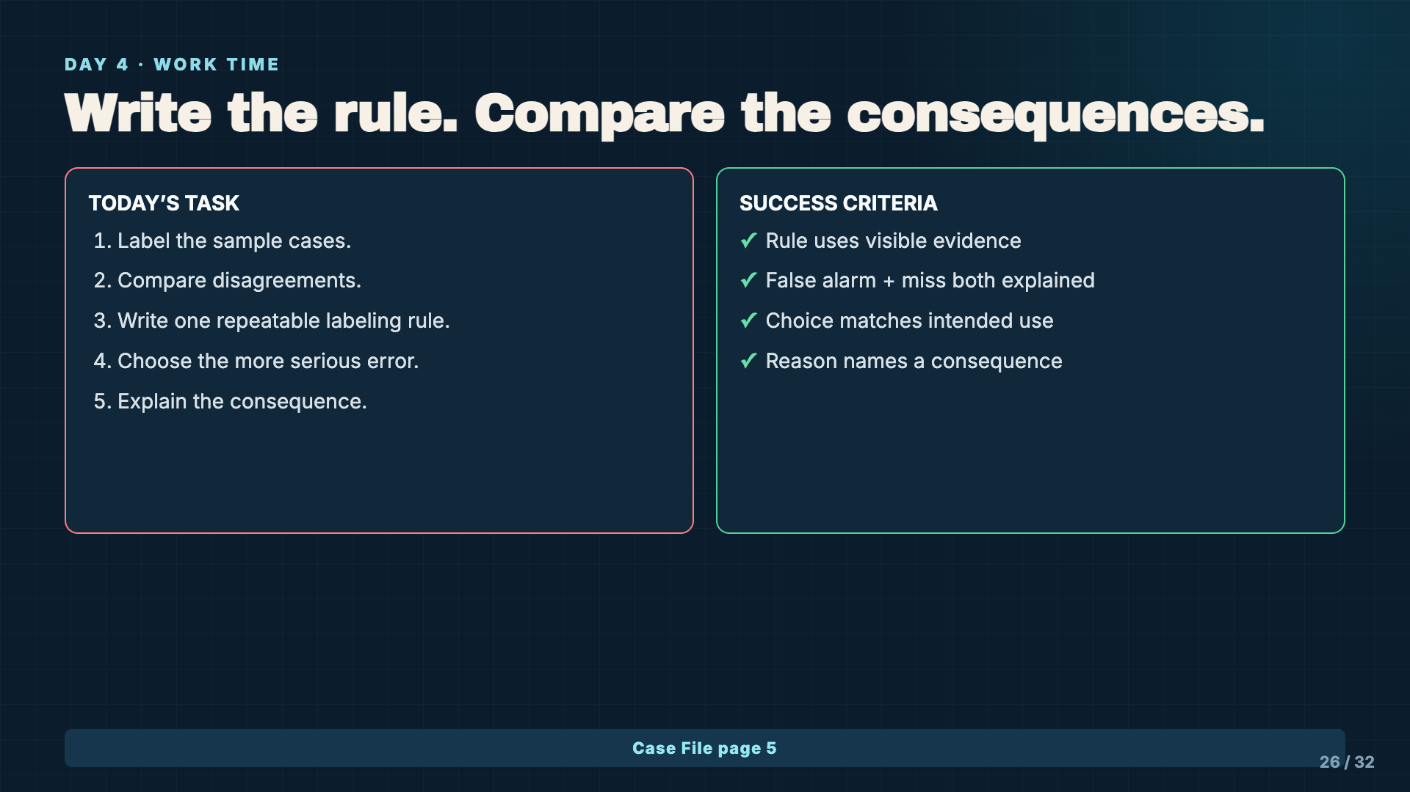
Notes:
Leave this slide projected. A student may choose either error as more serious if the reasoning matches the intended use and the consequence is plausible.
[Sources]
- Instructional examples and Model Reliability Case File supplied with this lesson.

Slide 27
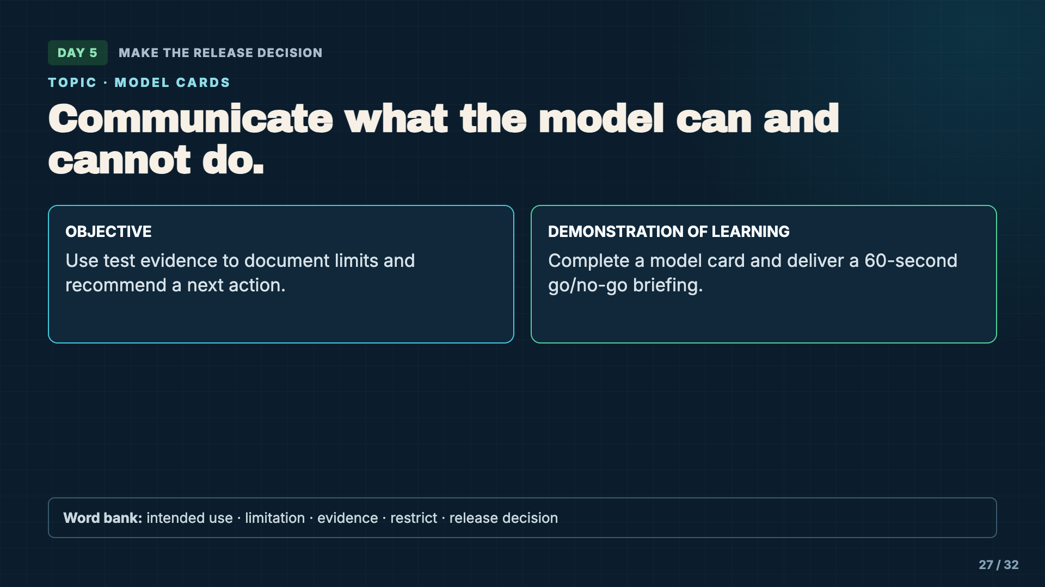
Notes:
Today students synthesize rather than run new tests. A responsible decision states the model’s intended use, known limits, and the exact next action.
[Sources]
- Instructional examples and Model Reliability Case File supplied with this lesson.

Slide 28
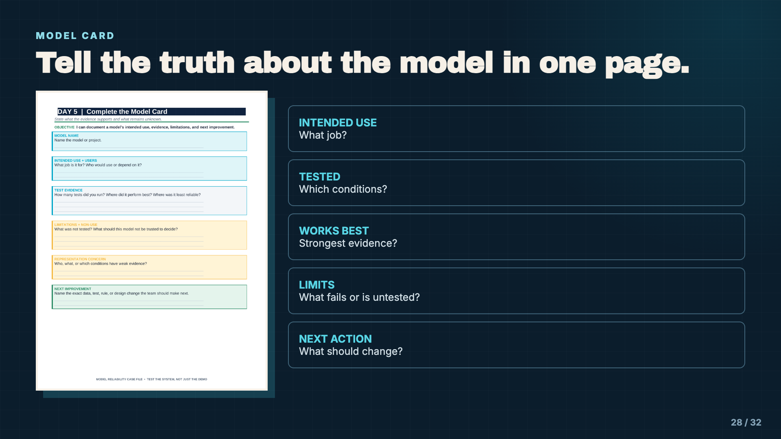
Notes:
Model cards do not prove a model is safe or fair. They make the intended use, evidence, and limits visible so another person can make a more informed decision.
[Sources]
- https://airc.nist.gov/airmf-resources/airmf/3-sec-characteristics/

Slide 29
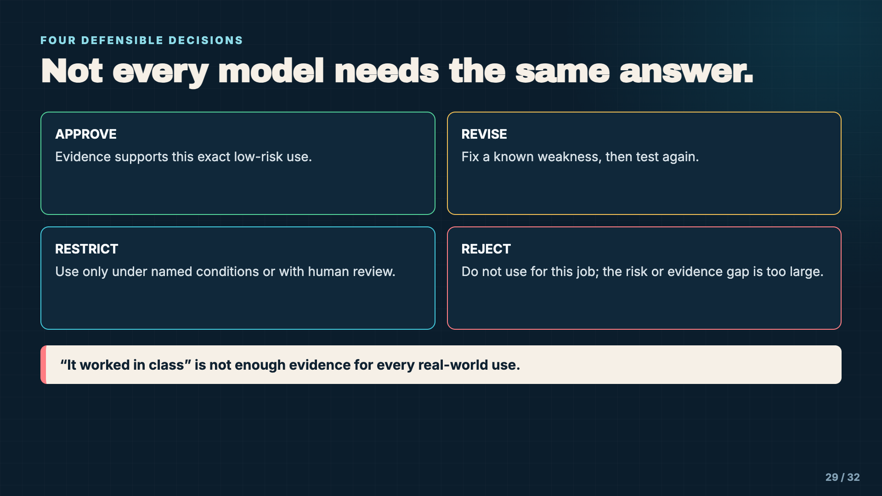
Notes:
Clarify that reject applies to the model for the named use, not necessarily to all models or all future revisions. Restrict is often the most responsible conclusion when evidence supports only a narrow use.
[Sources]
- https://airc.nist.gov/airmf-resources/airmf/3-sec-characteristics/

Slide 30
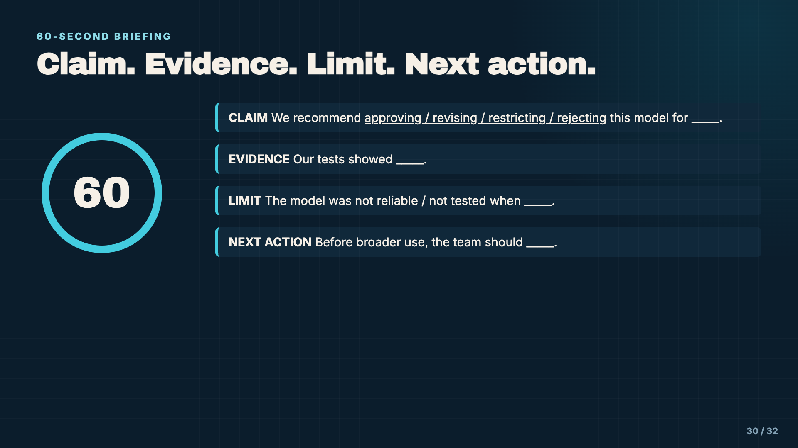
Notes:
Give partners one minute to rehearse before presentations. The briefing is not a sales pitch. Students should name a limitation even when they recommend approval.
[Sources]
- Instructional examples and Model Reliability Case File supplied with this lesson.

Slide 31
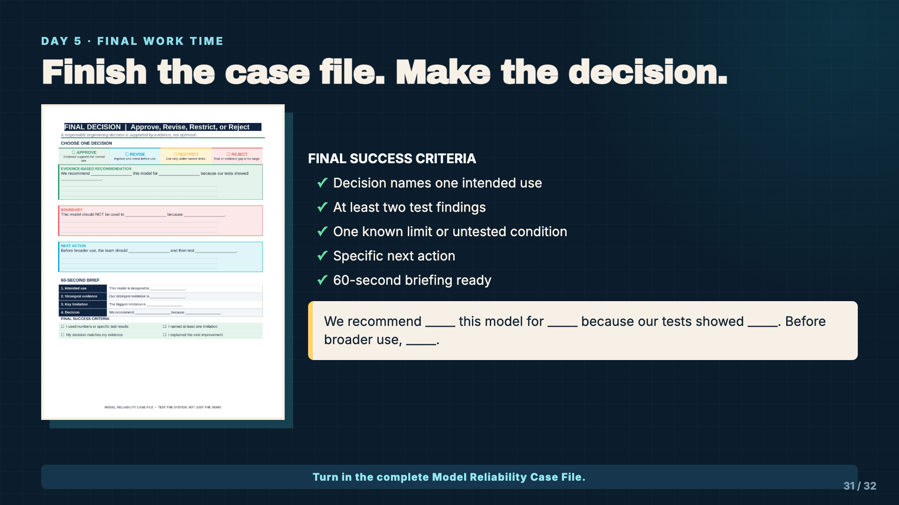
Notes:
Leave this slide projected. Check that the decision is about a named use. Students should not write “AI is good” or “AI is bad”; they are evaluating one system for one purpose.
[Sources]
- Instructional examples and Model Reliability Case File supplied with this lesson.

Slide 32
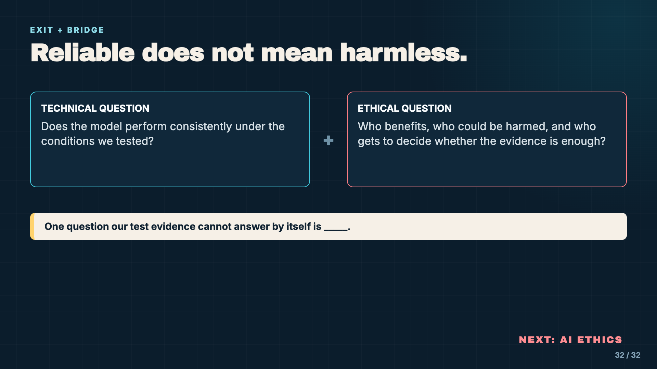
Notes:
Close by distinguishing technical reliability from broader ethical acceptability. Ask students to carry one unresolved question into the AI Ethics unit. Reliability evidence informs an ethical decision; it does not replace one.
[Sources]
- https://airc.nist.gov/airmf-resources/airmf/3-sec-characteristics/

