Slide 1
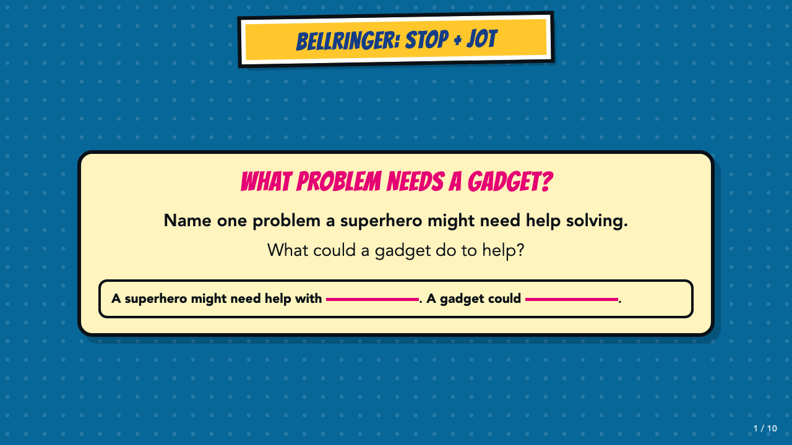
Notes:
Give students two quiet minutes for the Stop and Jot, then invite two or three examples. Accept imaginative problems and impossible gadget ideas.
[Sources]
- Smart Solutions Comics Lesson 3 owner-approved student and teacher materials, revised 2026-08-19.

Slide 2
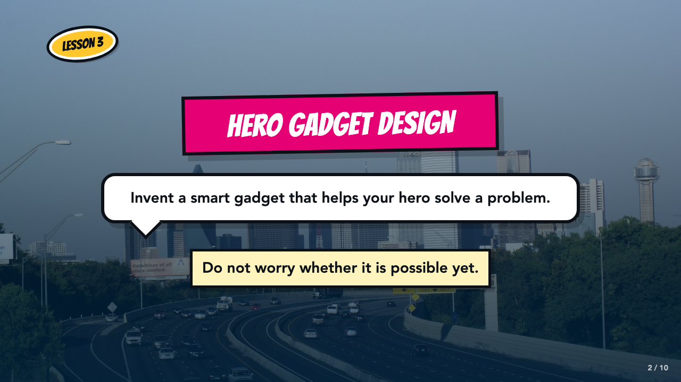
Notes:
Set the creative contract: invent a smart gadget that solves a problem. Do not evaluate feasibility today.
[Sources]
- Smart Solutions Comics Lesson 3 owner-approved student and teacher materials, revised 2026-08-19.

Slide 3
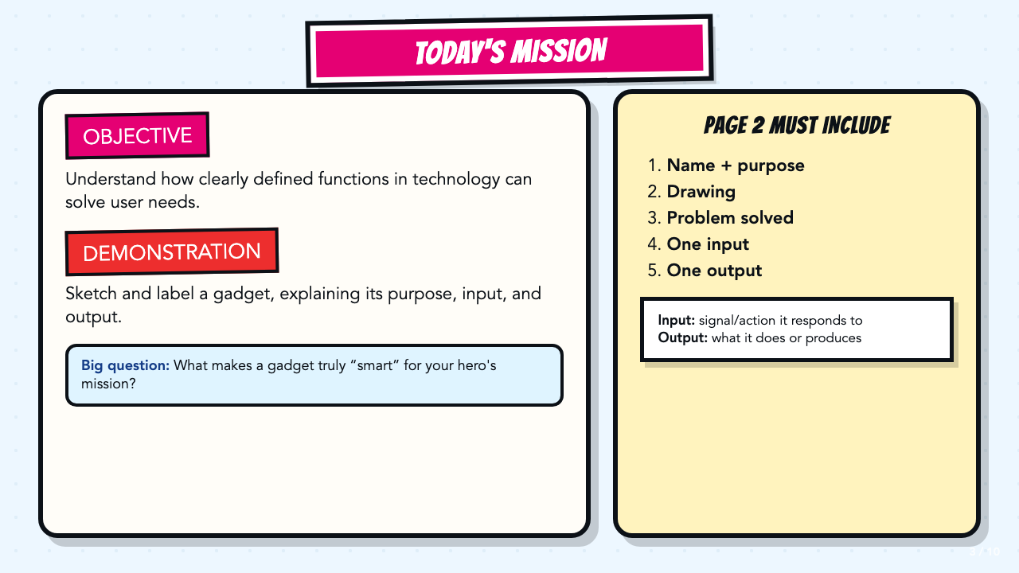
Notes:
Read the original objective and demonstration aloud. Define input and output briefly; do not introduce a process chain.
[Sources]
- Smart Solutions Comics Lesson 3 owner-approved student and teacher materials, revised 2026-08-19.

Slide 4
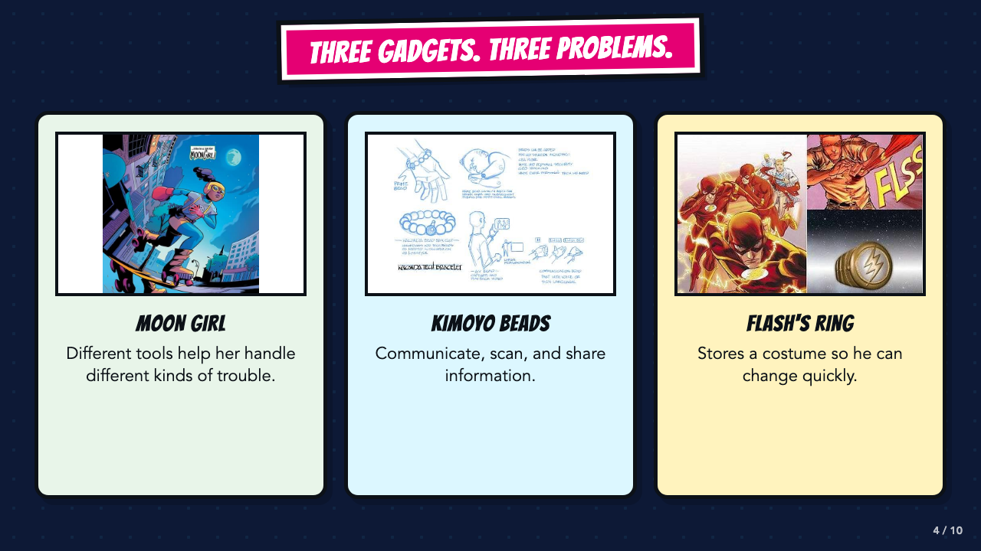
Notes:
Connect each example to a job or problem. The examples are inspiration, not technical models students must copy.
[Sources]
- Smart Solutions Comics Lesson 3 owner-approved student and teacher materials, revised 2026-08-19.
- The Flash #763, DC official issue page describing the Flash ring: https://www.dc.com/comics/the-flash-2016/the-flash-763
- Wakanda's Tech Today, Marvel official description of Kimoyo beads: https://www.marvel.com/articles/comics/wakanda-s-tech-today-the-reviews-are-in

Slide 5
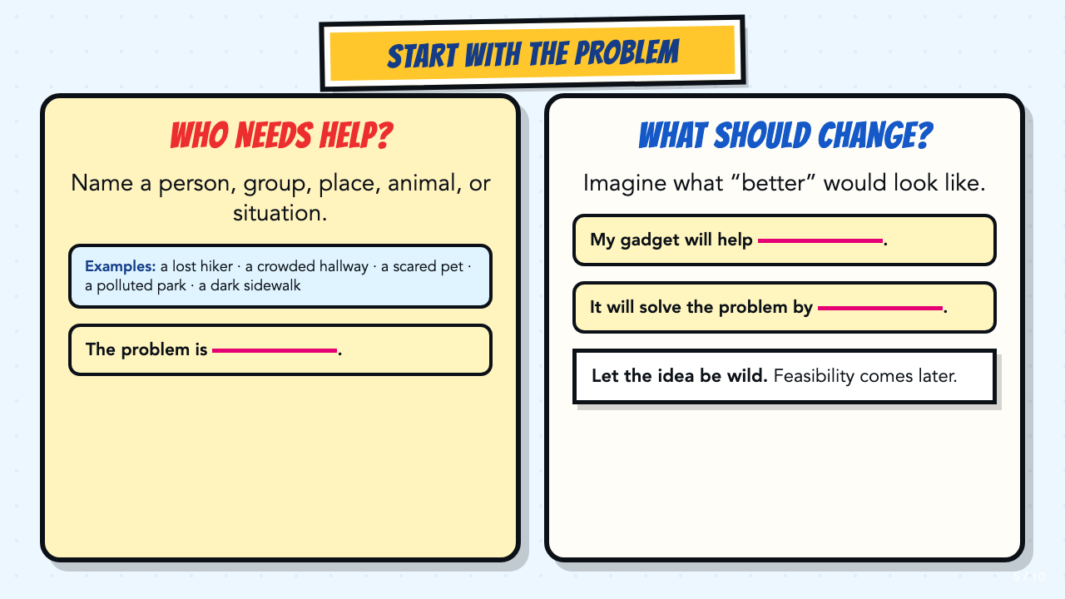
Notes:
Have students name the problem before naming the gadget. If they are stuck, use the examples on screen.
[Sources]
- Smart Solutions Comics Lesson 3 owner-approved student and teacher materials, revised 2026-08-19.

Slide 6
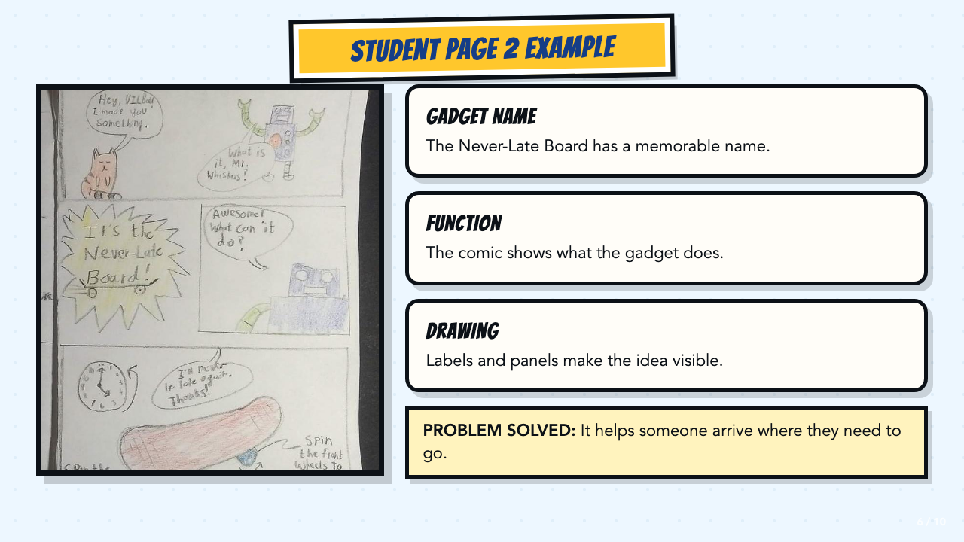
Notes:
Point out the gadget name, function, drawing, and problem solved. Drawing skill is not the goal.
[Sources]
- Smart Solutions Comics Lesson 3 owner-approved student and teacher materials, revised 2026-08-19.
- Authentic student Page 2 work supplied by the course author.

Slide 7
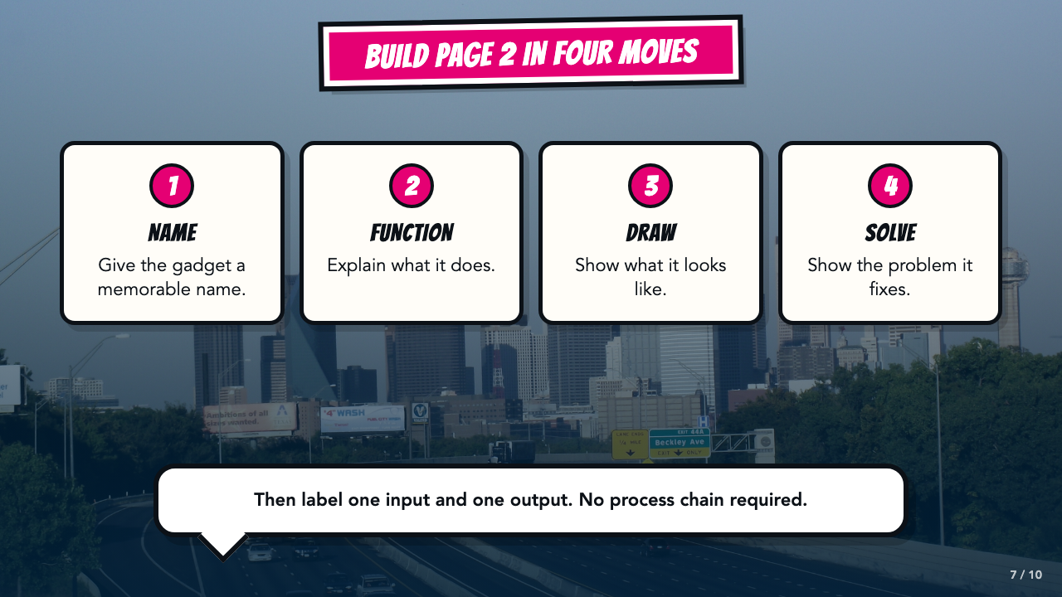
Notes:
Preview the four creative moves, then add one input and one output label. Skip process rules.
[Sources]
- Smart Solutions Comics Lesson 3 owner-approved student and teacher materials, revised 2026-08-19.

Slide 8
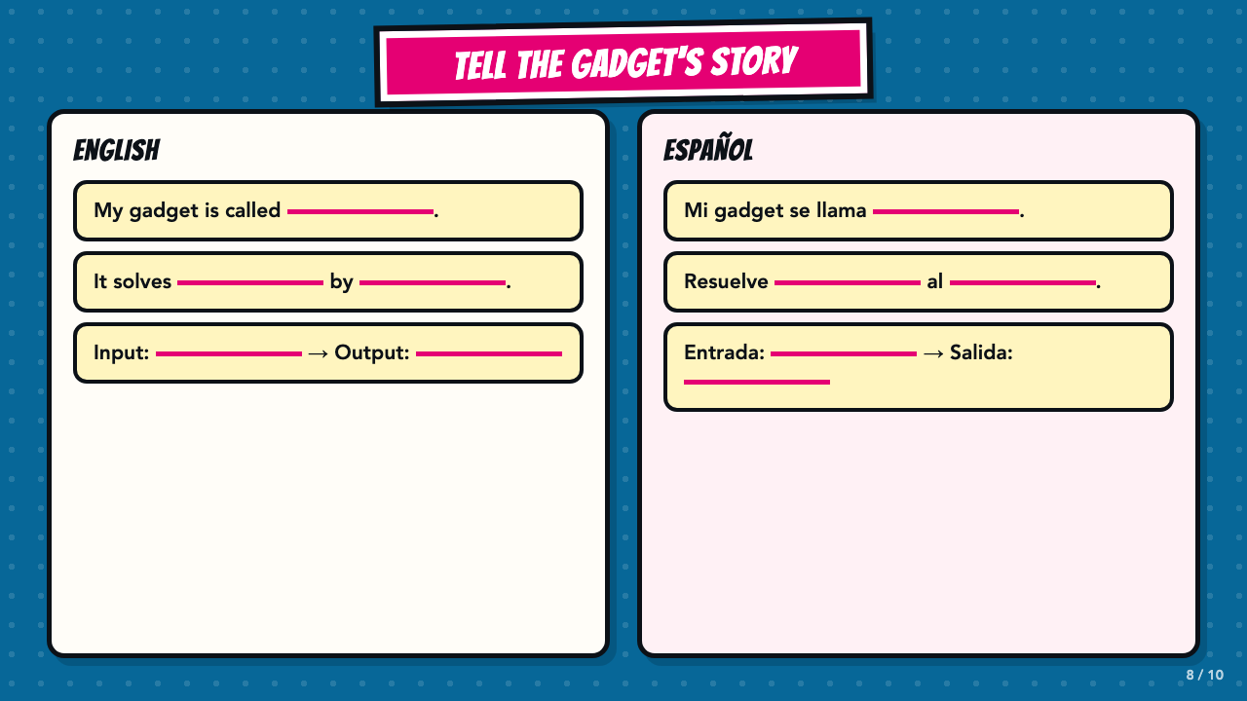
Notes:
Keep these bilingual stems visible for oral rehearsal. Students name a problem, input, and output.
[Sources]
- Smart Solutions Comics Lesson 3 owner-approved student and teacher materials, revised 2026-08-19.

Slide 9
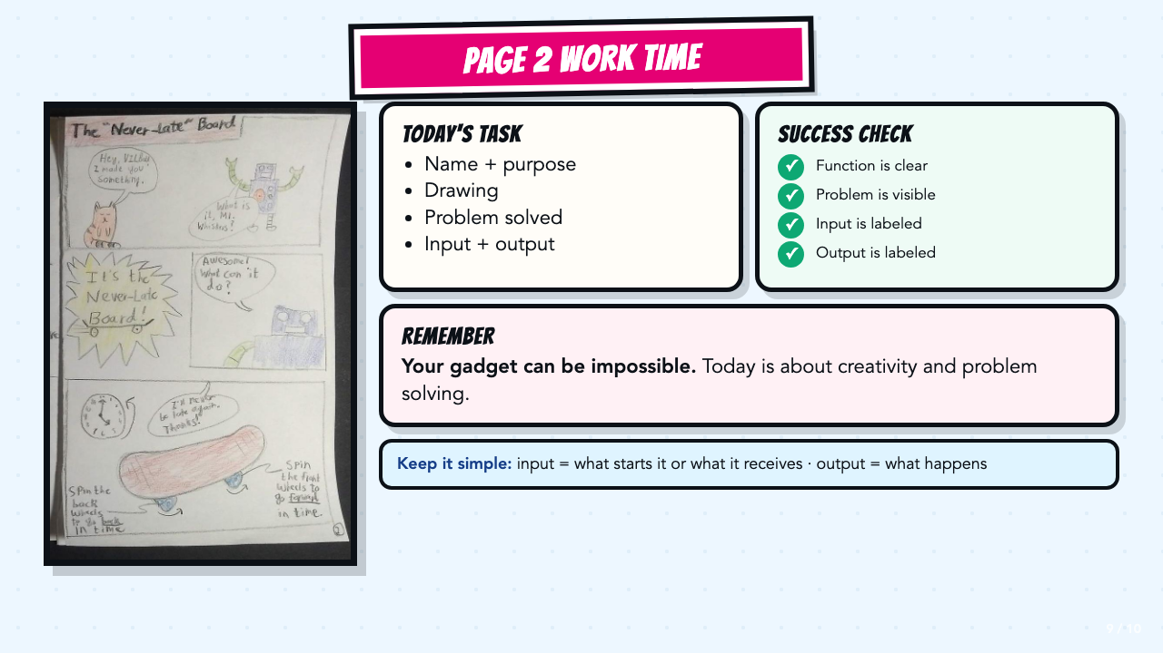
Notes:
Leave this slide projected during work time. Require a simple input and output, not a full system chain.
[Sources]
- Smart Solutions Comics Lesson 3 owner-approved student and teacher materials, revised 2026-08-19.
- Authentic student Page 2 work supplied by the course author.

Slide 10
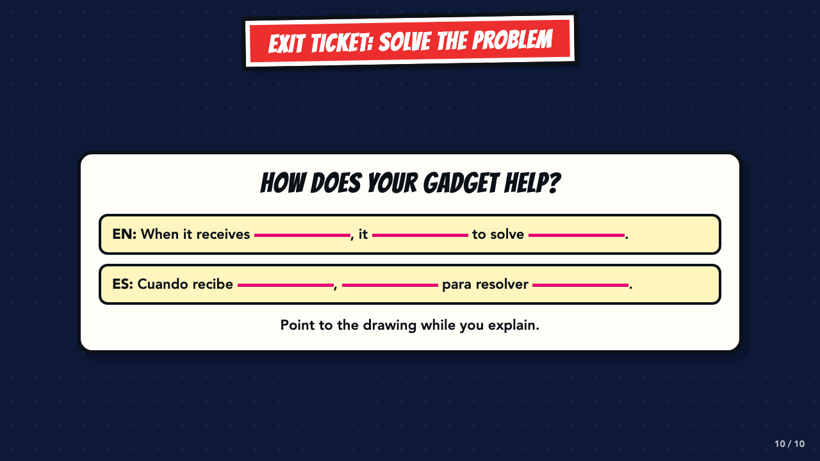
Notes:
Use this as an oral or written exit ticket. Listen for purpose, input, output, and a problem solved.
[Sources]
- Smart Solutions Comics Lesson 3 owner-approved student and teacher materials, revised 2026-08-19.

