Slide 1

Design a Pop Art T-shirt
Paths, shapes, and colors in Canva
Bright colors.
Repeating shapes.
Bold text.
Strong borders.
Today your name tag idea moves from paper to Canva.
Notes:
About 50 minutes. This is student Lesson 3 in Canvas and facilitator-guide Lesson 4, because the Read Visual Design video sits between Lessons 2 and 3. Students make a T-shirt graphic in Canva, not a printed shirt. Name the four features while pointing to the artwork: flat bright color, repeated printing dots, bold lettering, and thick outlines. Every one of them returns in the assignment. Keep this to 1 minute.
[Sources]
Student task: Verizon Canvas course 23402, assignment 1183366 (Lesson 3: Paths, Shapes, and Colors), module item 2634024, read September 15, 2026. Teaching sequence: Elisha Lucero, September 15, 2026 brief and the current lesson tutorial narration. Standard: innovative-technology-site/docs/SLIDE_AUTHORING_STANDARD.md and the approved Lesson 1/2 exemplars.
Artwork: POP! comic burst, retained from the user-supplied Unit 1 DPI 2026 teaching materials (source-9.png). Rights remain with the creator; no open license is asserted.

Slide 2
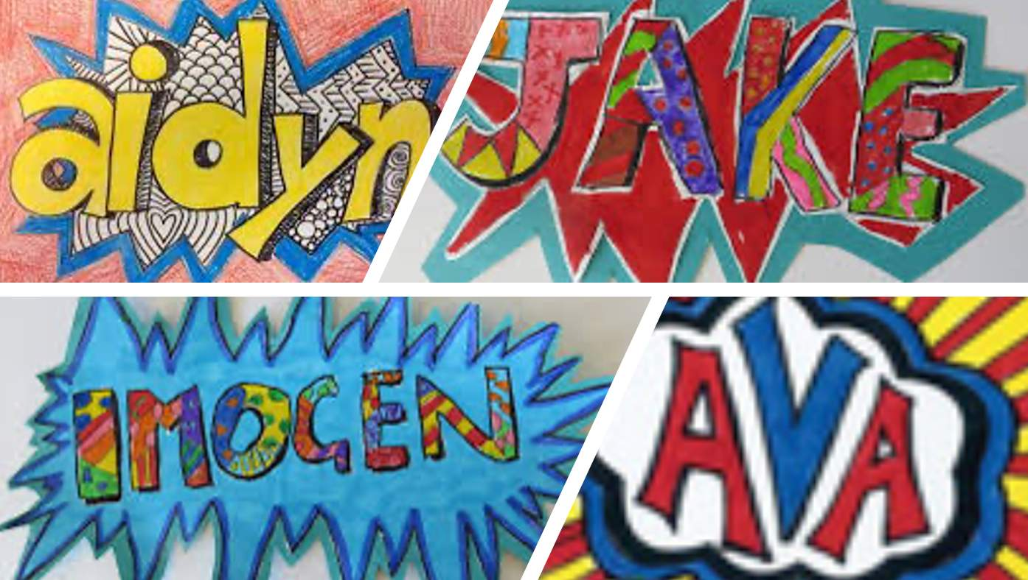
As you enter
Look at your Lesson 1 name tag. Which Pop Art features did you use?
My name tag uses ______
and ______.
bright colors · repeating dots · strong borders · bold text
Today you rebuild that idea in Canva
as a T-shirt graphic.
Student name tags from Lesson 1
Notes:
Bell ringer, 2 minutes. Students find their Lesson 1 name tag photo in Canvas or picture it, then finish the stem out loud or on a notecard. Take two or three responses and point to the matching feature in the examples. Then say the bridge: the same word or name, the same energy, now built in Canva. This is the one planned opening discussion; the middle of the lesson is teacher explanation with visible examples.
[Sources]
Student task: Verizon Canvas course 23402, assignment 1183366 (Lesson 3: Paths, Shapes, and Colors), module item 2634024, read September 15, 2026. Teaching sequence: Elisha Lucero, September 15, 2026 brief and the current lesson tutorial narration. Standard: innovative-technology-site/docs/SLIDE_AUTHORING_STANDARD.md and the approved Lesson 1/2 exemplars.
Name-tag examples: user-supplied classroom materials (source-56.jpg), also used on the approved Lesson 1 work slide.

Slide 3
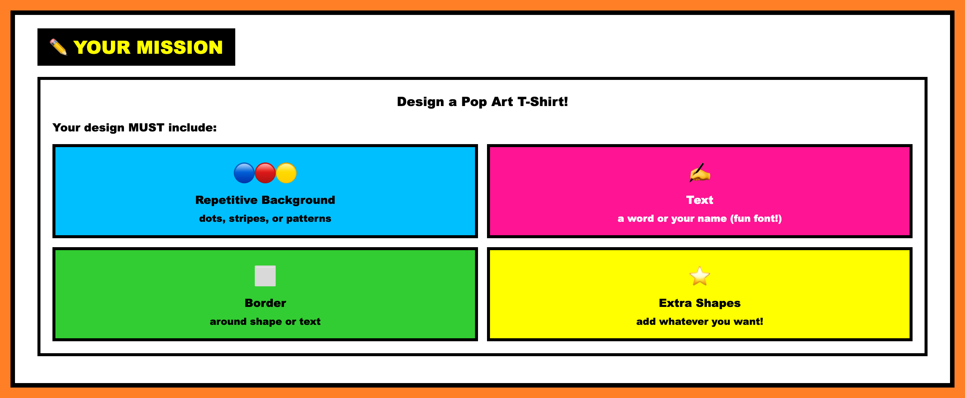
Your mission
Start from
your name tag.
Same word or name.
Same energy.
Now in Canva, sized for a shirt.
Level up: make four copies and change the colors on each one, like Warhol.
Required
1 A repeating background: dots, stripes, or a pattern
2 Text: a word or your name in a fun font
3 A border around a shape or the text
4 Extra shapes if you want them
Notes:
1 minute. Read the four required parts from the mission box. Point out that the name-tag idea already gives students the word and the feeling; today the tools change. Extra shapes are optional. Do not require a shirt mockup; the graphic itself is the product. The level-up (four color versions submitted as one panel) is the existing extension in Canvas, not a new requirement.
[Sources]
Student task: Verizon Canvas course 23402, assignment 1183366 (Lesson 3: Paths, Shapes, and Colors), module item 2634024, read September 15, 2026. Teaching sequence: Elisha Lucero, September 15, 2026 brief and the current lesson tutorial narration. Standard: innovative-technology-site/docs/SLIDE_AUTHORING_STANDARD.md and the approved Lesson 1/2 exemplars.
Mission box: rendered from the live Canvas assignment HTML (assignment 1183366), September 15, 2026, so the projected version matches what students see on their page.

Slide 4
Primary, secondary, tertiary
Pop Art favorites: the primaries, plus black outlines.
Primary
Red, yellow, blue. You cannot mix them from other colors.
Secondary
Orange, green, purple. Two primaries mixed.
Tertiary
Red-orange, blue-green, and more. A primary plus its neighbor.
Notes:
2 minutes. Point around the wheel. The three largest circles are the primaries. The middle-sized circles sit between two primaries and are made by mixing them. The small circles sit between a primary and a secondary. Pop Art often uses the primaries side by side, separated by black outlines, which is why the comic look feels so loud. Students will use these names in the next comparison; they do not need to memorize every tertiary name. On the next slide, ask them to choose before you reveal.
[Sources]
Student task: Verizon Canvas course 23402, assignment 1183366 (Lesson 3: Paths, Shapes, and Colors), module item 2634024, read September 15, 2026. Teaching sequence: Elisha Lucero, September 15, 2026 brief and the current lesson tutorial narration. Standard: innovative-technology-site/docs/SLIDE_AUTHORING_STANDARD.md and the approved Lesson 1/2 exemplars.
Color wheel: original teaching diagram. Traditional red-yellow-blue painter's wheel used in art classrooms; it is a classroom model, not the printer's CMY model.

Slide 5
Same design, different colors
Which one shouts? Which one feels calmer? What changed?
A
B
ZAP!
ZAP!
Three primaries
Three secondaries
Same shapes, same word. Only the colors changed. Primaries shout; secondaries feel softer.
Notes:
Comparison, 2 minutes. Keep both posters visible. Students vote A or B for “shouts,” then say what changed. Click once to reveal both labels and the explanation. Point out that nothing moved: same dot field, same burst, same word. A uses the three primaries; B uses the three secondaries. Then say the practical version: in Canva, a Pop Art element has a few color circles, and changing them changes the whole feeling. A student who reads the moods differently should name the visible cue. The labels show the intended reading, not a rule.
[Sources]
Student task: Verizon Canvas course 23402, assignment 1183366 (Lesson 3: Paths, Shapes, and Colors), module item 2634024, read September 15, 2026. Teaching sequence: Elisha Lucero, September 15, 2026 brief and the current lesson tutorial narration. Standard: innovative-technology-site/docs/SLIDE_AUTHORING_STANDARD.md and the approved Lesson 1/2 exemplars.
Posters: original editable teaching diagrams built from native shapes. The reveal uses the same one-click exit animation as the approved Lesson 2 deck.

Slide 6
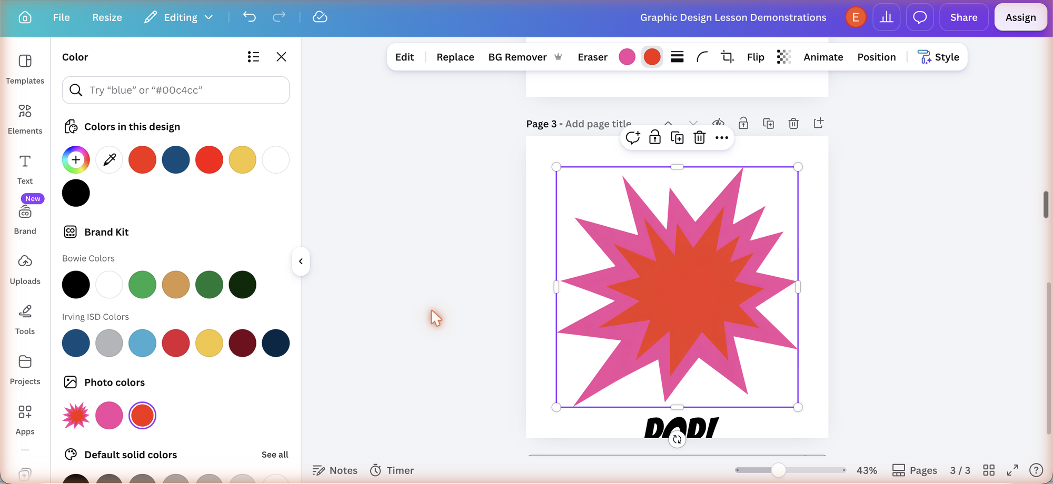
Change a color in Canva
Each color circle in the toolbar is one color in the element.
1
Click the element you want to change.
2
Click a color circle in the toolbar.
3
Pick a color, or type a hex code such as 1955DB in the search box.
4
Repeat for each circle. Three circles means three colors.
Real Colors panel, school account, September 15, 2026
Pop Art tip: keep one circle black or very dark so the outline stays strong.
Notes:
2 minutes, then model it live. Point to the ring: the circles at the left of the toolbar are the element's colors. Clicking one opens the Colors panel shown here. Colors in this design and the brand kit are quick picks; the search box takes a color name or a hex code. Recolor one circle at a time so students see the effect of each change. A pop art element found through Elements search usually has two to four circles. Tell students to keep black or a very dark color for outlines so the design keeps its comic edge.
[Sources]
Student task: Verizon Canvas course 23402, assignment 1183366 (Lesson 3: Paths, Shapes, and Colors), module item 2634024, read September 15, 2026. Teaching sequence: Elisha Lucero, September 15, 2026 brief and the current lesson tutorial narration. Standard: innovative-technology-site/docs/SLIDE_AUTHORING_STANDARD.md and the approved Lesson 1/2 exemplars.
Canva screenshots: Graphic Design Lesson Demonstrations design, Bowie Middle School account, captured September 7 and September 15, 2026. Labels can differ by account and release; recheck before teaching. This capture shows a pop art burst from the Elements search with the Colors panel open after one circle was changed to yellow.

Slide 7
Repeat a shape to make a background
Copy and paste builds a pattern fast.
1
Elements, then Shapes. Add one circle.
1
2
Copy and paste it three times. Line them up.
2
3
Select the whole row. Copy and paste to add rows.
Shortcut: Cmd or Ctrl + C, then Cmd or Ctrl + V.
Or search Elements for “pop art dots” and use a ready-made pattern.
3
Notes:
3 minutes, then let students try it for a minute. Model one circle, three pastes, then select the row by dragging across it and paste again. Pasted copies land slightly offset; drag each one into line and use Canva's alignment guides. Duplicate (the copy icon above a selected element) does the same job. Students may also start with a ready-made dot, stripe, or halftone pattern from Elements; the requirement is a repeating background, not hand-built dots. If the pattern covers the word later, fix the layer order with Position, then Layers.
[Sources]
Student task: Verizon Canvas course 23402, assignment 1183366 (Lesson 3: Paths, Shapes, and Colors), module item 2634024, read September 15, 2026. Teaching sequence: Elisha Lucero, September 15, 2026 brief and the current lesson tutorial narration. Standard: innovative-technology-site/docs/SLIDE_AUTHORING_STANDARD.md and the approved Lesson 1/2 exemplars.
Stages: original editable diagram of one circle, a row of four, and a four-by-four grid.

Slide 8
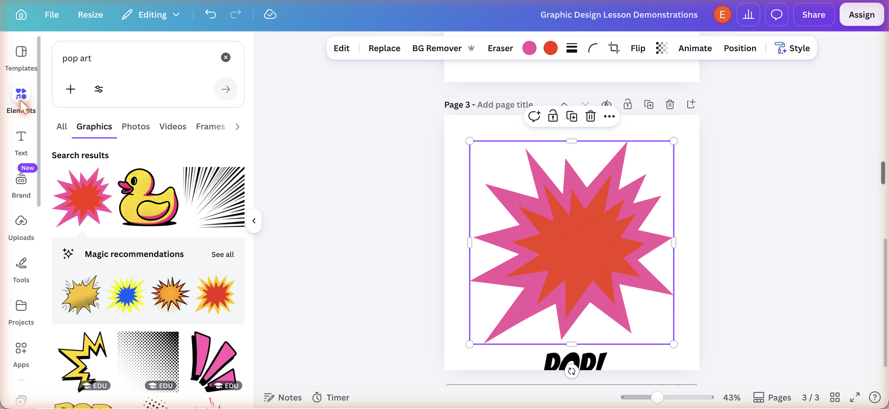
Find Pop Art elements
Elements, then search “pop art.” Click an element or drag it into your design.
Look for
Bursts
Speech bubbles
Dot patterns
Stripes
Halftone backgrounds
Once it is on the page, the toolbar shows its color circles.
Real search results, school account, September 15, 2026
Notes:
2 minutes. Open Elements, type pop art in the search box, and scroll the results. Clicking an element adds it to the page; dragging places it where you drop it. Bursts and speech bubbles make good borders around a word. Dot and stripe graphics can become the repeating background. Show one element being resized from a corner handle, then show its color circles in the toolbar. Elements marked EDU are included in the school account; a crown icon marks Pro content to skip.
[Sources]
Student task: Verizon Canvas course 23402, assignment 1183366 (Lesson 3: Paths, Shapes, and Colors), module item 2634024, read September 15, 2026. Teaching sequence: Elisha Lucero, September 15, 2026 brief and the current lesson tutorial narration. Standard: innovative-technology-site/docs/SLIDE_AUTHORING_STANDARD.md and the approved Lesson 1/2 exemplars.
Canva screenshots: Graphic Design Lesson Demonstrations design, Bowie Middle School account, captured September 7 and September 15, 2026. Labels can differ by account and release; recheck before teaching. This capture shows the Graphics tab of the pop art search results.

Slide 9
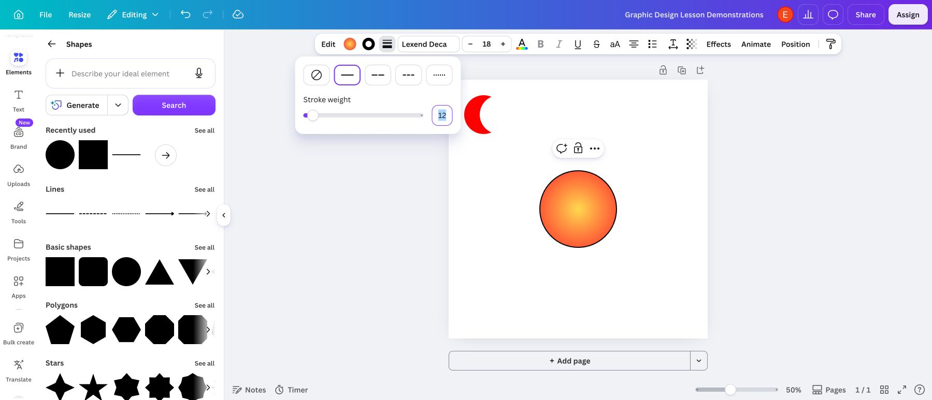
Add a border
Fill colors the inside. A border marks the edge.
Fill only
Fill + border
Shape
Click it. Open Stroke style. Choose the solid line. Raise Stroke weight.
Stroke style panel on a selected shape
A thick dark border keeps a bright shape readable on a busy background.
Text
Click it. Open Effects. Choose Outline, then set its color and thickness.
Notes:
2 minutes. Compare the two circles: same fill, and the border is the only difference. In Canva, select a native shape and open the Stroke style control (the three-line icon beside the color circles), choose the solid line, and raise the weight; add color where the account shows a border color option. For text, the border is a text effect: select the text, open Effects, and choose Outline. A burst or speech bubble from Elements can also serve as the border around a word. Check every student design for one visible border before export.
[Sources]
Student task: Verizon Canvas course 23402, assignment 1183366 (Lesson 3: Paths, Shapes, and Colors), module item 2634024, read September 15, 2026. Teaching sequence: Elisha Lucero, September 15, 2026 brief and the current lesson tutorial narration. Standard: innovative-technology-site/docs/SLIDE_AUTHORING_STANDARD.md and the approved Lesson 1/2 exemplars.
Canva screenshots: Graphic Design Lesson Demonstrations design, Bowie Middle School account, captured September 7 and September 15, 2026. Labels can differ by account and release; recheck before teaching. Text Effects labels (Outline, Hollow, Splice) were confirmed in Canva's text effects list; recheck in the school account.

Slide 10
A font is a style of lettering
Same word. Different voice.
POP!
Tall and loud
Impact
POP!
Wide and sturdy
Arial Black
POP!
Comic and friendly
Comic Sans MS Bold
In Canva, search fonts such as Bangers, Anton, Luckiest Guy, Bebas Neue, or Lilita One. Skip thin or script fonts: Pop Art letters are chunky.
Notes:
1 minute. A font is one complete set of letters drawn in one style. Read the same word in each style and name what changes: height, width, weight, and curves. Pop Art borrowed comic and advertising lettering, so heavy, simple, high-contrast letters fit best. The five suggested Canva fonts are free display fonts in the Canva library as of September 2026; confirm they appear in the school account. Students may pick any bold font; the check is whether the word reads clearly from across the room.
[Sources]
Student task: Verizon Canvas course 23402, assignment 1183366 (Lesson 3: Paths, Shapes, and Colors), module item 2634024, read September 15, 2026. Teaching sequence: Elisha Lucero, September 15, 2026 brief and the current lesson tutorial narration. Standard: innovative-technology-site/docs/SLIDE_AUTHORING_STANDARD.md and the approved Lesson 1/2 exemplars.
Lettering: Impact, Arial Black, and Comic Sans MS Bold rendered as editable text. These are modern fonts, not the lettering of any historical artwork.

Slide 11
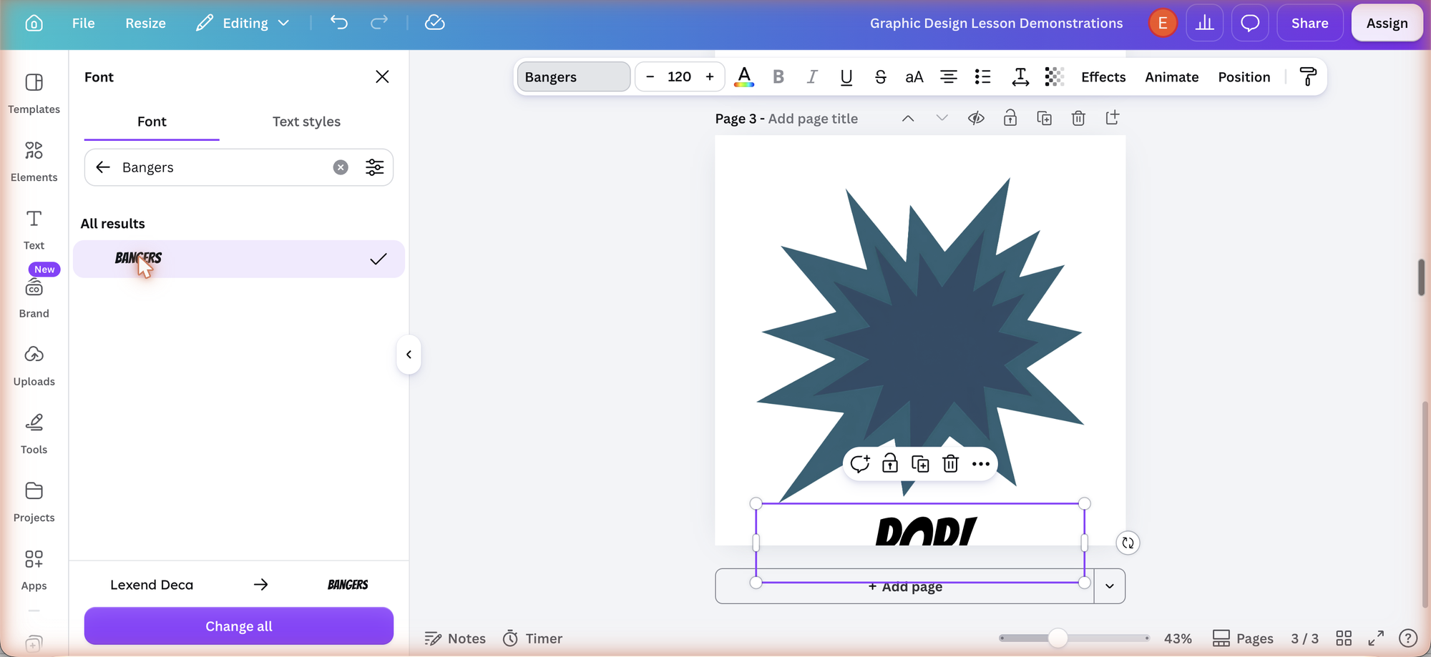
Change the font in Canva
1
Text, then Add a text box.
2
Type your word or your name.
3
Click the font name in the toolbar.
4
Search a font, then click it.
5
Make it big. Pick a color that stands out.
Font panel after searching Bangers. The ring marks the font name in the toolbar.
Type a chunky display font in the search box: Bangers, Anton, Luckiest Guy, Bebas Neue, Lilita One.
Notes:
2 minutes, then model it live. Open Text and click Add a text box, or press T. Type the word. With the text selected, the toolbar shows the font name; click it to open the Font panel shown here, type a name in the search box, and click the font. Use the size box or a corner handle to enlarge the text. Then pick a text color with strong contrast against the background, and add an Outline effect if the word sits on a pattern. Bangers was confirmed in the school account font list on September 15, 2026.
[Sources]
Student task: Verizon Canvas course 23402, assignment 1183366 (Lesson 3: Paths, Shapes, and Colors), module item 2634024, read September 15, 2026. Teaching sequence: Elisha Lucero, September 15, 2026 brief and the current lesson tutorial narration. Standard: innovative-technology-site/docs/SLIDE_AUTHORING_STANDARD.md and the approved Lesson 1/2 exemplars.
Canva screenshots: Graphic Design Lesson Demonstrations design, Bowie Middle School account, captured September 7 and September 15, 2026. Labels can differ by account and release; recheck before teaching. This capture shows the Font panel with Bangers applied to a 120-point POP! text box.

Slide 12
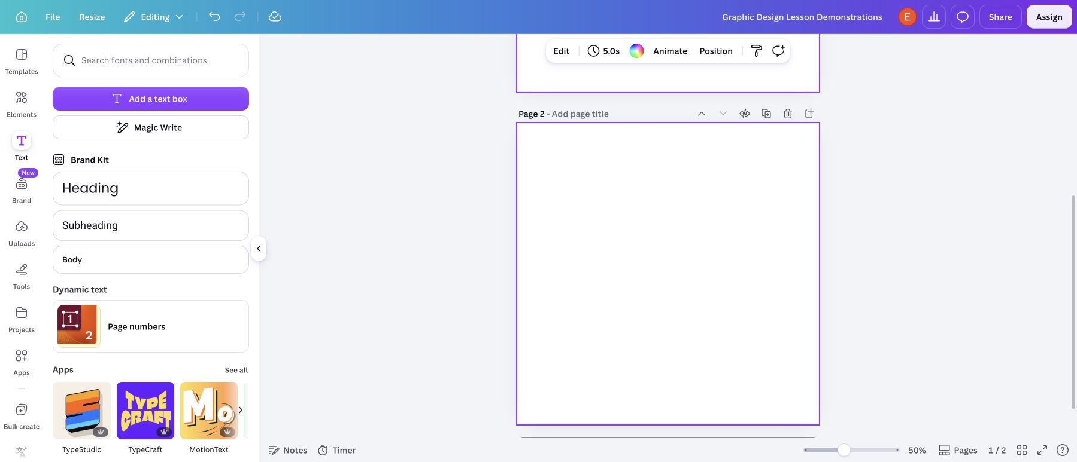
Canva demo
Watch a T-shirt design come together.
Search “pop art”
Copy and paste
Colors
Text and font
Border
Download PNG
Replay the tutorial: English
Ver el tutorial: Español
Notes:
Live demonstration, 6 to 8 minutes. Switch to Canva through ClassLink and open a blank design. Follow the facilitator guide checklist: search Elements for pop art and add a dot background or build one with copy and paste; add a burst; recolor its circles with a primary palette; add a text box, change the font to a chunky display font, enlarge it, and add an Outline effect; add a native shape with a thick stroke; fix the layer order with Position, then Layers; then Share, Download, PNG, and rename the file LastName-FirstName-Canva-Tshirt.png. Finish by opening Lesson 3 and showing the file upload and the Comments box. The two links open the existing lesson tutorial for replay or for an absent student; they are alternatives to the live demo, not an extra segment. English: https://www.youtube.com/watch?v=Cep7BeszAX8 . Español: https://www.youtube.com/watch?v=dD8OxR0LLfo .
[Sources]
Student task: Verizon Canvas course 23402, assignment 1183366 (Lesson 3: Paths, Shapes, and Colors), module item 2634024, read September 15, 2026. Teaching sequence: Elisha Lucero, September 15, 2026 brief and the current lesson tutorial narration. Standard: innovative-technology-site/docs/SLIDE_AUTHORING_STANDARD.md and the approved Lesson 1/2 exemplars.
Canva screenshots: Graphic Design Lesson Demonstrations design, Bowie Middle School account, captured September 7 and September 15, 2026. Labels can differ by account and release; recheck before teaching.

Slide 13
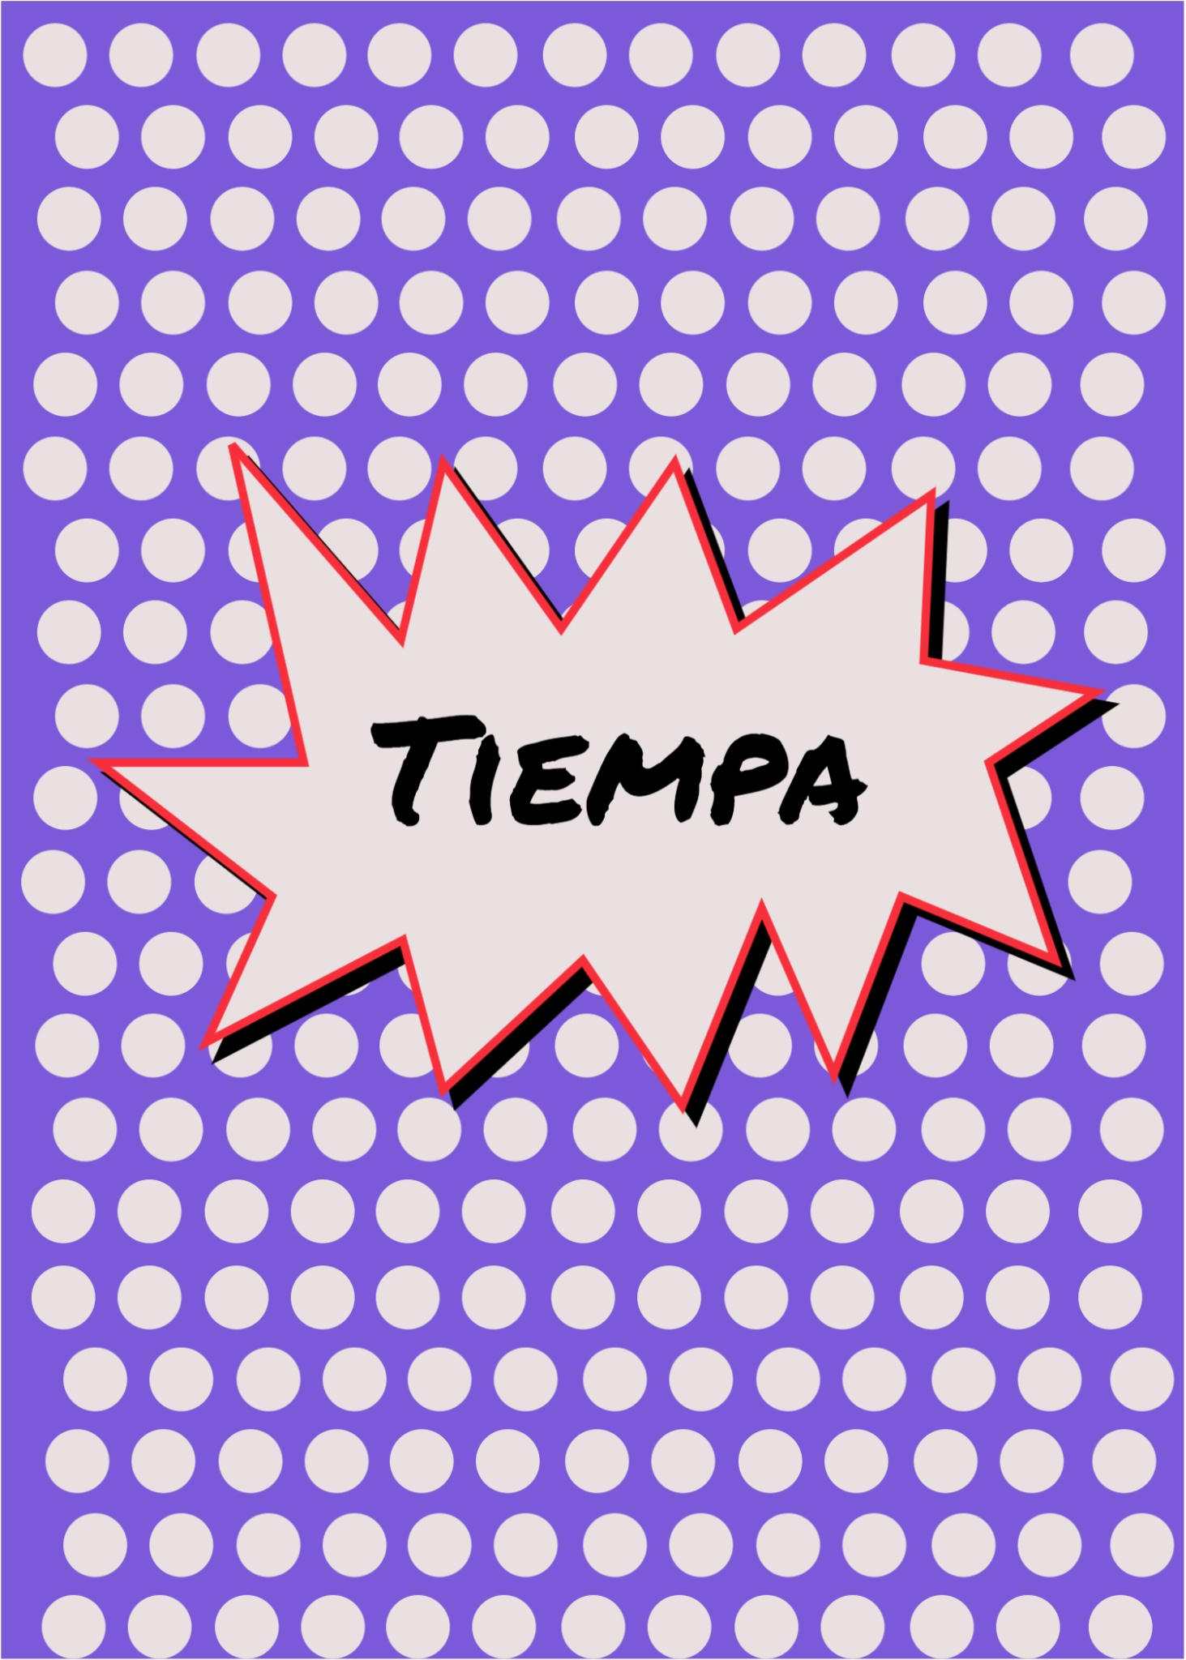

Your Pop Art T-shirt
Canvas: SW1 · Graphic Design with the 1960s
Make
A repeating background.
A word or your name in a bold font.
A border around a shape or the text.
Extra shapes if you want them.
Ready to turn in?
All four parts are there.
The word reads clearly from across the room.
File named LastName-FirstName-Canva-Tshirt.png
Examples: repeating dots, a word, a strong border
Turn it in
Open Lesson 3 in Canvas
Share, Download, PNG. Upload it to Lesson 3.
Comments: My design looks like Pop Art because
I used ______ to create ______.
bright colors · repeating dots · strong borders · patterns
circles · lines · bold text · repetition
Notes:
Leave this screen projected for the whole work block. Students begin from their name-tag idea. Check three things in order while circulating: the four required parts; one design choice the student can point to and name with the word bank; and the export. Download as PNG, rename the file LastName-FirstName-Canva-Tshirt.png, upload it to Lesson 3, and write the one reflection sentence in Comments using the stem and word bank. The existing rubric and 5 points stay authoritative. The level-up is four color versions submitted as one panel; it is optional. The examples are possibilities, not templates to copy.
[Sources]
Student task: Verizon Canvas course 23402, assignment 1183366 (Lesson 3: Paths, Shapes, and Colors), module item 2634024, read September 15, 2026. Teaching sequence: Elisha Lucero, September 15, 2026 brief and the current lesson tutorial narration. Standard: innovative-technology-site/docs/SLIDE_AUTHORING_STANDARD.md and the approved Lesson 1/2 exemplars.
Examples: student Tiempa design (source-10.png) and POP! artwork (source-9.png) from the user-supplied Unit 1 DPI 2026 materials. Canvas banner: real teacher-view assignment capture, September 7, 2026, cropped to the header. Filename convention follows the approved Lesson 2 pattern (LastName-FirstName-Canva-Lines.png).

