Slide 1
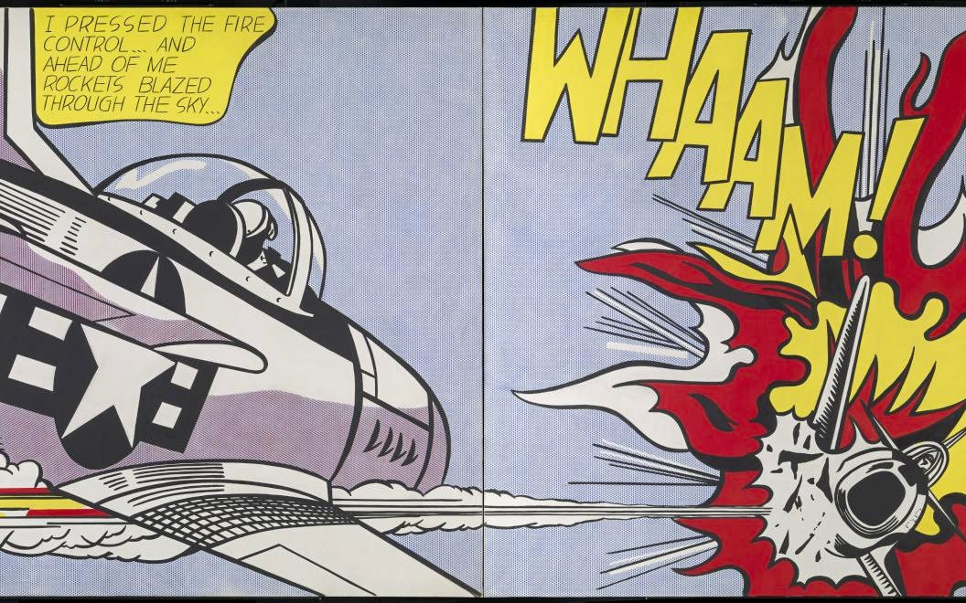
Pop Art review
Name two visual features
you remember from Pop Art.
Two Pop Art features are
_____ and _____.
Write on your notecard.
Notes:
Bell ringer, 2 minutes. Students write silently on a notecard. Take two or three short responses. They may identify bold flat colors, dark outlines, comic lettering, printing dots, or repetition. Use the next slide to reconnect their observations to visible examples. No partner discussion is required.
[Sources]
Teaching sequence and comparison intent: Elisha Lucero, Lesson2RevisedSlides2026LiveTeach.pptx and September 9, 2026 feedback. Student task: Verizon Canvas course 23402, assignment 1183355 / module item 2634022, read September 9, 2026.
Artwork: Roy Lichtenstein, Whaam!, 1963. Tate, https://www.tate.org.uk/art/artworks/lichtenstein-whaam-t00897 . Main comic source: Irv Novick, DC Comics, 1962. © Estate of Roy Lichtenstein.

Slide 2
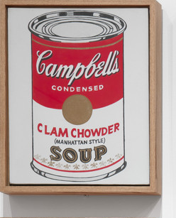
Pop Art choices
POW!
Printing
dots
Bold, flat
color
Thick
outlines
Comic
lettering
Repetition
Notes:
Review, 1 minute. Point to the examples as you name the choices students recalled. Today we will use a smaller set of materials, lines and circles, to communicate. These are useful choices often associated with Pop Art, not a checklist every historical Pop artwork must satisfy.
[Sources]
Teaching sequence and comparison intent: Elisha Lucero, Lesson2RevisedSlides2026LiveTeach.pptx and September 9, 2026 feedback. Student task: Verizon Canvas course 23402, assignment 1183355 / module item 2634022, read September 9, 2026.
Warhol: Campbell’s Soup Cans, 1962, MoMA https://www.moma.org/collection/works/79809 . Dots, palette, outline and lettering are original teaching diagrams, not reproductions of historical artworks.

Slide 3
Good design speaks without words
Small design choices can change what we notice and feel.
Size
Spacing
Repetition
Direction
Layering
Notes:
Introduction, 30–45 seconds. Name these five choices. Size affects what attracts attention. Spacing changes the gaps. Repetition repeats a mark. Direction guides where the eye travels. Layering changes what sits in front. Students will see examples next, before choosing their project words. These are quick teacher-led comparisons, not five separate turn-and-talks.
[Sources]
Teaching sequence and comparison intent: Elisha Lucero, Lesson2RevisedSlides2026LiveTeach.pptx and September 9, 2026 feedback. Student task: Verizon Canvas course 23402, assignment 1183355 / module item 2634022, read September 9, 2026.

Slide 4
Size creates emphasis
What grabs your eye first?
A
B
Similar attention
One focal point
The larger circle stands out. Emphasis means making something stand out.
Notes:
Comparison, 1 minute. Ask students to point to what they noticed first in A and B. Click once to reveal both labels and the explanation. The same color and similar spacing help isolate the size change. In the live demo, also connect thickness and length to the size of a line. Students do not need to memorize the term before seeing the effect.
[Sources]
Teaching sequence and comparison intent: Elisha Lucero, Lesson2RevisedSlides2026LiveTeach.pptx and September 9, 2026 feedback. Student task: Verizon Canvas course 23402, assignment 1183355 / module item 2634022, read September 9, 2026.

Slide 5
Spacing and alignment
Which arrangement feels organized? Which feels chaotic?
A
B
Organized
Chaotic
Even gaps and aligned rows create order. Uneven gaps and scattered positions change it.
Notes:
Comparison, 1 minute. Students vote A or B. Click once for the labels. Ask one student to point to the gaps or rows that led to the choice. Both examples use 24 identical black circles. Spacing and alignment change together here; do not claim spacing is the only difference. Preserve the original organized-versus-chaotic comparison.
[Sources]
Teaching sequence and comparison intent: Elisha Lucero, Lesson2RevisedSlides2026LiveTeach.pptx and September 9, 2026 feedback. Student task: Verizon Canvas course 23402, assignment 1183355 / module item 2634022, read September 9, 2026.

Slide 6
Lines can change the feeling
Which feels relaxed? Which feels intense or urgent?
A
B
Relaxed
Intense / movement
Open space and gentle curves feel calmer. Tight clusters and changing lengths suggest urgency.
Notes:
Comparison, 2 minutes. Keep both drawings visible together. Students point or vote before the reveal. Click once. Trace a gentle curve and the generous gaps in A. In B, point to the close clusters, straighter lines, changing lengths and shared direction. Together they suggest motion and urgency. Do not label the curved example as a demonstration of movement alone. The expected reading follows the source lesson; if a student reads it differently, ask for a visible clue rather than declaring their feeling wrong.
[Sources]
Teaching sequence and comparison intent: Elisha Lucero, Lesson2RevisedSlides2026LiveTeach.pptx and September 9, 2026 feedback. Student task: Verizon Canvas course 23402, assignment 1183355 / module item 2634022, read September 9, 2026.

Slide 7
Repetition and direction
Where does your eye travel?
A
B
Across a steady row
Along a rising path
The circle repeats in both designs. Its placement changes the direction your eye follows.
Notes:
Comparison, 1 minute. Trace each path with your hand and invite students to trace in the air. Click once to reveal. Repetition forms a pattern or rhythm. Direction comes from the arrangement, even without arrowheads. Connect this to the clustered lines in the preceding example without reducing urgency to direction alone.
[Sources]
Teaching sequence and comparison intent: Elisha Lucero, Lesson2RevisedSlides2026LiveTeach.pptx and September 9, 2026 feedback. Student task: Verizon Canvas course 23402, assignment 1183355 / module item 2634022, read September 9, 2026.

Slide 8
Layering creates depth
Which composition has a clear front and back?
A
B
Separate circles
Overlapping circles
A shape that covers another shape appears to sit in front.
Notes:
Comparison, 1 minute. Ask which circle seems closest in B and have students point to the overlapping edge. Click once to reveal the labels. Layering means front-to-back order. This uses ordinary Canva shapes and Position/Layers; it does not require Combo or compound-shape operations. In the demo, move a circle forward and backward to show the change.
[Sources]
Teaching sequence and comparison intent: Elisha Lucero, Lesson2RevisedSlides2026LiveTeach.pptx and September 9, 2026 feedback. Student task: Verizon Canvas course 23402, assignment 1183355 / module item 2634022, read September 9, 2026.

Slide 9
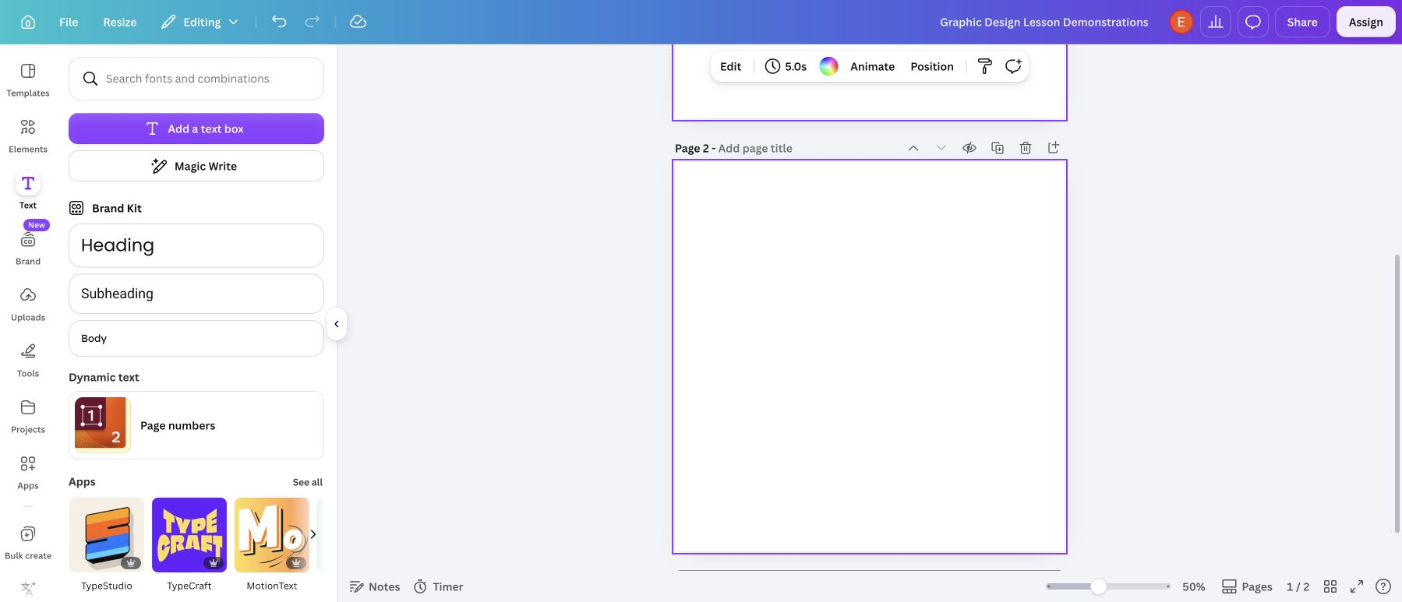
Canva demo
Watch how a few changes affect the design.
Lines
Shapes
Borders
Size and spacing
Layers
Notes:
Live demonstration, about 6–8 minutes. Switch to Canva now. Use the facilitator-guide checklist: open through ClassLink and start blank; add a line and adjust its length, angle and weight; duplicate it and change spacing; show a curved-line option or Draw stroke as available; add native circles; resize; change fill and add a border using Stroke style/weight; duplicate and align; overlap circles and change front/back order using Position/Layers; demonstrate Undo. Finish by exporting each page as a separate PNG. Name them LastName-FirstName-Canva-Lines.png and LastName-FirstName-Canva-Circles.png. Show File Upload and Add Another File to attach both PNGs to the same submission. Model the two reflection sentences in Comments and show how to save a comment from Submission Details. Students watch this short model, then begin both designs with slide 10 left up. Avoid introducing text, photos or stickers as part of the two required graphics.
[Sources]
Teaching sequence and comparison intent: Elisha Lucero, Lesson2RevisedSlides2026LiveTeach.pptx and September 9, 2026 feedback. Student task: Verizon Canvas course 23402, assignment 1183355 / module item 2634022, read September 9, 2026.
Screenshot: actual Canva editor, Bowie Middle School account, captured September 7, 2026. Reference design DAHUiq9hUJg. The facilitator guide identifies object-dependent controls.

Slide 10
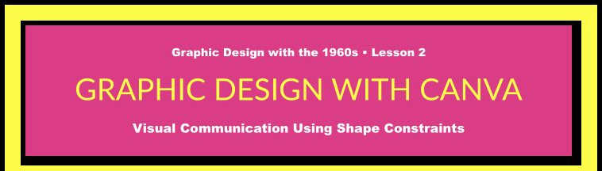
Two designs. Two PNGs.
Canvas: SW1 · Graphic Design with the 1960s
Make
Check both words’ meanings.
One word using only lines.
Another word using only circles.
No text, photos, stickers or extra shapes.
Ready to turn in?
Relaxed / lines
Organized / circles
Both files named:
LastName-FirstName-Canva-Lines.png
LastName-FirstName-Canva-Circles.png
Words: rapid, relaxed, complicated,
organized, labyrinth
Turn it in
Open Lesson 2 in Canvas
Upload both PNGs in one submission.
Comments (2 sentences):
My lines show _____ because I used _____.
For _____, circles were _____ compared
with lines because _____.
Notes:
Leave this screen projected for the entire work period. First name the five existing word choices aloud: rapid (fast), relaxed (calm), complicated (many connected parts), organized (clear order), labyrinth (a maze-like network of passages). The word bank is in their Canvas assignment. Students look up unfamiliar meanings but do not turn in definitions. Students choose two different words. Use only lines for one design and only circles for the other. Each design communicates its word without spelling it inside the artwork. Check that students use spacing, size, form or another visible choice intentionally. Upload both named PNGs directly to Lesson 2 in the same submission. Write two sentences in Comments: My lines show _____ because I used _____. For _____, circles were _____ compared with lines because _____. Save the comment and check that both files are attached. The facilitator guide keeps a Google Doc worksheet as a teacher-selected alternative, not an additional student requirement. The two examples show possibilities, not a template to copy.
[Sources]
Teaching sequence and comparison intent: Elisha Lucero, Lesson2RevisedSlides2026LiveTeach.pptx and September 9, 2026 feedback. Student task: Verizon Canvas course 23402, assignment 1183355 / module item 2634022, read September 9, 2026.
Canvas banner: real teacher-view assignment screenshot captured September 7, 2026; assignment directions updated by the owner on September 10 to PNG uploads with two comment sentences.

