Slide 1

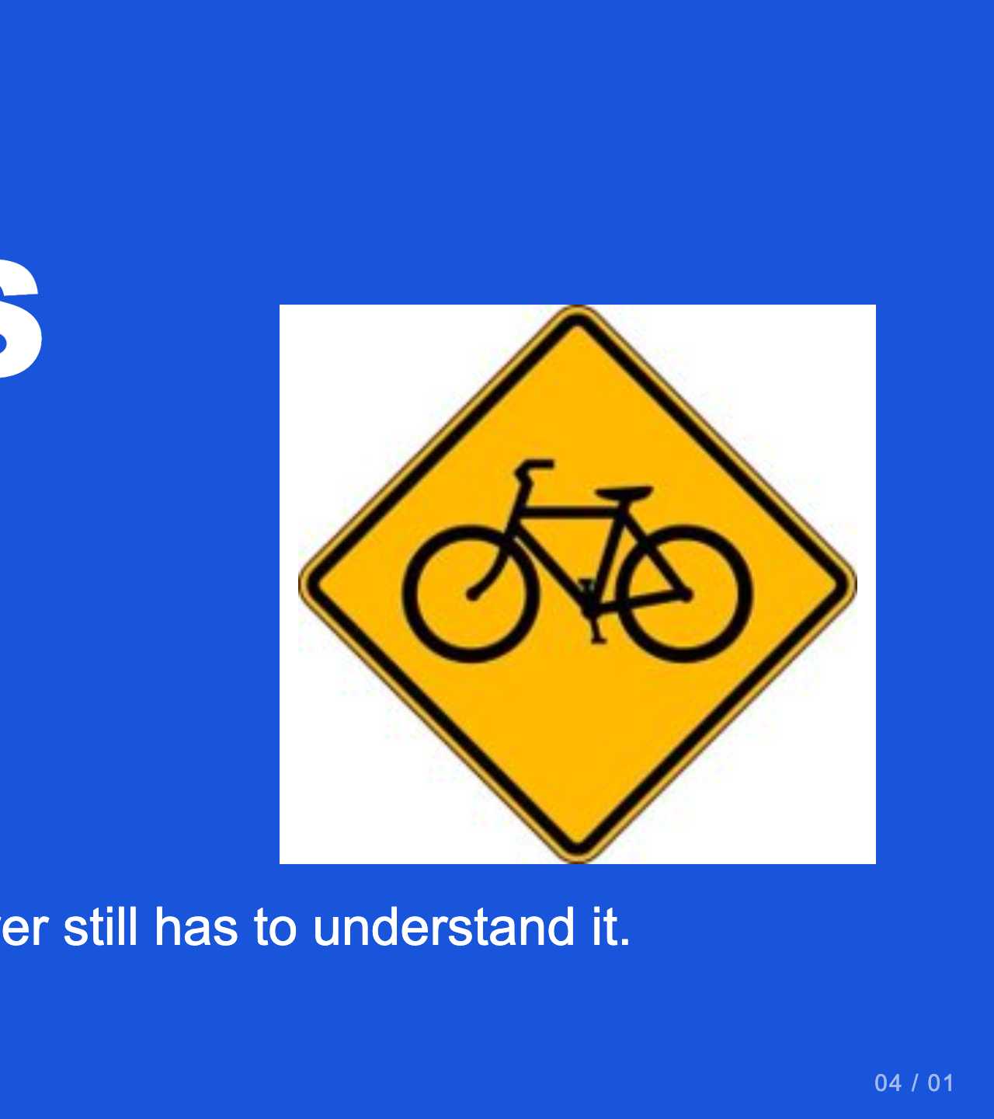
Notes:
Teacher move: About 50 minutes. Students make two pictographs using shapes, with at least one Gestalt principle in each. Do not replace the current task with an emoji assignment.
[Sources]
Current course snapshot, generated student pages and facilitator guides in innovative-technology-site, inspected 2026-09-07. Original ZIP supplied by Elisha Lucero.
Canva editor and Combo app, Graphic Design Lesson Demonstrations, https://www.canva.com/design/DAHUiq9hUJg/IwU_7AR5EXsmRbdnEBtkhA/edit . Screenshots captured directly in the Bowie Middle School account, 2026-09-07. Interface labels may vary by account. Canva screenshots used for classroom software instruction.
Selected instructional image retained from the user-supplied Unit 1 DPI 2026 teaching materials. Reuse is for this classroom teaching adaptation. Original image rights remain with their respective creators; no open license is asserted.
Visual: source-24.jpg. Selected instructional image retained from the user-supplied Unit 1 DPI 2026 teaching materials. Reuse is for this classroom teaching adaptation. Original image rights remain with their respective creators; no open license is asserted.
Visual reference: source-24.jpg. Supplied teaching artwork or a direct Canva interface capture, as recorded in the source ledger.

Slide 2
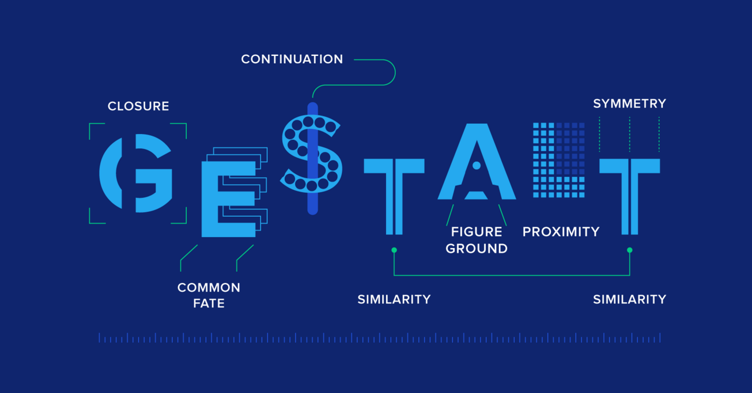

Slide 3

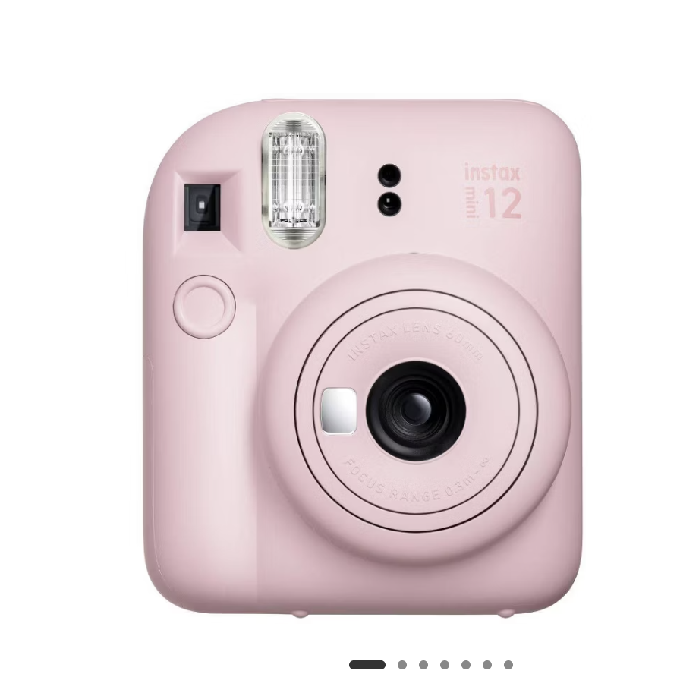
What do you see?

Slide 4
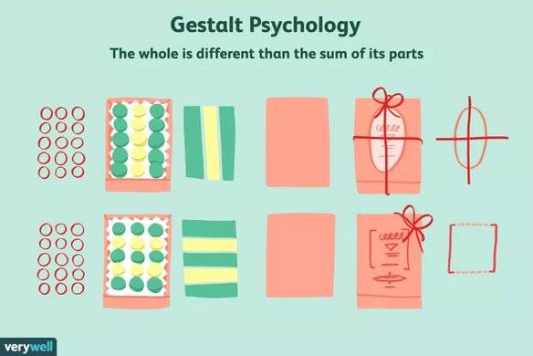
Gestalt Design Principles
[GUHSH] + [TALT] ​
Gestalt Principles of Design are rules that describe how the human brain perceives visual elements. They also support how the brain views the shapes as a single, united form rather than the separate simpler elements involved. ​
Los Principios de Diseño Gestalt son reglas que describen cómo el ojo humano percibe los elementos visuales. También respaldan cómo los ojos ven las formas como una forma única y unida en lugar de los elementos separados más simples involucrados.​
Image credit: verywell mind
Notes:
Gestalt is a German word that roughly means "configuration" or the way things are put together to form a whole object.​

Slide 5
The six Gestalt Design Principles
1. Similarity | Similitud ​
2. Continuation | Continuación​
3. Closure | Cierre ​
4. Proximity | Proximidad ​
5. Figure | Figura/suelo ​
6. Symmetry & Order | Simetría y orden

Slide 6
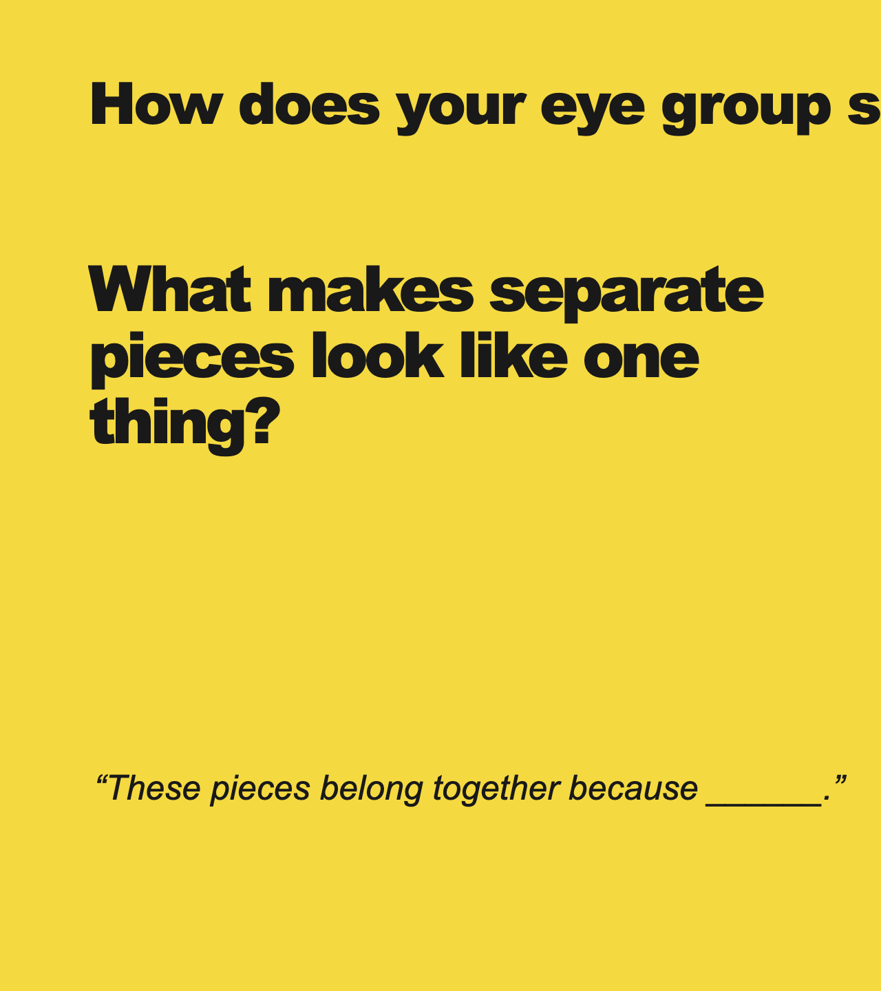
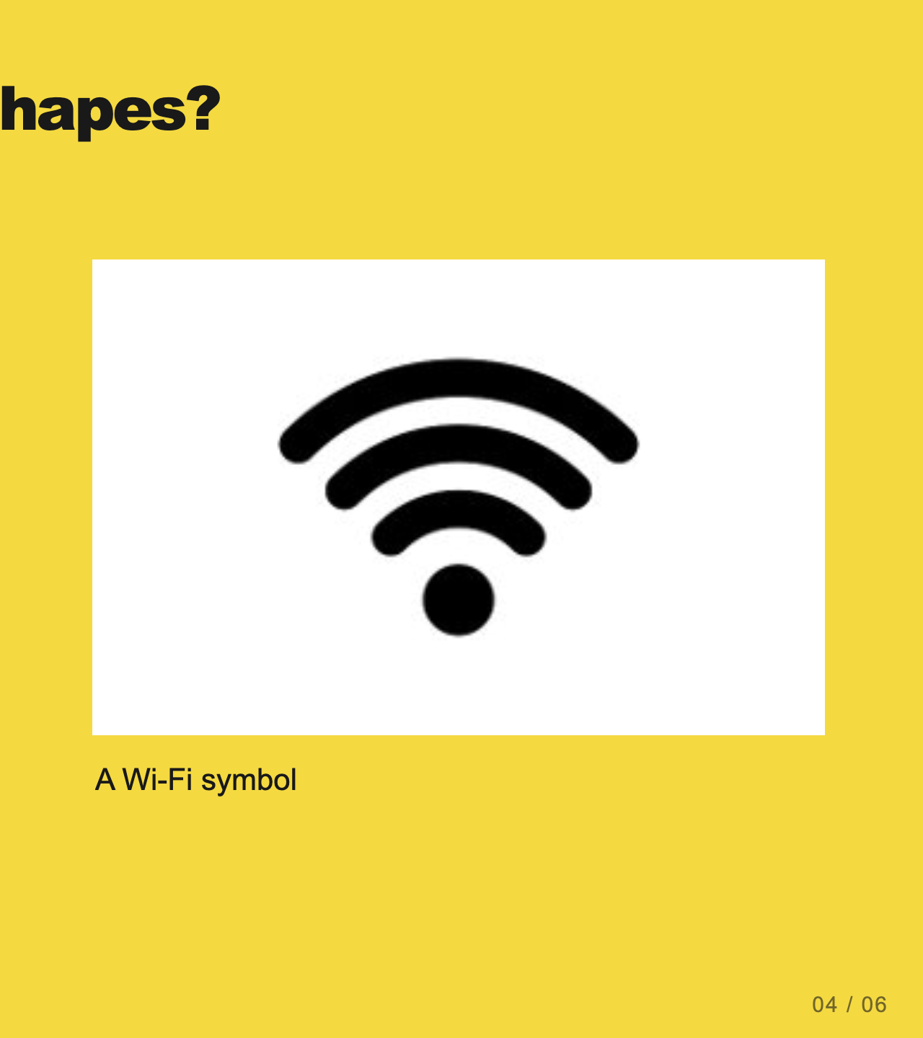
Notes:
Teacher move: 1 minute. Introduce Gestalt principles as descriptions of common perceptual tendencies. They are useful design guides, not guarantees that every viewer perceives the same thing. Each next slide names one principle and shows it.
[Sources]
Current course snapshot, generated student pages and facilitator guides in innovative-technology-site, inspected 2026-09-07. Original ZIP supplied by Elisha Lucero.
Canva editor and Combo app, Graphic Design Lesson Demonstrations, https://www.canva.com/design/DAHUiq9hUJg/IwU_7AR5EXsmRbdnEBtkhA/edit . Screenshots captured directly in the Bowie Middle School account, 2026-09-07. Interface labels may vary by account. Canva screenshots used for classroom software instruction.
Selected instructional image retained from the user-supplied Unit 1 DPI 2026 teaching materials. Reuse is for this classroom teaching adaptation. Original image rights remain with their respective creators; no open license is asserted.
Visual reference: source-36.jpg. Supplied teaching artwork or a direct Canva interface capture, as recorded in the source ledger.

Slide 8
Gestalt Design Principles
[GUHSH] + [TALT] ​
Gestalt Principles of Design are rules that describe how the human brain perceives visual elements. They also support how the brain views the shapes as a single, united form rather than the separate simpler elements involved. ​
Los Principios de Diseño Gestalt son reglas que describen cómo el ojo humano percibe los elementos visuales. También respaldan cómo los ojos ven las formas como una forma única y unida en lugar de los elementos separados más simples involucrados.​
Image credit: verywell mind
Notes:
Gestalt is a German word that roughly means "configuration" or the way things are put together to form a whole object.​

Slide 9
What do you see?

Slide 10

Gestalt Design Principles
[GUHSH] + [TALT] ​
Gestalt Principles of Design are rules that describe how the human brain perceives visual elements. They also support how the brains view the shapes as a single, united form rather than the separate simpler elements involved. ​
Los Principios de Diseño Gestalt son reglas que describen cómo el ojo humano percibe los elementos visuales. También respaldan cómo los ojos ven las formas como una forma única y unida en lugar de los elementos separados más simples involucrados.​
Image credit: verywell mind
Notes:
Gestalt is a German word that roughly means "configuration" or the way things are put together to form a whole object.​

Slide 11
The six Gestalt Design Principles
1. Similarity | Similitud ​
2. Continuation | Continuación​
3. Closure | Cierre ​
4. Proximity | Proximidad ​
5. Figure | Figura/suelo ​
6. Symmetry & Order | Simetría y orden

Slide 12
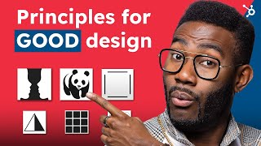

Slide 13
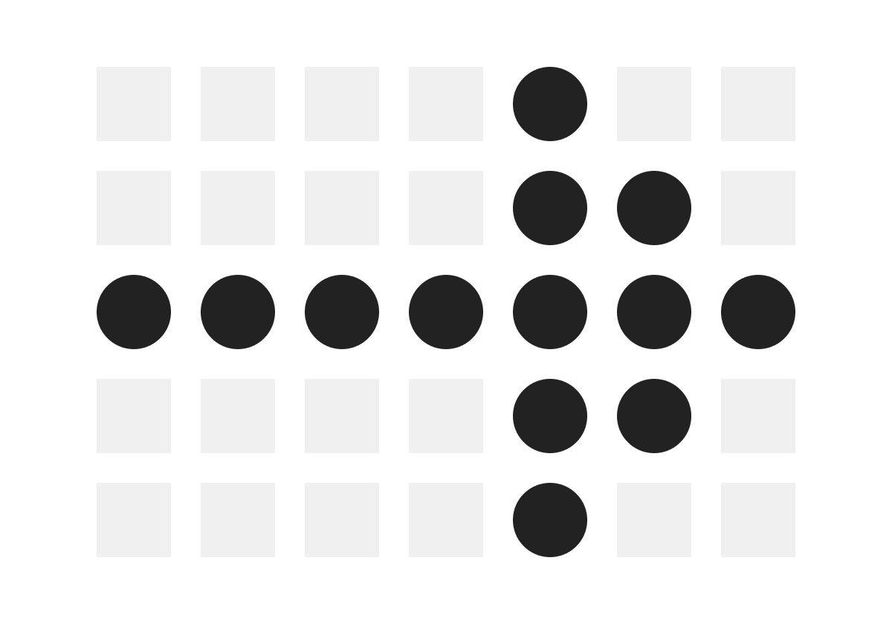
Similarity
It’s natural to group like things together. In Gestalt, similar elements are grouped regardless of their proximity to each other. They can be grouped by color, shape or size. ​

Slide 14
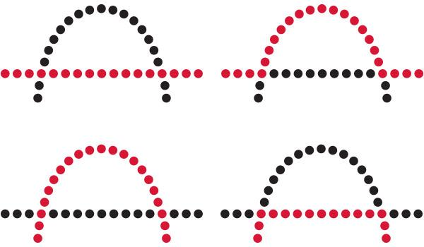
2. Continuation
The law of continuity shows that the human eye will follow the smoothest path when viewing lines, regardless of how the lines were drawn.​
This continuation can be a valuable tool when the goal is to guide a visitor’s eye in a certain direction. They will follow the simplest path on the page, so make sure the most vital parts they should see fall within that path.​

Slide 15
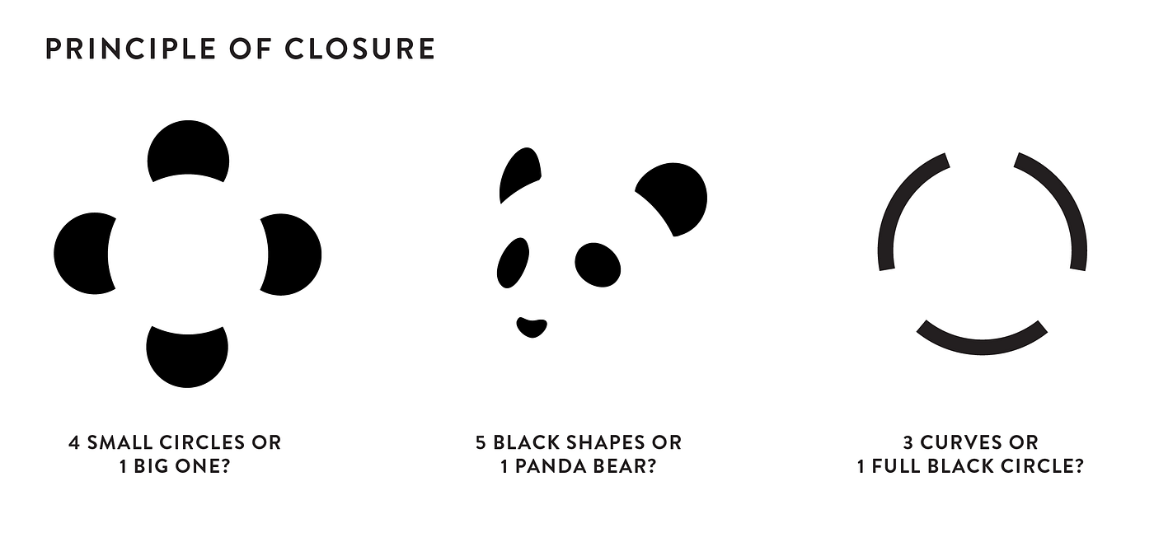
3. Closure
It’s the idea that your brain will fill in the missing parts of a design or image to create a whole.​

Slide 16

4. Proximity
Proximity refers to how close elements are to one another. The strongest proximity relationships are those between overlapping subjects, but just grouping objects into a single area can also have a strong proximity effect.​
The opposite is also true, of course. By putting space between elements, you can add separation even when their other characteristics are the same. Take this group of circles, for example:​

Slide 17


5. Figure/ground
The figure/ground principle is similar to the closure principle in that it takes advantage of the way the brain processes negative space.​

Slide 18
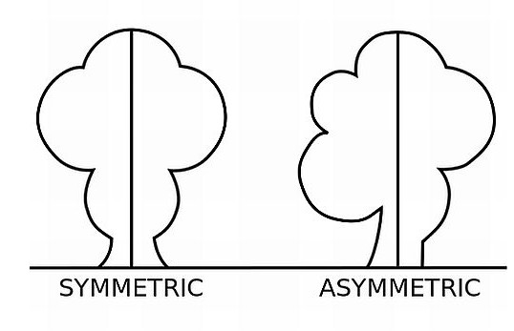
6. Symmetry/order
The law of symmetry and order is also known as prägnanz, the German word for “good figure.” What this principle says is that your brain will perceive ambiguous shapes in as simple a manner as possible.​

Slide 19
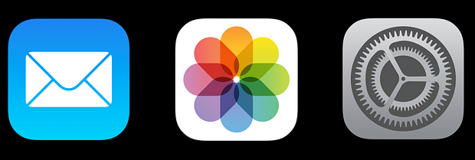

What design principles do you see in these images?
1. Similarity | Similitud ​
2. Continuation | Continuación​
3. Closure | Cierre ​
4. Proximity | Proximidad ​
5. Figure | Figura/suelo ​
6. Symmetry | Simetría

Slide 20
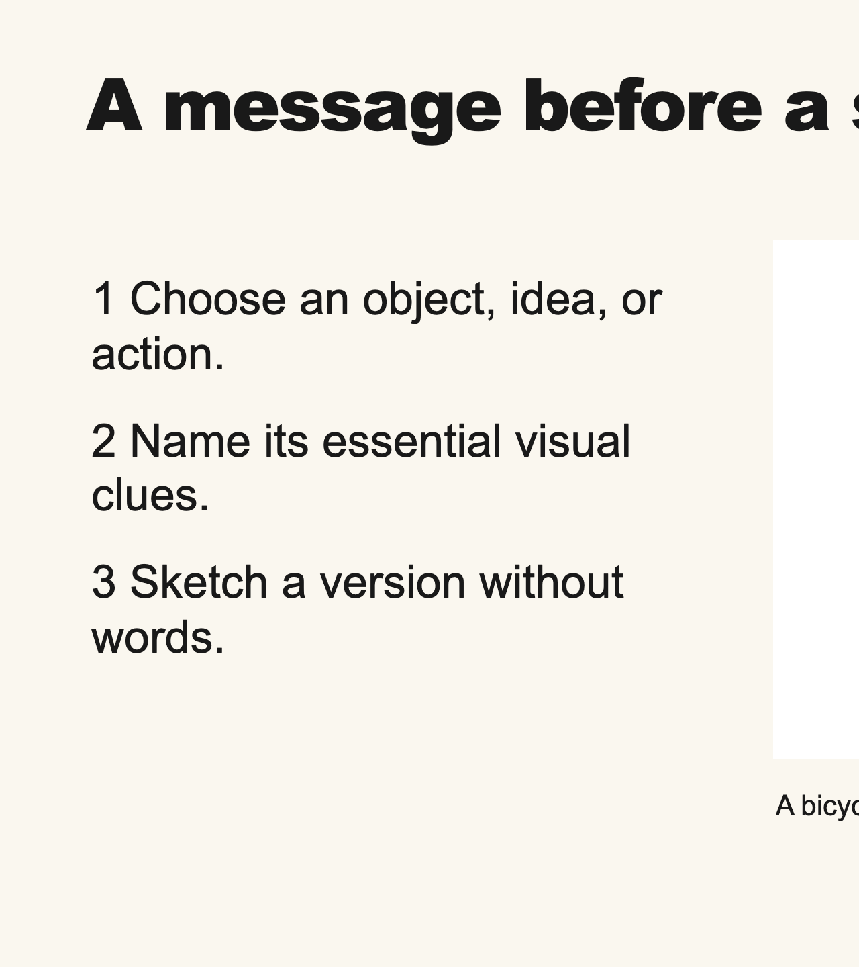
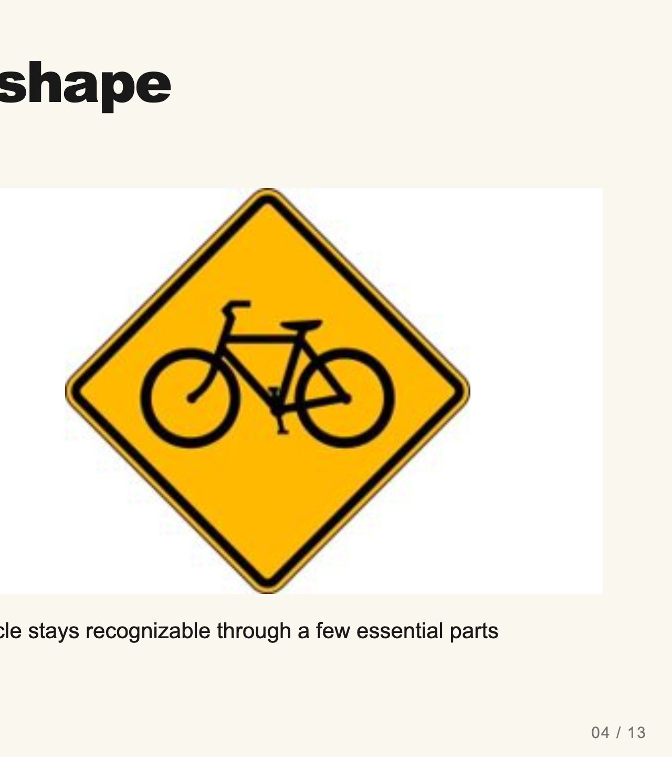
Notes:
Teacher move: 3 minutes. Model identifying two circles and a connecting frame in a bicycle sign. Then sketch a different simple message live, such as a pause area or water refill location. Keep familiar pictographs as inspiration and have students build their own shapes.
[Sources]
Current course snapshot, generated student pages and facilitator guides in innovative-technology-site, inspected 2026-09-07. Original ZIP supplied by Elisha Lucero.
Canva editor and Combo app, Graphic Design Lesson Demonstrations, https://www.canva.com/design/DAHUiq9hUJg/IwU_7AR5EXsmRbdnEBtkhA/edit . Screenshots captured directly in the Bowie Middle School account, 2026-09-07. Interface labels may vary by account. Canva screenshots used for classroom software instruction.
Selected instructional image retained from the user-supplied Unit 1 DPI 2026 teaching materials. Reuse is for this classroom teaching adaptation. Original image rights remain with their respective creators; no open license is asserted.
Visual: source-24.jpg. Selected instructional image retained from the user-supplied Unit 1 DPI 2026 teaching materials. Reuse is for this classroom teaching adaptation. Original image rights remain with their respective creators; no open license is asserted.
Visual reference: source-24.jpg. Supplied teaching artwork or a direct Canva interface capture, as recorded in the source ledger.

Slide 21
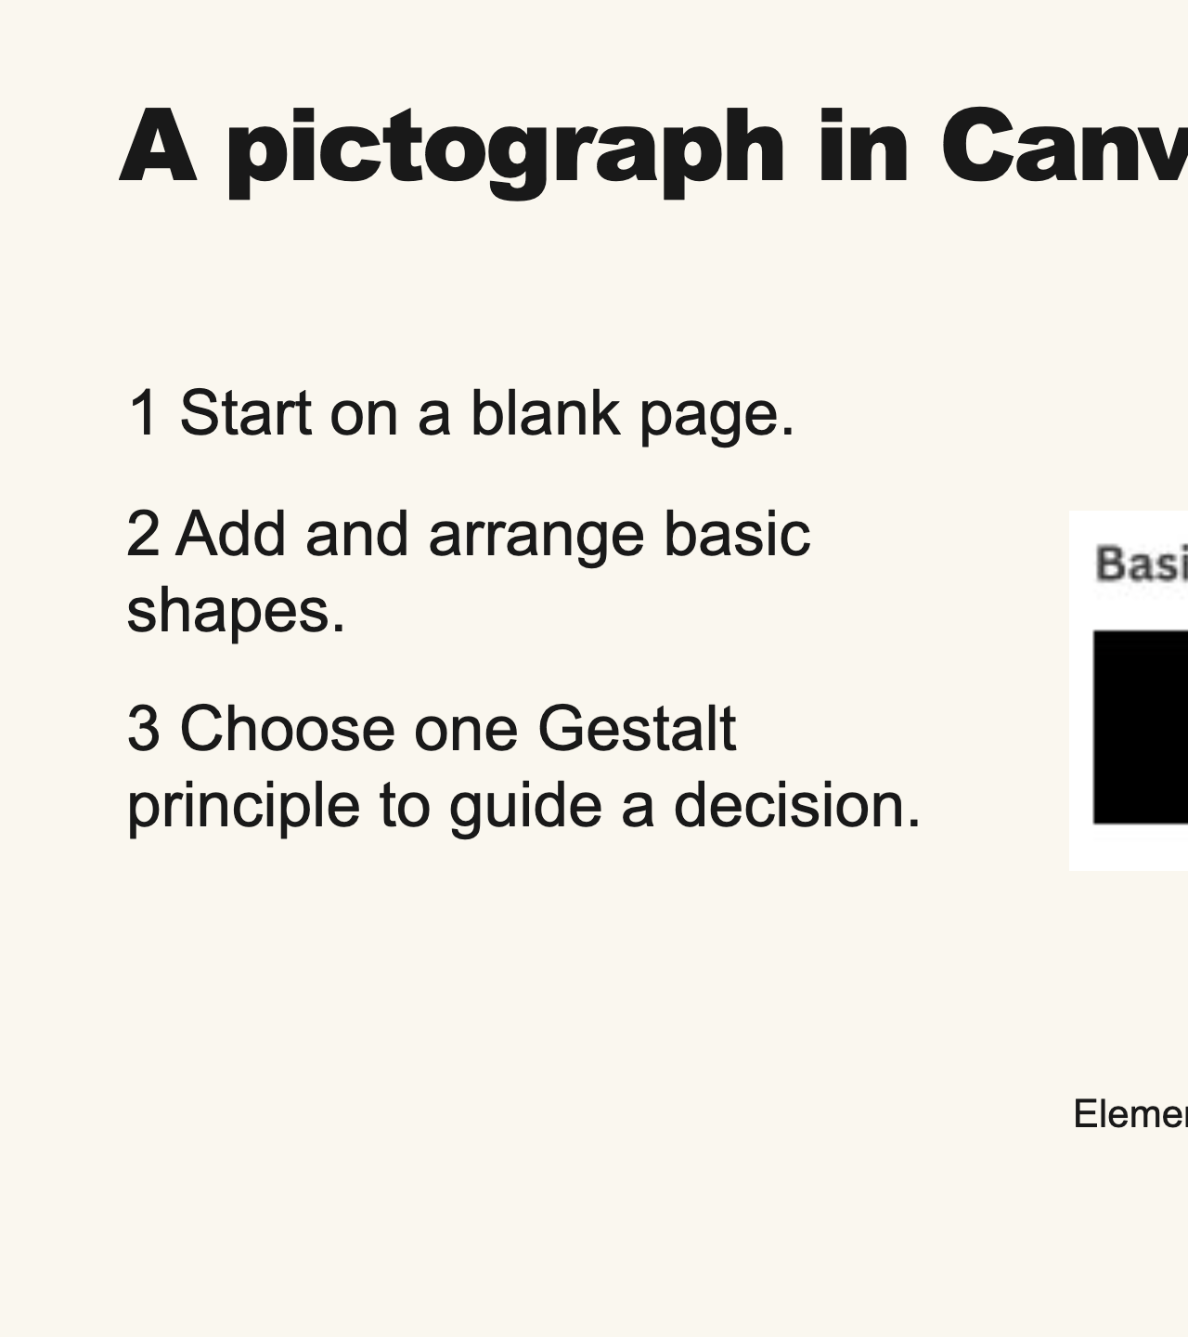
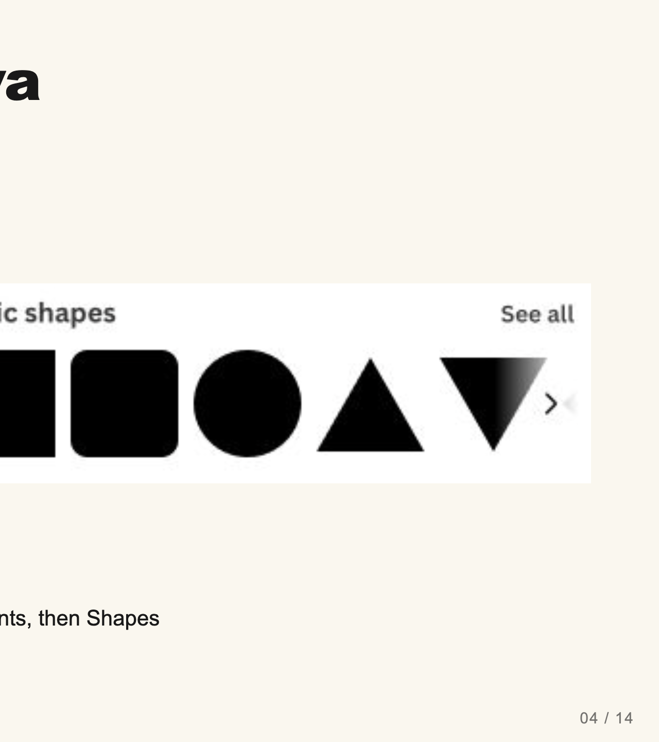
Notes:
Teacher move: 3 minutes. Model a pause symbol live: add one rectangle, make it narrow and tall, duplicate it, and place the two bars side by side with a clear gap. Keep their height, width, and color equal. Name similarity as the principle connecting them. Ask a partner to infer the meaning before you explain. Then change the gap to show how proximity affects the grouping. No text or pre-made icon is needed.
[Sources]
Current course snapshot, generated student pages and facilitator guides in innovative-technology-site, inspected 2026-09-07. Original ZIP supplied by Elisha Lucero.
Canva editor and Combo app, Graphic Design Lesson Demonstrations, https://www.canva.com/design/DAHUiq9hUJg/IwU_7AR5EXsmRbdnEBtkhA/edit . Screenshots captured directly in the Bowie Middle School account, 2026-09-07. Interface labels may vary by account. Canva screenshots used for classroom software instruction.
Selected instructional image retained from the user-supplied Unit 1 DPI 2026 teaching materials. Reuse is for this classroom teaching adaptation. Original image rights remain with their respective creators; no open license is asserted.
Visual: canva-shapes.png. Canva editor and Combo app, Graphic Design Lesson Demonstrations, https://www.canva.com/design/DAHUiq9hUJg/IwU_7AR5EXsmRbdnEBtkhA/edit . Screenshots captured directly in the Bowie Middle School account, 2026-09-07. Interface labels may vary by account. Canva screenshots used for classroom software instruction.
Visual reference: canva-shapes.png. Supplied teaching artwork or a direct Canva interface capture, as recorded in the source ledger.

Slide 22
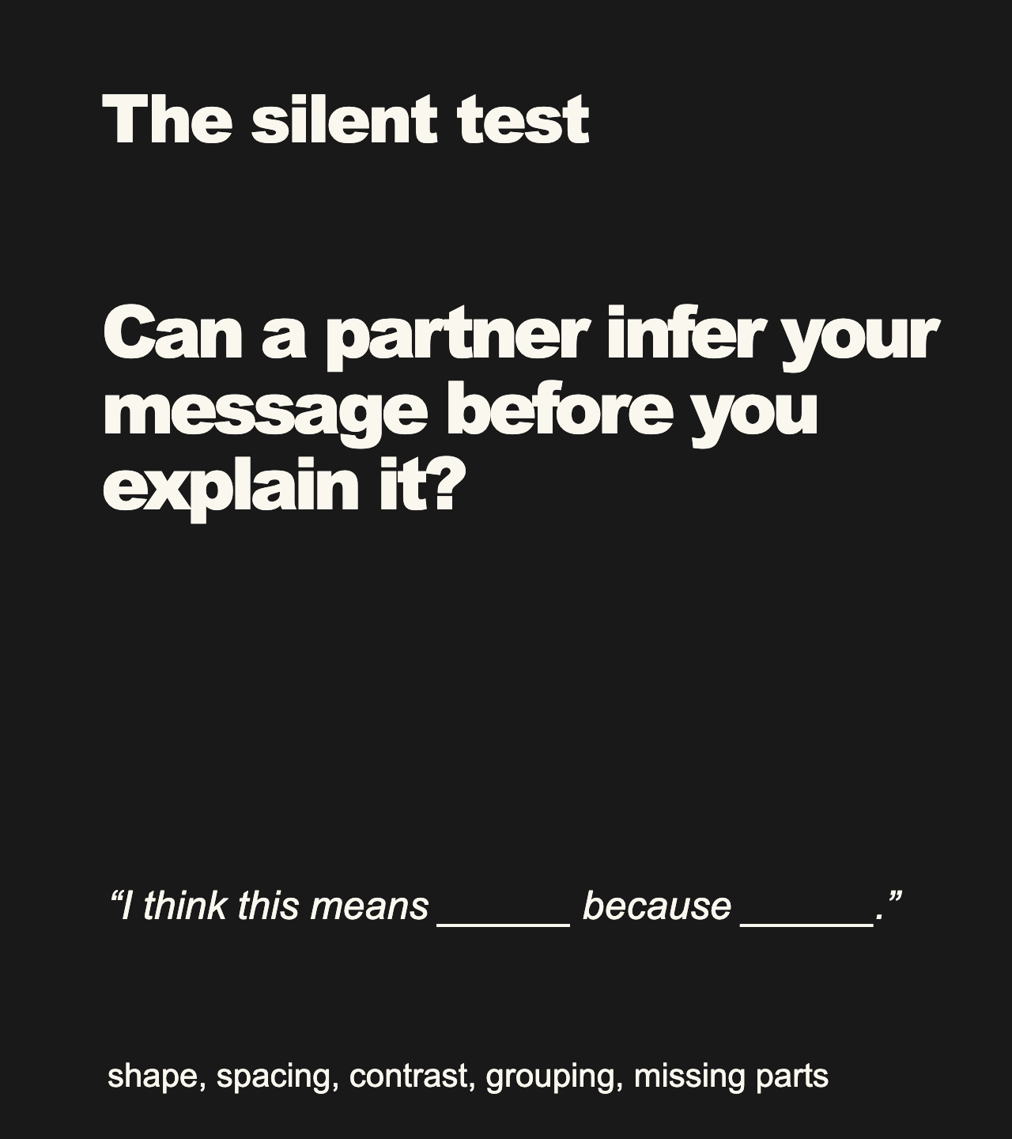
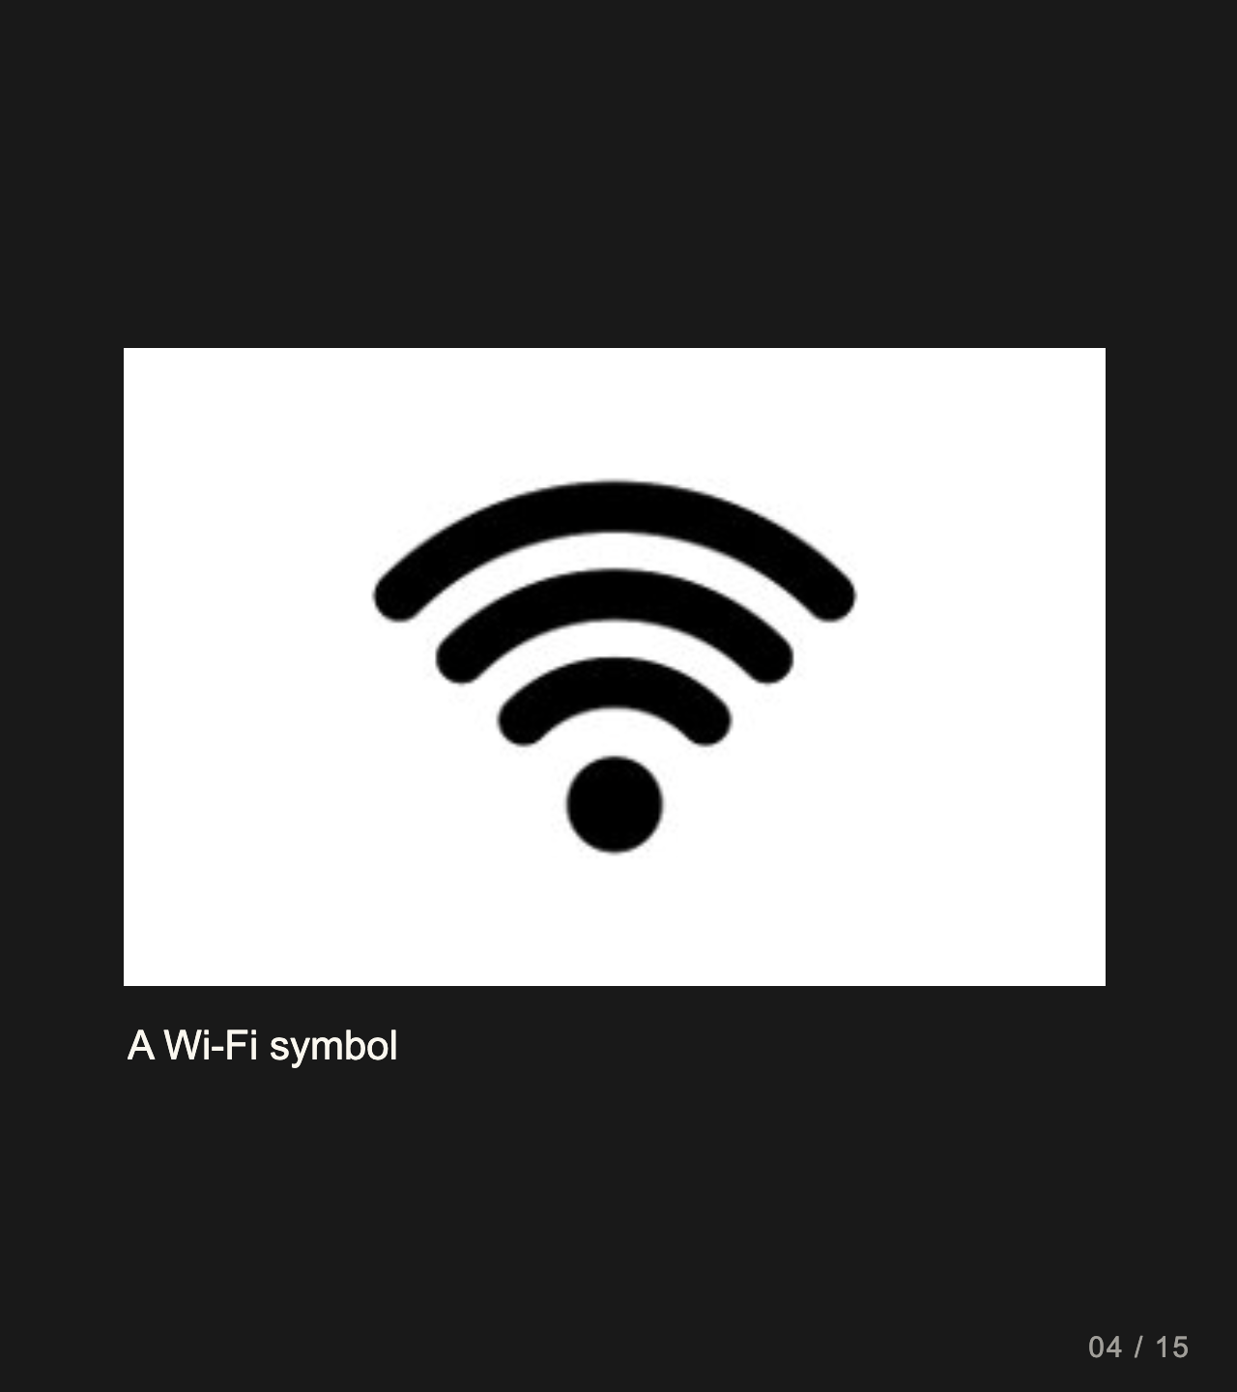
Notes:
Teacher move: 2 minutes. Partner A shows the graphic without speaking. Partner B names the message and the clue. Swap roles. If the message is unclear, revise one shape or its arrangement.
[Sources]
Current course snapshot, generated student pages and facilitator guides in innovative-technology-site, inspected 2026-09-07. Original ZIP supplied by Elisha Lucero.
Canva editor and Combo app, Graphic Design Lesson Demonstrations, https://www.canva.com/design/DAHUiq9hUJg/IwU_7AR5EXsmRbdnEBtkhA/edit . Screenshots captured directly in the Bowie Middle School account, 2026-09-07. Interface labels may vary by account. Canva screenshots used for classroom software instruction.
Selected instructional image retained from the user-supplied Unit 1 DPI 2026 teaching materials. Reuse is for this classroom teaching adaptation. Original image rights remain with their respective creators; no open license is asserted.
Visual reference: source-36.jpg. Supplied teaching artwork or a direct Canva interface capture, as recorded in the source ledger.

Slide 23
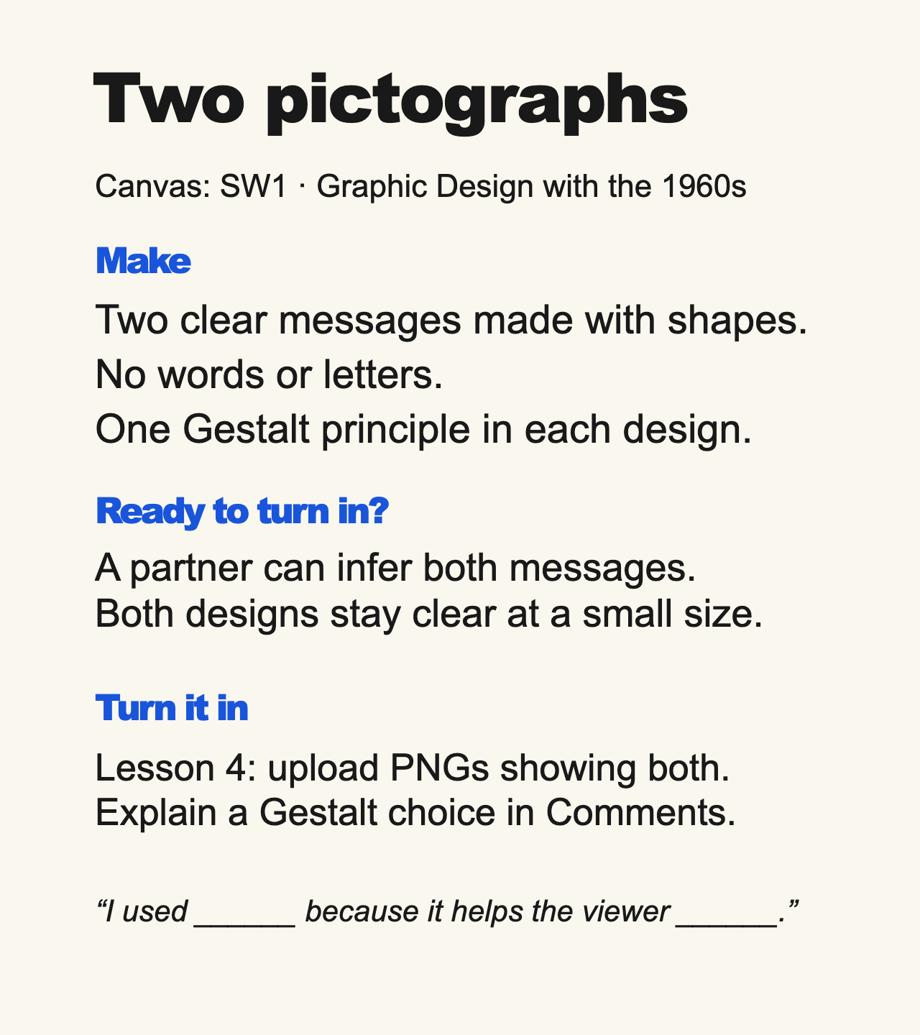
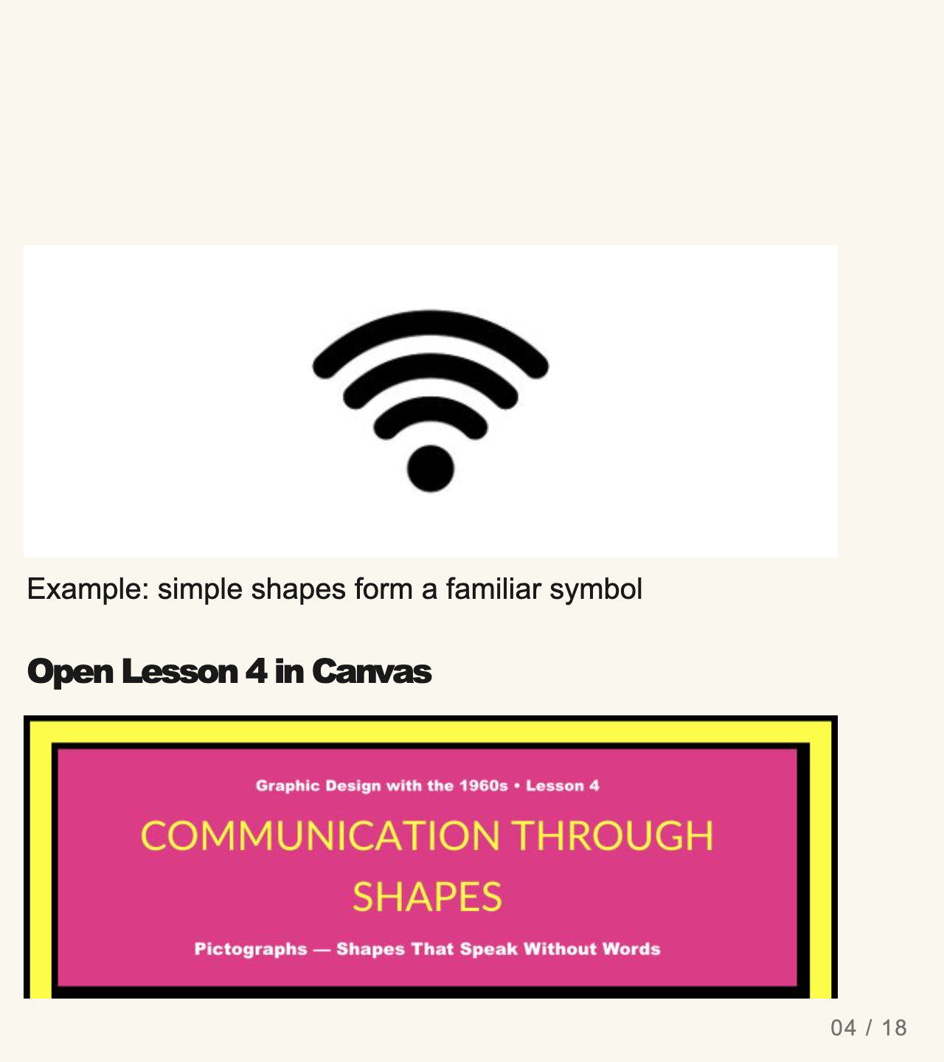
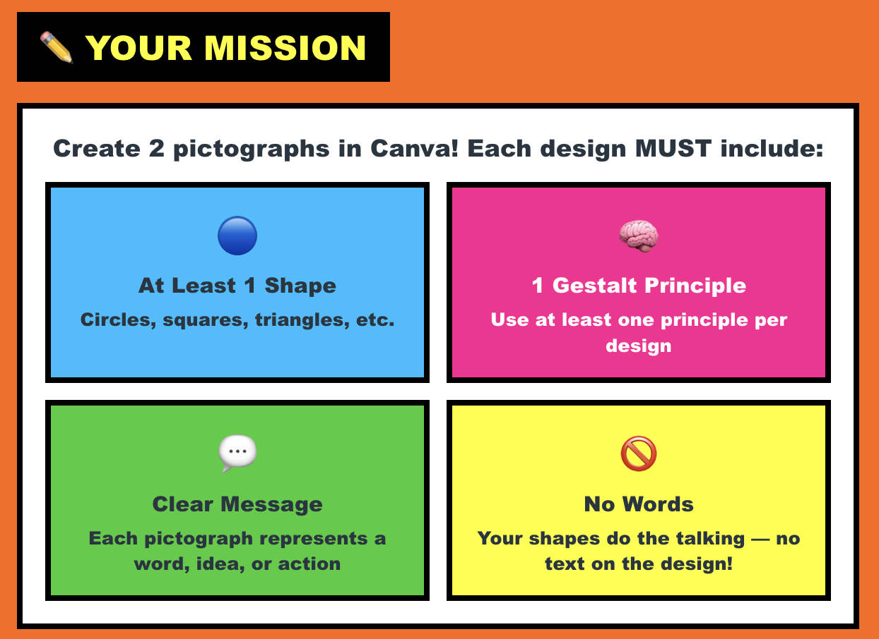
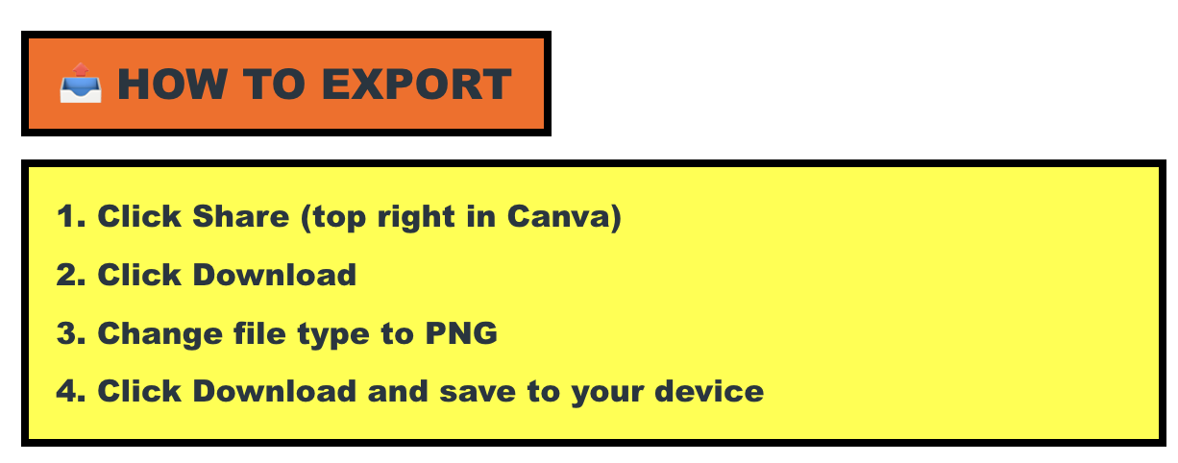
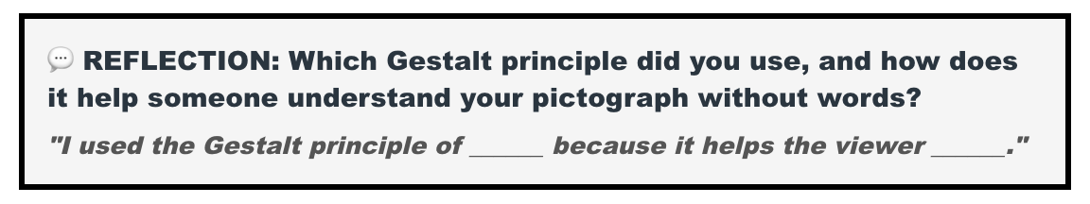
LastName-FirstName-Icon.png
Custom Size = 1000x1000 px
Notes:
Teacher move: Leave this screen projected throughout independent work. It contains the required product, observable completion checks, an exemplar, and the existing submission route. Use verbal reminders and brief conferences instead of cycling through separate task, submission, and done slides. The exemplar is inspiration, not a template to copy. Before class, open the named assignment in your own course and confirm the submission controls.
Each of the two pictographs needs at least one shape and at least one Gestalt principle. Students may export them together on one page or as separate PNGs. They should test the messages silently with a partner.
The existing assignment rubric and points remain authoritative. Confer on one useful revision at a time.
[Sources]
Current course snapshot, generated student pages and facilitator guides in innovative-technology-site, inspected 2026-09-07. Original ZIP supplied by Elisha Lucero.
Canva editor and Combo app, Graphic Design Lesson Demonstrations, https://www.canva.com/design/DAHUiq9hUJg/IwU_7AR5EXsmRbdnEBtkhA/edit . Screenshots captured directly in the Bowie Middle School account, 2026-09-07. Interface labels may vary by account. Canva screenshots used for classroom software instruction.
Selected instructional image retained from the user-supplied Unit 1 DPI 2026 teaching materials. Reuse is for this classroom teaching adaptation. Original image rights remain with their respective creators; no open license is asserted.
Exemplar: source-36.jpg, from the supplied classroom materials. Canvas: live assignment and submission types verified through the API on September 7, 2026. Screenshot: real teacher-view assignment banner, cropped to omit editing controls. The unpublished template module prevents Student View access; publication was not changed.

Slide 24
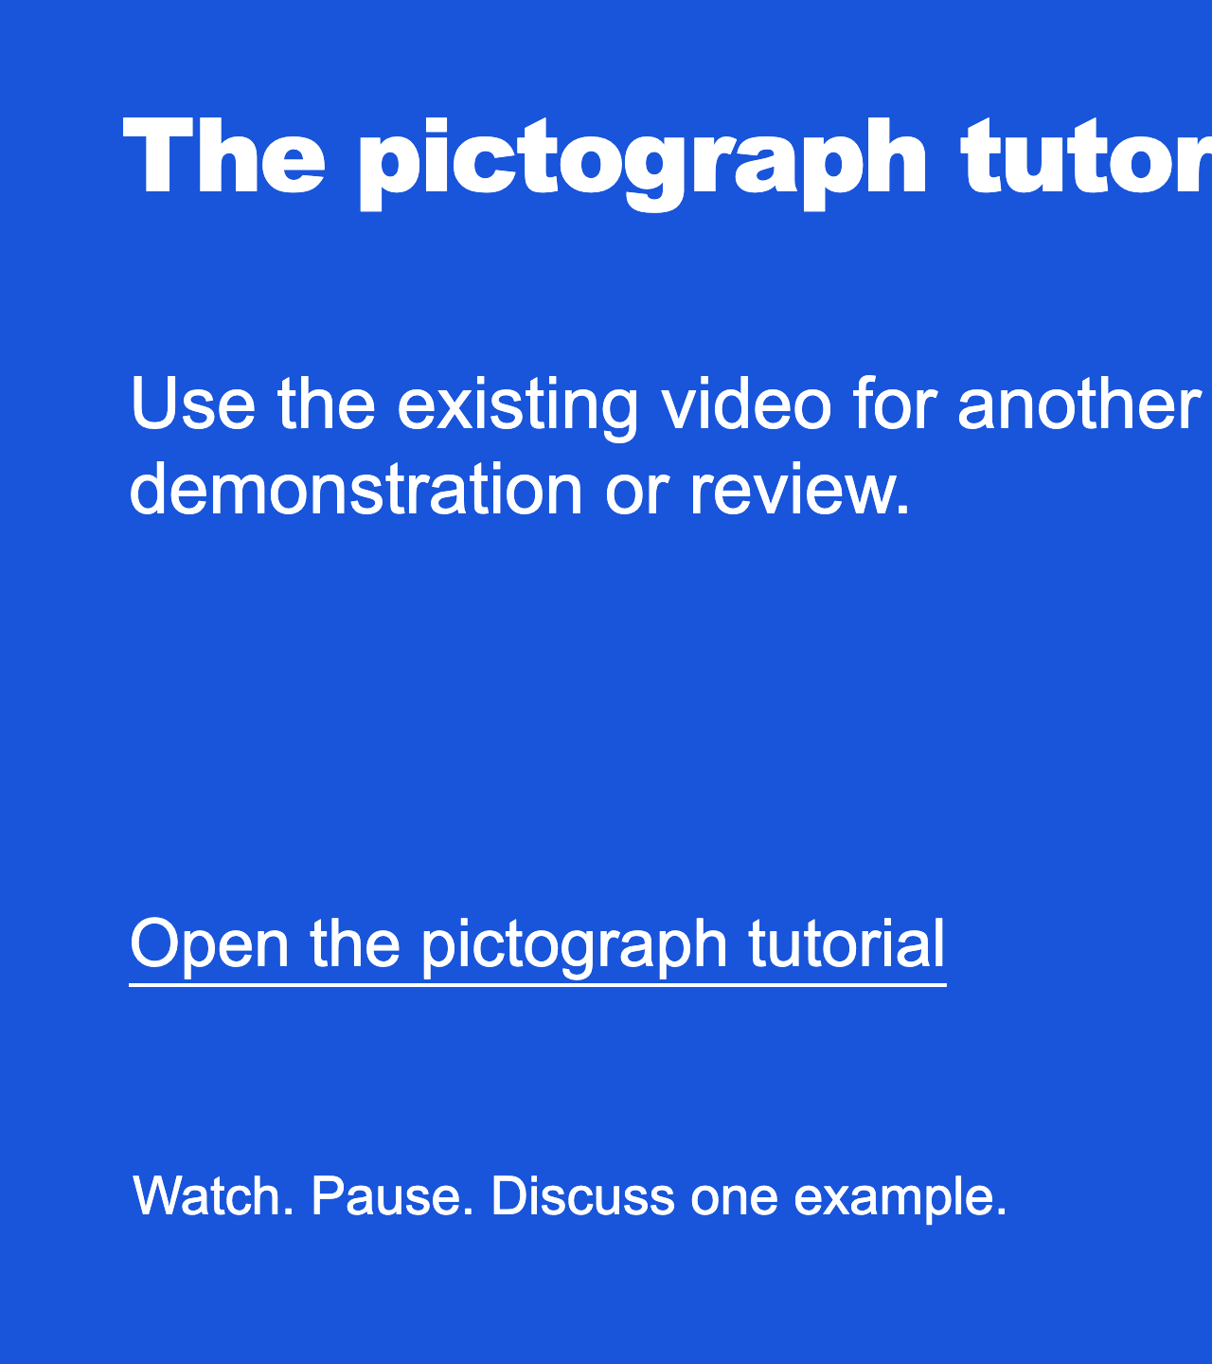
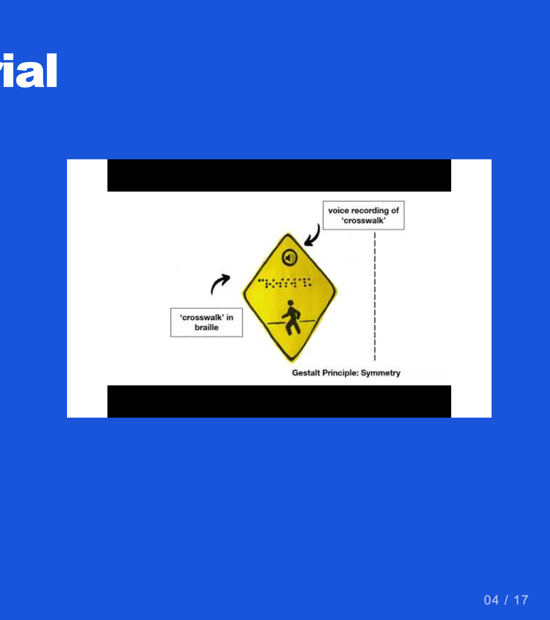
Notes:
Teacher move: Optional reference. Current lesson tutorial: https://www.youtube.com/watch?v=etexc2tkE1I . Preview it before class and pause when students need time to practice.
[Sources]
Current course snapshot, generated student pages and facilitator guides in innovative-technology-site, inspected 2026-09-07. Original ZIP supplied by Elisha Lucero.
Canva editor and Combo app, Graphic Design Lesson Demonstrations, https://www.canva.com/design/DAHUiq9hUJg/IwU_7AR5EXsmRbdnEBtkhA/edit . Screenshots captured directly in the Bowie Middle School account, 2026-09-07. Interface labels may vary by account. Canva screenshots used for classroom software instruction.
Selected instructional image retained from the user-supplied Unit 1 DPI 2026 teaching materials. Reuse is for this classroom teaching adaptation. Original image rights remain with their respective creators; no open license is asserted.
Visual reference: video-04.jpg. Thumbnail published by the linked video on YouTube.

