Slide 1
PICTURE THIS | DAY 3 OF 5
Be the AI
Yesterday you read about it. Today you ARE the model.
Smart Solutions | Engineering & Technology
Your Teacher
WED | 1/11
Notes:
Run the paper classification test before the digital model. Ask teams to state the rule they used and where it failed.
[Sources]
- Teacher-authored Picture This classroom presentation and print set (Lucero, 2025).
- Google Teachable Machine, official tool: https://teachablemachine.withgoogle.com/ (accessed 2026-08-15).

Slide 2
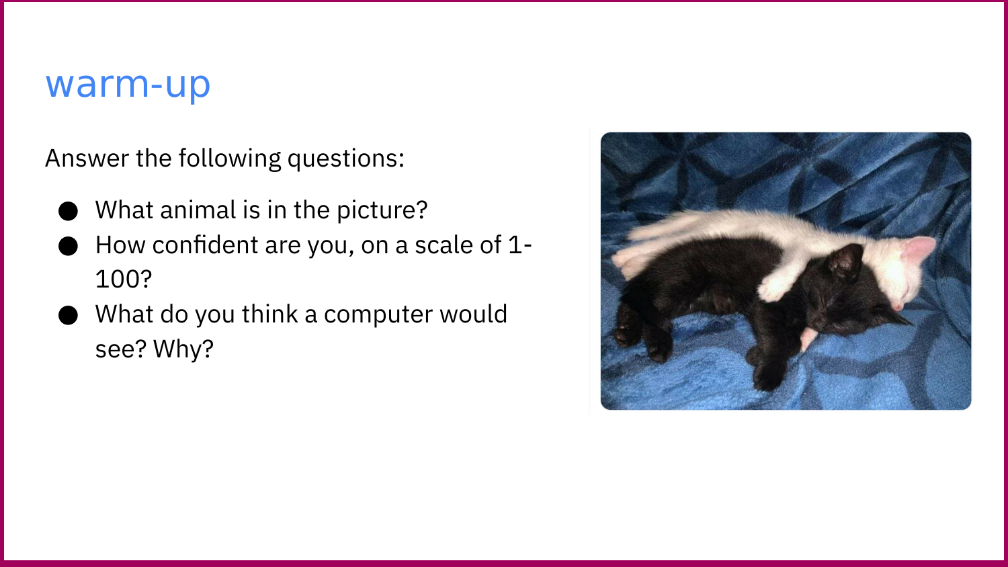
Smart Solutions | Engineering & Tech
WED | 2/11
Notes:
Run the paper classification test before the digital model. Ask teams to state the rule they used and where it failed.
[Sources]
- Teacher-authored Picture This classroom presentation and print set (Lucero, 2025).
- Google Teachable Machine, official tool: https://teachablemachine.withgoogle.com/ (accessed 2026-08-15).
- COLORED PENCIL magazine, "FEBRUARY 2014 CPM Art Challenge Photo 'Portrait of a Cat' #1402," CC BY 2.0, https://www.flickr.com/photos/61446950@N06/12175509725 (accessed 2026-08-15).
- Kit4na, "Newest addition to the family," CC BY 2.0, https://www.flickr.com/photos/44843078@N03/7604210572 (accessed 2026-08-15).
- Pets4Dawn, "Cognac at Pet Photography Workshop #2," CC BY 2.0, https://www.flickr.com/photos/38621030@N07/12474422135 (accessed 2026-08-15).
- ankakay, "Luna's Closeup," CC BY 2.0, https://www.flickr.com/photos/56738296@N00/3876436286 (accessed 2026-08-15).
- faith goble, "See How She Treats Me?," CC BY 2.0, https://www.flickr.com/photos/24420613@N08/3506250273 (accessed 2026-08-15).
- foxypar4, "Slobbering Dog," CC BY 2.0, https://www.flickr.com/photos/43145783@N00/1318449097 (accessed 2026-08-15).
- Dailypuppies, "Cute Puppies @ December 20, 2015 at 09:36AM," CC0 1.0, https://www.flickr.com/photos/136292790@N05/23232445753 (accessed 2026-08-15).
- istolethetv, "dog eat dog," CC BY 2.0, https://www.flickr.com/photos/44124401641@N01/3186313121 (accessed 2026-08-15).

Slide 3
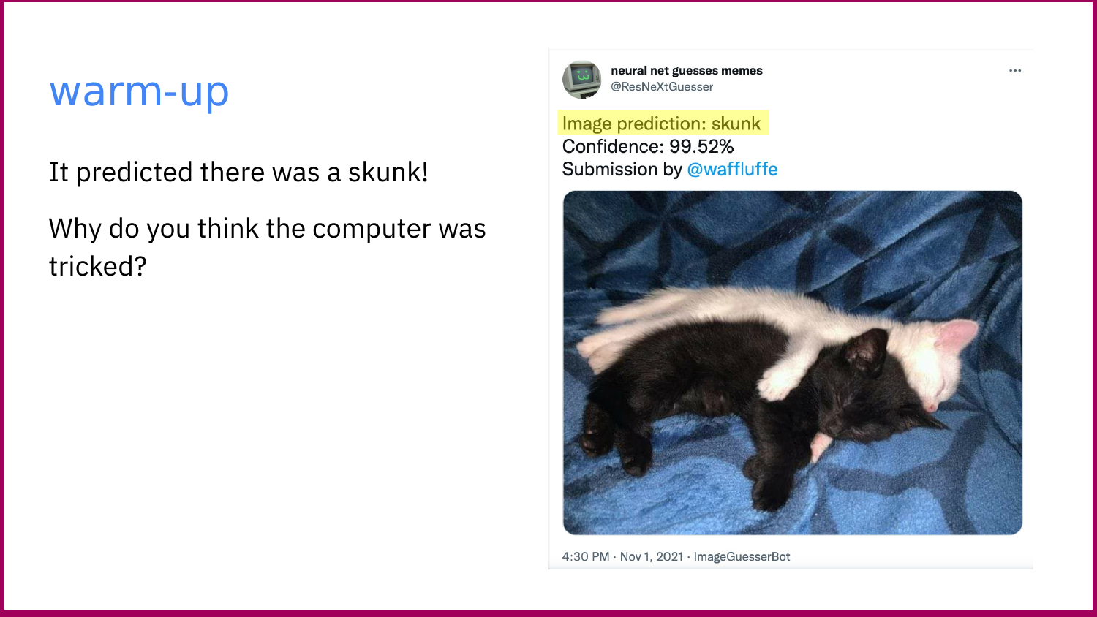
Smart Solutions | Engineering & Tech
WED | 3/11
Notes:
Run the paper classification test before the digital model. Ask teams to state the rule they used and where it failed.
[Sources]
- Teacher-authored Picture This classroom presentation and print set (Lucero, 2025).
- Google Teachable Machine, official tool: https://teachablemachine.withgoogle.com/ (accessed 2026-08-15).

Slide 4
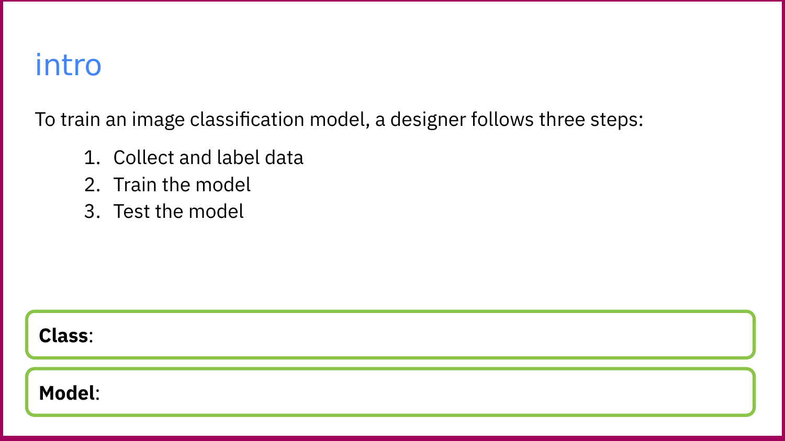
Smart Solutions | Engineering & Tech
WED | 4/11
Notes:
Run the paper classification test before the digital model. Ask teams to state the rule they used and where it failed.
[Sources]
- Teacher-authored Picture This classroom presentation and print set (Lucero, 2025).
- Google Teachable Machine, official tool: https://teachablemachine.withgoogle.com/ (accessed 2026-08-15).

Slide 5
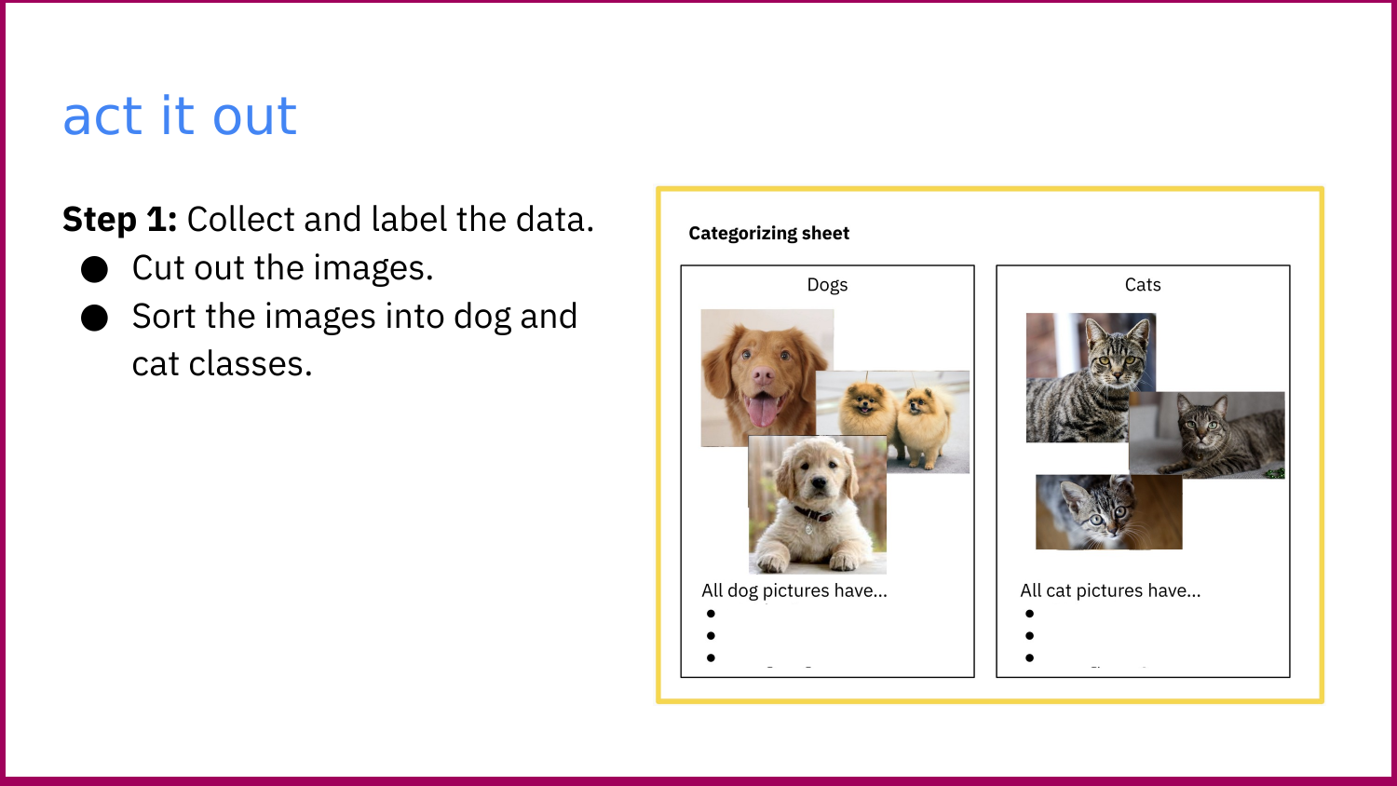
Smart Solutions | Engineering & Tech
WED | 5/11
Notes:
Run the paper classification test before the digital model. Ask teams to state the rule they used and where it failed.
[Sources]
- Teacher-authored Picture This classroom presentation and print set (Lucero, 2025).
- Google Teachable Machine, official tool: https://teachablemachine.withgoogle.com/ (accessed 2026-08-15).
- COLORED PENCIL magazine, "FEBRUARY 2014 CPM Art Challenge Photo 'Portrait of a Cat' #1402," CC BY 2.0, https://www.flickr.com/photos/61446950@N06/12175509725 (accessed 2026-08-15).
- Kit4na, "Newest addition to the family," CC BY 2.0, https://www.flickr.com/photos/44843078@N03/7604210572 (accessed 2026-08-15).
- Pets4Dawn, "Cognac at Pet Photography Workshop #2," CC BY 2.0, https://www.flickr.com/photos/38621030@N07/12474422135 (accessed 2026-08-15).
- ankakay, "Luna's Closeup," CC BY 2.0, https://www.flickr.com/photos/56738296@N00/3876436286 (accessed 2026-08-15).
- faith goble, "See How She Treats Me?," CC BY 2.0, https://www.flickr.com/photos/24420613@N08/3506250273 (accessed 2026-08-15).
- foxypar4, "Slobbering Dog," CC BY 2.0, https://www.flickr.com/photos/43145783@N00/1318449097 (accessed 2026-08-15).
- Dailypuppies, "Cute Puppies @ December 20, 2015 at 09:36AM," CC0 1.0, https://www.flickr.com/photos/136292790@N05/23232445753 (accessed 2026-08-15).
- istolethetv, "dog eat dog," CC BY 2.0, https://www.flickr.com/photos/44124401641@N01/3186313121 (accessed 2026-08-15).

Slide 6
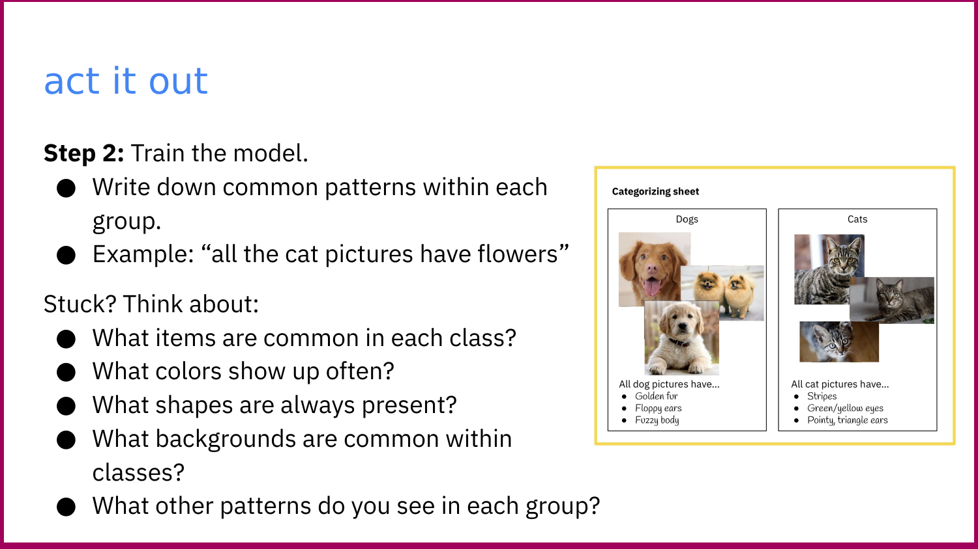
Smart Solutions | Engineering & Tech
WED | 6/11
Notes:
Run the paper classification test before the digital model. Ask teams to state the rule they used and where it failed.
[Sources]
- Teacher-authored Picture This classroom presentation and print set (Lucero, 2025).
- Google Teachable Machine, official tool: https://teachablemachine.withgoogle.com/ (accessed 2026-08-15).
- COLORED PENCIL magazine, "FEBRUARY 2014 CPM Art Challenge Photo 'Portrait of a Cat' #1402," CC BY 2.0, https://www.flickr.com/photos/61446950@N06/12175509725 (accessed 2026-08-15).
- Kit4na, "Newest addition to the family," CC BY 2.0, https://www.flickr.com/photos/44843078@N03/7604210572 (accessed 2026-08-15).
- Pets4Dawn, "Cognac at Pet Photography Workshop #2," CC BY 2.0, https://www.flickr.com/photos/38621030@N07/12474422135 (accessed 2026-08-15).
- ankakay, "Luna's Closeup," CC BY 2.0, https://www.flickr.com/photos/56738296@N00/3876436286 (accessed 2026-08-15).
- faith goble, "See How She Treats Me?," CC BY 2.0, https://www.flickr.com/photos/24420613@N08/3506250273 (accessed 2026-08-15).
- foxypar4, "Slobbering Dog," CC BY 2.0, https://www.flickr.com/photos/43145783@N00/1318449097 (accessed 2026-08-15).
- Dailypuppies, "Cute Puppies @ December 20, 2015 at 09:36AM," CC0 1.0, https://www.flickr.com/photos/136292790@N05/23232445753 (accessed 2026-08-15).
- istolethetv, "dog eat dog," CC BY 2.0, https://www.flickr.com/photos/44124401641@N01/3186313121 (accessed 2026-08-15).

Slide 7
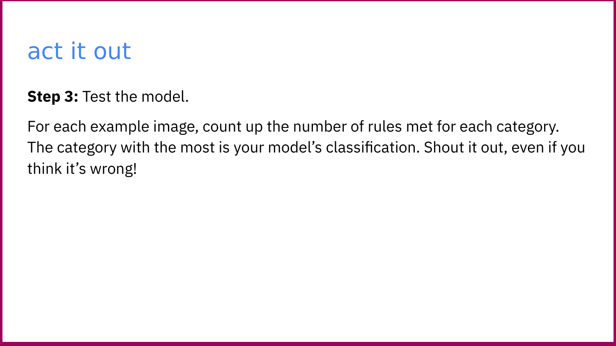
Smart Solutions | Engineering & Tech
WED | 7/11
Notes:
Run the paper classification test before the digital model. Ask teams to state the rule they used and where it failed.
[Sources]
- Teacher-authored Picture This classroom presentation and print set (Lucero, 2025).
- Google Teachable Machine, official tool: https://teachablemachine.withgoogle.com/ (accessed 2026-08-15).

Slide 8
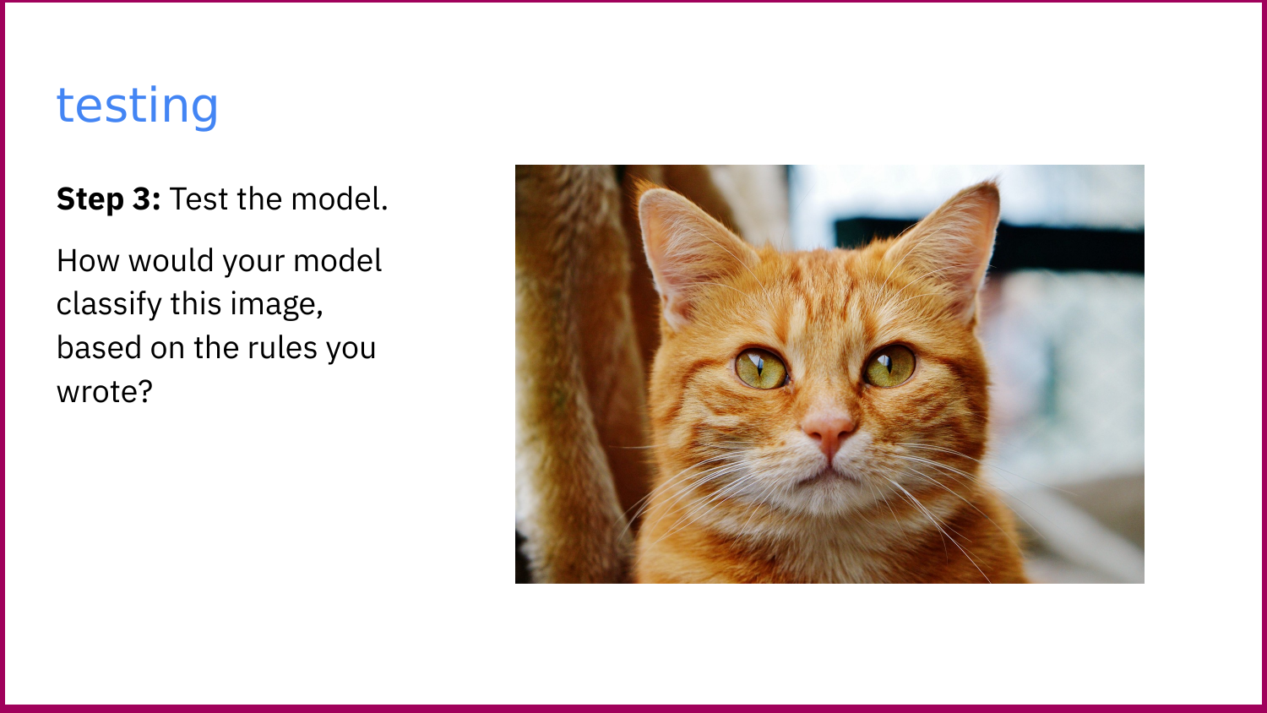
Smart Solutions | Engineering & Tech
WED | 8/11
Notes:
Run the paper classification test before the digital model. Ask teams to state the rule they used and where it failed.
[Sources]
- Teacher-authored Picture This classroom presentation and print set (Lucero, 2025).
- Google Teachable Machine, official tool: https://teachablemachine.withgoogle.com/ (accessed 2026-08-15).

Slide 9
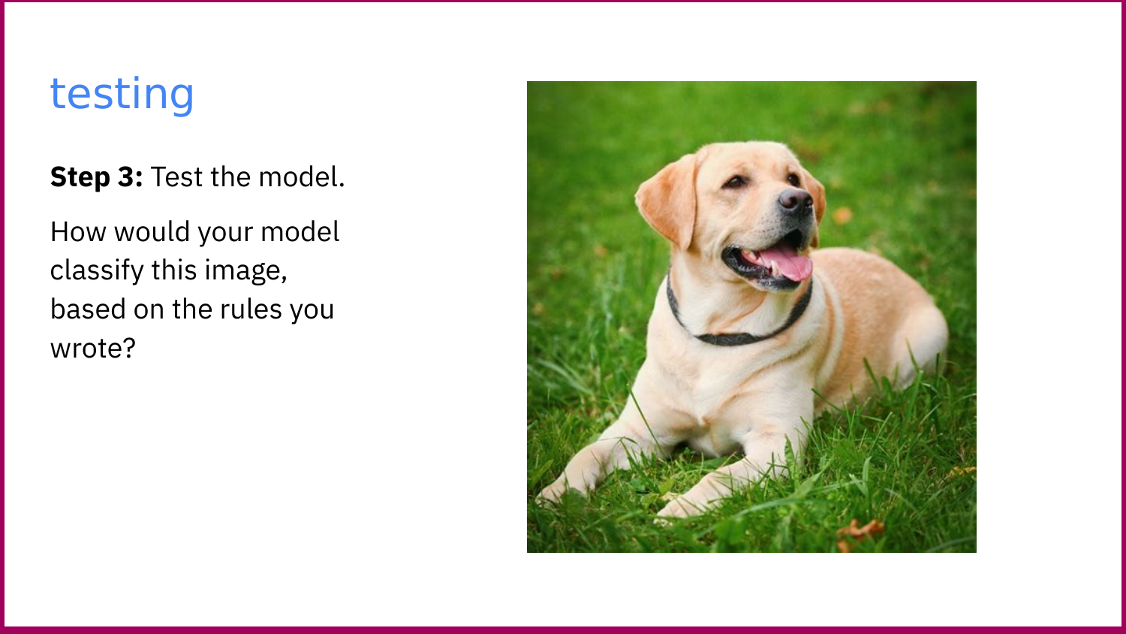
Smart Solutions | Engineering & Tech
WED | 9/11
Notes:
Run the paper classification test before the digital model. Ask teams to state the rule they used and where it failed.
[Sources]
- Teacher-authored Picture This classroom presentation and print set (Lucero, 2025).
- Google Teachable Machine, official tool: https://teachablemachine.withgoogle.com/ (accessed 2026-08-15).

Slide 10
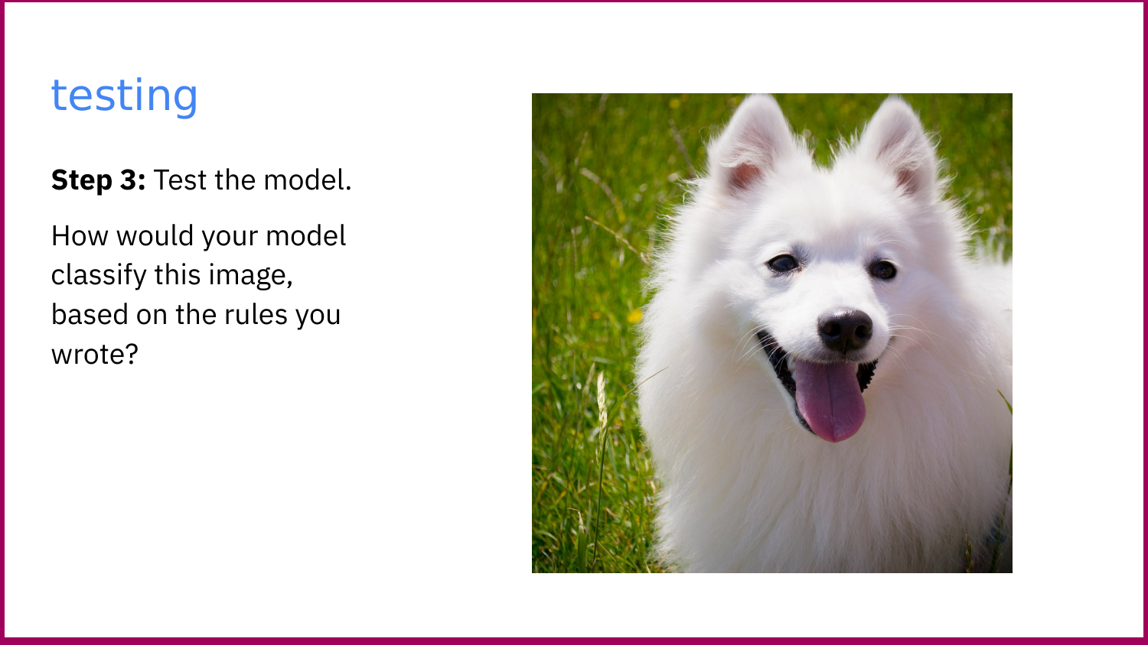
Smart Solutions | Engineering & Tech
WED | 10/11
Notes:
Run the paper classification test before the digital model. Ask teams to state the rule they used and where it failed.
[Sources]
- Teacher-authored Picture This classroom presentation and print set (Lucero, 2025).
- Google Teachable Machine, official tool: https://teachablemachine.withgoogle.com/ (accessed 2026-08-15).

Slide 11
Voice 2 | Pair Work
BIAS CLIMAX | OPEN YOUR CHROMEBOOK
Now do it in real AI.
1
2
3
Open Teachable Machine.
Image Project. Standard.
Make 2 classes: "cat" and "dog."
Use ONLY the photos from your
paper dataset. No extras!
Train. Then test with the
bias photos at your table.
What happens?
When your model fails, discuss:
What was MISSING from your training data? | Who would your AI fail in the real world? | What would you ADD to fix it?
Then: pick up your RAISE exit ticket.
Smart Solutions | Engineering & Technology
Your Teacher
WED | 11/11
Notes:
Run the paper classification test before the digital model. Ask teams to state the rule they used and where it failed.
[Sources]
- Teacher-authored Picture This classroom presentation and print set (Lucero, 2025).
- Google Teachable Machine, official tool: https://teachablemachine.withgoogle.com/ (accessed 2026-08-15).

