Slide 1
PICTURE THIS | DAY 4 OF 5
Train Your Model
Tomorrow you code. Today you train.
Smart Solutions | Engineering & Technology
Your Teacher
THU | 1/10
Notes:
Follow the visible build sequence. Pause for teams to check class balance and test before exporting.
[Sources]
- Teacher-authored Picture This classroom presentation and planning sheet (Lucero, 2025).
- Google Teachable Machine, official tool: https://teachablemachine.withgoogle.com/ (accessed 2026-08-15).
- MIT RAISE Playground, official tool: https://playground.raise.mit.edu/ (accessed 2026-08-15).

Slide 2
Voice 1 | Discuss
WARM-UP | YESTERDAY'S EXIT TICKET
Remember the happy / sad face AI?
THE BIAS
WHY IT MATTERS TODAY
All HAPPY training photos
were women.
All SAD training photos
were men.
When a SAD WOMAN appeared,
the AI said "happy."
The AI learned
"happy = woman."
It wasn't really learning
happy. It was learning
women.
Today: how do we make
OUR data fair?
Pair-share for 90 seconds: when YOU train your AI today, how will you avoid this kind of bias?
Smart Solutions | Engineering & Technology
Your Teacher
THU | 2/10
Notes:
Follow the visible build sequence. Pause for teams to check class balance and test before exporting.
[Sources]
- Teacher-authored Picture This classroom presentation and planning sheet (Lucero, 2025).
- Google Teachable Machine, official tool: https://teachablemachine.withgoogle.com/ (accessed 2026-08-15).
- MIT RAISE Playground, official tool: https://playground.raise.mit.edu/ (accessed 2026-08-15).

Slide 3
FRIDAY'S EXEMPLAR
Tomorrow, your AI will control a dinosaur.
When you lean LEFT, the dinosaur runs LEFT.
When you lean RIGHT, the dinosaur runs RIGHT.
Or make it your own:
• Thumbs up = jump | thumbs down = duck
• Open hand = stop | closed fist = go
• Smile = run | frown = freeze
• Your choice...
Smart Solutions | Engineering & Technology
Your Teacher
THU | 3/10
Notes:
Follow the visible build sequence. Pause for teams to check class balance and test before exporting.
[Sources]
- Teacher-authored Picture This classroom presentation and planning sheet (Lucero, 2025).
- Google Teachable Machine, official tool: https://teachablemachine.withgoogle.com/ (accessed 2026-08-15).
- MIT RAISE Playground, official tool: https://playground.raise.mit.edu/ (accessed 2026-08-15).

Slide 4
PLAN BEFORE YOU TRAIN
Pick your 2 classes.
Get a planning sheet. Decide what your AI will tell apart. Write it down.
Smart Solutions | Engineering & Technology
Your Teacher
THU | 4/10
Notes:
Follow the visible build sequence. Pause for teams to check class balance and test before exporting.
[Sources]
- Teacher-authored Picture This classroom presentation and planning sheet (Lucero, 2025).
- Google Teachable Machine, official tool: https://teachablemachine.withgoogle.com/ (accessed 2026-08-15).
- MIT RAISE Playground, official tool: https://playground.raise.mit.edu/ (accessed 2026-08-15).

Slide 5
Voice 2 | Working
Train | 25 min
TRAIN YOUR MODEL
1
2
3
4
Open TM
Name your 2 classes
Take 30+ photos per class
Train, test, export
teachablemachine.withgoogle.com → Image Project → Standard.
Use the names from your planning sheet.
Vary your angle, lighting, distance. This is where bias starts.
Click Train. Test it. Click Export Model → Upload → COPY THE URL.
Smart Solutions | Engineering & Technology
Your Teacher
THU | 5/10
Notes:
Follow the visible build sequence. Pause for teams to check class balance and test before exporting.
[Sources]
- Teacher-authored Picture This classroom presentation and planning sheet (Lucero, 2025).
- Google Teachable Machine, official tool: https://teachablemachine.withgoogle.com/ (accessed 2026-08-15).
- MIT RAISE Playground, official tool: https://playground.raise.mit.edu/ (accessed 2026-08-15).

Slide 6
BEFORE YOU LEAVE
BIAS CHECK
Test your model on edge cases:
• Does it work for a different person?
• Does it work in different lighting?
• Does it work when you're further away?
• What's the WORST case where it fails?
Write the bias you found on Box 5 of your planning sheet. Tomorrow you'll fix it.
Smart Solutions | Engineering & Technology
Your Teacher
THU | 6/10
Notes:
Follow the visible build sequence. Pause for teams to check class balance and test before exporting.
[Sources]
- Teacher-authored Picture This classroom presentation and planning sheet (Lucero, 2025).
- Google Teachable Machine, official tool: https://teachablemachine.withgoogle.com/ (accessed 2026-08-15).
- MIT RAISE Playground, official tool: https://playground.raise.mit.edu/ (accessed 2026-08-15).

Slide 7
BEFORE YOU IMPORT
Get your model URL.
Click Export Model → Upload (shareable link) → copy the URL.
Paste it into your Canvas submission comment RIGHT NOW.
Once your URL is saved, we're going to import your AI into the RAISE Playground.
Tomorrow you'll remix it. Today we just get it working.
Smart Solutions | Engineering & Technology
Your Teacher
THU | 7/10
Notes:
Follow the visible build sequence. Pause for teams to check class balance and test before exporting.
[Sources]
- Teacher-authored Picture This classroom presentation and planning sheet (Lucero, 2025).
- Google Teachable Machine, official tool: https://teachablemachine.withgoogle.com/ (accessed 2026-08-15).
- MIT RAISE Playground, official tool: https://playground.raise.mit.edu/ (accessed 2026-08-15).

Slide 8
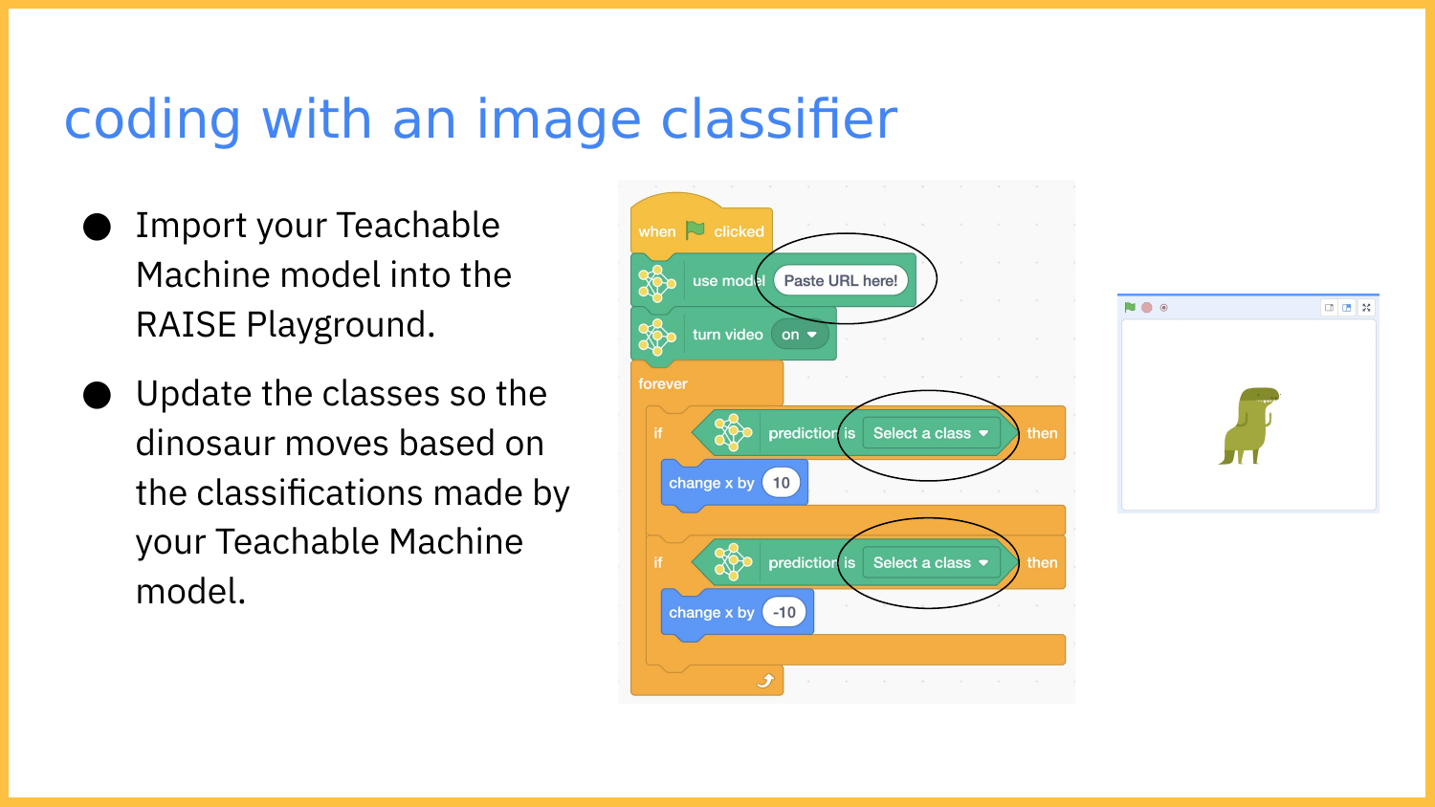
Smart Solutions | Engineering & Tech
THU | 8/10
Notes:
Follow the visible build sequence. Pause for teams to check class balance and test before exporting.
[Sources]
- Teacher-authored Picture This classroom presentation and planning sheet (Lucero, 2025).
- Google Teachable Machine, official tool: https://teachablemachine.withgoogle.com/ (accessed 2026-08-15).
- MIT RAISE Playground, official tool: https://playground.raise.mit.edu/ (accessed 2026-08-15).

Slide 9
Voice 2 | Pair Work
Code | 10 min
GET IT WORKING | ~10 MIN
1
2
3
4
Open template
Paste your URL
Set your classes
Run it
Open the RAISE Playground template linked in Canvas.
Find the "use model" block. Copy the model URL from your Canvas submission comment.
On each "if prediction is" block, click the dropdown and pick a class name.
Click the green flag. Webcam turns on. Test it. The dinosaur should react. If it doesn't, check the URL.
Smart Solutions | Engineering & Technology
Your Teacher
THU | 9/10
Notes:
Follow the visible build sequence. Pause for teams to check class balance and test before exporting.
[Sources]
- Teacher-authored Picture This classroom presentation and planning sheet (Lucero, 2025).
- Google Teachable Machine, official tool: https://teachablemachine.withgoogle.com/ (accessed 2026-08-15).
- MIT RAISE Playground, official tool: https://playground.raise.mit.edu/ (accessed 2026-08-15).

Slide 10
Voice 0 | Silent
EXIT TICKET
What did your AI fail at?
"My AI failed when ___________. I think it's because ___________."
Be specific. Tomorrow you'll fix it.
Smart Solutions | Engineering & Technology
Your Teacher
THU | 10/10
Notes:
Follow the visible build sequence. Pause for teams to check class balance and test before exporting.
[Sources]
- Teacher-authored Picture This classroom presentation and planning sheet (Lucero, 2025).
- Google Teachable Machine, official tool: https://teachablemachine.withgoogle.com/ (accessed 2026-08-15).
- MIT RAISE Playground, official tool: https://playground.raise.mit.edu/ (accessed 2026-08-15).

