Slide 1
SMART SOLUTIONS · CODING FOUNDATIONS
Plan it. Test it. Code it.
A reusable pseudocode routine plus a two-day bridge from blocks to text.
PLAN
NOTICE
TEST
REVISE
TRANSFER
Notes:
Use this deck only for the retrofit moments. Keep the existing Intro to CS, Video Game Design, and RVR decks for the rest of each unit.
[Sources]
- https://tea.texas.gov/laws-and-rules/texas-administrative-code/19-tac-chapter-126

Slide 2
CODING FOUNDATIONS
One Passport follows the whole coding arc
Students add one checkpoint at a time instead of completing a second coding unit.
1 · DECOMPOSE
2 · PATTERNS
3 · REVISE
4 · TEXT CODE
5 · RVR
The planning language stays stable while the programming surface changes.
SMART SOLUTIONS · CODING FOUNDATIONS
VILS 2027
Notes:
Show the five Passport pages. Tell students they complete only the checkpoint assigned today and keep the same document.
[Sources]
- https://tea.texas.gov/laws-and-rules/texas-administrative-code/19-tac-chapter-126

Slide 3
PSEUDOCODE LAUNCH
DAY 1
Pseudocode must be precise enough to execute
A useful plan removes hidden assumptions without copying programming-language syntax.
USE
AVOID
Short commands
Indent repeated steps
Name variables by purpose
Show decisions and repetition
End where the task is complete
“Make it work”
Unexplained jumps
Directions only the writer understands
Copying blocks without a plan
Decorating before testing
SMART SOLUTIONS · CODING FOUNDATIONS
VILS 2027
Notes:
Read one example aloud literally. Ask what a computer or partner would do when the direction is ambiguous.
[Sources]
- https://tea.texas.gov/laws-and-rules/texas-administrative-code/19-tac-chapter-126

Slide 4
PSEUDOCODE LAUNCH
DAY 1
Break one goal into smaller jobs
Complete Passport Checkpoint 1 before opening Code.org.
GOAL
INPUT + OUTPUT
SUBPROBLEMS
What must the finished program make happen?
What enters the system?
What should the system produce?
What are the three or more smaller jobs?
If a job is still vague, break it down again.
SMART SOLUTIONS · CODING FOUNDATIONS
VILS 2027
Notes:
Model with the Angry Birds route or another route puzzle already in the lesson. Keep the decomposition brief; students still complete the existing coding task.
[Sources]
- https://tea.texas.gov/laws-and-rules/texas-administrative-code/19-tac-chapter-126

Slide 5
PSEUDOCODE LAUNCH
DAY 1
Write the route before touching the blocks
Use commands another person can perform without asking what you meant.
START
MOVE forward 2 spaces
TURN right
REPEAT 3 times
MOVE forward 1 space
END REPEAT
END
CHECK THE PLAN
Is every move observable?
Is the repeated group indented?
Could the numbers change?
Where would a variable help?
SMART SOLUTIONS · CODING FOUNDATIONS
VILS 2027
Notes:
Students draft on Passport Checkpoint 1, then build the same route in Code.org. Pseudocode does not need to match a single vendor syntax.
[Sources]
- https://tea.texas.gov/laws-and-rules/texas-administrative-code/19-tac-chapter-126

Slide 6
PSEUDOCODE LAUNCH
DAY 1
Literal testing exposes the missing assumption
The partner may follow only the written plan.
READ
EXECUTE
STOP AT CONFUSION
MARK THE LINE
REVISE
“I stopped at ______ because the plan did not say ______.”
Do not explain the missing step until your partner marks it.
SMART SOLUTIONS · CODING FOUNDATIONS
VILS 2027
Notes:
Keep this to a fast partner test. The purpose is to create evidence for revision, not to grade reading performance.
[Sources]
- https://tea.texas.gov/laws-and-rules/texas-administrative-code/19-tac-chapter-126

Slide 7
PATTERNS AND VARIABLES
DAY 2
Name the repeated pattern before using a loop
Complete Passport Checkpoint 2 during Intro to CS Day 2.
MOVE forward
TURN right
MOVE forward
TURN right
MOVE forward
TURN right
REPEAT 3 times
MOVE forward
TURN right
END REPEAT
→
SMART SOLUTIONS · CODING FOUNDATIONS
VILS 2027
Notes:
Ask students to bracket the smallest useful repeated group before they name the loop.
[Sources]
- https://tea.texas.gov/laws-and-rules/texas-administrative-code/19-tac-chapter-126

Slide 8
PATTERNS AND VARIABLES
DAY 2
Variables give changing details useful names
Record a name, type, starting value, and operation in the Passport.
NUMBER
STRING
BOOLEAN
boxesRemaining = 12
rows = 3
columns = 4
Operations: + − × ÷
missionName =
“Emergency Supply Grid”
Operation: join text
priorityMode = true
carryingBox = false
Operations: AND, OR, NOT
SMART SOLUTIONS · CODING FOUNDATIONS
VILS 2027
Notes:
Students may first encounter variables in blocks. Require meaningful names and connect each type to what it can store or control.
[Sources]
- https://tea.texas.gov/laws-and-rules/texas-administrative-code/19-tac-chapter-126
- https://arcade.makecode.com/javascript/variables

Slide 9
PATTERNS AND VARIABLES
DAY 2
Abstraction turns one route into a reusable procedure
Keep the repeated idea; replace the details that may change.
MOVE 4 spaces
TURN right
MOVE 4 spaces
PROCEDURE moveAndTurn(distance, direction)
MOVE distance spaces
TURN direction
END PROCEDURE
Now the same plan can solve more than one route.
SMART SOLUTIONS · CODING FOUNDATIONS
VILS 2027
Notes:
Students do not need to write a programming-language function yet. The abstraction evidence is the generalized pseudocode and explanation.
[Sources]
- https://tea.texas.gov/laws-and-rules/texas-administrative-code/19-tac-chapter-126

Slide 10
TEST AND REVISE
DAY 3
Predict before pressing Run
Complete the prediction column before the program produces evidence.
PREDICT
RUN
OBSERVE
CHANGE ONE THING
RUN AGAIN
What do you expect the computer to do—and which instruction should cause it?
SMART SOLUTIONS · CODING FOUNDATIONS
VILS 2027
Notes:
This extends the existing Debugging Detective bug log. Students should not backfill a prediction after seeing the result.
[Sources]
- https://tea.texas.gov/laws-and-rules/texas-administrative-code/19-tac-chapter-126

Slide 11
TEST AND REVISE
DAY 3
One controlled change makes the result explainable
The evidence must connect a cause to an observed effect.
PREDICTION
OBSERVED
ONE CHANGE
RESULT
What should happen?
What actually happened?
What exact line or value changed?
What changed after the test?
“When I changed ______, the program ______ because ______.”
SMART SOLUTIONS · CODING FOUNDATIONS
VILS 2027
Notes:
Require three records in Passport Checkpoint 3. A screenshot alone does not replace the cause-and-effect record.
[Sources]
- https://tea.texas.gov/laws-and-rules/texas-administrative-code/19-tac-chapter-126

Slide 12
TEST AND REVISE
DAY 3
Revise the pseudocode—not only the blocks
A better executable program should leave behind a better plan.
BEFORE
AFTER
REPEAT 3 times
MOVE forward
END REPEAT
REPEAT 4 times
MOVE forward
CHECK for wall
END REPEAT
Name the exact revision and the evidence that justified it.
SMART SOLUTIONS · CODING FOUNDATIONS
VILS 2027
Notes:
Students copy one changed pseudocode line into the Passport and explain why the new algorithm is better.
[Sources]
- https://tea.texas.gov/laws-and-rules/texas-administrative-code/19-tac-chapter-126

Slide 13
GAME REMIX
LESSON 2
Plan one game feature before adding it
Complete Passport Checkpoint 4 at the start of Video Game Design Lesson 2.
FEATURE GOAL
TRIGGER
RESULT
Challenge · reward · rule
identity choice · feedback
progression
WHEN ______ happens...
...the program SHOULD ______.
SMART SOLUTIONS · CODING FOUNDATIONS
VILS 2027
Notes:
Students choose one of the two required remix features and plan it before editing the project. Keep the existing feature requirements and rubric.
[Sources]
- https://tea.texas.gov/laws-and-rules/texas-administrative-code/19-tac-chapter-126

Slide 14
GAME REMIX
LESSON 2
A when/should statement becomes pseudocode
The feature plan predicts behavior before the code is changed.
WHEN player overlaps reward
ADD 1 TO score
PLAY success sound
MOVE reward to new location
END WHEN
Test question: Does the reward change score, feedback, and position every time?
SMART SOLUTIONS · CODING FOUNDATIONS
VILS 2027
Notes:
After students build the feature in blocks, they record the test result in the same Passport section.
[Sources]
- https://tea.texas.gov/laws-and-rules/texas-administrative-code/19-tac-chapter-126

Slide 15
TEXT-CODE BRIDGE
Blocks show the structure.
Text makes every instruction visible.
Emergency Supply Grid · two class periods · MakeCode Arcade JavaScript
TRACE
PREDICT
RUN
CHANGE
EXPLAIN
Notes:
This is the only new standalone bridge in the sprint. Students already have block-code experience from Video Game Design.
[Sources]
- https://tea.texas.gov/laws-and-rules/texas-administrative-code/19-tac-chapter-126
- https://arcade.makecode.com/docs

Slide 16
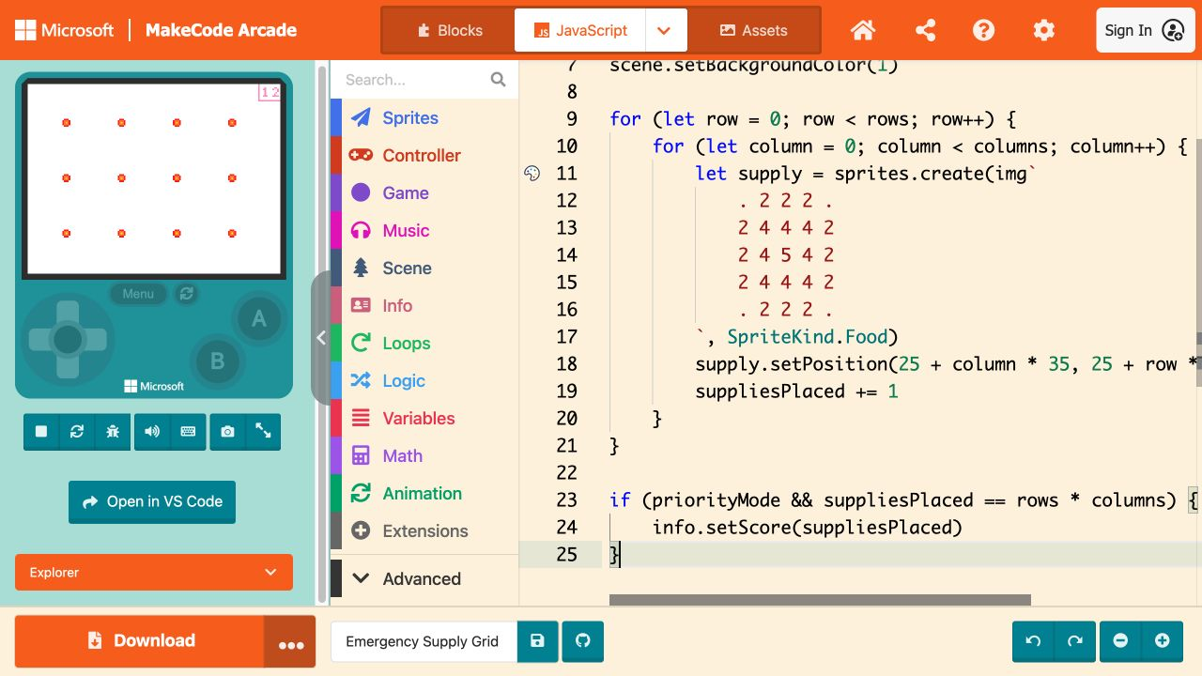
TEXT-CODE BRIDGE
DAY 1
Open a new project and select JavaScript
No import or personal account is required for the core route.
START HERE
1. Open arcade.makecode.com
2. Choose New Project
3. Name it Emergency Supply Grid
4. Select JavaScript
5. Keep the simulator visible
SMART SOLUTIONS · CODING FOUNDATIONS
VILS 2027
Notes:
Model the route once. If the welcome tour covers the language tabs, close it before selecting JavaScript.
[Sources]
- https://arcade.makecode.com/
- https://arcade.makecode.com/docs

Slide 17
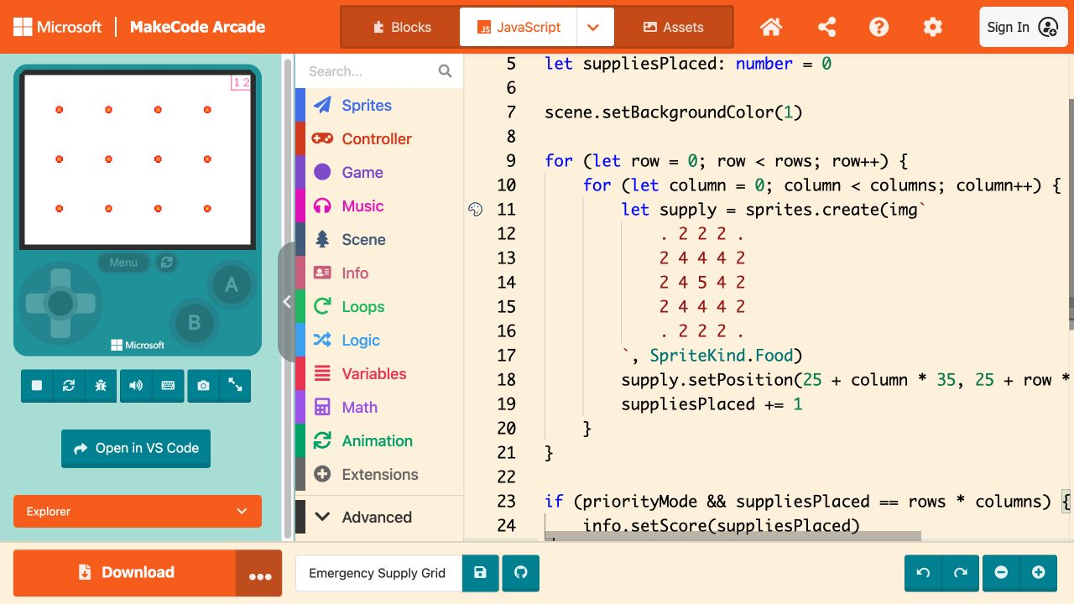
TEXT-CODE BRIDGE
DAY 1
Read named variables from top to bottom
Type, starting value, and purpose belong together.
TRACE FOUR VALUES
missionName → string
rows / columns → numbers
priorityMode → Boolean
suppliesPlaced → number
Predict before running.
SMART SOLUTIONS · CODING FOUNDATIONS
VILS 2027
Notes:
Use the Passport trace table. Students identify what each variable stores or controls before changing any value.
[Sources]
- https://arcade.makecode.com/javascript/variables

Slide 18
TEXT-CODE BRIDGE
DAY 1
The outer loop makes rows; the inner loop makes columns
One complete inner loop places every supply in one row.
for (let row = 0; row < rows; row++) {
for (let column = 0; column < columns; column++) {
placeSupply(row, column)
suppliesPlaced += 1
}
}
TRACE: row 0 → columns 0, 1, 2, 3 · then row 1 begins
SMART SOLUTIONS · CODING FOUNDATIONS
VILS 2027
Notes:
Physically trace the first row with a finger. Ask how many times the inner loop runs and how many times the outer loop runs.
[Sources]
- https://arcade.makecode.com/javascript/statements
- https://arcade.makecode.com/blocks/loops

Slide 19
TEXT-CODE BRIDGE
DAY 1
One calculation places every supply
The formula uses both loop variables instead of twelve separate positions.
x = 25 + column × 35
y = 25 + row × 35
TRY row = 2, column = 3
x = 25 + 3 × 35 = 130
y = 25 + 2 × 35 = 95
The same formula works for every cell in the grid.
SMART SOLUTIONS · CODING FOUNDATIONS
VILS 2027
Notes:
Students calculate one position by hand, then point to the multiplication and addition operations in the code.
[Sources]
- https://tea.texas.gov/laws-and-rules/texas-administrative-code/19-tac-chapter-126

Slide 20
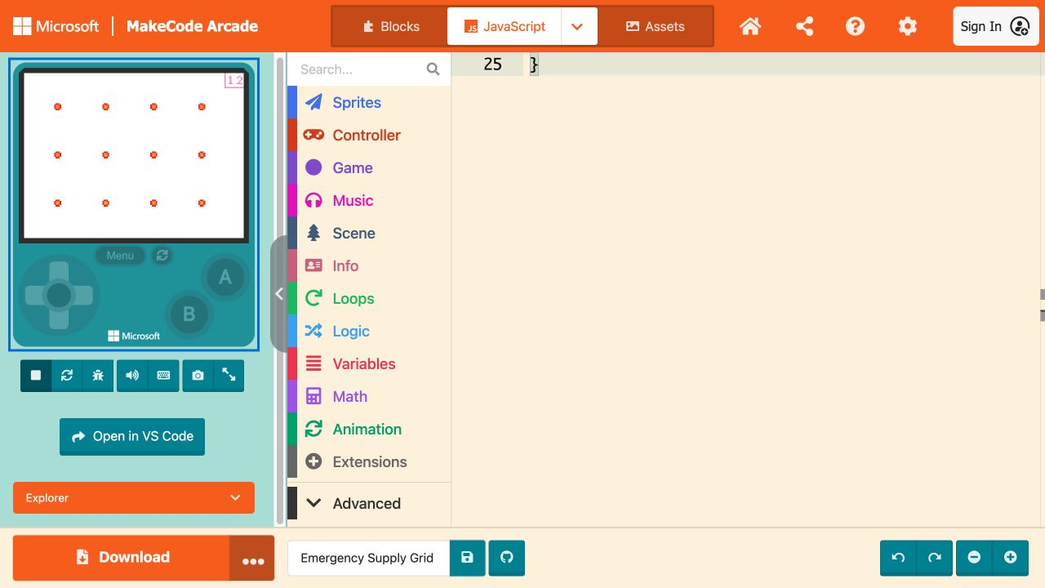
TEXT-CODE BRIDGE
DAY 1
Run the grid and compare it with the prediction
A 3 × 4 grid should produce 12 supply markers.
EVIDENCE
Grid screenshot
Visible score
Predicted total
Observed total
One sentence explaining the nested loops
SMART SOLUTIONS · CODING FOUNDATIONS
VILS 2027
Notes:
If the grid does not match the prediction, students use the Passport test table before asking for a replacement project.
[Sources]
- https://arcade.makecode.com/

Slide 21
TEXT-CODE BRIDGE
DAY 1
Day 1: trace, predict, and repair
Students read working text code before independently changing it.
TRACE
PREDICT
REPAIR
Label the outer loop, inner loop, variables, data types, and operations.
Calculate suppliesPlaced and one x/y position before Run.
Correct one teacher-provided loop or value bug and record the evidence.
SMART SOLUTIONS · CODING FOUNDATIONS
VILS 2027
Notes:
Supported route: give students the complete code and one highlighted bug. Core route: students identify the bug from the mismatched result.
[Sources]
- https://tea.texas.gov/laws-and-rules/texas-administrative-code/19-tac-chapter-126
- https://arcade.makecode.com/javascript/statements

Slide 22
TEXT-CODE BRIDGE
DAY 2
Day 2: change the grid with purpose
The new version must still use text, named variables, operations, and nested loops.
CORE
SUPPORTED
EXTENSION
Change rows and columns
Predict the new total
Change spacing without overlap
Run and revise
Explain both loops
Use a partially completed code frame
Choose from tested dimensions
Trace with a row/column table
Explain orally or in writing
Use priorityMode to change color or placement
Add a reusable function
Create one blocked cell
Explain the new subproblem
SMART SOLUTIONS · CODING FOUNDATIONS
VILS 2027
Notes:
Do not require the extension for proficiency. The core artifact already satisfies the text-code and nested-loop evidence when students can explain it.
[Sources]
- https://tea.texas.gov/laws-and-rules/texas-administrative-code/19-tac-chapter-126
- https://arcade.makecode.com/javascript/statements

Slide 23
TEXT-CODE BRIDGE
DAY 2
Evidence must show both code and thinking
The final screenshot is necessary, but it is not the whole demonstration.
TEXT CODE
DATA + OPERATIONS
Readable JavaScript with two nested loops and named variables.
String, number, Boolean, and visible operations on values.
TEST EVIDENCE
EXPLANATION
Prediction, screenshot, one controlled change, and observed result.
How the loops address row and column subproblems in the real context.
SMART SOLUTIONS · CODING FOUNDATIONS
VILS 2027
Notes:
Score each category with the assignment rubric. Students may explain orally when documented by the teacher, but the code and test evidence remain required.
[Sources]
- https://tea.texas.gov/laws-and-rules/texas-administrative-code/19-tac-chapter-126

Slide 24
RVR TRANSFER
DAY 1
Reuse the same planning routine with RVR
Complete Passport Checkpoint 5 before the drawing mission.
ASSIGN ROLES
SET MILESTONES
WRITE PSEUDOCODE
RUN LITERALLY
REVISE
ROLES
TIMELINE
Planner · programmer · tester/evidence lead
Plan approved · first run · revision run
SMART SOLUTIONS · CODING FOUNDATIONS
VILS 2027
Notes:
Add this before students select Draw or Blocks. The planning evidence should name heading, speed, duration/distance, waits, and repeated actions.
[Sources]
- https://tea.texas.gov/laws-and-rules/texas-administrative-code/19-tac-chapter-126

Slide 25
RVR TRANSFER
DAY 1
Let the robot expose the missing step
The physical result makes vague pseudocode visible.
PLAN
RUN
REVISE
What should the robot draw?
What did it actually draw?
Which exact command, value, or repeated group changed?
“The robot ______ because our pseudocode ______. We revised ______.”
SMART SOLUTIONS · CODING FOUNDATIONS
VILS 2027
Notes:
Require the team to update the Passport after the first run. Do not accept a corrected robot program with an unchanged plan.
[Sources]
- https://tea.texas.gov/laws-and-rules/texas-administrative-code/19-tac-chapter-126

Slide 26
CLOSE AND TRANSFER
FINAL
One planning language now connects three coding surfaces
Students can explain how the same algorithm moved from blocks to text to a robot.
BLOCKS
TEXT
ROBOT
Sequence, event, loop, condition
What structure did the blocks make visible?
Named types, operations, syntax, nested loops
What became more explicit?
Heading, speed, distance, timing, physical evidence
What did the real result reveal?
Use one specific revision in the Passport final reflection.
SMART SOLUTIONS · CODING FOUNDATIONS
VILS 2027
Notes:
Close with the final Passport reflection. This is the synthesis evidence for transfer across tools and contexts.
[Sources]
- https://tea.texas.gov/laws-and-rules/texas-administrative-code/19-tac-chapter-126

