Slide 1

Notes:
Teacher move: About 50 minutes. This is student Lesson 3 and facilitator-guide Lesson 4 because the separate Read Visual Design video sits between the lessons. Keep that course sequence intact. Students create a graphic, not a purchased or printed shirt. Selected instructional image retained from the user-supplied Unit 1 DPI 2026 teaching materials. Reuse is for this classroom teaching adaptation. Original image rights remain with their respective creators; no open license is asserted.
[Sources]
Current course snapshot, generated student pages and facilitator guides in innovative-technology-site, inspected 2026-09-07. Original ZIP supplied by Elisha Lucero.
Canva editor and Combo app, Graphic Design Lesson Demonstrations, https://www.canva.com/design/DAHUiq9hUJg/IwU_7AR5EXsmRbdnEBtkhA/edit . Screenshots captured directly in the Bowie Middle School account, 2026-09-07. Interface labels may vary by account. Canva screenshots used for classroom software instruction.
Visual: source-9.png. Selected instructional image retained from the user-supplied Unit 1 DPI 2026 teaching materials. Reuse is for this classroom teaching adaptation. Original image rights remain with their respective creators; no open license is asserted.
Visual reference: source-9.png. Supplied teaching artwork or a direct Canva interface capture, as recorded in the source ledger.

Slide 2
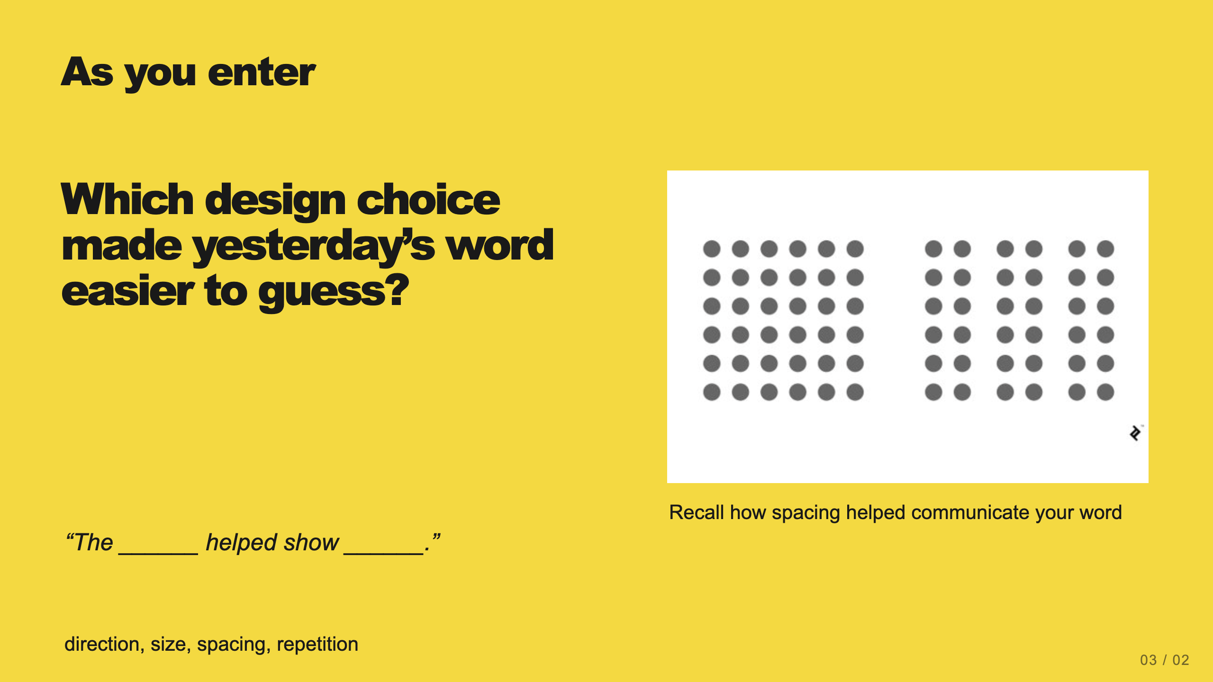
Notes:
Teacher move: 2 minutes. Connect spacing, shape, or contrast to meaning. Invite a student to point to the visible evidence. Explain that today text joins those tools.
[Sources]
Current course snapshot, generated student pages and facilitator guides in innovative-technology-site, inspected 2026-09-07. Original ZIP supplied by Elisha Lucero.
Canva editor and Combo app, Graphic Design Lesson Demonstrations, https://www.canva.com/design/DAHUiq9hUJg/IwU_7AR5EXsmRbdnEBtkhA/edit . Screenshots captured directly in the Bowie Middle School account, 2026-09-07. Interface labels may vary by account. Canva screenshots used for classroom software instruction.
Visual reference: source-46.jpg. Supplied teaching artwork or a direct Canva interface capture, as recorded in the source ledger.

Slide 3
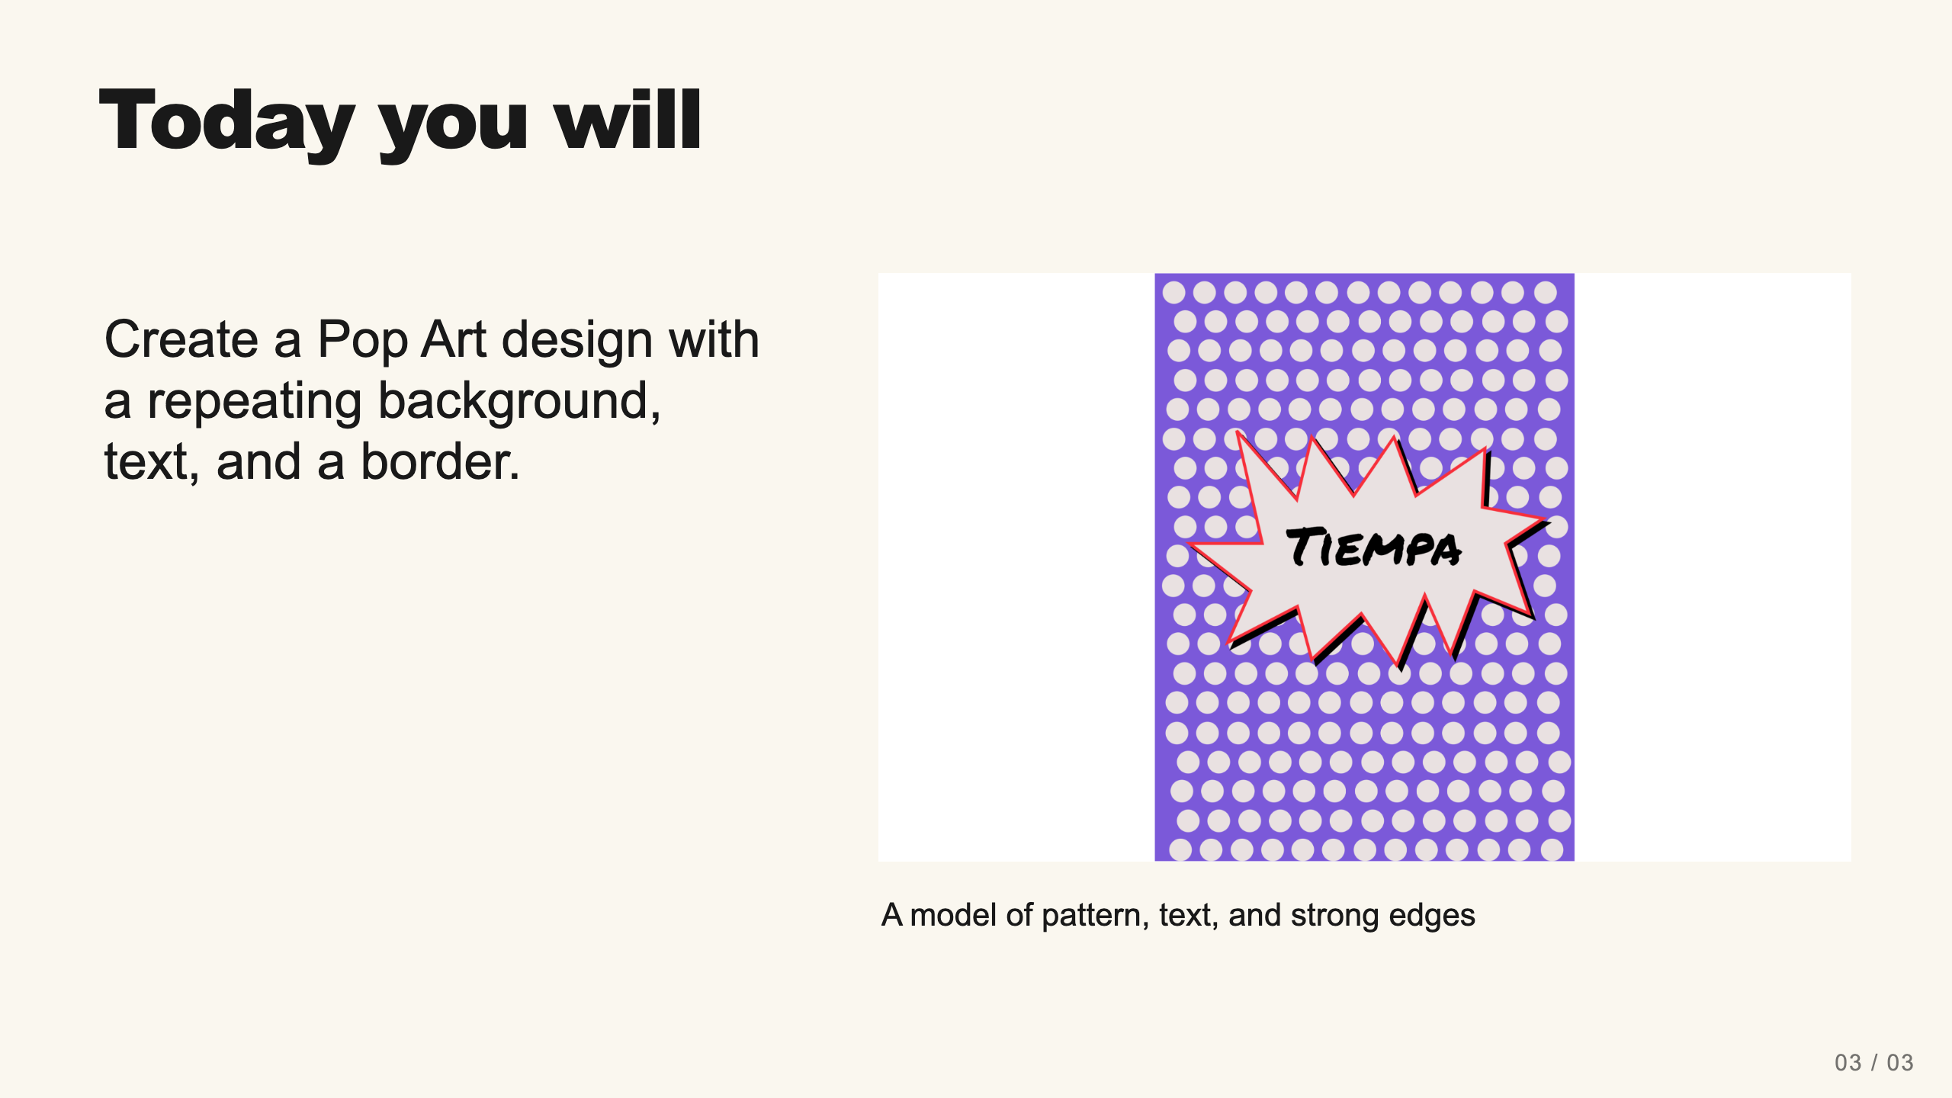
Notes:
Teacher move: 1 minute. Explain the current assignment’s requirements. Extra shapes are available for design choices, while the required evidence is a PNG and the existing reflection. Do not require a shirt mockup. Selected instructional image retained from the user-supplied Unit 1 DPI 2026 teaching materials. Reuse is for this classroom teaching adaptation. Original image rights remain with their respective creators; no open license is asserted.
[Sources]
Current course snapshot, generated student pages and facilitator guides in innovative-technology-site, inspected 2026-09-07. Original ZIP supplied by Elisha Lucero.
Canva editor and Combo app, Graphic Design Lesson Demonstrations, https://www.canva.com/design/DAHUiq9hUJg/IwU_7AR5EXsmRbdnEBtkhA/edit . Screenshots captured directly in the Bowie Middle School account, 2026-09-07. Interface labels may vary by account. Canva screenshots used for classroom software instruction.
Visual: source-10.png. Selected instructional image retained from the user-supplied Unit 1 DPI 2026 teaching materials. Reuse is for this classroom teaching adaptation. Original image rights remain with their respective creators; no open license is asserted.
Visual reference: source-10.png. Supplied teaching artwork or a direct Canva interface capture, as recorded in the source ledger.

Slide 4
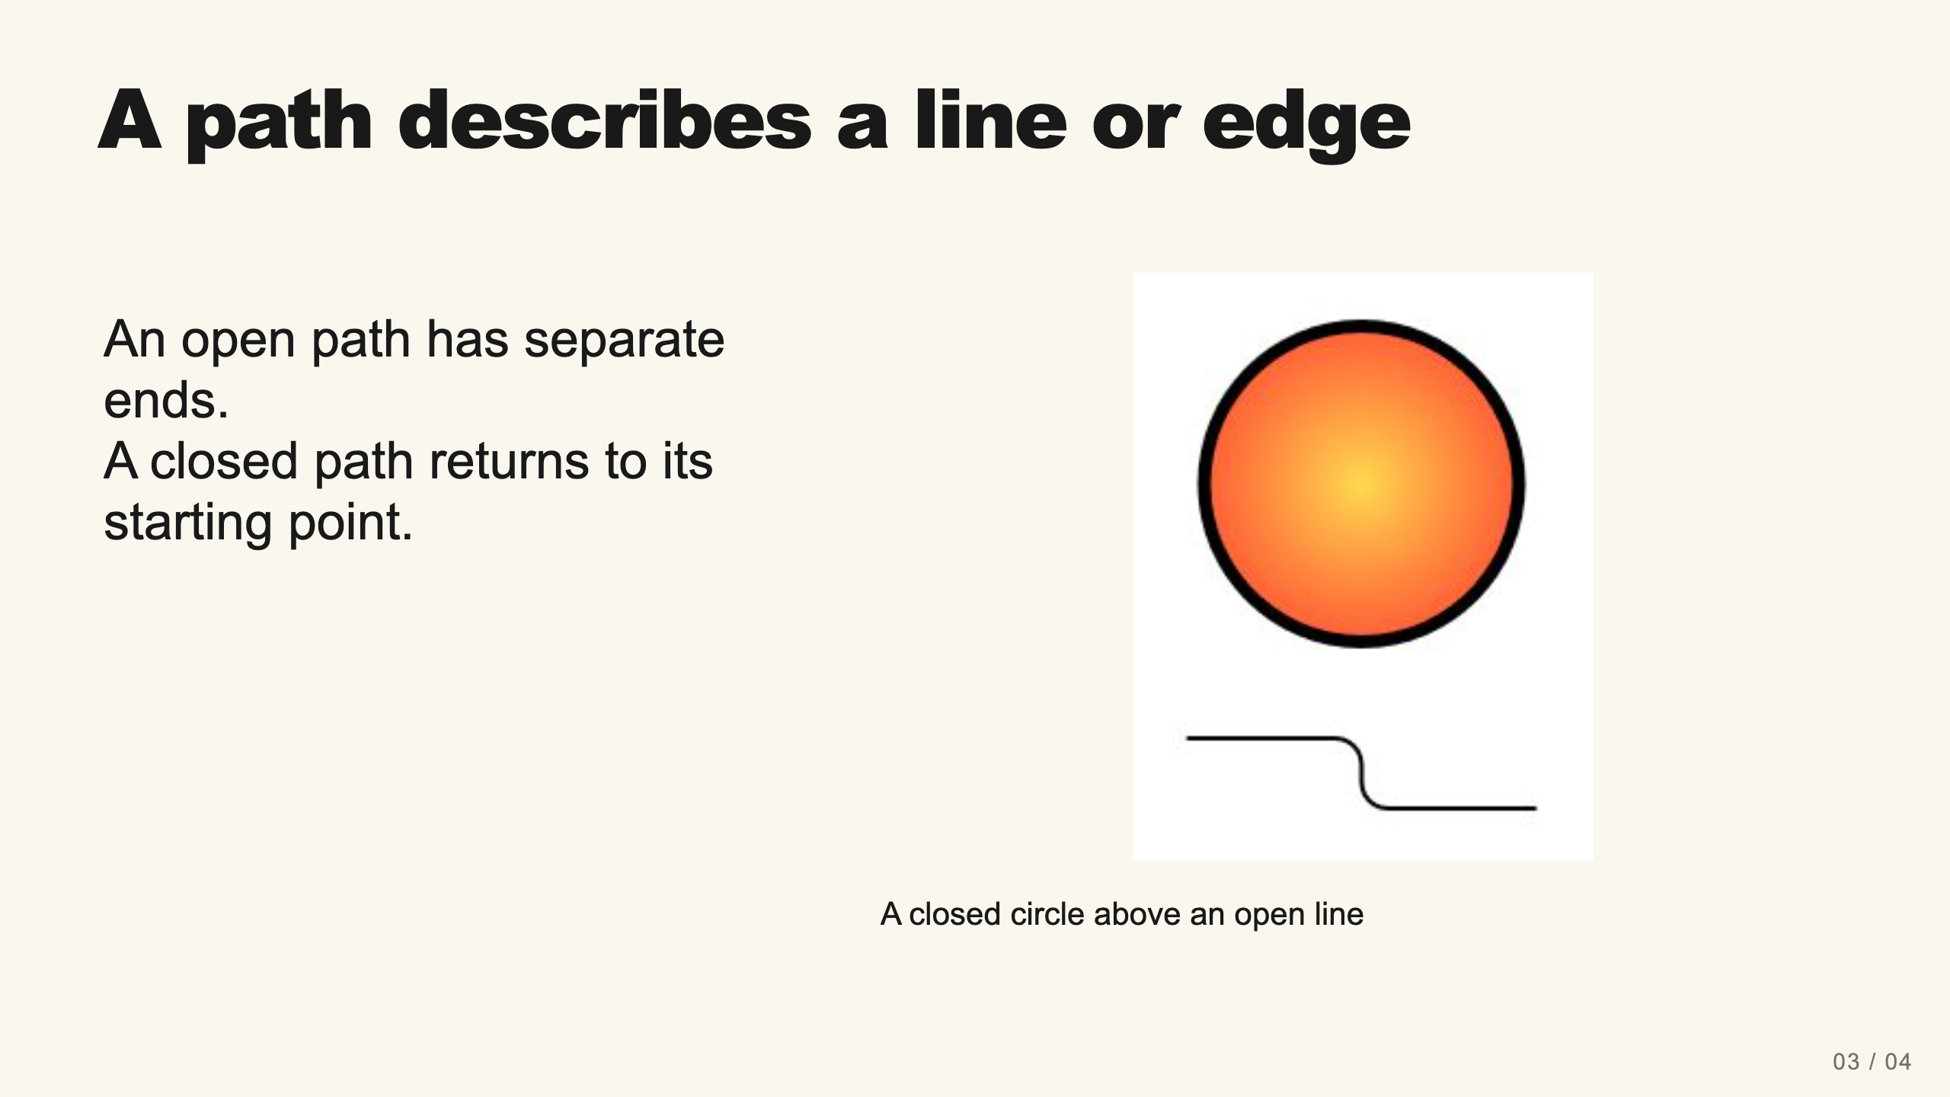
Notes:
Teacher move: 2 minutes. Model an open line and a closed outline on paper or live in Canva. Explain that a vector path can describe a shape’s boundary. Canva Draw is a freehand tool; simply closing a stroke does not guarantee a filled, editable native shape. Use native Shapes for predictable fill and border controls.
[Sources]
Current course snapshot, generated student pages and facilitator guides in innovative-technology-site, inspected 2026-09-07. Original ZIP supplied by Elisha Lucero.
Canva editor and Combo app, Graphic Design Lesson Demonstrations, https://www.canva.com/design/DAHUiq9hUJg/IwU_7AR5EXsmRbdnEBtkhA/edit . Screenshots captured directly in the Bowie Middle School account, 2026-09-07. Interface labels may vary by account. Canva screenshots used for classroom software instruction.
Visual: canva-draw.png. Canva editor and Combo app, Graphic Design Lesson Demonstrations, https://www.canva.com/design/DAHUiq9hUJg/IwU_7AR5EXsmRbdnEBtkhA/edit . Screenshots captured directly in the Bowie Middle School account, 2026-09-07. Interface labels may vary by account. Canva screenshots used for classroom software instruction.
Visual reference: canva-draw.png. Supplied teaching artwork or a direct Canva interface capture, as recorded in the source ledger.

Slide 5
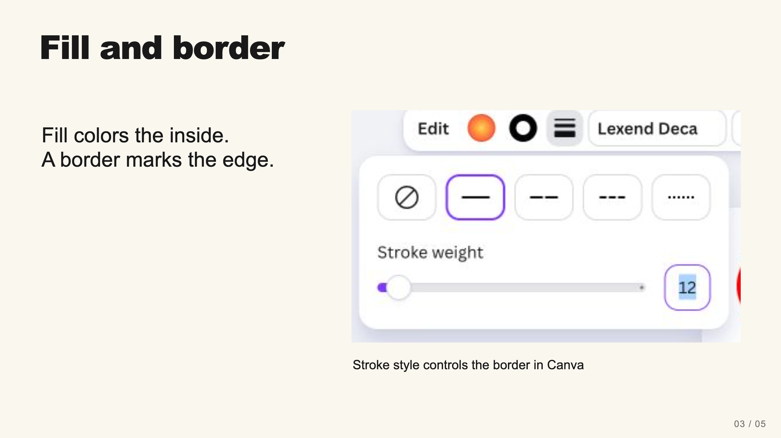
Notes:
Teacher move: 2 minutes. On a native shape choose a solid border and increase Stroke weight. Let students compare the filled interior with the dark outline. A visible outline can separate a bright foreground from a busy background.
[Sources]
Current course snapshot, generated student pages and facilitator guides in innovative-technology-site, inspected 2026-09-07. Original ZIP supplied by Elisha Lucero.
Canva editor and Combo app, Graphic Design Lesson Demonstrations, https://www.canva.com/design/DAHUiq9hUJg/IwU_7AR5EXsmRbdnEBtkhA/edit . Screenshots captured directly in the Bowie Middle School account, 2026-09-07. Interface labels may vary by account. Canva screenshots used for classroom software instruction.
Visual: canva-border.png. Canva editor and Combo app, Graphic Design Lesson Demonstrations, https://www.canva.com/design/DAHUiq9hUJg/IwU_7AR5EXsmRbdnEBtkhA/edit . Screenshots captured directly in the Bowie Middle School account, 2026-09-07. Interface labels may vary by account. Canva screenshots used for classroom software instruction.
Visual reference: canva-border.png. Supplied teaching artwork or a direct Canva interface capture, as recorded in the source ledger.

Slide 6
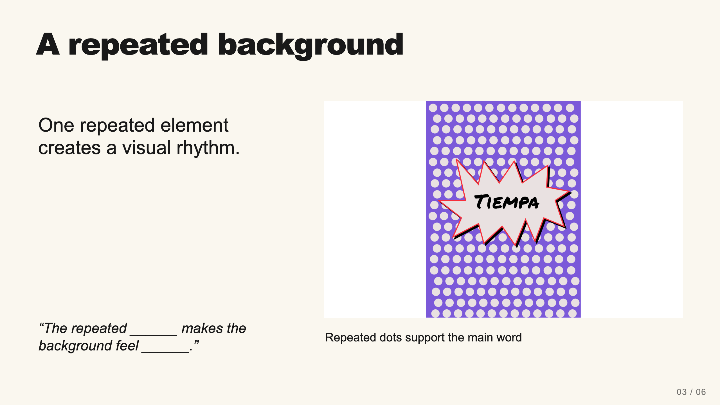
Notes:
Teacher move: 2 minutes. Identify the repeating unit and the main message. Explain that a background can be energetic without competing with the word. Selected instructional image retained from the user-supplied Unit 1 DPI 2026 teaching materials. Reuse is for this classroom teaching adaptation. Original image rights remain with their respective creators; no open license is asserted.
[Sources]
Current course snapshot, generated student pages and facilitator guides in innovative-technology-site, inspected 2026-09-07. Original ZIP supplied by Elisha Lucero.
Canva editor and Combo app, Graphic Design Lesson Demonstrations, https://www.canva.com/design/DAHUiq9hUJg/IwU_7AR5EXsmRbdnEBtkhA/edit . Screenshots captured directly in the Bowie Middle School account, 2026-09-07. Interface labels may vary by account. Canva screenshots used for classroom software instruction.
Visual: source-10.png. Selected instructional image retained from the user-supplied Unit 1 DPI 2026 teaching materials. Reuse is for this classroom teaching adaptation. Original image rights remain with their respective creators; no open license is asserted.
Visual reference: source-10.png. Supplied teaching artwork or a direct Canva interface capture, as recorded in the source ledger.

Slide 7
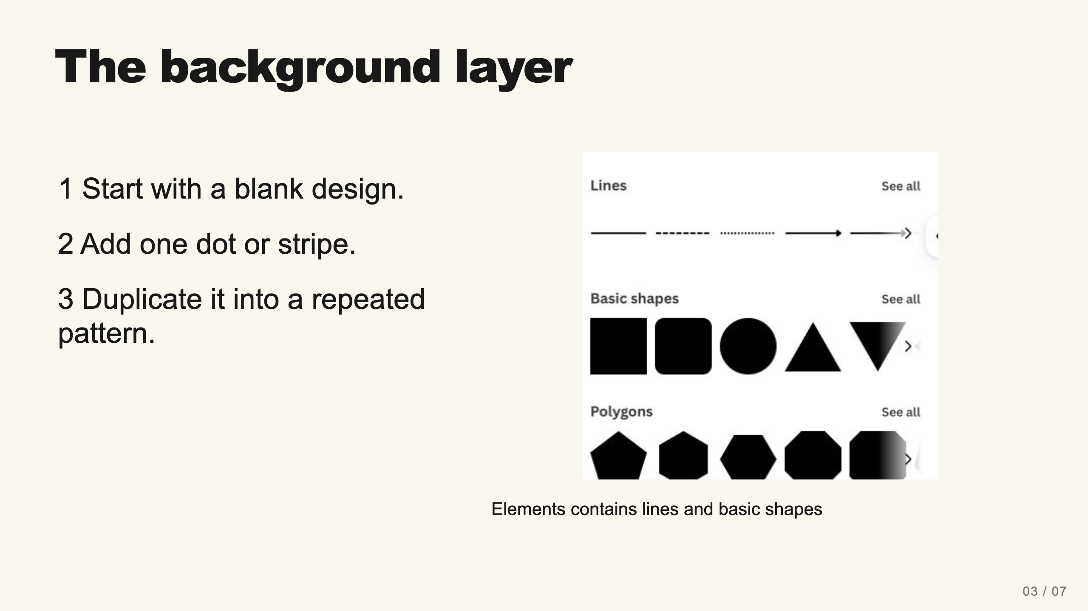
Notes:
Teacher move: 4 minutes. Model a small repeated row, then let students practice. They may use dots, stripes, or another repeated pattern allowed in the current assignment. Build enough repetition to communicate the idea before adding more detail.
[Sources]
Current course snapshot, generated student pages and facilitator guides in innovative-technology-site, inspected 2026-09-07. Original ZIP supplied by Elisha Lucero.
Canva editor and Combo app, Graphic Design Lesson Demonstrations, https://www.canva.com/design/DAHUiq9hUJg/IwU_7AR5EXsmRbdnEBtkhA/edit . Screenshots captured directly in the Bowie Middle School account, 2026-09-07. Interface labels may vary by account. Canva screenshots used for classroom software instruction.
Visual: canva-shapes.png. Canva editor and Combo app, Graphic Design Lesson Demonstrations, https://www.canva.com/design/DAHUiq9hUJg/IwU_7AR5EXsmRbdnEBtkhA/edit . Screenshots captured directly in the Bowie Middle School account, 2026-09-07. Interface labels may vary by account. Canva screenshots used for classroom software instruction.
Visual reference: canva-shapes.png. Supplied teaching artwork or a direct Canva interface capture, as recorded in the source ledger.

Slide 8
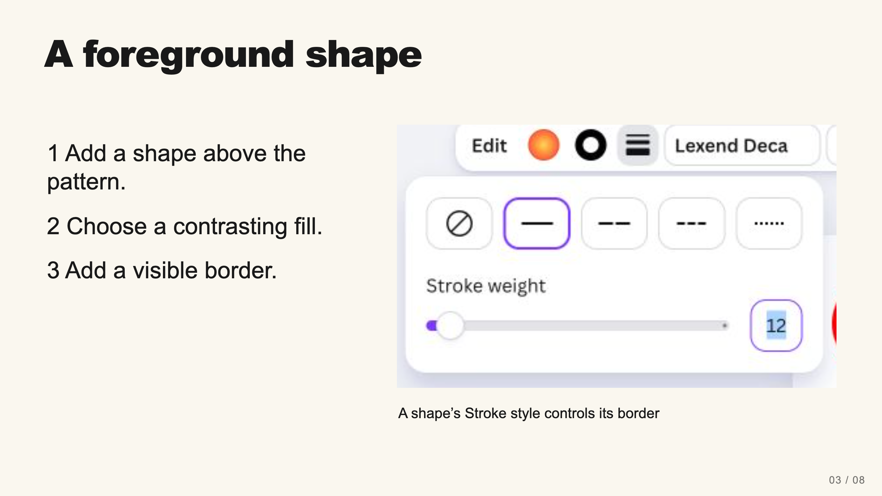
Notes:
Teacher move: 3 minutes. Select the shape to expose its controls. Choose a solid stroke, then adjust its weight. Demonstrate a readable contrast. Students can use a name-tag composition as the supported starting route.
[Sources]
Current course snapshot, generated student pages and facilitator guides in innovative-technology-site, inspected 2026-09-07. Original ZIP supplied by Elisha Lucero.
Canva editor and Combo app, Graphic Design Lesson Demonstrations, https://www.canva.com/design/DAHUiq9hUJg/IwU_7AR5EXsmRbdnEBtkhA/edit . Screenshots captured directly in the Bowie Middle School account, 2026-09-07. Interface labels may vary by account. Canva screenshots used for classroom software instruction.
Visual: canva-border.png. Canva editor and Combo app, Graphic Design Lesson Demonstrations, https://www.canva.com/design/DAHUiq9hUJg/IwU_7AR5EXsmRbdnEBtkhA/edit . Screenshots captured directly in the Bowie Middle School account, 2026-09-07. Interface labels may vary by account. Canva screenshots used for classroom software instruction.
Visual reference: canva-border.png. Supplied teaching artwork or a direct Canva interface capture, as recorded in the source ledger.

Slide 9
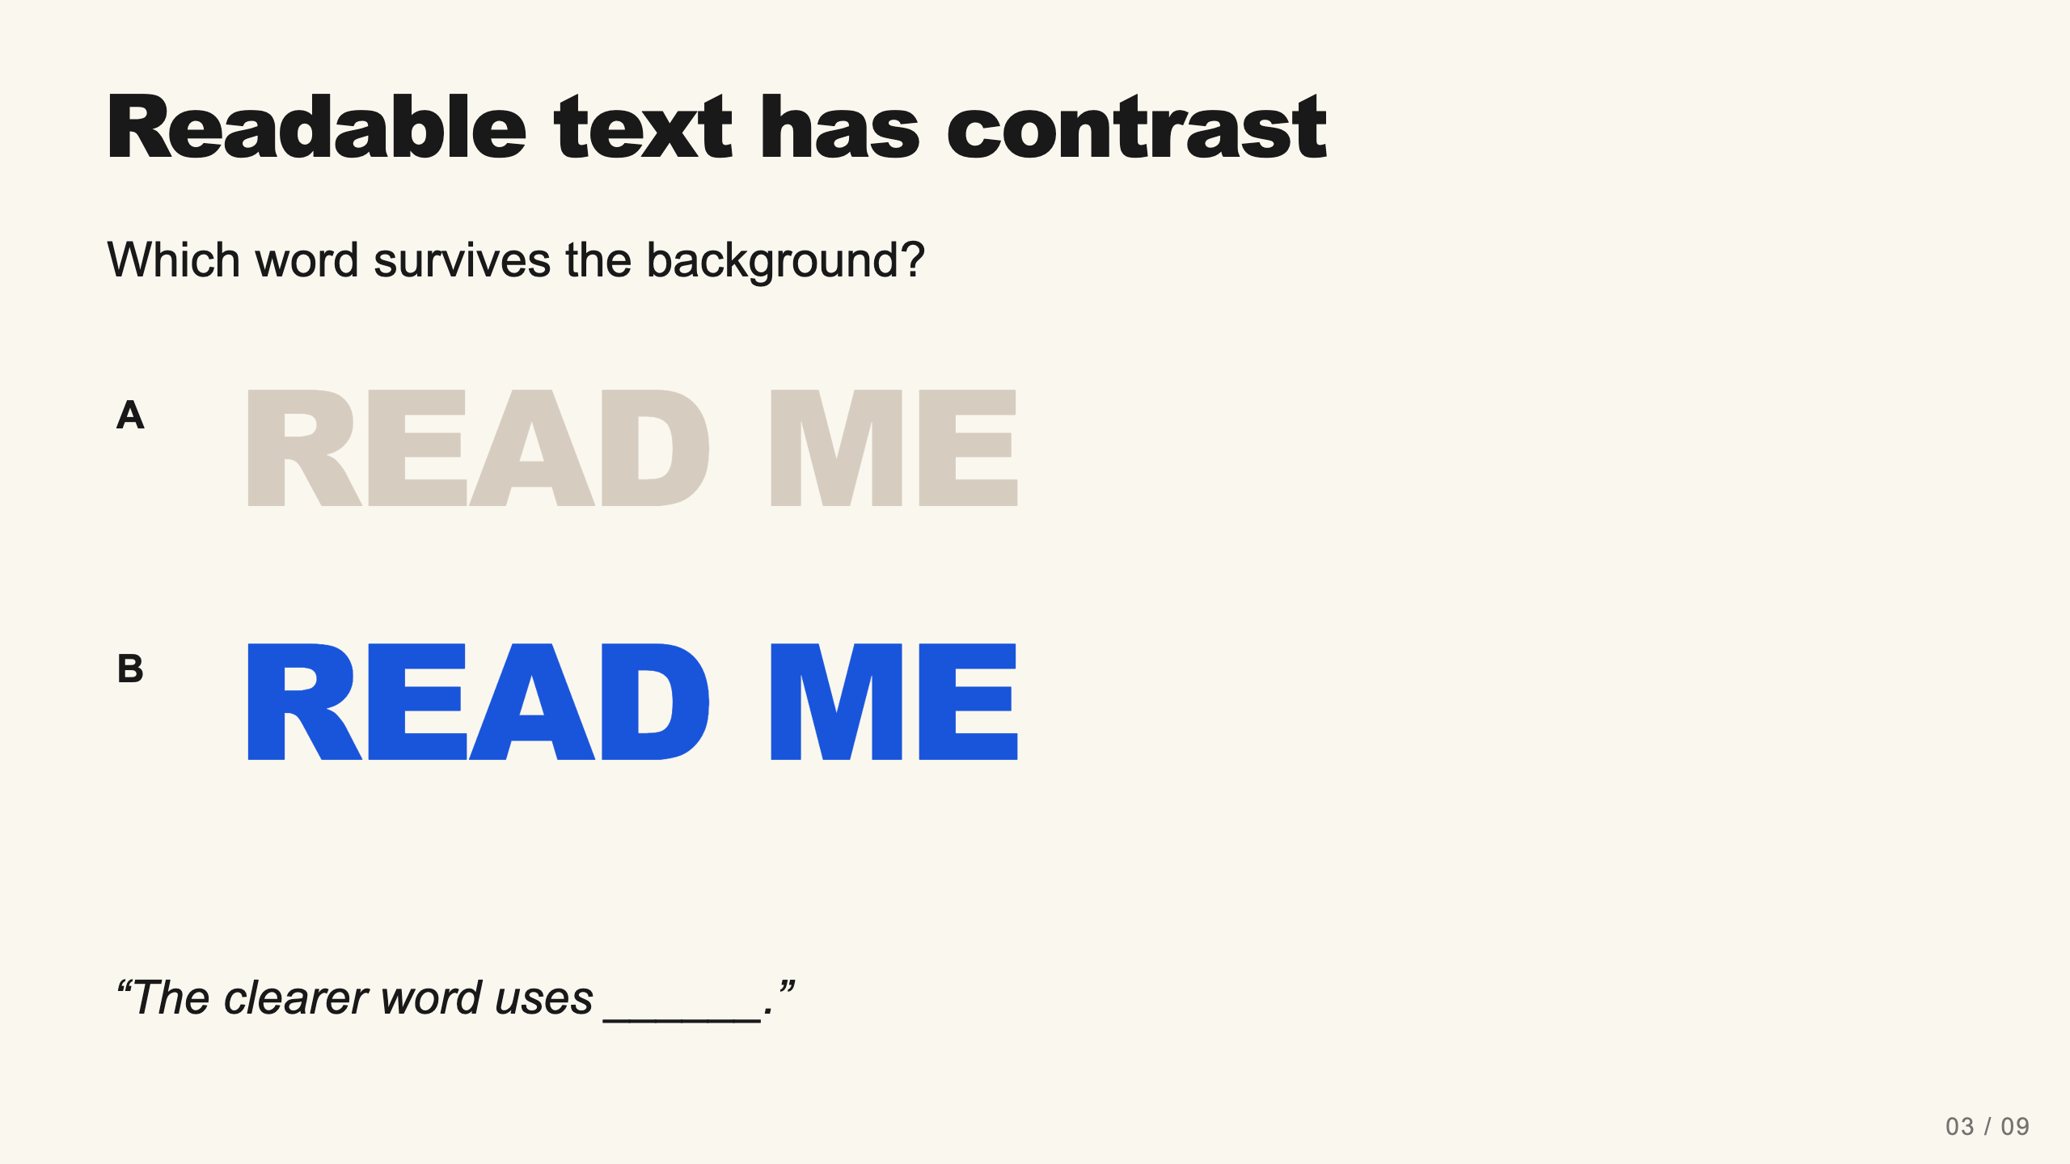
Notes:
Teacher move: 2 minutes. Emphasize the difference between letter color and background color. Brightness alone does not guarantee readability. Ask students to evaluate from a distance rather than zooming in.
[Sources]
Current course snapshot, generated student pages and facilitator guides in innovative-technology-site, inspected 2026-09-07. Original ZIP supplied by Elisha Lucero.
Canva editor and Combo app, Graphic Design Lesson Demonstrations, https://www.canva.com/design/DAHUiq9hUJg/IwU_7AR5EXsmRbdnEBtkhA/edit . Screenshots captured directly in the Bowie Middle School account, 2026-09-07. Interface labels may vary by account. Canva screenshots used for classroom software instruction.

Slide 10
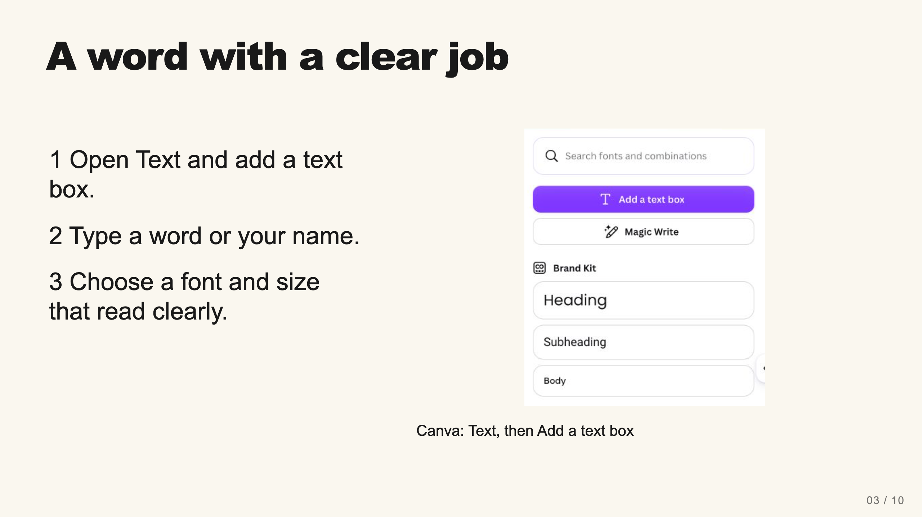
Notes:
Teacher move: 3 minutes. Demonstrate live in Canva. A font is a style of lettering. Keep the sample word short enough to read. Place it above the foreground shape, then compare two fonts. A decorative font still has to communicate the actual word.
[Sources]
Current course snapshot, generated student pages and facilitator guides in innovative-technology-site, inspected 2026-09-07. Original ZIP supplied by Elisha Lucero.
Canva editor and Combo app, Graphic Design Lesson Demonstrations, https://www.canva.com/design/DAHUiq9hUJg/IwU_7AR5EXsmRbdnEBtkhA/edit . Screenshots captured directly in the Bowie Middle School account, 2026-09-07. Interface labels may vary by account. Canva screenshots used for classroom software instruction.
Visual reference: canva-text.png. Supplied teaching artwork or a direct Canva interface capture, as recorded in the source ledger.

Slide 11
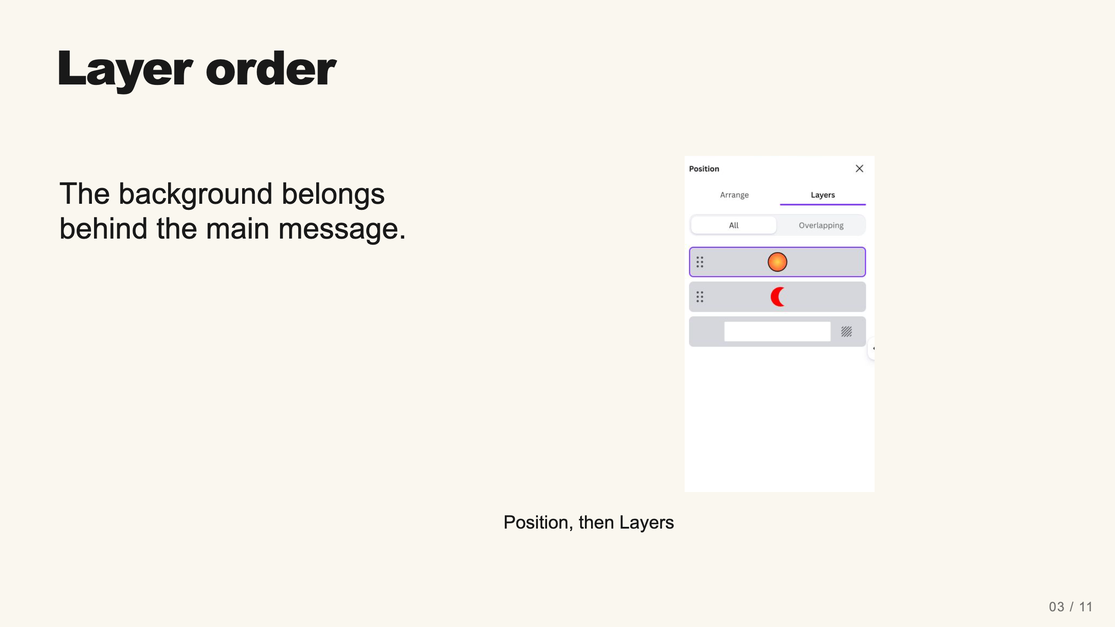
Notes:
Teacher move: 2 minutes. Open Position and switch to Layers. Explain that the top item covers lower items where they overlap. If the name disappears, inspect the stack. Move the supporting shape behind the text rather than changing colors at random.
[Sources]
Current course snapshot, generated student pages and facilitator guides in innovative-technology-site, inspected 2026-09-07. Original ZIP supplied by Elisha Lucero.
Canva editor and Combo app, Graphic Design Lesson Demonstrations, https://www.canva.com/design/DAHUiq9hUJg/IwU_7AR5EXsmRbdnEBtkhA/edit . Screenshots captured directly in the Bowie Middle School account, 2026-09-07. Interface labels may vary by account. Canva screenshots used for classroom software instruction.
Visual: canva-layers.png. Canva editor and Combo app, Graphic Design Lesson Demonstrations, https://www.canva.com/design/DAHUiq9hUJg/IwU_7AR5EXsmRbdnEBtkhA/edit . Screenshots captured directly in the Bowie Middle School account, 2026-09-07. Interface labels may vary by account. Canva screenshots used for classroom software instruction.
Visual reference: canva-layers.png. Supplied teaching artwork or a direct Canva interface capture, as recorded in the source ledger.

Slide 12
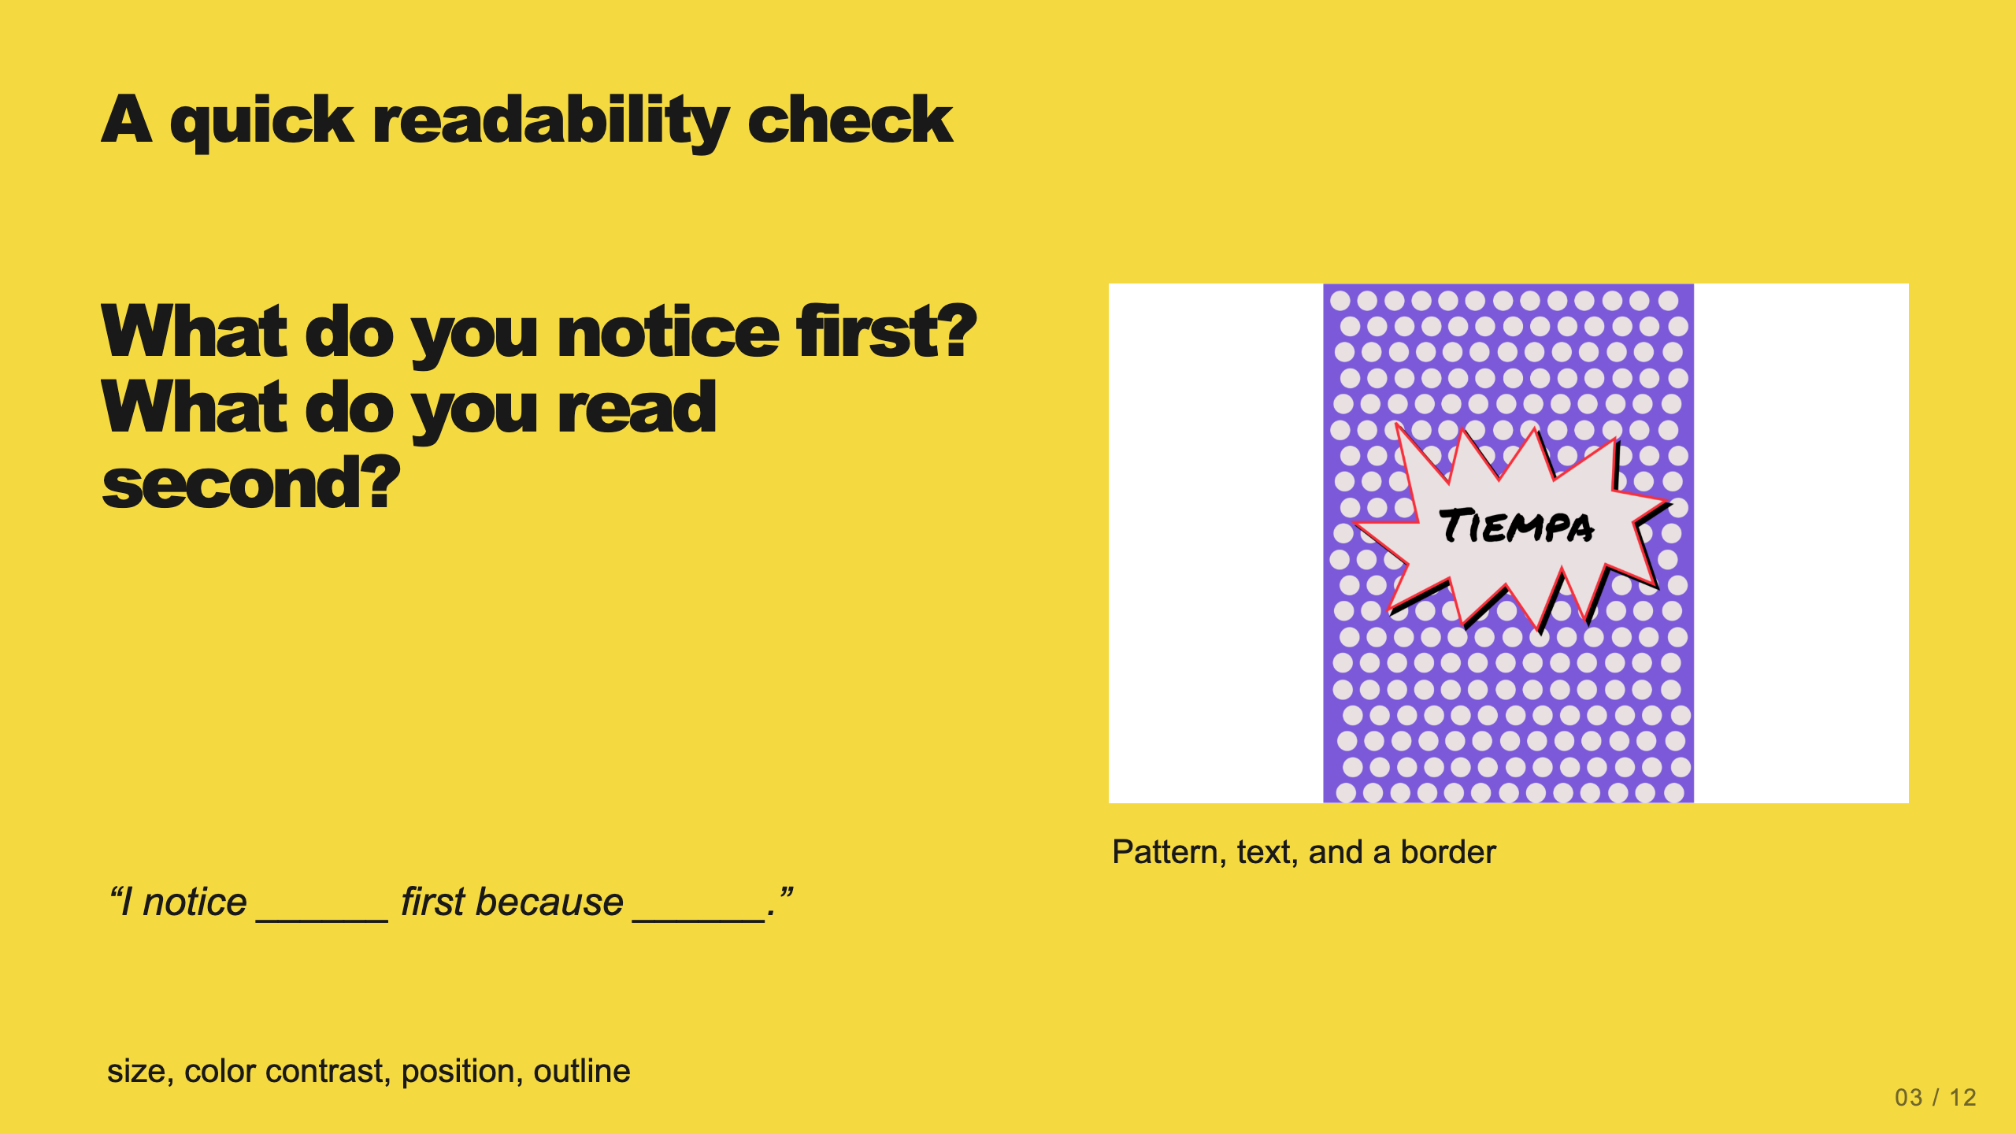
Notes:
Teacher move: 2 minutes. Have a partner view the draft. The main word should be easy to find. Invite one helpful revision to background contrast, font, size, or placement.
[Sources]
Current course snapshot, generated student pages and facilitator guides in innovative-technology-site, inspected 2026-09-07. Original ZIP supplied by Elisha Lucero.
Canva editor and Combo app, Graphic Design Lesson Demonstrations, https://www.canva.com/design/DAHUiq9hUJg/IwU_7AR5EXsmRbdnEBtkhA/edit . Screenshots captured directly in the Bowie Middle School account, 2026-09-07. Interface labels may vary by account. Canva screenshots used for classroom software instruction.
Visual reference: source-10.png. Supplied teaching artwork or a direct Canva interface capture, as recorded in the source ledger.

Slide 13
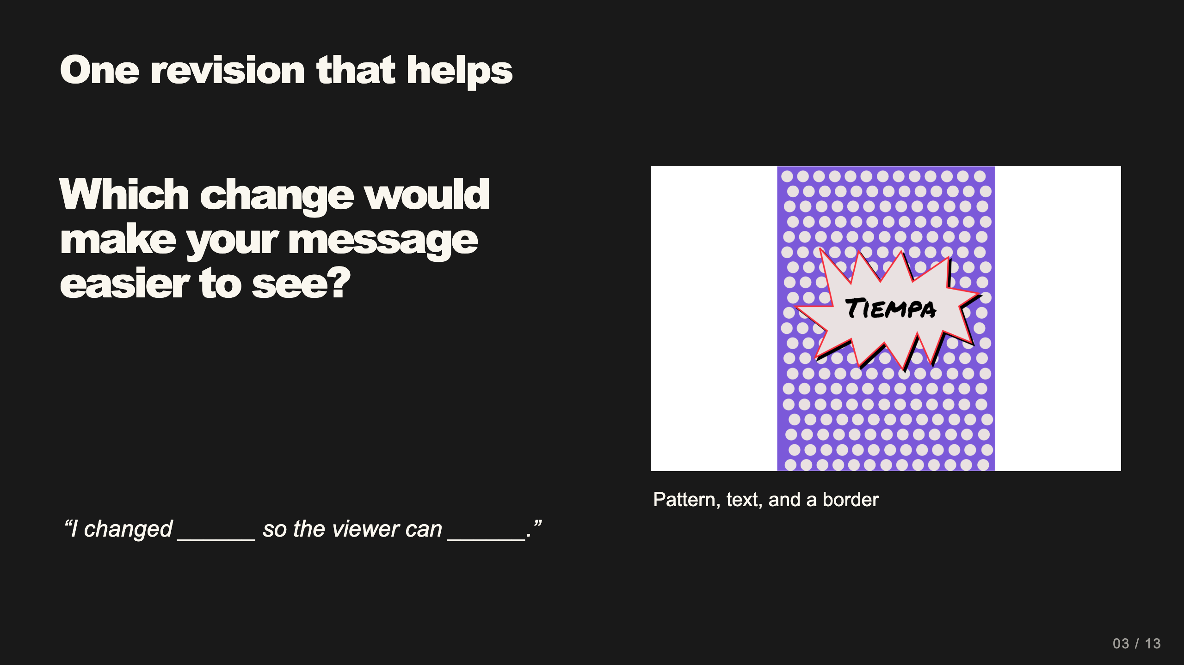
Notes:
Teacher move: 2 minutes within work time. Students make a visible revision and can explain its effect. If the design is already clear, ask whether every background element contributes.
[Sources]
Current course snapshot, generated student pages and facilitator guides in innovative-technology-site, inspected 2026-09-07. Original ZIP supplied by Elisha Lucero.
Canva editor and Combo app, Graphic Design Lesson Demonstrations, https://www.canva.com/design/DAHUiq9hUJg/IwU_7AR5EXsmRbdnEBtkhA/edit . Screenshots captured directly in the Bowie Middle School account, 2026-09-07. Interface labels may vary by account. Canva screenshots used for classroom software instruction.
Visual reference: source-10.png. Supplied teaching artwork or a direct Canva interface capture, as recorded in the source ledger.

Slide 14
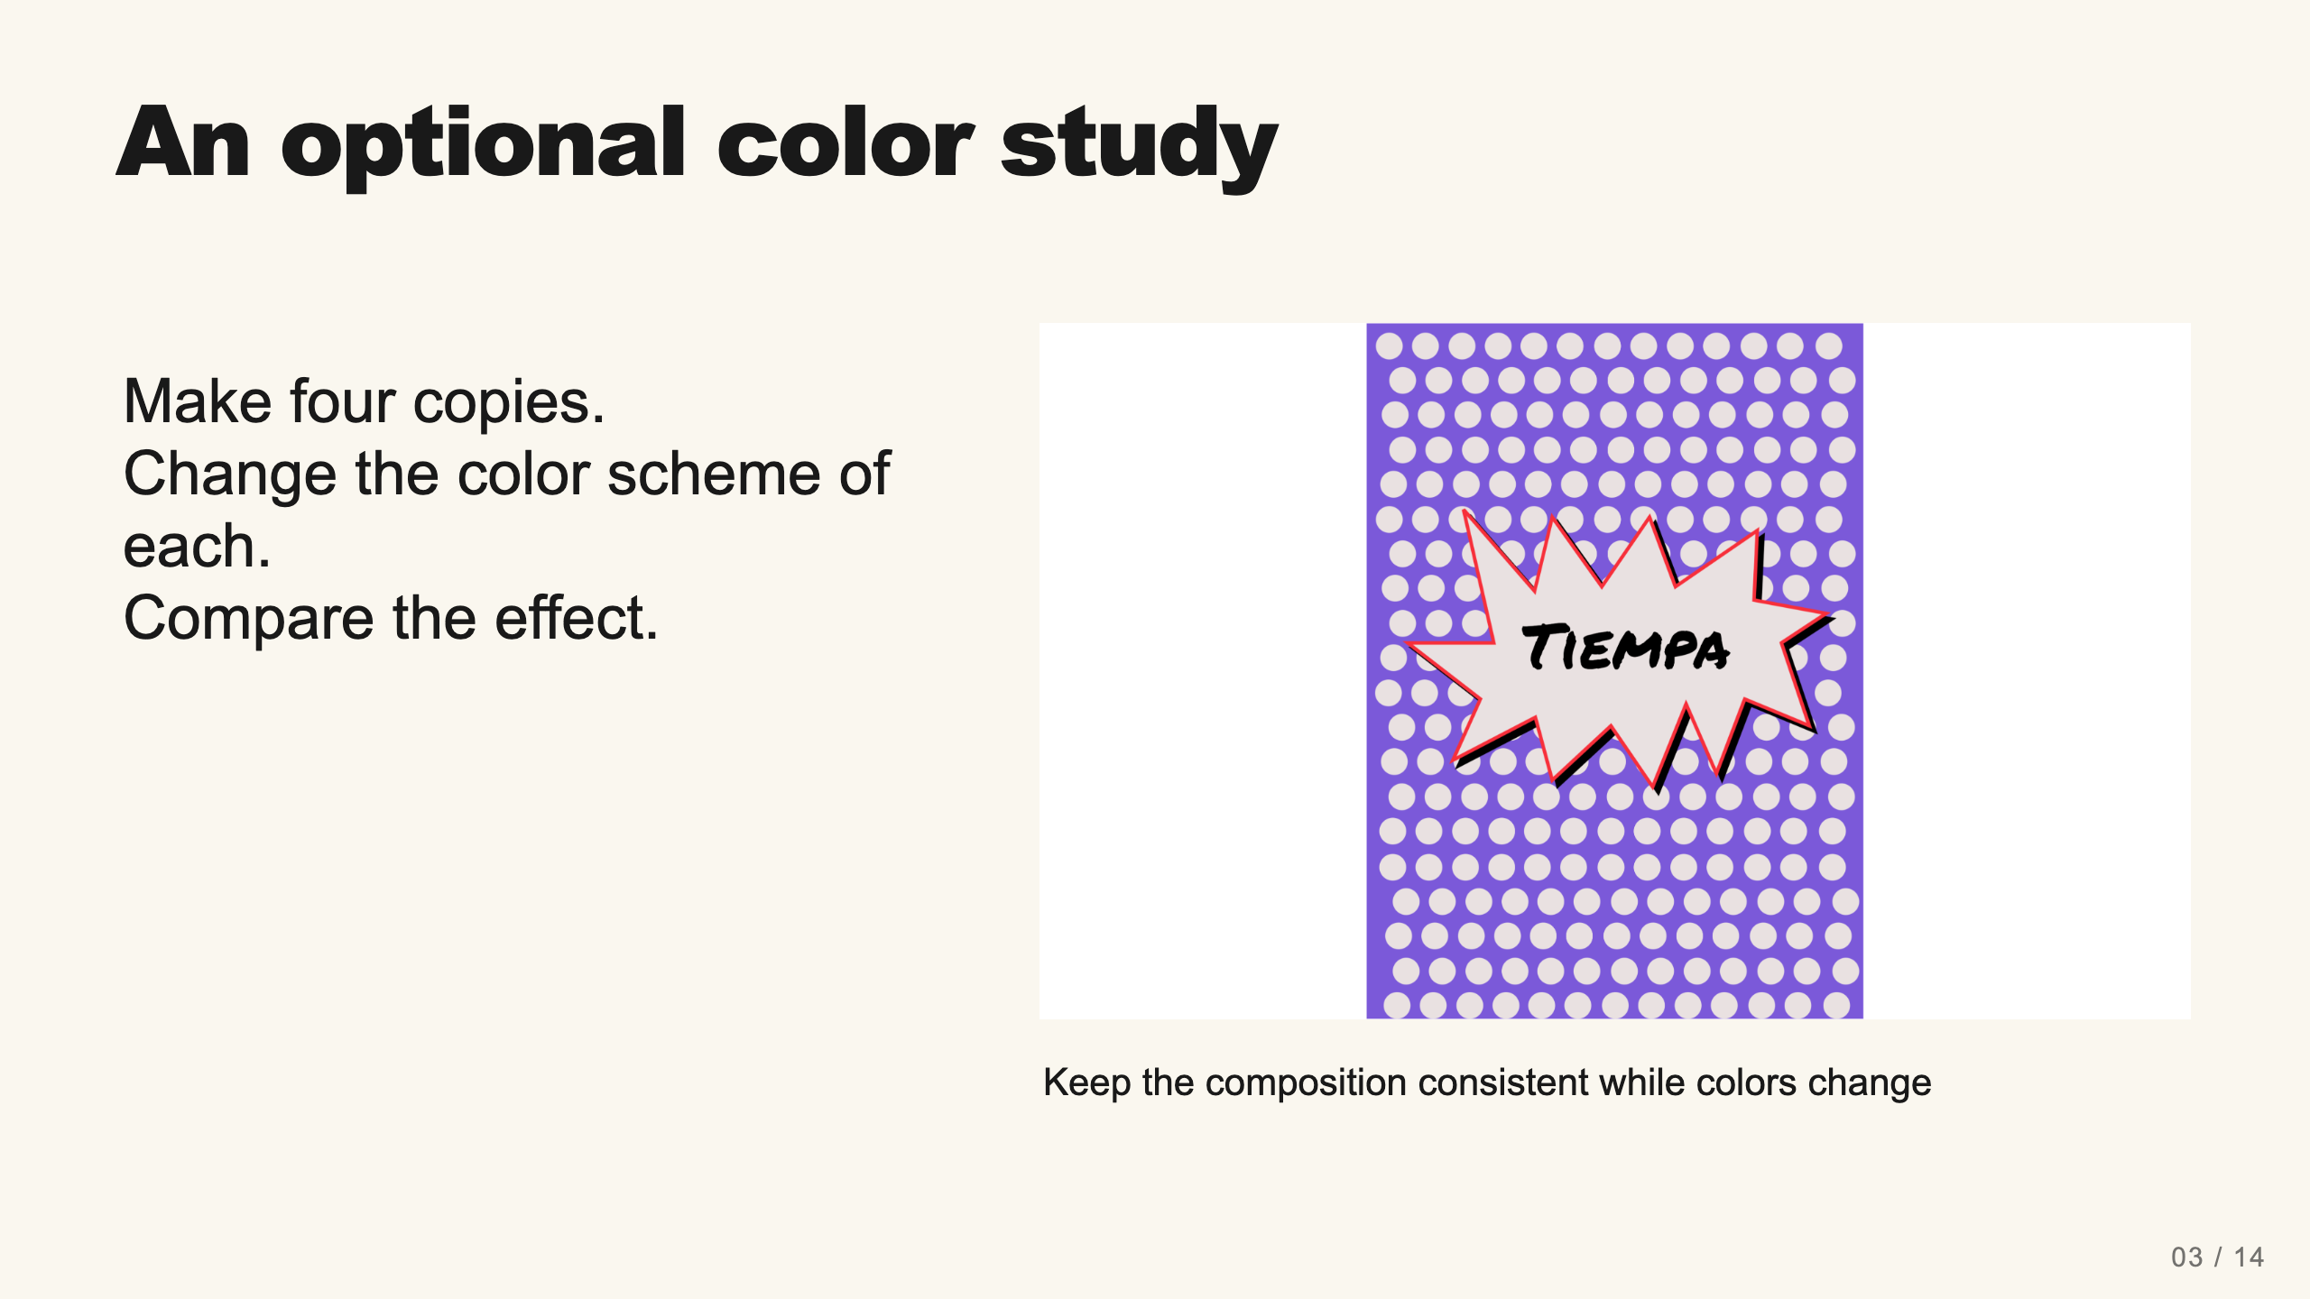
Notes:
Teacher move: Extension after the core work. This preserves the existing four-version stretch task. Students submit all four as a panel if they choose it. Explain that repetition with color variation is associated with Warhol, without labeling a student exercise as his original work.
[Sources]
Current course snapshot, generated student pages and facilitator guides in innovative-technology-site, inspected 2026-09-07. Original ZIP supplied by Elisha Lucero.
Canva editor and Combo app, Graphic Design Lesson Demonstrations, https://www.canva.com/design/DAHUiq9hUJg/IwU_7AR5EXsmRbdnEBtkhA/edit . Screenshots captured directly in the Bowie Middle School account, 2026-09-07. Interface labels may vary by account. Canva screenshots used for classroom software instruction.
Visual: source-10.png. Selected instructional image retained from the user-supplied Unit 1 DPI 2026 teaching materials. Reuse is for this classroom teaching adaptation. Original image rights remain with their respective creators; no open license is asserted.
Visual reference: source-10.png. Supplied teaching artwork or a direct Canva interface capture, as recorded in the source ledger.

Slide 15
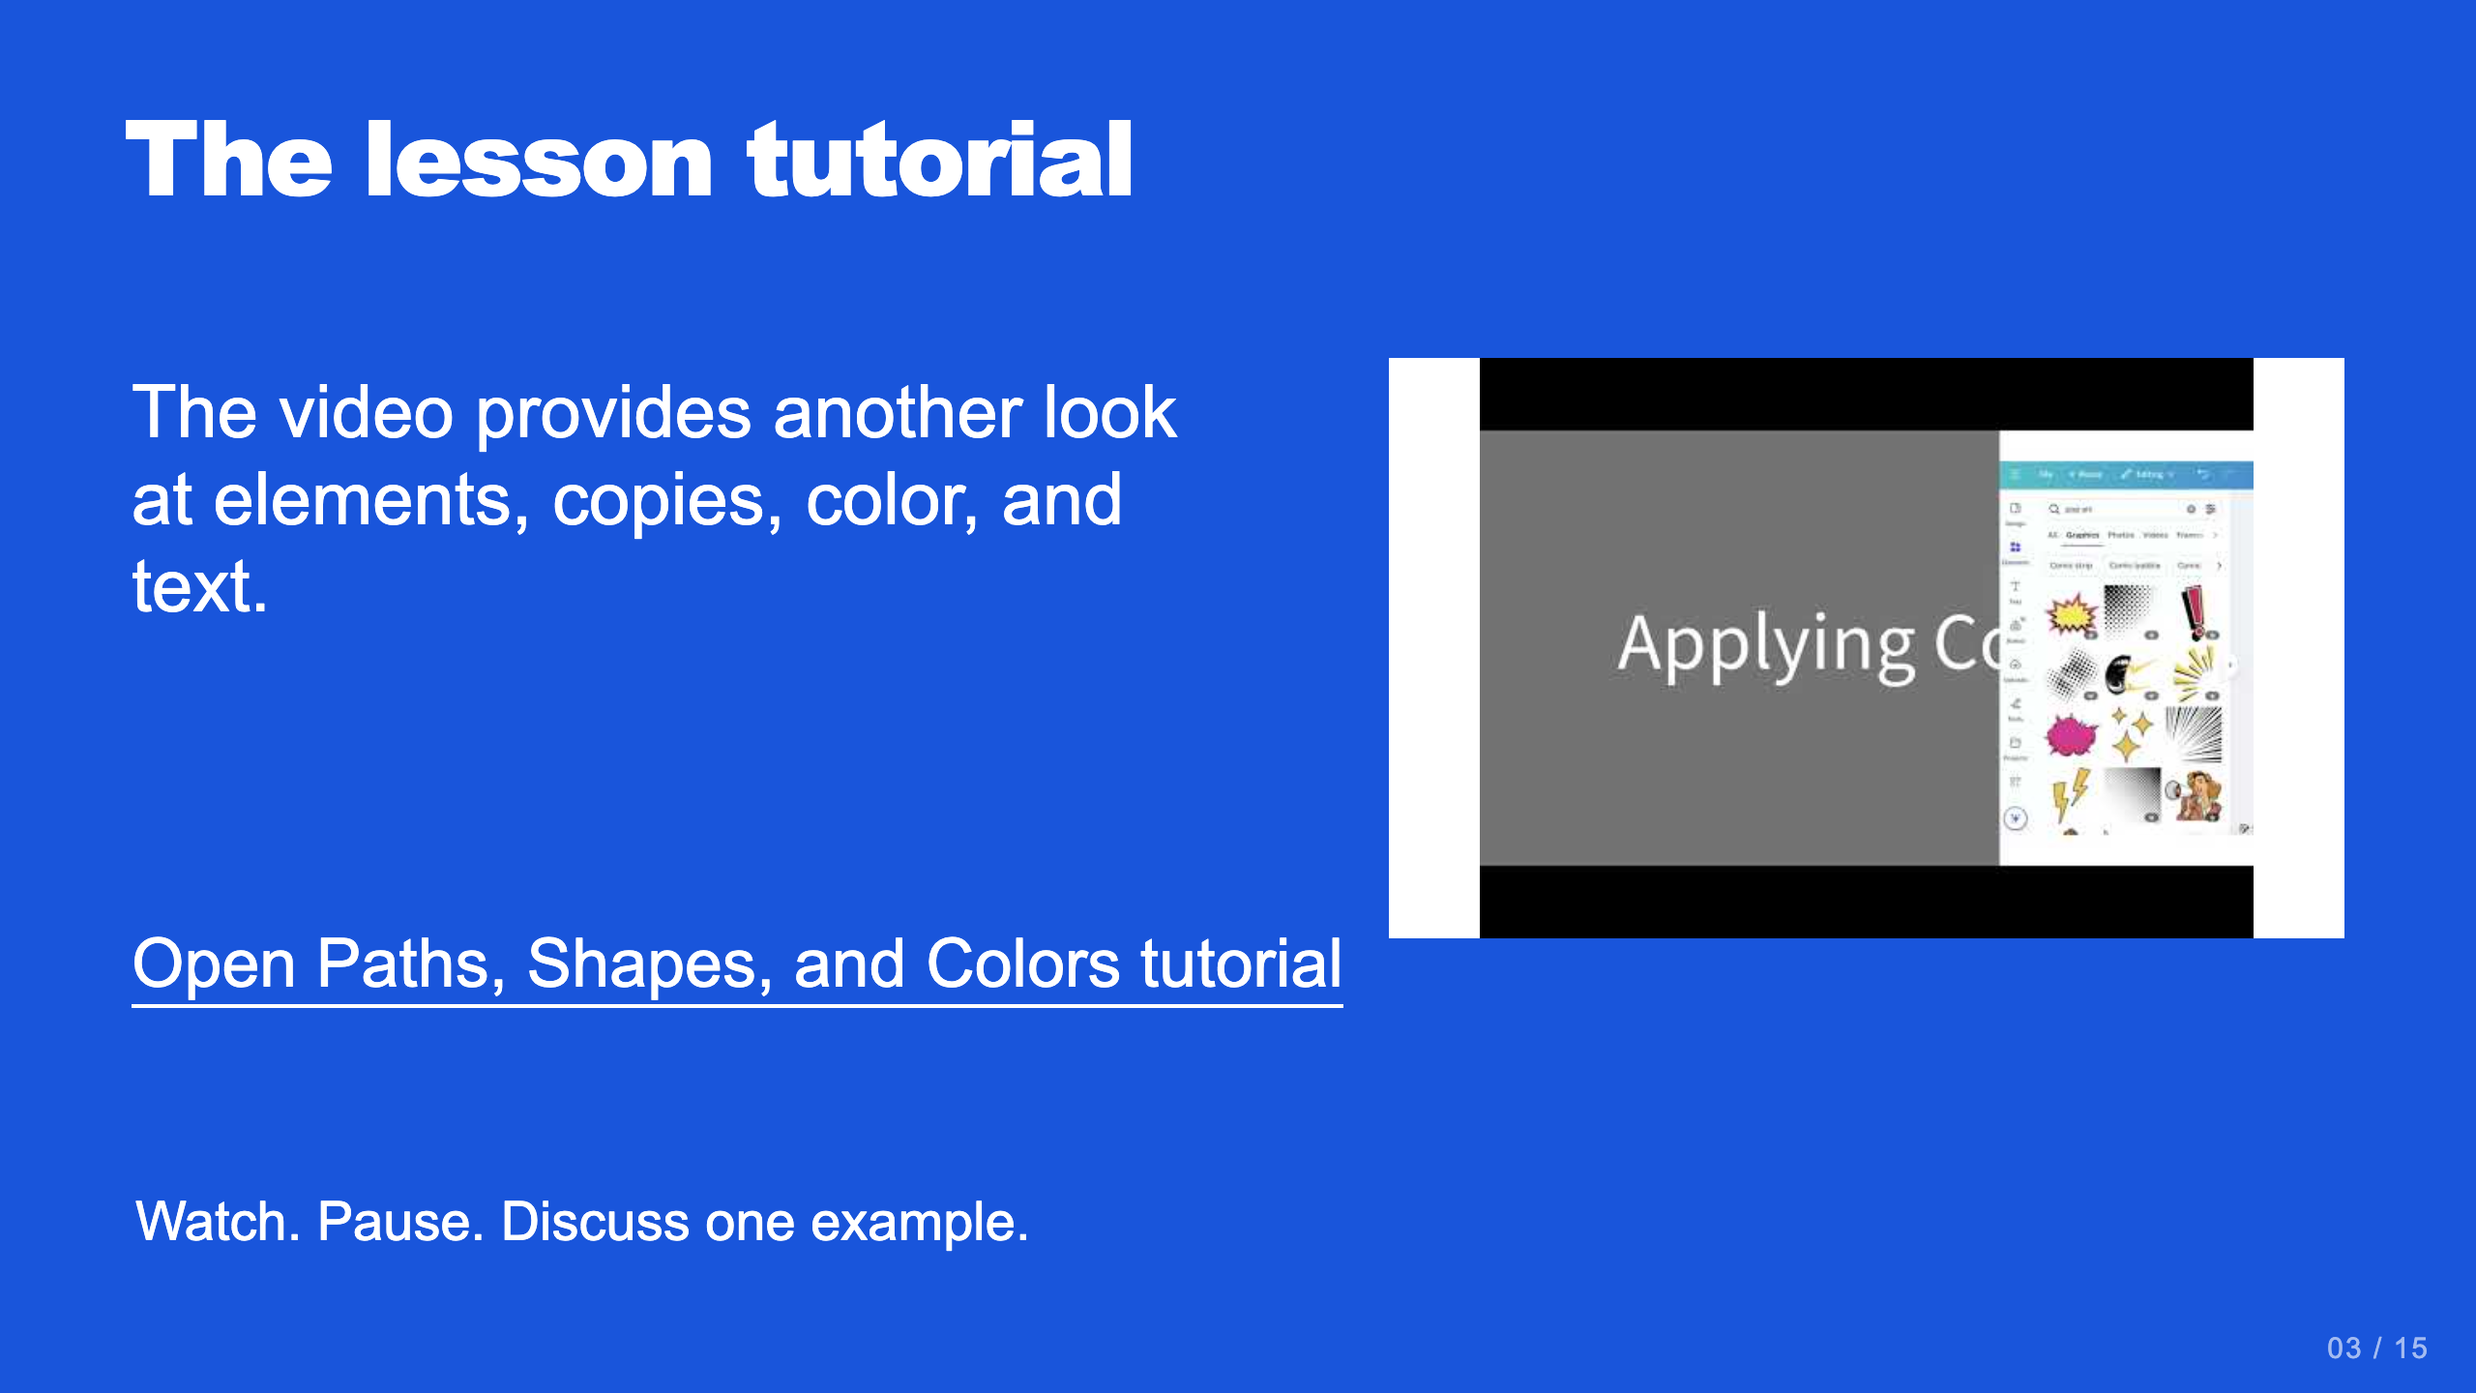
Notes:
Teacher move: Optional reference. The current English tutorial is https://www.youtube.com/watch?v=Cep7BeszAX8 . The Canvas page also retains its Spanish video route.
[Sources]
Current course snapshot, generated student pages and facilitator guides in innovative-technology-site, inspected 2026-09-07. Original ZIP supplied by Elisha Lucero.
Canva editor and Combo app, Graphic Design Lesson Demonstrations, https://www.canva.com/design/DAHUiq9hUJg/IwU_7AR5EXsmRbdnEBtkhA/edit . Screenshots captured directly in the Bowie Middle School account, 2026-09-07. Interface labels may vary by account. Canva screenshots used for classroom software instruction.
Visual reference: video-03.jpg. Thumbnail published by the linked video on YouTube.

Slide 16
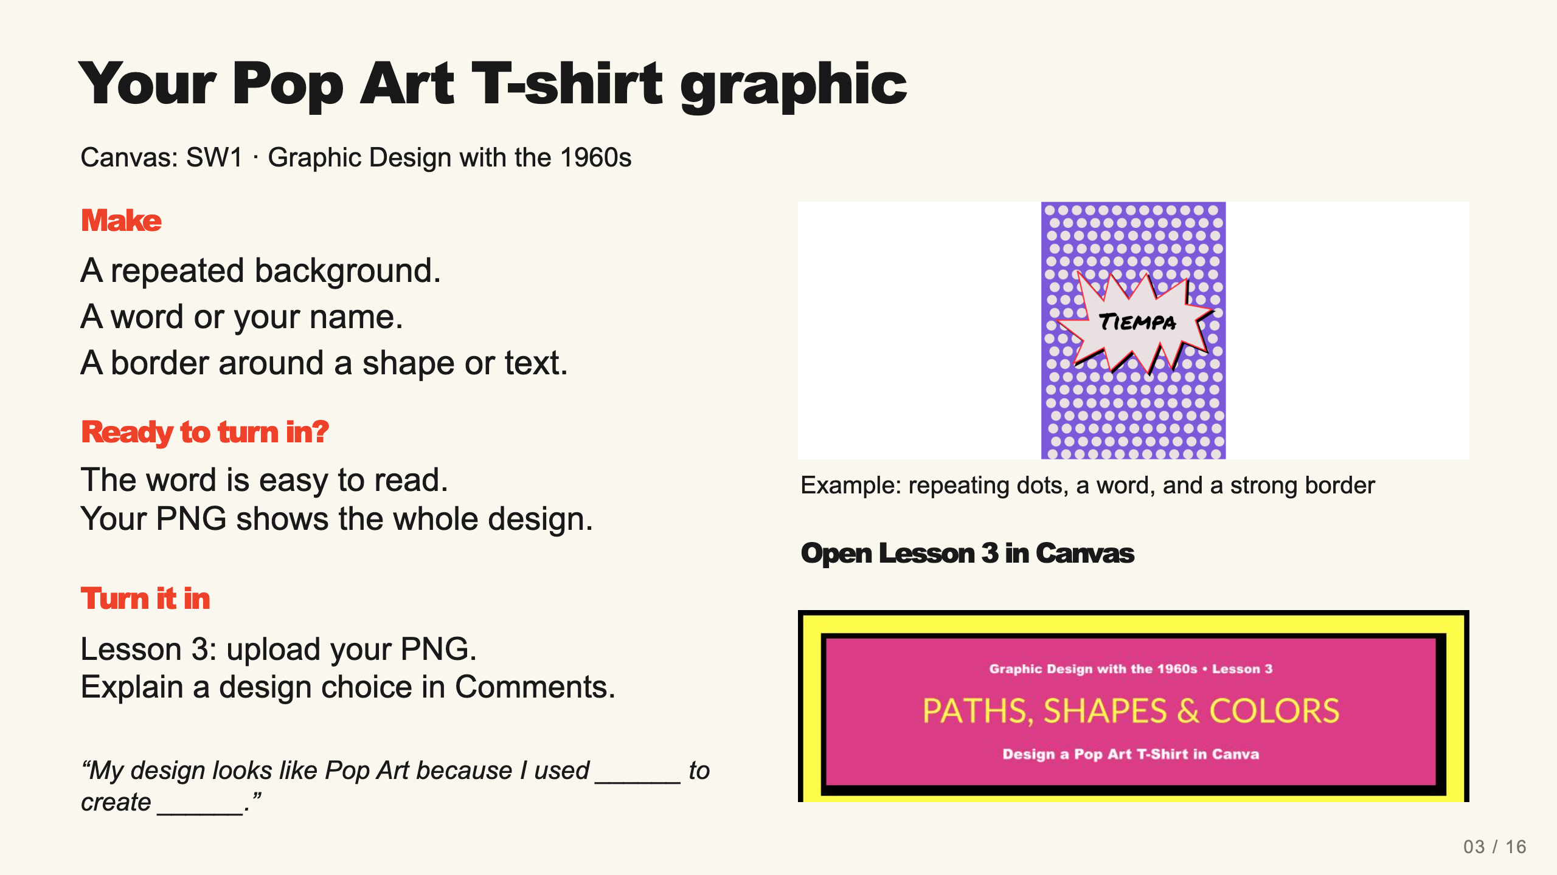
Notes:
Teacher move: Leave this screen projected throughout independent work. It contains the required product, observable completion checks, an exemplar, and the existing submission route. Use verbal reminders and brief conferences instead of cycling through separate task, submission, and done slides. The exemplar is inspiration, not a template to copy. Before class, open the named assignment in your own course and confirm the submission controls.
Check pattern, text, and a border before students export. The task creates a graphic for a shirt, not a printed product.
The existing assignment rubric and points remain authoritative. Confer on one useful revision at a time.
[Sources]
Current course snapshot, generated student pages and facilitator guides in innovative-technology-site, inspected 2026-09-07. Original ZIP supplied by Elisha Lucero.
Canva editor and Combo app, Graphic Design Lesson Demonstrations, https://www.canva.com/design/DAHUiq9hUJg/IwU_7AR5EXsmRbdnEBtkhA/edit . Screenshots captured directly in the Bowie Middle School account, 2026-09-07. Interface labels may vary by account. Canva screenshots used for classroom software instruction.
Exemplar: source-10.png, from the supplied classroom materials. Canvas: live assignment and submission types verified through the API on September 7, 2026. Screenshot: real teacher-view assignment banner, cropped to omit editing controls. The unpublished template module prevents Student View access; publication was not changed.

