Slide 1
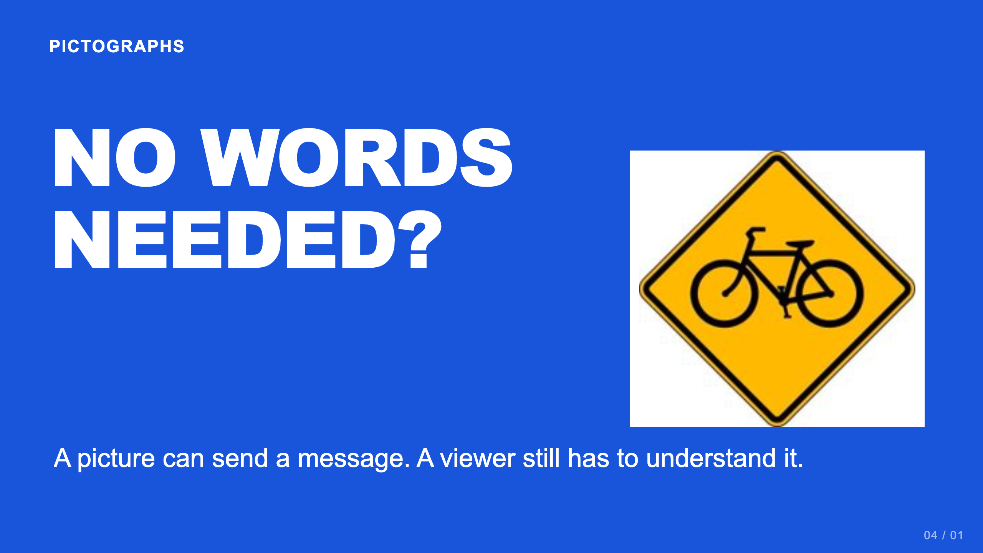
Notes:
Teacher move: About 50 minutes. Students make two pictographs using shapes, with at least one Gestalt principle in each. Do not replace the current task with an emoji assignment.
[Sources]
Current course snapshot, generated student pages and facilitator guides in innovative-technology-site, inspected 2026-09-07. Original ZIP supplied by Elisha Lucero.
Canva editor and Combo app, Graphic Design Lesson Demonstrations, https://www.canva.com/design/DAHUiq9hUJg/IwU_7AR5EXsmRbdnEBtkhA/edit . Screenshots captured directly in the Bowie Middle School account, 2026-09-07. Interface labels may vary by account. Canva screenshots used for classroom software instruction.
Selected instructional image retained from the user-supplied Unit 1 DPI 2026 teaching materials. Reuse is for this classroom teaching adaptation. Original image rights remain with their respective creators; no open license is asserted.
Visual: source-24.jpg. Selected instructional image retained from the user-supplied Unit 1 DPI 2026 teaching materials. Reuse is for this classroom teaching adaptation. Original image rights remain with their respective creators; no open license is asserted.
Visual reference: source-24.jpg. Supplied teaching artwork or a direct Canva interface capture, as recorded in the source ledger.

Slide 2
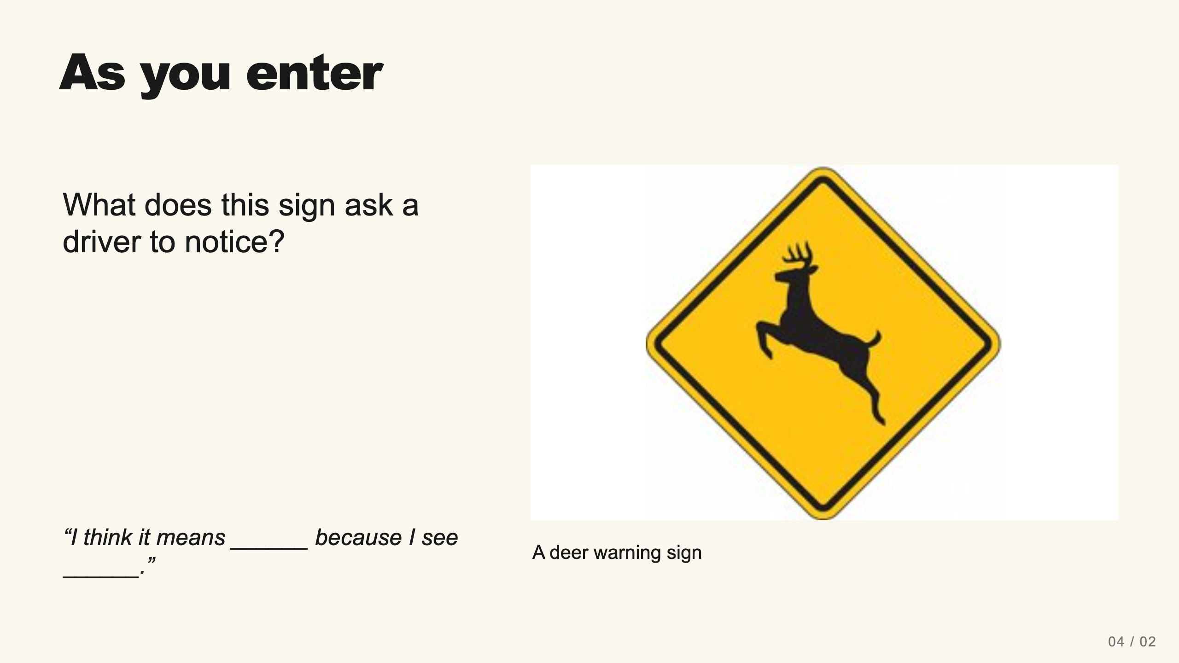
Notes:
Teacher move: 2 minutes. Ask what students recognize and which shapes carry the meaning. A warning sign relies on learned conventions and context. Avoid claiming every symbol is universal.
[Sources]
Current course snapshot, generated student pages and facilitator guides in innovative-technology-site, inspected 2026-09-07. Original ZIP supplied by Elisha Lucero.
Canva editor and Combo app, Graphic Design Lesson Demonstrations, https://www.canva.com/design/DAHUiq9hUJg/IwU_7AR5EXsmRbdnEBtkhA/edit . Screenshots captured directly in the Bowie Middle School account, 2026-09-07. Interface labels may vary by account. Canva screenshots used for classroom software instruction.
Selected instructional image retained from the user-supplied Unit 1 DPI 2026 teaching materials. Reuse is for this classroom teaching adaptation. Original image rights remain with their respective creators; no open license is asserted.
Visual: source-23.jpg. Selected instructional image retained from the user-supplied Unit 1 DPI 2026 teaching materials. Reuse is for this classroom teaching adaptation. Original image rights remain with their respective creators; no open license is asserted.
Visual reference: source-23.jpg. Supplied teaching artwork or a direct Canva interface capture, as recorded in the source ledger.

Slide 3
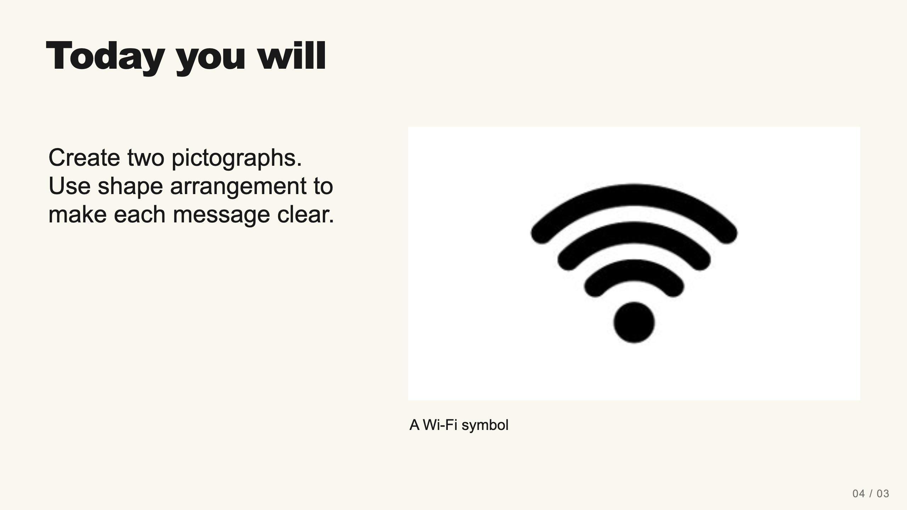
Notes:
Teacher move: 1 minute. Each pictograph needs at least one shape and one Gestalt principle. No words or letters in the designs. The current assignment asks for PNG evidence and its reflection.
[Sources]
Current course snapshot, generated student pages and facilitator guides in innovative-technology-site, inspected 2026-09-07. Original ZIP supplied by Elisha Lucero.
Canva editor and Combo app, Graphic Design Lesson Demonstrations, https://www.canva.com/design/DAHUiq9hUJg/IwU_7AR5EXsmRbdnEBtkhA/edit . Screenshots captured directly in the Bowie Middle School account, 2026-09-07. Interface labels may vary by account. Canva screenshots used for classroom software instruction.
Selected instructional image retained from the user-supplied Unit 1 DPI 2026 teaching materials. Reuse is for this classroom teaching adaptation. Original image rights remain with their respective creators; no open license is asserted.
Visual reference: source-36.jpg. Supplied teaching artwork or a direct Canva interface capture, as recorded in the source ledger.

Slide 4
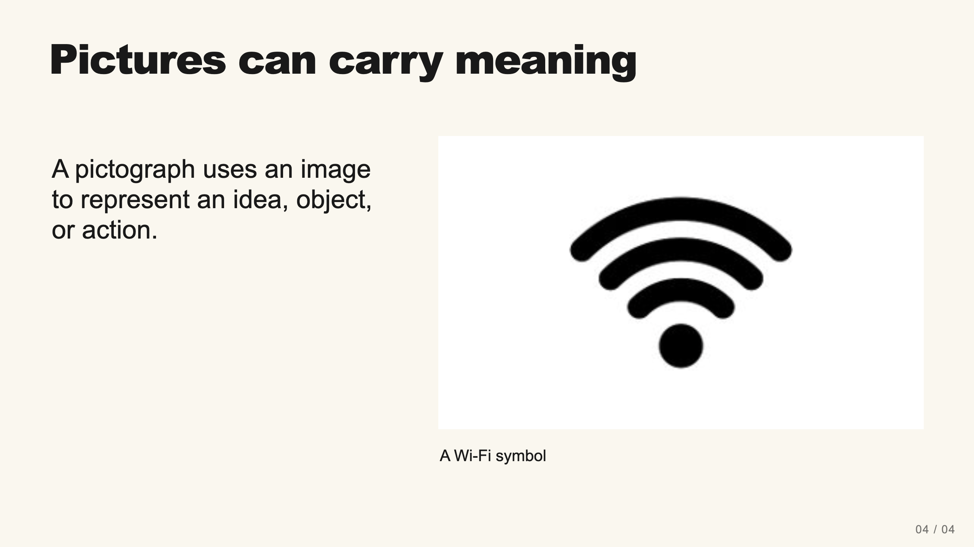
Notes:
Teacher move: 1 minute. Connect the term with icons students already recognize. Explain that meaning comes partly from learning and context. A Wi-Fi icon is a modern example of visual communication, not proof of a direct lineage from a particular ancient mark.
[Sources]
Current course snapshot, generated student pages and facilitator guides in innovative-technology-site, inspected 2026-09-07. Original ZIP supplied by Elisha Lucero.
Canva editor and Combo app, Graphic Design Lesson Demonstrations, https://www.canva.com/design/DAHUiq9hUJg/IwU_7AR5EXsmRbdnEBtkhA/edit . Screenshots captured directly in the Bowie Middle School account, 2026-09-07. Interface labels may vary by account. Canva screenshots used for classroom software instruction.
Selected instructional image retained from the user-supplied Unit 1 DPI 2026 teaching materials. Reuse is for this classroom teaching adaptation. Original image rights remain with their respective creators; no open license is asserted.
Visual: source-36.jpg. Selected instructional image retained from the user-supplied Unit 1 DPI 2026 teaching materials. Reuse is for this classroom teaching adaptation. Original image rights remain with their respective creators; no open license is asserted.
Visual reference: source-36.jpg. Supplied teaching artwork or a direct Canva interface capture, as recorded in the source ledger.

Slide 5
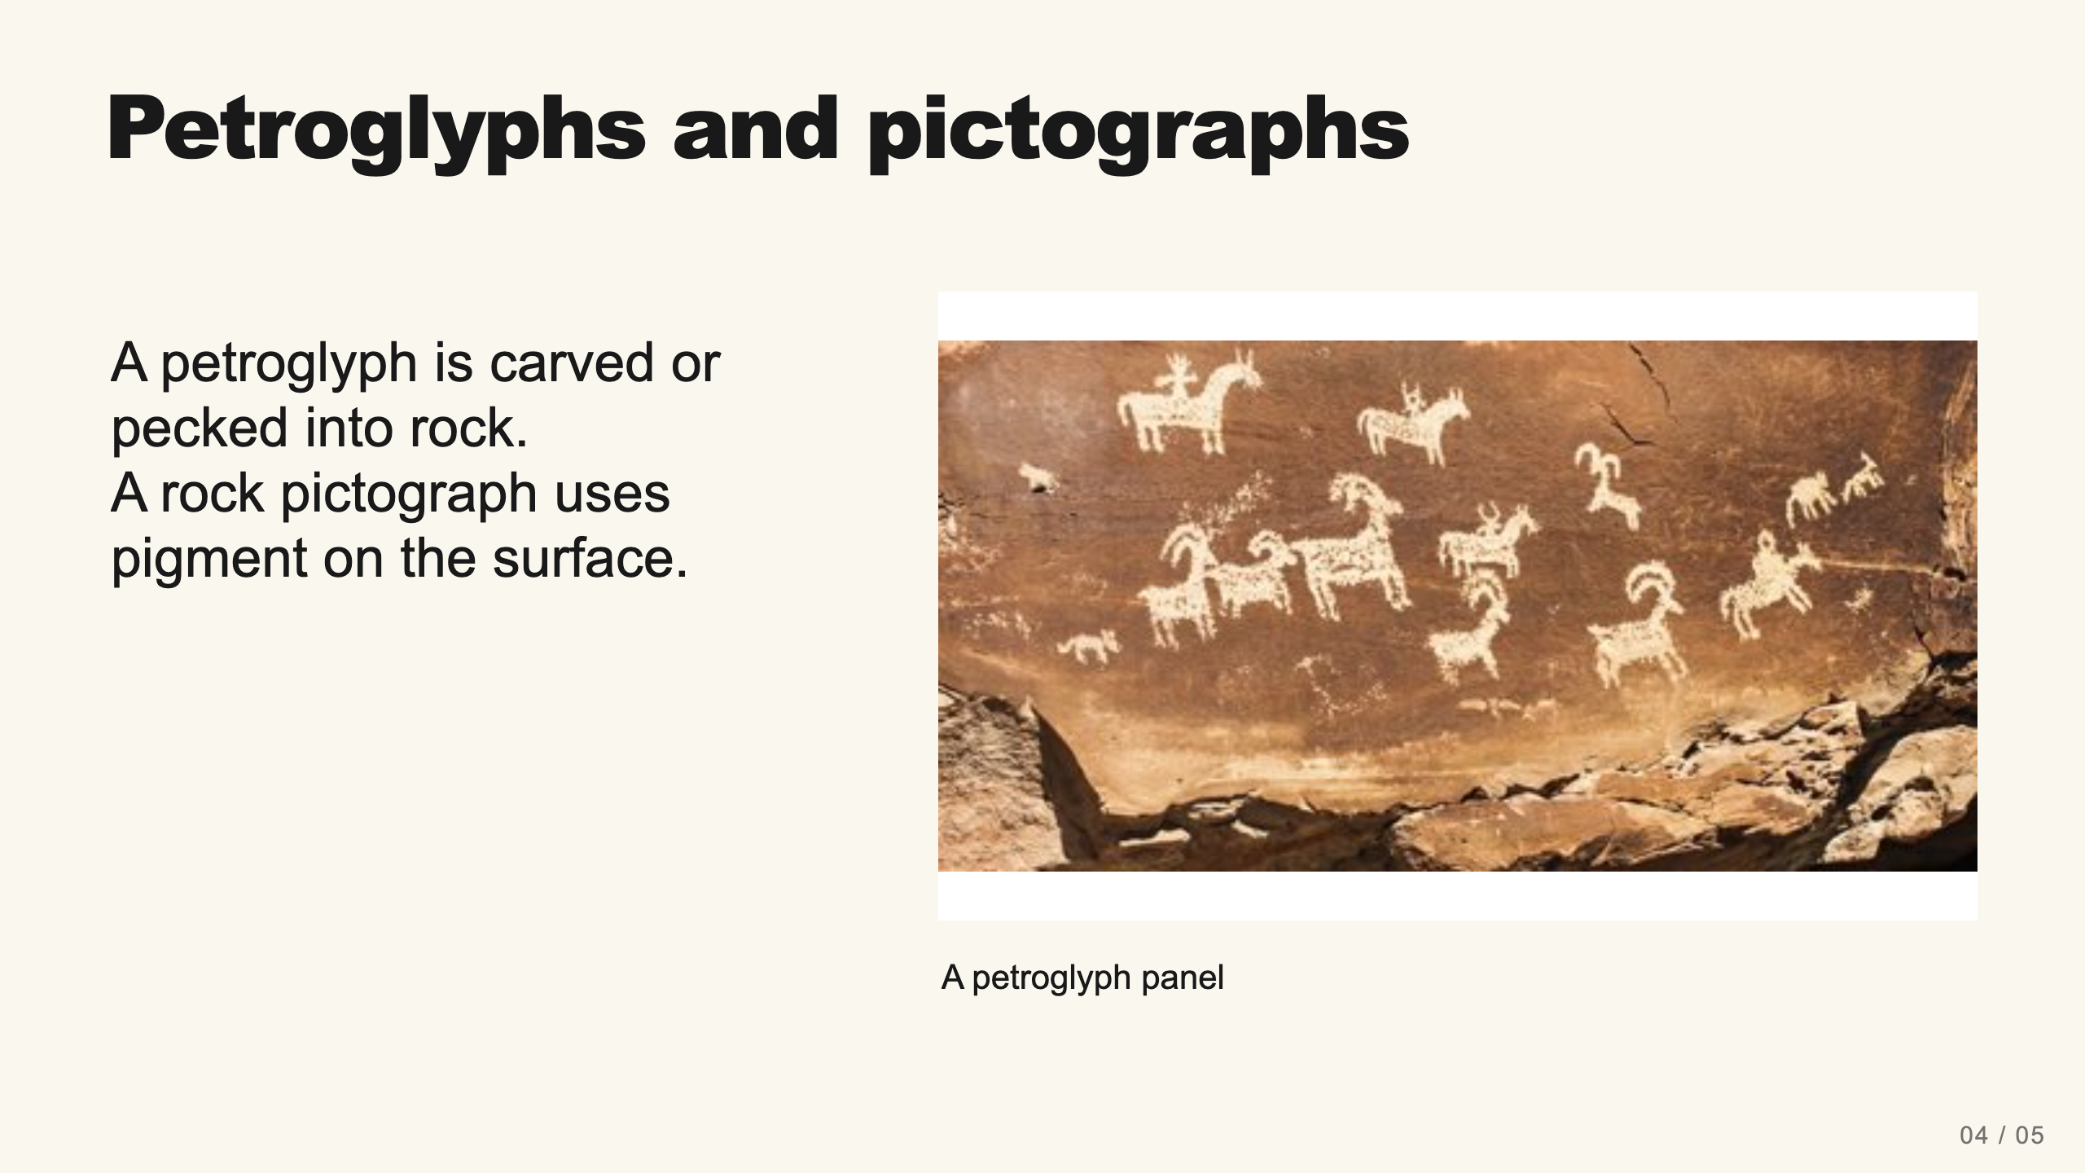
Notes:
Teacher move: 2 minutes. Use the photo to discuss the visible surface. Do not assign a meaning, date, or culture based only on appearance. NPS distinguishes petroglyphs by removal of rock and pictographs by applied pigment. Source: https://www.nps.gov/petr/planyourvisit/def.htm . Do not teach all rock art as the earliest writing.
[Sources]
Current course snapshot, generated student pages and facilitator guides in innovative-technology-site, inspected 2026-09-07. Original ZIP supplied by Elisha Lucero.
Canva editor and Combo app, Graphic Design Lesson Demonstrations, https://www.canva.com/design/DAHUiq9hUJg/IwU_7AR5EXsmRbdnEBtkhA/edit . Screenshots captured directly in the Bowie Middle School account, 2026-09-07. Interface labels may vary by account. Canva screenshots used for classroom software instruction.
Selected instructional image retained from the user-supplied Unit 1 DPI 2026 teaching materials. Reuse is for this classroom teaching adaptation. Original image rights remain with their respective creators; no open license is asserted.
Visual: source-32.jpg. Selected instructional image retained from the user-supplied Unit 1 DPI 2026 teaching materials. Reuse is for this classroom teaching adaptation. Original image rights remain with their respective creators; no open license is asserted.
Visual reference: source-32.jpg. Supplied teaching artwork or a direct Canva interface capture, as recorded in the source ledger.

Slide 6
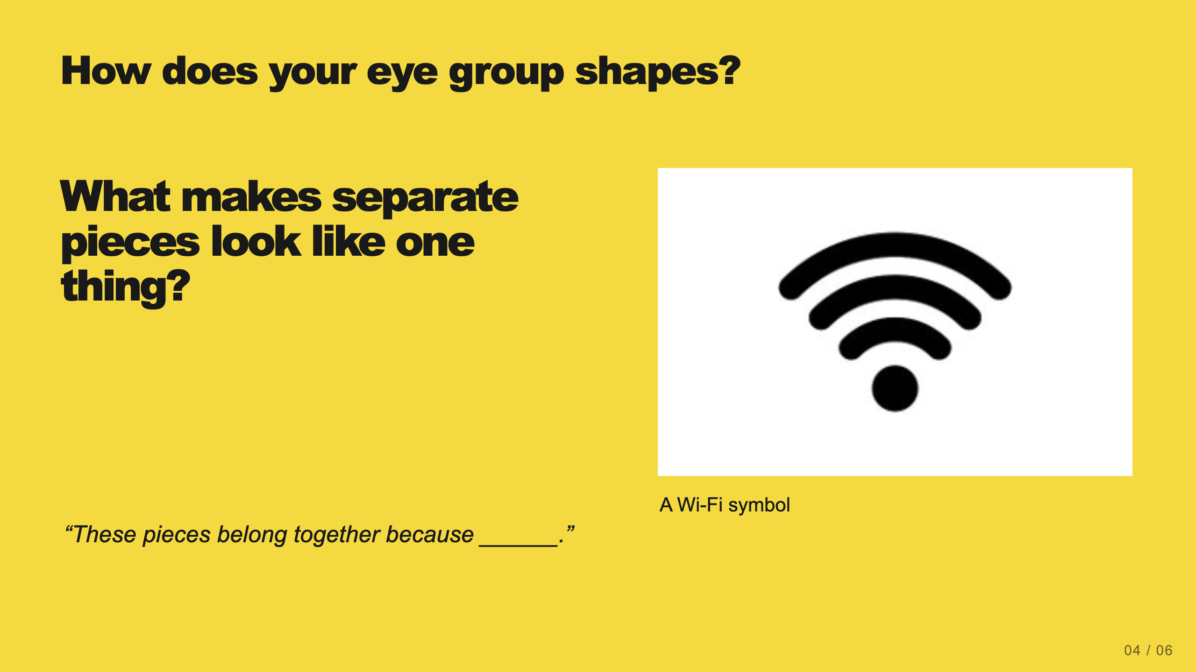
Notes:
Teacher move: 1 minute. Introduce Gestalt principles as descriptions of common perceptual tendencies. They are useful design guides, not guarantees that every viewer perceives the same thing. Each next slide names one principle and shows it.
[Sources]
Current course snapshot, generated student pages and facilitator guides in innovative-technology-site, inspected 2026-09-07. Original ZIP supplied by Elisha Lucero.
Canva editor and Combo app, Graphic Design Lesson Demonstrations, https://www.canva.com/design/DAHUiq9hUJg/IwU_7AR5EXsmRbdnEBtkhA/edit . Screenshots captured directly in the Bowie Middle School account, 2026-09-07. Interface labels may vary by account. Canva screenshots used for classroom software instruction.
Selected instructional image retained from the user-supplied Unit 1 DPI 2026 teaching materials. Reuse is for this classroom teaching adaptation. Original image rights remain with their respective creators; no open license is asserted.
Visual reference: source-36.jpg. Supplied teaching artwork or a direct Canva interface capture, as recorded in the source ledger.

Slide 7
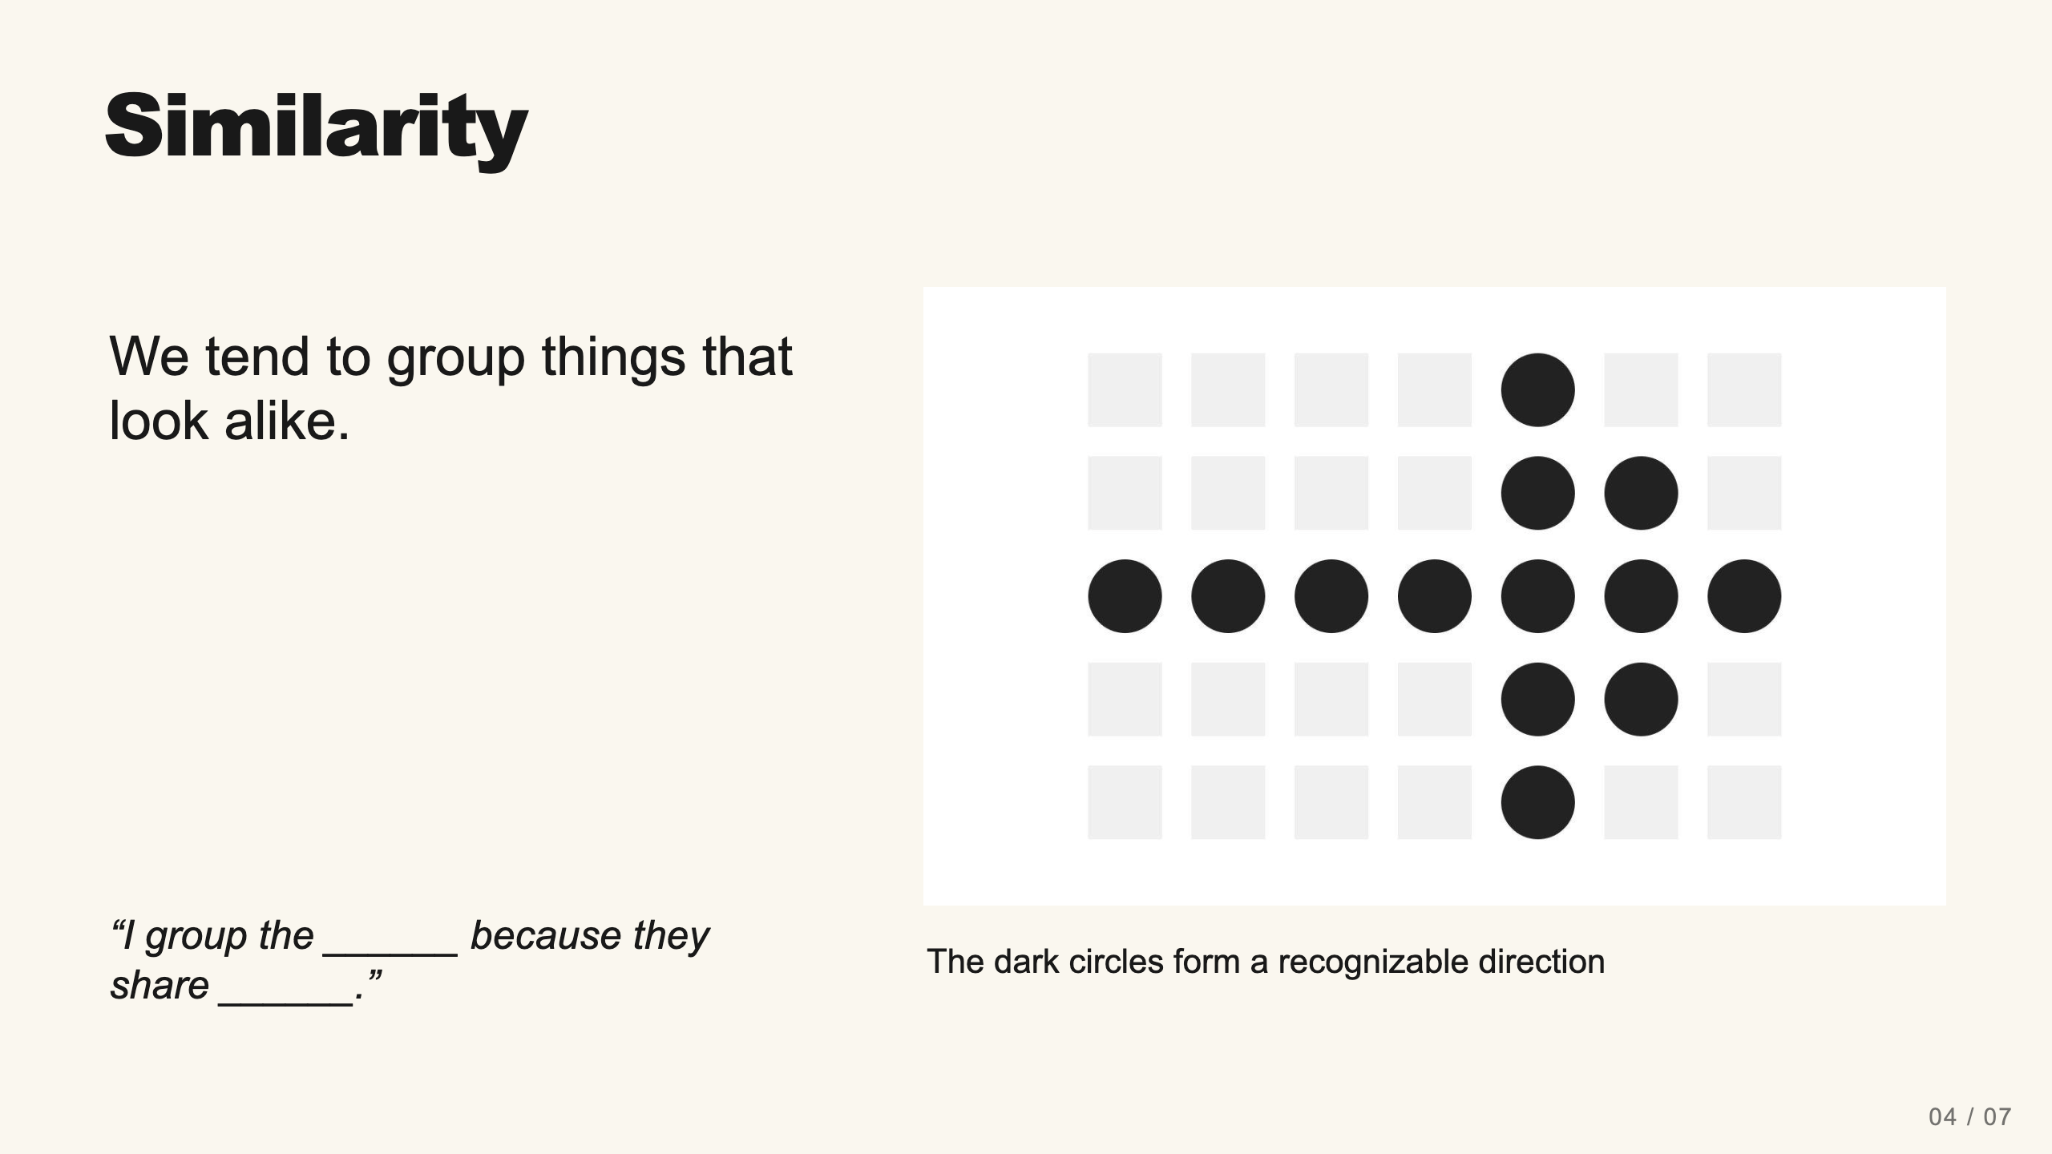
Notes:
Teacher move: 2 minutes. Ask students to identify the arrow before naming the rule. The dark circles share shape and color, which separates them from the pale squares. For a shapes-only design, repeated visual features can connect related parts.
[Sources]
Current course snapshot, generated student pages and facilitator guides in innovative-technology-site, inspected 2026-09-07. Original ZIP supplied by Elisha Lucero.
Canva editor and Combo app, Graphic Design Lesson Demonstrations, https://www.canva.com/design/DAHUiq9hUJg/IwU_7AR5EXsmRbdnEBtkhA/edit . Screenshots captured directly in the Bowie Middle School account, 2026-09-07. Interface labels may vary by account. Canva screenshots used for classroom software instruction.
Selected instructional image retained from the user-supplied Unit 1 DPI 2026 teaching materials. Reuse is for this classroom teaching adaptation. Original image rights remain with their respective creators; no open license is asserted.
Visual: source-43.jpg. Selected instructional image retained from the user-supplied Unit 1 DPI 2026 teaching materials. Reuse is for this classroom teaching adaptation. Original image rights remain with their respective creators; no open license is asserted.
Visual reference: source-43.jpg. Supplied teaching artwork or a direct Canva interface capture, as recorded in the source ledger.

Slide 8
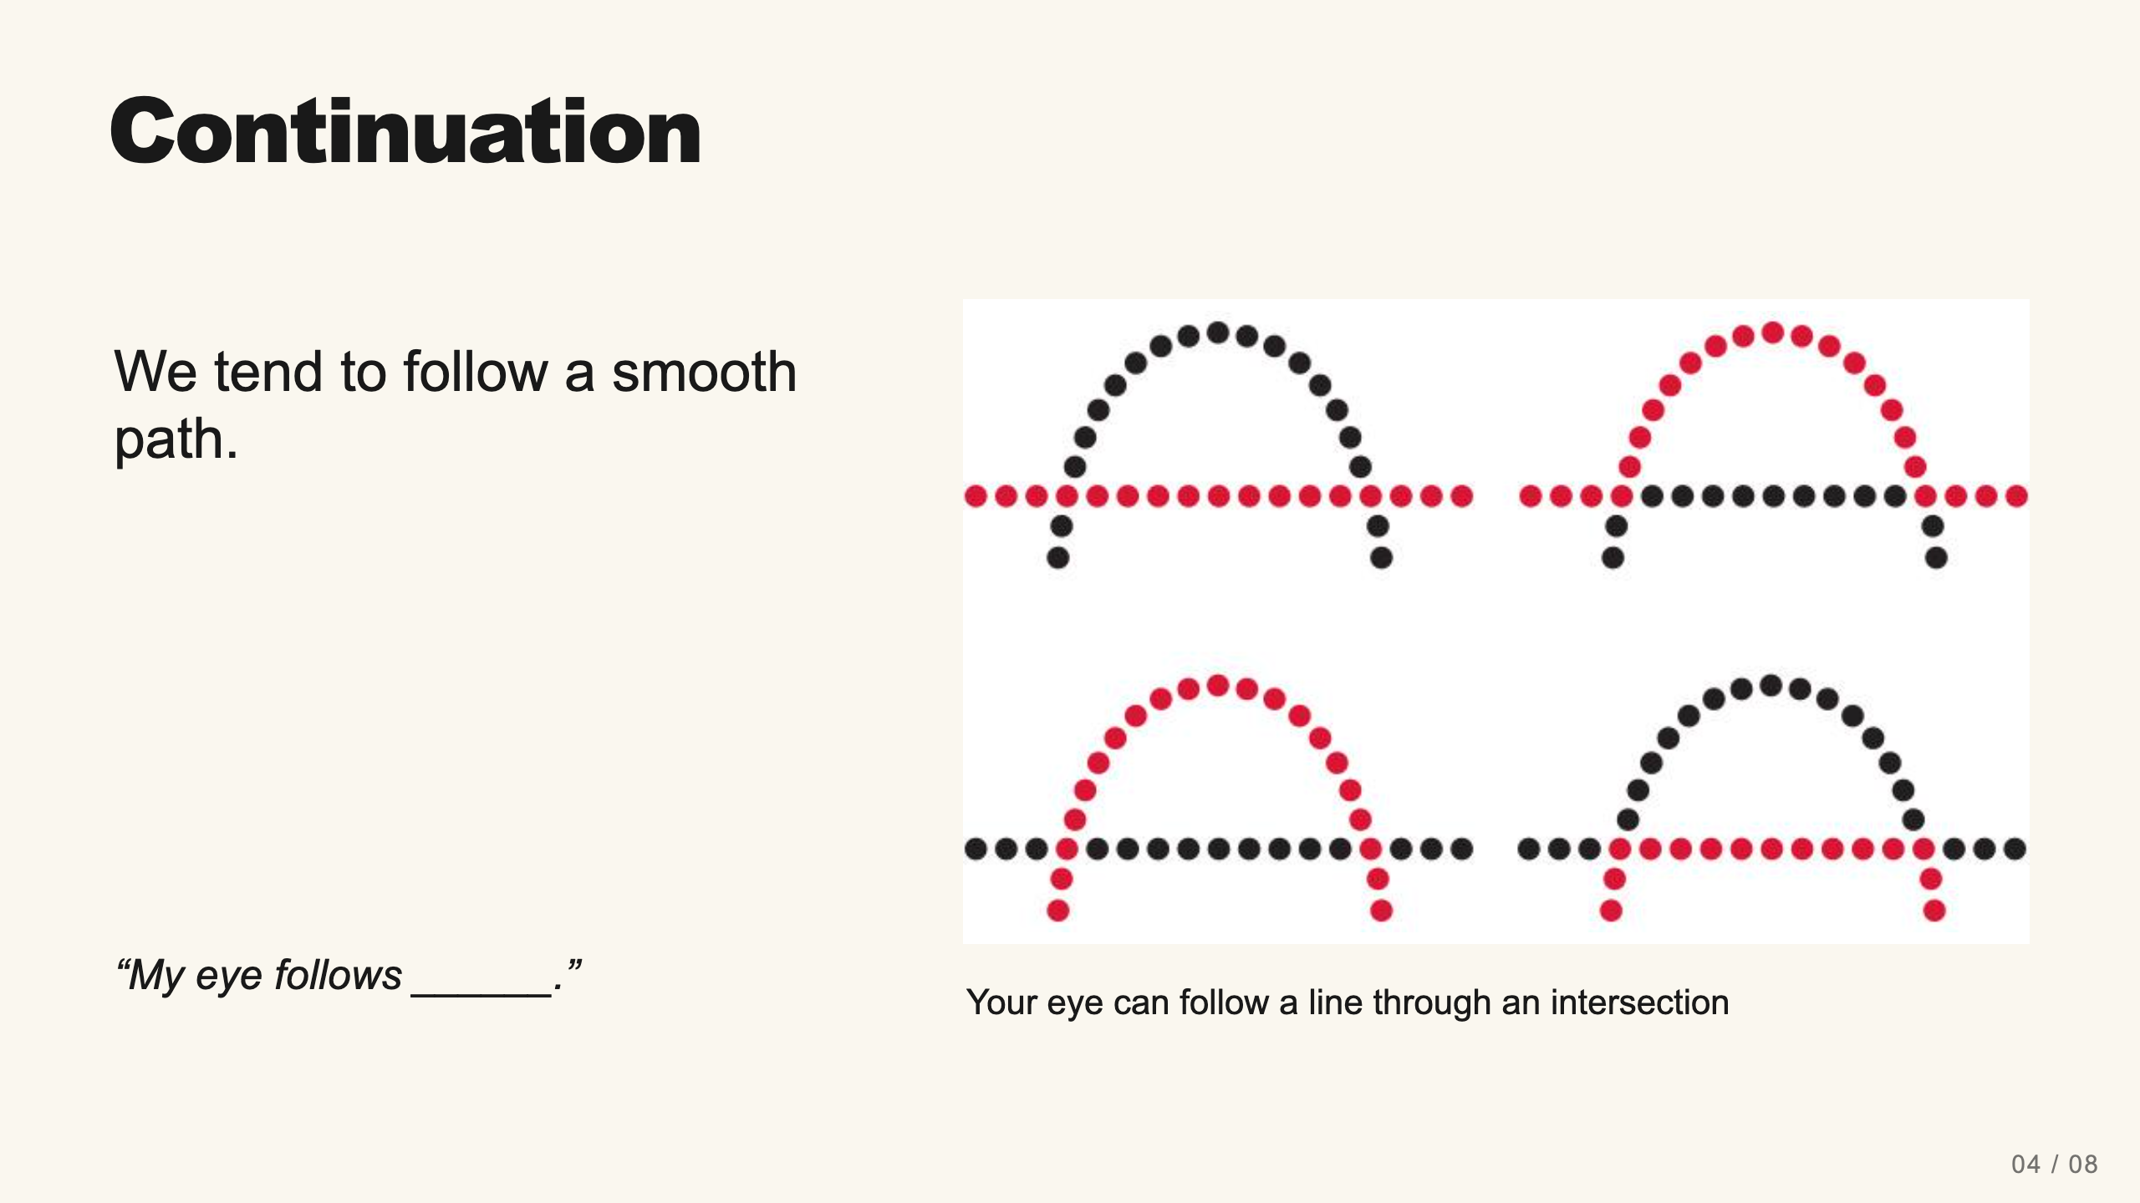
Notes:
Teacher move: 2 minutes. Students trace the smooth curve and the straight row with a finger in the air. Different colors do not necessarily prevent the eye from following the path. Connect this to guiding attention.
[Sources]
Current course snapshot, generated student pages and facilitator guides in innovative-technology-site, inspected 2026-09-07. Original ZIP supplied by Elisha Lucero.
Canva editor and Combo app, Graphic Design Lesson Demonstrations, https://www.canva.com/design/DAHUiq9hUJg/IwU_7AR5EXsmRbdnEBtkhA/edit . Screenshots captured directly in the Bowie Middle School account, 2026-09-07. Interface labels may vary by account. Canva screenshots used for classroom software instruction.
Selected instructional image retained from the user-supplied Unit 1 DPI 2026 teaching materials. Reuse is for this classroom teaching adaptation. Original image rights remain with their respective creators; no open license is asserted.
Visual: source-44.jpg. Selected instructional image retained from the user-supplied Unit 1 DPI 2026 teaching materials. Reuse is for this classroom teaching adaptation. Original image rights remain with their respective creators; no open license is asserted.
Visual reference: source-44.jpg. Supplied teaching artwork or a direct Canva interface capture, as recorded in the source ledger.

Slide 9
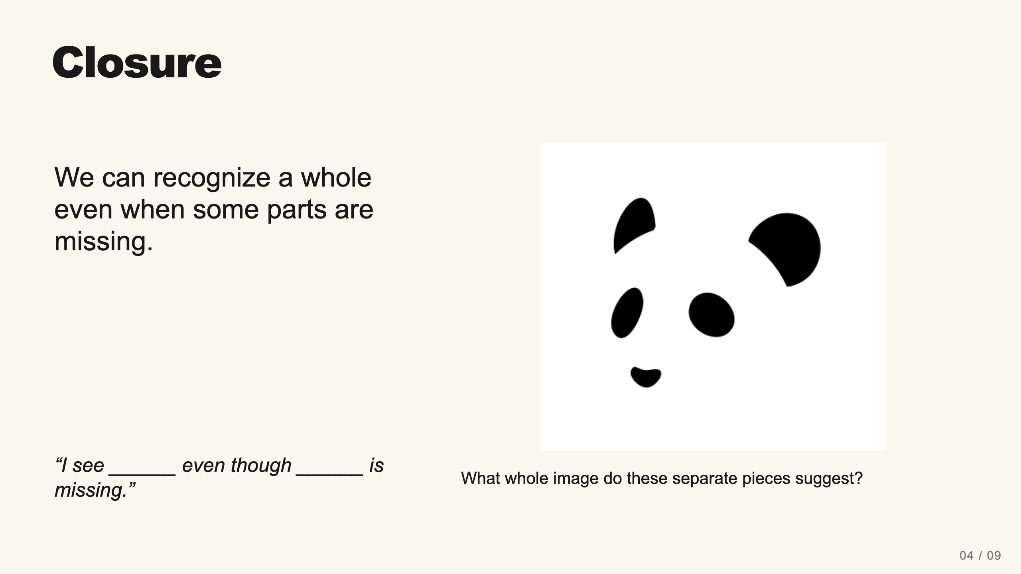
Notes:
Teacher move: 2 minutes. Ask what students see before saying panda. The missing outline does not stop many viewers from recognizing a face. Explain that too much missing information can make a design ambiguous.
[Sources]
Current course snapshot, generated student pages and facilitator guides in innovative-technology-site, inspected 2026-09-07. Original ZIP supplied by Elisha Lucero.
Canva editor and Combo app, Graphic Design Lesson Demonstrations, https://www.canva.com/design/DAHUiq9hUJg/IwU_7AR5EXsmRbdnEBtkhA/edit . Screenshots captured directly in the Bowie Middle School account, 2026-09-07. Interface labels may vary by account. Canva screenshots used for classroom software instruction.
Selected instructional image retained from the user-supplied Unit 1 DPI 2026 teaching materials. Reuse is for this classroom teaching adaptation. Original image rights remain with their respective creators; no open license is asserted.
Visual: source-45.png. Selected instructional image retained from the user-supplied Unit 1 DPI 2026 teaching materials. Reuse is for this classroom teaching adaptation. Original image rights remain with their respective creators; no open license is asserted.
Visual reference: source-45.png. Supplied teaching artwork or a direct Canva interface capture, as recorded in the source ledger.

Slide 10
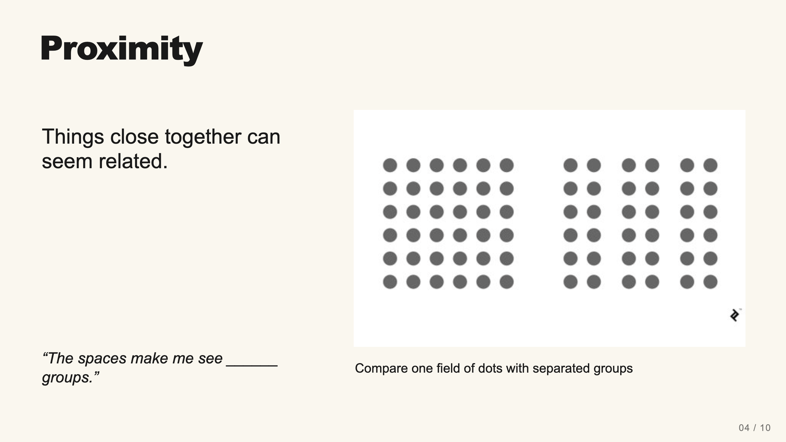
Notes:
Teacher move: 2 minutes. Students count apparent groups, not dots. The right arrangement separates columns through spacing. Connect this to keeping parts of one icon together.
[Sources]
Current course snapshot, generated student pages and facilitator guides in innovative-technology-site, inspected 2026-09-07. Original ZIP supplied by Elisha Lucero.
Canva editor and Combo app, Graphic Design Lesson Demonstrations, https://www.canva.com/design/DAHUiq9hUJg/IwU_7AR5EXsmRbdnEBtkhA/edit . Screenshots captured directly in the Bowie Middle School account, 2026-09-07. Interface labels may vary by account. Canva screenshots used for classroom software instruction.
Selected instructional image retained from the user-supplied Unit 1 DPI 2026 teaching materials. Reuse is for this classroom teaching adaptation. Original image rights remain with their respective creators; no open license is asserted.
Visual: source-46.jpg. Selected instructional image retained from the user-supplied Unit 1 DPI 2026 teaching materials. Reuse is for this classroom teaching adaptation. Original image rights remain with their respective creators; no open license is asserted.
Visual reference: source-46.jpg. Supplied teaching artwork or a direct Canva interface capture, as recorded in the source ledger.

Slide 11
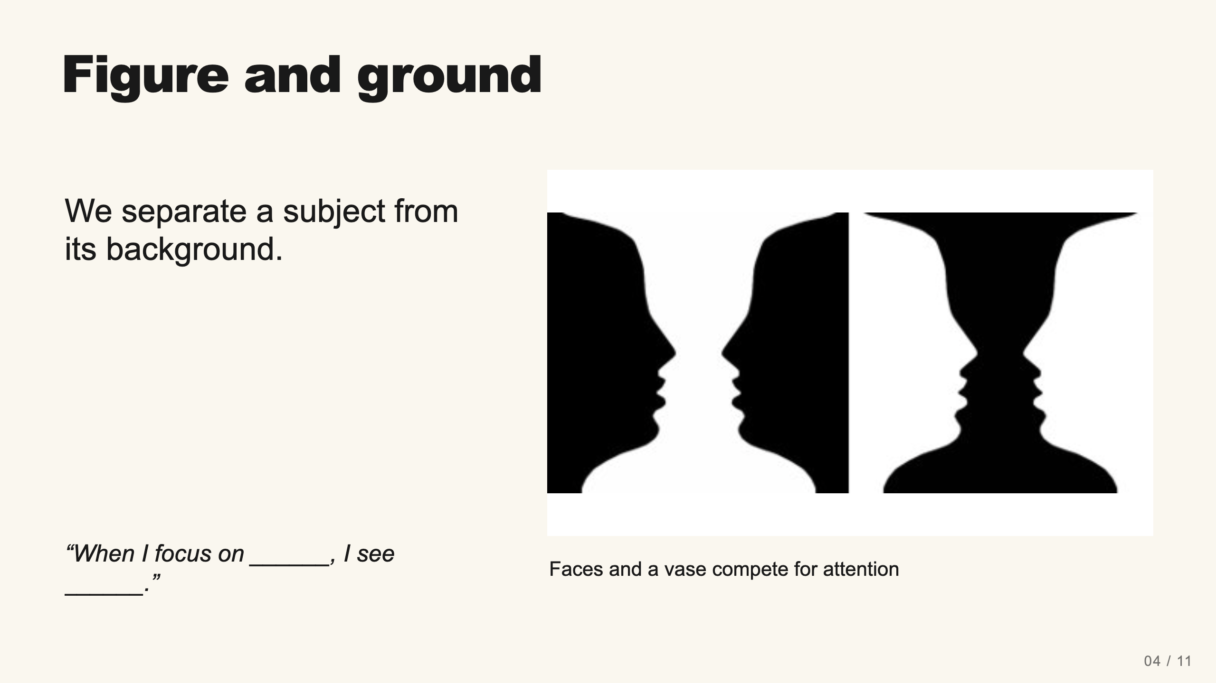
Notes:
Teacher move: 2 minutes. Allow different answers. Ask students to switch attention between dark and light regions. Neither color is always the figure. In a pictograph, deliberate contrast can keep the intended subject clear.
[Sources]
Current course snapshot, generated student pages and facilitator guides in innovative-technology-site, inspected 2026-09-07. Original ZIP supplied by Elisha Lucero.
Canva editor and Combo app, Graphic Design Lesson Demonstrations, https://www.canva.com/design/DAHUiq9hUJg/IwU_7AR5EXsmRbdnEBtkhA/edit . Screenshots captured directly in the Bowie Middle School account, 2026-09-07. Interface labels may vary by account. Canva screenshots used for classroom software instruction.
Selected instructional image retained from the user-supplied Unit 1 DPI 2026 teaching materials. Reuse is for this classroom teaching adaptation. Original image rights remain with their respective creators; no open license is asserted.
Visual: source-48.jpg. Selected instructional image retained from the user-supplied Unit 1 DPI 2026 teaching materials. Reuse is for this classroom teaching adaptation. Original image rights remain with their respective creators; no open license is asserted.
Visual reference: source-48.jpg. Supplied teaching artwork or a direct Canva interface capture, as recorded in the source ledger.

Slide 12
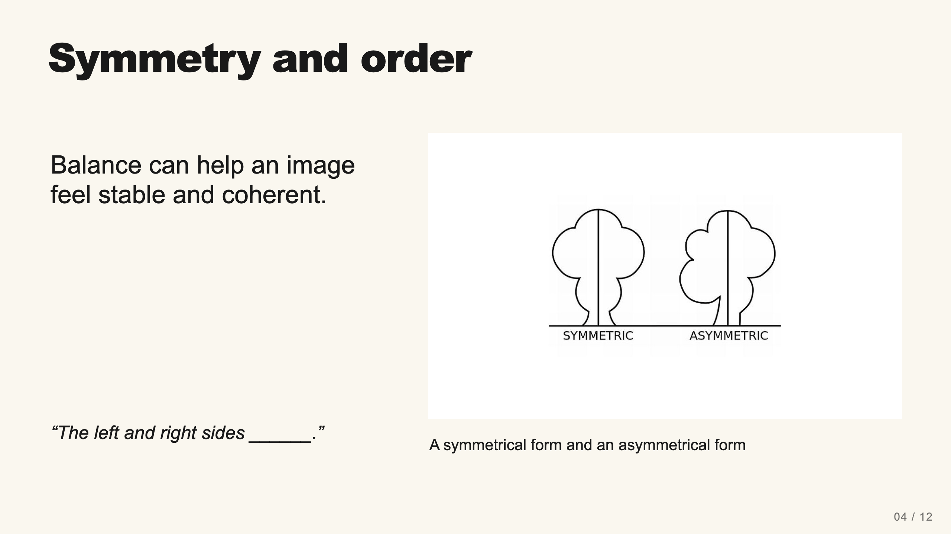
Notes:
Teacher move: 2 minutes. Ask where a mirror line would fall. Symmetry is one option, not a rule that every successful design must obey. The current lesson groups symmetry and order together.
[Sources]
Current course snapshot, generated student pages and facilitator guides in innovative-technology-site, inspected 2026-09-07. Original ZIP supplied by Elisha Lucero.
Canva editor and Combo app, Graphic Design Lesson Demonstrations, https://www.canva.com/design/DAHUiq9hUJg/IwU_7AR5EXsmRbdnEBtkhA/edit . Screenshots captured directly in the Bowie Middle School account, 2026-09-07. Interface labels may vary by account. Canva screenshots used for classroom software instruction.
Selected instructional image retained from the user-supplied Unit 1 DPI 2026 teaching materials. Reuse is for this classroom teaching adaptation. Original image rights remain with their respective creators; no open license is asserted.
Visual: source-49.jpg. Selected instructional image retained from the user-supplied Unit 1 DPI 2026 teaching materials. Reuse is for this classroom teaching adaptation. Original image rights remain with their respective creators; no open license is asserted.
Visual reference: source-49.jpg. Supplied teaching artwork or a direct Canva interface capture, as recorded in the source ledger.

Slide 13
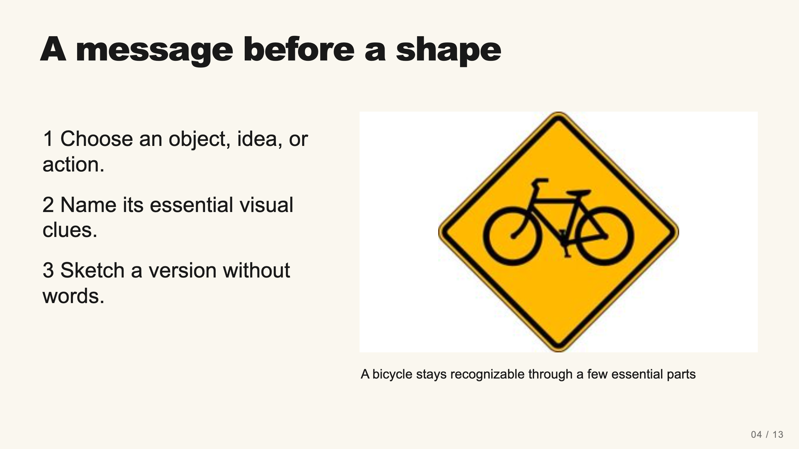
Notes:
Teacher move: 3 minutes. Model identifying two circles and a connecting frame in a bicycle sign. Then sketch a different simple message live, such as a pause area or water refill location. Keep familiar pictographs as inspiration and have students build their own shapes.
[Sources]
Current course snapshot, generated student pages and facilitator guides in innovative-technology-site, inspected 2026-09-07. Original ZIP supplied by Elisha Lucero.
Canva editor and Combo app, Graphic Design Lesson Demonstrations, https://www.canva.com/design/DAHUiq9hUJg/IwU_7AR5EXsmRbdnEBtkhA/edit . Screenshots captured directly in the Bowie Middle School account, 2026-09-07. Interface labels may vary by account. Canva screenshots used for classroom software instruction.
Selected instructional image retained from the user-supplied Unit 1 DPI 2026 teaching materials. Reuse is for this classroom teaching adaptation. Original image rights remain with their respective creators; no open license is asserted.
Visual: source-24.jpg. Selected instructional image retained from the user-supplied Unit 1 DPI 2026 teaching materials. Reuse is for this classroom teaching adaptation. Original image rights remain with their respective creators; no open license is asserted.
Visual reference: source-24.jpg. Supplied teaching artwork or a direct Canva interface capture, as recorded in the source ledger.

Slide 14
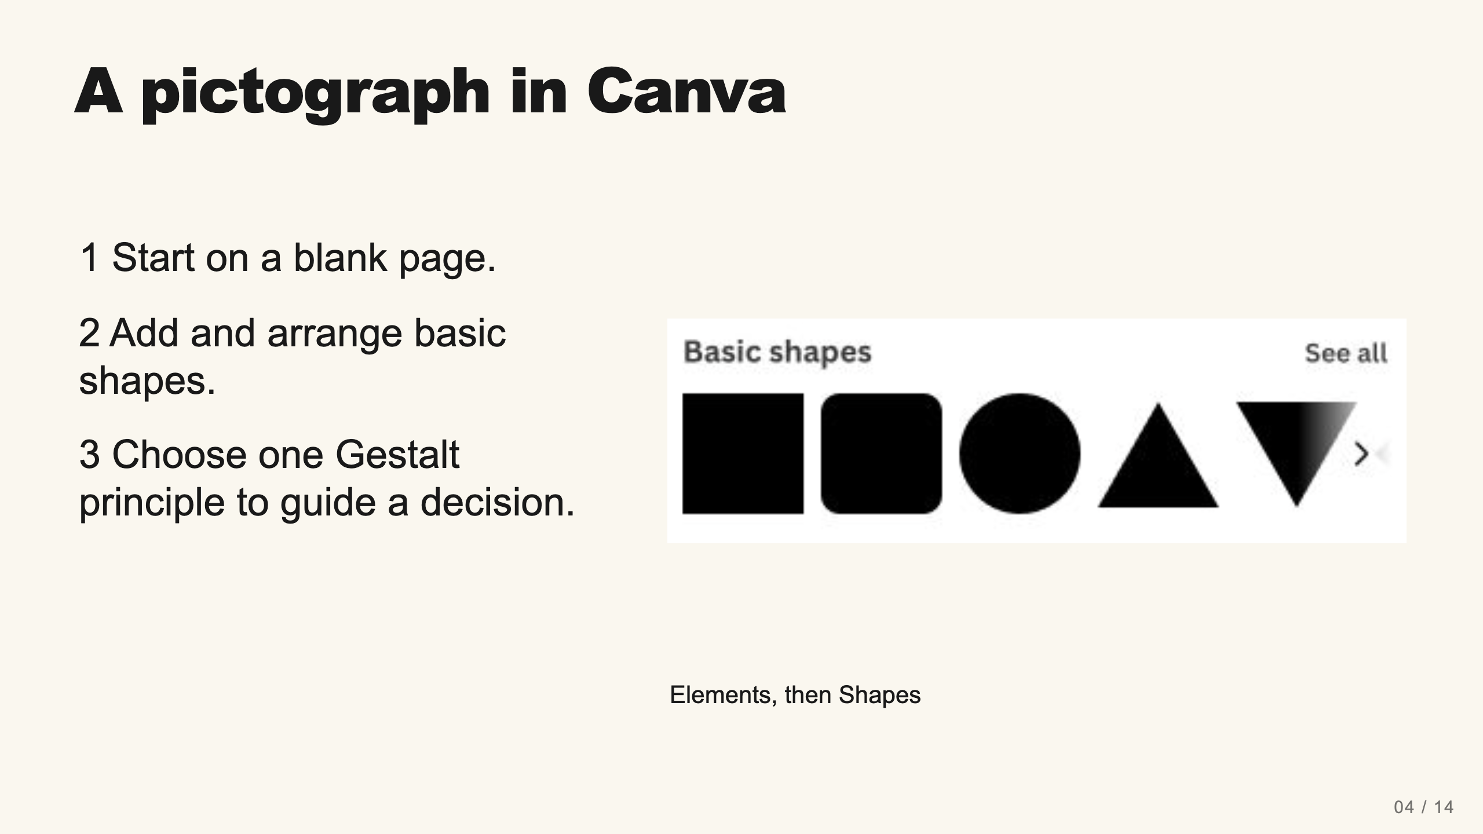
Notes:
Teacher move: 3 minutes. Model a pause symbol live: add one rectangle, make it narrow and tall, duplicate it, and place the two bars side by side with a clear gap. Keep their height, width, and color equal. Name similarity as the principle connecting them. Ask a partner to infer the meaning before you explain. Then change the gap to show how proximity affects the grouping. No text or pre-made icon is needed.
[Sources]
Current course snapshot, generated student pages and facilitator guides in innovative-technology-site, inspected 2026-09-07. Original ZIP supplied by Elisha Lucero.
Canva editor and Combo app, Graphic Design Lesson Demonstrations, https://www.canva.com/design/DAHUiq9hUJg/IwU_7AR5EXsmRbdnEBtkhA/edit . Screenshots captured directly in the Bowie Middle School account, 2026-09-07. Interface labels may vary by account. Canva screenshots used for classroom software instruction.
Selected instructional image retained from the user-supplied Unit 1 DPI 2026 teaching materials. Reuse is for this classroom teaching adaptation. Original image rights remain with their respective creators; no open license is asserted.
Visual: canva-shapes.png. Canva editor and Combo app, Graphic Design Lesson Demonstrations, https://www.canva.com/design/DAHUiq9hUJg/IwU_7AR5EXsmRbdnEBtkhA/edit . Screenshots captured directly in the Bowie Middle School account, 2026-09-07. Interface labels may vary by account. Canva screenshots used for classroom software instruction.
Visual reference: canva-shapes.png. Supplied teaching artwork or a direct Canva interface capture, as recorded in the source ledger.

Slide 15
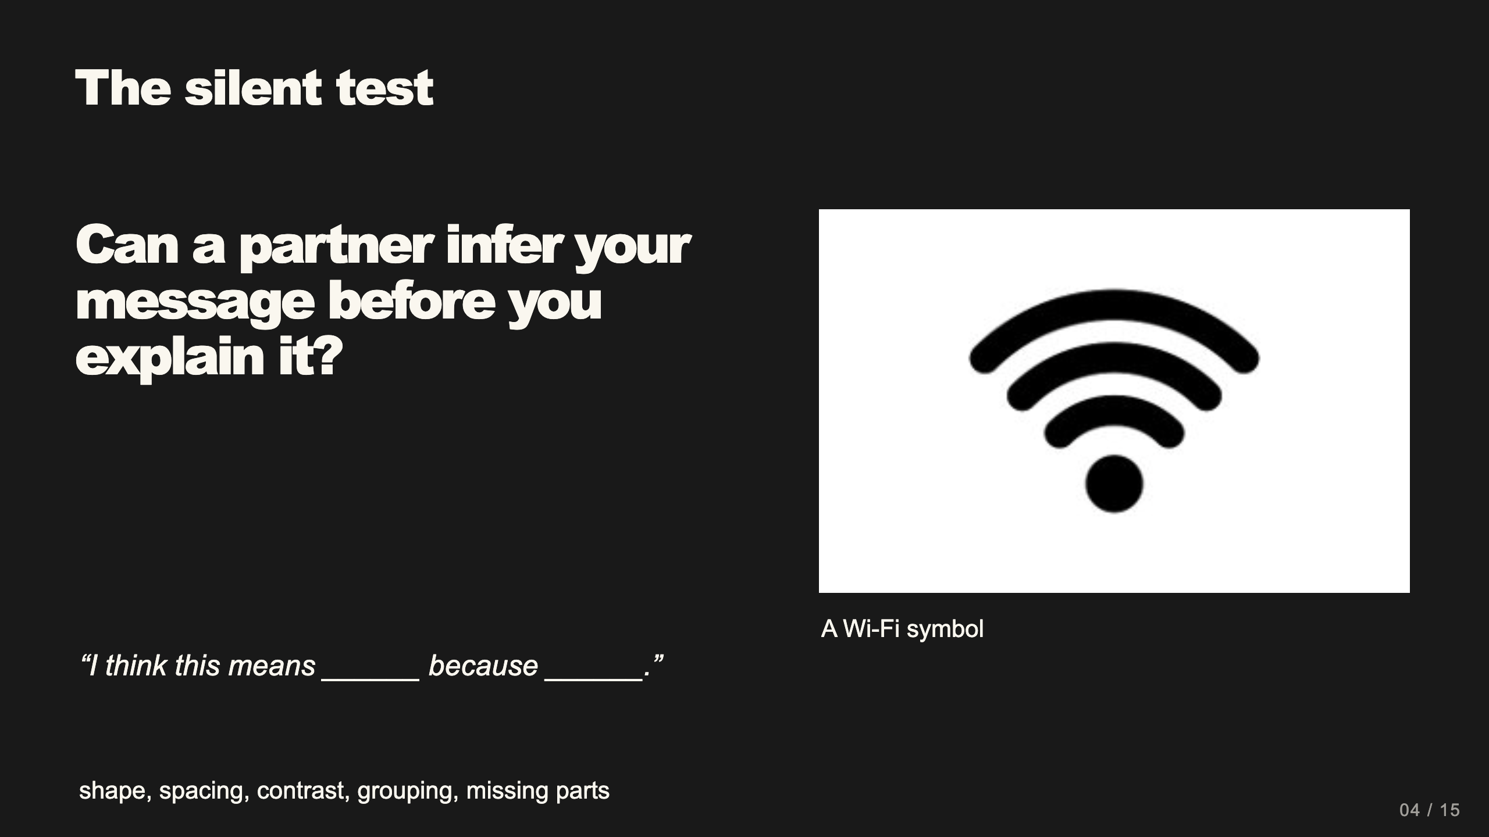
Notes:
Teacher move: 2 minutes. Partner A shows the graphic without speaking. Partner B names the message and the clue. Swap roles. If the message is unclear, revise one shape or its arrangement.
[Sources]
Current course snapshot, generated student pages and facilitator guides in innovative-technology-site, inspected 2026-09-07. Original ZIP supplied by Elisha Lucero.
Canva editor and Combo app, Graphic Design Lesson Demonstrations, https://www.canva.com/design/DAHUiq9hUJg/IwU_7AR5EXsmRbdnEBtkhA/edit . Screenshots captured directly in the Bowie Middle School account, 2026-09-07. Interface labels may vary by account. Canva screenshots used for classroom software instruction.
Selected instructional image retained from the user-supplied Unit 1 DPI 2026 teaching materials. Reuse is for this classroom teaching adaptation. Original image rights remain with their respective creators; no open license is asserted.
Visual reference: source-36.jpg. Supplied teaching artwork or a direct Canva interface capture, as recorded in the source ledger.

Slide 16
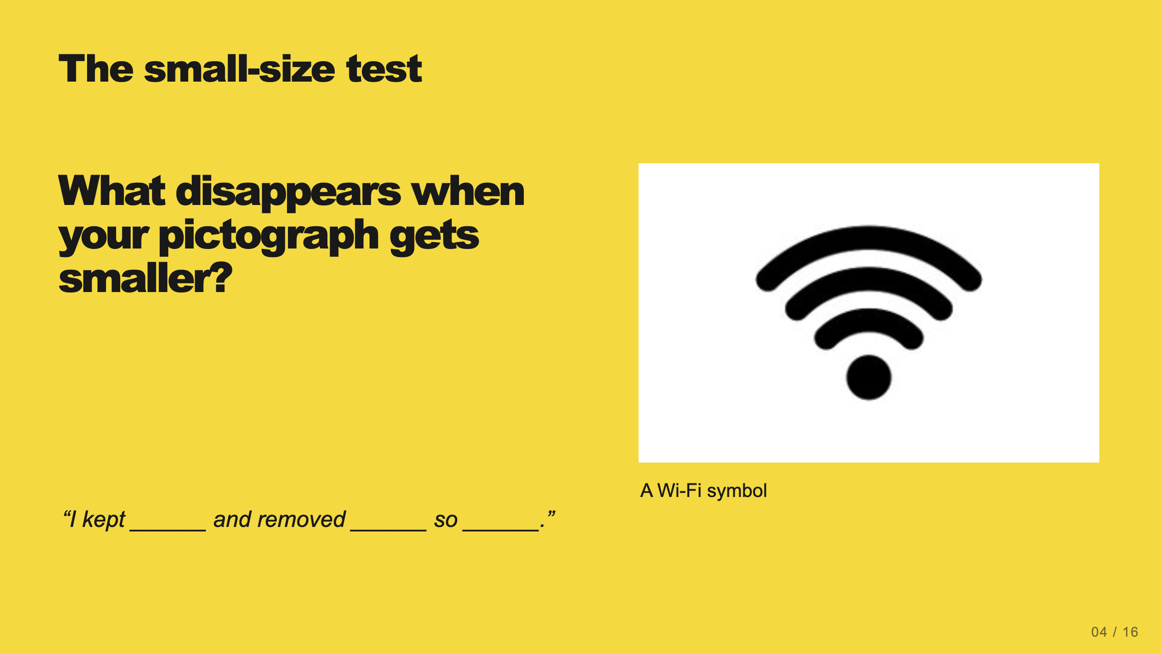
Notes:
Teacher move: 2 minutes within work time. Zoom out or view the design at a reduced size. Students may remove tiny details, enlarge an essential feature, or increase contrast. Do not claim a visual symbol alone serves a blind reader. An accessible context may also need a text alternative.
[Sources]
Current course snapshot, generated student pages and facilitator guides in innovative-technology-site, inspected 2026-09-07. Original ZIP supplied by Elisha Lucero.
Canva editor and Combo app, Graphic Design Lesson Demonstrations, https://www.canva.com/design/DAHUiq9hUJg/IwU_7AR5EXsmRbdnEBtkhA/edit . Screenshots captured directly in the Bowie Middle School account, 2026-09-07. Interface labels may vary by account. Canva screenshots used for classroom software instruction.
Selected instructional image retained from the user-supplied Unit 1 DPI 2026 teaching materials. Reuse is for this classroom teaching adaptation. Original image rights remain with their respective creators; no open license is asserted.
Visual reference: source-36.jpg. Supplied teaching artwork or a direct Canva interface capture, as recorded in the source ledger.

Slide 17
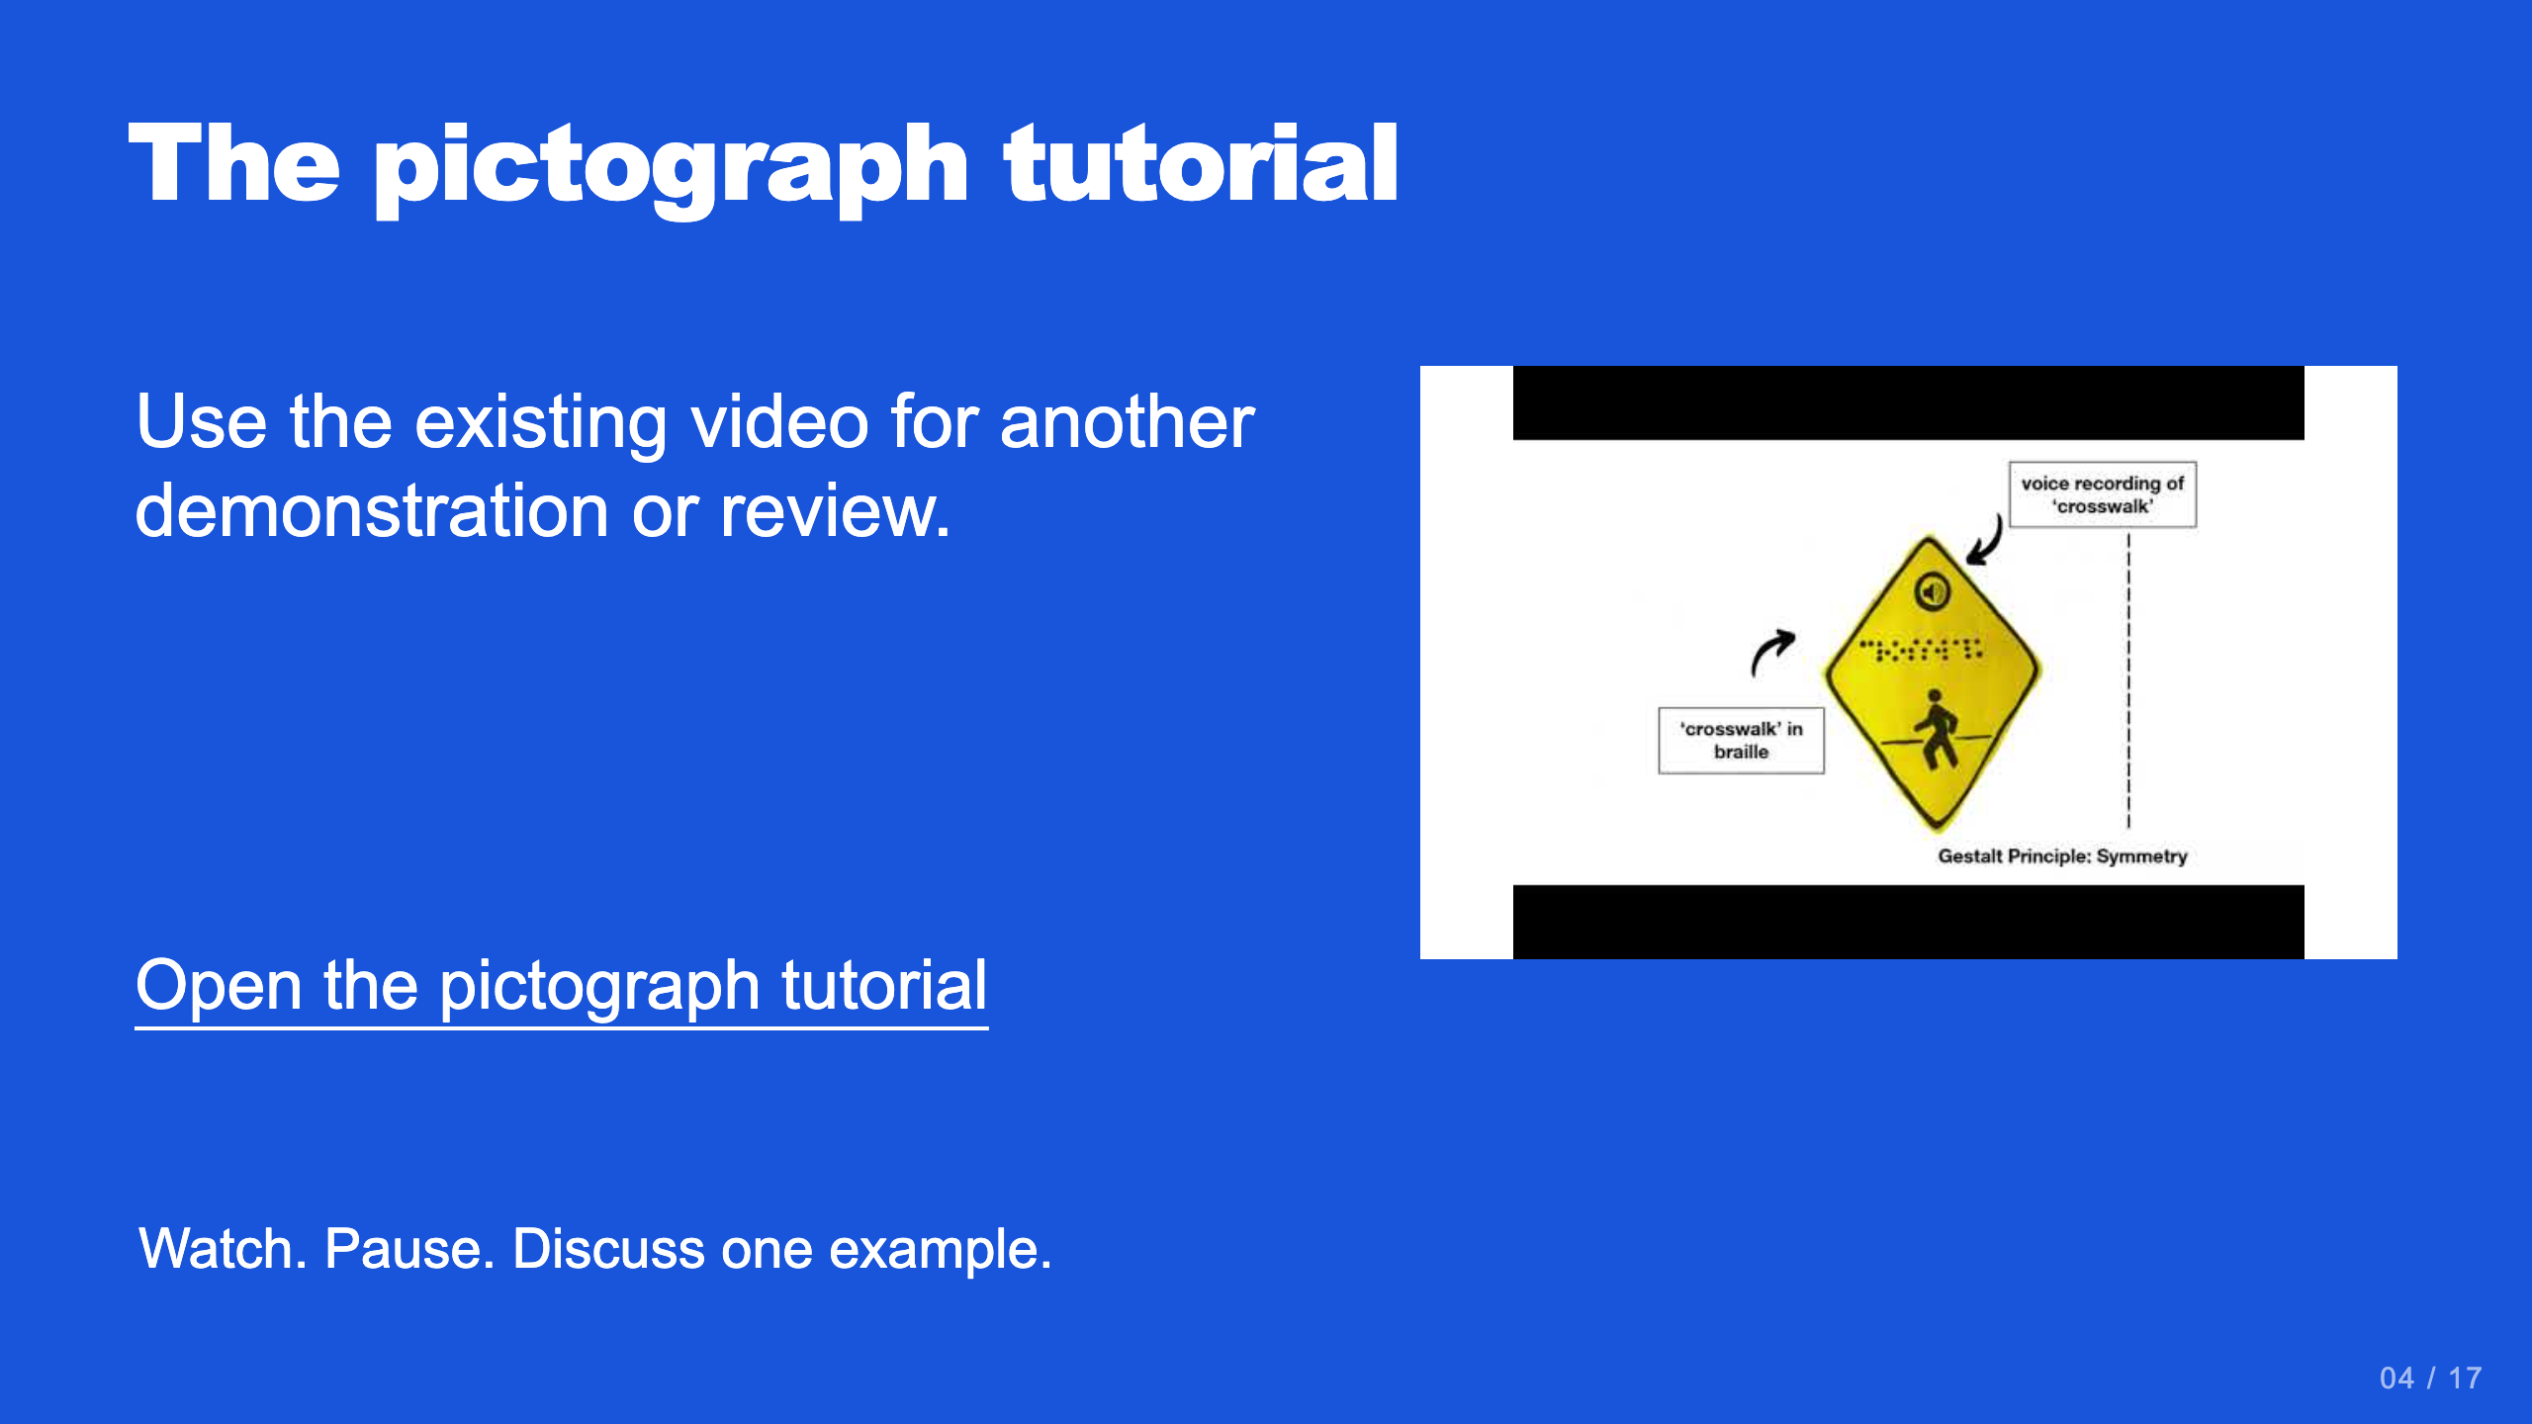
Notes:
Teacher move: Optional reference. Current lesson tutorial: https://www.youtube.com/watch?v=etexc2tkE1I . Preview it before class and pause when students need time to practice.
[Sources]
Current course snapshot, generated student pages and facilitator guides in innovative-technology-site, inspected 2026-09-07. Original ZIP supplied by Elisha Lucero.
Canva editor and Combo app, Graphic Design Lesson Demonstrations, https://www.canva.com/design/DAHUiq9hUJg/IwU_7AR5EXsmRbdnEBtkhA/edit . Screenshots captured directly in the Bowie Middle School account, 2026-09-07. Interface labels may vary by account. Canva screenshots used for classroom software instruction.
Selected instructional image retained from the user-supplied Unit 1 DPI 2026 teaching materials. Reuse is for this classroom teaching adaptation. Original image rights remain with their respective creators; no open license is asserted.
Visual reference: video-04.jpg. Thumbnail published by the linked video on YouTube.

Slide 18
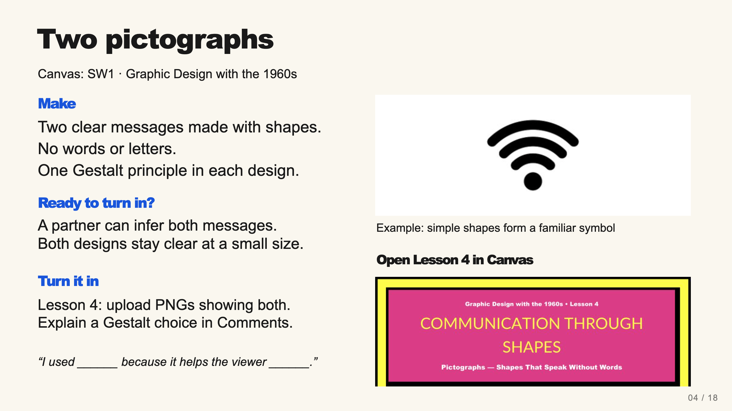
Notes:
Teacher move: Leave this screen projected throughout independent work. It contains the required product, observable completion checks, an exemplar, and the existing submission route. Use verbal reminders and brief conferences instead of cycling through separate task, submission, and done slides. The exemplar is inspiration, not a template to copy. Before class, open the named assignment in your own course and confirm the submission controls.
Each of the two pictographs needs at least one shape and at least one Gestalt principle. Students may export them together on one page or as separate PNGs. They should test the messages silently with a partner.
The existing assignment rubric and points remain authoritative. Confer on one useful revision at a time.
[Sources]
Current course snapshot, generated student pages and facilitator guides in innovative-technology-site, inspected 2026-09-07. Original ZIP supplied by Elisha Lucero.
Canva editor and Combo app, Graphic Design Lesson Demonstrations, https://www.canva.com/design/DAHUiq9hUJg/IwU_7AR5EXsmRbdnEBtkhA/edit . Screenshots captured directly in the Bowie Middle School account, 2026-09-07. Interface labels may vary by account. Canva screenshots used for classroom software instruction.
Selected instructional image retained from the user-supplied Unit 1 DPI 2026 teaching materials. Reuse is for this classroom teaching adaptation. Original image rights remain with their respective creators; no open license is asserted.
Exemplar: source-36.jpg, from the supplied classroom materials. Canvas: live assignment and submission types verified through the API on September 7, 2026. Screenshot: real teacher-view assignment banner, cropped to omit editing controls. The unpublished template module prevents Student View access; publication was not changed.

