Slide 1
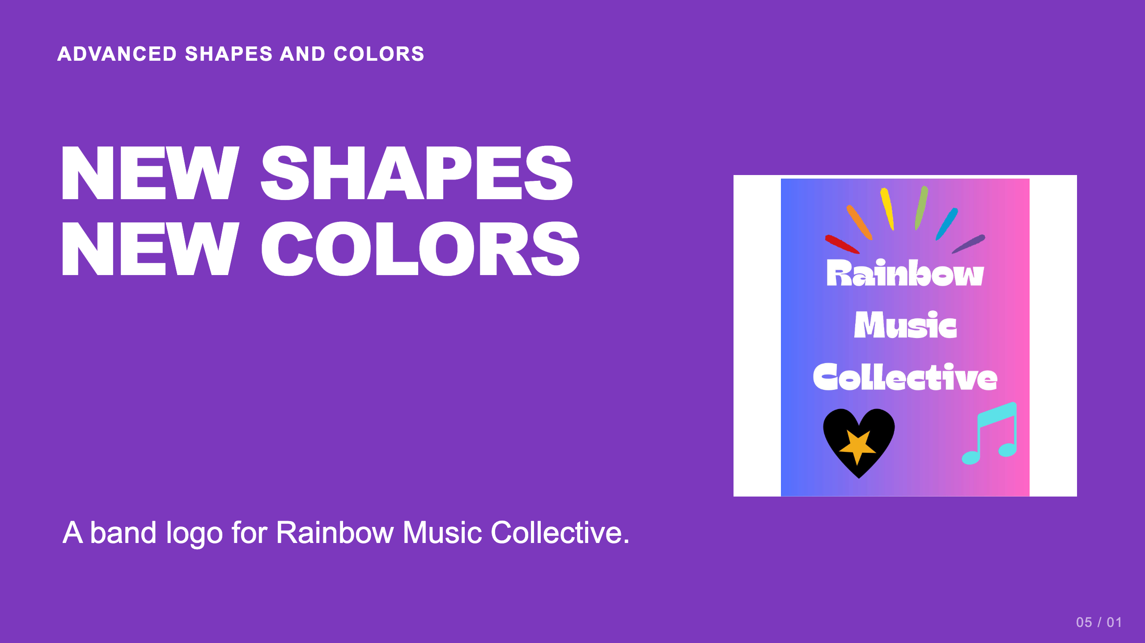
Notes:
Teacher move: About 50 minutes. Open Canva and the already available Combo app in the school account. Students create the current band-logo task with the band name, at least one compound shape, and at least one gradient.
[Sources]
Current course snapshot, generated student pages and facilitator guides in innovative-technology-site, inspected 2026-09-07. Original ZIP supplied by Elisha Lucero.
Canva editor and Combo app, Graphic Design Lesson Demonstrations, https://www.canva.com/design/DAHUiq9hUJg/IwU_7AR5EXsmRbdnEBtkhA/edit . Screenshots captured directly in the Bowie Middle School account, 2026-09-07. Interface labels may vary by account. Canva screenshots used for classroom software instruction.
Visual: source-58.jpg. Selected instructional image retained from the user-supplied Unit 1 DPI 2026 teaching materials. Reuse is for this classroom teaching adaptation. Original image rights remain with their respective creators; no open license is asserted.
Visual reference: source-58.jpg. Supplied teaching artwork or a direct Canva interface capture, as recorded in the source ledger.

Slide 2
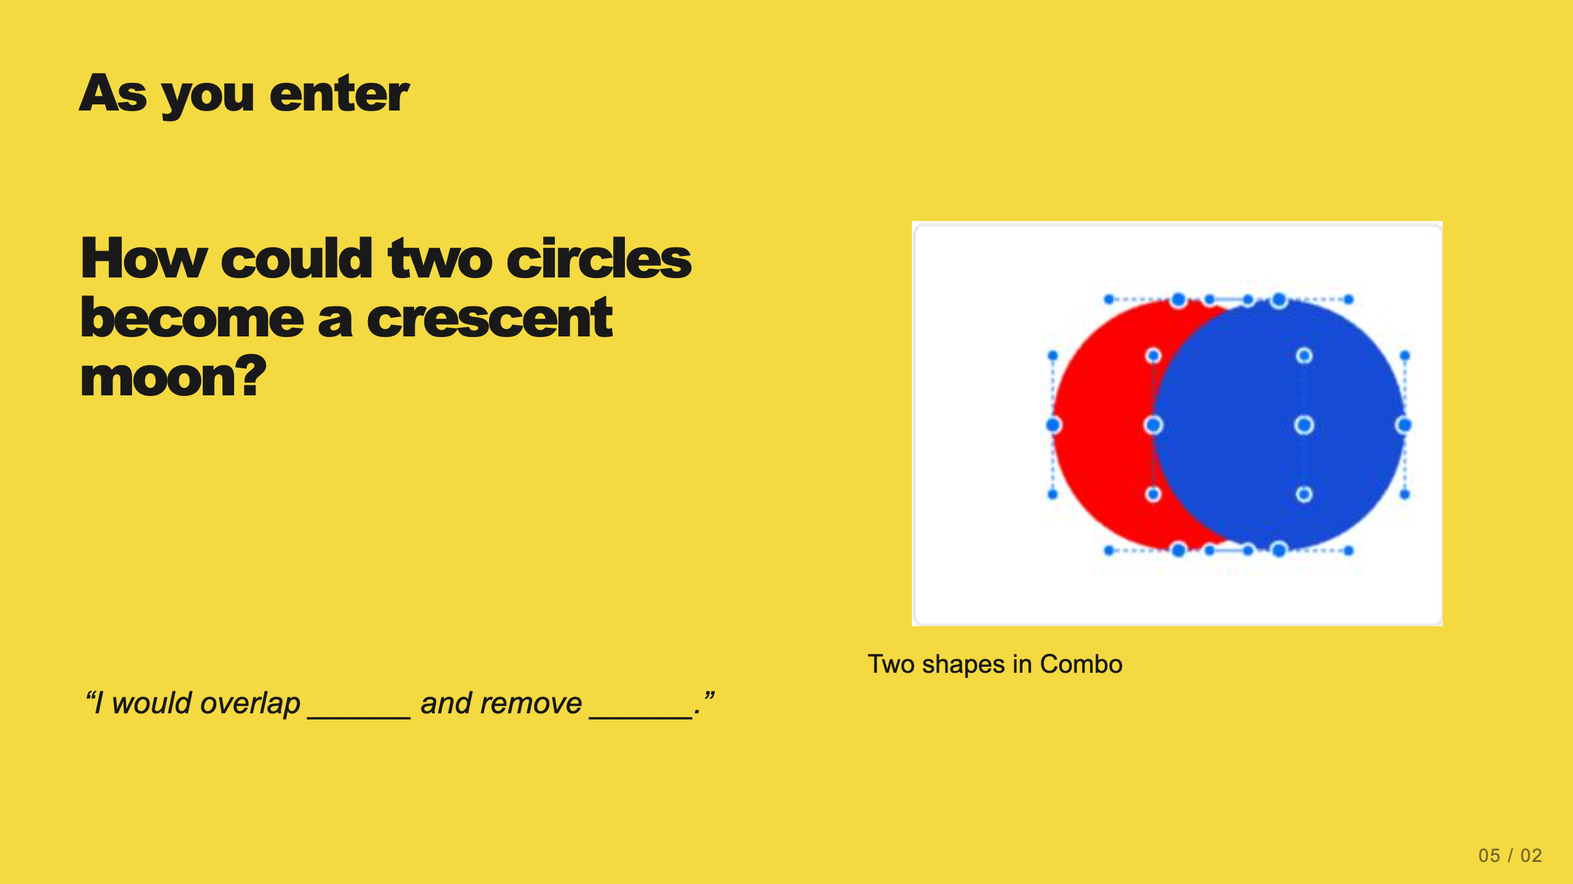
Notes:
Teacher move: 2 minutes. Students sketch or describe an overlap and a cut. Accept an initial prediction before opening the app. Save the answer for the Subtract demonstration.
[Sources]
Current course snapshot, generated student pages and facilitator guides in innovative-technology-site, inspected 2026-09-07. Original ZIP supplied by Elisha Lucero.
Canva editor and Combo app, Graphic Design Lesson Demonstrations, https://www.canva.com/design/DAHUiq9hUJg/IwU_7AR5EXsmRbdnEBtkhA/edit . Screenshots captured directly in the Bowie Middle School account, 2026-09-07. Interface labels may vary by account. Canva screenshots used for classroom software instruction.
Visual reference: combo-two-colors.png. Supplied teaching artwork or a direct Canva interface capture, as recorded in the source ledger.

Slide 3
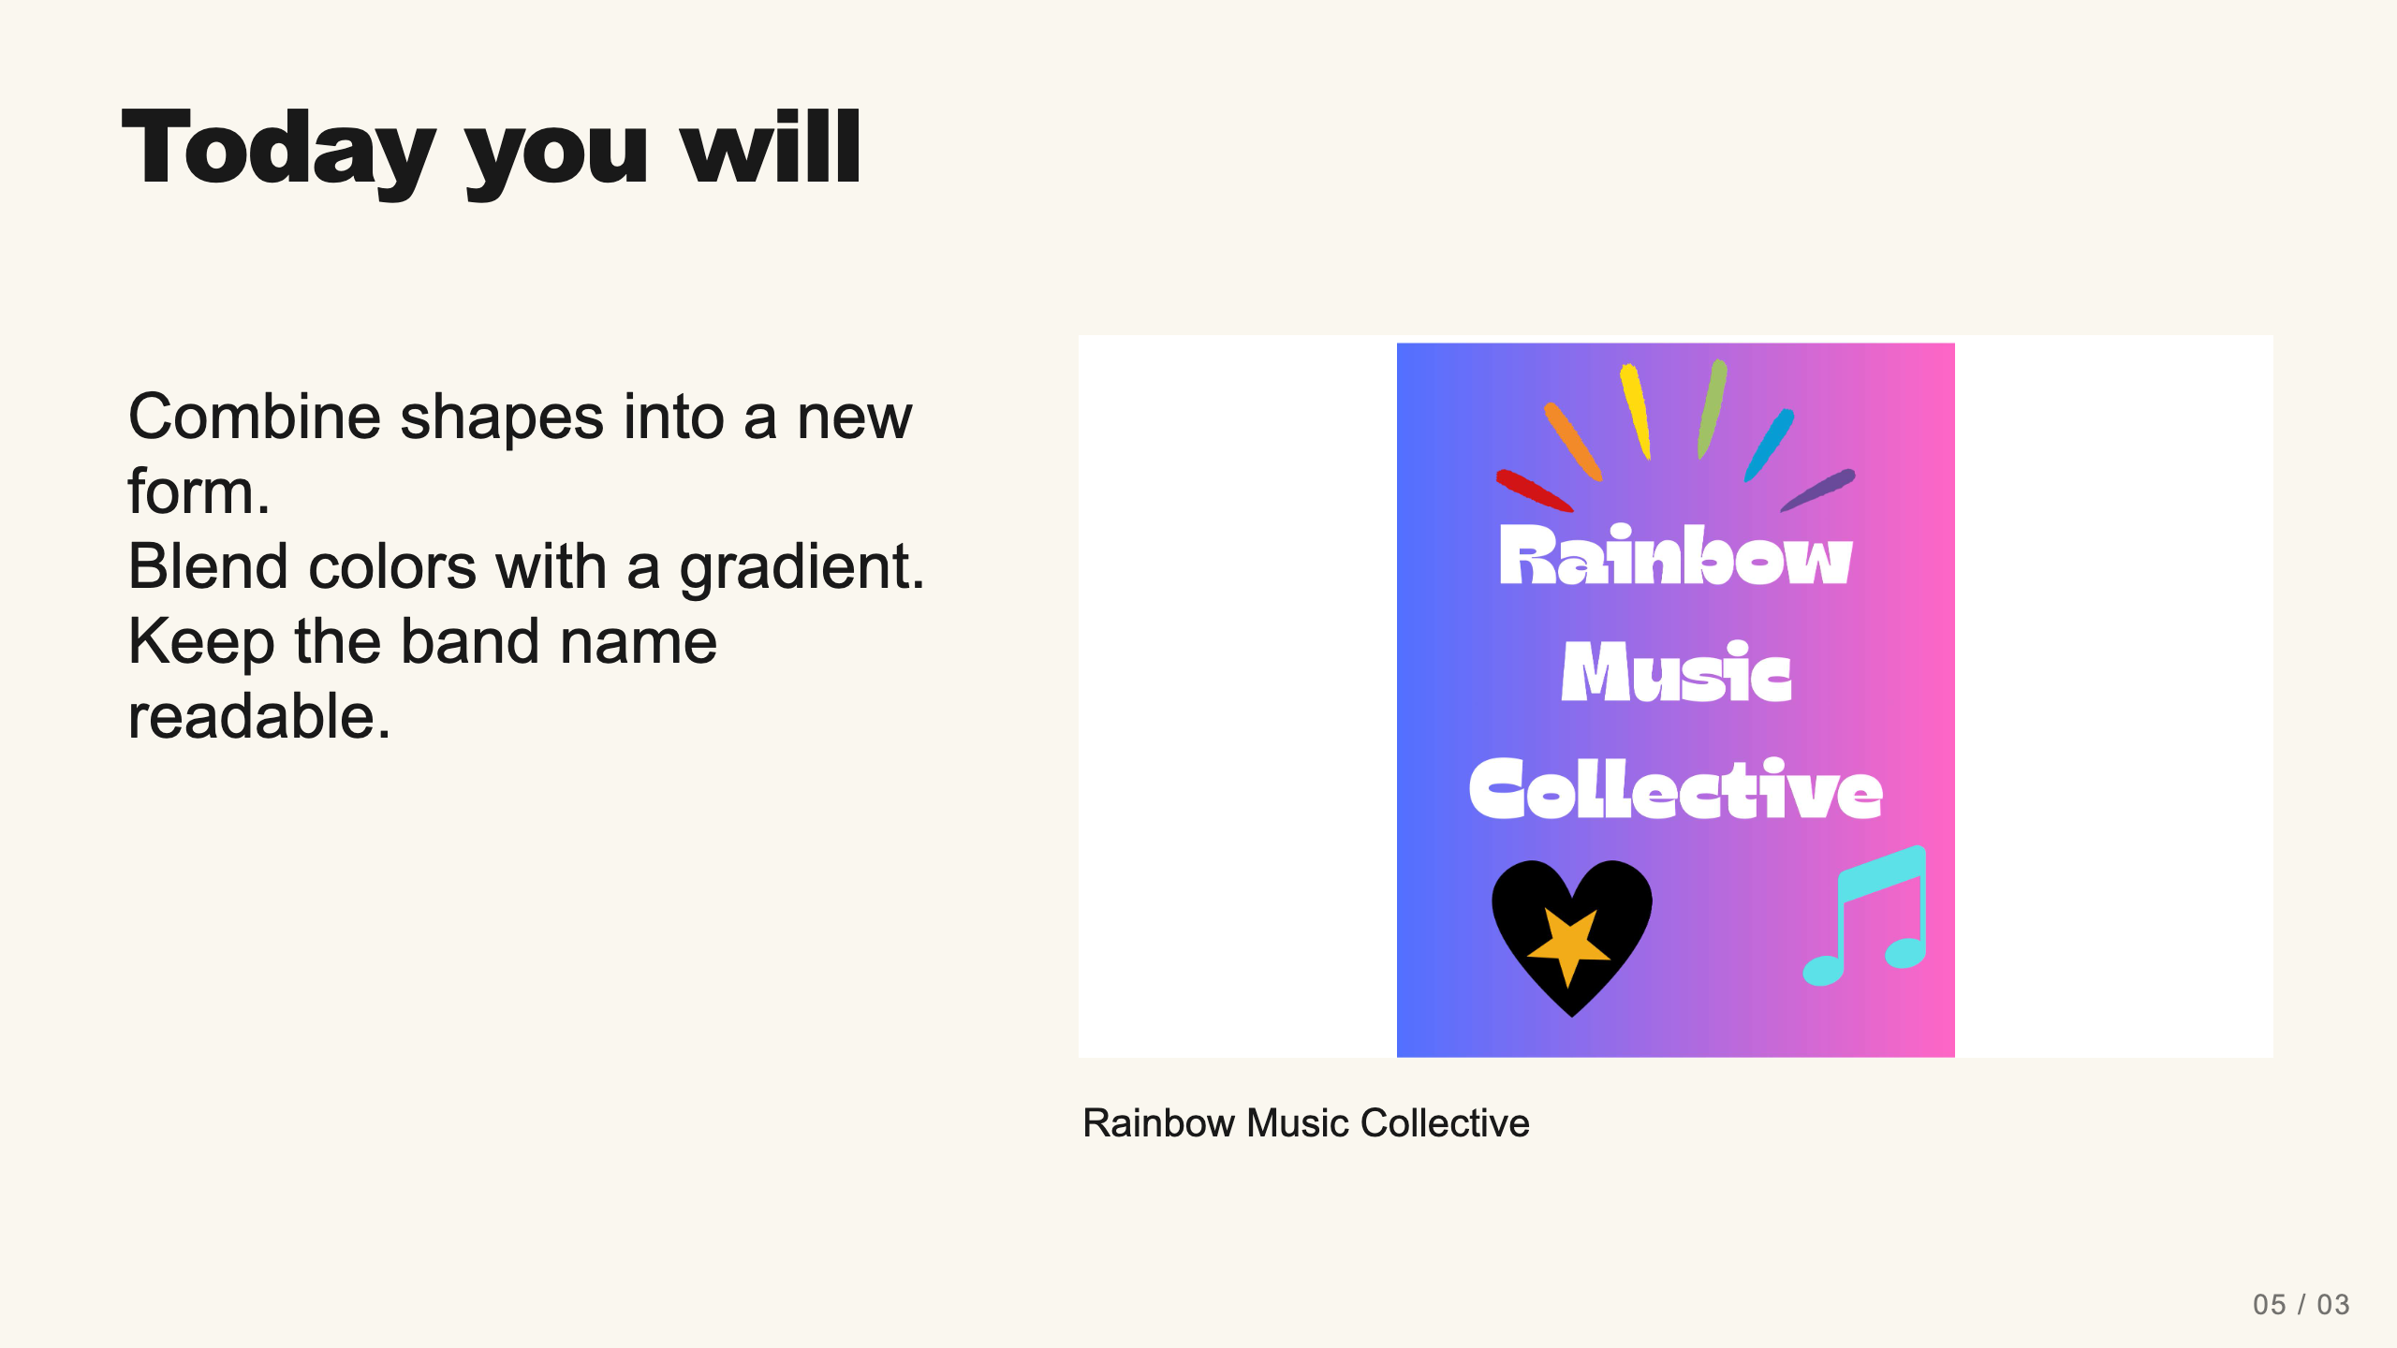
Notes:
Teacher move: 1 minute. The current assignment asks for the exact band name, one or more compound shapes, and one or more gradients. Students may use a bold 1960s-inspired visual style. Printing or buying a logo product is not part of this task.
[Sources]
Current course snapshot, generated student pages and facilitator guides in innovative-technology-site, inspected 2026-09-07. Original ZIP supplied by Elisha Lucero.
Canva editor and Combo app, Graphic Design Lesson Demonstrations, https://www.canva.com/design/DAHUiq9hUJg/IwU_7AR5EXsmRbdnEBtkhA/edit . Screenshots captured directly in the Bowie Middle School account, 2026-09-07. Interface labels may vary by account. Canva screenshots used for classroom software instruction.
Visual: source-58.jpg. Selected instructional image retained from the user-supplied Unit 1 DPI 2026 teaching materials. Reuse is for this classroom teaching adaptation. Original image rights remain with their respective creators; no open license is asserted.
Visual reference: source-58.jpg. Supplied teaching artwork or a direct Canva interface capture, as recorded in the source ledger.

Slide 4
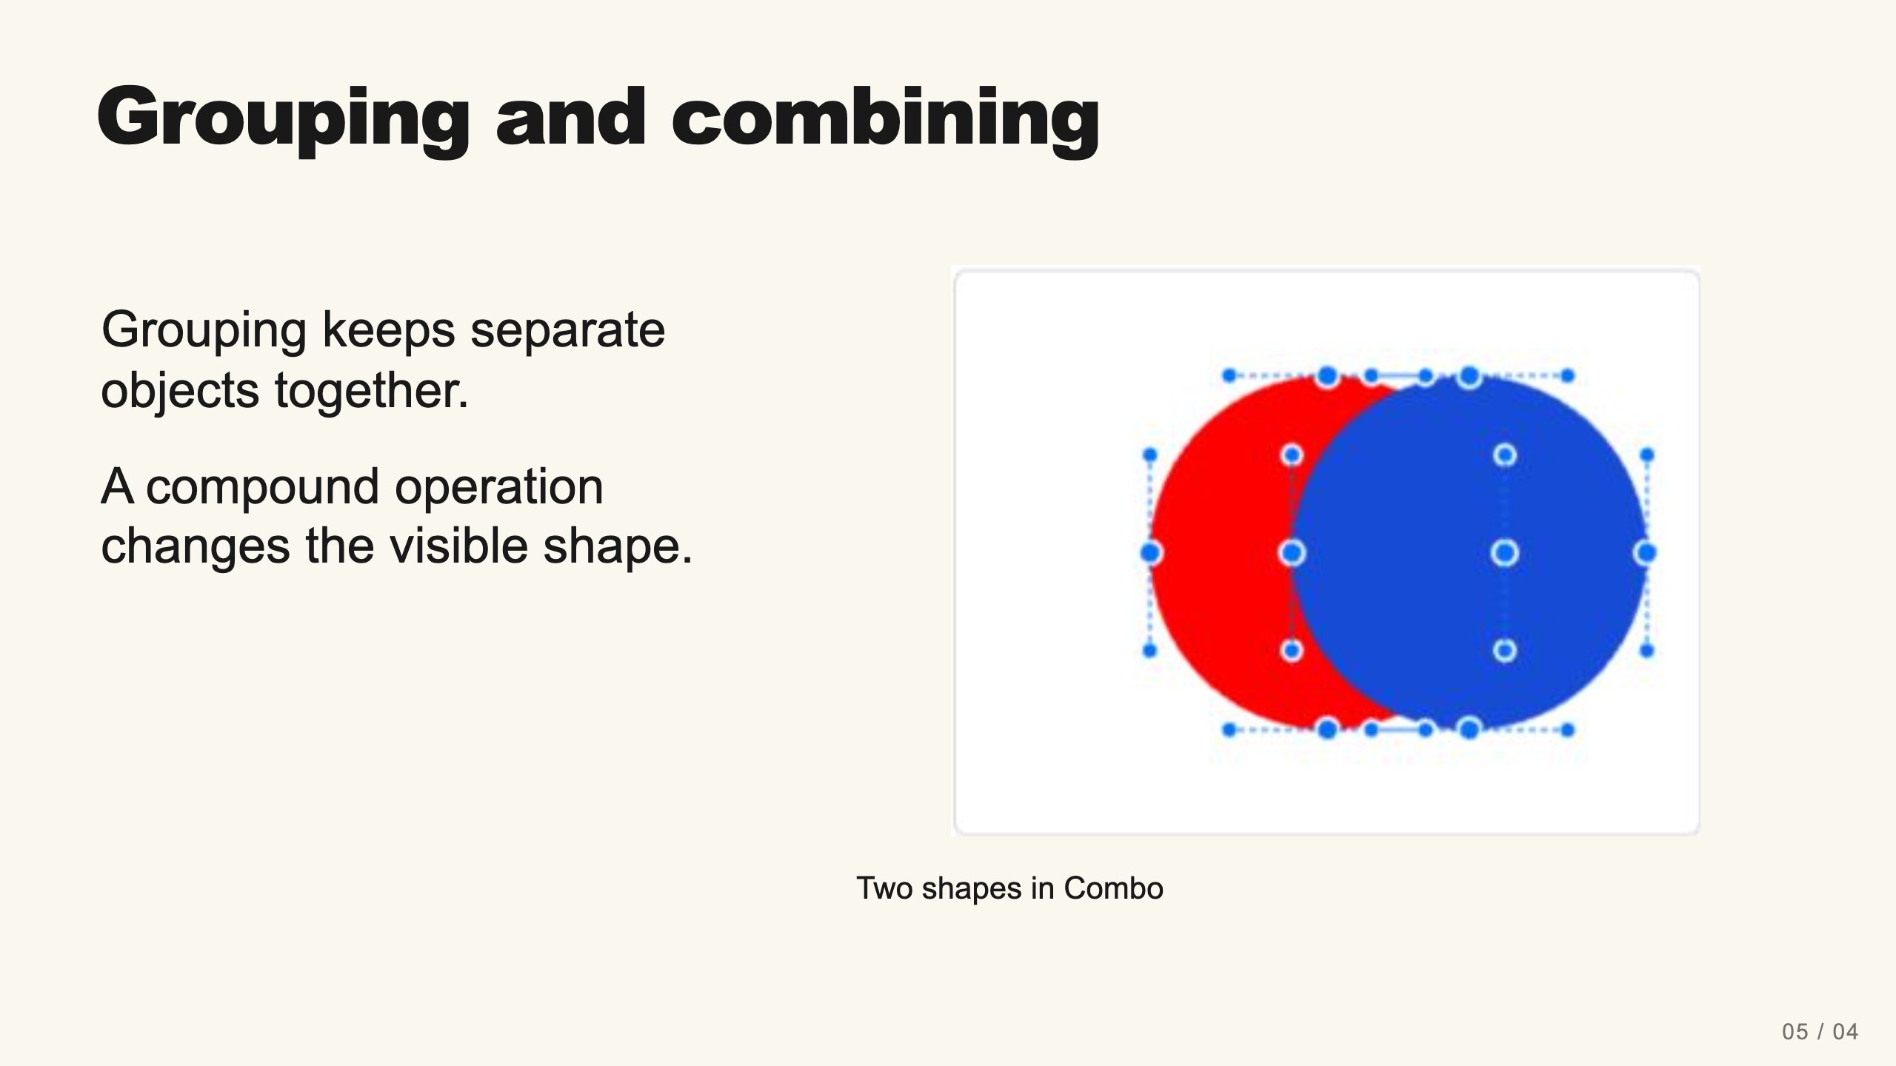
Notes:
Teacher move: 2 minutes. Demonstrate two ordinary shapes grouped in Canva: they move together but retain their outlines. Explain that Combo’s Union, Subtract, Intersect, and Exclude calculate new regions. Ask students to explain whether the parts still exist as separate objects.
[Sources]
Current course snapshot, generated student pages and facilitator guides in innovative-technology-site, inspected 2026-09-07. Original ZIP supplied by Elisha Lucero.
Canva editor and Combo app, Graphic Design Lesson Demonstrations, https://www.canva.com/design/DAHUiq9hUJg/IwU_7AR5EXsmRbdnEBtkhA/edit . Screenshots captured directly in the Bowie Middle School account, 2026-09-07. Interface labels may vary by account. Canva screenshots used for classroom software instruction.
Visual reference: combo-two-colors.png. Supplied teaching artwork or a direct Canva interface capture, as recorded in the source ledger.

Slide 5
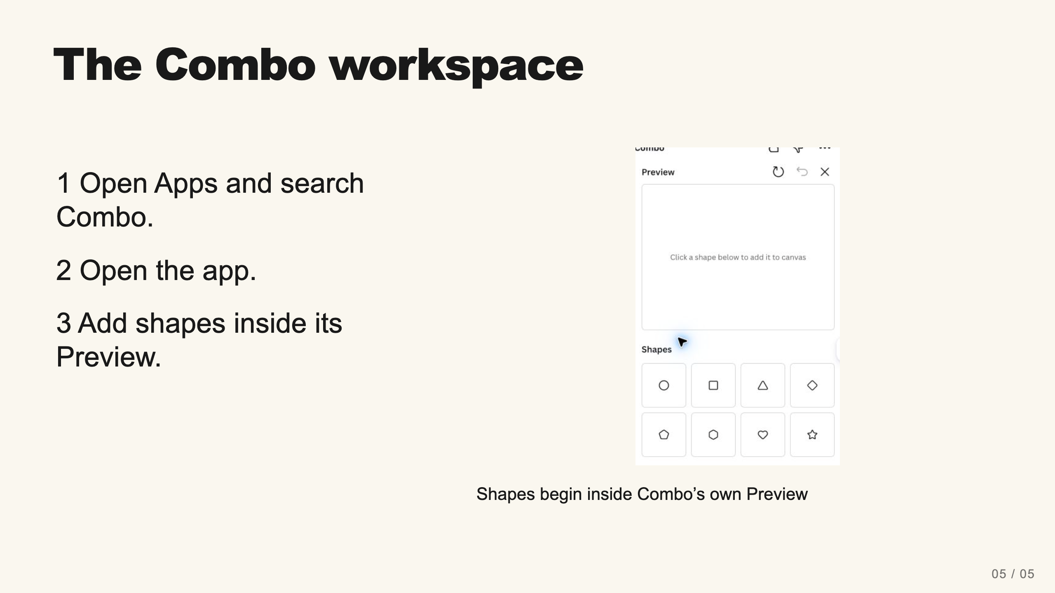
Notes:
Teacher move: 2 minutes. The verified app builds shapes in its own Preview, then inserts the result into Canva. Do not start by selecting objects on the main Canva page and expect the app to import them. If Apps is not visible, scroll the left rail.
[Sources]
Current course snapshot, generated student pages and facilitator guides in innovative-technology-site, inspected 2026-09-07. Original ZIP supplied by Elisha Lucero.
Canva editor and Combo app, Graphic Design Lesson Demonstrations, https://www.canva.com/design/DAHUiq9hUJg/IwU_7AR5EXsmRbdnEBtkhA/edit . Screenshots captured directly in the Bowie Middle School account, 2026-09-07. Interface labels may vary by account. Canva screenshots used for classroom software instruction.
Visual: combo-empty.png. Canva editor and Combo app, Graphic Design Lesson Demonstrations, https://www.canva.com/design/DAHUiq9hUJg/IwU_7AR5EXsmRbdnEBtkhA/edit . Screenshots captured directly in the Bowie Middle School account, 2026-09-07. Interface labels may vary by account. Canva screenshots used for classroom software instruction.
Visual reference: combo-empty.png. Supplied teaching artwork or a direct Canva interface capture, as recorded in the source ledger.

Slide 6
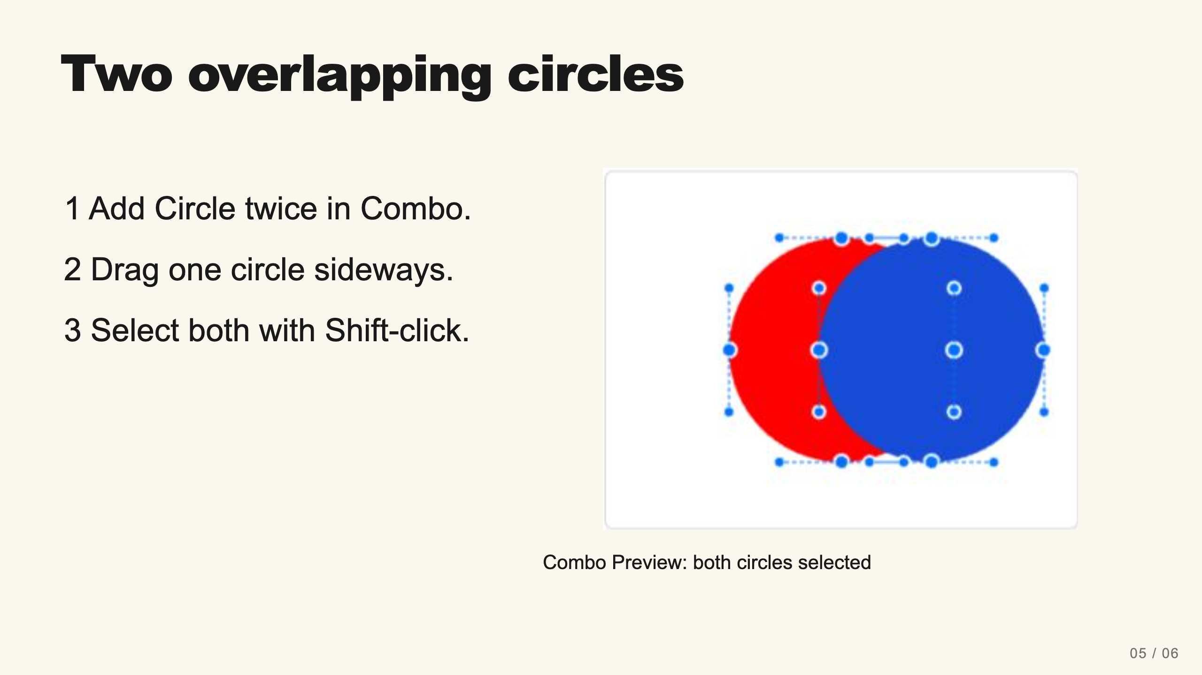
Notes:
Teacher move: 3 minutes. Expand Layers if selecting in the Preview is difficult. Click one Circle row and Shift-click the other. Choose exactly two. If the two circles perfectly cover each other, subtraction may leave nothing. Offset them first. This is a check for understanding, not merely a click sequence.
[Sources]
Current course snapshot, generated student pages and facilitator guides in innovative-technology-site, inspected 2026-09-07. Original ZIP supplied by Elisha Lucero.
Canva editor and Combo app, Graphic Design Lesson Demonstrations, https://www.canva.com/design/DAHUiq9hUJg/IwU_7AR5EXsmRbdnEBtkhA/edit . Screenshots captured directly in the Bowie Middle School account, 2026-09-07. Interface labels may vary by account. Canva screenshots used for classroom software instruction.
Visual: combo-two-colors.png. Canva editor and Combo app, Graphic Design Lesson Demonstrations, https://www.canva.com/design/DAHUiq9hUJg/IwU_7AR5EXsmRbdnEBtkhA/edit . Screenshots captured directly in the Bowie Middle School account, 2026-09-07. Interface labels may vary by account. Canva screenshots used for classroom software instruction.
Visual reference: combo-two-colors.png. Supplied teaching artwork or a direct Canva interface capture, as recorded in the source ledger.

Slide 7
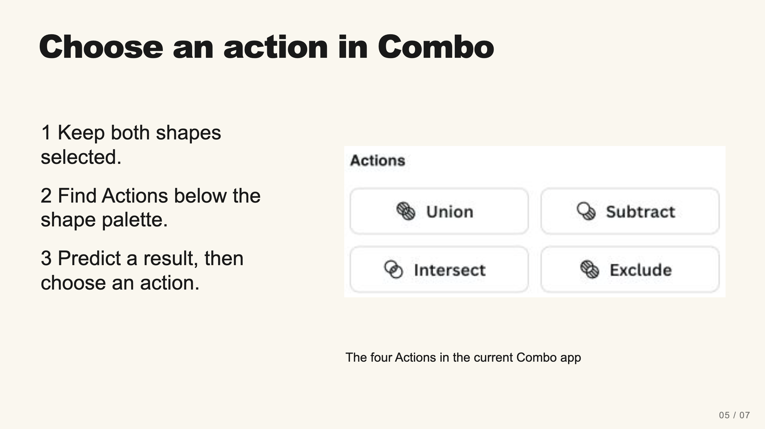
Notes:
Teacher move: 2 minutes. Point to Union, Subtract, Intersect, and Exclude in the actual app. These are the four operations verified on September 7, 2026. Divide appears in some other vector editors but is not a button in this Combo version. Teach the region concept without inventing a Divide workflow. Keep the pair overlapped and selected, then model each result on the next slides.
[Sources]
Current course snapshot, generated student pages and facilitator guides in innovative-technology-site, inspected 2026-09-07. Original ZIP supplied by Elisha Lucero.
Canva editor and Combo app, Graphic Design Lesson Demonstrations, https://www.canva.com/design/DAHUiq9hUJg/IwU_7AR5EXsmRbdnEBtkhA/edit . Screenshots captured directly in the Bowie Middle School account, 2026-09-07. Interface labels may vary by account. Canva screenshots used for classroom software instruction.
Visual: combo-two-colors.png. Canva editor and Combo app, Graphic Design Lesson Demonstrations, https://www.canva.com/design/DAHUiq9hUJg/IwU_7AR5EXsmRbdnEBtkhA/edit . Screenshots captured directly in the Bowie Middle School account, 2026-09-07. Interface labels may vary by account. Canva screenshots used for classroom software instruction.
Visual reference: combo-two-colors.png. Supplied teaching artwork or a direct Canva interface capture, as recorded in the source ledger.

Slide 8
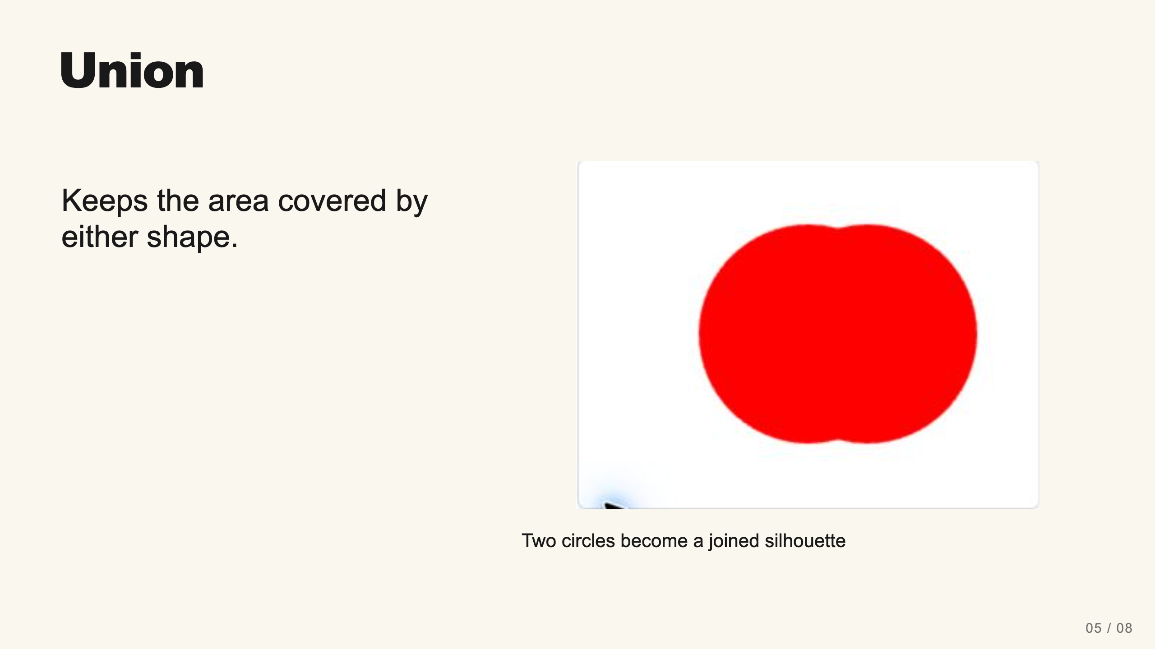
Notes:
Teacher move: 1 minute. Model Union. Ask which region remains. The screenshot shows the actual result from the current Combo app. Use a new pair or Undo to prepare the next comparison; check the overlap again after undoing.
[Sources]
Current course snapshot, generated student pages and facilitator guides in innovative-technology-site, inspected 2026-09-07. Original ZIP supplied by Elisha Lucero.
Canva editor and Combo app, Graphic Design Lesson Demonstrations, https://www.canva.com/design/DAHUiq9hUJg/IwU_7AR5EXsmRbdnEBtkhA/edit . Screenshots captured directly in the Bowie Middle School account, 2026-09-07. Interface labels may vary by account. Canva screenshots used for classroom software instruction.
Visual: combo-union.png. Canva editor and Combo app, Graphic Design Lesson Demonstrations, https://www.canva.com/design/DAHUiq9hUJg/IwU_7AR5EXsmRbdnEBtkhA/edit . Screenshots captured directly in the Bowie Middle School account, 2026-09-07. Interface labels may vary by account. Canva screenshots used for classroom software instruction.
Visual reference: combo-union.png. Supplied teaching artwork or a direct Canva interface capture, as recorded in the source ledger.

Slide 9
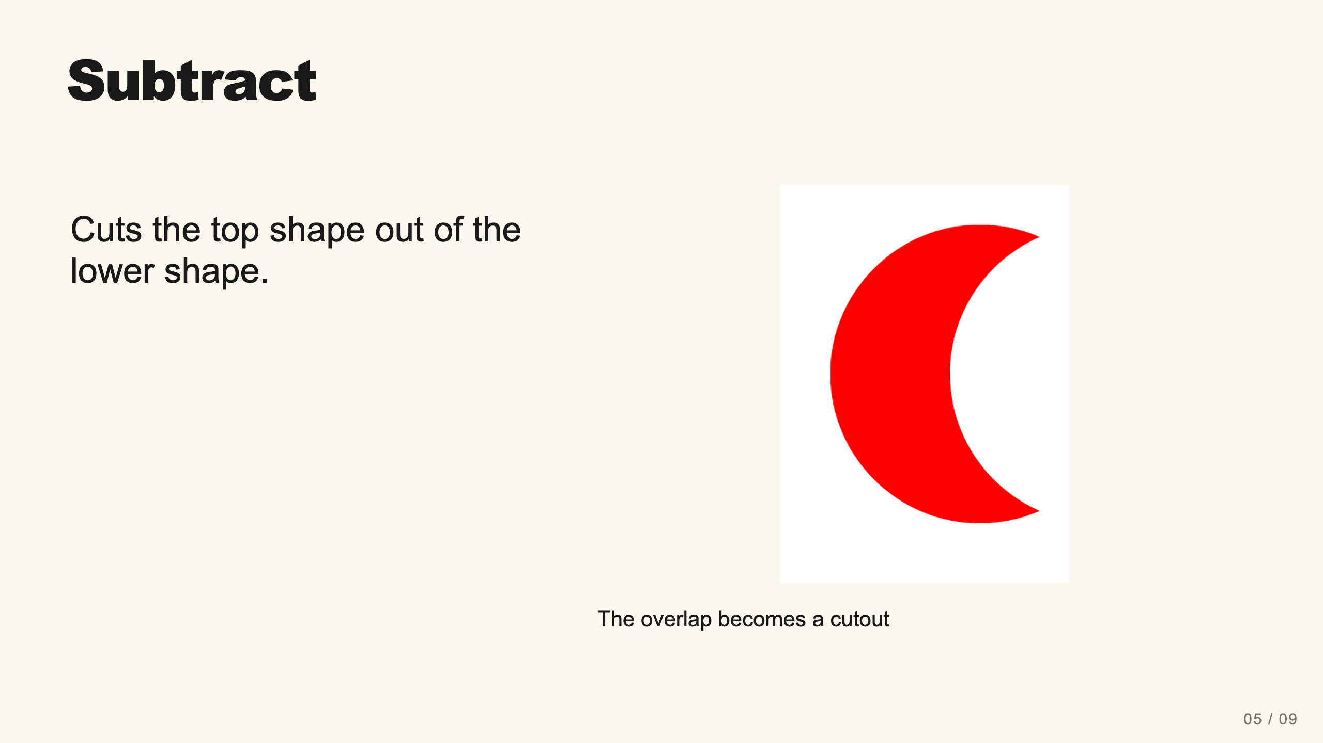
Notes:
Teacher move: 2 minutes. Model the crescent. Point out that order matters. If the unexpected side survives, inspect the layer order. If everything disappears, check whether the circles are identical and perfectly aligned.
[Sources]
Current course snapshot, generated student pages and facilitator guides in innovative-technology-site, inspected 2026-09-07. Original ZIP supplied by Elisha Lucero.
Canva editor and Combo app, Graphic Design Lesson Demonstrations, https://www.canva.com/design/DAHUiq9hUJg/IwU_7AR5EXsmRbdnEBtkhA/edit . Screenshots captured directly in the Bowie Middle School account, 2026-09-07. Interface labels may vary by account. Canva screenshots used for classroom software instruction.
Visual: canva-artwork.png. Canva editor and Combo app, Graphic Design Lesson Demonstrations, https://www.canva.com/design/DAHUiq9hUJg/IwU_7AR5EXsmRbdnEBtkhA/edit . Screenshots captured directly in the Bowie Middle School account, 2026-09-07. Interface labels may vary by account. Canva screenshots used for classroom software instruction.
Visual reference: canva-artwork.png. Supplied teaching artwork or a direct Canva interface capture, as recorded in the source ledger.

Slide 10
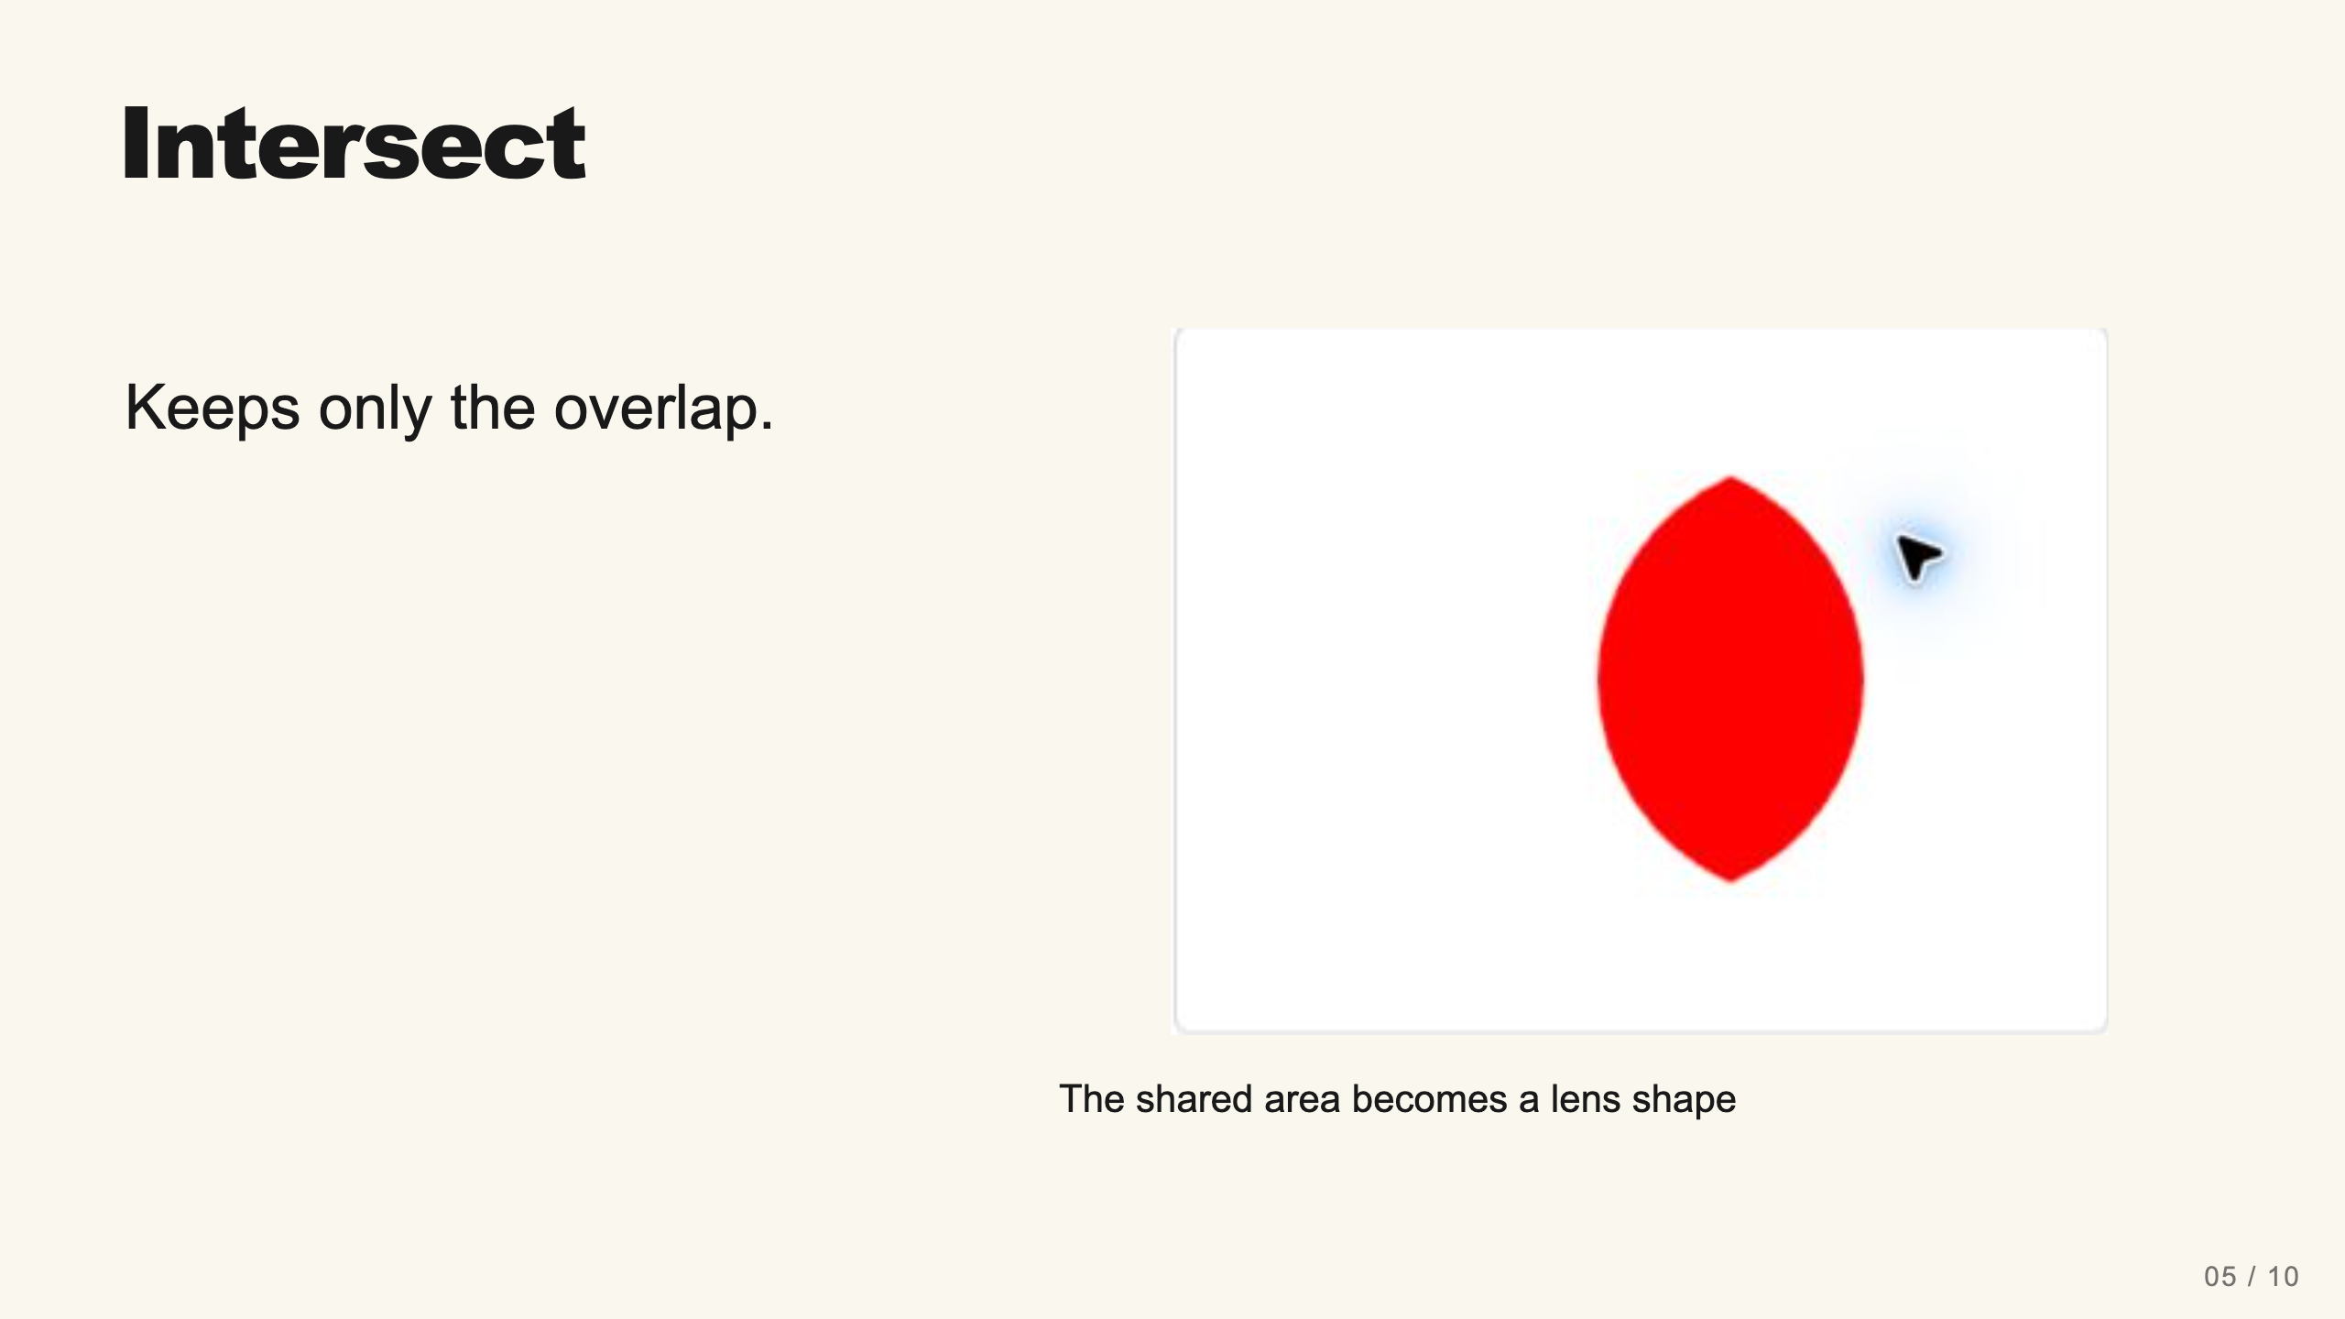
Notes:
Teacher move: 1 minute. Ask students to predict the result before showing it. Intersect retains the common area, so separated shapes produce no visible result.
[Sources]
Current course snapshot, generated student pages and facilitator guides in innovative-technology-site, inspected 2026-09-07. Original ZIP supplied by Elisha Lucero.
Canva editor and Combo app, Graphic Design Lesson Demonstrations, https://www.canva.com/design/DAHUiq9hUJg/IwU_7AR5EXsmRbdnEBtkhA/edit . Screenshots captured directly in the Bowie Middle School account, 2026-09-07. Interface labels may vary by account. Canva screenshots used for classroom software instruction.
Visual: combo-intersect.png. Canva editor and Combo app, Graphic Design Lesson Demonstrations, https://www.canva.com/design/DAHUiq9hUJg/IwU_7AR5EXsmRbdnEBtkhA/edit . Screenshots captured directly in the Bowie Middle School account, 2026-09-07. Interface labels may vary by account. Canva screenshots used for classroom software instruction.
Visual reference: combo-intersect.png. Supplied teaching artwork or a direct Canva interface capture, as recorded in the source ledger.

Slide 11
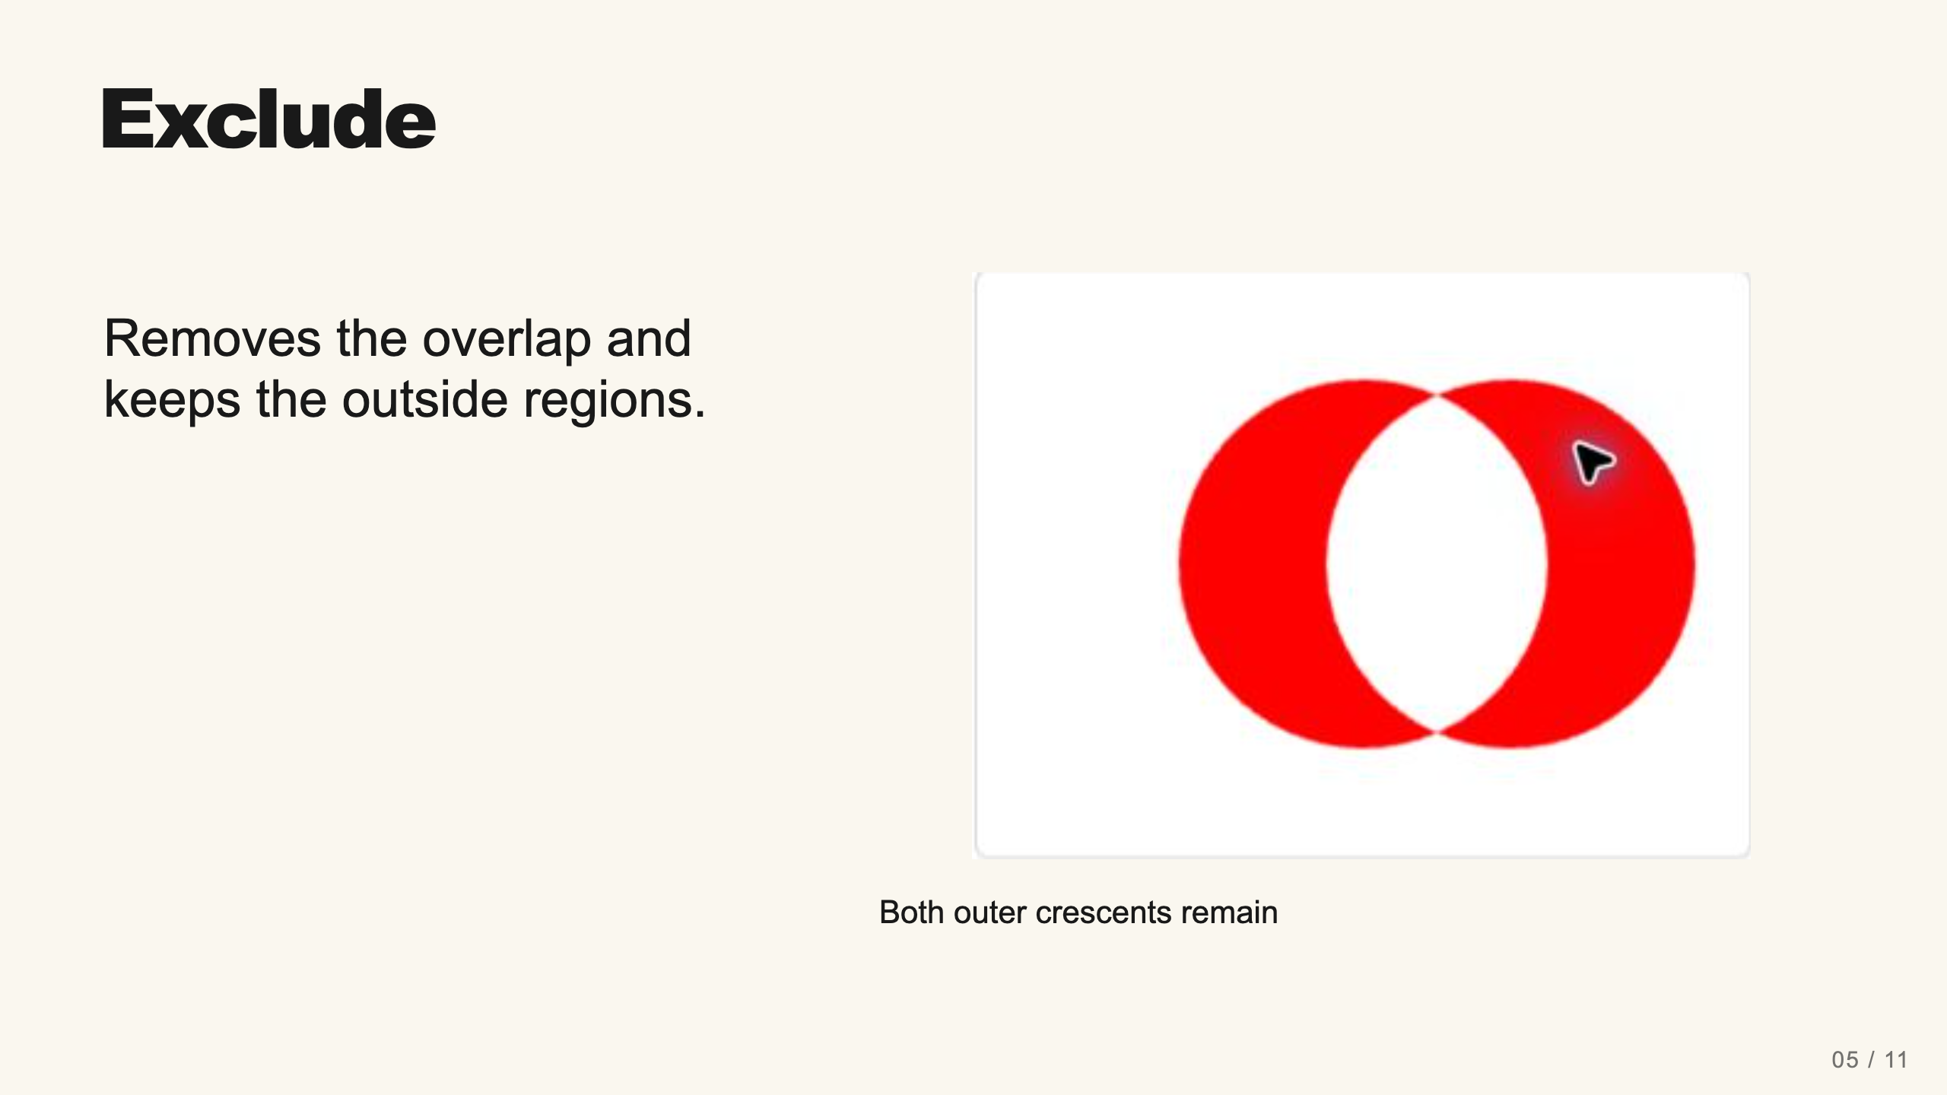
Notes:
Teacher move: 1 minute. The current app labels this Exclude. Some earlier materials also call it Difference. The live result contains two remaining parts in Layers. Avoid describing it as necessarily one continuous object.
[Sources]
Current course snapshot, generated student pages and facilitator guides in innovative-technology-site, inspected 2026-09-07. Original ZIP supplied by Elisha Lucero.
Canva editor and Combo app, Graphic Design Lesson Demonstrations, https://www.canva.com/design/DAHUiq9hUJg/IwU_7AR5EXsmRbdnEBtkhA/edit . Screenshots captured directly in the Bowie Middle School account, 2026-09-07. Interface labels may vary by account. Canva screenshots used for classroom software instruction.
Visual: combo-exclude.png. Canva editor and Combo app, Graphic Design Lesson Demonstrations, https://www.canva.com/design/DAHUiq9hUJg/IwU_7AR5EXsmRbdnEBtkhA/edit . Screenshots captured directly in the Bowie Middle School account, 2026-09-07. Interface labels may vary by account. Canva screenshots used for classroom software instruction.
Visual reference: combo-exclude.png. Supplied teaching artwork or a direct Canva interface capture, as recorded in the source ledger.

Slide 12
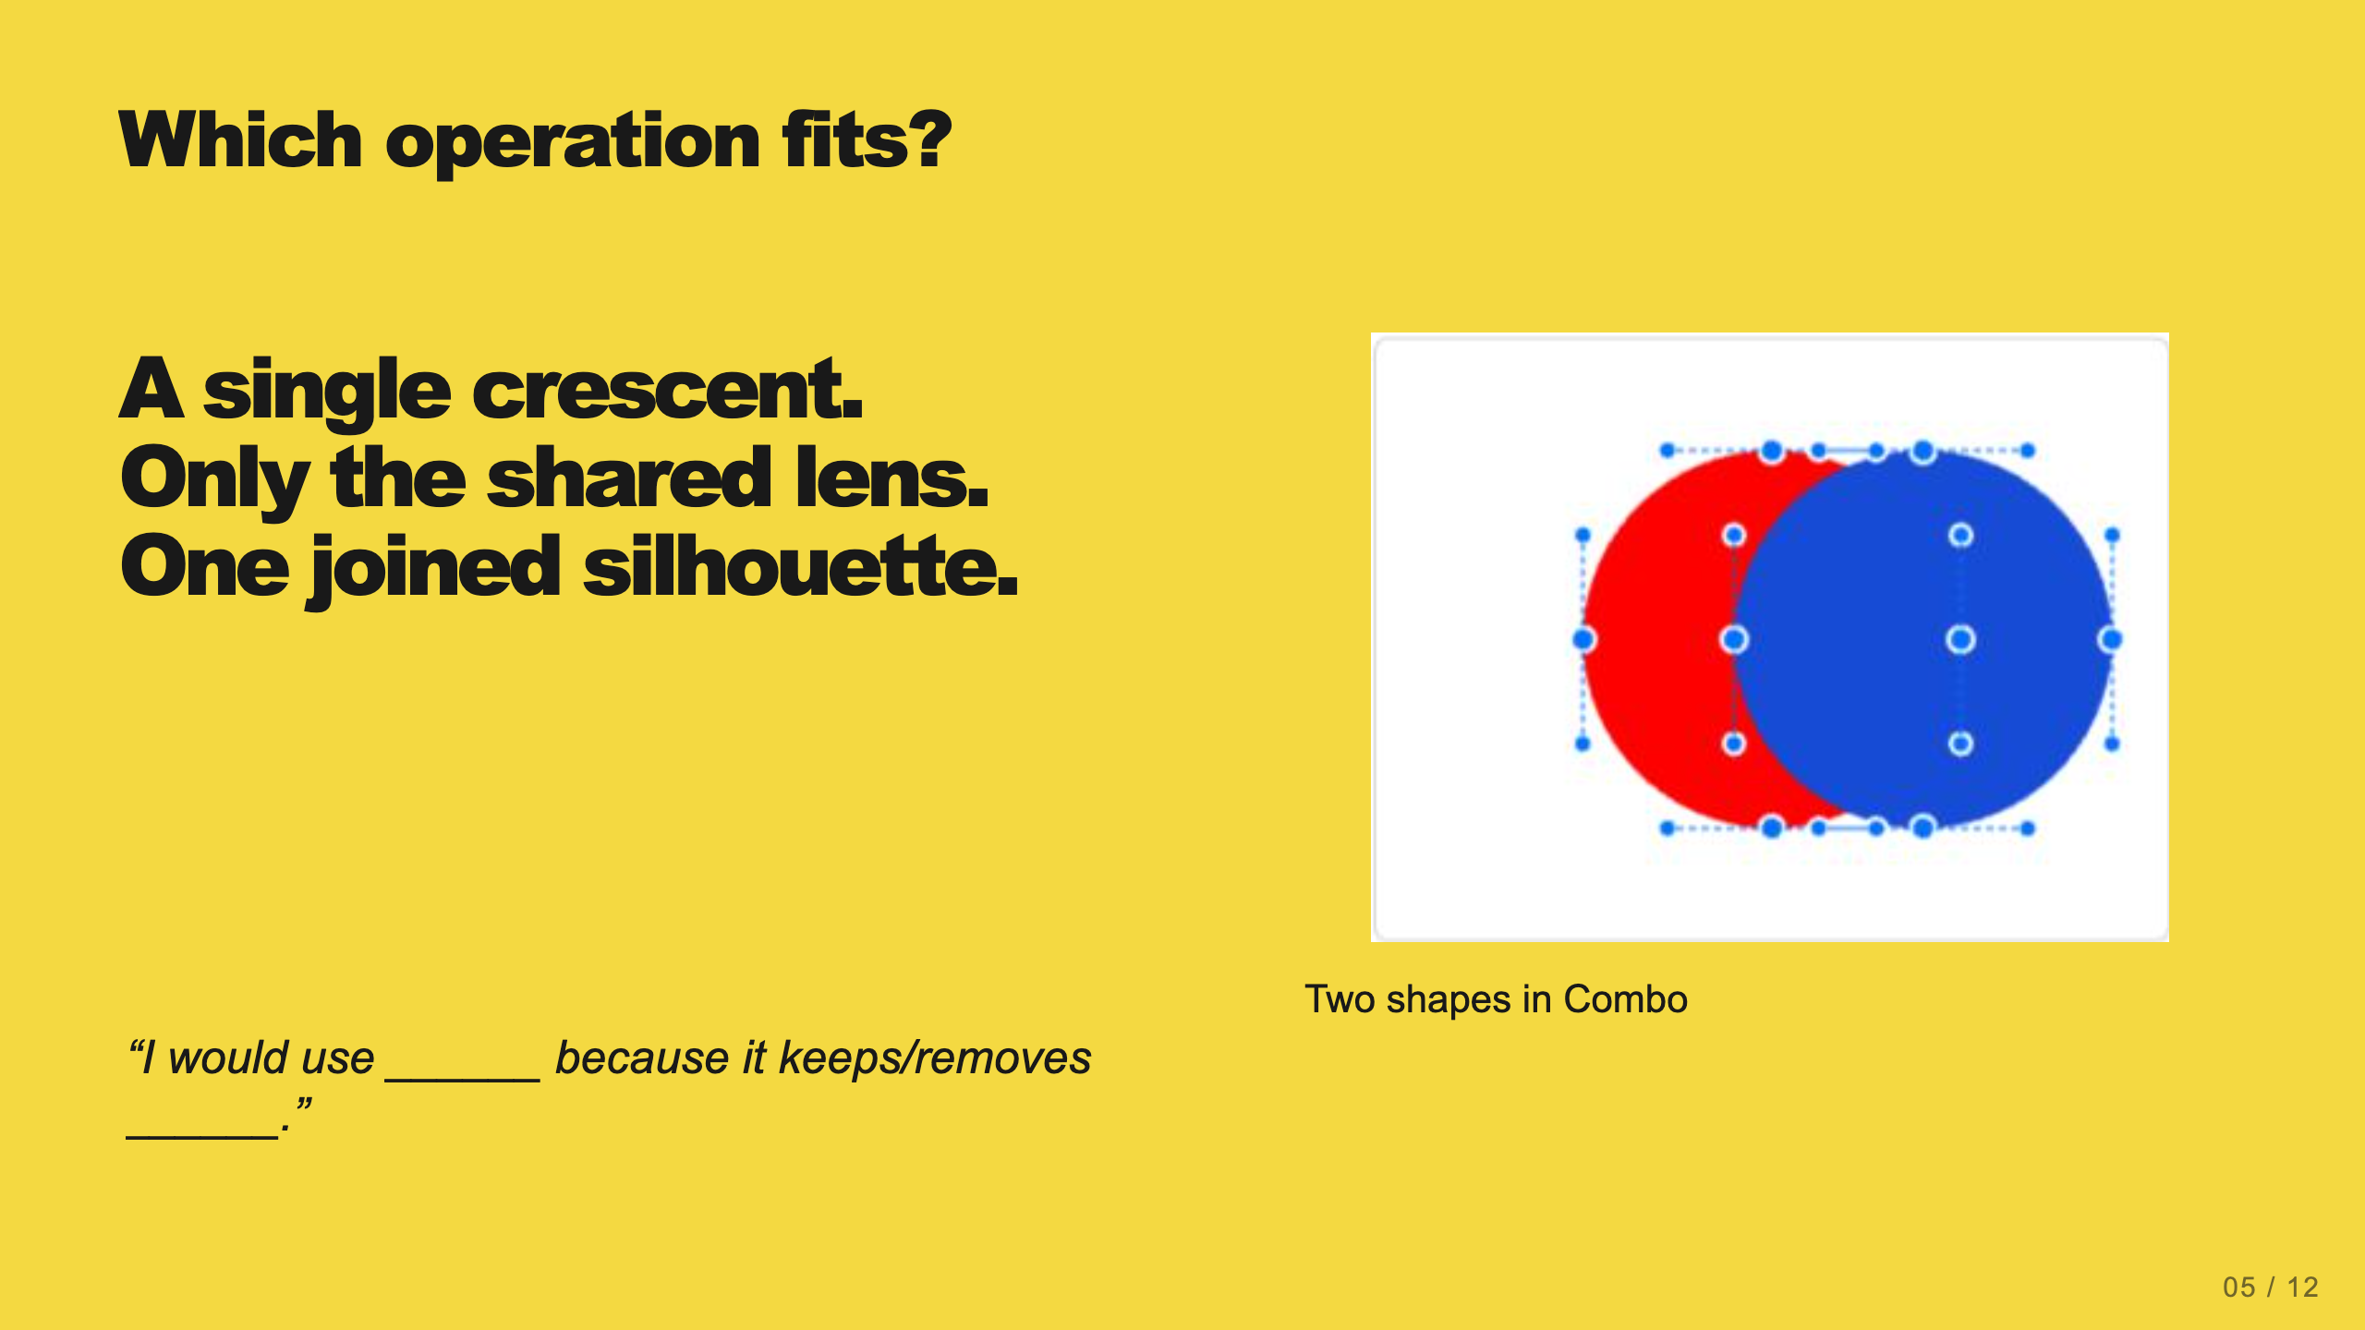
Notes:
Teacher move: 2 minutes. Have students answer before revealing verbally: Subtract, Intersect, Union. Ask one student to explain the region that survives. If they only memorize button names, return to the image of two overlapping circles.
[Sources]
Current course snapshot, generated student pages and facilitator guides in innovative-technology-site, inspected 2026-09-07. Original ZIP supplied by Elisha Lucero.
Canva editor and Combo app, Graphic Design Lesson Demonstrations, https://www.canva.com/design/DAHUiq9hUJg/IwU_7AR5EXsmRbdnEBtkhA/edit . Screenshots captured directly in the Bowie Middle School account, 2026-09-07. Interface labels may vary by account. Canva screenshots used for classroom software instruction.
Visual reference: combo-two-colors.png. Supplied teaching artwork or a direct Canva interface capture, as recorded in the source ledger.

Slide 13
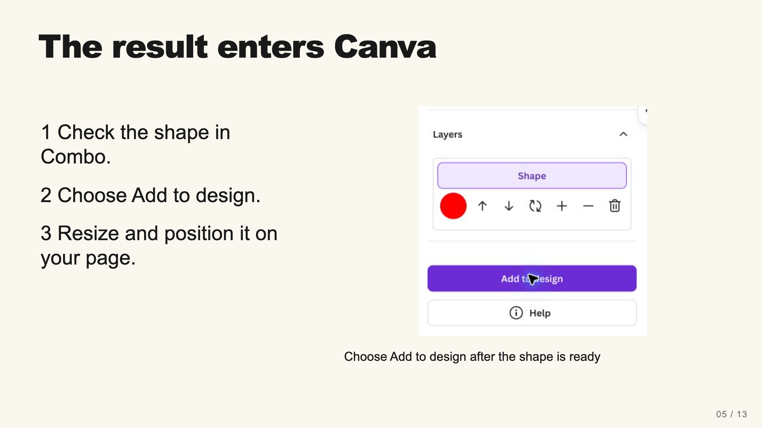
Notes:
Teacher move: 2 minutes. The inserted shape may be small and near the top-left of the page. Select it and enlarge it using a corner handle. Keep the result visible before closing Combo.
[Sources]
Current course snapshot, generated student pages and facilitator guides in innovative-technology-site, inspected 2026-09-07. Original ZIP supplied by Elisha Lucero.
Canva editor and Combo app, Graphic Design Lesson Demonstrations, https://www.canva.com/design/DAHUiq9hUJg/IwU_7AR5EXsmRbdnEBtkhA/edit . Screenshots captured directly in the Bowie Middle School account, 2026-09-07. Interface labels may vary by account. Canva screenshots used for classroom software instruction.
Visual: combo-add-to-design.png. Canva editor and Combo app, Graphic Design Lesson Demonstrations, https://www.canva.com/design/DAHUiq9hUJg/IwU_7AR5EXsmRbdnEBtkhA/edit . Screenshots captured directly in the Bowie Middle School account, 2026-09-07. Interface labels may vary by account. Canva screenshots used for classroom software instruction.
Visual reference: combo-add-to-design.png. Supplied teaching artwork or a direct Canva interface capture, as recorded in the source ledger.

Slide 14
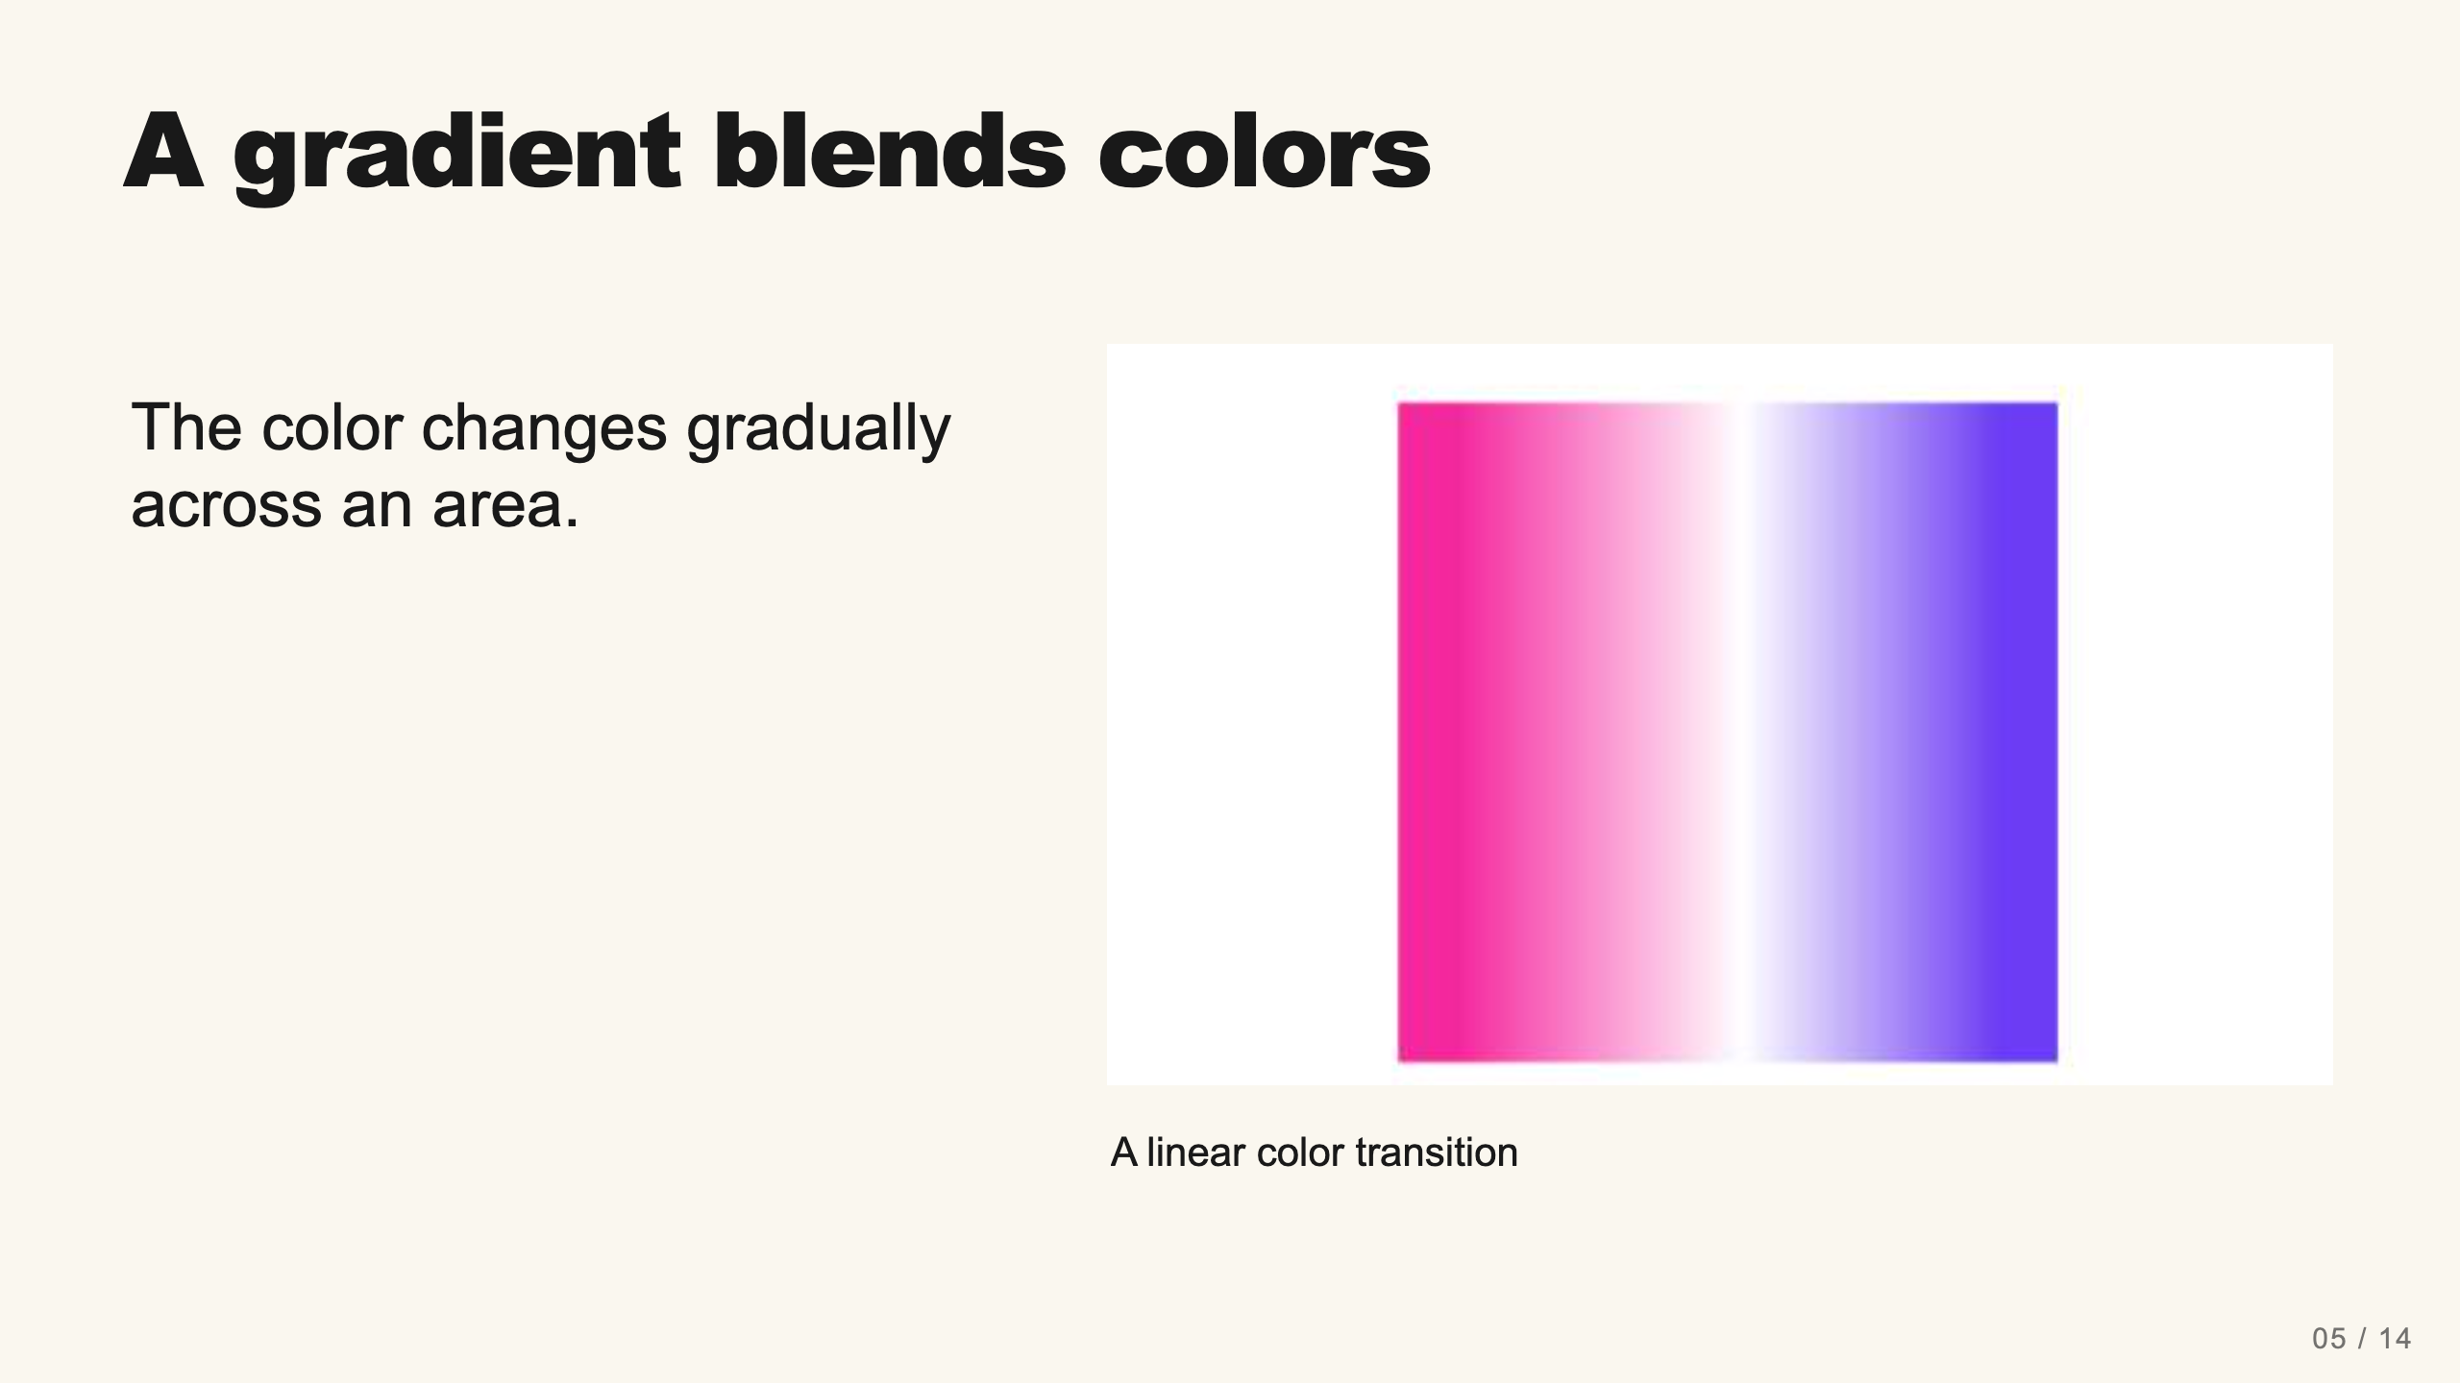
Notes:
Teacher move: 1 minute. Compare a smooth transition with separate stripes of flat colors. A gradient can occur in a background or supported shape; it does not have to appear inside the compound shape itself. Selected instructional image retained from the user-supplied Unit 1 DPI 2026 teaching materials. Reuse is for this classroom teaching adaptation. Original image rights remain with their respective creators; no open license is asserted.
[Sources]
Current course snapshot, generated student pages and facilitator guides in innovative-technology-site, inspected 2026-09-07. Original ZIP supplied by Elisha Lucero.
Canva editor and Combo app, Graphic Design Lesson Demonstrations, https://www.canva.com/design/DAHUiq9hUJg/IwU_7AR5EXsmRbdnEBtkhA/edit . Screenshots captured directly in the Bowie Middle School account, 2026-09-07. Interface labels may vary by account. Canva screenshots used for classroom software instruction.
Visual: source-55.jpg. Selected instructional image retained from the user-supplied Unit 1 DPI 2026 teaching materials. Reuse is for this classroom teaching adaptation. Original image rights remain with their respective creators; no open license is asserted.
Visual reference: source-55.jpg. Supplied teaching artwork or a direct Canva interface capture, as recorded in the source ledger.

Slide 15
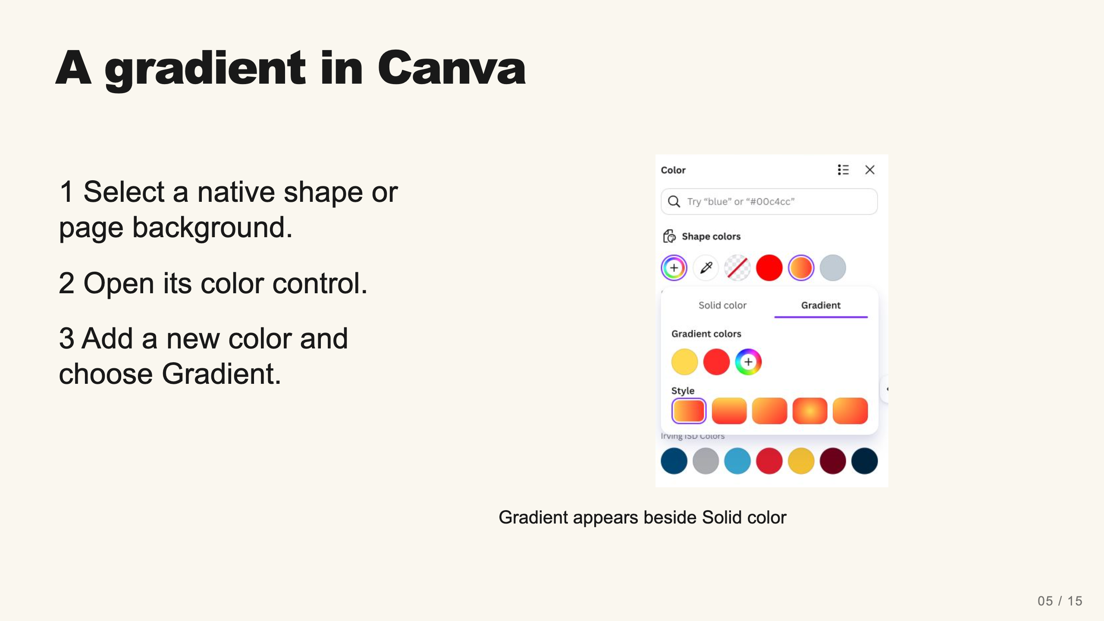
Notes:
Teacher move: 2 minutes. The verified route uses a native Canva circle. Imported graphics and some other object types expose different controls. If the compound result only offers solid color, use a gradient background or a native shape alongside it. The assignment requires both techniques, not necessarily in one object.
[Sources]
Current course snapshot, generated student pages and facilitator guides in innovative-technology-site, inspected 2026-09-07. Original ZIP supplied by Elisha Lucero.
Canva editor and Combo app, Graphic Design Lesson Demonstrations, https://www.canva.com/design/DAHUiq9hUJg/IwU_7AR5EXsmRbdnEBtkhA/edit . Screenshots captured directly in the Bowie Middle School account, 2026-09-07. Interface labels may vary by account. Canva screenshots used for classroom software instruction.
Visual: canva-linear-gradient.png. Canva editor and Combo app, Graphic Design Lesson Demonstrations, https://www.canva.com/design/DAHUiq9hUJg/IwU_7AR5EXsmRbdnEBtkhA/edit . Screenshots captured directly in the Bowie Middle School account, 2026-09-07. Interface labels may vary by account. Canva screenshots used for classroom software instruction.
Visual reference: canva-linear-gradient.png. Supplied teaching artwork or a direct Canva interface capture, as recorded in the source ledger.

Slide 16
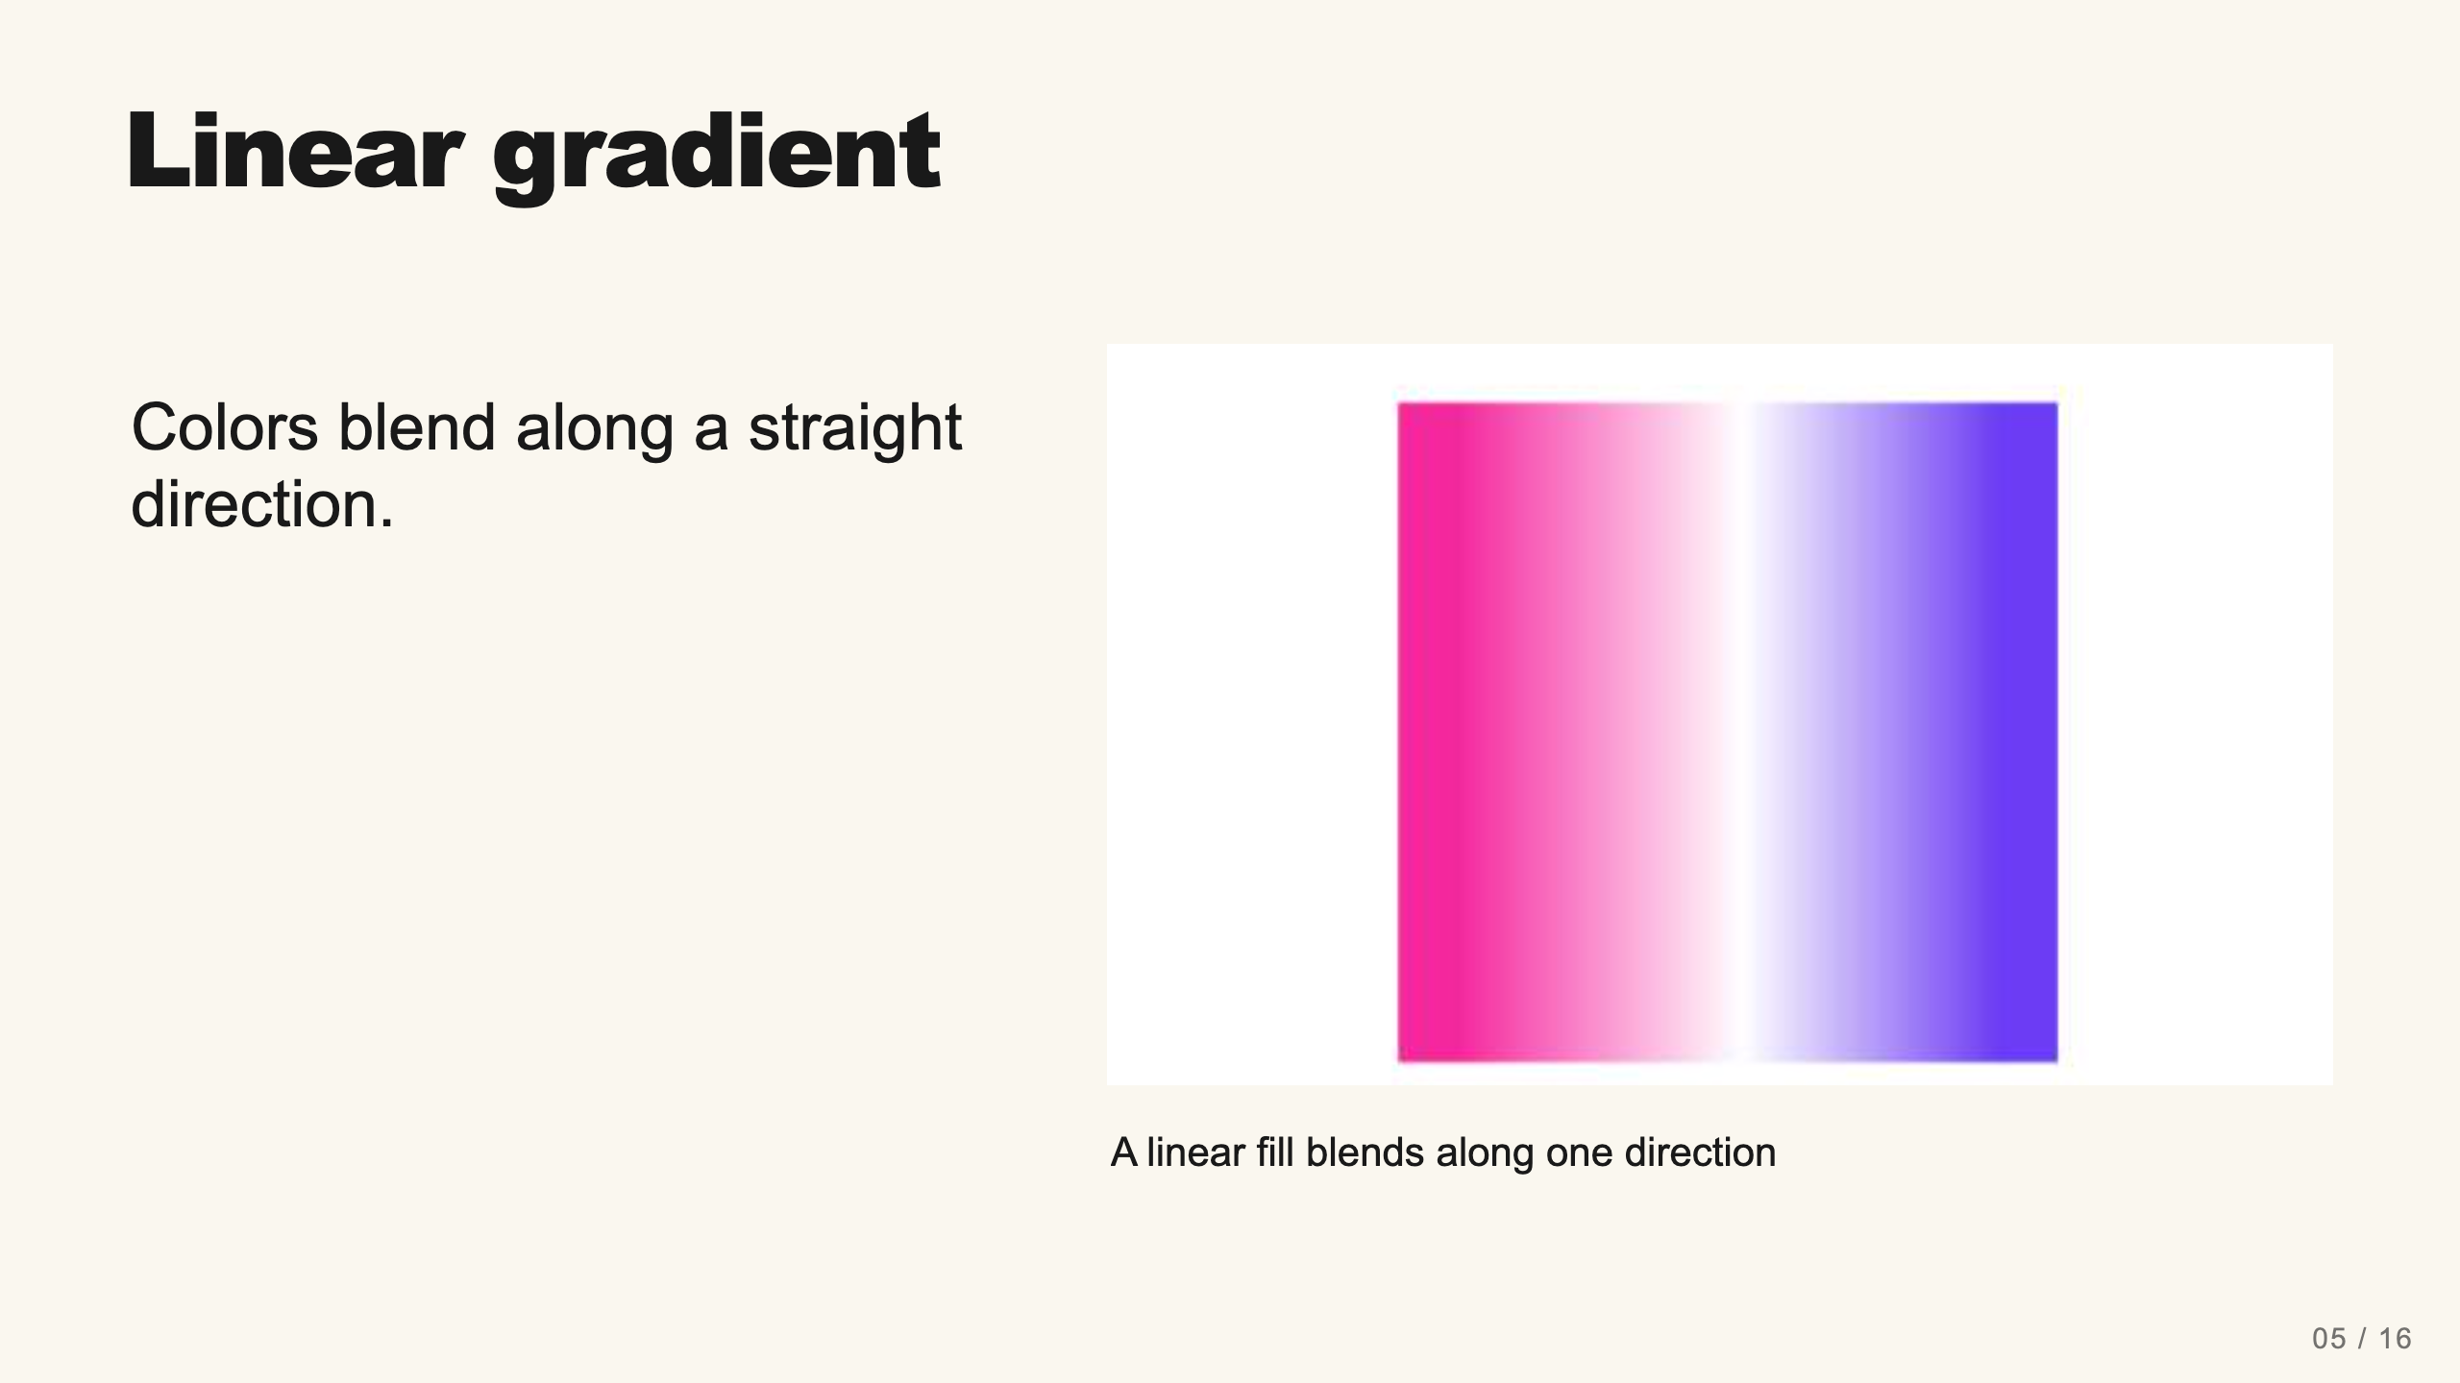
Notes:
Teacher move: 1 minute. Click each color stop to edit it. Compare the horizontal, vertical, and diagonal style tiles. The demonstration uses yellow and red to make the transition easy to see.
[Sources]
Current course snapshot, generated student pages and facilitator guides in innovative-technology-site, inspected 2026-09-07. Original ZIP supplied by Elisha Lucero.
Canva editor and Combo app, Graphic Design Lesson Demonstrations, https://www.canva.com/design/DAHUiq9hUJg/IwU_7AR5EXsmRbdnEBtkhA/edit . Screenshots captured directly in the Bowie Middle School account, 2026-09-07. Interface labels may vary by account. Canva screenshots used for classroom software instruction.
Visual: source-55.jpg. Selected instructional image retained from the user-supplied Unit 1 DPI 2026 teaching materials. Reuse is for this classroom teaching adaptation. Original image rights remain with their respective creators; no open license is asserted.
Visual reference: source-55.jpg. Supplied teaching artwork or a direct Canva interface capture, as recorded in the source ledger.

Slide 17
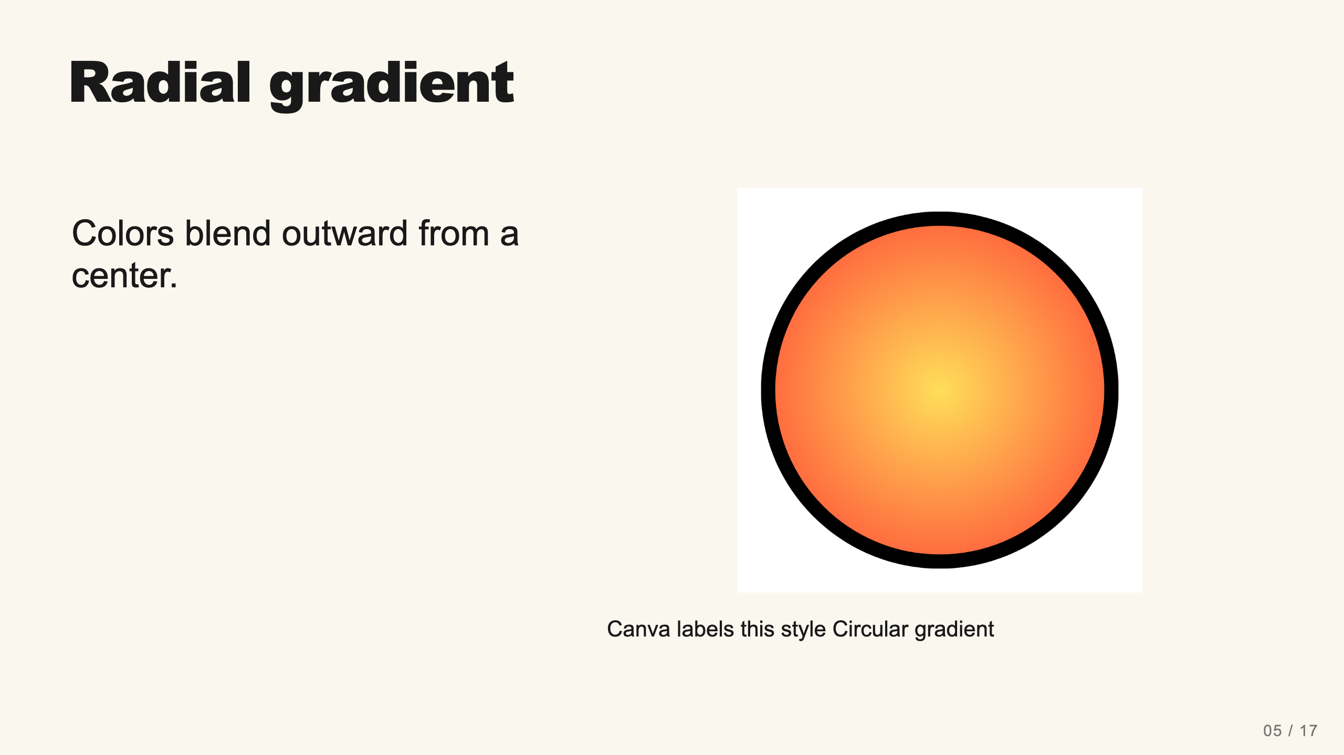
Notes:
Teacher move: 1 minute. The current picker offers circular styles centered in the shape or starting at a corner. The old lesson mentions angular gradients, but no angular control appeared in the verified picker. Linear or radial satisfies the existing gradient requirement.
[Sources]
Current course snapshot, generated student pages and facilitator guides in innovative-technology-site, inspected 2026-09-07. Original ZIP supplied by Elisha Lucero.
Canva editor and Combo app, Graphic Design Lesson Demonstrations, https://www.canva.com/design/DAHUiq9hUJg/IwU_7AR5EXsmRbdnEBtkhA/edit . Screenshots captured directly in the Bowie Middle School account, 2026-09-07. Interface labels may vary by account. Canva screenshots used for classroom software instruction.
Visual: canva-artwork.png. Canva editor and Combo app, Graphic Design Lesson Demonstrations, https://www.canva.com/design/DAHUiq9hUJg/IwU_7AR5EXsmRbdnEBtkhA/edit . Screenshots captured directly in the Bowie Middle School account, 2026-09-07. Interface labels may vary by account. Canva screenshots used for classroom software instruction.
Visual reference: canva-artwork.png. Supplied teaching artwork or a direct Canva interface capture, as recorded in the source ledger.

Slide 18
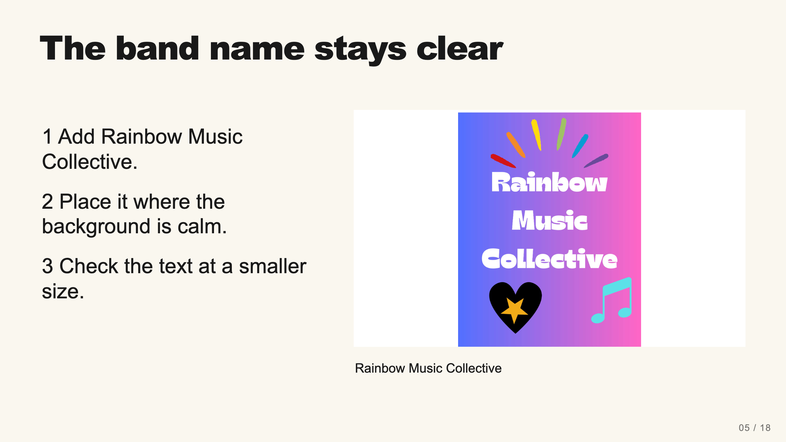
Notes:
Teacher move: 2 minutes. Model adding the exact band name with a text box. Compare a dark text/light area or light text/dark area. Avoid placing small text over the busiest part of a gradient or shape. The exemplar is one possible solution, not a template students must copy.
[Sources]
Current course snapshot, generated student pages and facilitator guides in innovative-technology-site, inspected 2026-09-07. Original ZIP supplied by Elisha Lucero.
Canva editor and Combo app, Graphic Design Lesson Demonstrations, https://www.canva.com/design/DAHUiq9hUJg/IwU_7AR5EXsmRbdnEBtkhA/edit . Screenshots captured directly in the Bowie Middle School account, 2026-09-07. Interface labels may vary by account. Canva screenshots used for classroom software instruction.
Visual: source-58.jpg. Selected instructional image retained from the user-supplied Unit 1 DPI 2026 teaching materials. Reuse is for this classroom teaching adaptation. Original image rights remain with their respective creators; no open license is asserted.
Visual reference: source-58.jpg. Supplied teaching artwork or a direct Canva interface capture, as recorded in the source ledger.

Slide 19
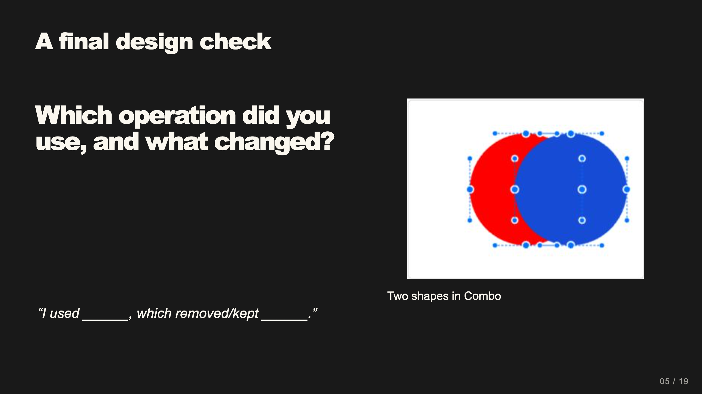
Notes:
Teacher move: 2 minutes within work time. Ask students to point to the actual compound result. If they only grouped ordinary shapes, revisit Combo. Also ask whether their gradient or decorative elements obscure the name.
[Sources]
Current course snapshot, generated student pages and facilitator guides in innovative-technology-site, inspected 2026-09-07. Original ZIP supplied by Elisha Lucero.
Canva editor and Combo app, Graphic Design Lesson Demonstrations, https://www.canva.com/design/DAHUiq9hUJg/IwU_7AR5EXsmRbdnEBtkhA/edit . Screenshots captured directly in the Bowie Middle School account, 2026-09-07. Interface labels may vary by account. Canva screenshots used for classroom software instruction.
Visual reference: combo-two-colors.png. Supplied teaching artwork or a direct Canva interface capture, as recorded in the source ledger.

Slide 20
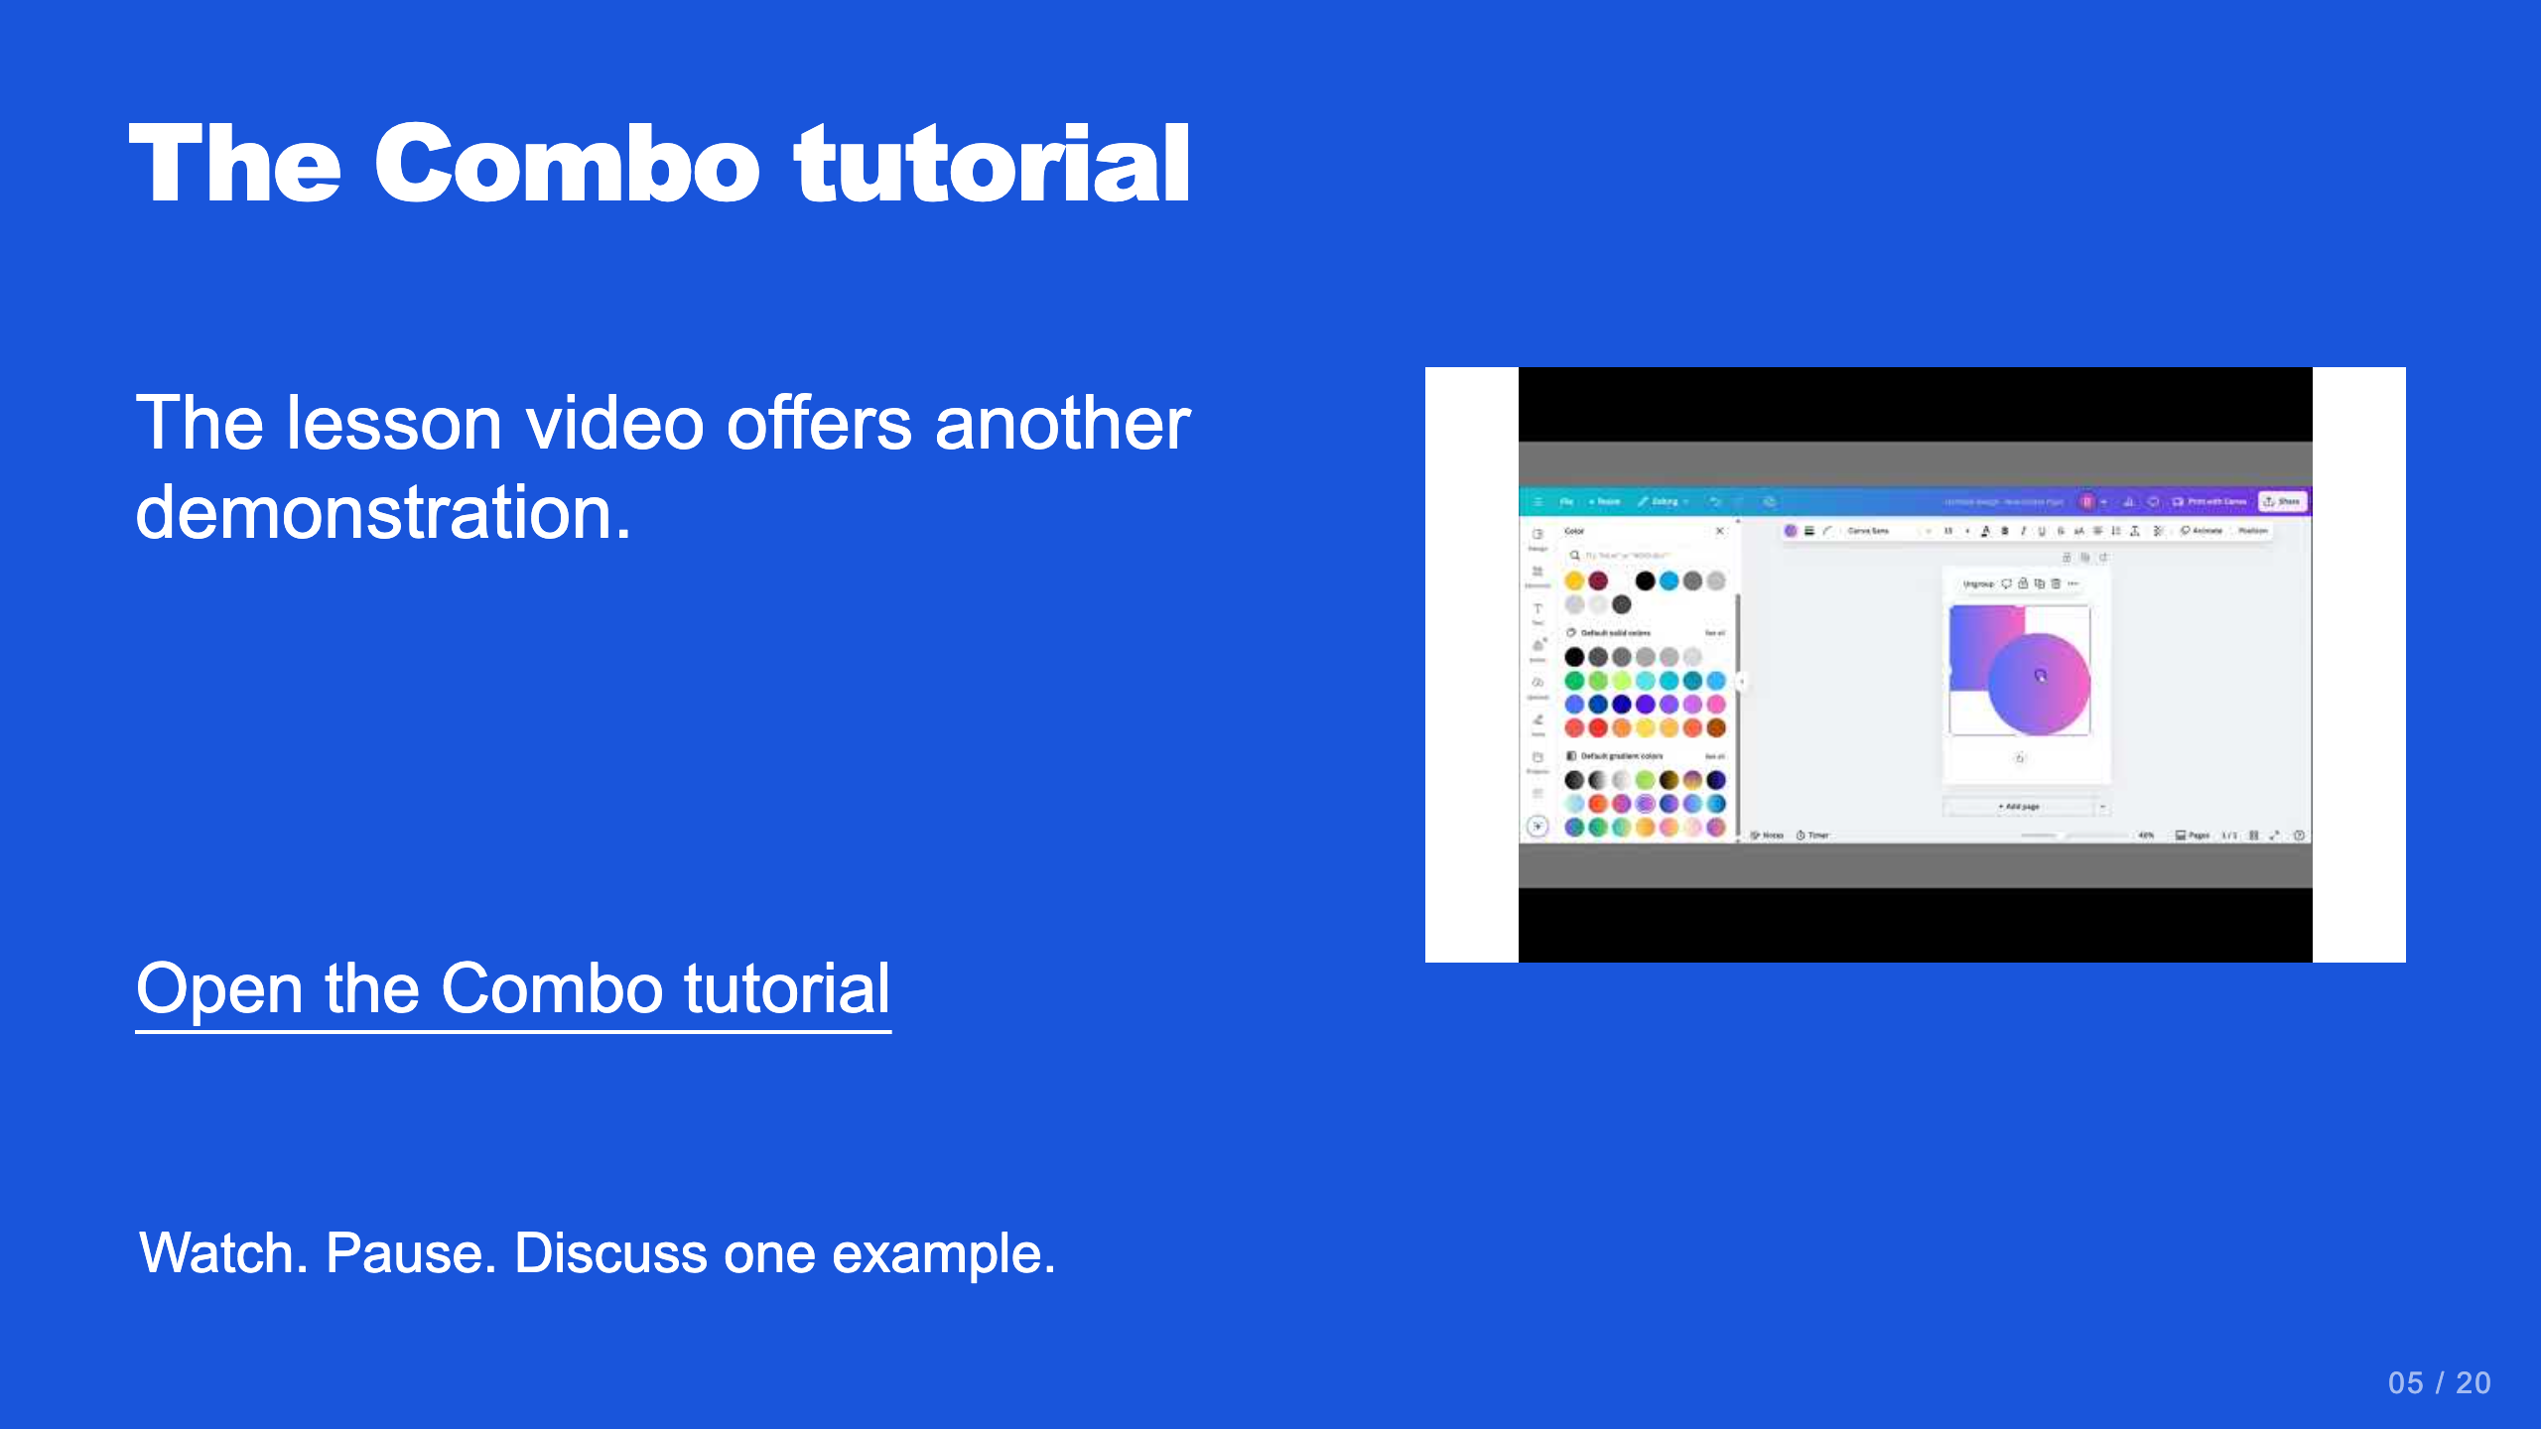
Notes:
Teacher move: Optional reference. Existing Combo video: https://www.youtube.com/watch?v=goCGQ3b9DvM . Existing concept overview: https://www.youtube.com/watch?v=qCK07WdB7W8 . The latter shows an older tool; use the real current Combo screenshots in this deck for the interface workflow.
[Sources]
Current course snapshot, generated student pages and facilitator guides in innovative-technology-site, inspected 2026-09-07. Original ZIP supplied by Elisha Lucero.
Canva editor and Combo app, Graphic Design Lesson Demonstrations, https://www.canva.com/design/DAHUiq9hUJg/IwU_7AR5EXsmRbdnEBtkhA/edit . Screenshots captured directly in the Bowie Middle School account, 2026-09-07. Interface labels may vary by account. Canva screenshots used for classroom software instruction.
Visual reference: video-05.jpg. Thumbnail published by the linked video on YouTube.

Slide 21
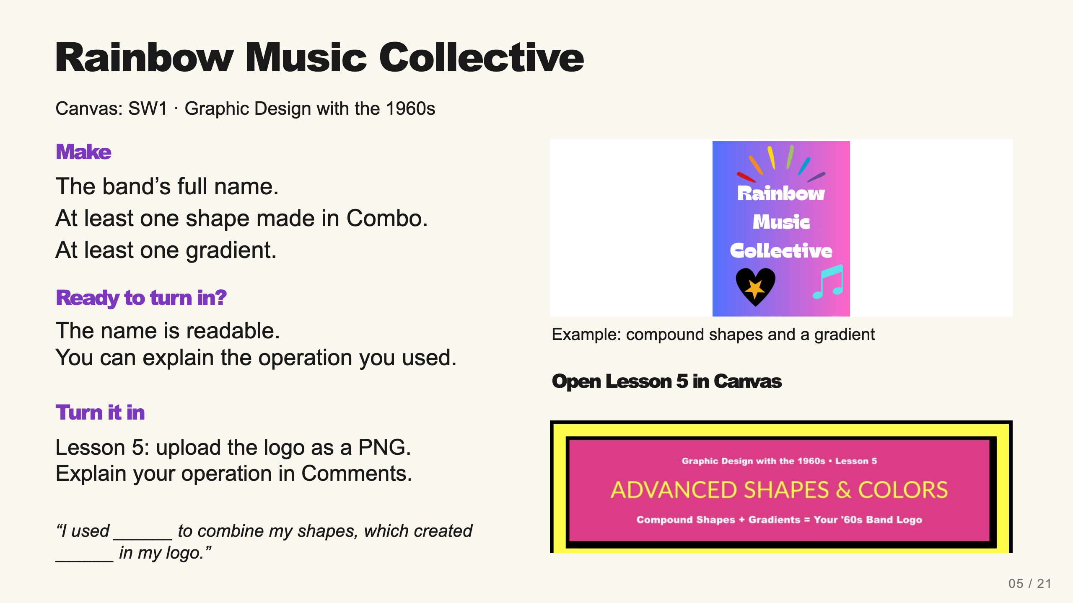
Notes:
Teacher move: Leave this screen projected throughout independent work. It contains the required product, observable completion checks, an exemplar, and the existing submission route. Use verbal reminders and brief conferences instead of cycling through separate task, submission, and done slides. The exemplar is inspiration, not a template to copy. Before class, open the named assignment in your own course and confirm the submission controls.
Verify a real compound operation rather than ordinary grouping. A gradient on a native Canva shape or background satisfies the gradient requirement. Check the exact band name and readability before export.
The existing assignment rubric and points remain authoritative. Confer on one useful revision at a time.
[Sources]
Current course snapshot, generated student pages and facilitator guides in innovative-technology-site, inspected 2026-09-07. Original ZIP supplied by Elisha Lucero.
Canva editor and Combo app, Graphic Design Lesson Demonstrations, https://www.canva.com/design/DAHUiq9hUJg/IwU_7AR5EXsmRbdnEBtkhA/edit . Screenshots captured directly in the Bowie Middle School account, 2026-09-07. Interface labels may vary by account. Canva screenshots used for classroom software instruction.
Exemplar: source-58.jpg, from the supplied classroom materials. Canvas: live assignment and submission types verified through the API on September 7, 2026. Screenshot: real teacher-view assignment banner, cropped to omit editing controls. The unpublished template module prevents Student View access; publication was not changed.

