Slide 1
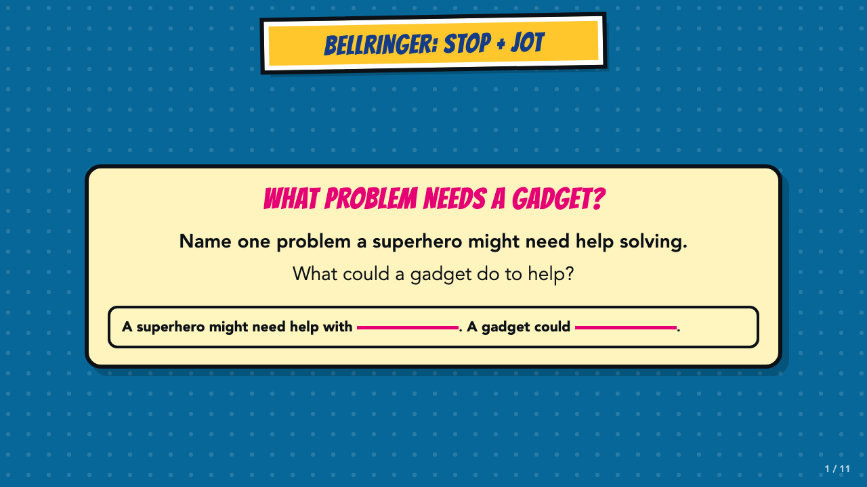
Notes:
Give students two quiet minutes for the Stop and Jot. Ask two or three students to share. The problem can be realistic or impossible.
[Sources]
- Smart Solutions Comics Lesson 3 owner-approved student and teacher materials, revised 2026-08-19.

Slide 2
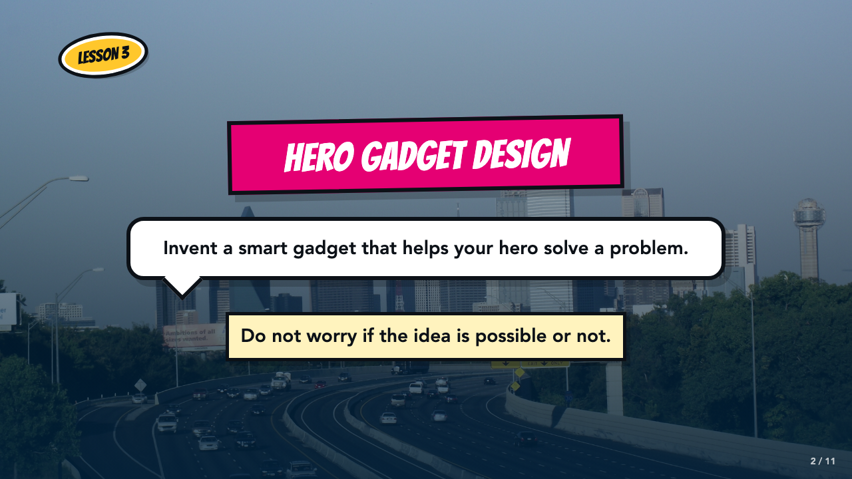
Notes:
Students invent a smart gadget that solves a problem. Tell them the idea does not have to be possible.
[Sources]
- Smart Solutions Comics Lesson 3 owner-approved student and teacher materials, revised 2026-08-19.

Slide 3
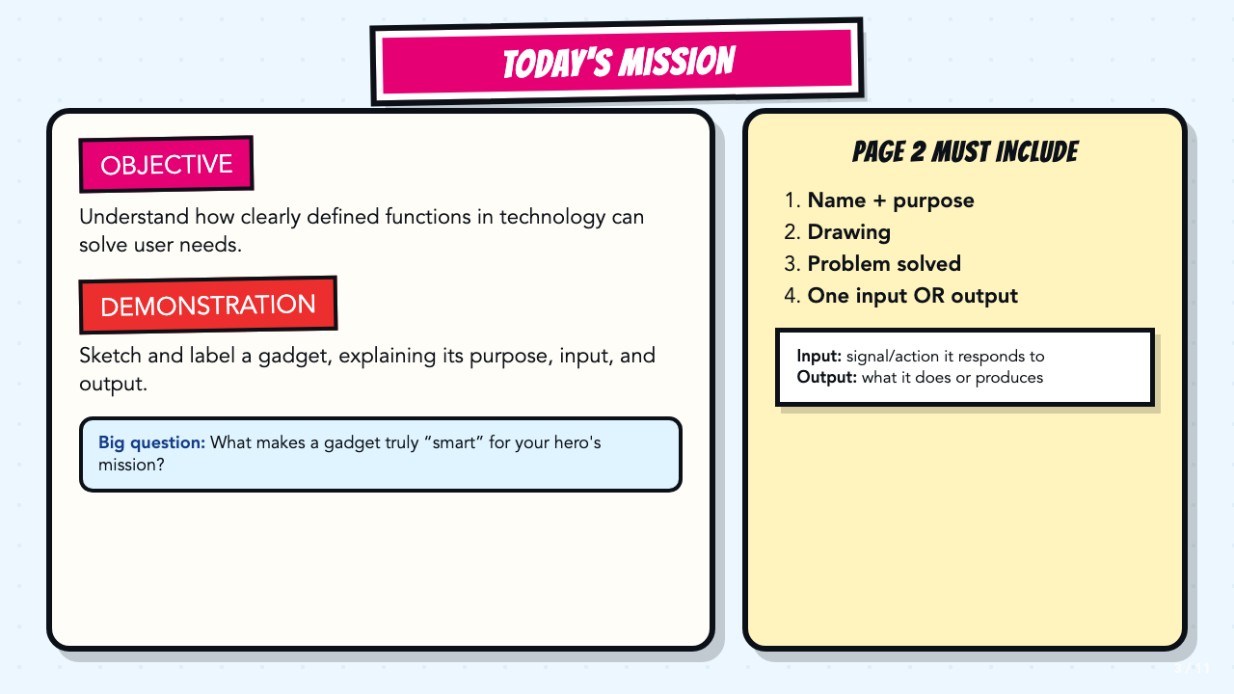
Notes:
Read the objective and demonstration aloud. Define input and output. Do not add a process chain.
[Sources]
- Smart Solutions Comics Lesson 3 owner-approved student and teacher materials, revised 2026-08-19.

Slide 4
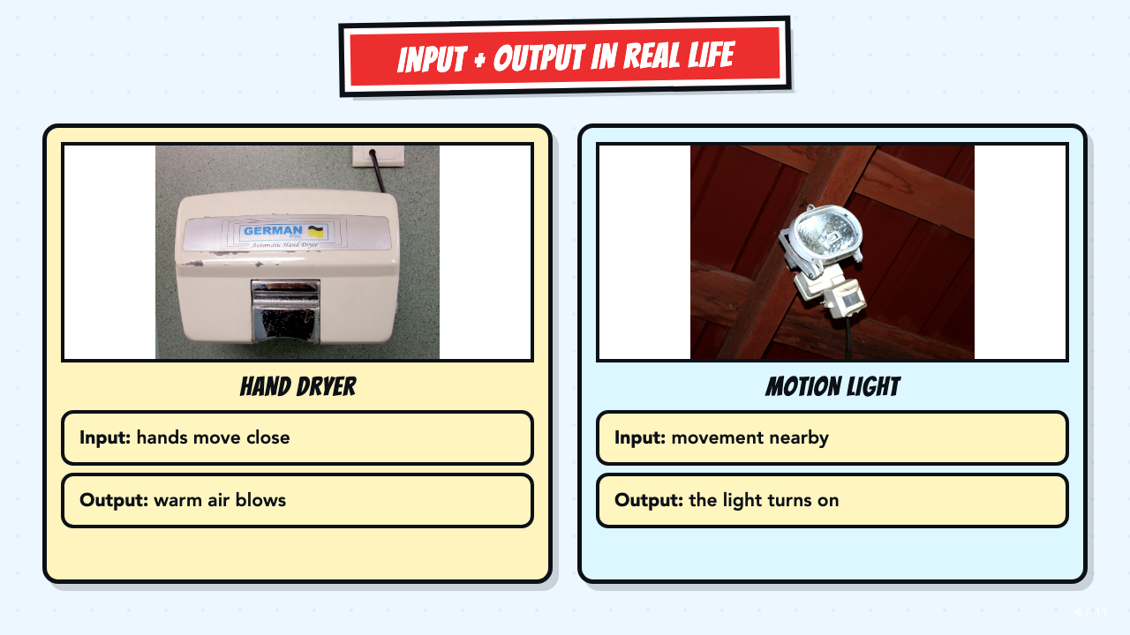
Notes:
Use the hand dryer and motion light as quick input/output examples. Ask what each device notices and what happens next. Students will later label either an input or an output on their own page.
[Sources]
- Smart Solutions Comics Lesson 3 owner-approved student and teacher materials, revised 2026-08-19.
- Automatic hand dryer photograph by Mk2010, CC BY-SA 3.0: https://commons.wikimedia.org/wiki/File:Automatic_hand_dryer.JPG
- Motion sensor light photograph by Santeri Viinamäki, CC BY-SA 4.0: https://commons.wikimedia.org/wiki/File:Motion_sensor_light.jpg

Slide 5
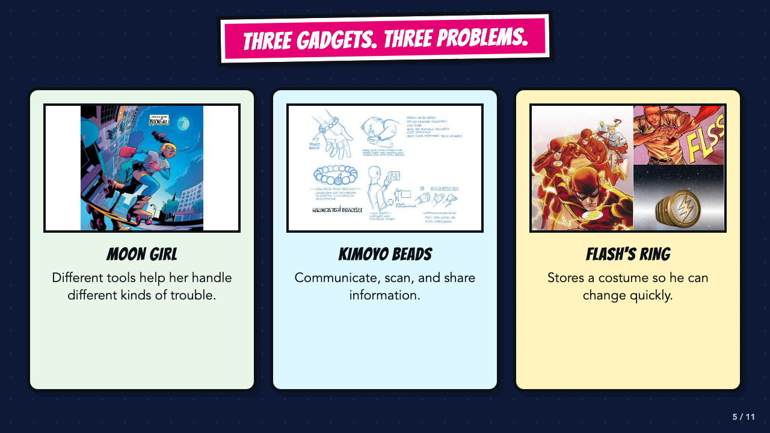
Notes:
Ask what problem each gadget solves. Students do not need to copy how any of these gadgets work.
[Sources]
- Smart Solutions Comics Lesson 3 owner-approved student and teacher materials, revised 2026-08-19.
- The Flash #763, DC official issue page describing the Flash ring: https://www.dc.com/comics/the-flash-2016/the-flash-763
- Wakanda's Tech Today, Marvel official description of Kimoyo beads: https://www.marvel.com/articles/comics/wakanda-s-tech-today-the-reviews-are-in

Slide 6
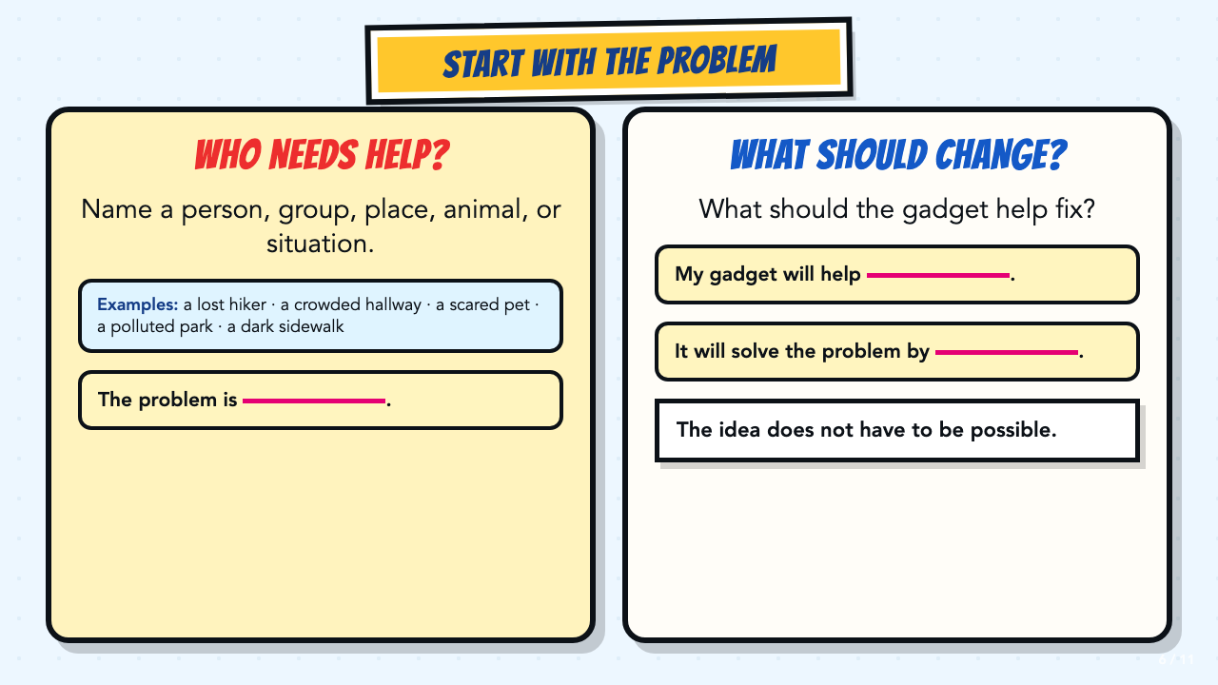
Notes:
Have students name the problem before naming the gadget. If they are stuck, use the examples on screen.
[Sources]
- Smart Solutions Comics Lesson 3 owner-approved student and teacher materials, revised 2026-08-19.

Slide 7
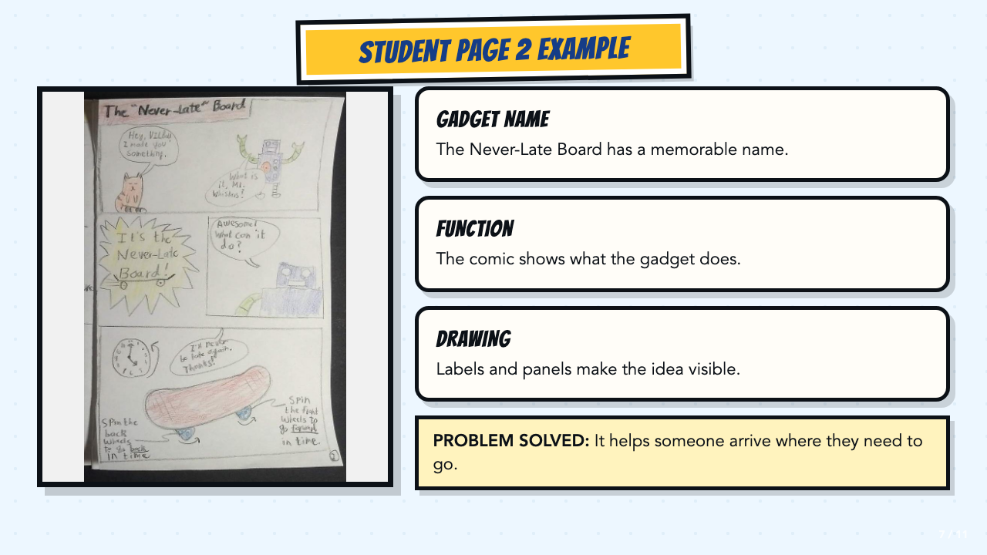
Notes:
Point out the gadget name, function, drawing, and problem solved. Drawing skill is not the goal.
[Sources]
- Smart Solutions Comics Lesson 3 owner-approved student and teacher materials, revised 2026-08-19.
- Authentic student Page 2 work supplied by the course author.

Slide 8
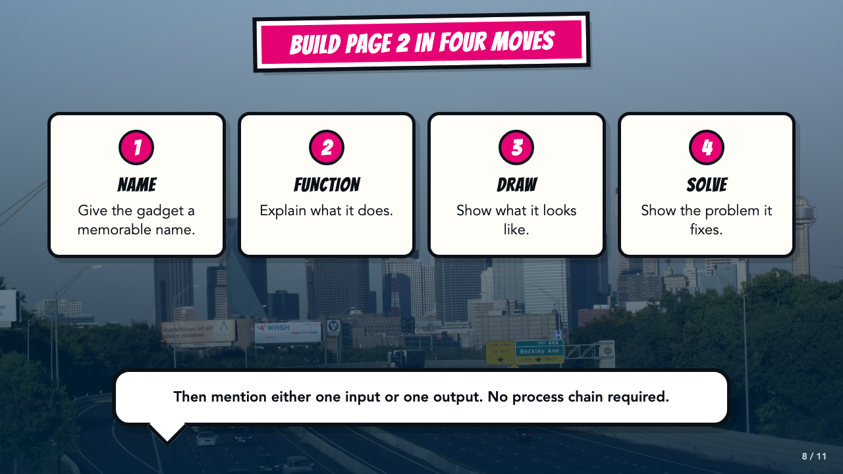
Notes:
Review the four parts of Page 2. Students also mention either one input or one output. Skip process rules.
[Sources]
- Smart Solutions Comics Lesson 3 owner-approved student and teacher materials, revised 2026-08-19.

Slide 9
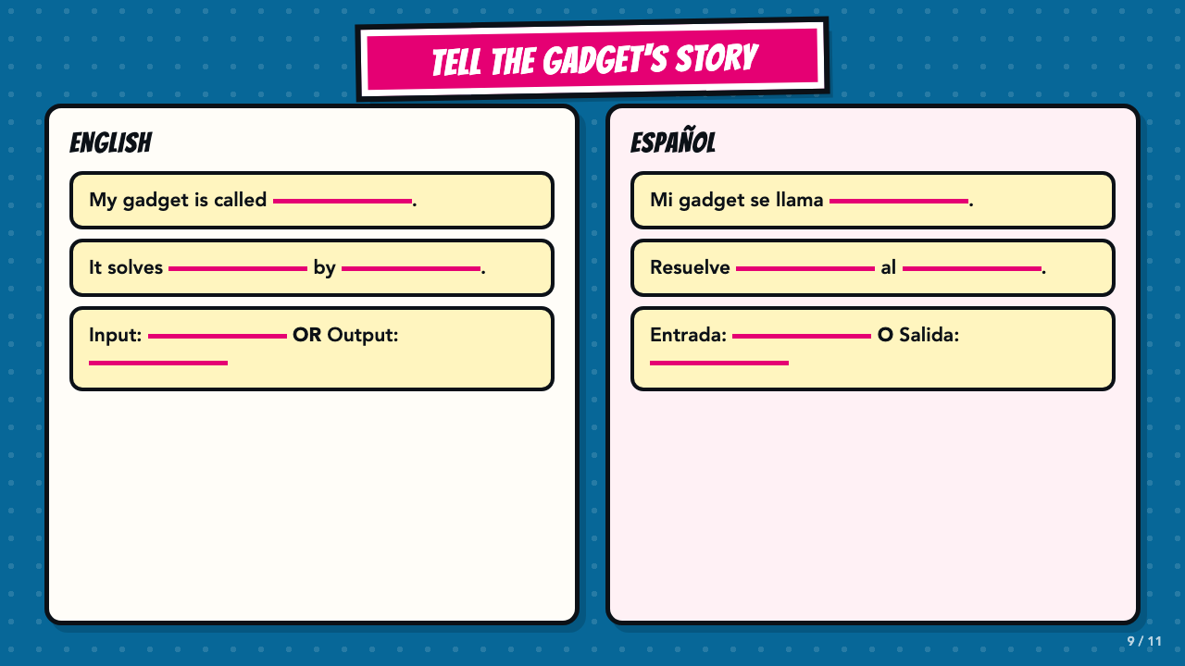
Notes:
Keep these bilingual stems visible for oral rehearsal. Students name a problem and either an input or an output.
[Sources]
- Smart Solutions Comics Lesson 3 owner-approved student and teacher materials, revised 2026-08-19.

Slide 10
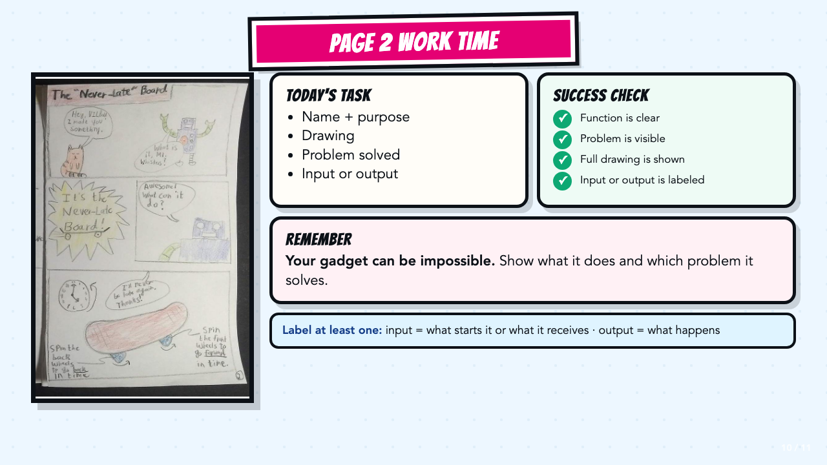
Notes:
Leave this slide projected during work time. Students need either an input or an output, not a full system chain. Use the VILBot page to point out the name, function, drawing, and problem solved.
[Sources]
- Smart Solutions Comics Lesson 3 owner-approved student and teacher materials, revised 2026-08-19.
- Authentic student Page 2 work supplied by the course author.

Slide 11
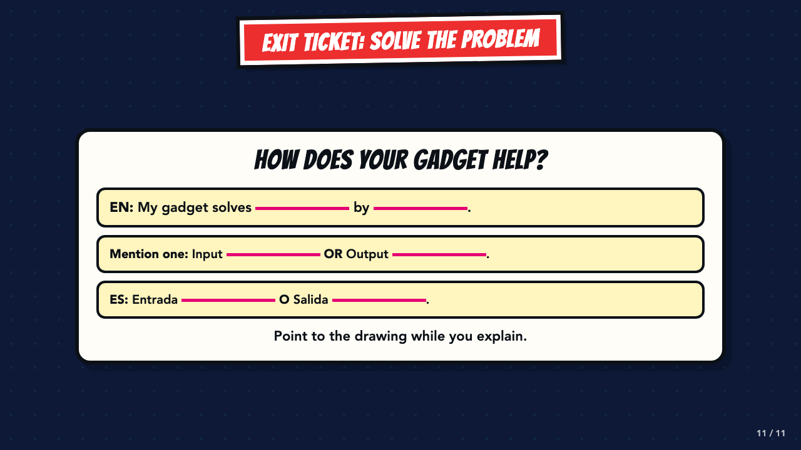
Notes:
Use this as an oral or written exit ticket. Listen for purpose, a problem solved, and either an input or an output.
[Sources]
- Smart Solutions Comics Lesson 3 owner-approved student and teacher materials, revised 2026-08-19.

