Slide 1
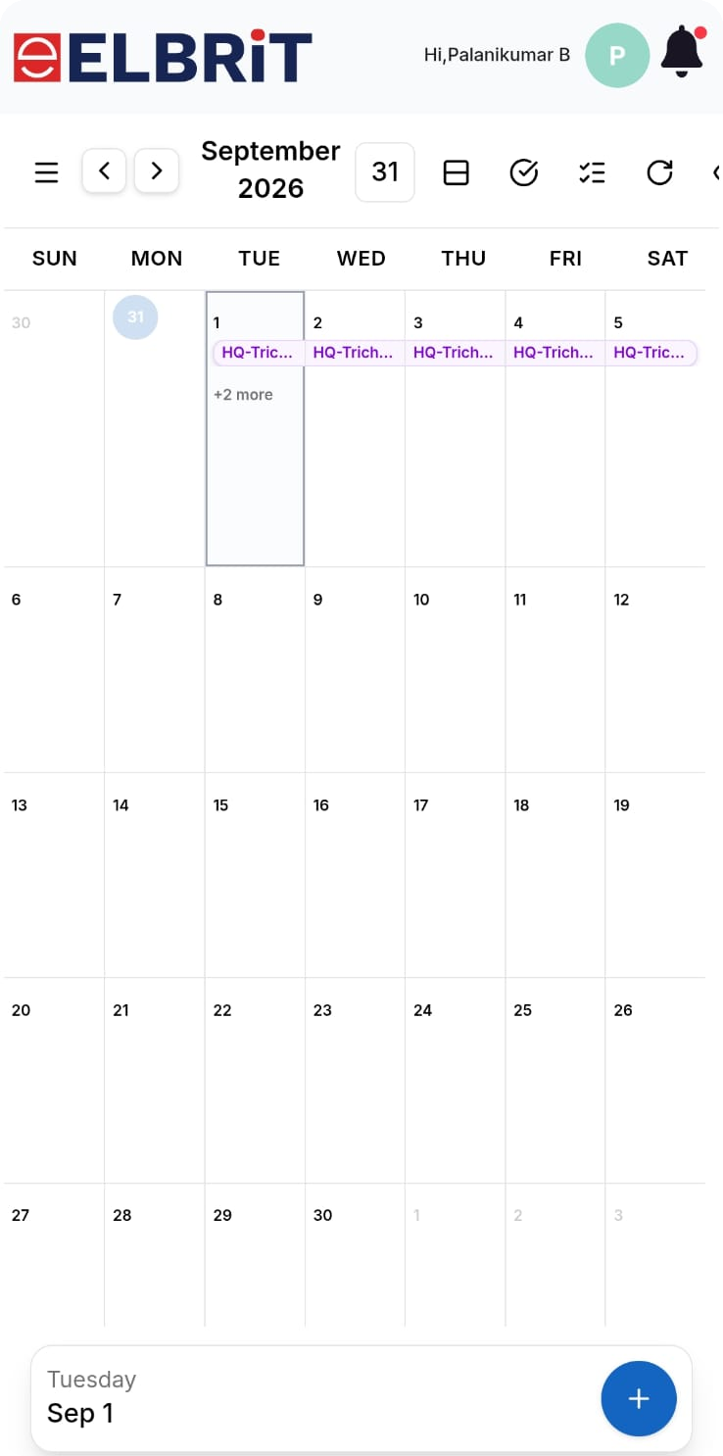
PRODUCT WALKTHROUGH · FIELD FORCE
Elbrit Calendar
Mobile Experience
One place to plan, share and close a field day — HQ tour plans, doctor visits, leave, to-dos and meetings.
TOLD FROM TWO PERSPECTIVES
BE
the reporting person
ABM
the manager above

Slide 2
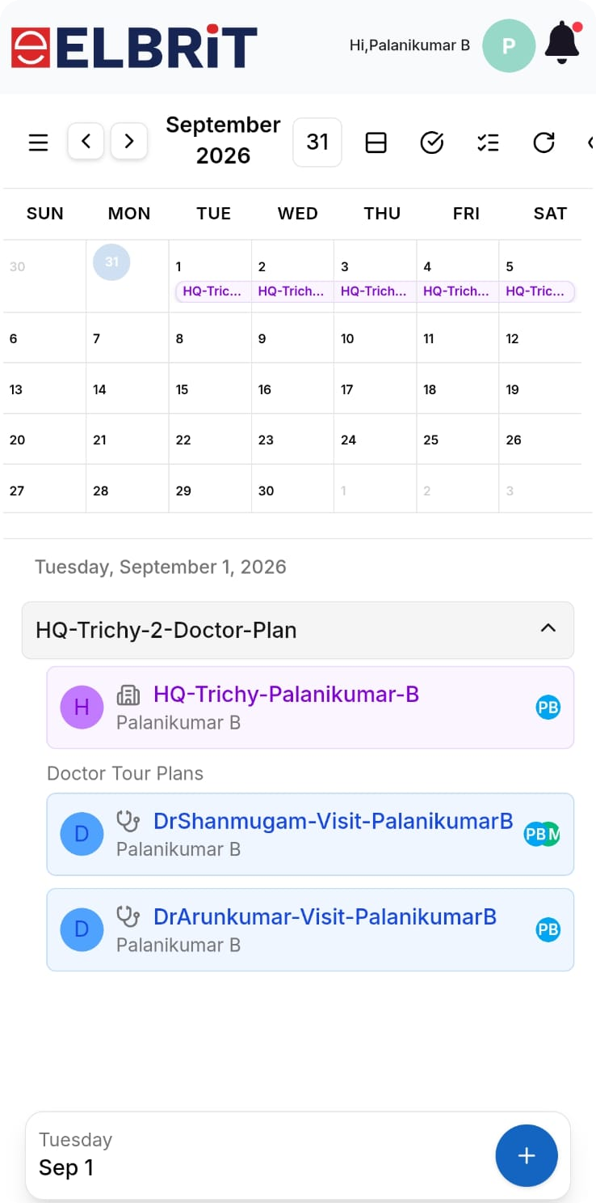
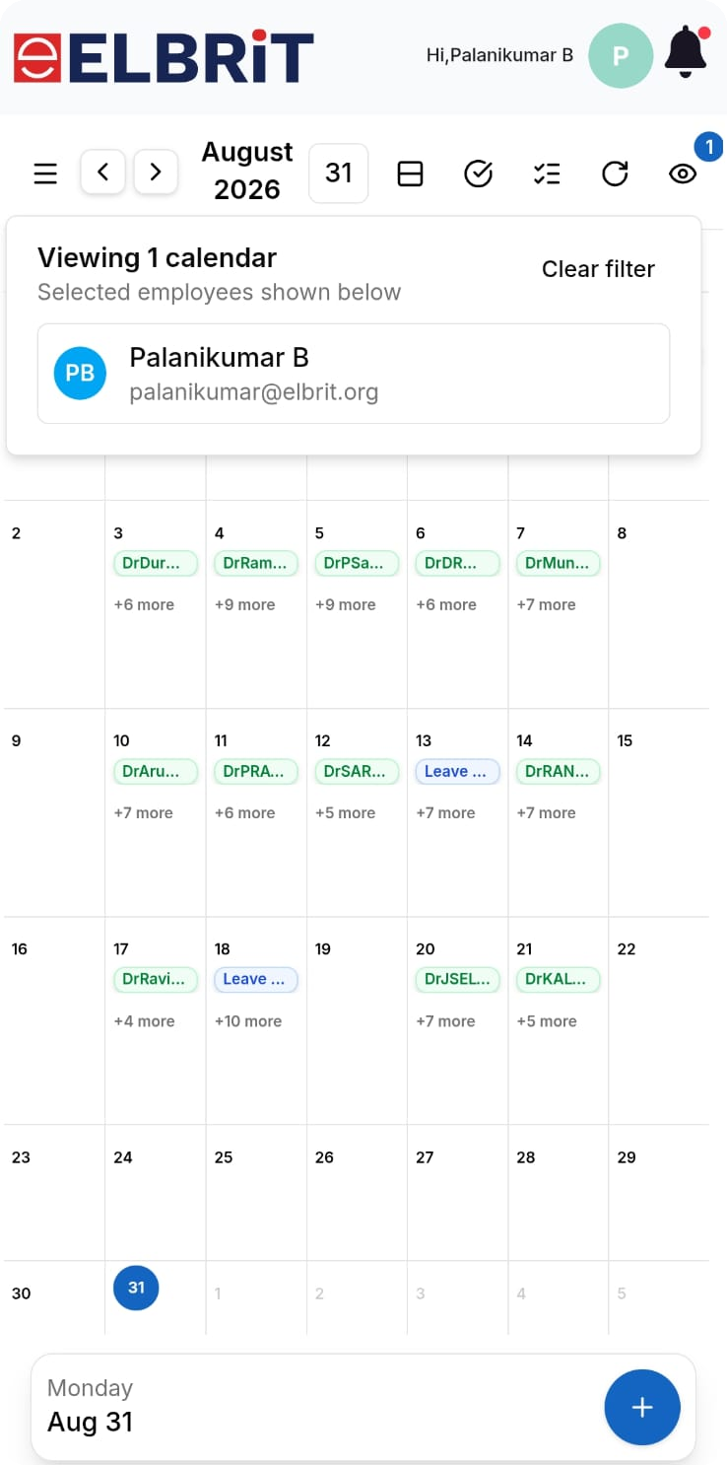
01 · WHO USES IT
Same app, two perspectives
BE
→
ABM
→
RBM
→
SM
Reporting chain — each level sees itself and everyone below it.
BE
The reporting person — plans and executes
Books their own HQ tour plan, doctor visits, leave and to-dos.
Shares each plan upward so the manager sees it without asking.
Runs the call, adds notes on the visit card and marks it Visited.
Sees only their own calendar by default.
ABM
The manager above — supervises and joins
Filters into any reporting BE's calendar and reads their month.
Joins a BE's doctor call instead of creating a duplicate entry.
Creates plans on behalf of the team and shares them down.
Schedules team meetings that land on every invitee's calendar.
BE — my own day, my own plans
ABM — switch into a BE's month
Elbrit Calendar · Mobile walkthrough
2

Slide 3
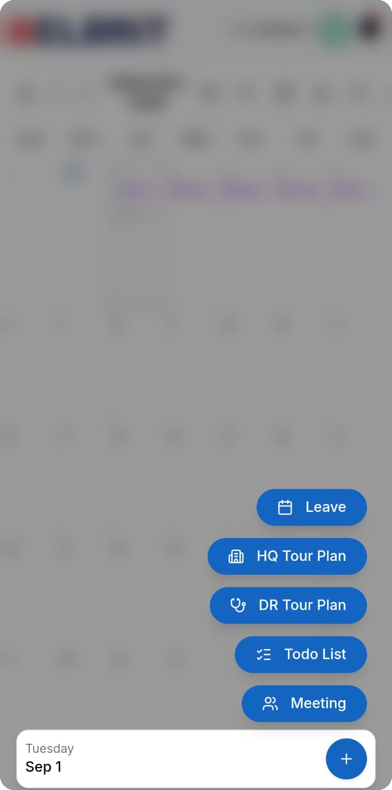
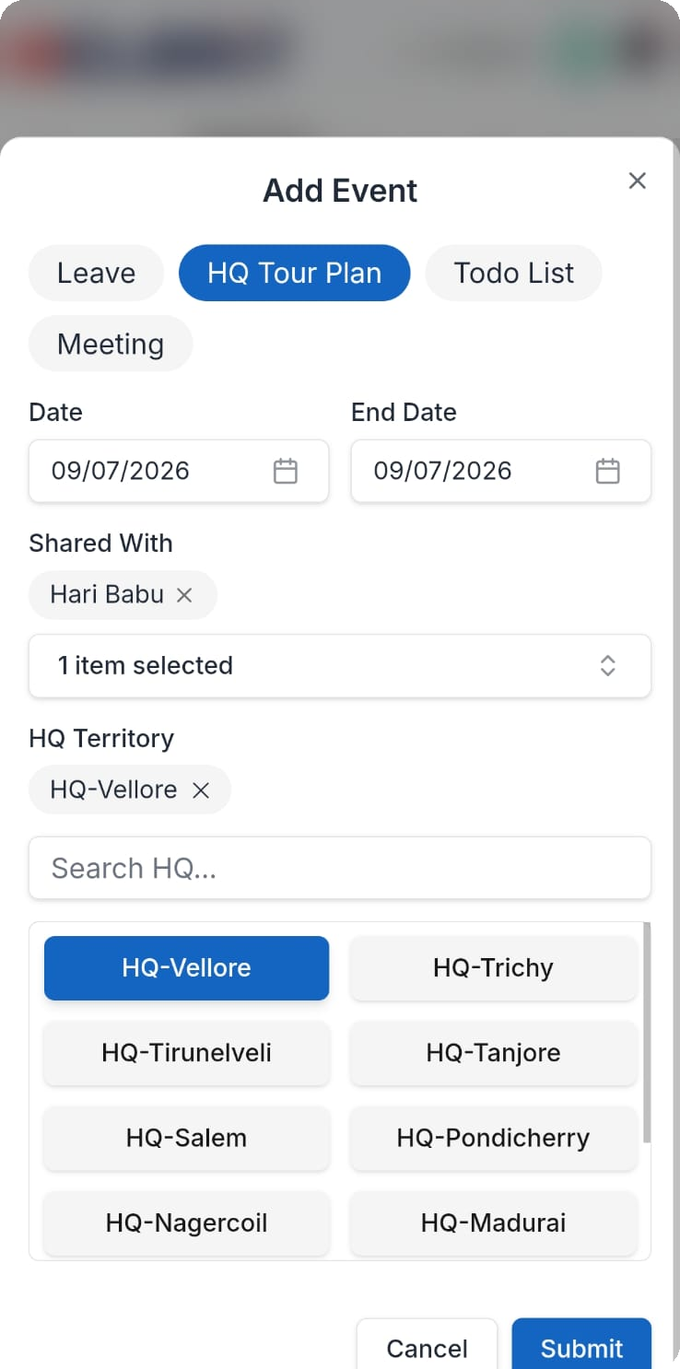
BE VIEW
02 · PLANNING THE MONTH
One + button, five kinds of event
Everything on the calendar is one of five event types, all created from the same floating + button.
1
Leave
Blocks the day. Once leave is booked the app disables adding a tour plan on that date.
2
HQ Tour Plan
The territory the BE will work in — same Date and End Date books one day, different dates repeat the plan across the range in one submit.
3
HQ Territory picker
Searchable list — Vellore, Trichy, Tirunelveli, Tanjore, Salem, Pondicherry, Nagercoil, Madurai. The selection turns blue.
4
Shared With
Adding the manager here is what makes the plan visible upward.
5
Todo List
The + button fans out five types
HQ Tour Plan — territory + dates
Personal follow-up items pinned to a date.
Elbrit Calendar · Mobile walkthrough
3

Slide 4
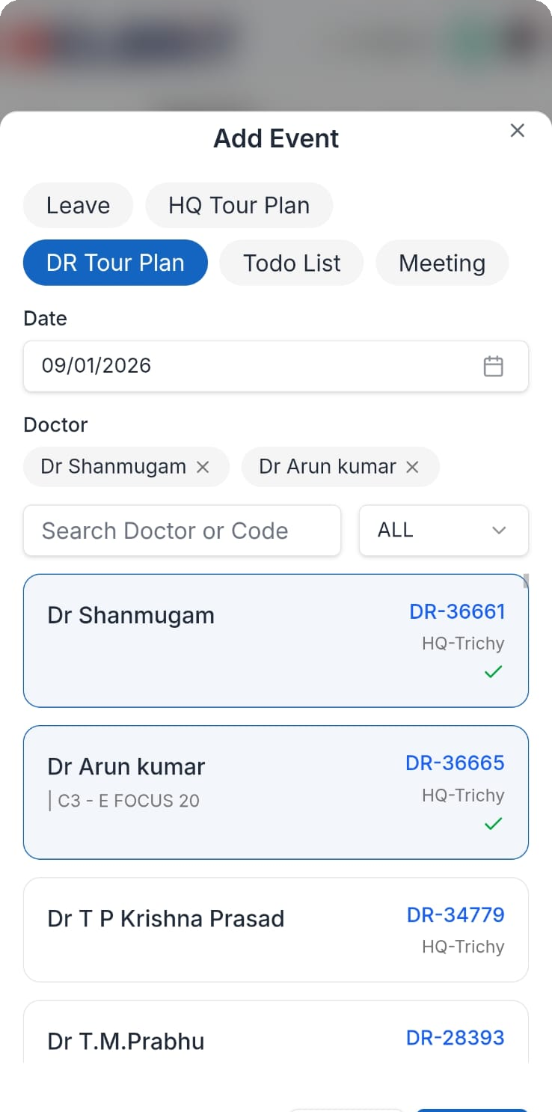
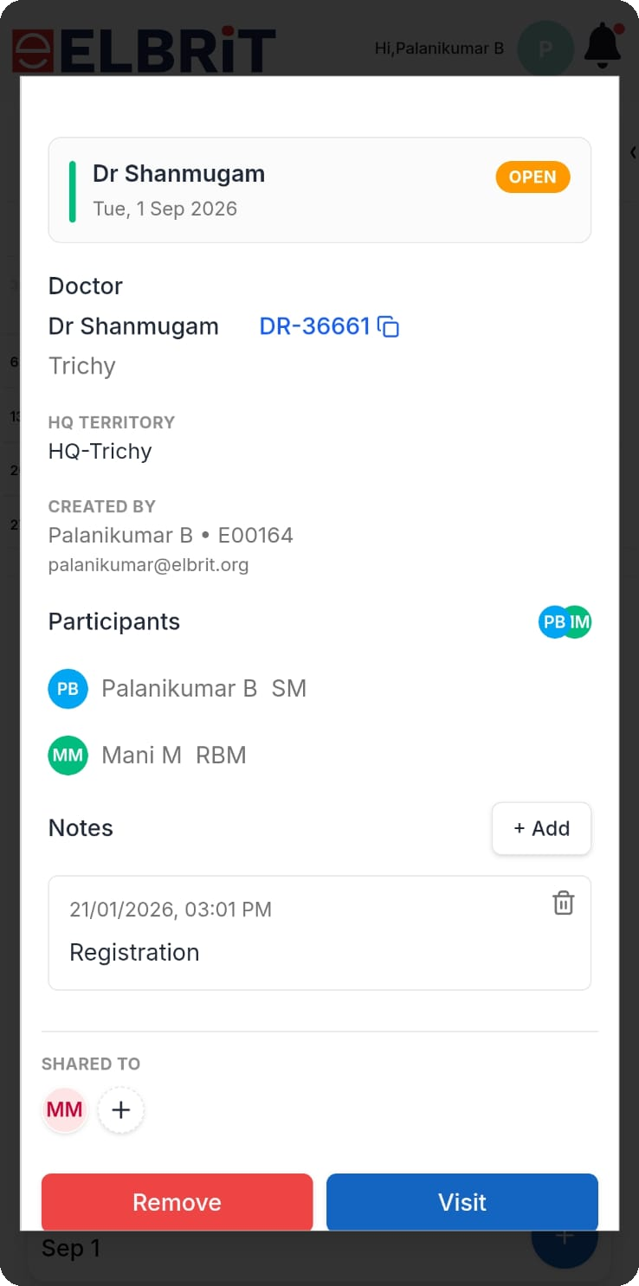
BE VIEW
03 · RUNNING THE DAY
Doctor visits — from plan to closed call
The HQ plan is the parent record; every doctor visit hangs underneath it on the same date.
1
Doctor picker
Search by name or DR code, filter by category, tick as many doctors as needed — each becomes its own visit.
2
Doctor cards
Name, unique code (DR-36661), class tag and the doctor's HQ.
3
The visit card
OPEN badge until the call is closed, with doctor, city, HQ territory and the creator's name, ID and email.
4
Notes
Time-stamped notes added before or after the call.
5
Remove / Visit
DR Tour Plan — pick the doctors
Own visit — Remove or Visit
Owner-only actions — drop the plan, or mark the call done and move it off OPEN.
Elbrit Calendar · Mobile walkthrough
4

Slide 5
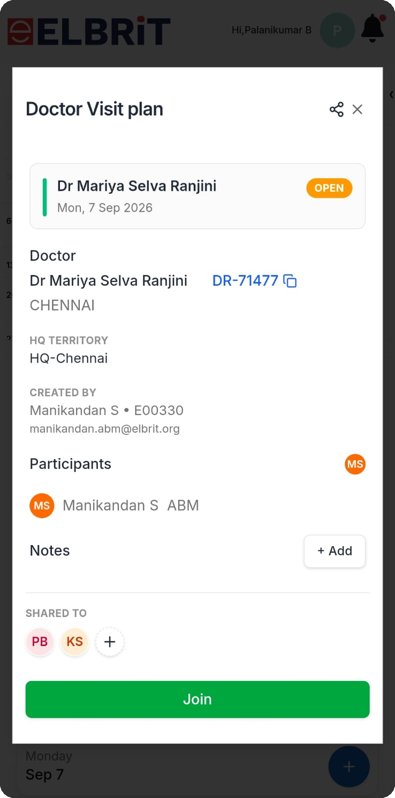
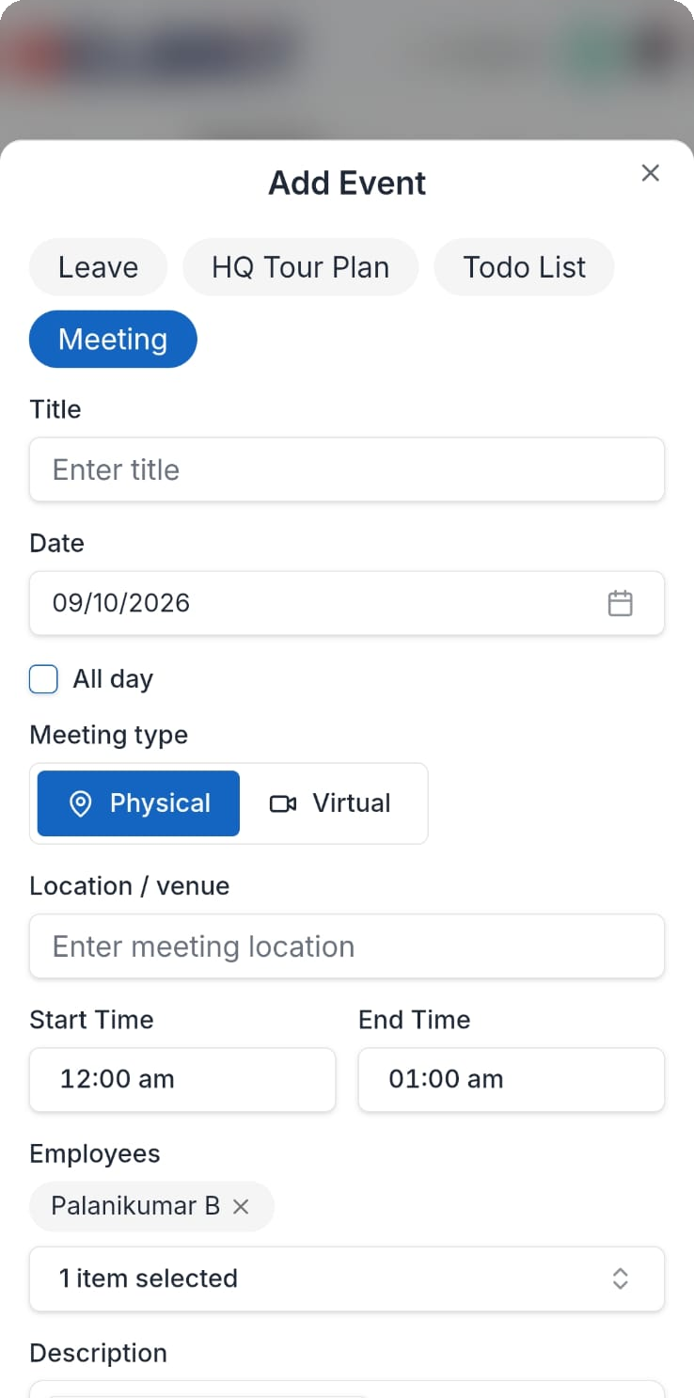
ABM VIEW
04 · SUPERVISING THE TEAM
What changes when the manager opens the app
Same screens, different rights. Ownership decides the action buttons; the filter decides whose month you are reading.
1
Join, not duplicate
On someone else's plan the red Remove becomes a green Join — joint work sits on one entry.
2
Participants and roles
Everyone on the call is listed with a role tag — SM, RBM, ABM.
3
Share downward
The share icon adds people to an existing plan at any time.
4
Team calendar filter
The eye icon opens "Viewing 1 calendar" — swap into any reporting BE's month, then Clear filter.
5
Meetings
Shared plan — the button is Join
Meeting — physical or virtual
Title, date, all-day toggle, Physical or Virtual, venue, time slot, invitees and a rich-text agenda.
Elbrit Calendar · Mobile walkthrough
5

Slide 6
05 · SUMMARY
The two journeys, side by side
BE
Plan the HQ
Add doctors
Share upward
Close the call
Territory for a date or a range
›
Multi-select the doctors for that day
›
Manager sees the plan without asking
›
Add notes, then hit Visit
ABM
Filter the team
Read the plan
Join a call
Call a meeting
Open any reporting BE's month
›
HQ, doctors, leave and gaps per day
›
One entry, two people, roles tagged
›
Invitees get it on their calendar
Guard rails built in
1
Leave blocks tour plans
2
No duplicate entries
3
Ownership is explicit
Adding an event on a date the employee is on leave is disabled.
Submitting the same plan twice for the same date is rejected.
Only the creator sees Remove; shared users see Join.
BE plans and closes. ABM reads, joins and directs. One calendar carries both.
Elbrit Calendar · Mobile walkthrough
6

