Slide 1
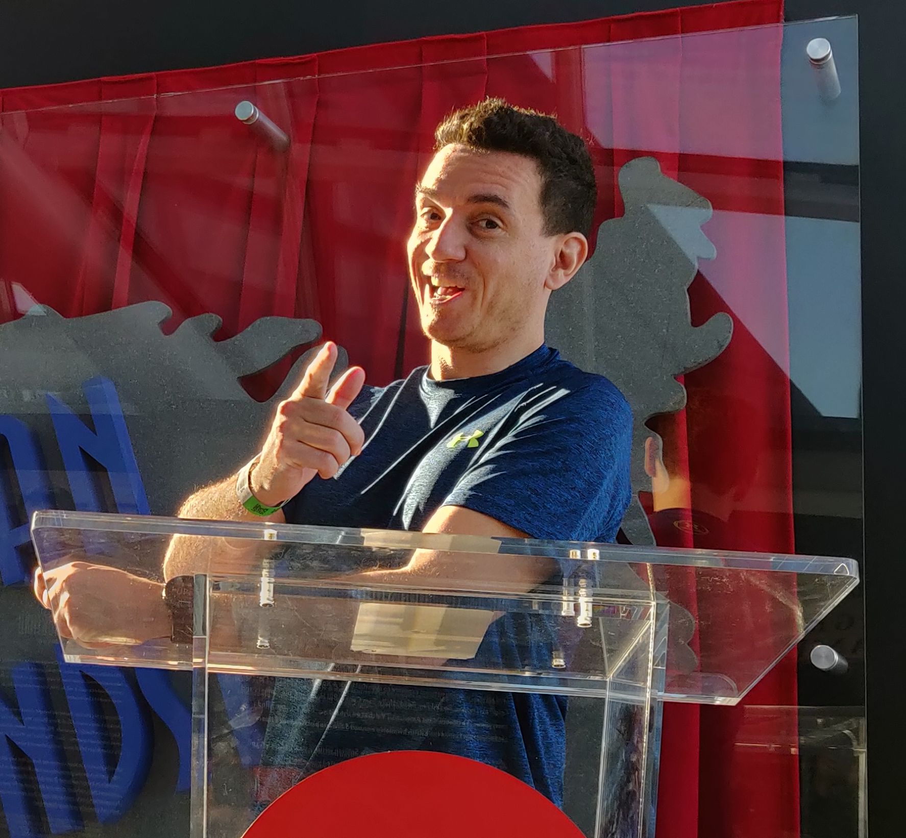
CUSTOM SKILLS / GITHUB COPILOT
From Tribal Knowledge
to Code
Custom Skills for
GitHub Copilot Modernization
Bruno Capuano
A practical, demo-driven session
Turn team knowledge into a reviewable change
Notes:
S01 | elapsed 0-3 minutes | Target: 3 minutes including host introduction
All application people, data, rules, and the audit component are synthetic.
- Every team has someone who says: yes, that code works, but we do not do it that way here
- Today we turn one of those explanations into explicit guidance and observable checks
- This is a synthetic .NET dependency/API migration, not an Azure migration
Show: PowerPoint title slide; keep unrelated desktop windows off the shared screen
Evidence: The runnable reference and legacy sample are real; independent Copilot captures are not-run
Transition: Let us start with a question: it compiles, but is it right for us?
Fallback: If the host handoff runs long, keep this introduction to one sentence
Source: docs/product-notes.md
Visual revision: v02 draft. Flare conceptual illustrations are not screenshots, run evidence, or official product artwork.
The presenter supplied the headshot for this introduction; it was embedded locally without image-service upload.
The v01 content, original slide files and original notes are preserved separately. Sunburst final-image generation has not happened.

Slide 2
THE REAL QUESTION
It compiles.
Is it right for us?
Technical
PARTNER QUOTE
Does it build?
3 x 33.35 = 100.05
Business
10% discount: -10.01
Does pricing stay correct?
Shipping: +12.00
Organizational
Total 102.04
Does it follow our rules?
A build is a starting point, not the whole review
Notes:
S02 | elapsed 3-5 minutes | Target: 2 minutes
All application people, data, rules, and the audit component are synthetic.
- Ask who has seen a successful build hide a business regression
- A partner quote for 33.35 times three should total 102.04, not just compile
- Show the rounding test early: the reference demonstrates a behavior, not agent superiority
Show: tests/Northwind.UnitTests/PricingTests.cs, midpoint case
Evidence: Concrete decimal rounding assertion and expected total 102.04
Transition: What are the explanations our team repeats when reviewing that change?
Fallback: Read the test from the file without starting a process
Source: tests/Northwind.UnitTests/PricingTests.cs
Visual revision: v02 draft. Flare conceptual illustrations are not screenshots, run evidence, or official product artwork.
The v01 content, original slide files and original notes are preserved separately. Sunburst final-image generation has not happened.

Slide 3

A FICTIONAL TEAM / A REAL PATTERN
The rules outside the prompt
R1
Pricing exceptions
Discounts and shipping thresholds
R2
Compatibility contract
Enums, nulls and field names
R3
Approved audit path
One abstraction, safe event fields
R4
Safe diagnostics
No customer data on failure
The source contains clues. The skill captures intent
Notes:
S03 | elapsed 5-7 minutes | Target: 2 minutes
All application people, data, rules, and the audit component are synthetic.
- Introduce the fictional Northwind Outfitters Quote Service
- Partner discounts start at three; shipping follows the discounted net
- Consumers expect lowercase strings and an explicit null; logs must exclude customer data
- These behaviors are visible in the legacy source; the skill makes them discoverable and repeatable
Show: knowledge/team-notes.md beside the small source tree
Evidence: Synthetic notes map to R1-R4 in knowledge/rules-catalog.md
Transition: We do not need to paste everything into every prompt
Fallback: Use the four cards and tell one short fictional team story
Source: knowledge/team-notes.md
Visual revision: v02 draft. Flare conceptual illustrations are not screenshots, run evidence, or official product artwork.
The v01 content, original slide files and original notes are preserved separately. Sunburst final-image generation has not happened.

Slide 4
FOUR TOOLS / DIFFERENT JOBS
Put knowledge where it belongs
Prompt
Today's task
Replace the library
Instructions
Project conventions
Build and safety
Skill
Specialized workflow
Rules and examples
Tests + CI
Observable evidence
Defined pass / fail
Assess > Plan > Change > Review
Use the right context, then check the result
Notes:
S04 | elapsed 7-11 minutes | Target: 4 minutes
All application people, data, rules, and the audit component are synthetic.
- A prompt states today's desired change
- Repository instructions describe conventions that apply broadly
- A skill packages a relevant workflow and supporting examples
- Tests define repeatable checks; people still decide whether the change is appropriate
Show: .github/copilot-instructions.md, then the skill directory
Evidence: Separate files with separate responsibilities; no domain-rule wall in general instructions
Transition: First, let us give the migration task without adding the specialized context
Fallback: Explain the distinction directly from this slide; no host feature depends on it
Source: https://docs.github.com/en/copilot/concepts/agents/about-agent-skills
Visual revision: v02 draft. Flare conceptual illustrations are not screenshots, run evidence, or official product artwork.
The v01 content, original slide files and original notes are preserved separately. Sunburst final-image generation has not happened.

Slide 5

DEMO / FIRST PASS
Modernize the library,
not the business rules
BASELINE / NOT-RUN
Newtonsoft.Json
System.Text.Json
Narrow change
Same observable behavior
Inspect the actual diff, whether it succeeds or fails
Notes:
S05 | elapsed 11-19 minutes | Target: 8 minutes
All application people, data, rules, and the audit component are synthetic.
- Open the isolated baseline root in a fresh app conversation, not this authoring repository
- Show the tiny working app, one request, and the exact prepared baseline prompt
- Review any real result fairly; a correct baseline is a valid outcome
- If no independent run exists, explicitly switch to the legacy/reference walkthrough
Show: Isolated baseline root; prompts/01-baseline.txt; src/Northwind.Quotes/QuoteJson.cs
Evidence: Input manifest and real output only; never call the reference a baseline capture
Transition: Now let us take one repeated explanation and make it actionable
Fallback: After 60-90 seconds, say: this is the prepared reference, not a captured Copilot run
Source: prompts/01-baseline.txt
Visual revision: v02 draft. Flare conceptual illustrations are not screenshots, run evidence, or official product artwork.
The v01 content, original slide files and original notes are preserved separately. Sunburst final-image generation has not happened.

Slide 6
FROM TEAM NOTE TO ACCEPTANCE CRITERION
Make one rule actionable
THE TEAM NOTE
THE CONTRACT
"No note yet" still
needs a property
"review_note": null
DefaultIgnoreCondition =
JsonIgnoreCondition.Never
Required field, optional value
Assert the parsed JSON shape
Preserve the contract, not the serializer defaults
Notes:
S06 | elapsed 19-23 minutes | Target: 4 minutes
All application people, data, rules, and the audit component are synthetic.
- Start with the fictional integration note: an absent review note still has a property
- Explain the difference between a preference and an observable contract
- Show the real serializer setting and the acceptance assertion
- Give one bad counterexample: ignoring nulls can silently change the response shape
Show: src/Northwind.Quotes/QuoteJson.cs and tests/Northwind.AcceptanceTests/ContractTests.cs
Evidence: Actual JsonIgnoreCondition.Never source excerpt; explicit null assertion
Transition: That rule is useful; the surrounding workflow makes it reusable
Fallback: The slide's source excerpt is copied directly by the generator
Source: src/Northwind.Quotes/QuoteJson.cs
Visual revision: v02 draft. Flare conceptual illustrations are not screenshots, run evidence, or official product artwork.
The v01 content, original slide files and original notes are preserved separately. Sunburst final-image generation has not happened.

Slide 7

THE REUSABLE SKILL
Package the know-how
SKILL.md
name: northwind-modernization
Supporting references
Pricing and contract
Audit and privacy
Review checklist
Guidance and resources, not guaranteed enforcement
Notes:
S07 | elapsed 23-27 minutes | Target: 4 minutes
All application people, data, rules, and the audit component are synthetic.
- Show the actual name and task-specific activation description
- The supporting references stay inside the skill package so exported links work
- Official docs describe relevance-based loading; this does not guarantee correct application
- The general app agent is the prepared route; dedicated Upgrade integration is unverified here
Show: .github/skills/northwind-modernization/SKILL.md and references/review-checklist.md
Evidence: Installed CLI skill inventory detects the project skill; that is not per-run activation telemetry
Transition: Now start again from the same input, with the skill supplied
Fallback: Open the files directly and disclose any explicit request to use the skill
Source: .github/skills/northwind-modernization/SKILL.md
Visual revision: v02 draft. Flare conceptual illustrations are not screenshots, run evidence, or official product artwork.
The v01 content, original slide files and original notes are preserved separately. Sunburst final-image generation has not happened.

Slide 8
DEMO / GUIDED PASS
Same task.
Explicit team context
GUIDED / NOT-RUN
Assess
18 matching source / test files
Plan
Change
+ 4 self-contained skill files
Review
Fresh conversation. Same core prompt
Change the supplied context, not the starting code
Notes:
S08 | elapsed 27-41 minutes | Target: 14 minutes
All application people, data, rules, and the audit component are synthetic.
- Open the separately exported guided root in a fresh conversation
- Show matching starting source/test manifests and the four added skill files
- Paste the exact guided prompt and inspect available evidence of skill use without inventing logs
- Evaluate both results with the same external criteria; preserve failures and interventions
Show: Guided root; prompts/02-guided.txt; external scripts/compare.ps1
Evidence: Identical starting source, smoke tests and prompt core; different supplied context
Transition: Let us compare evidence rather than impressions
Fallback: Use the reference walkthrough with unit/acceptance tests; say no independent guided output was captured
Source: scripts/export-demo.ps1
Visual revision: v02 draft. Flare conceptual illustrations are not screenshots, run evidence, or official product artwork.
The v01 content, original slide files and original notes are preserved separately. Sunburst final-image generation has not happened.

Slide 9

WHAT WE WILL CHECK
Compare evidence,
not impressions
BASELINE + GUIDED: NOT-RUN
Migration + build
Pricing + JSON contract
Audit + diagnostics
Diff scope + review
No captured runs. No declared winner
Notes:
S09 | elapsed 41-44 minutes | Target: 3 minutes
All application people, data, rules, and the audit component are synthetic.
- Both independent capture manifests currently say not-run
- Show the real not-run report rather than a placeholder success table
- The reference passes defined checks but is not evidence of generated-agent performance
- If both future candidates pass, show that; if guided fails, preserve and diagnose it
Show: demos/captures/baseline.json, guided.json; actual comparison.md
Evidence: Four allowed statuses: pass, fail, not-run, blocked; finite checks are not a compliance guarantee
Transition: The reusable asset is not a winning screenshot; it is a shared team practice
Fallback: Keep the checklist and explicitly say the independent experiment has not run
Source: scripts/compare.ps1
Visual revision: v02 draft. Flare conceptual illustrations are not screenshots, run evidence, or official product artwork.
The v01 content, original slide files and original notes are preserved separately. Sunburst final-image generation has not happened.

Slide 10
THE MAINTENANCE LOOP
Make it a team practice
Version + own
Review
One accountable owner
Intent, examples, tests
Maintain
Reuse
Learn from real failures
Try another small change
Skills guide. Tests check. People decide
Notes:
S10 | elapsed 44-47 minutes | Target: 3 minutes
All application people, data, rules, and the audit component are synthetic.
- Put the skill and examples under source control with the code they guide
- Assign an owner and update examples when the contract changes
- Review skills as executable-workflow guidance, including scripts and tool permissions
- The optional reuse prompt is a stretch exercise, not a second application
Show: docs/maintenance.md; optionally prompts/04-reuse.txt without executing it
Evidence: Rule-to-test ownership and change checklist, not promised deterministic generation
Transition: You can start much smaller than a complete company standards catalog
Fallback: Cut the optional reuse explanation if time is short
Source: docs/maintenance.md
Visual revision: v02 draft. Flare conceptual illustrations are not screenshots, run evidence, or official product artwork.
The v01 content, original slide files and original notes are preserved separately. Sunburst final-image generation has not happened.

Slide 11
YOUR FIRST SKILL
Start with one
repeated explanation
One task
One rule
One example
Small enough to check
Pick one task. Capture one rule. Review. Reuse
Notes:
S11 | elapsed 47-50 minutes | Target: 3 minutes
All application people, data, rules, and the audit component are synthetic.
- Choose one modernization task you already understand
- Write down the rule you explain every code review
- Add a good example, a counterexample, and evidence that would convince a reviewer
- Reuse it on another small change and refine it from actual failures
Show: Skill reference checklist; keep focus on the attendee's first next action
Evidence: One actionable rule can be checked; a vague paragraph cannot
Transition: Here are the resources and the three things I hope you take away
Fallback: Give the closing action verbatim and move to resources
Source: .github/skills/northwind-modernization/references/review-checklist.md
Visual revision: v02 draft. Flare conceptual illustrations are not screenshots, run evidence, or official product artwork.
The v01 content, original slide files and original notes are preserved separately. Sunburst final-image generation has not happened.

Slide 12
RESOURCES / Q&A
Try the workflow
Official agent skills docs
Q&A
docs.github.com
Official upgrade docs
Sample link pending
public verification
learn.microsoft.com
Make knowledge explicit. Check behavior. Reuse what works
Notes:
S12 | elapsed 50-52 minutes | Target: 2 minutes, then keep visible for Q&A until minute 60
All application people, data, rules, and the audit component are synthetic.
- The attendee repository is staged locally; its public URL must be verified before delivery
- Official skills and upgrade documentation are linked in the notes and resources file
- Close: pick one modernization task, capture one repeated rule, encode it in a skill, review, reuse
- Keep this slide visible for Q&A; do not claim public availability until it is verified
Show: docs/resources.md; Q&A answers in demos/runbook.md
Evidence: Verified official links; no fabricated sample URL or QR code
Transition: What is one rule your team keeps explaining?
Fallback: Direct attendees to the official docs; say the sample link will be supplied after access is verified
Source: https://docs.github.com/en/copilot/concepts/agents/about-agent-skills
https://docs.github.com/en/copilot/concepts/agents/about-agent-skills
https://learn.microsoft.com/en-us/dotnet/core/porting/github-copilot-upgrade/overview
Visual revision: v02 draft. Flare conceptual illustrations are not screenshots, run evidence, or official product artwork.
The v01 content, original slide files and original notes are preserved separately. Sunburst final-image generation has not happened.

