Slide 1
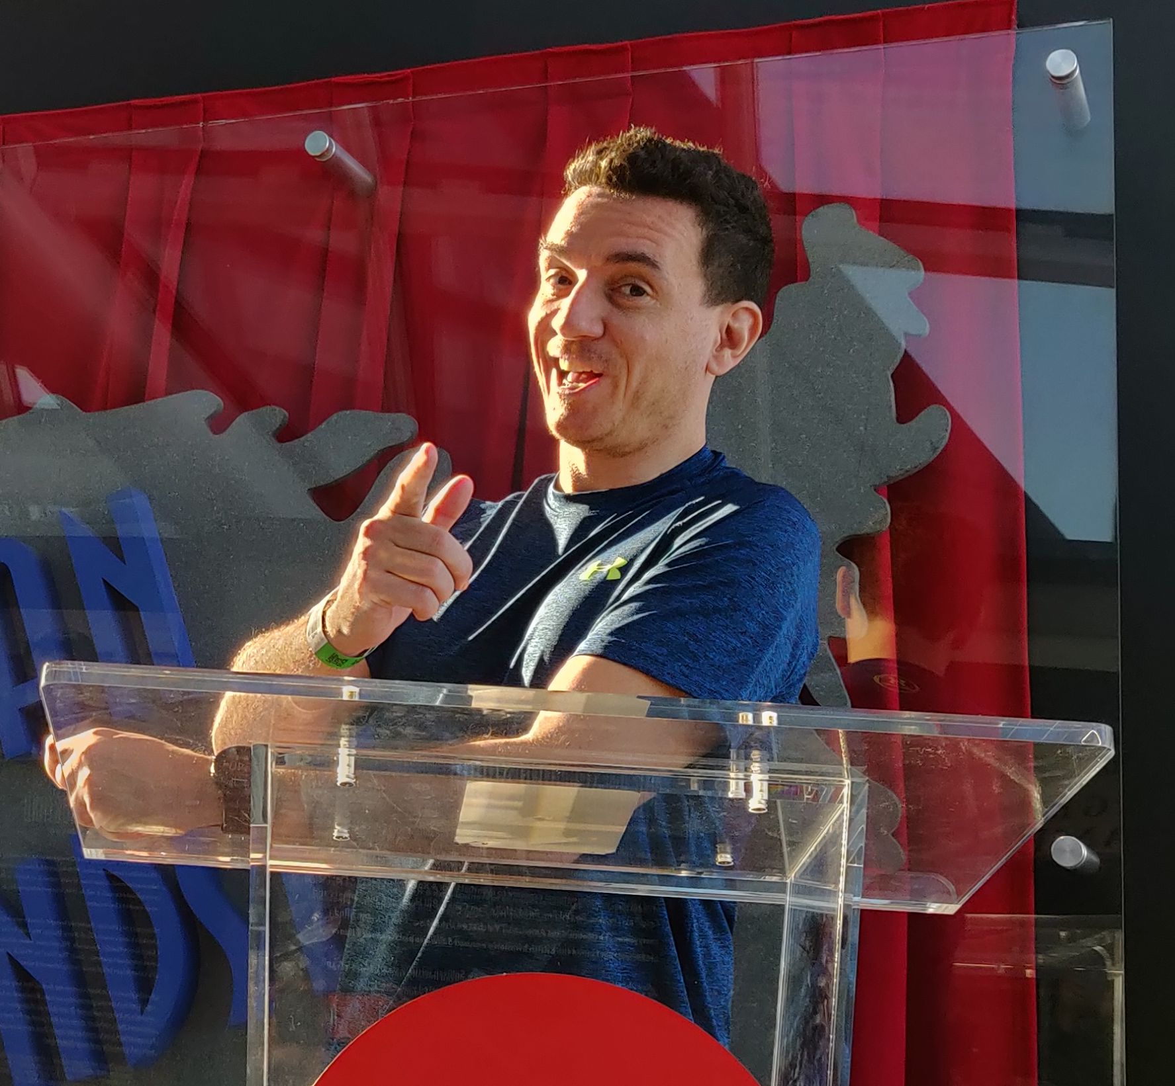
CUSTOM SKILLS / FIVE LIVE DEMOS
From Tribal Knowledge
to Code
Custom Skills for
GitHub Copilot Modernization
Bruno Capuano
One app. One skill. Five demos
Create a skill. Apply it. Test its limits. Reuse it
Notes:
S01 | elapsed 0-3 minutes | Set the challenge
Designed timing, not a measured human rehearsal. All application data, people and policies are synthetic.
- Introduce yourself and the recurring explanation: it works, but we do not do it that way here
- One synthetic .NET app, one reusable skill and five demos; slides are bookmarks, not the main event
- The app is local; independent Copilot generation needs an enabled account and network
- Prepared checkpoints and reference tests are real, but are not independent agent captures
Show: Title, local presenter photo, then the small app tree
Evidence: Seven labeled teaching checkpoints; generation status remains not-run
Transition: First, state only the technology change
Fallback: Keep the introduction to one minute if the host handoff runs long
Source: demos/v03/session.json
Presenter commands and spoken cues: demos/v03/runbook.md and demos/v03/demo-script.md
Visuals: original conceptual Flare illustrations, not screenshots, agent evidence or official product artwork. Presenter supplied the local headshot; it was not uploaded for generation.

Slide 2

DEMO 1 / TRY THE TASK
Modernize the library,
keep the behavior
BASELINE CAPTURE: NOT-RUN
Newtonsoft.Json
System.Text.Json
Working input
Inspect actual changes
A correct baseline is a valid result
Notes:
S02 | elapsed 3-8 minutes | Task without the organizational skill
Designed timing, not a measured human rehearsal. All application data, people and policies are synthetic.
- Open 01-baseline alone in a fresh conversation and run its smoke tests and partner request
- Point out total 270, explicit null and the separate audit event; the starting app works
- Explain the midpoint example: 100.05 subtotal minus 10.01 discount plus 12 shipping equals 102.04
- Paste prompts/01-baseline.txt exactly; inspect actual changes without presuming a failure
- At minute 8 move on; do not spend the session waiting on one generation
Show: 01-baseline source, real terminal output and the exact baseline prompt
Checkpoint: 01-baseline
Exact prompt: prompts/01-baseline.txt
Evidence: Legacy behavior is already correct; only real generated output can count as an agent result
Transition: Now package the team's intent rather than repeating it in every prompt
Fallback: After 60-90 seconds of unproductive waiting, show 04-reference and identify it as prepared
Source: prompts/01-baseline.txt
Presenter commands and spoken cues: demos/v03/runbook.md and demos/v03/demo-script.md
Visuals: original conceptual Flare illustrations, not screenshots, agent evidence or official product artwork. Presenter supplied the local headshot; it was not uploaded for generation.

Slide 3

DEMO 2 / SYNTHETIC TEAM KNOWLEDGE
Start with the explanations
your team repeats
R1 Pricing exceptions
R2 JSON compatibility
R3 Approved audit path
R4 Safe diagnostics
Real requirements need examples and observable checks
Notes:
S03 | elapsed 8-10 minutes | Build and review the skill with Copilot
Designed timing, not a measured human rehearsal. All application data, people and policies are synthetic.
- Switch to 02-author-skill, which has legacy code and synthetic team notes but no prewritten project skill
- Highlight pricing exceptions, wire compatibility, audit conventions and safe diagnostics
- The source already contains clues; the task is to make intent discoverable, not invent policy
- Use demos/v03/prompts/02-author-skill.txt to ask Copilot to author guidance only, not change application code
Show: knowledge/team-notes.md beside the small source tree
Checkpoint: 02-author-skill
Exact prompt: demos/v03/prompts/02-author-skill.txt
Evidence: Four synthetic requirements mapped to R1-R4
Transition: Give this knowledge a portable home
Fallback: Read one null-field note aloud and use the prepared skill to explain its translation
Source: knowledge/team-notes.md
Presenter commands and spoken cues: demos/v03/runbook.md and demos/v03/demo-script.md
Visuals: original conceptual Flare illustrations, not screenshots, agent evidence or official product artwork. Presenter supplied the local headshot; it was not uploaded for generation.

Slide 4

DEMO 2 / AUTHOR THE SKILL
Build a reusable package
SKILL.md
name: northwind-modernization
When to apply it
Workflow and references
What evidence to report
Keep the workflow focused and its references portable
Notes:
S04 | elapsed 10-14 minutes | Build and review the skill with Copilot
Designed timing, not a measured human rehearsal. All application data, people and policies are synthetic.
- Show the actual skill Copilot created, or explicitly switch to the prepared version
- Explain name and task-specific description, then inspect-first steps and concrete examples
- Keep references inside the skill directory so the exported package has no broken links
- Reject broad tool permissions, invented requirements and unrelated implementation changes
Show: .github/skills/northwind-modernization/SKILL.md and its references directory
Checkpoint: 02-author-skill
Exact prompt: demos/v03/prompts/02-author-skill.txt
Evidence: Documented repository skill structure; the package has four files
Transition: Before using generated guidance, review it like code
Fallback: Open the reviewed skill in 03-guided; call it prepared and explain one rule live
Source: https://docs.github.com/en/copilot/concepts/agents/about-agent-skills
Presenter commands and spoken cues: demos/v03/runbook.md and demos/v03/demo-script.md
Visuals: original conceptual Flare illustrations, not screenshots, agent evidence or official product artwork. Presenter supplied the local headshot; it was not uploaded for generation.

Slide 5
DEMO 2 / REVIEW BEFORE REUSE
When should it apply?
What would convince us?
Description
Relevant task and scope
Requirements
Concrete rules and examples
Workflow
Migration, repair or reuse
Evidence
Real checks and limitations
A description supports selection, not guaranteed adherence
Notes:
S05 | elapsed 14-18 minutes | Build and review the skill with Copilot
Designed timing, not a measured human rehearsal. All application data, people and policies are synthetic.
- Check that the description covers migration, contract repair and small serialization reuse
- Inspect an actionable R2 rule: explicit null property, good and bad examples, unchanged assertion
- Review migration versus repair versus reuse branches so unrelated tasks do not trigger dependency changes
- Announce the prepared reviewed skill handoff into 03-guided instead of silently substituting files
- A live-authored variation is fine for teaching, but is not the predefined comparison input
Show: Skill frontmatter, concrete traps, workflow branches and review checklist
Checkpoint: 02-author-skill
Exact prompt: demos/v03/prompts/02-author-skill.txt
Evidence: Skill text and real tests, not claims about hidden activation telemetry
Transition: Start again with the same input and explicit team context
Fallback: Use the prepared checklist and stop the skill-authoring segment at minute 18
Source: .github/skills/northwind-modernization/SKILL.md
Presenter commands and spoken cues: demos/v03/runbook.md and demos/v03/demo-script.md
Visuals: original conceptual Flare illustrations, not screenshots, agent evidence or official product artwork. Presenter supplied the local headshot; it was not uploaded for generation.

Slide 6
DEMO 3 / APPLY THE SKILL
Same task.
Explicit team context
GUIDED CAPTURE: NOT-RUN
Assess
18 matching input files
Plan
Change
+ 4 reviewed skill files
Review
Fresh conversation. Explicit request
Inspect the real diff and run the same checks
Notes:
S06 | elapsed 18-30 minutes | Apply the skill to modernization
Designed timing, not a measured human rehearsal. All application data, people and policies are synthetic.
- Use 03-guided as its own project and a fresh conversation, never the parent folder
- Show the 18 matching legacy source/test files and four added skill files
- Paste prompts/02-guided.txt; it explicitly requests the skill
- Show only activation or file-access evidence the host actually exposes; availability alone is not use
- Run visible tests and external evaluation if there is a completed candidate
- Do not replace a candidate with the reference and call it generated output
Show: Guided prompt, skill, real diff, test output and scripts/evaluate.ps1
Checkpoint: 03-guided
Exact prompt: prompts/02-guided.txt
Evidence: Baseline and guided independent captures are currently not-run; no claimed winner
Transition: A good skill still needs a way to catch mistakes
Fallback: Run real tests in 04-reference and label it authored reference; move on at minute 30
Source: prompts/02-guided.txt
Presenter commands and spoken cues: demos/v03/runbook.md and demos/v03/demo-script.md
Visuals: original conceptual Flare illustrations, not screenshots, agent evidence or official product artwork. Presenter supplied the local headshot; it was not uploaded for generation.

Slide 7
DEMO 4 / INTRODUCE A TEACHING BUG
One option.
A broken contract
THE CONTRACT
THE TEACHING BUG
"review_note": null
WhenWritingNull
Required field
Optional value
Property disappears
The assertion catches it
Deliberately introduced, not a captured Copilot mistake
Notes:
S07 | elapsed 30-32 minutes | Reproduce and repair a deliberate contract regression
Designed timing, not a measured human rehearsal. All application data, people and policies are synthetic.
- Disclose the intentional regression before showing the red test
- Open 05-null-regression and show WhenWritingNull in the serializer options
- Run SerializationTests.PreservesExplicitNull with a build of current code
- Read the real assertion about review_note existing even when its value is null
Show: Faulted setting and unchanged null-contract test
Checkpoint: 05-null-regression
Exact prompt: demos/v03/prompts/04-repair.txt
Evidence: Scripted rehearsal observes the exact intended assertion, not an arbitrary nonzero exit
Transition: Use the skill to explain and repair the mismatch
Fallback: The broken checkpoint is already prepared; do not break the source repository
Source: tests/Northwind.UnitTests/SerializationTests.cs
Presenter commands and spoken cues: demos/v03/runbook.md and demos/v03/demo-script.md
Visuals: original conceptual Flare illustrations, not screenshots, agent evidence or official product artwork. Presenter supplied the local headshot; it was not uploaded for generation.

Slide 8
DEMO 4 / REPAIR AND VERIFY
Keep the test.
Repair the implementation
Reproduce
Repair
Verify
Read the actual
failed assertion
Restore null handling
Keep the assertion
Same test, then
the full suite
Prepared red / green exercise, not agent-performance evidence
Skills carry intent. Tests detect defined regressions
Notes:
S08 | elapsed 32-37 minutes | Reproduce and repair a deliberate contract regression
Designed timing, not a measured human rehearsal. All application data, people and policies are synthetic.
- Paste demos/v03/prompts/04-repair.txt and require reproduction before changes
- Reject removing or weakening the assertion as a fix
- After the minimal repair, run the exact same focused test and then the full suite
- If using set-demo-null-rule.ps1, disclose the scripted repair rather than calling it agent-generated
- These finite checks do not guarantee universal compliance
Show: Focused failure, serializer repair, same test passing and full-suite result
Checkpoint: 05-null-regression
Exact prompt: demos/v03/prompts/04-repair.txt
Evidence: Actual prepared-fixture red/green rehearsal; no fabricated agent run
Transition: Can the same skill help with a different task?
Fallback: Use the guarded scripted repair and show real tests; hard stop at minute 37
Source: scripts/set-demo-null-rule.ps1
Presenter commands and spoken cues: demos/v03/runbook.md and demos/v03/demo-script.md
Visuals: original conceptual Flare illustrations, not screenshots, agent evidence or official product artwork. Presenter supplied the local headshot; it was not uploaded for generation.

Slide 9
DEMO 5 / REUSE THE KNOWLEDGE
A new task.
The same contract
Two existing responses
One JSON array
Same output options
Same per-item contract
Order stays intact
Empty input: []
Null input: reject
No changes to CLI, pricing or audit
Reuse output options, not another wall of instructions
Notes:
S09 | elapsed 37-45 minutes | Reuse the skill for batch serialization
Designed timing, not a measured human rehearsal. All application data, people and policies are synthetic.
- Start a fresh conversation in 06-reuse-start and paste demos/v03/prompts/05-reuse.txt
- Add WriteBatch for existing responses without changing CLI, pricing, audit or dependencies
- Preserve item order, field names, string enums, numeric money and explicit null
- Check empty input produces an array and a null collection throws
- Check actual executed test counts; a filter matching zero tests is not success
- Prepared 07-reuse-complete has three focused tests and the full contract suite
Show: Small batch method and focused per-item equivalence tests
Checkpoint: 06-reuse-start
Exact prompt: demos/v03/prompts/05-reuse.txt
Evidence: Existing CLI, domain and audit source stay hash-identical in the prepared reuse checkpoint
Transition: Name the pieces you just watched work together
Fallback: At the cutoff, switch to 07-reuse-complete, disclose it and run its real tests
Source: demos/v03/prompts/05-reuse.txt
Presenter commands and spoken cues: demos/v03/runbook.md and demos/v03/demo-script.md
Visuals: original conceptual Flare illustrations, not screenshots, agent evidence or official product artwork. Presenter supplied the local headshot; it was not uploaded for generation.

Slide 10
RECAP / WHAT YOU JUST USED
Four tools, different jobs
Prompt
Immediate task
Instructions
Broad project conventions
Skill
Relevant workflow and resources
Tests
Observable behavior
Context guides the work; evidence supports the review
Notes:
S10 | elapsed 45-47 minutes | Context choices and team ownership
Designed timing, not a measured human rehearsal. All application data, people and policies are synthetic.
- The prompt stated the immediate task
- Instructions supplied broad project conventions
- The skill supplied a relevant workflow, examples and resources
- Tests checked observable cases; a person still reviewed scope and intent
- Keep this recap short: attendees have already seen the distinctions live
Show: Prompt, instructions, skill package and test files as concrete examples
Evidence: Different files with distinct responsibilities
Transition: Make the skill a maintained team asset
Fallback: Give the four definitions in one sentence and protect Q&A
Source: https://docs.github.com/en/copilot/concepts/agents/about-agent-skills
Presenter commands and spoken cues: demos/v03/runbook.md and demos/v03/demo-script.md
Visuals: original conceptual Flare illustrations, not screenshots, agent evidence or official product artwork. Presenter supplied the local headshot; it was not uploaded for generation.

Slide 11
YOUR NEXT STEP / ONE REPEATED EXPLANATION
Make it a team practice
Version + own
Review
One accountable owner
Intent, examples, tests
Maintain
Reuse
Learn from real failures
Another small change
Pick one task. Capture one rule. Check it. Reuse it
Notes:
S11 | elapsed 47-50 minutes | Context choices and team ownership
Designed timing, not a measured human rehearsal. All application data, people and policies are synthetic.
- Version the skill with the code, give it an owner and review changes
- Update examples and tests when the business contract changes
- Start with a narrow task rather than a company-wide standards catalog
- Close with one repeated explanation the attendee can encode tomorrow
Show: Editable ownership/review/reuse/maintenance loop
Evidence: Maintenance checklist rather than a promise of deterministic generation
Transition: Here is the complete kit; what would your first skill capture?
Fallback: Close in one minute if needed; reach resources at minute 50
Source: docs/maintenance.md
Presenter commands and spoken cues: demos/v03/runbook.md and demos/v03/demo-script.md
Visuals: original conceptual Flare illustrations, not screenshots, agent evidence or official product artwork. Presenter supplied the local headshot; it was not uploaded for generation.

Slide 12
RESOURCES / Q&A
Try the five-demo workflow
The complete local demo kit
github.com/elbruno/GitHubCopilotModernizationSamples
Official agent skills docs
Q&A
docs.github.com
Create a skill. Apply it. Test its limits. Reuse it
Notes:
S12 | elapsed 50-60 minutes | Resources and protected Q&A
Designed timing, not a measured human rehearsal. All application data, people and policies are synthetic.
- Keep the public sample and official documentation visible for the protected ten-minute Q&A
- The repository includes seven local checkpoints, exact prompts, real tests, notes and fallbacks
- Publication must be verified independently of generation and deck QA
- A correct baseline or imperfect guided run is legitimate; no forced success story
- Human rehearsal and actual independent agent captures remain separate pending activities
Show: Public sample URL and official agent-skills link
Evidence: Use the publication receipt and signed-out access check, not a guessed URL
Transition: What is one rule your team keeps explaining?
Fallback: If audience access fails, share official docs and resolve sample access after the session
Source: https://docs.github.com/en/copilot/concepts/agents/about-agent-skills
Presenter commands and spoken cues: demos/v03/runbook.md and demos/v03/demo-script.md
Visuals: original conceptual Flare illustrations, not screenshots, agent evidence or official product artwork. Presenter supplied the local headshot; it was not uploaded for generation.
https://github.com/elbruno/GitHubCopilotModernizationSamples
https://docs.github.com/en/copilot/concepts/agents/about-agent-skills

