Slide 1
Big Data Analytics for Discovering Electricity Consumption Patterns in Smart Cities
The new methodology to uncover patterns in big data time series
Presented by:
Alyakaev Kamil
Ushakov Stanislav

Slide 2
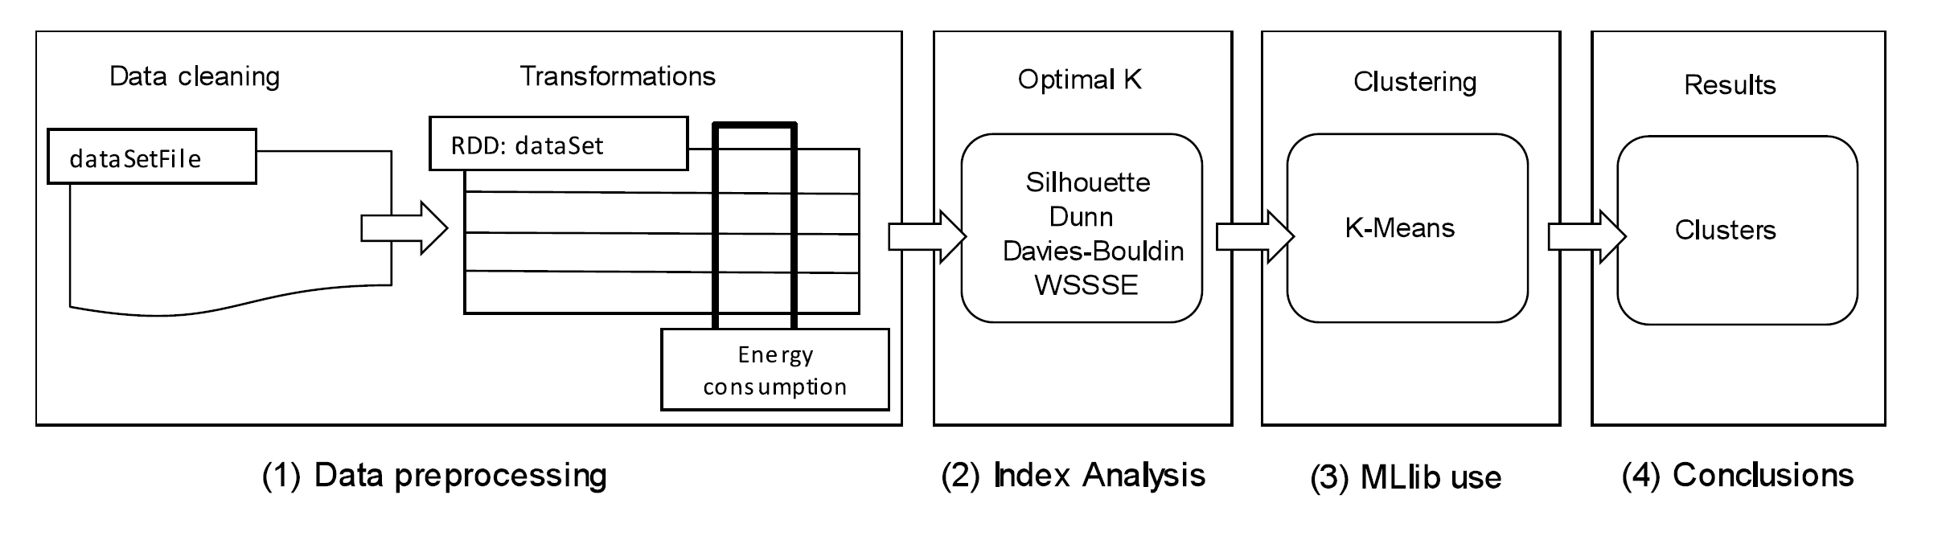
Methodology description

Slide 3
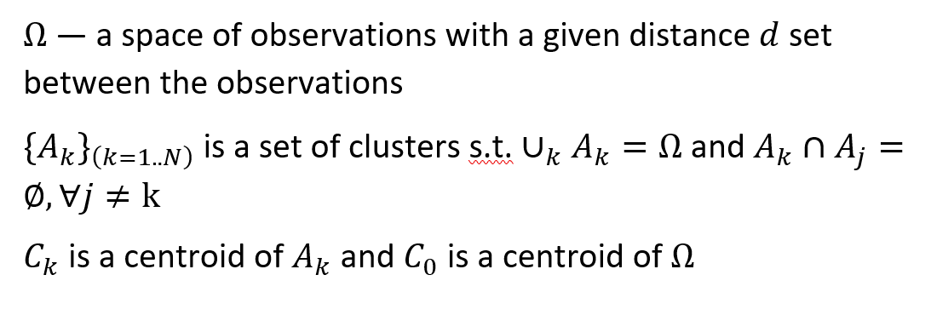
Variables

Slide 4
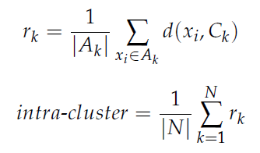


I. Cluster Validity Indices — CVI’s

Slide 5
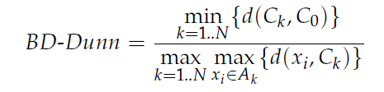
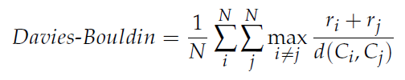
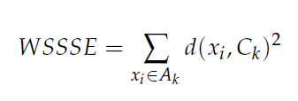
II. Cluster Validity Indices — CVI’s

Slide 6
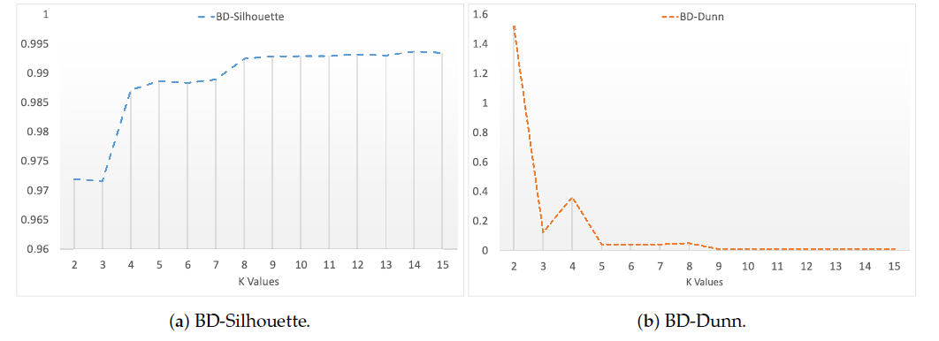
III. Cluster Validity Indices — CVI’s

Slide 7
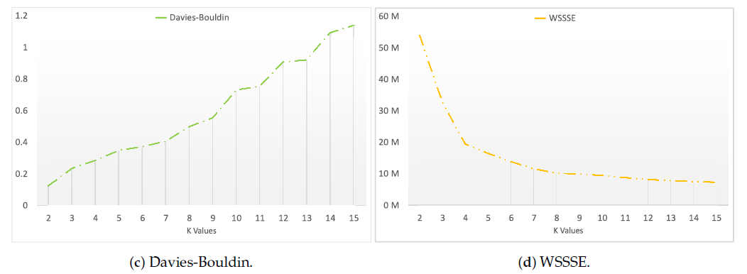
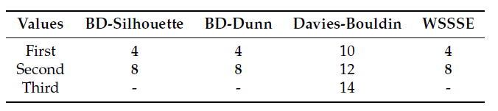
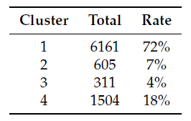
IV. Cluster Validity Indices — CVI’s

Slide 8
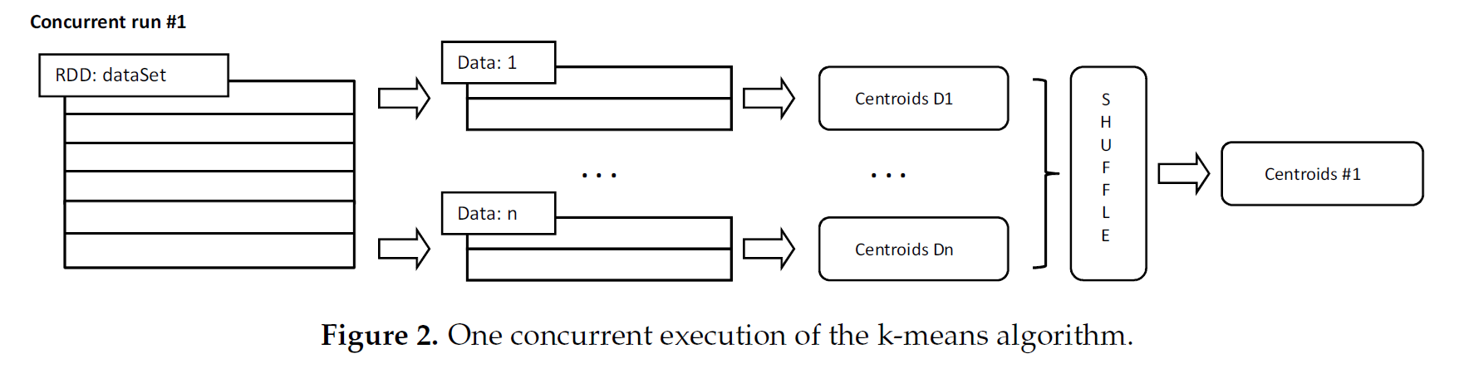
K-means

Slide 9
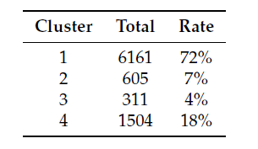
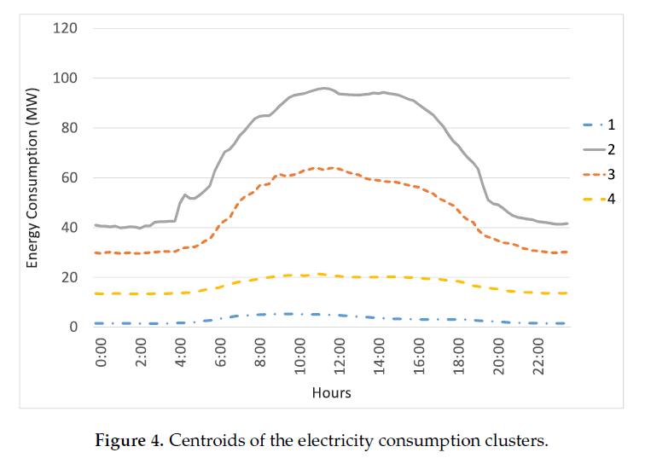
Clustering Results

Slide 10
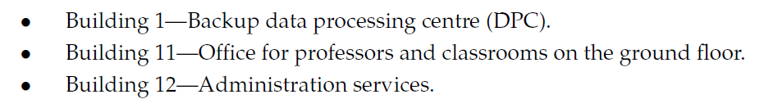
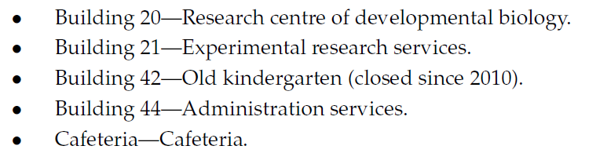
Preprocessing

Slide 11
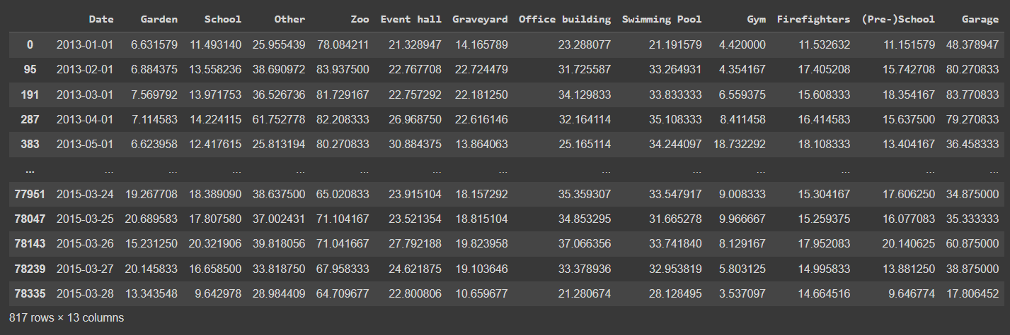
Our Preprocessing
• No instance of RDD variable was left for us to compare
• Missing values pre-processing was not specified
• Million of observations is not something google colab (or any IDE at that) can easily handle

Slide 12
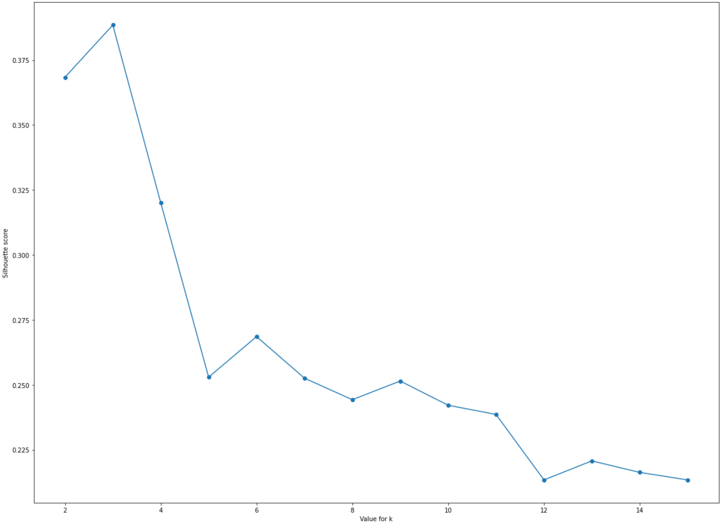
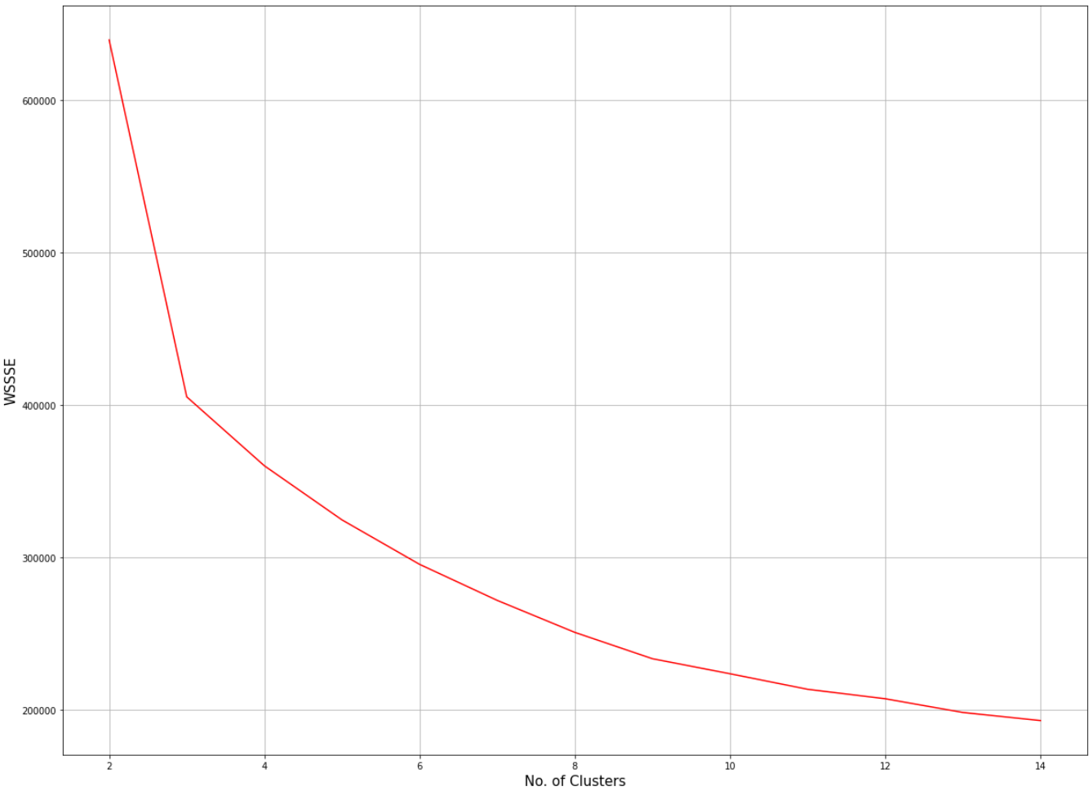
I. Our CVI’s
(a) BD-Silhouette.
(b) WSSSE

Slide 13
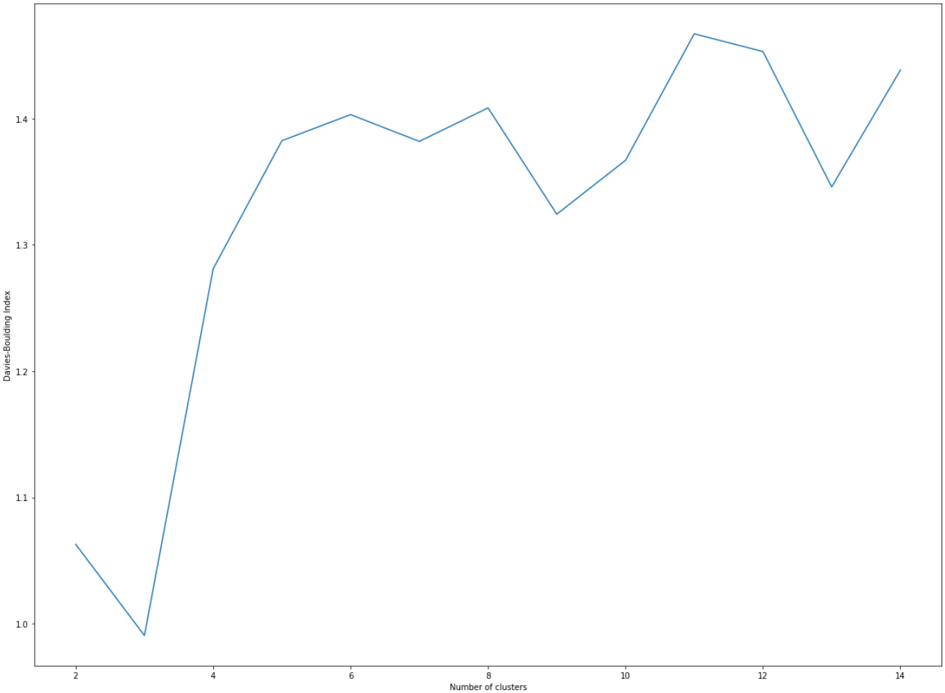
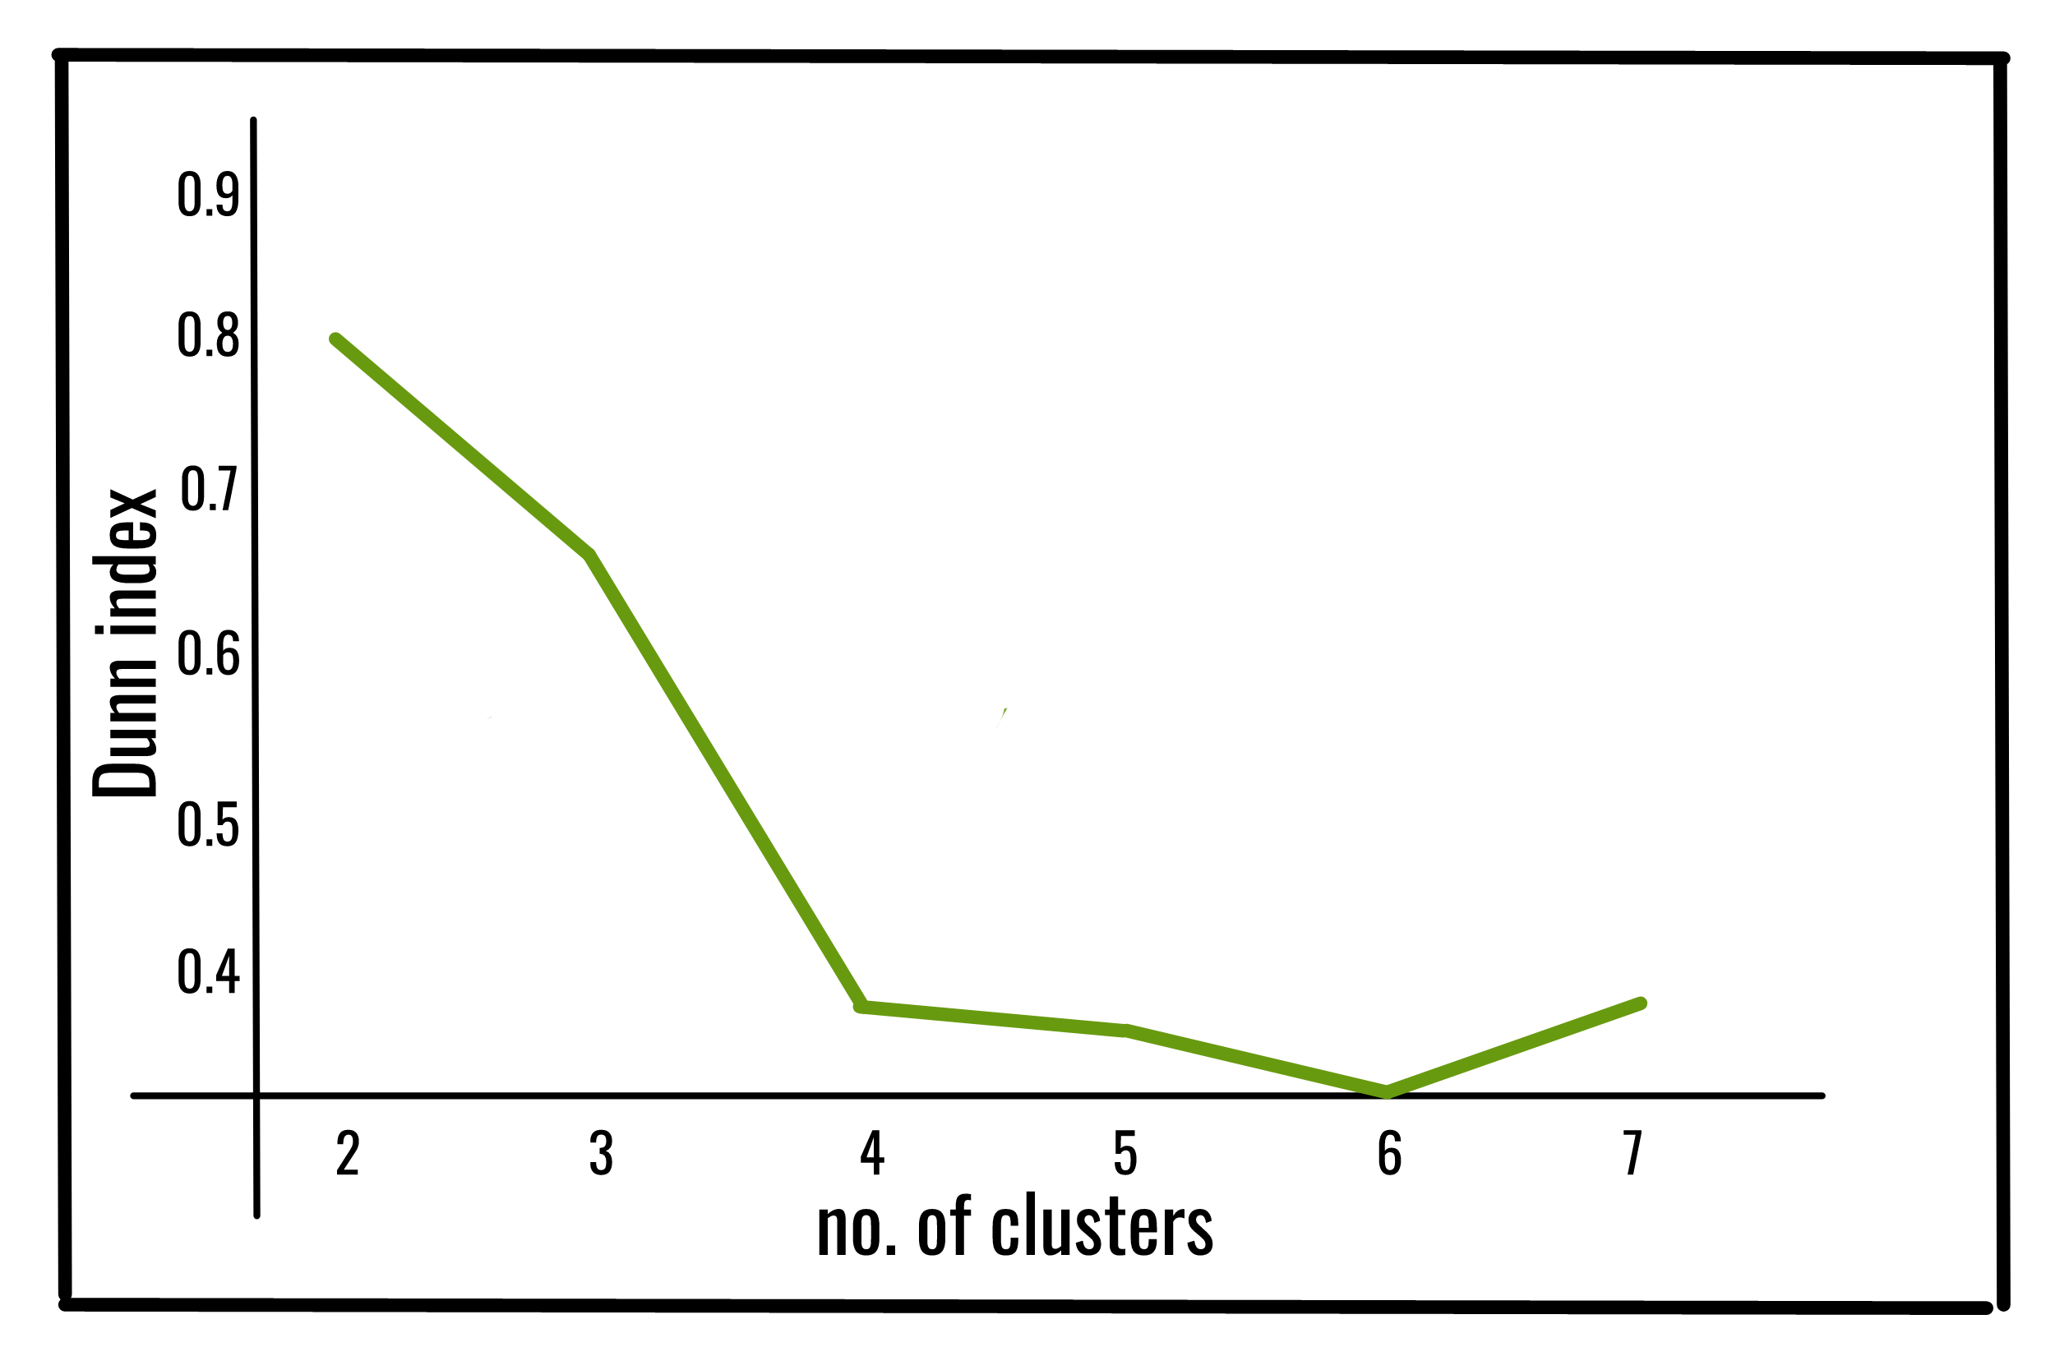

II. Our CVI’s
(c) Davies-Bouldin.
(d) BD-Dunn.

Slide 14
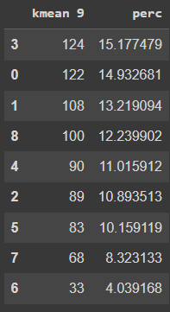
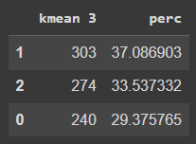
III. Our CVI’s
Values | BD-Silhouette | WSSSE | Davies-Bouldin | BD-Dunn
First | 3 | 3 | 3 | [CENSORED]
Second | 6 | 9 | 9 | [CENSORED]
Third | 9 | - | 12 | [CENSORED]

Slide 15
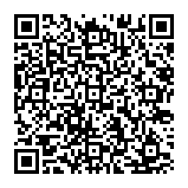
Code and dataset

