Slide 1
Research and Development of methods for recovering document illumination
Presented by:
Alyakaev Kamil
Stanislav Ushakov

Slide 2
Presentation Structure
Project’s background
ST-CGAN
Custom Model
Document Cropping
Shadow Detection
Shadow Removal
Project’s State
Project Plan
Further Research

Slide 3
Project’s Background: Original Plan
Methodology Research
Testing Environment
Create Dataset
Tune Models
Compare Models
Final Selection

Slide 4
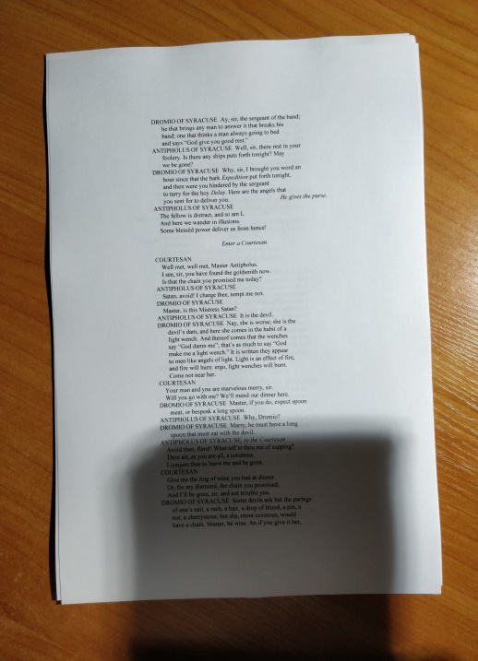

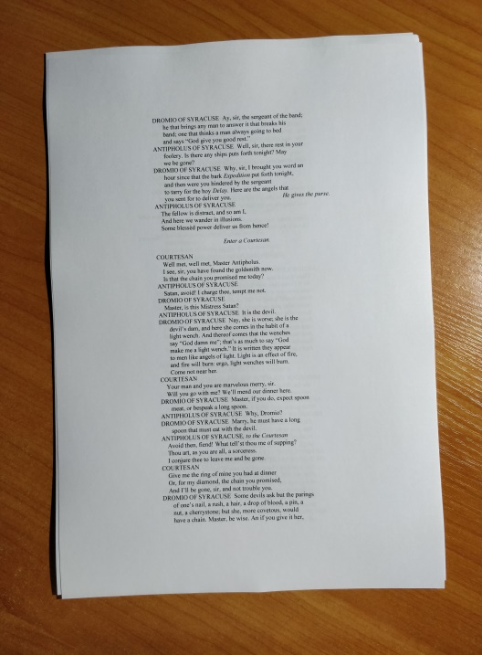
Project’s Background: Dataset
Image with shadow
Shadow Map
Ground-Truth

Slide 5
Project’s Background: Result
Models
Tuned ST-CGAN
A list of other models with their advantages, shortcomings and other details
Dataset
Testing Dataset with random text images, approx. 5000 instances
Completely custom training dataset, approx. 1250 triplets
State of the art summary

Slide 6
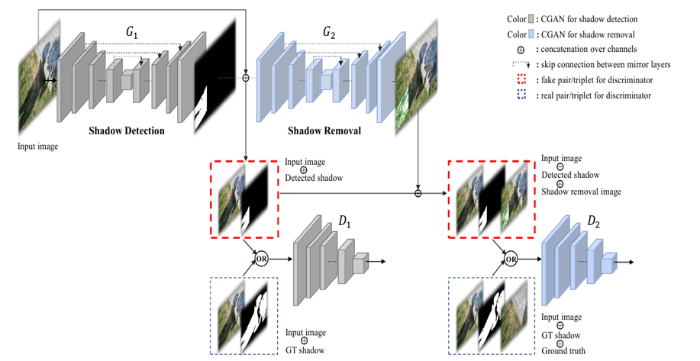
ST-CGAN: Working Principle

Slide 7
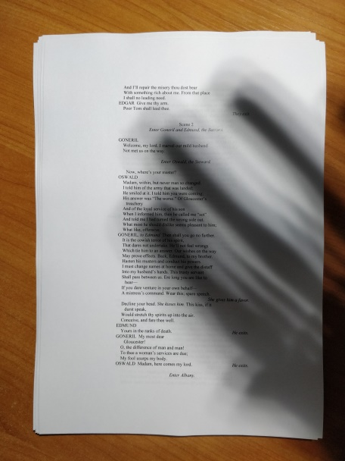
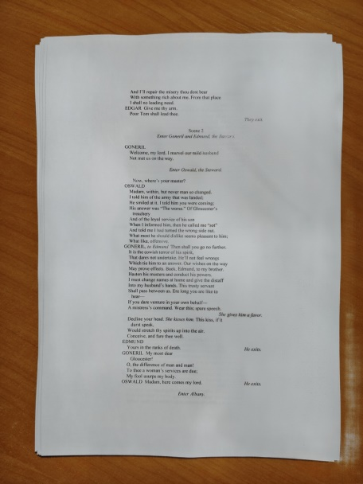
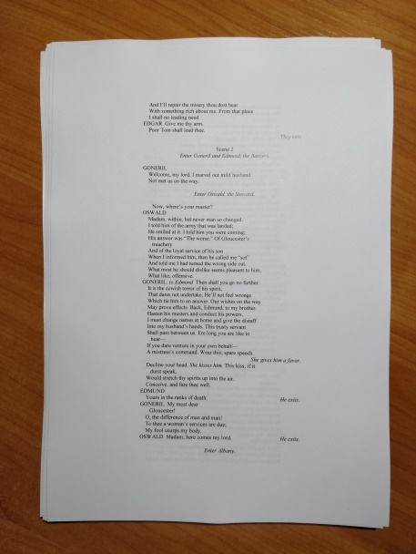
ST-CGAN: Results
Image with shadow
ST-CGAN output
Ground-Truth

Slide 8
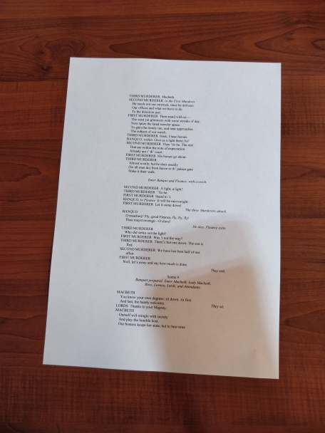
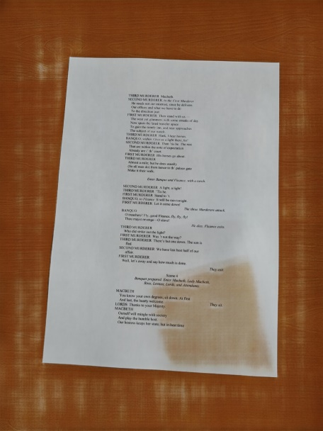
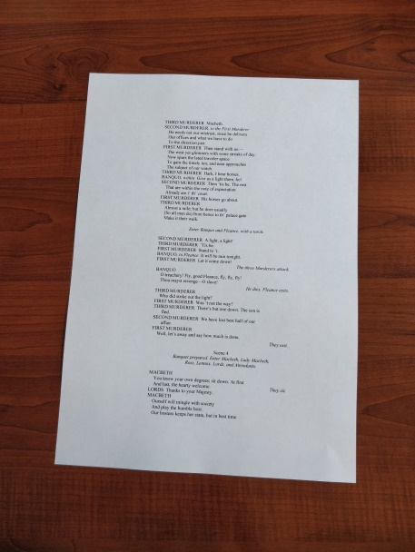
Limitations
Image with shadow
ST-CGAN output
Ground-Truth

Slide 9
New Concept: Custom Model
Document Cropping
Solves background training bias
Shadow Detection
Shadow maps are essential to give the model understanding of contrast
Shadow Removal
The main process of the model

Slide 10
Document Cropping: State of the art
Model types
CNN
Evaluation Metrics
Intersection Over Union (IOU)
Precision
Models being tested
HU-PageScan
dgSegment
Graph Cut Segmentation
Watershed Segmentation
Recall
F1 score
Document Layout Similarity (DLS)
Document Image Quality (DIQ)
docExtractor
Pytorch-deeplabV3 GrabCut and Watershed

Slide 11
Shadow Detection: State of the art
Model types
CNN
Evaluation Metrics
Precision
Models being tested
ST-CGAN
GAN
Recall
F1-score
IOU (mIOU)
ROC/AUC curves
Feature-based models
BMNet

Slide 12
Shadow Removal: State of the art
Model types
CNN
Evaluation Metrics
PSNR
Models being tested
See on the next slide
SSIM
MAE
RMSE
CDM
GAN

Slide 13
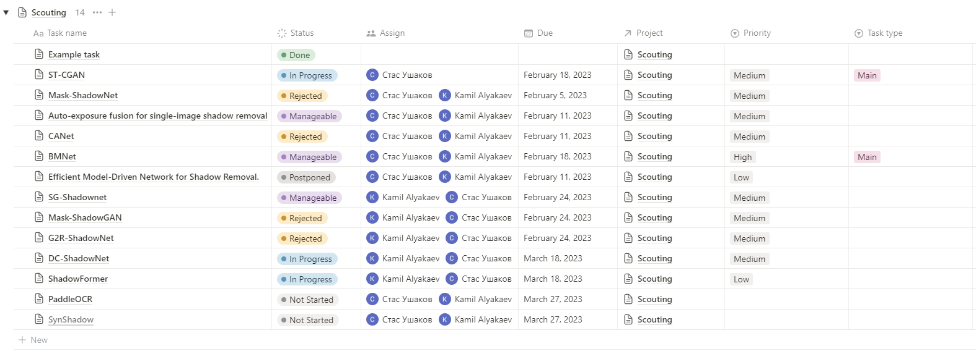
Project’s State

Slide 14
Project Plan
Methodology Research
Formulating requirements for dataset
Designing a testing system
Tuning
Comparing
Engineering Custom Model(s)

Slide 15
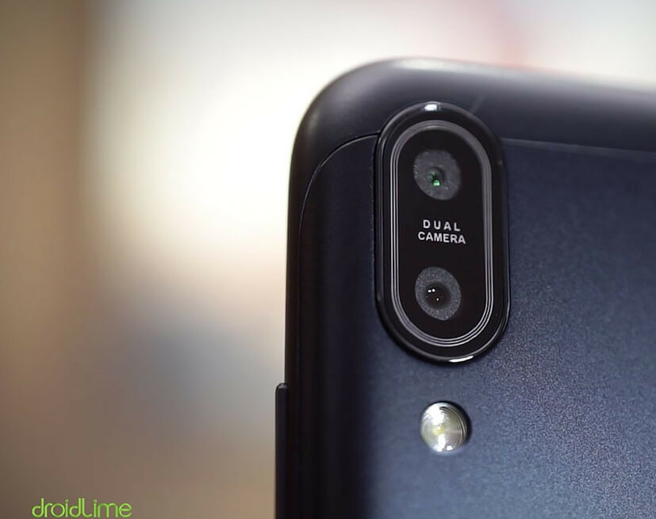
Further Research

Slide 16


Resources
Dataset
Notion

