Slide 1

AWS Cloud
Application Load Balancer
Listener
Rule
Rule
T2.large
T2.large
M4.large
M4.large
Security Group
us-east-1a
T2.large
T2.large
M4.large
M4.large
us-east-1b
T2.large
us-east-1c
Target Group T2
Target Group M4

Slide 2
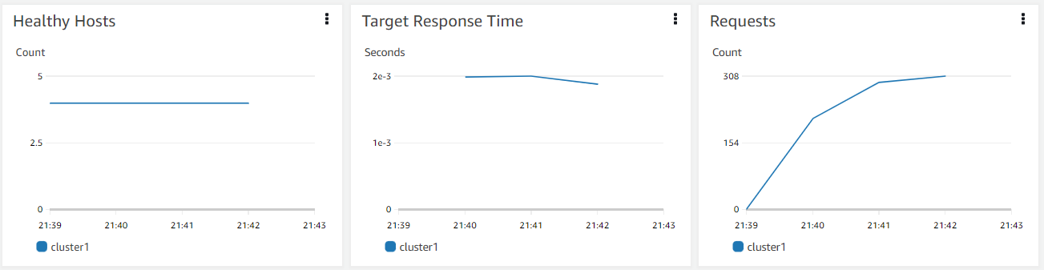
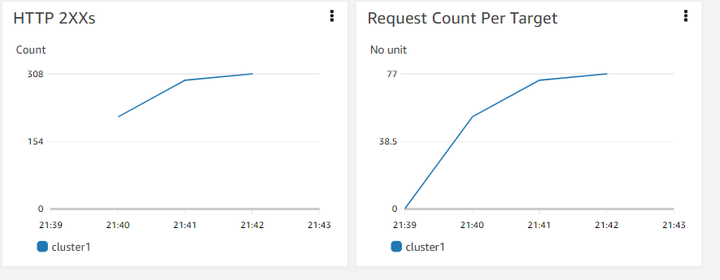
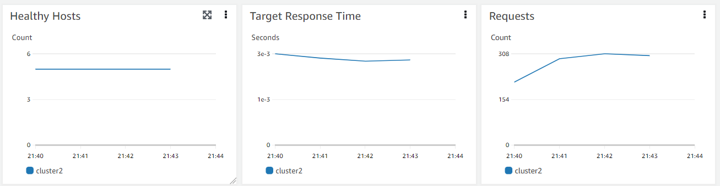
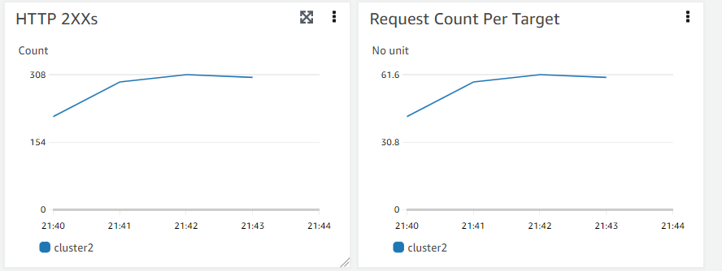
M4.Large
T2.Large

