Slide 1
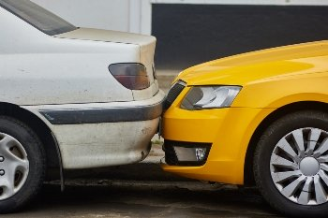
Neel Mitra
Coursera Car Accident Severity by Factors in Seattle
September 2020

Slide 2
Description of Problem and Data
  Description of Problem
The goal is to try to reduce both the number and severity of car collisions in Seattle. We are given a dataset and try to both qualitatively and quantitatively highlight the drivers of number and severity of car collisions as to help drivers avoid catastrophic situatins.
Description of Data
The issue we are trying to solve is taking the dependent variables
  A) car accidents in Seattle and
  B) the severity (severity code: 0-5 although 1&2 are only in this dataset) of such accidents with a higher number indicating a more serious accident
Numerous categorical vehicles are provided that seem to be relevant independent variables.
  A) road conditions
  B) light conditions
  C) weather
  D) collision type
Location is provided to target popular intersections.

Slide 3
Introduction
  Introduction
The goal is to try to reduce both the number and severity of car collisions in Seattle. We are given a dataset and try to both qualitatively and quantitatively highlight the drivers of number and severity of car collisions as to help drivers avoid catastrophic situations.
This dataset can be used by a wide array of constituents. Individual citizens who are trying to be careful, public planning officials, and first responders.
Description of Data (repeated)
The issue we are trying to solve is taking the dependent variables
  A) car accidents in Seattle and
  B) the severity (severity code: 0-5 although 1&2 are only in this dataset) of such accidents with a higher number indicating a more serious accident
Numerous categorical vehicles are provided that seem to be relevant independent variables.
  A) road conditions
  B) light conditions
  C) weather
  D) collision type
Location is provided to target popular intersections.

Slide 4
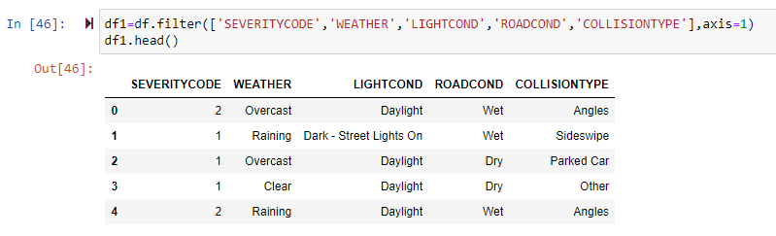
Data and Methodology
  Data
We are provided a CSV file which needs to be cleansed. There are too many columns. I used pandas to load the csv file as a dataframe.
After looking at the data, there are simply too many columns. I reduced the table to the dependent variable (accident severity) and a couple of independent variables.

Slide 5
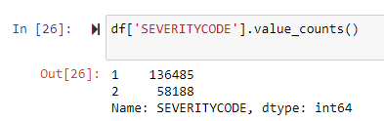
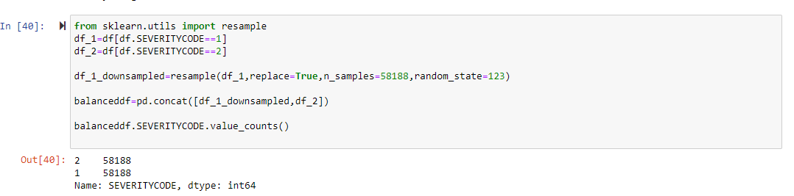
Severity Code: Dependent Variable
Severity code is skewed to LESS negative outcomes.
I balanced data for machine learning purposes; not needed for this exercise, using SKLEARN.

Slide 6
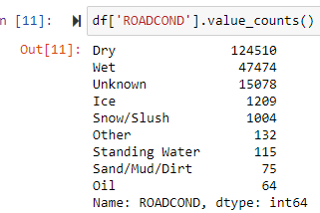
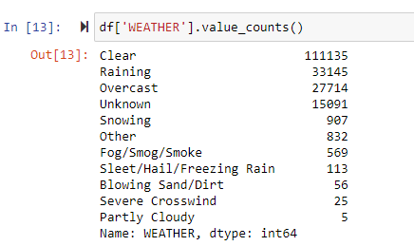
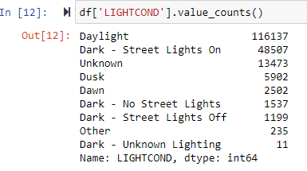
Independent Variables: Value Counts
The first 3 independent variables did not equate to telling a story of being in an accident.
Accidents happened most when it was:
Dry
Clear
Daylight

Slide 7
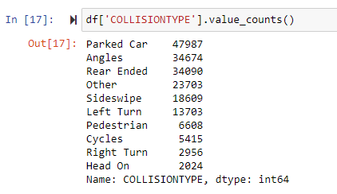
The Telling Independent Variable and Conclusions
The collision type explains the dependent variable.
  The most accidents occurred with parked cars.
  This explains why the majority of the data involved less severe accidents.
  It also explains why other variables that normally contribute to accidents didn’t contribute.
  Accidents with parked cars are minor and are usually out of carelessness rather than a major contributing factor.

