Slide 1
Vibration control with piezoelectric shunt
Alberto bono,
Andrea chiappe,
Nicolò torre,
Simone lombardi,
Alberto didonna,

Slide 2







Experimental setup
Connection hub: Clock source for sincronization of the data, amplifier and power direction
Electromagnetic coil: used with a magnet mounted on the bar to force the bar without contact
Laser speed gauge: mesures the speed of the free side of the bar, without contact
Current gauge: Needed to measure the behaviour of the piezo patch
Electromagnetic coil
Connection hub
F
Zsh
Foto barretta
A
Data collection
Current gauge
Laser speed gauge

Slide 3
Experimental setup
The bar
The bar is constrained on a single end, the lenght of the bar is much greater of the width to be able to approximate to a single dimesion.
The magnet and the mesurement point have to be in the center of the bar to minimize the effect of the torsion on the movement.
The two piezo patch are placed in a way that is optimal to control the first mode(lower patch) and the second mode.
Foto barretta

Slide 4
GOALS
The gal of our project is:
- SINGLE MODE optimization
Find the optimal value of Resistance to conncet with the pizoelectric bar for reduce the vibration of specific natural frequence.
Find the optimal value of the Indicutance and Resistance to conncet with one piezo and snnoze vibration of specic natural frequence
MULTI MODE optimization
Find the correct values of L1, R1, L2, R2 and connect these circuit to both piezo patch attached to metallic bar for snnoze the vubration associated to first and second natual frequences of the system

Slide 5
Experiment procedure SINGLE MODE
The procedure utilized for the single mode piezo-shaunt optimization is the following:
Prepare and check all the laboratory equipement
Set all the Dewesoft parameters for excite and acquiring correctly data ( sampling freq, and natural freequences of our interest)
Catch all the bar variable we need (equivalent capacity Cpi, ki parameters)
Excite the bar with WHITE NOISE signal, elaborate a little bit the WN signal for better analysis (use of hanning window)
Find the FRF (Frequency response funcion with different system configuration:
FRF_sc_sc: two piezo in short circuit ( no influemce of the piezo voltage on mechanical system)
FRF_oc_sc: the first piezo id now in open circuit, so its voltage influenzate the system maechanical behaviour
FRF_sc_oc: now the first piezo is in short circuit and the second in open circit

Slide 6
Dewesoft parameters

Slide 7
Equivalent capacity cpi

Slide 8
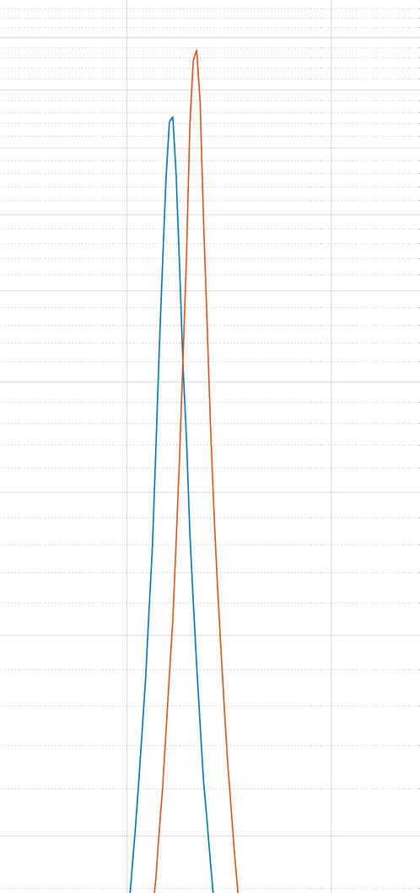
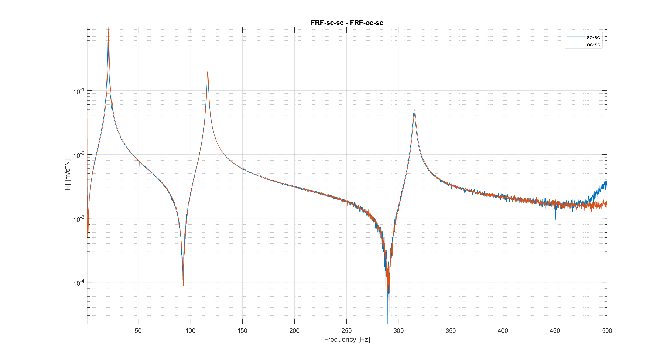
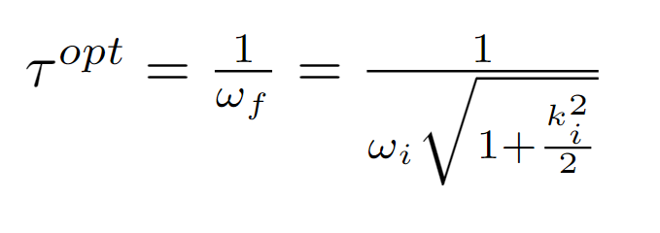


FRF SC-SC / OC-sc
The GOAL of the resistence optimization for first mode:
Find the value of R for wich the new FRF curv has his maximum point in the crossing point between the FRF sc-sc and FRF oc_sc.
The optimization process consist to find:
Knowing also that
We are able now to find the optimal R associated to the first mode:
FRF sc-sc allow us to find:
Natual frequences of the mecchanical system without the influence of the two piezo’s voltage
Mechanical damping of the system associated to different mode shape csi
FRF oc-sc allow us to find:
Natual frequences of the mecchanical system with the influence of the first piezo’s voltage. This cause an increase of stifness of the system, so the natural freq. are little bit high
Mechanical damping of the system associated to different mode shape csi, also the damping is little bit high

Slide 9
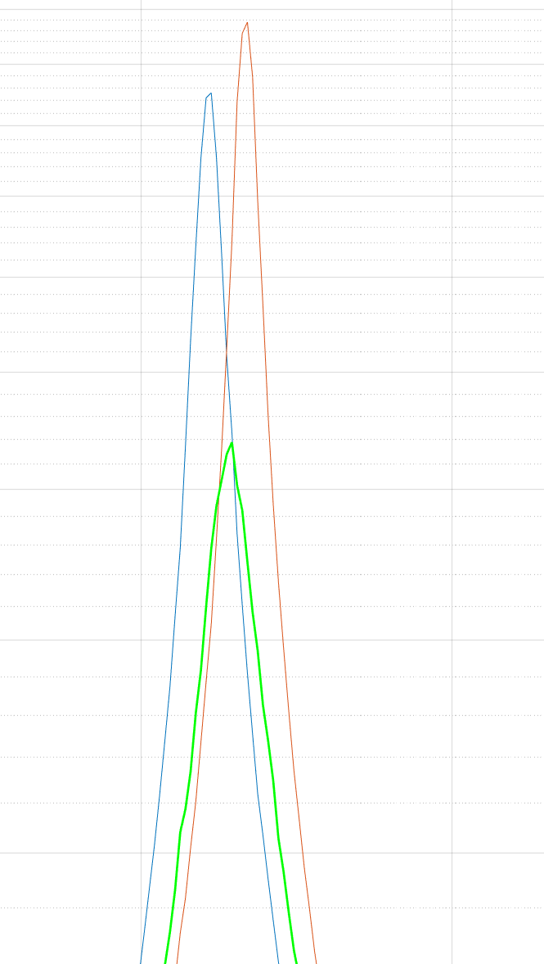
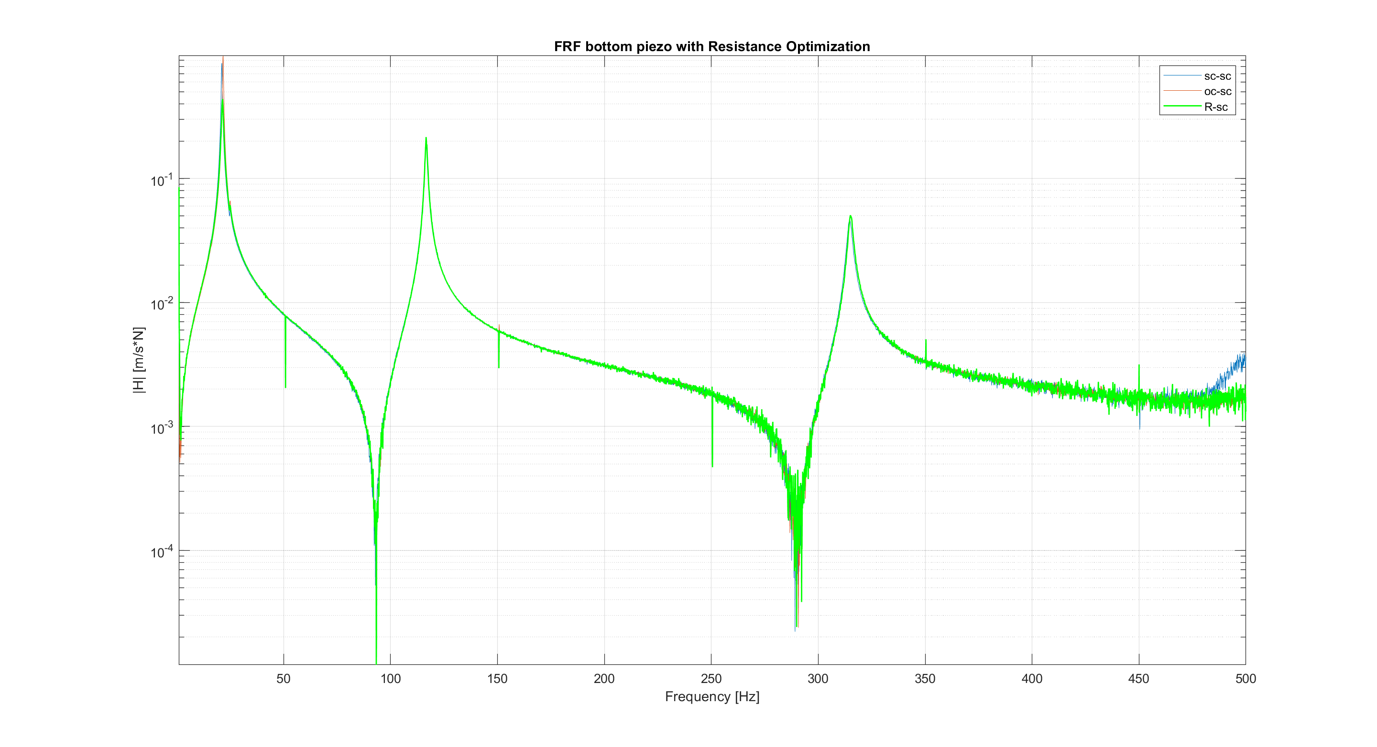
First mode, R OPTIMIZATION
The GOAL of the resistence optimization for first mode:
Find the value of R for wich the new FRF curv has his maximum point in the crossing point between the FRF sc-sc and FRF oc_sc.
The optimization process consist to find:
Knowing also that
We are able now to find the optimal R associated to the first mode:

Slide 10
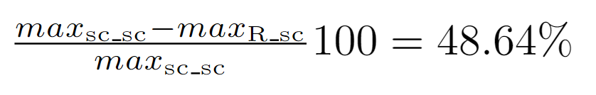
First mode, RESISTIVE SHAUNT
Here we have the zoom on first peak of FRF R-sc, the frequency response function with the Resistance attached to first piezo and the second piezo in short circuit.
The peak is not precisely on the crossing point but we accept this result.
The attenuation of first mode vibration with this methos is:
The method used is very satisfactory considering that only a resistor is used to dissipate the energy that comes from our system.
However, there are much more effective methods such as using Resistors and Inductors (R + L) as we will see in the next slides

Slide 11

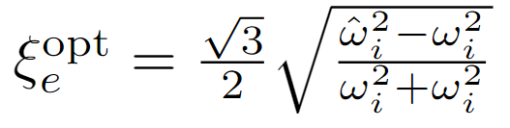

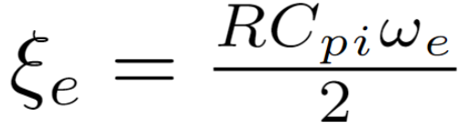
Second mode R, L optimization
In this part we want to optimize the resonant shaunt for snooze the vibration associated to the second mode.
For this type of optimization we followed an analitic procedure, so we can exacltly derive the fomulas for the optimal Resistance (R) and optimal Inductance (L).
Starting from the equation of the system is poossible to derive:
- Electric Natural Frequency:
- Electrical damping
And also we have the forlmulas for find :
The optimal electical natural frequencies
The optimal electrical damping
And then after computing this values is possible to find the optimal L and R for second mode knowing already the Cpi
L = 24.48 [H]
R = 4.1174 [Kohm]

Slide 12
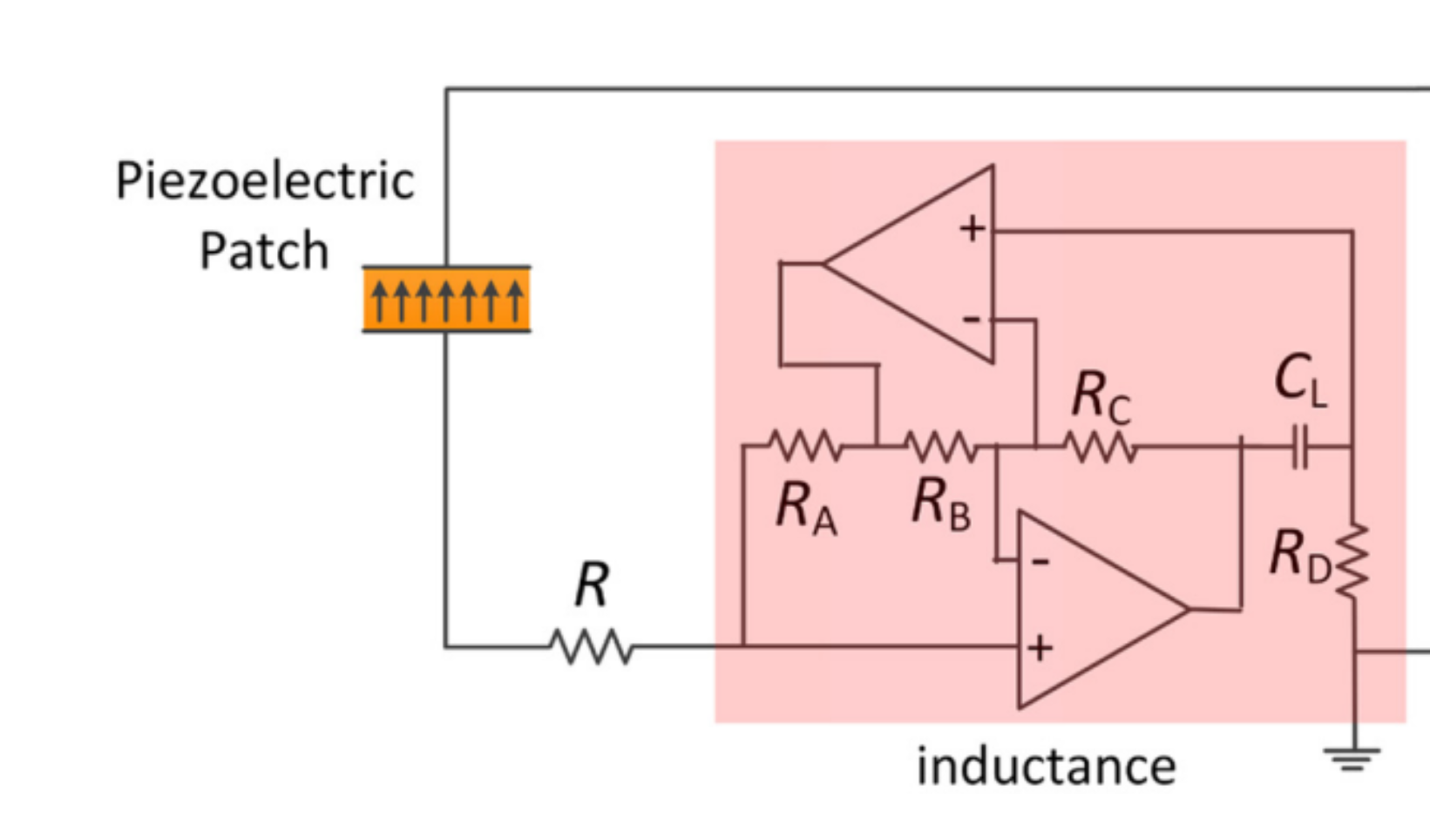
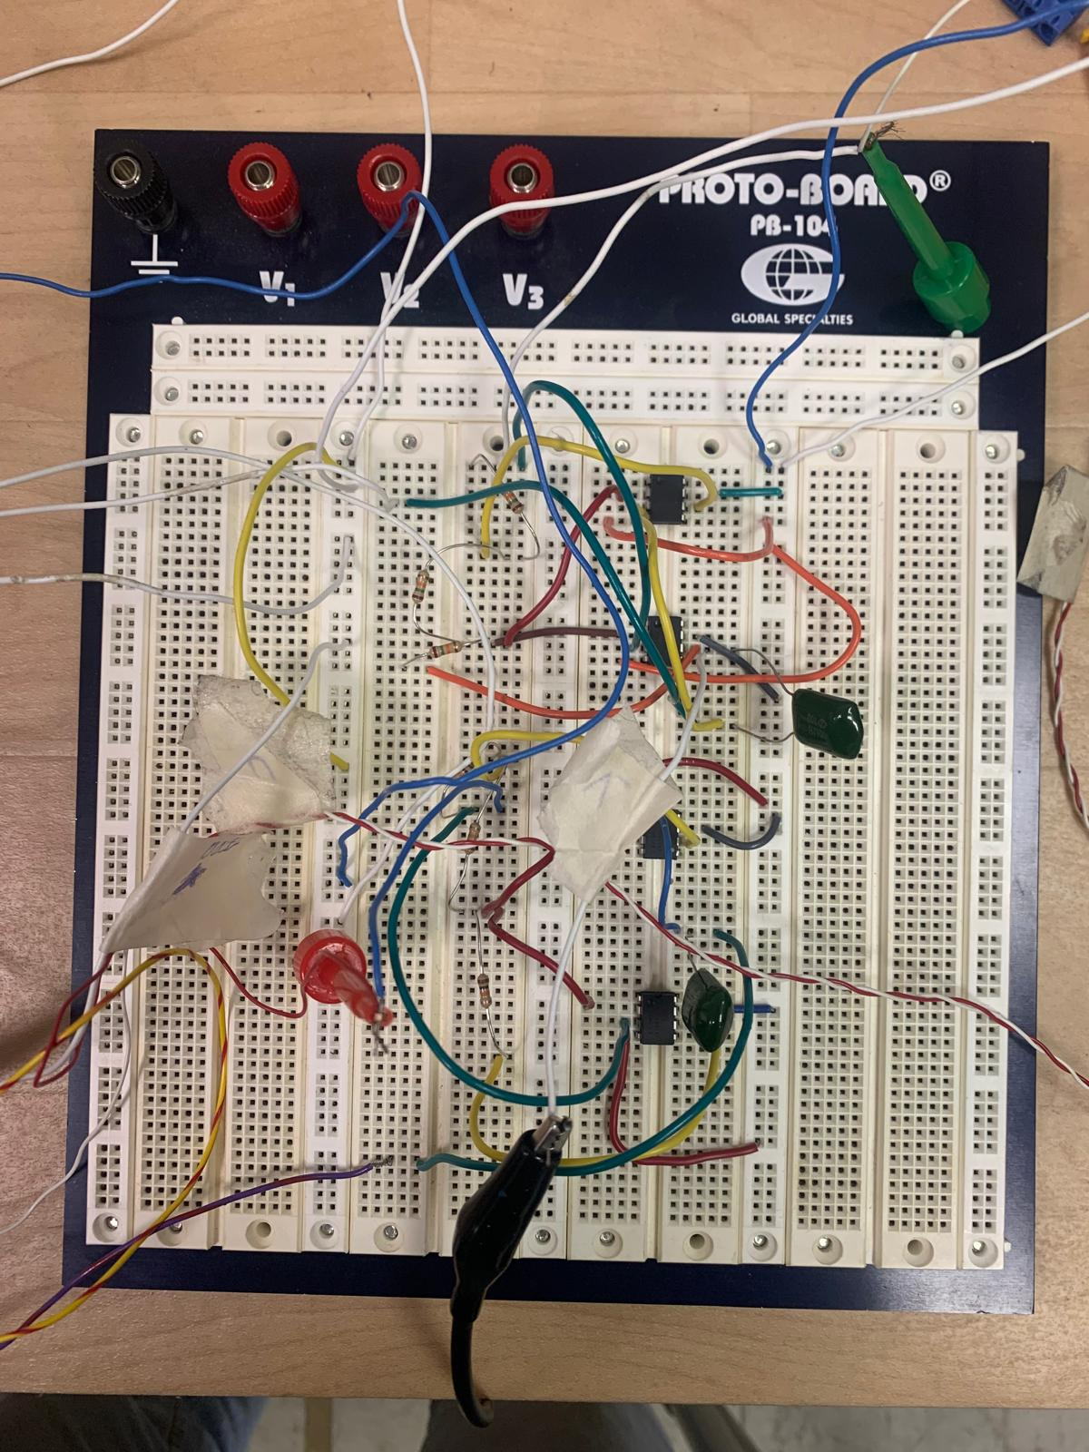
ELECTRICAL CIRCUIT FOR THE SYNTHETIC INDuCTANCE
The problem in this case arises due to the high value of the inductance. Such a high value needs to be achieved through a synthetic inductance. This inductance is realized through Antoniou's circuit.
Schemtic of the Circuit
Physical implementation of the electric circuit

Slide 13
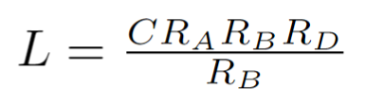
Circuit sizing
A possible problem that could arise is the possibility that the two op-amps could go into saturation regime , i.e. at their input ends there would be too high a voltage, greater than v_{source} / gain.
If this happens, the op-amp would no longer work in a linear regime, but would output the source voltage, in our case 30V.
In any case, in our tests, with these sizes of R and C, the op-amps have always worked in liner regime.
From the point of view of circuit sizing we know this formula:
And the values we diced to use as firs dimensioning this values:
C = 100 x 10⁻⁹ (the smallest one into lab)
R_{A ,} R_{B} , R_{C} = 10⁴
R_{D} = 24.48 10³

Slide 14
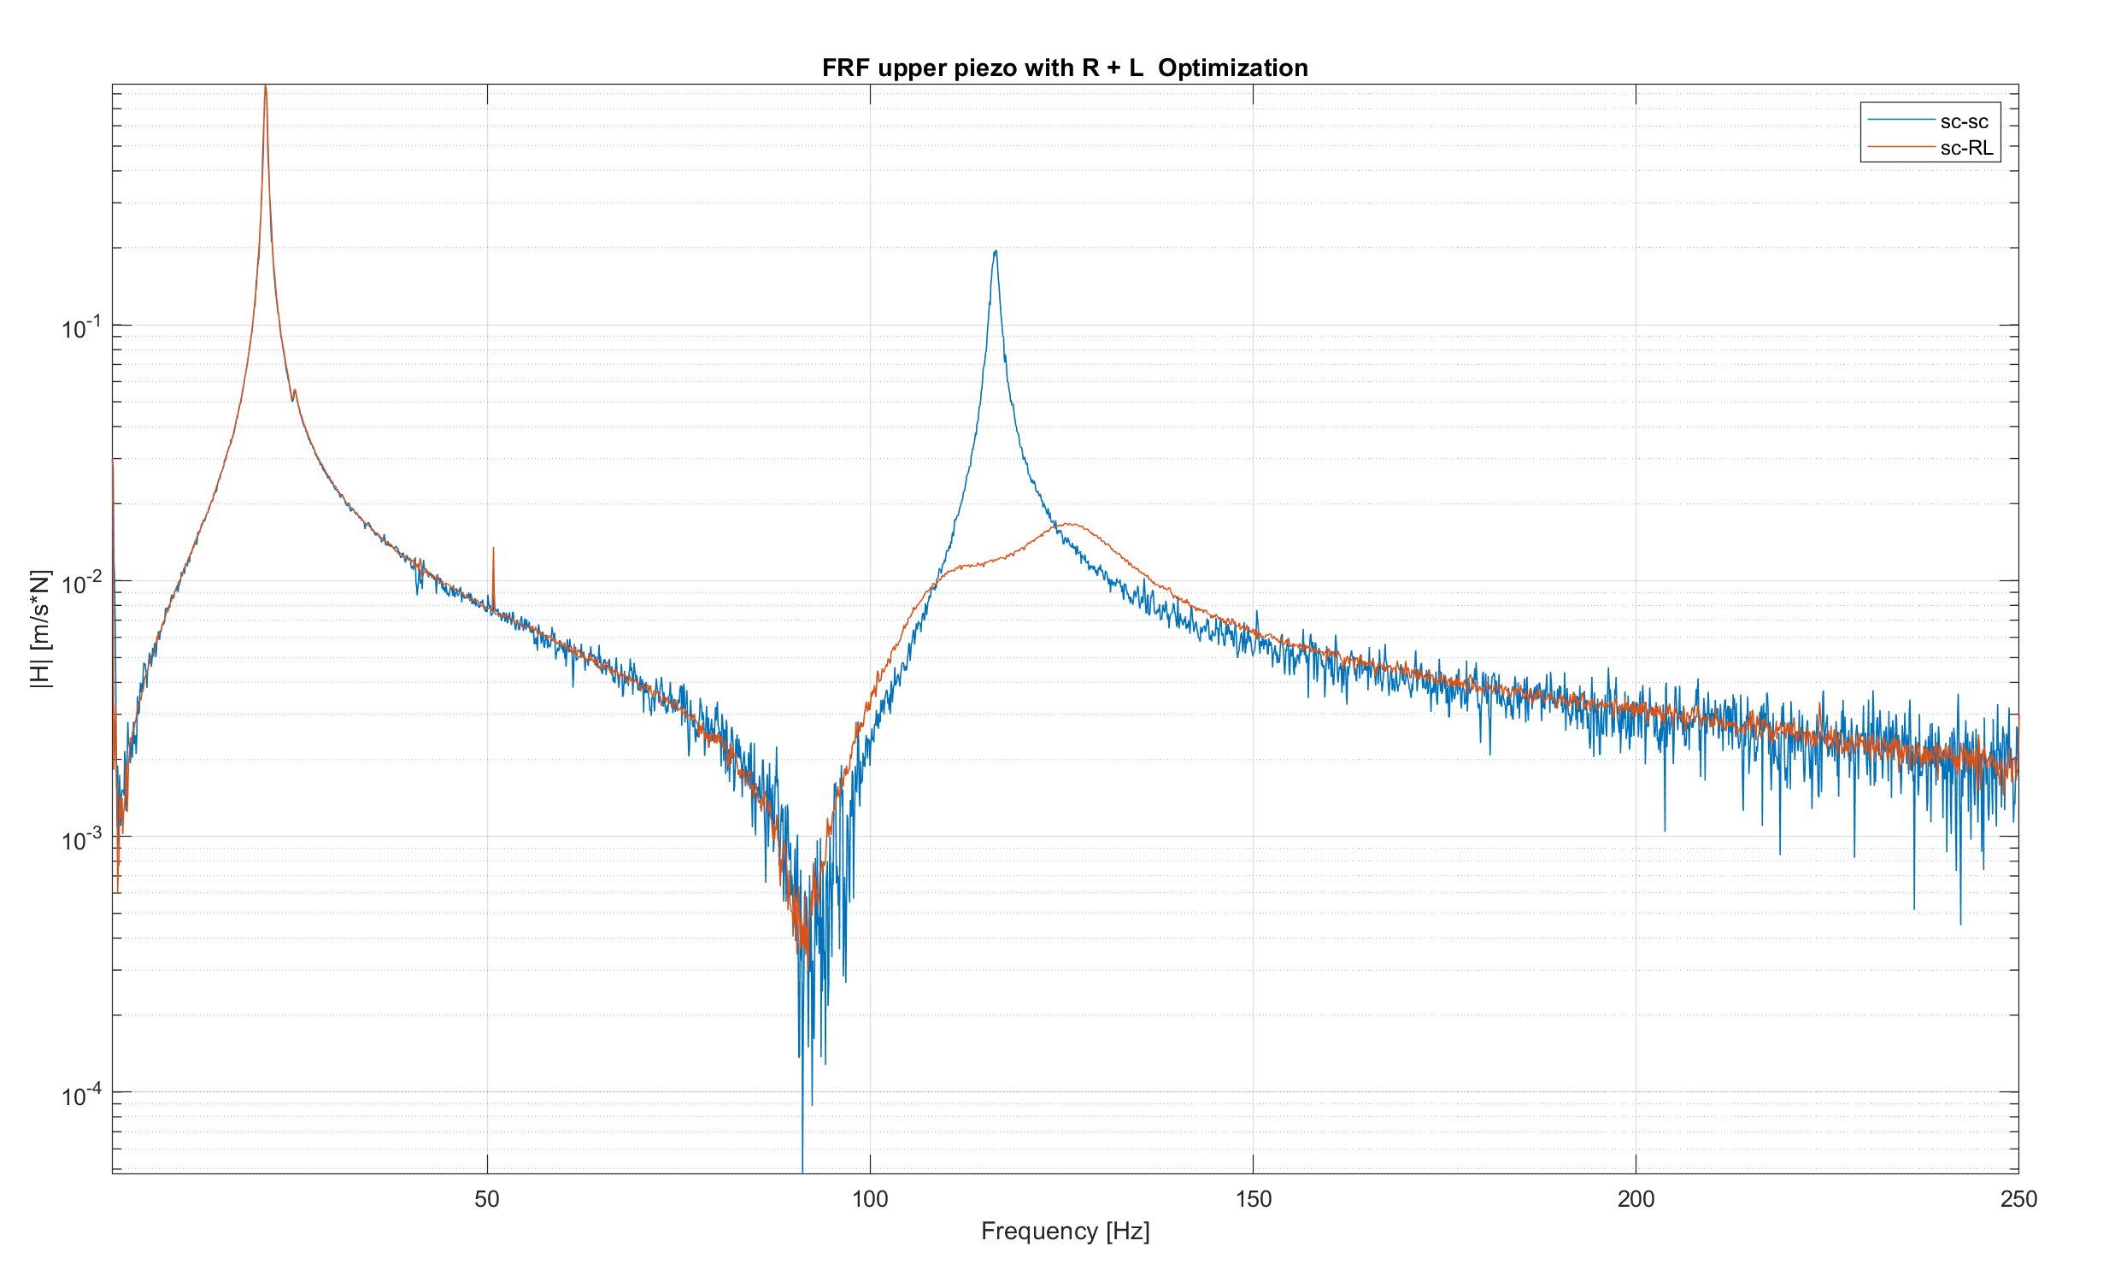
SECOND MODE RESONANT SHAUNT
RESULT
Blue: FRF sc-sc
Red: FRF RL-sc
As we can see the attenuation on second

Slide 15
second mode attenuation result
Resonant

Slide 16
Double piezo
Double resonant shaunt
For optimization of double piezo we will use two Resonant shaunt.
So the opimization consist into finding the optimization of these parameters:
L1, R1 for the first piezoeletric bar
L2, R2 for the second piezoeletric bar
The passage we followed for find this optimal values are:
- Try to use the optimal values for single piezo optimization (NOT GOOD)
Find (PHI) the mode shape of the bar (bacause there are bit difference between the analitic and measured peaks):
Deduct the PHI values from the experimental FRF and use it for fit the analitic function
Use the values of PHI to weigh also the values of analitic H_rl_rl
Optimize L into the H_rl_rl fitted
Optimize R into the H_rl_rl fitted

