Slide 1
Vibration control with piezoelectric shunt
Alberto bono,
Andrea chiappe,
Nicolò torre,
Simone lombardi,
Alberto didonna,

Slide 2







Experimental setup
Connection hub: Clock source for sincronization of the data, amplifier and power direction
Electromagnetic coil: used with a magnet mounted on the bar to force the bar without contact
Laser speed gauge: mesures the speed of the free side of the bar, without contact
Current gauge: Needed to measure the behaviour of the piezo patch
Electromagnetic coil
Connection hub
F
Zsh
Foto barretta
A
Data collection
Current gauge
Laser speed gauge

Slide 3
Experimental setup
The bar
The bar is constrained on a single end, the lenght of the bar is much greater of the width to be able to approximate to a single dimesion.
The magnet and the mesurement point have to be in the center of the bar to minimize the effect of the torsion on the movement.
The two piezo patch are placed in a way that is optimal to control the first mode(lower patch) and the second mode.
Foto barretta

Slide 4
GOALS
The gal of our project is:
- SINGLE MODE optimization
Find the optimal value of Resistance to conncet with the pizoelectric bar for reduce the vibration of specific natural frequence.
Find the optimal value of the Indicutance and Resistance to conncet with one piezo and snnoze vibration of specic natural frequence
MULTI MODE optimization
Find the correct values of L and R and connect these circuit to both piezo patch attached to metallic bar for snnoze the vubration associated to first and second natual frequences of the system

Slide 5
Experiment procedure SINGLE MODE
The procedure utilized for the single mode piezo-shaunt optimization is the following:
Preoare and check all the laboratory equipement
Set all the Dewesoft parameters for acquiring correct data ( sampling freq, and natural freequences of our interest)
Excite the bar with WHITE NOISE signal, elaborate a little bit the WN signal for better analysis (use of hanning window)
Find the FRF (Frequency response funcion with different system configuration:
FRF_sc_sc: two piezo in short circuit ( no influemce of the piezo voltage on mechanical system)
FRF_oc_sc: the first piezo id now in open circuit, so its voltage influenzate the system maechanical behaviour
FRF_sc_oc: now the first piezo is in short circuit and the second in open circit

Slide 6
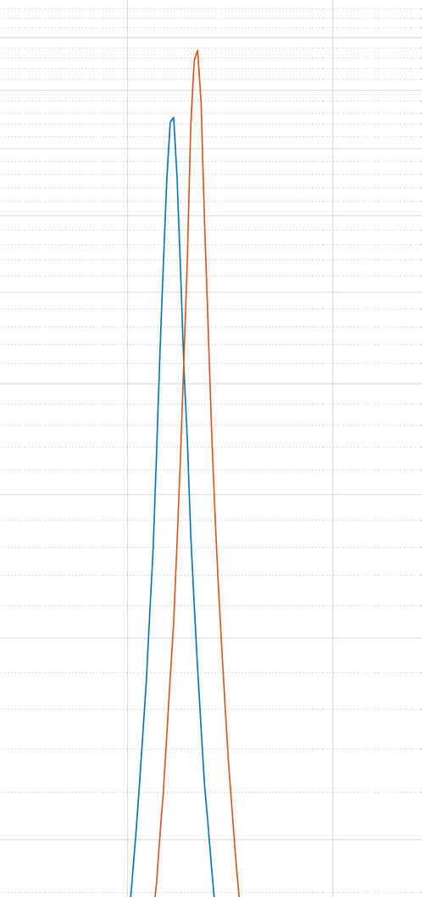
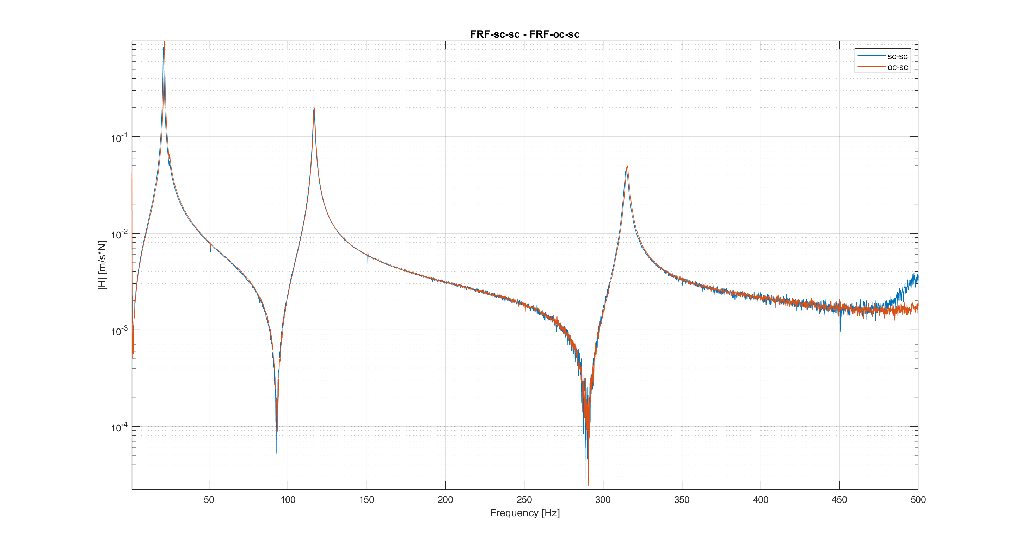
FRF SC-SC / OC-OC

Slide 7
FRF sc-sc allow us to find:
Natual frequences of the mecchanical system without the influence of the two piezo’s voltage
w_1 = 20.122 [Hz]
w_2 = 115.74 [Hz]
w_2 = 314.24 [Hz]
Mechanical damping of the system associated to different mode shape csi
csi_1 = 0.0010033
csi_2= 0.0047168
- csi_3 = 0.0028293
FRF oc-sc allow us to find:
Natual frequences of the mecchanical system with the influence of the first piezo’s voltage. This cause an increase of stifness of the system, so the natural freq. are little bit high
w_1 = 20.723 [Hz]
w_2 = 115.94 [Hz]
w_2 = 314.81 [Hz]
Mechanical damping of the system associated to different mode shape csi, also the damping is little bit high
csi_1 = 0.0086232
csi_2= 0.0053901
- csi_3 = 0.0040261

Slide 8
First mode RESISTIVE SHAUNT
The goal of the resistence optimization is to find the value of R for wich the new FRF curv has his maximum point in the crossing poinnt between the FRF sc-sc and FRF oc_sc.

Slide 9
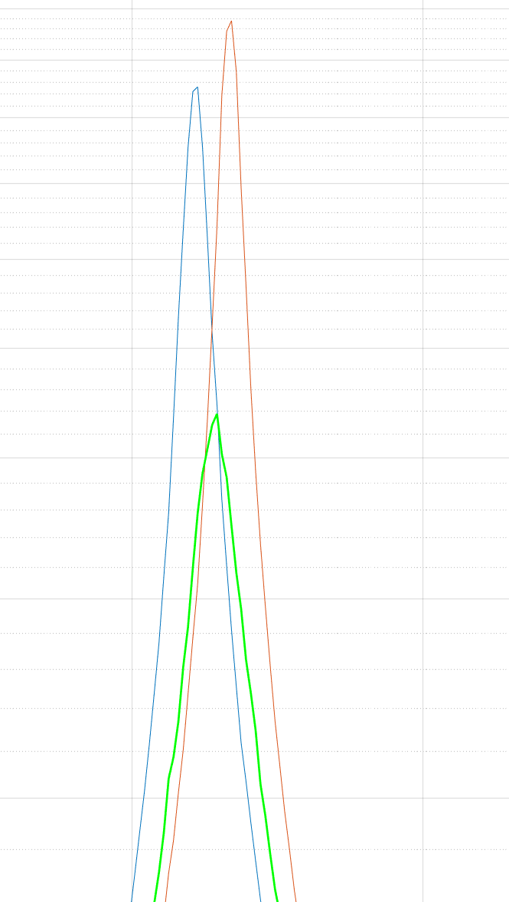
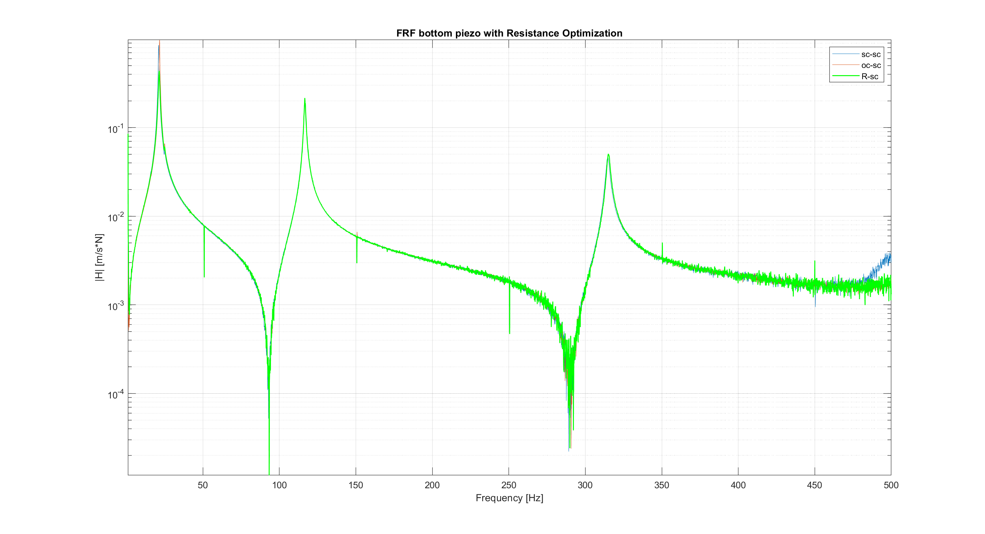
FRF SC-SC / OC-OC / R-sc

Slide 10
second mode attenuation result
Resistive

Slide 11
second mode attenuation result
Resonant

Slide 12
Double piezo
Resistive

