Slide 1
Vibration control with piezoelectric shunt
Alberto bono,
Andrea chiappe,
Nicolò torre,
Simone lombardi,
Alberto di donna,

Slide 2







Experimental setup
Connection hub: Clock source for sincronization of the data, amplifier and power direction
Electromagnetic coil: used with a magnet mounted on the bar to force the bar without contact
Laser speed gauge: mesures the speed of the free side of the bar, without contact
Current gauge: Needed to measure the behaviour of the piezo patch
Electromagnetic coil
Connection hub
F(w)
Zsh
Foto barretta
A
Data collection
Current gauge
Laser speed gauge

Slide 3
Experimental setup
The bar
The bar is constrained on a single end, the lenght of the bar is much greater of the width to be able to approximate to a single dimesion.
The magnet and the mesurement point have to be in the center of the bar to minimize the effect of the torsion on the movement.
The two piezo patch are placed in a way that is optimal to control the first mode(lower patch) and the second mode.
Foto barretta

Slide 4
GOALS
The gal of our project is:
- SINGLE MODE optimization
Find the optimal value of Resistance to conncet with the pizoelectric bar for reduce the vibration of specific natural frequence.
Find the optimal value of the Indicutance and Resistance to conncet with one piezo and snnoze vibration of specic natural frequence
MULTI MODE optimization
Find the correct values of L1, R1, L2, R2 and connect these circuit to both piezo patch attached to metallic bar for snnoze the vubration associated to first and second natual frequences of the system

Slide 5
Experiment procedure SINGLE MODE
The procedure utilized for the single mode piezo-shaunt optimization is the following:
Prepare and check all the laboratory equipement
Set all the Dewesoft parameters for excite and acquiring correctly data ( sampling freq, and natural freequences of our interest)
Catch all the bar variable we need (equivalent capacity Cpi, ki parameters)
Excite the bar with WHITE NOISE signal, elaborate a little bit the WN signal for better analysis (use of hanning window)
Find the FRF (Frequency response funcion with different system configuration:
FRF_sc_sc: two piezo in short circuit ( no influemce of the piezo voltage on mechanical system)
FRF_oc_sc: the first piezo id now in open circuit, so its voltage influenzate the system maechanical behaviour
FRF_sc_oc: now the first piezo is in short circuit and the second in open circit

Slide 6
Dewesoft parameters

Slide 7
Equivalent capacity cpi

Slide 8
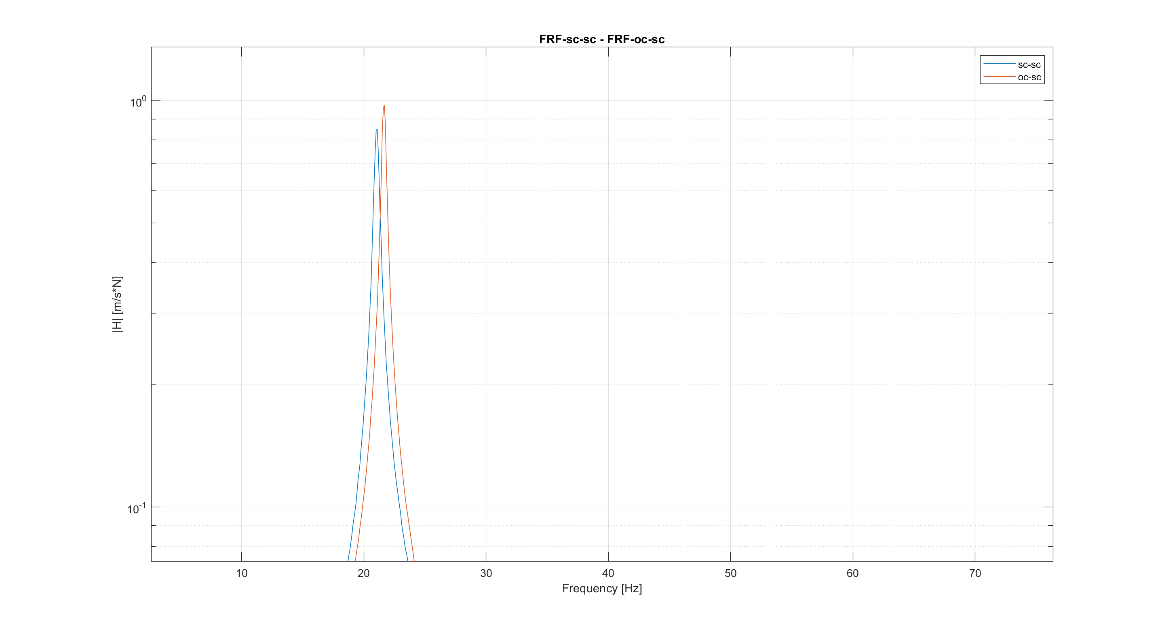
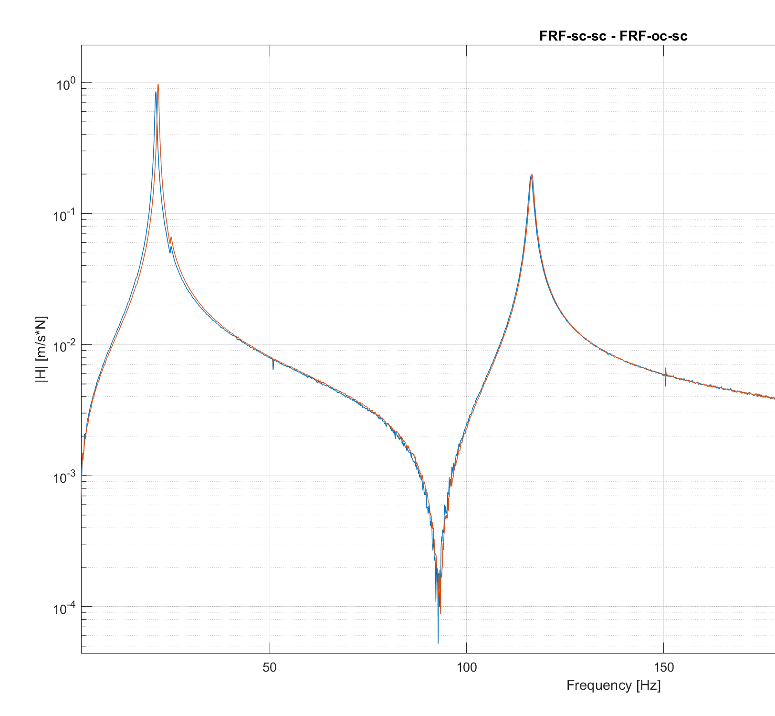
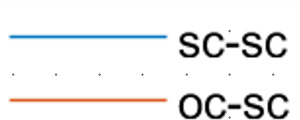
FRF SC-SC / OC-sc
FRF sc-sc allow us to find:
Natual frequences of the mecchanical system without the influence of the two piezo’s voltage
Mechanical damping of the system associated to different mode shape csi
FRF oc-sc allow us to find:
Natual frequences of the mecchanical system with the influence of the first piezo’s voltage. This cause an increase of stifness of the system, so the natural freq. are little bit high
Mechanical damping of the system associated to different mode shape csi, also the damping is little bit high

Slide 9
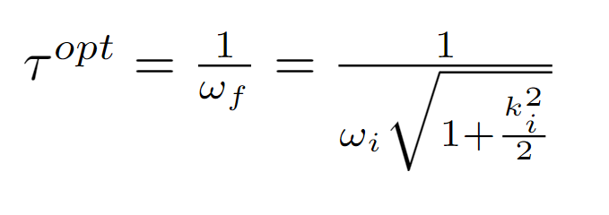



First mode, R optimization
The GOAL of the resistence optimization for first mode:
Find the value of R for wich the new FRF curv has his maximum point in the crossing point between the FRF sc-sc and FRF oc_sc.
The optimization process consist to find:
Knowing also that
We are able now to find the optimal R associated to the first mode:
The GOAL of the resistence optimization for first mode:
Find the value of R for wich the new FRF curv has his maximum point in the crossing point between the FRF sc-sc and FRF oc_sc.
The optimization process consist to find:
$$τ^{\text{opt}}=\frac{1}{ω_{f}}=\frac{1}{ω_{i}\sqrt{1+\frac{k_{i}^{2}}{2}}}$$
Knowing also that
$$τ^{\text{opt}}=R_{i}∗Cp_{i}$$
We are able now to find the optimal R associated to the first mode:
R₁ = 99.57 KΩ

Slide 10
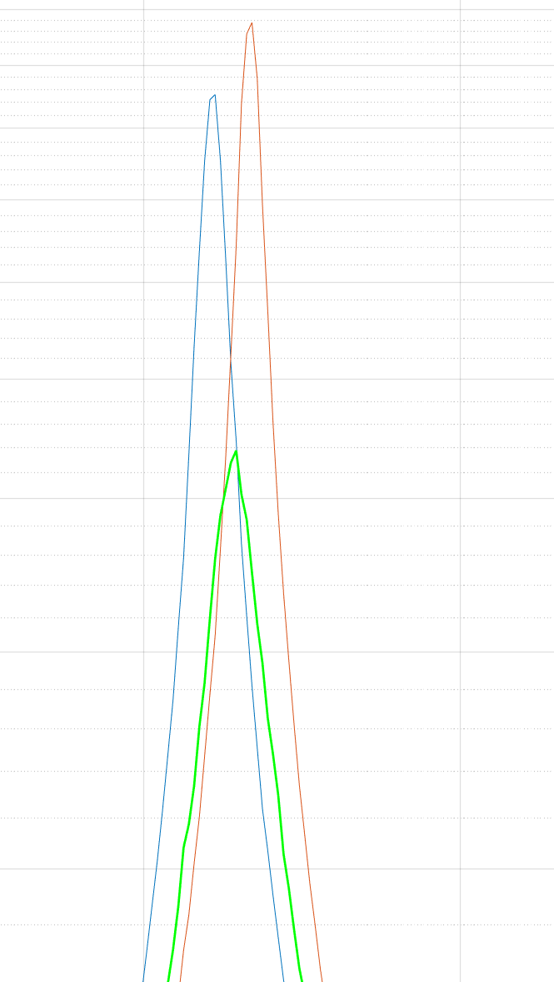

First mode, RESISTIVE SHUNT
RESULT
Here we have the zoom on first peak of FRF R-sc, the frequency response function with the Resistance attached to first piezo and the second piezo in short circuit.
The peak is not precisely on the crossing point but we accept this result.
The attenuation of first mode vibration with this methos is:
$$\frac{max_{\text{sc}\text{_}\text{sc}}−max_{\text{R}\text{_}\text{sc}}}{max_{\text{sc}\text{_}\text{sc}}}100=48.64\%$$
The method used is very satisfactory considering that only a resistor is used to dissipate the energy that comes from our system.
However, there are much more effective methods such as using Resistors and Inductors (R + L) as we will see in the next slides

Slide 11


Second mode R, L optimization
In this part we want to optimize the resonant shaunt for snooze the vibration associated to the second mode.
For this type of optimization we followed an analitic procedure, so we can exacltly derive the fomulas for the optimal Resistance (R) and optimal Inductance (L).
Derive form system eq:
- Electric Natural Frequency:
\
$ω_{e}=\frac{1}{\sqrt{LCp_{i}}}$
- Electrical damping
$ξ_{e}=\frac{RC_{pi}ω_{e}}{2}$
And also we have the forlmulas for find :
The optimal electical natural frequencies
$$ω_{e}^{\text{opt}}=\hat{ω_{i}}=ω_{open_circuit}$$
The optimal electrical damping
$ξ_{e}^{opt}=\frac{\sqrt{3}}{2}\sqrt{\frac{\hat{ω_{i}^{2}}−ω_{i}^{2}}{ω_{i}^{2}+ω_{i}^{2}}}$
And then after computing this values is possible to find the optimal L and R for second mode knowing already the Cpi
L = 24.48 [H]
R = 4.1174 [KΩ]

Slide 12
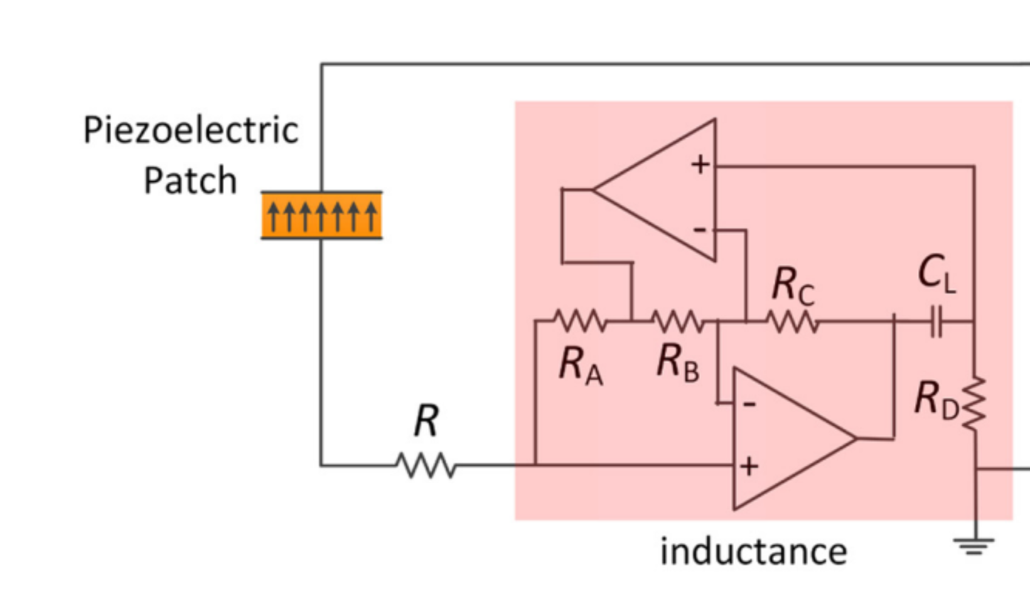
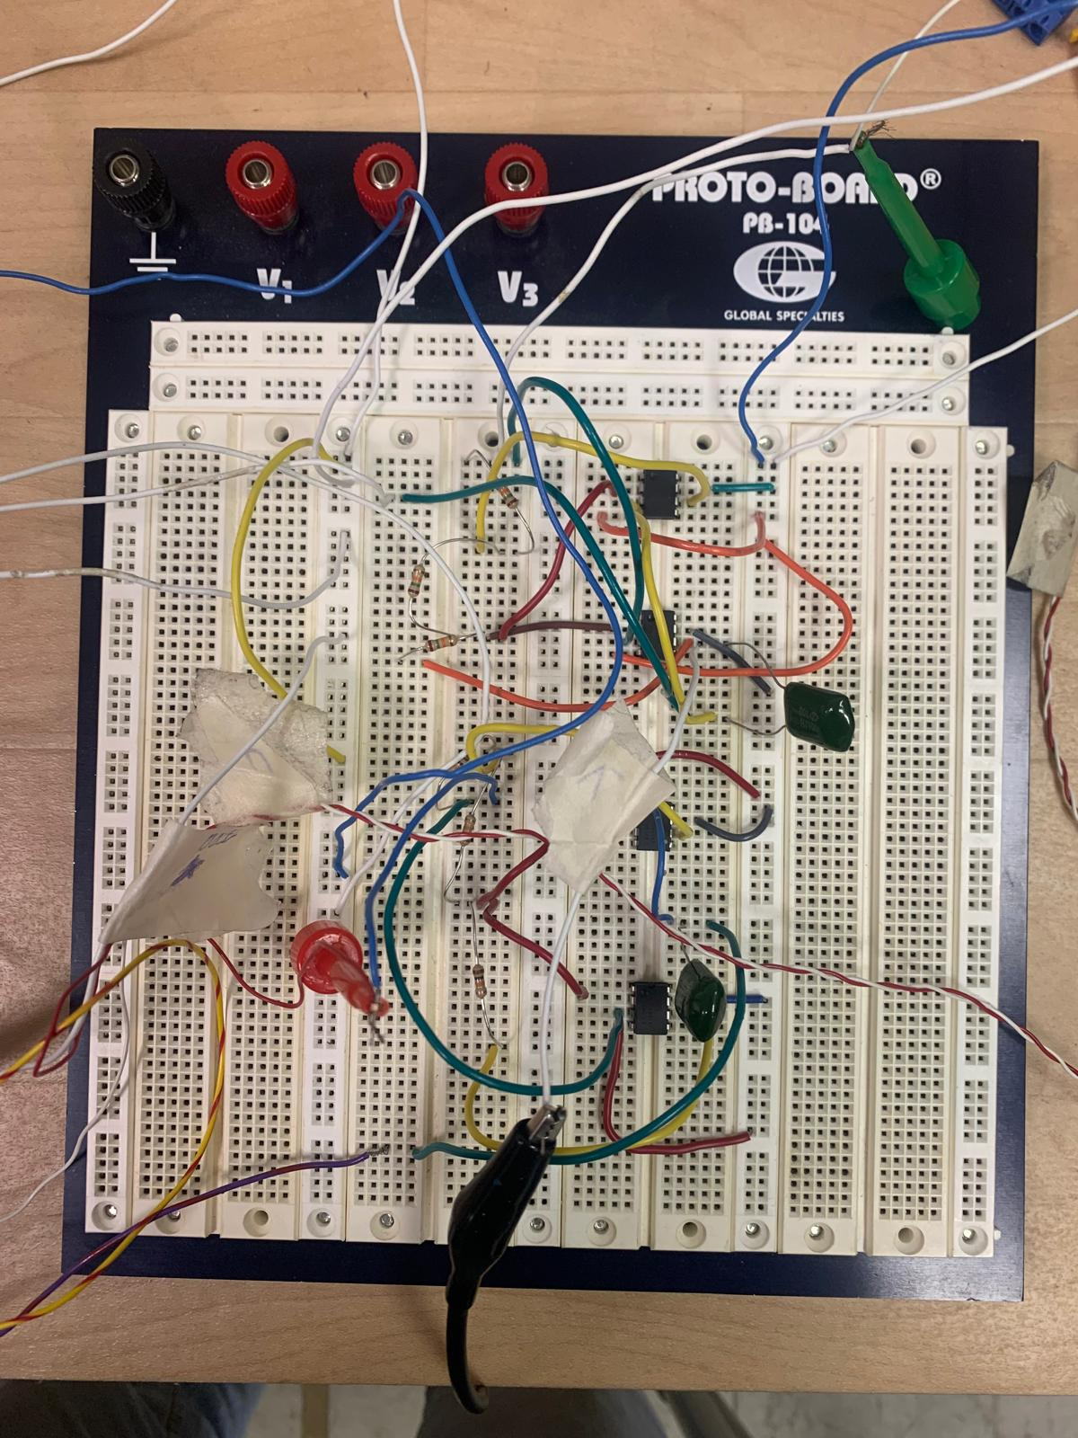
ELECTRICAL CIRCUIT FOR THE SYNTHETIC INDuCTANCE
The problem in this case arises due to the high value of the inductance. Such a high value needs to be achieved through a synthetic inductance. This inductance is realized through Antoniou's circuit.
Schemtic of the Circuit
Physical implementation of the electric circuit

Slide 13

Circuit parametrization
A possible problem that could arise is the possibility that the two op-amps could go into saturation regime , i.e. at their input ends there would be too high a voltage, greater than v_{source} / gain.
If this happens, the op-amp would no longer work in a linear regime, but would output the source voltage, in our case 30V.
In any case, in our tests, with these sizes of R and C, the op-amps have worked in liner regime.
From the point of view of circuit sizing we know this formula:
$$L=\frac{CR_{A}R_{B}R_{D}}{R_{B}}$$
And the values we diced to use as first sizing this values:
C = 100 x 10⁻⁹ (the smallest one into lab)
R_{A ,} R_{B} , R_{C} = 10⁴
R_{D} = 24.48 10³

Slide 14
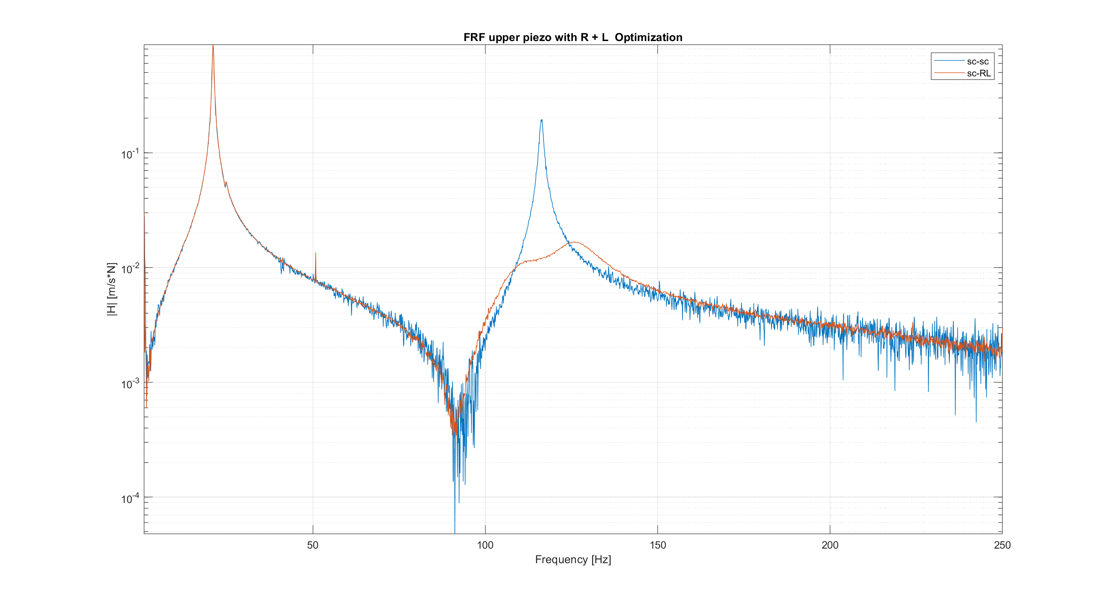


SECOND MODE, RESONANT SHAUNT
RESULT
Blue: FRF sc-sc
Red: FRF RL-sc
As we can see the attenuation on second is much more with respect with only the resistive method.
$\frac{max_{\text{sc}\text{_}\text{sc}}−max_{\text{sc}\text{_}rl}}{max_{\text{sc}\text{_}\text{sc}}}100=91.53\%$
And in decibel the attenuation is:
$A_{\text{dB}}=20\log_{10}\left(\frac{{\text{FRF}}_{\text{sc}\text{_}\text{sc}}}{{\text{FRF}}_{\text{sc}\text{_}\text{RL}}}\right)$ = 49.38 [dB]
The magnitude of the FRF in this case with the resonant shunt is significantly reduced compared to the resistive shant.
0.1932

Slide 15
Double piezo resonant shunt
both piezoeletric patch simultanesly
For optimization of double piezo we will use two Resonant shunt.
So the opimization consist into finding the optimal values of these parameters:
L1, R1 for the first piezoeletric bar
L2, R2 for the second piezoeletric bar
The passage we followed for find this optimal values are:
Use the values of PHI (mode shape) to weigh also the H_rl_rl
Optimize L into the H_rl_rl fitted
Optimize R into the H_rl_rl fitted

Slide 16
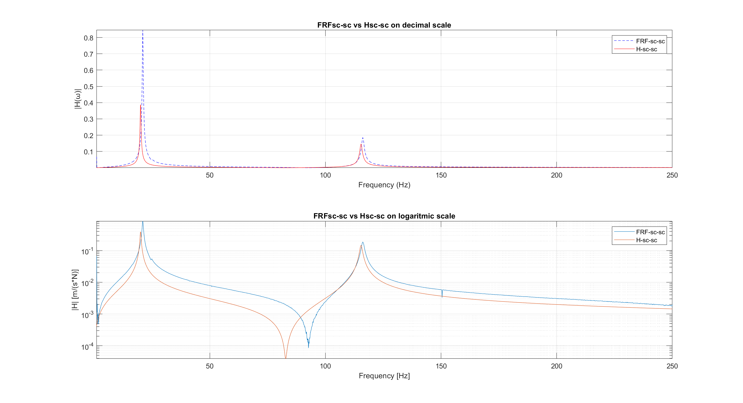

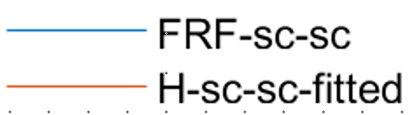

H vs frf
The Freq. response of system with both piezo in short circuit configuration have this analytical formula
$$Hsc_sc=jw\sum_{i=1}^{N}{\frac{A_{jk}}{\left(w_{i}^{2}+i2ξ_{i}w_{i}w−w^{2}\right)}}$$
Where the numerator represent the mode shape
$A_{jk}=φ_{ij}φ_{ik}$
j (forcing point) = k (measuring point)
At the beginning we considered $A_{jk}$= 1
With this numerator the difference in amplitude of the first peak of analytical function w.r.t the experimental one is different so:
- Need to find the correct mode shape of the function

Slide 17
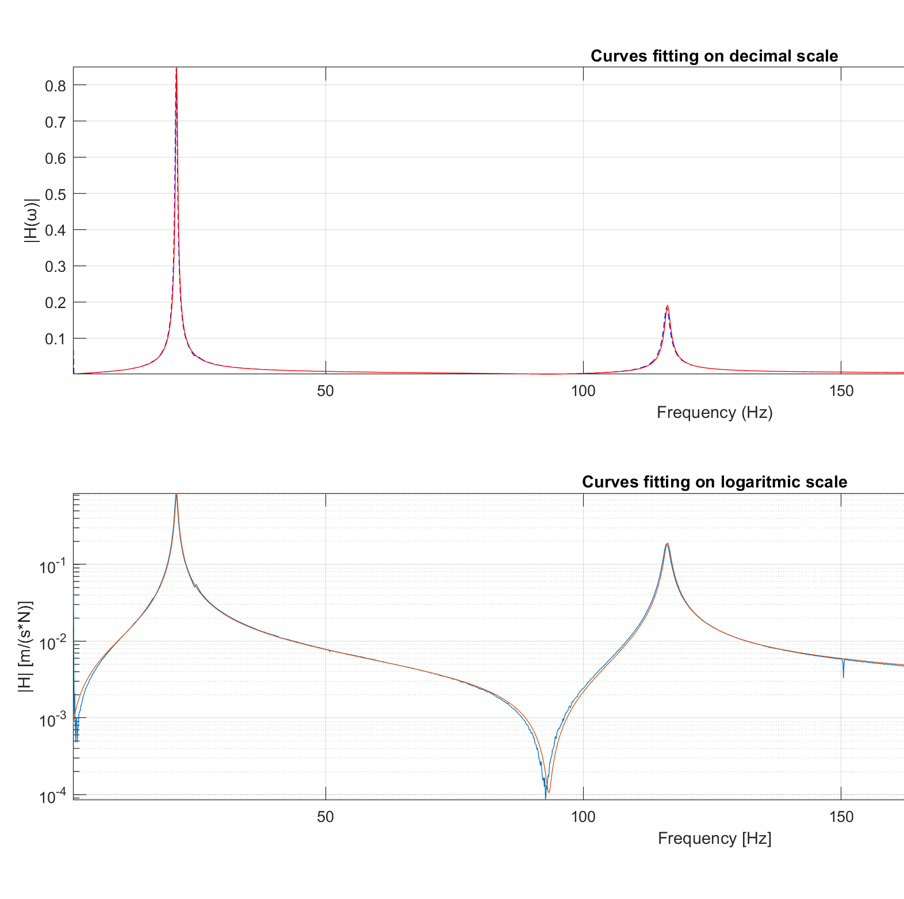

Mode shape identification
We utilized a matlab script that imlements a curve fitting algorithm to find the optimal weight $φ$_{opt} that best aporximate the analytical H_{sc_sc} from the experimental FRF
The script uses lsqcurvefit, a least squares minimization function, to find the optimal values of $φ$_{opt} starting from an initial estimate of [0.1, 0.1]
Then compute the fitted H_{sc_sc_fitted} of the first two mode:
$H_{sc_sc_fitted}=\frac{φ_{opt}^{2}}{w_{1}^{2}+i2ξ_{1}w_{1}w−w^{2}}+\frac{φ_{opt}^{2}}{w_{2}^{2}+i2ξ_{2}w_{2}w−w^{2}}$

Slide 18
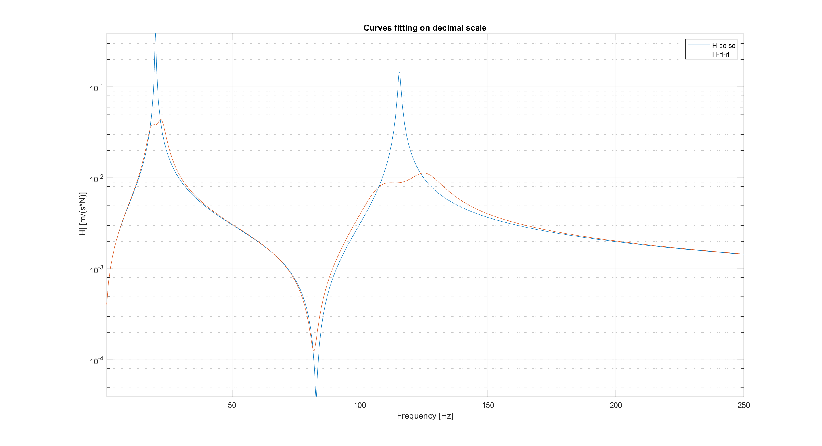

First H_{rl_rl} sizing
The first size of the parameters is done under this assumption:
‘the two modes were sufficiently distant from each other so as not to influence each other’
Compute the electrical component size considering the single mode formulas
H_{RL_RL} analytical is computed as sum of independent piezo contributions. So each piezo is considered the only one active for each mode neglecting the contribution of the other one.
H_{RL_RL} = H_{RL_SC} + H_{SC_RL}
L1 = 747.95 [H] R1 = 31[KΩ]
L2 = 24.48 [H] R2 = 4.1174 [KΩ]
This solution seemed numerically acceptable via software simulation:
peaks of the function seemed to be quite equal in height and symmetrical.

Slide 19
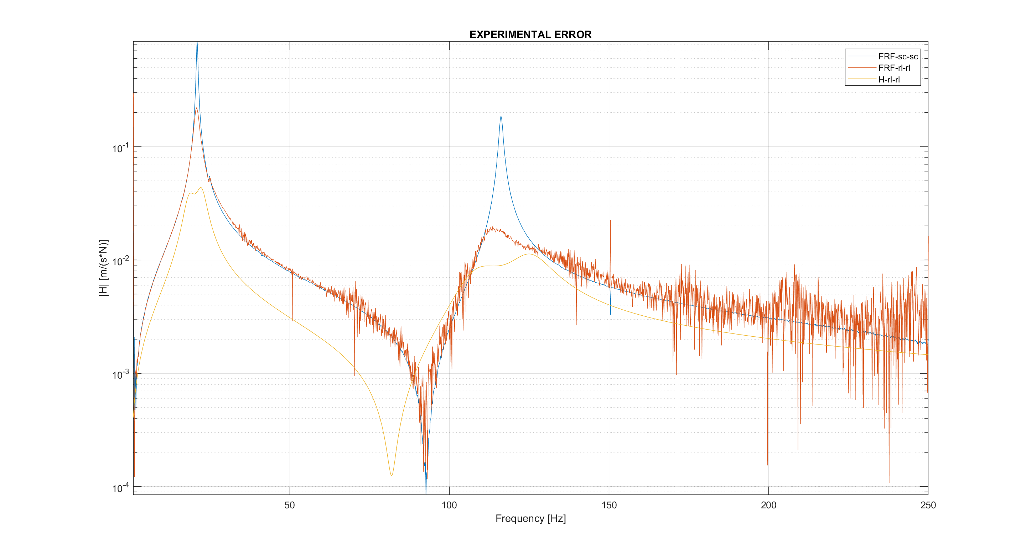
Over damped responde
(wrong)
FRF in this peak is similar resistive shaunt more than R + L
Maybe the R value is too high
This wrong respone is maybe due to the interference of second mode
This two peaks are asymetric:
Due to the first mode interference
Also in simulation they were not too good

Slide 20

H_{rl_rl} optimization
The assumption:
“the two modes were sufficiently distant from each other so as not to influence each other”
IS NOT VALID => the two modes are not distant enough for be neglected
Procedure now:
H_{RL_RL} is not more the sum of single mode H_{RL_RL,} is needed to compute the one that take in account the interference one piezo to the other
Utilize the weight $φ$_{opt} found during the fitting of H_{sc_sc} also in H_{RL_RL}
Optimization process for all the parameters (L1, R1, L2 and R2)

Slide 21

1. Analytical h_{rl_rl}
Starting from the single mode quation (white) we add the contribution of the second piezo to the first one (red)
⎧ q̈ᵢ + 2ξ wᵢ q̇ᵢ - wᵢ kᵢ₁ V̅₁ - wᵢ kᵢ₂ V̅₂ = Fᵢ ⎪ q̈ᵢ + 2 ξᵢ wᵢ q̇ᵢ + ŵᵢ qᵢ - wᵢ kᵢ Q̅₁ - wᵢ kᵢ₂ Q̅₂ = Fᵢ ⎨ V̅₁ - Q̅₁ + wᵢ Kᵢ₁ qᵢ = 0 ⎪ V̅₂ - Q̅₂ + wᵢ Kᵢ₂ qᵢ = 0 ⎩
Knowing the equation of the charge expressed in modal coordinate
$\overline{Q}=\frac{w_{e}^{2}w_{i}k_{i}}{−w_{2}+i2ξ_{e}w_{w}w+w_{e}^{2}}$q_{i}
We are now able to derive the complete analytical equation of the frequency response function with the electrical contribution of both piezoelectric patch.

Slide 22

1. H_{rl-rl} analytical
$$H_{rl,rl}=\frac{\left(−w^{2}+2iξ_{1}w_{1}w+w_{1}^{2}\right)\left(−w^{2}+2iξ_{2}w_{2}w+w_{2}^{2}\right)}{−w^{6}+2iw^{5}\left(ξ_{1}w_{1}+ξ_{2}w_{2}+ξ_{i}w_{i}\right)+…}$$
As we expected, the equation is of the sixth degree, since we are introducing into the system two poles and two zeros due to resonant shunt. This equations take in account the interference that the two piezo exert itselves.
The parameters (L1, R1, L2, R2) characterize the two shunt, so by setting these parameters we can ''modify'' the position of the poles and zeros into the system.
So, starting from this analytical equation we can proceed with the optimization regarding the link between the optimal frequences and damping w.r.t parameters:
$$L_{i−opt}=\frac{1}{w_{i−opt}^{2}C_{pi}}{ R}_{i−opt}=\frac{2ξ_{i−opt}}{C_{pi}w_{i−opt}}$$

Slide 23
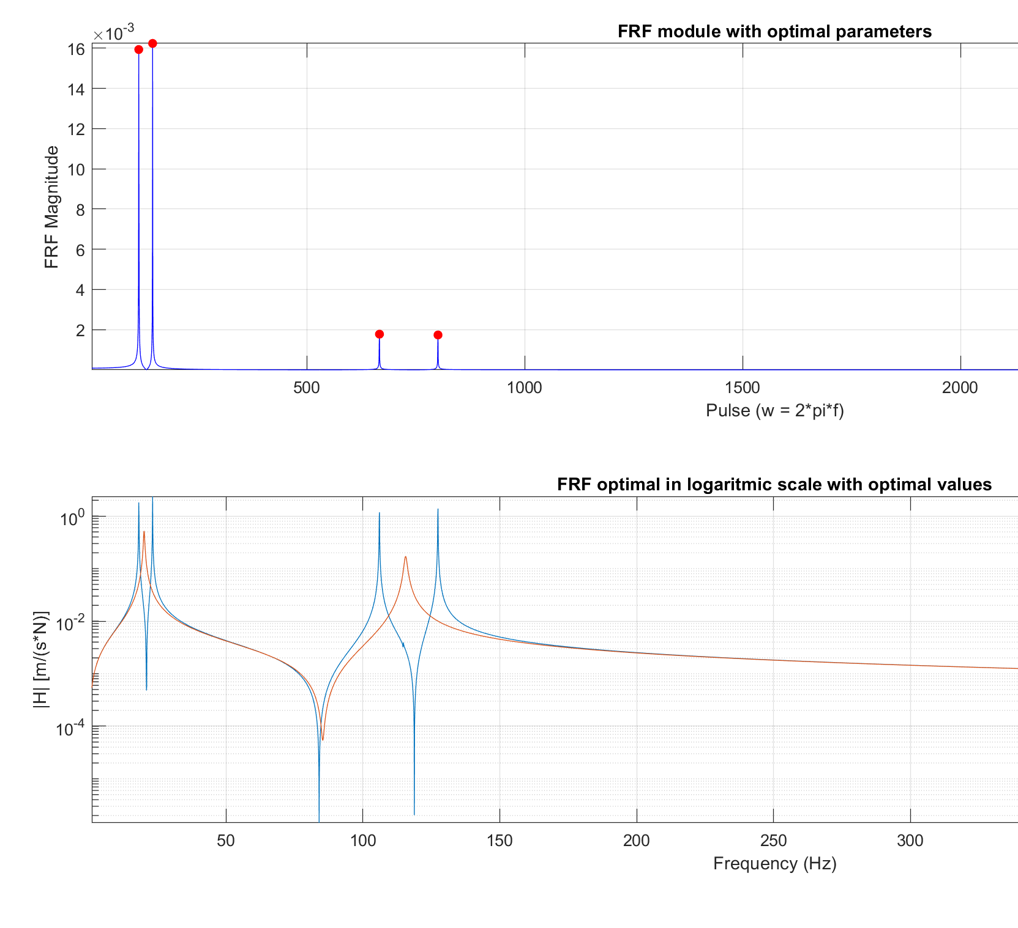
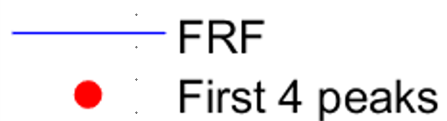


3. L optimization
This optimization is divided into two parts:
Find the optimal values of L1 and L2. Having that the two inductand depend by w_{1-opt} and w_{2-opt} into the H_{RL-RL} equation:
$$w_{i−opt}=\frac{1}{\sqrt{L_{i}C_{pi}}}$$
Then we search iteratively around w_{i-opt} starting from the optimal value of single mode until obtain:
First two peaks of the H_{RL_RL} that have the same height
Third and forth peaks of HRL_RL must be equally high.
when we find the smallest error in height of peaks, the optimal value of L1 and L2 has been found

Slide 24

3. R optimization
R optimization consint into finding the best value that minimize the height of the four peaks.
Knowing the ralation of the r with the electrical damping:
$$ξ_{i_opt}=\frac{RCw_{i_opt}}{2}$$
Let's proceed in the same way as we did previously with the inductors.
Starting from the optimal damping values obtained with the single piezo formulas
Look in a neighborhood in order to minimize the height of the peaks.
As before when the smallest error is found we have the optimal values of R1 and R2

