Slide 1
Signals from Body
EMG (Electromyography) – electrical activity by skeletal muscles
ECG (Electrocardiography) – electrical activity of the heart
EEG (Electroencephalography) – electrical activity of the brain
Pace signal – Signal from Pacemaker
Respiration – study of impedance created from inhale/exhale

Slide 2
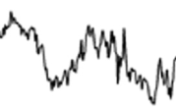
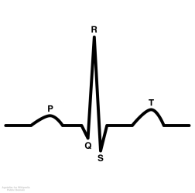
Bandwidth of interest
~10mV
EMG Signal
~5mV
ECG Signal
Max Signal Amplitude
~5mV
Pacemaker Signal
Including Gamma
~1mV
EEG Signal
Respiration 0 to 0.4Hz
*Amplitude dependent on external current source
0.05Hz
20Hz
60Hz
120Hz
150Hz
500Hz
10 KHz
50Hz
*Frequency ranges are estimates. Actual frequency range will depend on specific application
Frequency

