Slide 1
Bottero Glass‑Assist AI
Design review
April 2026

Slide 2

✅ Decision Targets (Today)
We must align on
🎯 Product scope
🧭 Market analysis and 🔎 Competitor analisys
⚙️ General description
Building blocks, high level bill of material
🎯 Initiative scope,⚙️ Features
🛡️ Safety & cybersecurity guardrails + governance ownership
🗓️ Pilot plan: Gantt, Milestones, Validation KPIs
🧾 Business Model 💰Costs

Slide 3
✅ Decision Targets (Today)
What we need from this design review (outcome)
🎯 Approve MVP boundaries and key feature
⚙️ Freeze reference architecture + deployment workflow (dataset packaging)
🔌 Confirm integration path + 2027 Ready for market
💶 Confirm cost model assumptions (capex and opex baseline)
🔎 Competitor IP survey

Slide 4
🗓️ Agenda (60 min)
Time-boxed flow
0–5′ Context & objectives
5–15′ Market need + product concept
15–35′ MVP scope + architecture + data/connectivity
35–50′ Safety/cyber guardrails + HW/network segregation
50–60′ Timeline, cost model, org & stage gates
61’–70′ Decisions, open points, next steps

Slide 5
🎯 PURPOSE
Product scope
‘Glass‑Assist AI’ is a provisional name for the product.
Glass-Assist AI is an on‑premise industrial copilot for troubleshooting and operational analysis on Bottero hollow glass equipment.
Glass-Assist AI is intended both for
customer-side (Shopfloor): operators + Tier 2/3 maintenance
internal Bottero (Customer Service Companion): Tier 2/3 service engineers
See «1 PURPOSE»

Slide 6
🎯 PURPOSE
Key points
Customer‑side focus
📖 preservation of validated Bottero know‑how
🌍 multilingual assistance at shopfloor level
⚡ faster troubleshooting
Supports HG product portfolio: IS machines, Stackers, Bottero Robots, HTH hoods (and approved peripherals)
Internal Bottero focus
⚡ faster troubleshooting
Companion for technical analysis, case triage, and consistent troubleshooting support
See «1 PURPOSE»

Slide 7
🧭 Market requests
Key points
📣 The market requires:
⚡ Reduce downtime (faster troubleshooting / lower MTTR)
📏 Standardize support quality across plants (repeatable triage, consistent answers)
📚 Validated Bottero know‑how (single source of truth, less «tribal» knowledge)
🌍 Multilingual shopfloor assistance (operators + maintenance)
🧰Service enabler (spare parts + scheduled and predictive maintenance )
🏭🔒🛡️ On‑premise deployment + cybersecurity-by-design
See «2.1 Market requests»

Slide 8
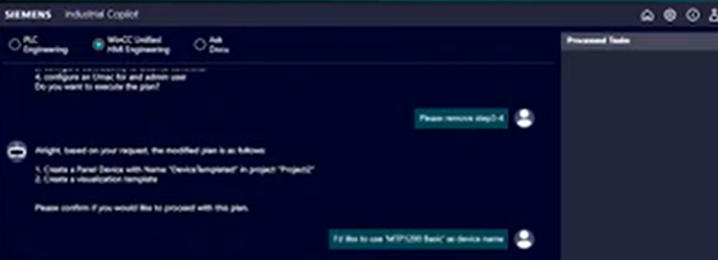
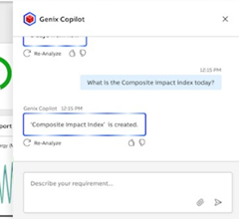
🔎 Competition analysis
Key points
Siemens
https://www.siemens.com/en-us/company/insights/digital-transformation-industrial-copilot/
ABB
https://new.abb.com/process-automation/genix/abb-genix-copilot
See «2.2 Competition analysis»

Slide 9
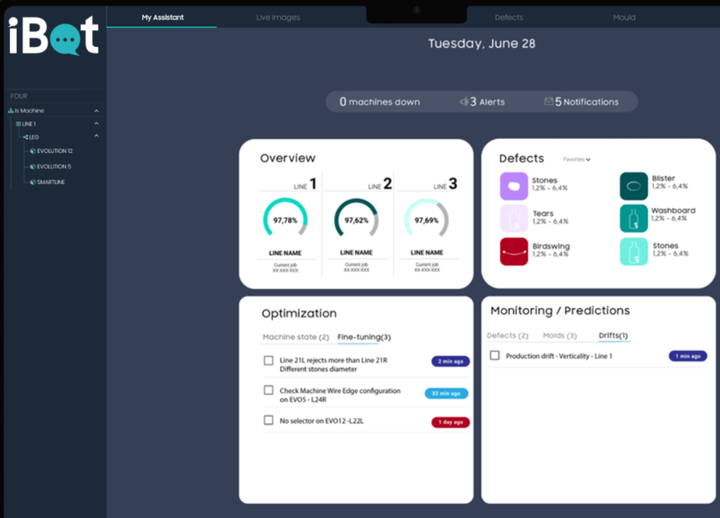
🔎 Competition analysis
Key points
Iris
https://www.iris-im.com/2023/05/23/ready-to-adopt-ibot/
See «2.2 Competition analysis»

Slide 10
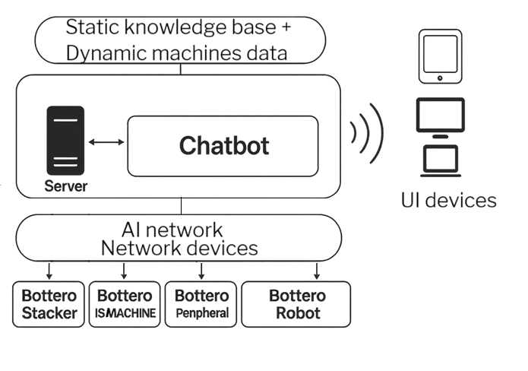
⚙️ General description of project
Building blocks
A Chat front-end interface
and a technical backoffice for setup, according a
customer-specific line configuration.
Static knowledge base, as a Training dataset as
user manuals,
troubleshooting manuals,
electrical schematics,
hardware documentation (e.g. PLC, Drive, etc),
customer care cases.
Dynamic machines data, such as alarm tables,
event logs, production counters (read-only).
Network items to connect items
Server cpu unit for LLM
UI devices

Slide 11

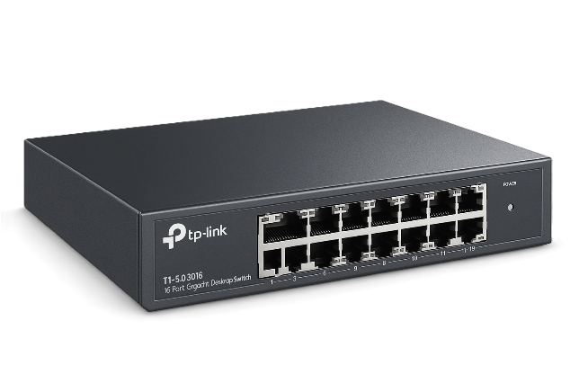




⚙️ General description of project
High level bill of material
1–2 On‑prem servers (AI compute + application services)
1–2 managed Ethernet switches (AI network / segmentation)
Additional network hardware (as needed)
access point
Client endpoints:
control‑room PC,
shopfloor kiosk/totem,
rugged tablet/laptop
Wiring & accessories:
power supply,
patch cords,
mounting and labeling

Slide 12


⚙️ General description of project
Features
Legenda
Included in the first release (baseline scope)
Planned post‑MVP (roadmap / next releases)

Slide 13
⚙️ General description of project
Features
Chat‑based guided troubleshooting grounded on validated Bottero documentation + read‑only machine context Structured workflow (Context → Docs retrieval → Read‑only data retrieval → Grounded answer → Session summary & next prompts)
Triage report generation for Tier 2/3 (status, recent alarms, suggested checks, user‑confirmed actions)
Multilingual interaction with preserved technical terminology and cited sources
Guardrails by design: no write access to machinery, explicit “I do not know” when evidence is missing, no unsafe tuning recommendations
See «3.2 General goals of project»

Slide 14
⚙️ General description of project
Features
Preventive / predictive maintenance: detect recurring patterns across alarms/events/counters
Assisted spare‑parts identification from user manual (photos, partial codes, ballooned drawings) + potential workflow to sales/service follow‑up
Directional reporting
Training session
Multiline configuration
See «3.2 General goals of project»

Slide 15
⚙️ General description of project
Features
Software solution developed as an on-premise industrial application running on a dedicated server external to the machine control system.
Based on LLM with Retrieval-Augmented Generation (RAG) architecture.
Must combine static technical knowledgebase and dynamic machine context in the same answer flow.
Static technical knowledge must include Bottero manuals for IS machines, Stackers, Bottero Robot, HTH hoods and other Bottero peripherals.
Static technical knowledge may include troubleshooting manuals, electrical schematics,
drive documentation and validated technical anonymized e-mails.
See «4.3.1.1 High-level software requirements»

Slide 16
⚙️ General description of project
Features
Dynamic machine context
Dynamic machine context must IS machines and Bottero Robot.
Stackers, HTH hoods and other Bottero peripherals must be foreseen.
Dynamic data of interest include alarm tables, event logs, production counters and
other validated machine context snapshots (e.g. lubricant consumption from
Bottero Robot).
The system must never execute write commands toward PLCs, SQL databases,
or supervisory systems.
See «4.3.1.1 High-level software requirements»

Slide 17
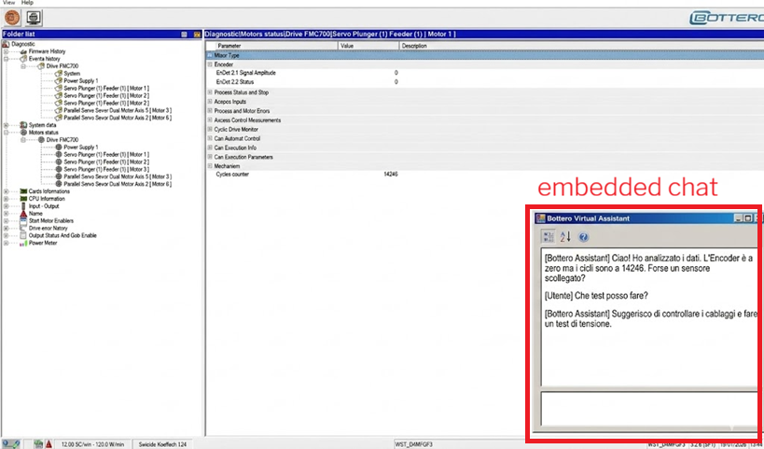
⚙️ General description of project
Features
Dynamic machine context
Compatibility with Bottero SQL Server-based integrations
API availability for embedding
integration
Compatibility with OPCua server technology
See «4.3.1.1 High-level software requirements»
4.3.1.3 Communication with machine-related systems

Slide 18
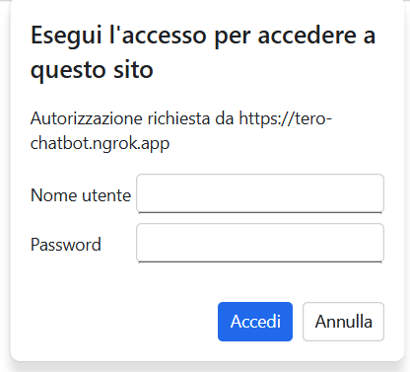
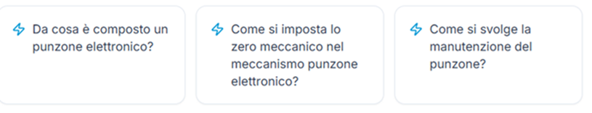
⚙️ General description of project
Features
User authenfication required According user authentication, chatbot shall
be able to retrieve and present relevant previous conversations, adapt its
answers to the user’s operational needs (personas).
According user authetification, chatbot
provides tailored suggested prompts to
support troubleshooting and consultation
activities.
See «4.3.1.1 High-level software requirements»

Slide 19
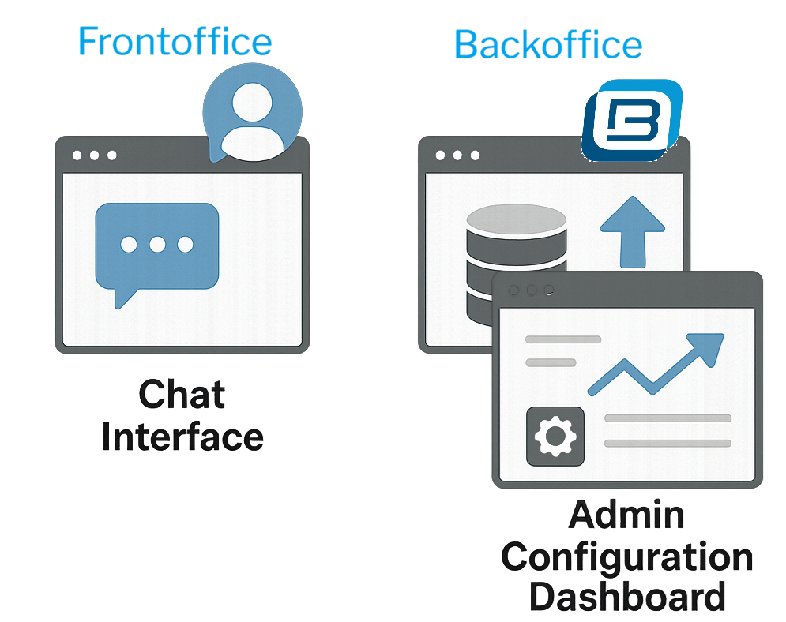
⚙️ General description of project
Features
Software interface must expose
the following logical modules:
Frontoffice
Backoffice
See «4.3.1.1 High-level software requirements»

Slide 20


⚙️ General description of project
Features
🧠 Retrieval & Reasoning Engine Decouple LLM engine from UI
🔎 Retrieval Flow Correlate alarm codes to technical document
Media Support
  images
  video
Answer quality survey
See «4.3.1.2 Retrieval and reasoning engine software interface»

Slide 21
⚙️ General description of project
Features
Must have
Setup program for automatic software installation, with dependencies included in the installer.
Initiative includes documentation release for software installation, upgrade, patching procedure addressed to Bottero operation and customer service personnel.
Compatibility with Windows 11 (client PC) or greater, Microsoft Edge version 140 or later and Windows Server 2025.
Compatibility with Chrome version 146.0.7680.165 or later
Nice to have
See «4.3.3 Producibility / Installability / Maintenance»

Slide 22
🗓️ Pilot plan
Scope & MVPs
The initiative scope is
to create a Bottero-native industrial copilot for troubleshooting and technical support on IS machines, Stackers, Bottero Robot, Hot treatment hoods and other Bottero peripherals, deployed on-premise.
deliverable
MVP1 Pilot customer shopfloor Glass-Assist and
MVP2 “Customer Service Companion” (internal use).
include guided troubleshooting,
documentation retrieval,
multilanguage support,
operation and corporate analytics (prompt tracing).
See «3.2 General goals of project»

Slide 23
🗓️ Pilot plan
MVPs validation
MVP1 Customer MVP Validation KPI:
Periodic follow up meeting where can be analized
# of prompt, prompt cluster context, argument, feedback (via prompt survey & direct)
MVP2 Internal MVP Validation KPI:
Periodic follow up with Bottero customer service where can be analized
# of prompt, prompt cluster context, argument, case solved
Note: According to this requirement, it’s necessary to have KPI available and ready in backoffice section.
See «4.2 Time Line of project (Gantt)»

Slide 24
🗓️ Pilot plan
MVPs Gantt
April 2026
May
2026
October
2026
January 2027
Ready to
market
MVP use case
Internal
Dataset
validation
MVP1:
Customer
Start of product
validation period
Start of product
validation period
MVP 2:
Internal MVP
June
2026
Q2 2026: interviews with initiative champions, definition of MVP use cases, and preparation of the first validated dataset with Bottero documents and recurring technical questions.
Material supply for MPV1(server, network switch, etc..)
Q3 2026: deployment of MVP in customer service area and validation of the triage workflow to reduce duplicated troubleshooting noise and improve first-level support consistency.
See «4.2 Time Line of project (Gantt)»

Slide 25
🔜 Future features plan
Future features gantt
April
2027
July
2027
October
2027
January
2027
January
2027
Ready to
market
Predictive
maointenance
Spare
parts
Training
session
Directional
Reporting
Mutliline
configuation
June
2027
New modules available starting from Q1 2027
See «3.1 General description of project»

Slide 26
🧾 Business model
Business Model
Recurring cost (Opex) + Hardware (Capex).
Standalone product & inside a “Service and Maintenance agreement” initiative.
See «4.1 Industrial costs of product»

Slide 27
💰 Costs
Costs
Capex: the product target cost shall be validated after HW architecture freeze.
Extimated product cost for standard application: 23k€.
Opex: TBDk€ Glassform.ai Opex annual cost.
The initiative scope shall include:
Bottero Glass-Assist AI software integration development (provided by Glassform.ai);
Bottero Glass-Assist AI hardware internal MVP;
Project management
Validation (internal and customer)
Includes material and manpower cost + supply transport + custom clearence + warranty
See «4.1 Industrial costs of product»

Slide 28
🔒 Confidentiality / Patentability / Certifications
Specification
📚 Grounded on Bottero documentation (dataset), with traceable citations
🔒 Bottero IP remains Bottero property (datasets, prompts/templates, configurations, workflows)
🔐 Secure-by-design: on‑premise deployment, segmentation, authentication
Compliance
ISO 9001 (for innovation process, production quality, and document management)
GDPR compliance
Customer IT governance requirements applicable to on-premise industrial software, with read-only integration, privileged access and controlled (by Bottero) content administration.
EU Data and AI Act
See « 3.4 Certification or Norms reference and documentation (laws and standards) »
See «4.3.2 Product Safety »

Slide 29
📌 Reference to similar or related project
Other
This project builds on previous internal knowledge-based support initiatives (“Lesson learned” teams) for Bottero hollow glass equipment.
Compared with those initiatives, Bottero Glass-Assist AI introduces a product-oriented approach for end customers and adds read-only integration with machinery.
See «3.3 Reference to similar or related project »

