Slide 1

WESTWORLD
Can We Identify the Humans?
Michal Riha
Lisa Demyanenko

Slide 2
WESTWORLD
SUMMARY OF THE
PROJECT
Research Question
Given the dialogues from the Westwold tv series, can we tell which replica was said by a human and which one by a robot?
Data
Subtitles for 27 episodes were manually annotated with the names of the characters and a variable showing whether they are a sythetic being or not
Classification
After running multiple models from Random Forests to CNN, the maximal accuracy we were able to get was around 65% on the binary decision variable
Structured Prediction
POS tagging was chosen as the Structured Prediction task and accuracy of over 95% was achieved on the test dataset with the modified Structured Perceptron

Slide 3
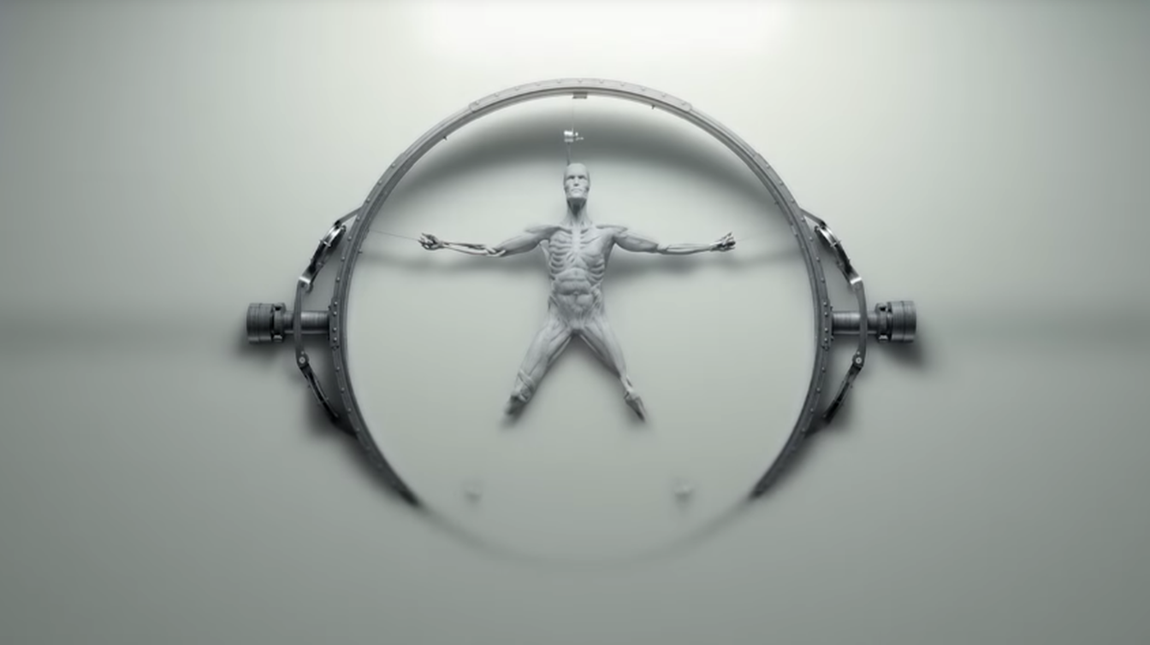
Data & Pre-processing
Structured Prediction
Research Question
Data & Pre-processing
Classification
Analysis

Slide 4



DATA
PREPROCESSING
The Story
Episodes
Dataset
Preprocessed
Wild-west sci-fi drama
27 episodes so far, each approximately 60 minutes long with around 10 both human and robotic main characters
Subtitles were used as the source of the replicas, nevertheless, all episodes had to be rewatched and the characters speaking had to be annotated for every replica
Removal of the punctuation, stop words and numbers as well as lemmatization after which we kept only 'NOUN', 'VERB', 'PROPN', 'ADJ', 'ADV’, INTJ & PRON left us with:
Artificial human beings are places into an amusement park to entertain real human guests
As the show progresses it becomes rather unclear who is and who is not a real human
Every episode includes dialogues between all possible combinations of humans and robots
Approximitely 7,900 replicas with the character saying them were obtained
Replicas: 7679
Tokens: 95,979
Types: 5261

Slide 5


Research
Question
Current Situation
With the rise of chatbots and AI generated text, interest in distinguising between human and robotic communication araise
Reasoning
The dataset of the replicas used in the show serves as an ideal dataset for studying the distinction of the artificial and human speech
Goal
Our goal is to examinate if we are able to tell apart the two types of conversation with the NLP tools at hand

Slide 6
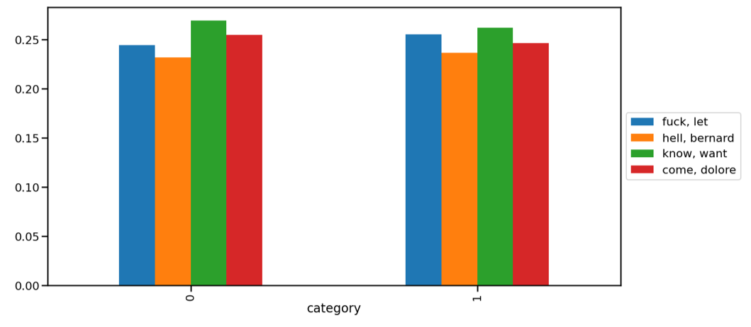
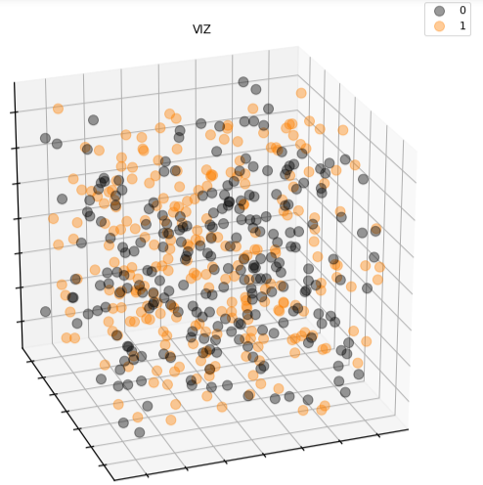
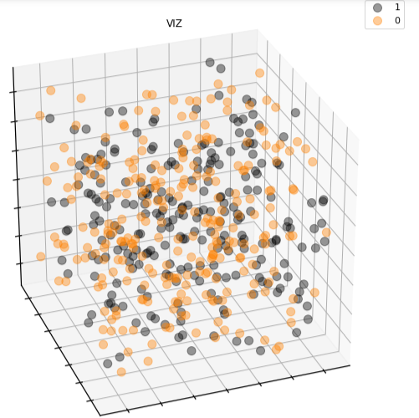
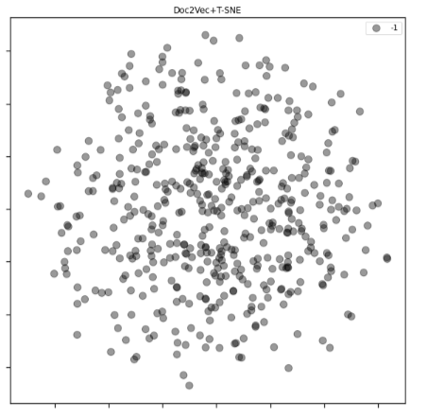
ANALYSIS
LDA
Clustering
T-SNE
Agglomerative
K-means
T-SNE, Agglomerative, K-means and DBSCAN clustering performed
LDA results in four main topics
Same distribution of the topics over humans and robots
K-means and Agglomerative yield two unseparable clusters in lower dimensions
Topics cannot help us predict the race of the speaker
T-SNE and DBSCAN prove the inseparability

Slide 7
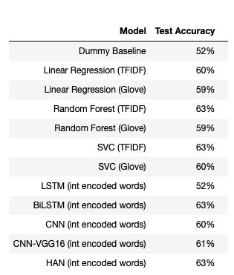
Results
MF Labeling, LogReg
According to the instructions, the Most-Frequent model was used on the dataset as baseline
52%-60%
Random Forest
As only small amount of data was obtained, before using data intensive Neural Nets, SVM and Random Forest was tested for performance improvement
63%
(Bi)LSTM
LSTM and Bidirectional-LSTM were implemented in the attempt to increase the performance
CLASSIFICATION
63%
CNN
After initial implementation of the model from class, more complex VGG16 architecture was implemented
65%
HAN
On top of the architectures done in class, Hierarchical Attention Network was used to improve the performance of the prediction
63%

Slide 8
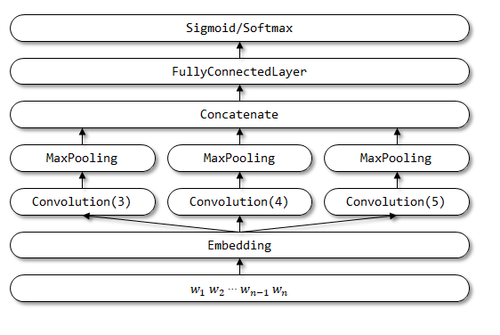
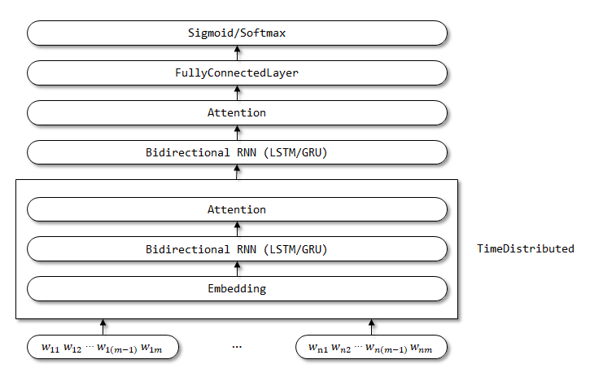
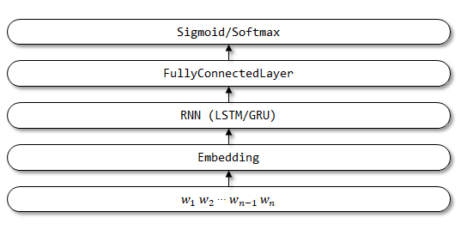
Deep Learning Models Architectures
Tuned number of hidden units
Tuned number of hidden units
“Attention” layer after BiSTM
Dropout 0.2
Uses TimeDistributed layer
Initializaed with Glove vectors
HAN
CNN
LSTM
Tuned number of filters, filter and stride size
Dropout 0.2
Initializaed with Glove vectors

Slide 9
STRUCTURED PREDICTION
Structured Perceptron
(lecture version)
Structured Perceptron
(additional features)
RNN
–
LSTM
The features of the model were tweaked, by modifying the methods defined in order to include 3-grams and 4-grams into the prediction
According to the instructions, the model used in class was reused on the dataset as baseline
Best chance of improved performance had the best performing model from the Classification section.
Also, larger conbinations of foregoing and subsequent words was used in features
Thefore, the BiLSTM was implemented to improve the performance when compared to the original Structured Perceptron
The greedy infence method outperformed the viterbi method by a significant amount
Different prepocessing than for classification, including maximum of the usable words, was used
Train
Test
Train
Test
Train
Test
Greedy
0.95
0.94
0.97
0.95
0.95
0.94
Viterbi
0.93
0.91
0.95
0.92
Results

