Slide 1
Data-Efficient Processor Algorithms for
Single-Photon 3D Cameras
Presented by: Cole A. Saldanha

Slide 2
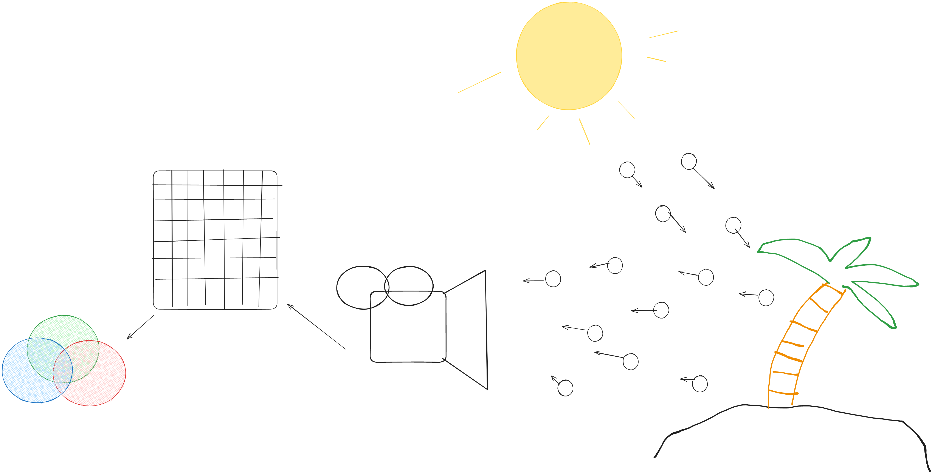
Single-Photon Cameras & SPAD Sensors

Slide 3
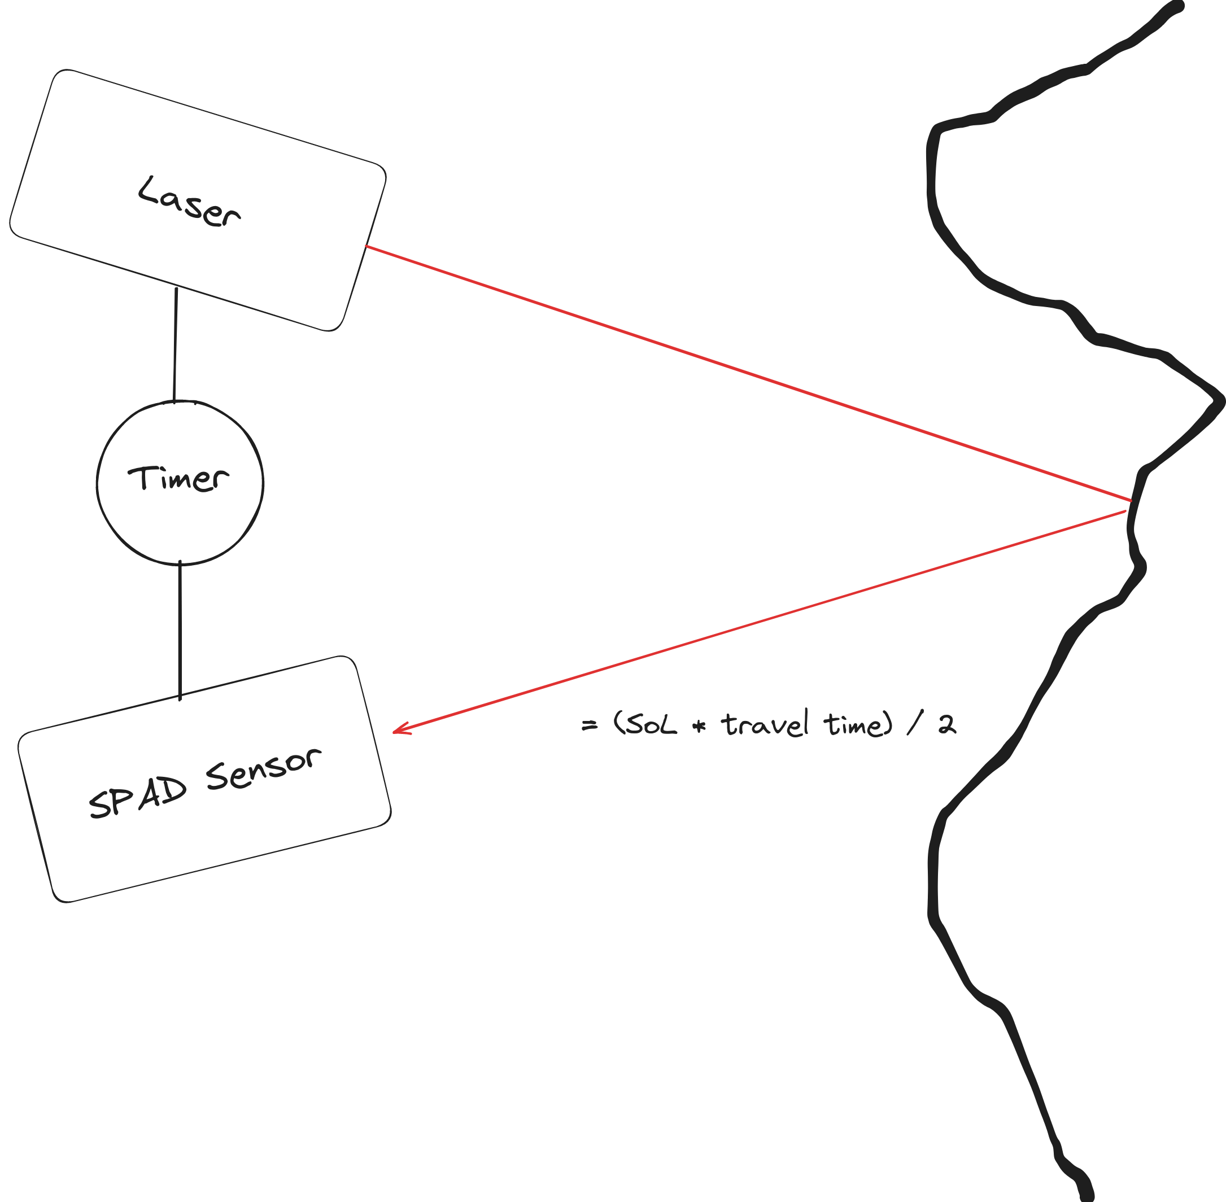
Time-of-Flight (ToF) 3D Cameras

Slide 4
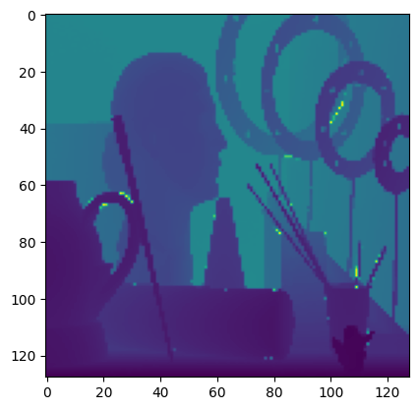
The Data Problem
(16x16) * sizeof(float) * # of bins

Slide 5
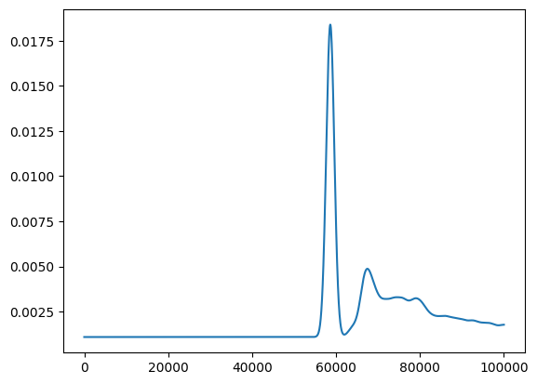
What We Know
Photon arrivals follow rules of poisson statistics
Discrete domain
Distribution varies...

Slide 6
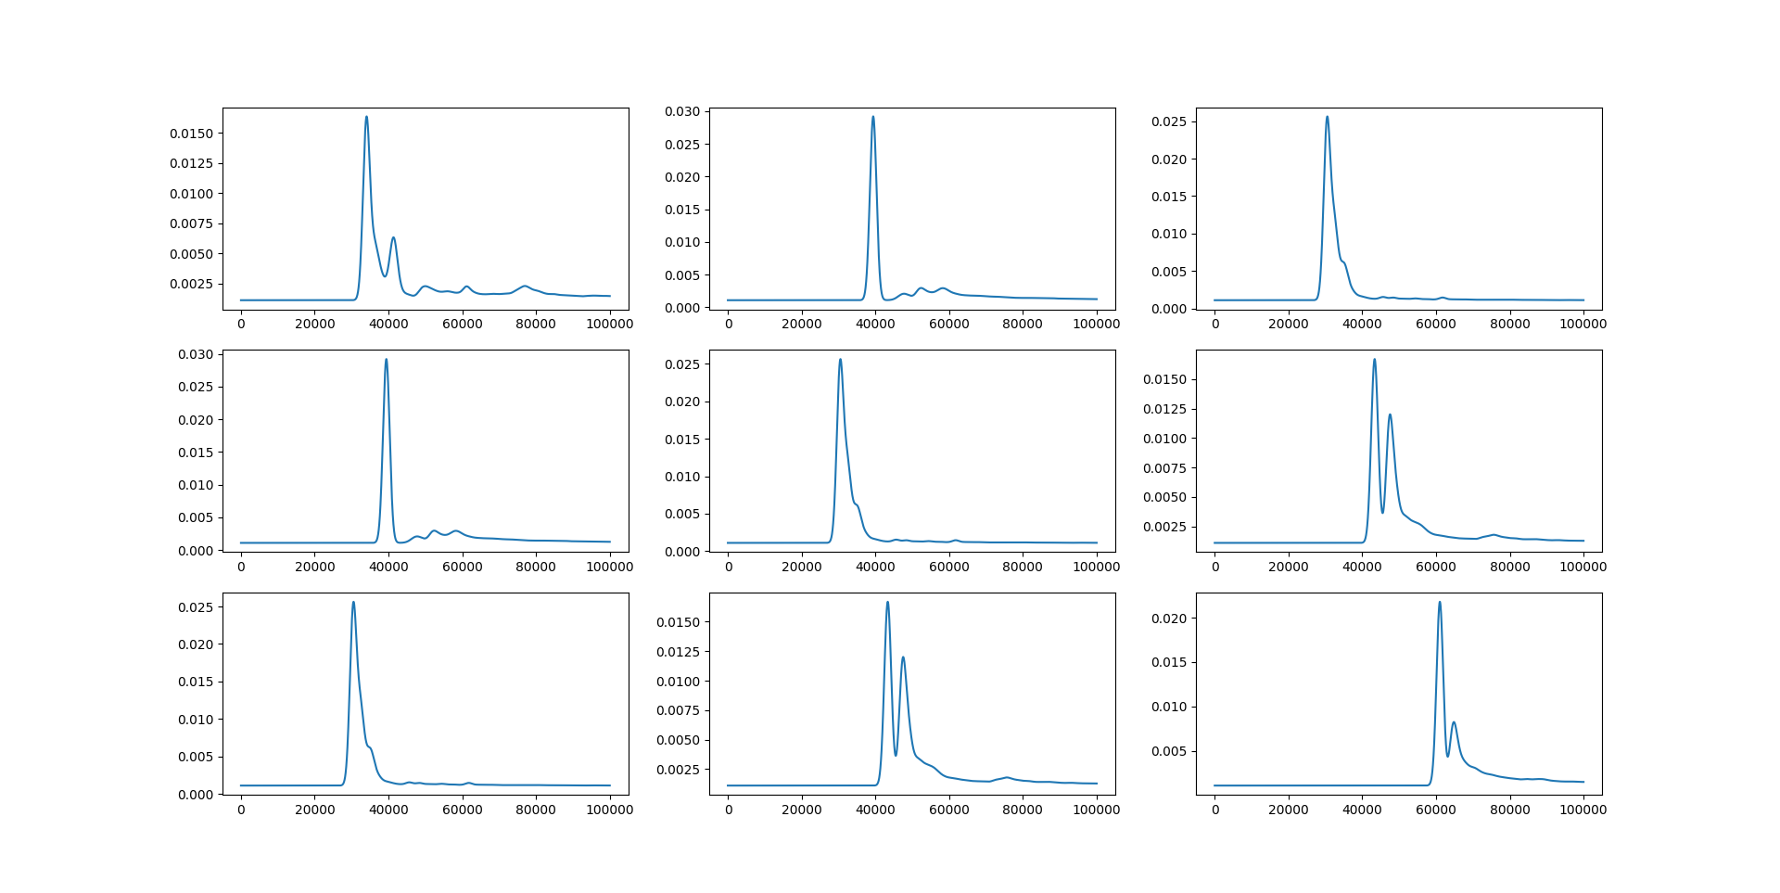

Slide 7
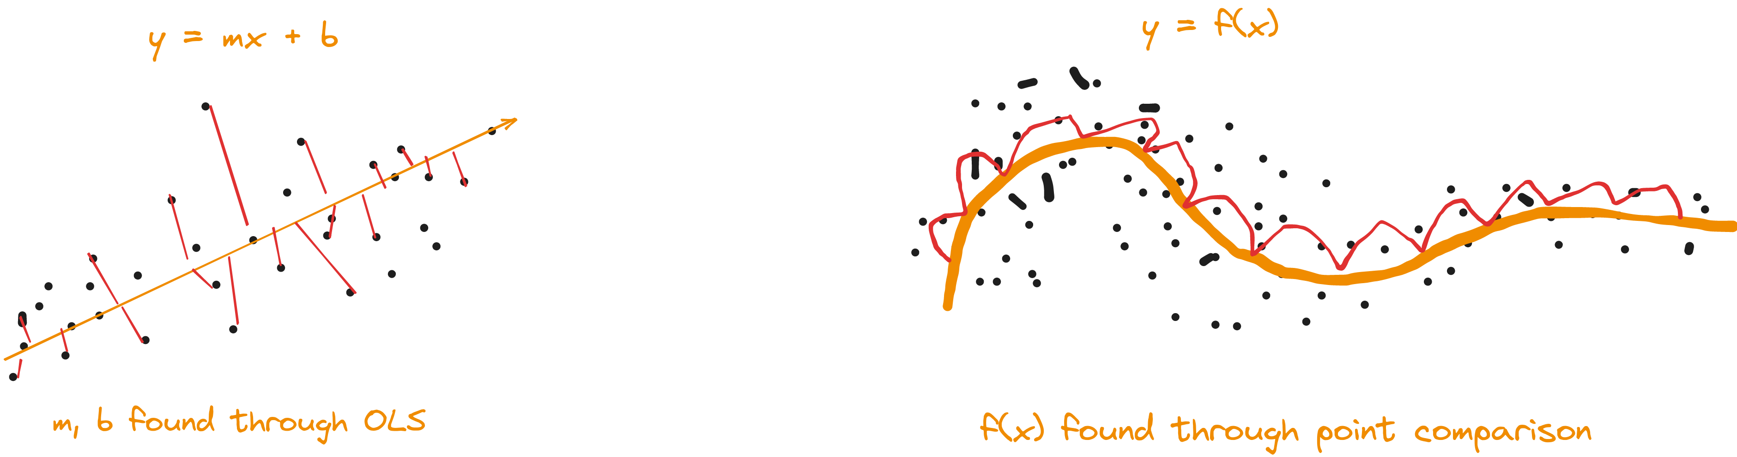
Parametic VS Non-parametic

Slide 8
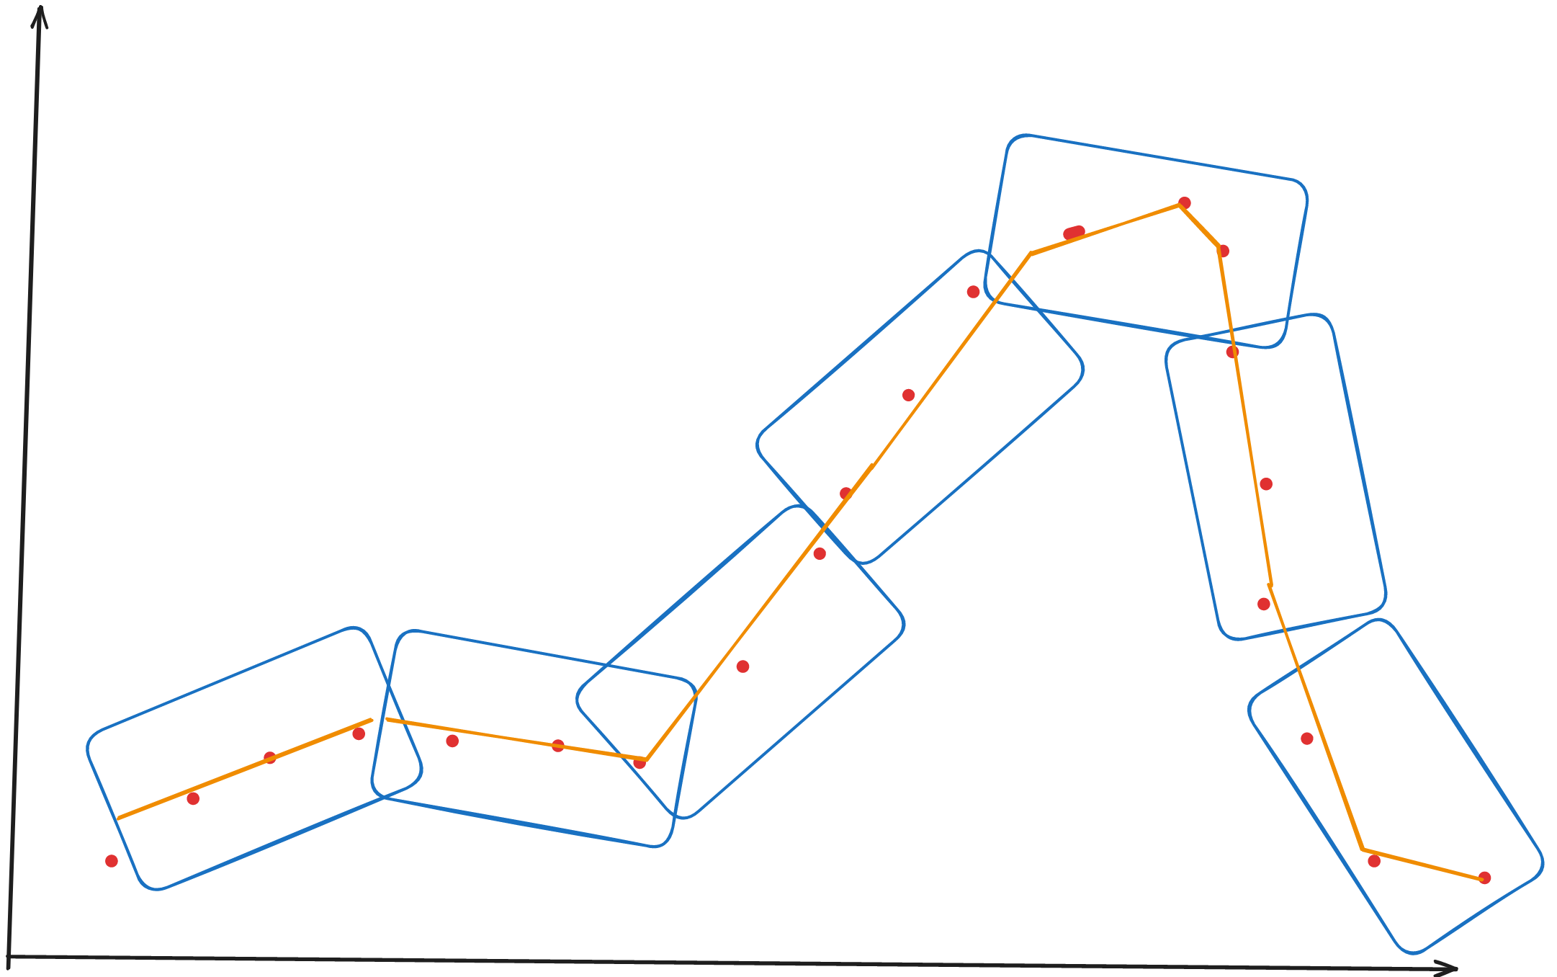
LOWESS Regression

Slide 9
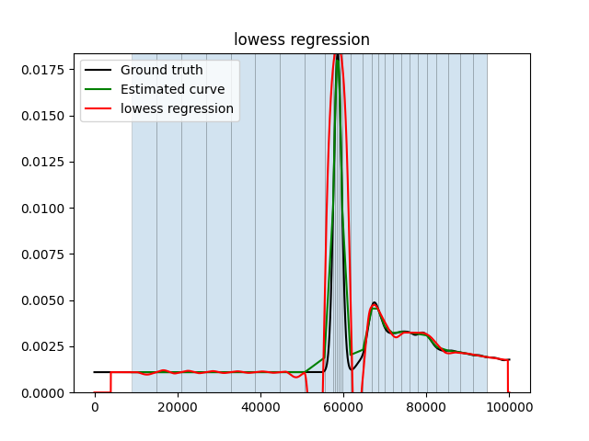
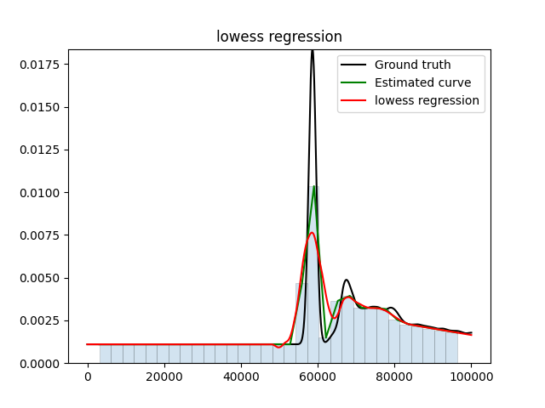
LOWESS Regression (Results)

Slide 10


Gaussian Process (GP) Regression
Radial Basis Function (RBF)
Radial Basis Function (RBF)
Radial Basis Function (RBF)
Rational Quadratic Function (RQ)

Slide 11
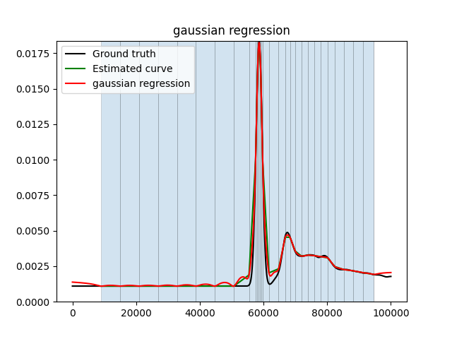
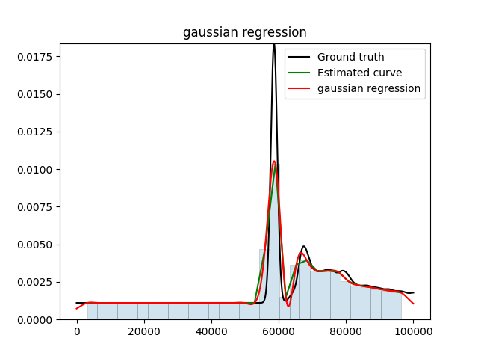
Gaussian Process Regression (Results)

Slide 12
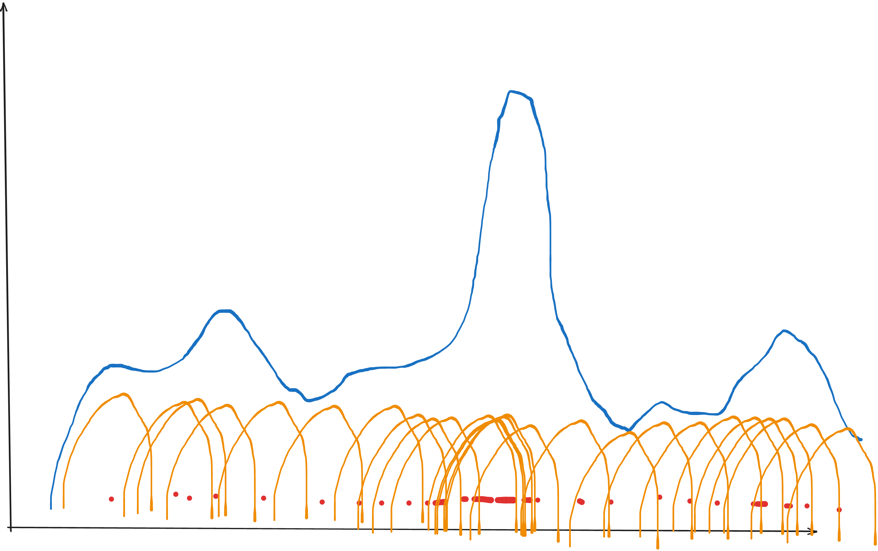
Kernel Density Estimation

Slide 13
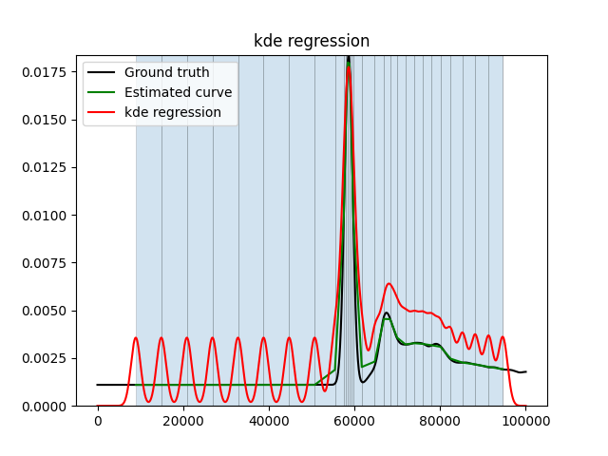
Kernel Density Estimation (Results)

Slide 14
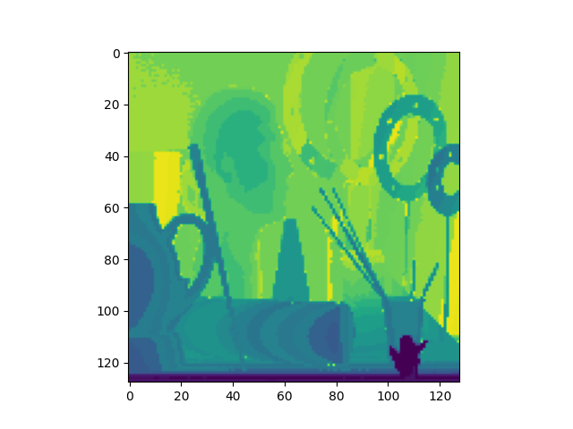
Depth Map Comparisons
Ground-Truth
Lowess

Slide 15
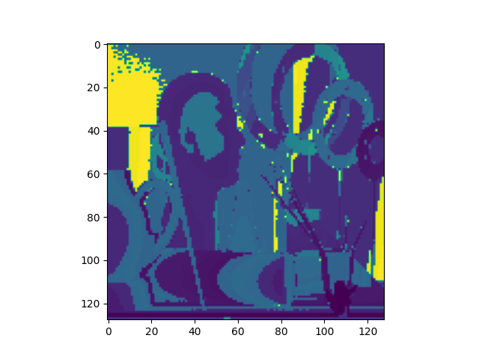
Depth Map Comparisons
Ground-Truth
Gaussian

Slide 16
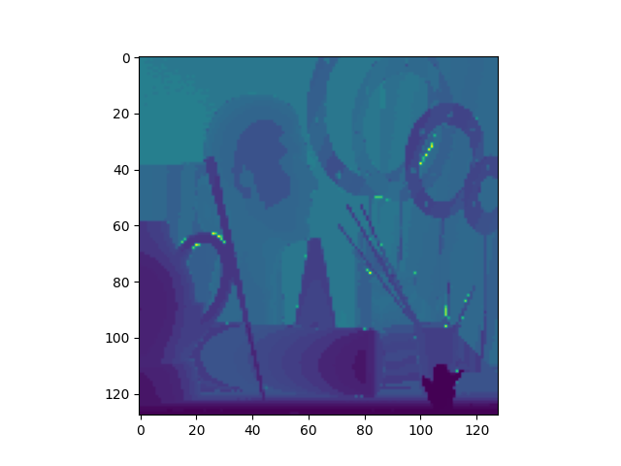
Depth Map Comparisons
Ground-Truth
KDE

Slide 17
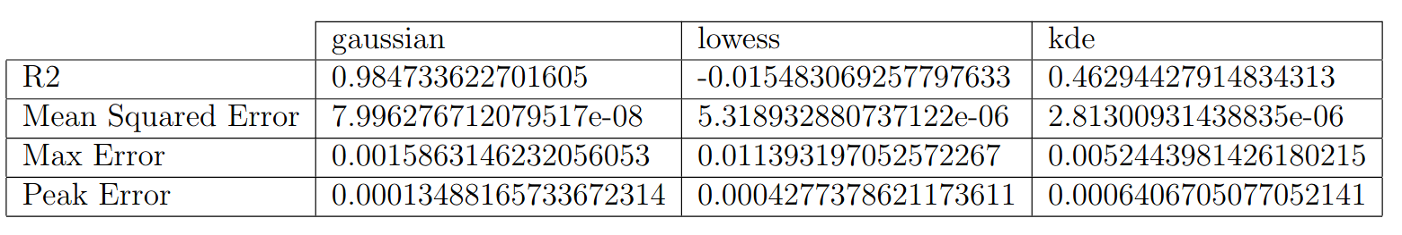
Conclusion
Comparing performance of each model
Limitations and potential improvements

Slide 18
Thank you!

Slide 19
Acknowledgments
Huge thank you to my mentor Daphne Kurzenhauser for guiding and advising me throughout the course of this research project.
Thank you to Atul Ingle, Kaustubh Sadekar, and the rest of PSU’s Computational Imaging Lab Team for providing both code and educational resources.

