Slide 1
Project 3: Interim Analysis
Eleanor Cotton

Slide 2
Summary/Goal
Sample
Healthy elders (n = 205)
Followed up yearly (7 years on average)
What is the rate of memory decline as participants age?
Healthy participants vs. Dementia participants
Is there a time period before the diagnosis in where the rate of the memory decline changes?

Slide 3
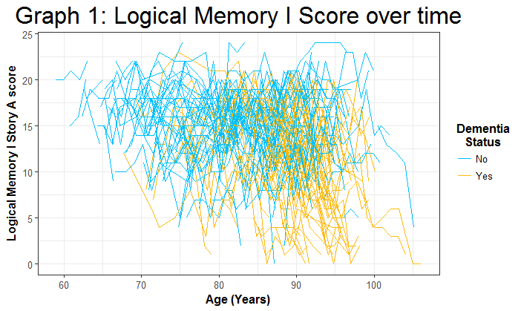
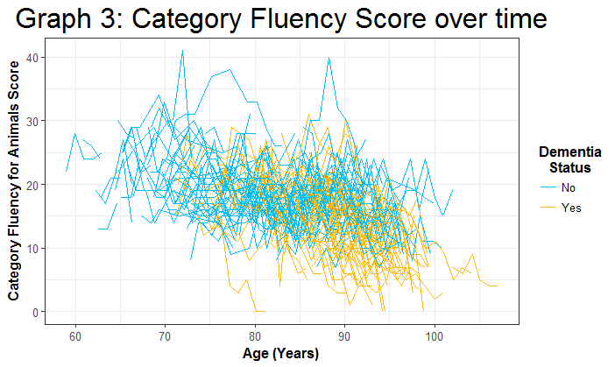
Data Overview
Table One: Demographics
Variable (Baseline) | All Patients | Dementia Diagnosis | No Dementia Diagnosis
N | 205 | 71 | 134
Sex (n (%))
Male | 42.44 (87) | 33.8 (24) | 47.01 (63)
Female | 57.56 (118) | 66.2 (47) | 52.99 (71)
SES (mean ± sd) | 49.33 ± 11.54 (Missing = 1 ) | 49.01 ± 12.89 | 49.5 ± 10.8 (Missing = 1)
Age (mean ± sd) | 79.96 ± 8.94 | 84.8 ± 6.07 | 77.4 ± 9.16
Age at onset (mean ± sd) | 90.7 ± 4.93 (Missing = 134) | 90.7 ± 4.93 | NA
Table Two: Outcomes
Variable (Baseline Values) | All Patients | Dementia Diagnosis | No Dementia Diagnosis
Block Design Test Score | 24.77 ± 9.35 | 21.99 ± 8.68 | 26.25 ± 9.39
Category Fluency for Animals Score | 18.16 ± 4.99 (Missing = 45) | 16.53 ± 4.63 (Missing = 24) | 18.84 ± 5 (Missing = 21)
Logical Memory I Story A Score | 13.64 ± 4.34 | 12.07 ± 4.39 | 14.47 ± 4.10
Logical Memory II Story A Score | 11.25 ± 4.87 | 9.01 ± 4.75 | 12.43 ± 4.52

Slide 4
Analysis Plan
Perform Mixed modeling
Account for repeated measures
Control for sex, SES, and age
One model for each outcome
Use statistical techniques to identify a point before diagnosis that patterns shift
Identify a change point before diagnosis
Account for this in modeling

