Slide 1
Project 3: Cognitive Loss over Time
Eleanor Cotton

Slide 2
Research Questions
What is the trajectory of cognitive loss for individuals who did not develop dementia?
What is the trajectory of cognitive loss for individuals who did develop dementia?
Is there a period before dementia diagnosis that cognitive loss trajectories change?

Slide 3
Data Summary
Table One: Demographics
Variable | All Patients | Dementia Diagnosis | No Dementia Diagnosis
N | 216 | 71 | 145
# Obs (mean ± sd) | 15.67 ± 8.42 | 18.73 ± 6.18 | 14.17 ± 8.97
Sex (n (%))
Male | 42.13 (91) | 33.8 (24) | 46.21 (67)
Female | 57.87 (125) | 66.2 (47) | 53.79 (78)
SES-Baseline (mean ± sd) | 49.1 ± 11.54 (NA = 1) | 49.01 ± 12.89 | 49.15 ± 10.86
Age-Baseline (mean ± sd) | 80.05 ± 9.22 | 84.8 ± 6.07 | 77.72 ± 9.62
Age at onset (mean ± sd) | 90.7 ± 4.93 (NA = 145) | 90.7 ± 4.93 | NA
216 individuals → 187 individuals for analysis due to missingness
Outcome: Category Fluency for animal test (Animal Score)

Slide 4
Analysis
Change point identified via likelihood maximization
Mixed Model with Animal Score as outcome
Random Intercept and AR(1) covariance structure
Included Age, dementia status, the interaction between age and dementia status, SES, gender and the change point in the model
Use bootstrapping to get CI around change point and accurate SE for the model estimates.

Slide 5
Results
Males and Non-dementia individuals are the reference group
Table Two: Model Results
Variable | Estimate | SE | 95% CI | P-value
Intercept | 24.59 | 1.3593 | (21.926,27.255) | <0.0001
Age | -0.183 | 0.0251 | (-0.232,-0.134) | <0.0001
Change Point | -0.929 | 0.1503 | (-1.223,-0.634) | <0.0001
Gender | -0.562 | 0.4649 | (-1.473,0.349) | 0.2269
SES | 0.039 | 0.0181 | (0.003,0.074) | 0.0314
Dementia | -4.348 | 2.5773 | (-9.4,0.703) | 0.0916
Interaction (Dementia and Age) | 0.005 | 0.0816 | (-0.155,0.165) | 0.9486
Age is adjusted (age – 59)
Change Point: Estimated at -3.9 (approximate 4 years prior to diagnosis)
Gender, Dementia and Interaction not significant
Age, SES, and Change point significant
Age: change in animal score for 1 year increase in age
SES: change in animal score for 1 unit increase in SES
Change Point: change in slope 4 years and onward after diagnosis

Slide 6
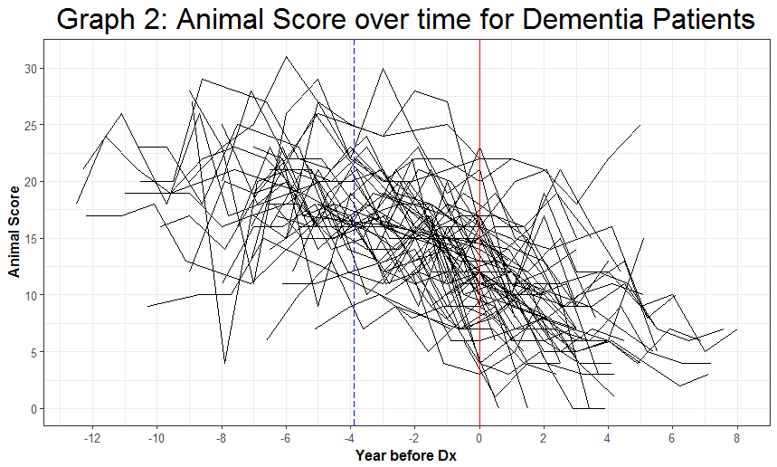
Results

Slide 7
Conclusions/Limitations
For non-dementia and dementia patients (4+ years prior to diagnosis)
1 year increase in age, there is on average a 0.183 point decrease in animal score
For dementia patients (less than 4 years prior to diagnosis and onward)
1 year increase in age is now associated with a 1.112 point decrease on average in animal score
Approximately 4 years prior to dementia in a crucial time for cognitive change.
Limitations
Sample size loss
Large CI around change point
More data on dementia patients

