Slide 1
Project 1: HIV and Drug Use
Eleanor Cotton

Slide 2
Research Question/Hypotheses
How does hard drug use affect treatment response in HIV+ men from baseline to two years after initiating HAART?
Some evidence that Drug Use → poorer immune system, replication
Hypothesis: The change in CD4+ and Viral Load from baseline to year 2 will be smaller in drug users compared to non-users
Not sure how drug use affects Quality of Life (QOL)
Hypothesis: The drug users and non-users will differ in their QOL score changes from baseline to year two

Slide 3
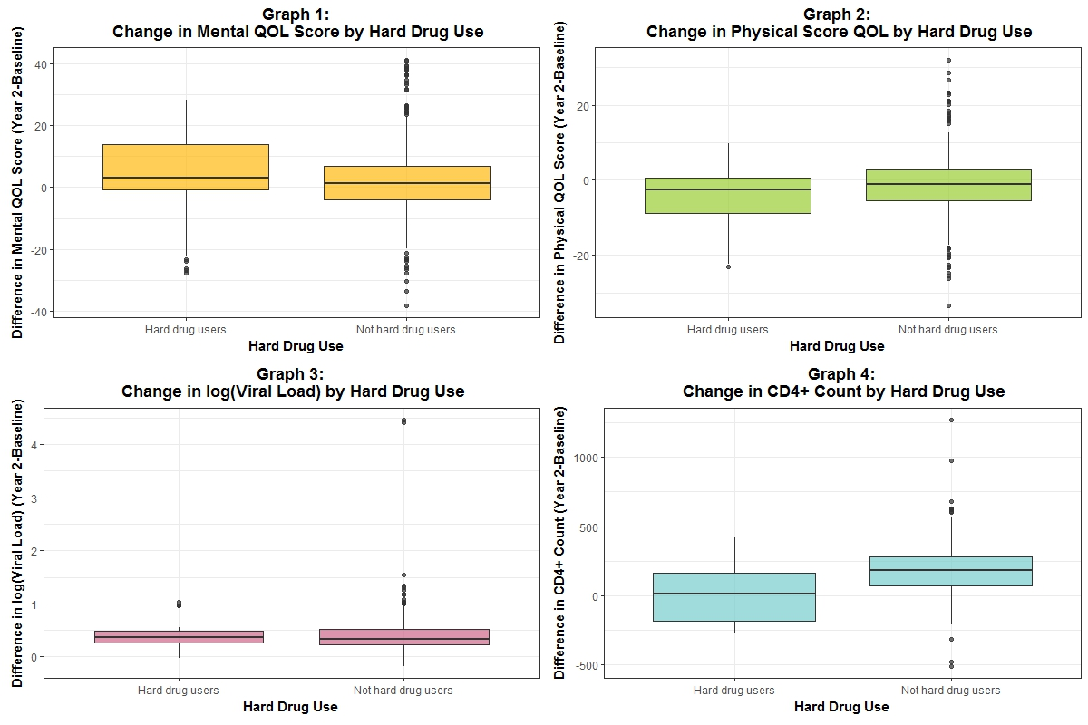
Data Summary
Table One: Demographics
Variable | All Patients | Drug Users | Not Drug Users
N | 476 | 39 | 437
Age (mean ± sd) | 43.26 ± 8.72 | 44.62 ± 9.49 | 43.14 ± 8.65
BMI (mean ± sd) | 25.21 ± 4.34 | 23.62 ± 3.45 | 25.34 ± 4.39
Race (% (n))
White | 62.61 (298) | 48.72 (19) | 63.84 (279)
Non-White | 37.39 (178) | 51.28 (20) | 36.16 (158)
Marijuana Use (% (n)) | 40.76 (194) | 30.77 (12) | 41.65 (182)
Income (% (n))
<10000 | 21.57 (99) | 35.9 (14) | 20.24 (85)
10000-39999 | 42.7 (196) | 41.03 (16) | 42.86 (180)
>40000 | 35.73 (164) | 23.08 (9) | 36.9 (155)
Smoker (% (n)) | 38.87 (185) | 76.92 (30) | 35.47 (155)
Alcohol consumption (% (n))
3 or less/week | 93.07 (443) | 94.87 (37) | 92.91 (406)
4 or more/week | 6.93 (33) | 5.13 (2) | 7.09 (31)
Education (% (n))
1 year college or less | 21.22 (101) | 41.03 (16) | 19.45 (85)
4 year college or more | 78.78 (375) | 58.97 (23) | 80.55 (352)
Adherence (% (n))
100% | 10.5 (50) | 2.56 (1) | 11.21 (49)
<100% | 89.5 (426) | 97.44 (38) | 88.79 (388)
476 Total Patients
Only individuals who had all four outcomes at baseline and year 2
Initial differences between Drug users and non-users
Outcomes: CD4+ count, Viral Load (log), Mental QOL, and Physical QOL
Demographics: Race, Income, Smoking, and Education

Slide 4
Analysis
Hybrid Linear regression model
Difference between year 2 and baseline for outcomes, adjusting for baseline
Bayesian Methods
Vague Priors
Covariates ~ Normal
Errors ~ Inverse Gamma
PROC MCMC → Random walk metropolis-Hastings algorithm
Convergence and mixing assessed visually
~200,000 iterations and ~20,000 burn in
Compared Full Models and Crude Models
DIC

Slide 5
Results-QOL
Mental: No evidence that drug users and non-users differed.
Estimate: -0.4596 (95% HPD: -4.0932 to 2.9386)
Physical: Evidence that drug users had lower Physical QOL differences than non-users
Estimate: -3.0955 (95% HPD: -5.9218 to -0.4560)

Slide 6
Results-Lab Values
CD4+: Evidence that drug users had lower CD4+ count difference than non-users
Estimate: -82.7244 (95% HPD: -128.0 to -40.1647)
Viral Load: No evidence that drug users and non-users differed
Estimate: -0.0265 (95% HPD: -0.1598 to 0.1020)

Slide 7
Conclusions/Limitations
Evidence that drug use has an negative effect on Physical QOL and CD4+
No evidence that drug use has an effect on Mental QOL and Viral Load
Small Drug user sample
Only two years of data
Missing Data

