Slide 1
Project 2: VA Hospital Mortality Rates
Eleanor Cotton

Slide 2
Research Question
Primary:
What are the predicted mortality rates for each VA hospital?
What is the variation associated with each predicted mortality rate?
Secondary:
Is albumin associated with mortality rates?

Slide 3
Data Summary
Table One: Demographics
Variable | All Patients | Drug Users | Not Drug Users
N | 476 | 39 | 437
Age (mean ± sd) | 43.26 ± 8.72 | 44.62 ± 9.49 | 43.14 ± 8.65
BMI (mean ± sd) | 25.21 ± 4.34 | 23.62 ± 3.45 | 25.34 ± 4.39
Race (% (n))
White | 62.61 (298) | 48.72 (19) | 63.84 (279)
Non-White | 37.39 (178) | 51.28 (20) | 36.16 (158)
Marijuana Use (% (n)) | 40.76 (194) | 30.77 (12) | 41.65 (182)
Income (% (n))
<10000 | 21.57 (99) | 35.9 (14) | 20.24 (85)
10000-39999 | 42.7 (196) | 41.03 (16) | 42.86 (180)
>40000 | 35.73 (164) | 23.08 (9) | 36.9 (155)
Smoker (% (n)) | 38.87 (185) | 76.92 (30) | 35.47 (155)
Alcohol consumption (% (n))
3 or less/week | 93.07 (443) | 94.87 (37) | 92.91 (406)
4 or more/week | 6.93 (33) | 5.13 (2) | 7.09 (31)
Education (% (n))
1 year college or less | 21.22 (101) | 41.03 (16) | 19.45 (85)
4 year college or more | 78.78 (375) | 58.97 (23) | 80.55 (352)
Adherence (% (n))
100% | 10.5 (50) | 2.56 (1) | 11.21 (49)
<100% | 89.5 (426) | 97.44 (38) | 88.79 (388)
Original Cohort = 26520
2 people were removed due to incorrect procedure
Complete case cohort consisted of 21346
Observed mortality rate was measured using the 4424 people from period 39.
Predicted mortality rate was measured using the 3478 people from period 39 who had compete case.

Slide 4
Analysis
Logistic Regression
30 day mortality as outcome
Controlling for ASA, procedure type, and BMI
Estimate predicted mortality rates by averaging the predicted mortality rate for each individual by hospital
Bootstrapping
Get the 95% confidence interval associated with each predicted mortality rate
Albumin Analysis
Logistic Regression
Controlling for Albumin, procedure type, and BMI

Slide 5
Results
Table Two: Death Rates by Hospital
Hospital | Number Died | Number Seen | Observed Death Rate | Predicted Death Rate | 95% CI of Pre. Death Rate | Obs./Pre. Death Rate | High or Low Ratio?
7 | 7 | 105 | 6.67 | 3.12 | (2.89, 3.35) | 2.14 | ≥ 1.20
17 | 13 | 93 | 13.98 | 3.48 | (3.22, 3.75) | 4.02 | ≥ 1.20
19 | 0 | 113 | 0 | 3.13 | (2.89, 3.37) | 0 | ≤ 0.80
32 | 0 | 93 | 0 | 3.19 | (2.96, 3.43) | 0 | ≤ 0.80
33 | 0 | 113 | 0 | 3.29 | (3.05, 3.54) | 0 | ≤ 0.80
34 | 14 | 99 | 14.14 | 3.17 | (2.93, 3.41) | 4.46 | ≥ 1.20
42 | 0 | 107 | 0 | 2.97 | (2.74, 3.20) | 0 | ≤ 0.80
44 | 0 | 98 | 0 | 3.20 | (2.97, 3.44) | 0 | ≤ 0.80

Slide 6
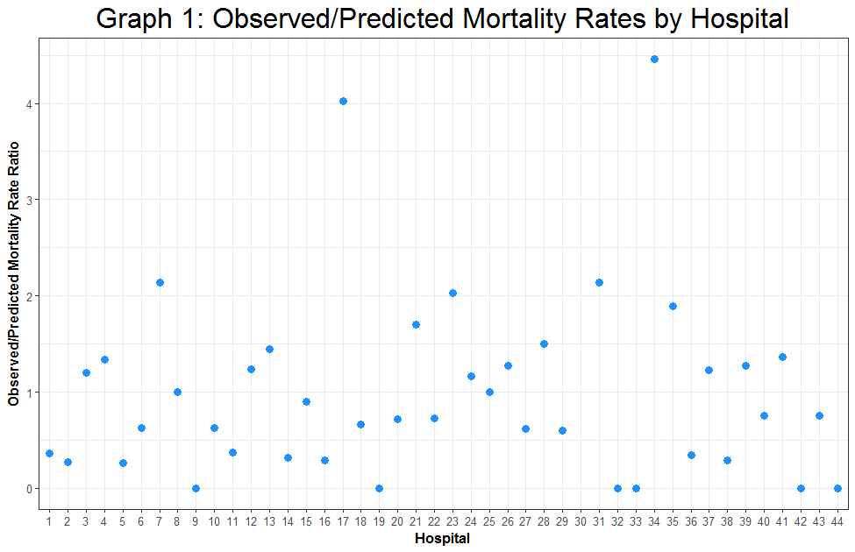
Results

Slide 7
Conclusions
Hospitals 7, 17, 34 should be investigated due to their much higher observed mortality rate compared to their predicted mortality rate
Hospitals 19,32,33,42, and 44 should be investigated due to their much lower observed mortality rate compared to their predicted mortality rate.
Albumin is not associated with mortality rate

Slide 8
Limitations
Hospital 30 did not have a predicted value estimated
Missing data
Albumin
Slight bias due to different population in observed and the predicted

