Slide 1
Project 2: VA Hospital Mortality Rates
Eleanor Cotton

Slide 2
Research Question
Primary:
What is the observed mortality rate for each VA hospital?
What is the predicted mortality rate for each VA hospital?
What is the variation associated with each predicted mortality rate?
Secondary:
Is albumin associated with mortality rates?

Slide 3
Data Summary
Table One: Comorbidities
Variable | All Periods | Current Period | Past Periods
N | 26518 | 4424 | 22094
Procedure*
Valve Surgery | 18.42 (4884) | 17.90 (792) | 18.52 (4092)
CABG Surgery | 75.90 (20126) | 76.40 (3380) | 75.79 (16746)
Missing | 5.69 (1508) | 5.70 (252) | 5.68 (1256)
ASA*
Low (1,2,3) | 22.44 (5950) | 22.81 (1009) | 22.36 (4941)
High (4 or 5) | 69.42 (18408) | 69.60 (3079) | 69.38 (15329)
Missing | 8.15 (2160) | 7.59 (336) | 8.26 (1824)
Weight (lbs)⁺ | 174.84 ± 26.91 (Missing = 1855) | 174.86 ± 27.37 (Missing = 418) | 174.84 ± 26.83 (Missing = 1437)
Height (inches)⁺ | 65.49 ± 2.56 (Missing = 1855) | 65.52 ± 2.61 (Missing = 418) | 65.48 ± 2.54 (Missing = 1437)
BMI⁺ | 28.61 ± 3.8 (Missing = 1855) | 28.58 ± 3.83 (Missing = 418) | 28.62 ± 3.79 (Missing = 1437)
Albumin⁺ | 3.89 ± 0.5 (Missing = 16496) | 3.89 ± 0.50 (Missing = 2695) | 3.9 ± 0.49 (Missing = 13801)
30 day mortality* | 3.27 (868) | 3.28 (145) | 3.27 (723)
Original Cohort = 26520
2 people were removed due to incorrect procedure
Complete case cohort consisted of 21346
Observed mortality rate was measured using the 4424 people from period 39.
Predicted mortality rate was measured using the 3478 people from period 39 who had compete case.
Those with albumin levels recorded only had high ASA scores (MAR)

Slide 4
Analysis
Logistic Regression
30 day mortality as outcome
Controlling for ASA, procedure type, and BMI
Estimate predicted mortality rates by averaging the predicted mortality rate for each individual by hospital
Bootstrapping
Get the 95% confidence interval associated with each predicted mortality rate
Albumin Analysis
Logistic Regression
Controlling for Albumin, procedure type, and BMI

Slide 5
Results
Table Three: Model Outcomes
 | Coeff. Estimates | SE | P-value
Model 1
Intercept | -4.832 | 0.326 | <0.0001
ASA | 1.007 | 0.126 | <0.0001
BMI | 0.011 | 0.011 | 0.315
Procedure Type | 0.334 | 0.109 | 0.002
Model 2
Intercept | -2.730 | 0.652 | <0.0001
Albumin | -0.147 | 0.113 | 0.193
BMI | -0.003 | 0.016 | 0.874
Procedure Type | 0.191 | 0.150 | 0.204
Model 1 (used for prediction)
ASA and procedure type significantly associated with mortality rate
Model 2
Albumin is not significantly associated with mortality rate
Cannot directly compare these models due to ASA not being in model 2.
Albumin missing by ASA score
Only high ASA scores for those with albumin

Slide 6
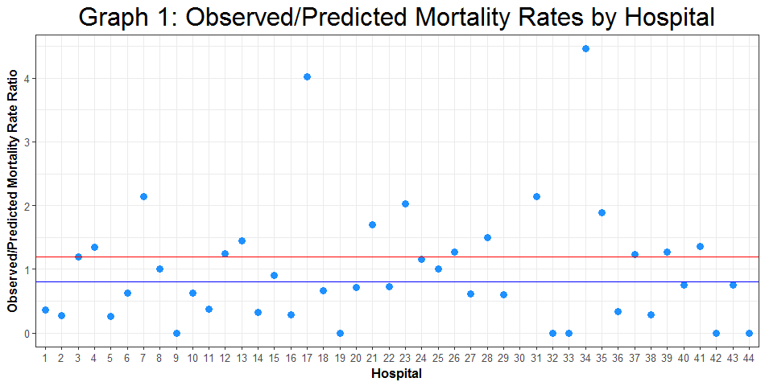
Results
Table Two: Death Rates by Hospital
Hospital | Number Died | Number Seen | Observed Death Rate | Predicted Death Rate | 95% CI of Pre. Death Rate | Obs./Pre. Death Rate | High or Low Ratio?
7 | 7 | 105 | 6.67 | 3.12 | (2.89, 3.35) | 2.14 | ≥ 1.20
17 | 13 | 93 | 13.98 | 3.48 | (3.22, 3.75) | 4.02 | ≥ 1.20
19 | 0 | 113 | 0 | 3.13 | (2.89, 3.37) | 0 | ≤ 0.80
23 | 6 | 97 | 6.19 | 3.05 | (2.83, 3.29) | 2.03 | ≥ 1.20
31 | 7 | 104 | 6.73 | 3.15 | (2.91, 3.39) | 2.14 | ≥ 1.20
32 | 0 | 93 | 0 | 3.19 | (2.96, 3.43) | 0 | ≤ 0.80
33 | 0 | 113 | 0 | 3.29 | (3.05, 3.54) | 0 | ≤ 0.80
34 | 14 | 99 | 14.14 | 3.17 | (2.93, 3.41) | 4.46 | ≥ 1.20
42 | 0 | 107 | 0 | 2.97 | (2.74, 3.20) | 0 | ≤ 0.80
44 | 0 | 98 | 0 | 3.20 | (2.97, 3.44) | 0 | ≤ 0.80

Slide 7
Conclusions/Limitations
16 hospitals have at least a 20% increase in their observed mortality compared to their predicted mortality
Notable hospitals 7, 17, 23, 31, 34 → at least 2x higher observed than predicted
23 hospitals have at least a 20% decrease in their observed mortality compared to their predicted mortality
Notable hospitals 19, 32, 33, 42, 44 → no mortalities observed
Albumin was not a significant predictor of mortality rate, when controlling for BMI and procedure type
ASA dichotomized
Missing Data
Prevented Hospital 30 prediction
Albumin: Missing at Random, limited modelling abilities
Bias in population: Complete vs. Incomplete cases (3.4% and 3.0% respectively)

