Slide 1

Project Zero: Gel Treatment For Gum Disease
Eleanor Cotton

Slide 2
Research Question
Does the proposed gel treatment reduce pocket depth from baseline to year 1?
Does the proposed gel treatment reduce attachment loss from baseline to year 1?
Hypothesis: The gel treatment will reduce pocket depth and attachment loss from baseline to 1 year.

Slide 3
Data summary
Table One: Demographics by Group
 | Treatment Group
Variable | Control | Placebo | Low | Medium | High
Number | 23 | 23 | 21 | 20 | 16
Sex (%)
Male | 30.43 | 43.48 | 42.86 | 35 | 18.75
Female | 69.57 | 56.52 | 57.14 | 65 | 81.25
Race (%)
Native American | 4.35 | 0.00 | 4.76 | 0.00 | 6.25
African American | 4.35 | 4.35 | 14.29 | 0.00 | 6.25
Asian | 4.35 | 4.35 | 0.00 | 5.00 | 0.00
White | 86.96 | 91.3 | 80.95 | 95.00 | 87.5
Smoker (%) | 69.57 | 56.52 | 71.43 | 55.00 | 68.75
Sites (mean ± sd) | 153.91 ± 11.24 | 159.65 ± 10.66 | 161.71 ± 8.16 | 153.5 ± 17.12 | 158.25 ± 8.73
5 treatment group
Collected Demographics (Table one)
Attachment loss and Pocket depth
Baseline and 1 year
Average from many sites
130 people → 103 people

Slide 4
Analysis
Linear modelling
Two models: One for pocket depth and one for attachment loss
Difference (year 1 – baseline) as outcome
Negative values = better at year 1
Treatment group and baseline as covariate
Demographics not included

Slide 5
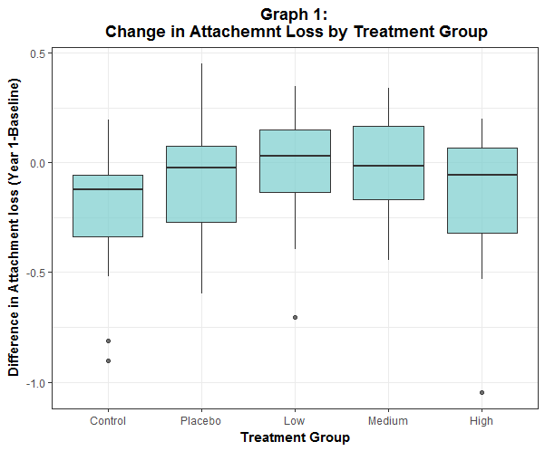
Results: Attachment Loss
Table Two: Model 1 (Attachment Loss) Outcomes
 | Coefficients | SE | P-Value
Control | 0.1071 | 0.0930 | 0.2527
Placebo-Control | 0.0420 | 0.0762 | 0.5824
Low-Control | 0.1460 | 0.0759 | 0.0573
Medium-Control | 0.1759 | 0.0762 | 0.0232
High-Control | 0.0266 | 0.0809 | 0.7425
Attachment Baseline | -0.1290 | 0.0304 | <0.0001

Slide 6
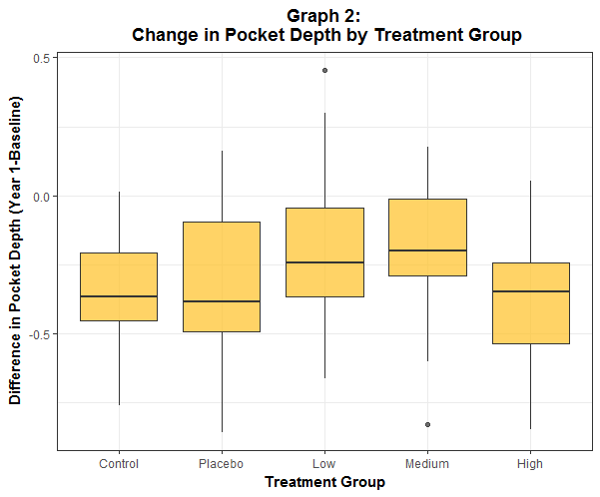
Results: Pocket Depth
Table Three: Model 2 (Pocket Depth) Outcomes
 | Coefficients | SE | P-Value
Control | 0.0334 | 0.1916 | 0.8618
Placebo | -0.0329 | 0.0768 | 0.6700
Low | 0.1248 | 0.0780 | 0.1127
Medium | 0.1084 | 0.0801 | 0.1787
High | -0.0562 | 0.0842 | 0.5061
Pocket Depth Baseline | -0.1130 | 0.0559 | 0.0461

Slide 7
Conclusions/Limitations
Evidence found that medium gel concentration treatment group had negative effect on attachment loss
Not enough evidence to demonstrate that the gel treatment had any effect on pocket depth
Small sample size
One site data collection
Missing data
Adherence to study guidelines?

