Slide 1
Interim Data Analysis Plan: Project 1
Eleanor Cotton

Slide 2
Goal/Hypotheses
How does treatment response differ between hard drug users and non-hard drug users?
HIV infected men
Comparing baseline to two years after being on HAART
Treatment Responses
CD4+ Count
Viral Load
SF-36 Mental QOL Score
SP-36 Physical QOL Score

Slide 3
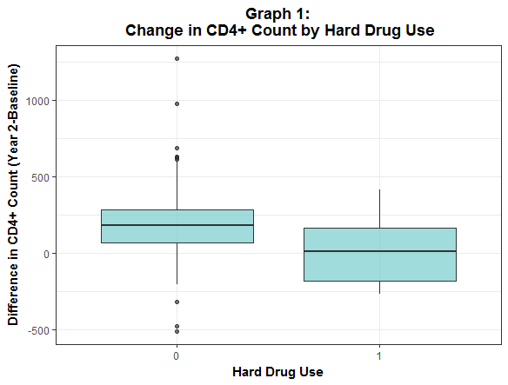
Data Overview
Table 2: Outcome Variables
Variable (mean ± sd) | All Patients | Drug Users | Not Drug Users
SF-36 Mental QOL Score (Baseline) | 45.28 ± 13.53 | 42.31 ± 11.22 | 45.53 ± 13.68
SF-36 Mental QOL Score (2 year) | 47.46 ± 11.94 | 45.89 ± 13.5 | 47.59 ± 11.81
SF 36 Physical QOL Score (Baseline) | 51.01 ± 9.2 | 47.7 ± 8.5 | 51.29 ± 9.21
SF 36 Physical QOL Score (2 year) | 49.41 ± 10.25 | 43.84 ± 11.62 | 49.88 ± 10
Viral Load (Baseline) | 989538.53 ± 11320008.72 | 184278.01 ± 430227.28 | 1058108.75 ± 11789942.3
Viral Load (2 year) | 8356.99 ± 51070.17 | 32946.83 ± 114453.02 | 6216.35 ± 40801.57
CD4+ T cell count (Baseline) | 375.56 ± 201.5 | 352.18 ± 194.67 | 377.55 ± 202.15
CD4+ T cell count (2 year) | 544 ± 268.04 | 365.62 ± 239.7 | 559.52 ± 264.98
Table One: Demographics
Variable | All Patients | Drug Users | Not Drug Users
N | 506 | 39 | 467
Age (mean ± sd) | 43.27 ± 8.78 | 44.62 ± 9.49 | 43.16 ± 8.72
BMI (mean ± sd) | 25.26 ± 4.41 | 23.62 ± 3.45 | 25.39 ± 4.46
Race (% (n))
White | 63.24 ( 320 ) | 48.72 ( 19 ) | 64.45 ( 301 )
Non-White | 36.76 ( 186 ) | 51.28 ( 20 ) | 35.55 ( 166 )
Marijuana Use (% (n)) | 41.11 ( 208 ) | 30.77 ( 12 ) | 41.97 ( 196 )
Income (% (n))
<10000 | 21.47 ( 105 ) | 35.9 ( 14 ) | 20.22 ( 91 )
10000-39999 | 42.94 ( 210 ) | 41.03 ( 16 ) | 43.11 ( 194 )
>40000 | 35.58 ( 174 ) | 23.08 ( 9 ) | 36.67 ( 165 )
Smoker (% (n)) | 38.74 ( 196 ) | 76.92 ( 30 ) | 35.55 ( 166 )
Alcohol consumption (% (n))
3 or less/week | 71.34 ( 361 ) | 79.49 ( 31 ) | 70.66 ( 330 )
4 or more/week | 28.66 ( 145 ) | 20.51 ( 8 ) | 29.34 ( 137 )
Education (% (n))
1 year college or less | 57.51 ( 291 ) | 74.36 ( 29 ) | 56.1 ( 262 )
4 year college or more | 42.49 ( 215 ) | 25.64 ( 10 ) | 43.9 ( 205 )
Adherence (% (n))
100% | 41.7 ( 211 ) | 53.85 ( 21 ) | 40.69 ( 190 )
<100% | 58.3 ( 295 ) | 46.15 ( 18 ) | 59.31 ( 277 )

Slide 4
Analysis Plan
Hybrid Model Design
Difference as outcome, adjusting for baseline measurements
Models for all four outcomes (CD4 + is primary)
Well distributed, lab value
Hard drug use is primary covariate
Bayesian Methods
Investigate prior knowledge about the subject matter
Vague prior →Informative Prior
Include demographics
Variables that differ between the groups (Smoker, education, Adherence, etc)
Sample Size/Viral Load Issues

