Slide 1


Verizon
Main task : detect planograms templates on realograms
Planograms
realograms
Solution : key points + homography

Slide 2

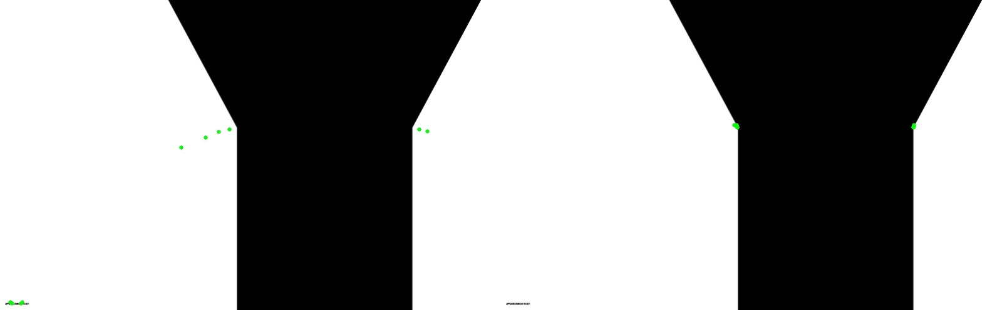
Problem : What are we going to do when we dont have enough key points ?
(Left – ORB , Right – Sift )

Slide 3

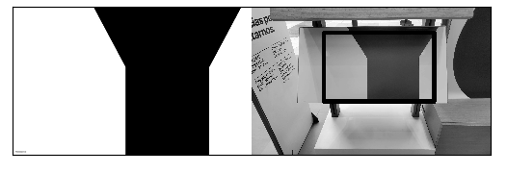

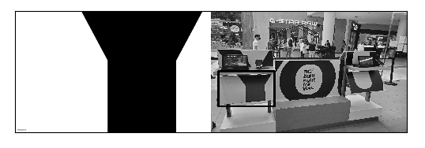
Template Matching
Easy cases :
More Challenging cases :

Slide 4
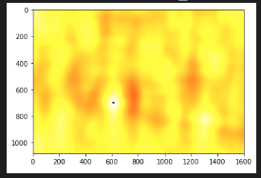
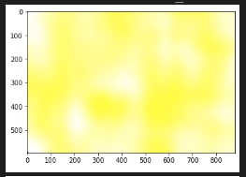
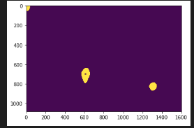
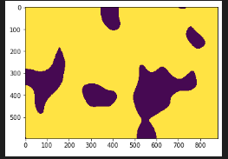


Inside the Corr map

