Slide 1
Accelerate Model Customization on AWS with SageMaker HyperPod
Notes:
Introducing Amazon SageMaker HyperPod
Reduce time to train foundation models by up to 40% by providing purpose-built infrastructure for distributed training at scale

Slide 2








Generative AI Stack
APPLICATIONS THAT LEVERAGE Foundation Models
Amazon Q
Business
Amazon Q
Developer
Amazon Q in
QuickSight
Amazon Q in
Connect
Amazon Q in
AWS Supply Chain
TOOLS TO BUILD APPS WITH FMs
Amazon Bedrock
Guardrails
Agents
Studio
Customization Capabilities
Broadest selection of models
INFRASTRUCTURE FOR FM TRAINING AND INFERENCE
GPUs
Trainium
Inferentia
SageMaker AI
UltraClusters
EFA
EC2 Capacity Blocks
Nitro
Neuron
Notes:
So when you are ready to get building where do you get started?
we continue to reinvent for our customers, and we’ve learned what is needed to bring generative AI to your customers and employees. You need the right tool for the job
If you are an application consumer that just wants to use applications that already have Generative AI capabilities and are enterprise ready, then you d look into the Amazon Q family of services. There are many sessions around here at the summit and many demos and booths that I encourage to visit.
If you are a builder that wants to build applications powered by LLMs, then you would look into Amazon Bedrock, as it provides access to a large selection of leading foundation models, as well as other level of abstractions to easily create more complex workflows.
but if instead you have the data science know-how, and you are looking for a performing infrastructure, we have you covered here, thanks to a large choice of GPU, or purpose build chips for training and inference, performing storage and networking.

Slide 3
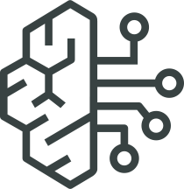
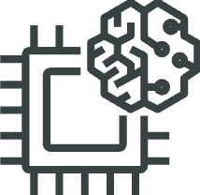





Generative AI Stack
APPLICATIONS THAT LEVERAGE Foundation Models (FMs)
Amazon Q
Business
Amazon Q
Developer
Amazon Q in
QuickSight
Amazon Q in
Connect
Amazon Q in
AWS Supply Chain
TOOLS TO BUILD WITH FMs
Amazon Bedrock
Guardrails
Agents
Studio
Customization Capabilities
Broadest selection of models
INFRASTRUCTURE FOR FM TRAINING AND INFERENCE
GPUs
Trainium
Inferentia
SageMaker HyperPod
UltraClusters
EFA
EC2 Capacity Blocks
Nitro
Neuron
Notes:
SageMaker HyperPod sits at this level, as a mean to abstract some of the complexity associated in managing the infrastructure at its lowest level.

Slide 4
Top reasons to customize models
Domain & Task -Specific Adaptation
Accuracy and Performance
Cost Efficiency
(Inference cost savings, accuracy, reduced prompt complexity)
Notes:
While GenAI FMs are incredibly powerful, they are not one-size-fits-all solutions. To achieve optimal results for your specific use case, customization is often required. Here are some reasons why customization is crucial:
Domain-Specific Adaptation: AI foundation models may lack specialized knowledge in certain domains. Customization can help them adapt to specific industries, such as healthcare, finance, or legal.
Data Specificity: Training data may differ significantly from one project to another. Customization allows you to fine-tune your model with your own data, making it more relevant to your use case.
Efficiency: A fully-trained foundation model can be resource-intensive, making it impractical for some applications. Fine-tuning can result in a more efficient model tailored to your needs.

Slide 5

Top model optimization requests
Accelerate training
Scale model size
1
2
Shorten training time using more nodes, more powerful nodes and better parallelism
Train bigger context windows or larger models
Reduce Inference costs
Smaller models but just as powerful
3
4
Deliver cost efficient small models without minimal performance degradation
Lower production costs while maintaining performance
5

Slide 6
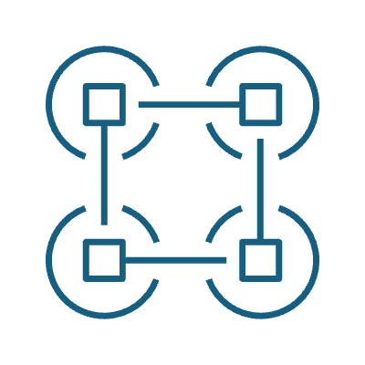
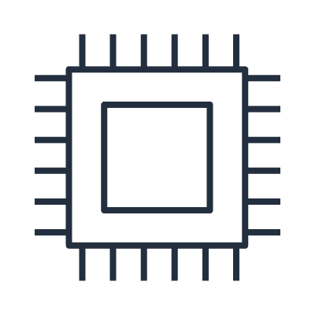
Optimization and scaling strategies
Data Parallel
Splits data across multiple GPUs
↑ Throughput
Model Parallel
Splits model across multiple GPU
↑ Throughput
Memory Optimizations
Gradient checkpoint, mixed precision, ZeRO
↓ Memory usage
Kernels
Custom operations and fused kernels
↑ Overall efficiency
Model Optimizations
Pruning, Distillation, Quantization
↑ Efficiency
Hardware
Neuron, GPU
↑ Overall performance
6

Slide 7
Cost considerations
TCO economics of Foundation Models Total Cost of Ownership (TCO) includes fixed customization costs and variable inference costs across a model's lifecycle. Off-the-shelf foundation models only incur inference costs, while customizing models require additional investment.
An initial investment into smaller, customized models can yield long-term cost advantages through reduced inference expenses.
TCO
Custom model storage
Custom model inference
Model customization
Model in production
Model lifecycle
Notes:
Secondary Considerations: Cost and Latency: Once a model that meets the accuracy threshold is identified, shift focus to optimizing operational efficiencies. Evaluate the models that satisfy the accuracy requirement on the basis of cost-effectiveness and processing speed. This ensures that while the primary criterion of accuracy is met, the model deployed is also the most economical and efficient for your needs. From there you can proceed with:
Evaluation of a More Compact Model: Test a smaller, less resource-intensive model to see if it can achieve similar accuracy levels at reduced cost and latency. For example, test Llama 8B vs. 11B.
Refinement through Model Distillation: Model distillation is a technique where a smaller model (student) is trained to replicate the behavior of a larger, more complex model (teacher). This process involves transferring the knowledge from the larger model to the smaller one, aiming to retain similar performance metrics in a more economical and efficient manner.

Slide 8
Challenges with training large-scale models
Large Datasets
Hardware Utilization
High Cost
Cluster Orchestration
Hardware Scalability
Stability & Resiliency
Notes:
Because of the massive size of foundation models and the datasets used for training, organizations need to split the data into chunks and load them onto a distributed training cluster with hundreds, or even thousands of accelerators.
First, we want to be training on the latest hardware. There is continuous innovation and every few years the training performance increases by 2 to 9 x. However, as with any large distributed system, there can be hardware challenges, and we need to think about health checks and making sure the hardware is working correctly to minimize disruption. We also want to think about orchestration of this hardware and ensuring that the various components involved in model training are happening correctly.
We also talked about how you need large datasets for larger models. There are various pitfalls in storing, processing, and loading these datasets. Doing this efficiently can require significant development effort. Similarly, we need to think about scaling up the infrastructure as well as the training algorithm. For example, today’s largest models don’t fit on a single GPU. We have to think about breaking down the model across these GPUs, and figuring out how to continue training efficiently.
Finally, we have to think about cost. Some papers share that the compute for training their large scale models can cost at least hundreds of thousands or millions of dollars. The machine learning lifecycle often starts with sporadic experiments to try out various ideas, but this can result in low utilization if you’re holding a large set of GPUs. We also want to think about how much time machine learning scientists are fighting against infrastructure as opposed to exploring model improvements. Many customers tell us that the ML team’s time is the most valuable resource, and the number one priority is ensuring their time is spent efficiently.
Training a foundation model can be incredibly challenging.
You need to acquire large amounts of data, create and maintain a large cluster of accelerators, write code to distribute model training across the cluster, frequently inspect and optimize the model, and manually remediate hardware issues. And all of this requires deep ML expertise.
This is a lot of work, because in order to make efficient use of compute and network resources, the distribution needs to be tailored to the characteristics of the data, the model architecture, as well as the underlying hardware configuration. That means you have to write a lot of code and optimize it repeatedly.
In addition, customers need to frequently pause and inspect model performance, optimize the code to make course corrections, and restart model training. To do this, customers manually save checkpoints of the model state so that training is able to resume without progress loss once the corrections are applied.
Finally, when any of the thousands of accelerators in the cluster fail, the entire training process is halted.
To resolve the issue, customers have to identify, isolate, repair, and recover the faulty instance, or change configurations to continue without it, further delaying progress.

Slide 9
Amazon SageMaker HyperPod
Improved efficiency
Tools for maximizing compute resources utilization, advanced observability, and seamless cluster customization
Reduced time-to-train
Resilience features and distributed training libraries help reduce time to train by up to 40%
Lower costs
Less time invested in hardware maintenance and more efficient cluster engagement reduces FM training TCO
Scale and accelerate generative AI model development across thousands of AI accelerators

Slide 10





HyperPod-EKS: Simplified architecture
AWS Cloud
HyperPod Service Account
AWS EKS VPC
COMPUTE NODES
Run containerized workloads
EKS API server
Engineers & Researchers
Create & manage EKS clusters
EKS Control Plane
Admin & Ops
Customer Account
Configure storage
FSxL distributed FS
Datasets & checkpoints in S3
Notes:
Here is an example architecture: The HyperPod cluster nodes are provisioned within the service account and connected via cross account Elastic Network Interfaces. FSx for Lustre Filesystem within the same Availabiltiy Zone is mounted to all the cluster nodes, and kept synced to a source S3 bucket via Data Repository Association. Users access the cluster via SSM / SSH to submit jobs. Optionally, users can deploy an Observability stack that integrates directly with HyperPod to export host level hardware metrics to an Amazon Managed Prometheus and Grafana workspace.

Slide 11
HyperPod’s versatile environment is highly customizable
Resilient
Versatile
Scalable
Efficient
Choice of Slurm or EKS as job orchestrators
Amazon Elastic Kubernetes Service (EKS)
Slurm
Broad compatibility with GenAI frameworks, tools and libraries—with extensive examples and tutorials
Job submission
Ray, Run.ai, kubectl, Composer, HyperPod CLI
Observability
Prometheus, Grafana, Cloudwatch
Dev, training and tuning
Studio, Kubeflow, Notebooks
PyTorch | TensorFlow | NeMo | JAX | BioNeMo
FSDP, DDP | SMDDP, SMP | DeepSpeed | MegatronLM
KubeFlow | Weights & Biases | MLflow
AWS or NVIDIA collective communications
NCCL | AWS Neuron Runtime
Access to the high-performing accelerators and storage hardware, optimized with EFA
Compute
GPUs instances (p5en, p5, etc.), AWS Trainium (trn2, trn1)
Storage
AWS S3, EFS, FSxL
Networking
EFA Device

Slide 12

HyperPod-Slurm: Simplified architecture
AWS Cloud
HyperPod Service Account
COMPUTE NODES
HEAD NODE
Jobs, SSH, & cluster state management
Engineers & Researchers
SSH/SSM, Cluster config and customization
Admin & Ops
Customer Account
Configure storage
FSxL distributed FS
Datasets & checkpoints in S3
Notes:
Here is an example architecture: The HyperPod cluster nodes are provisioned within the service account and connected via cross account Elastic Network Interfaces. FSx for Lustre Filesystem within the same Availabiltiy Zone is mounted to all the cluster nodes, and kept synced to a source S3 bucket via Data Repository Association. Users access the cluster via SSM / SSH to submit jobs. Optionally, users can deploy an Observability stack that integrates directly with HyperPod to export host level hardware metrics to an Amazon Managed Prometheus and Grafana workspace.

Slide 13
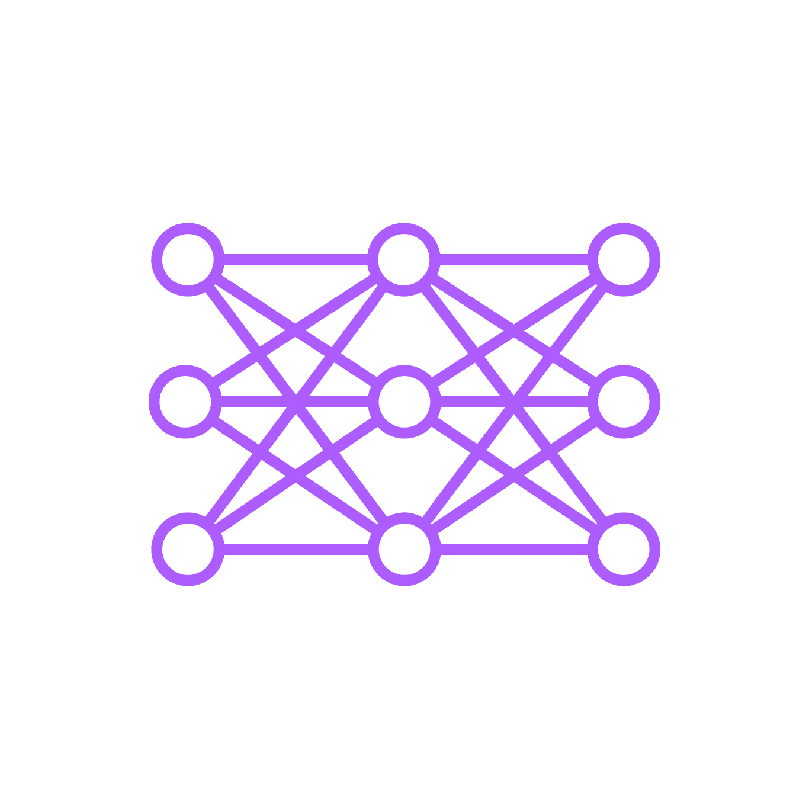
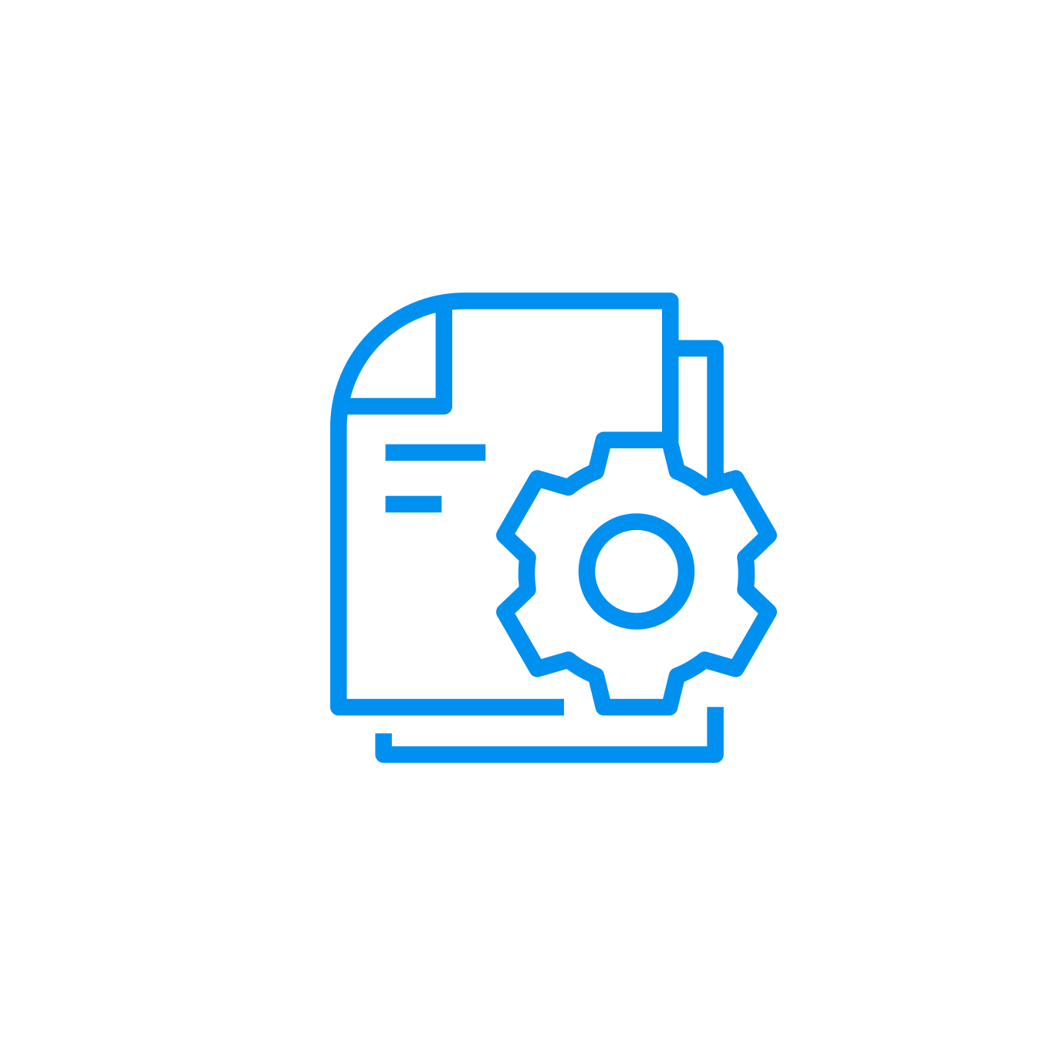
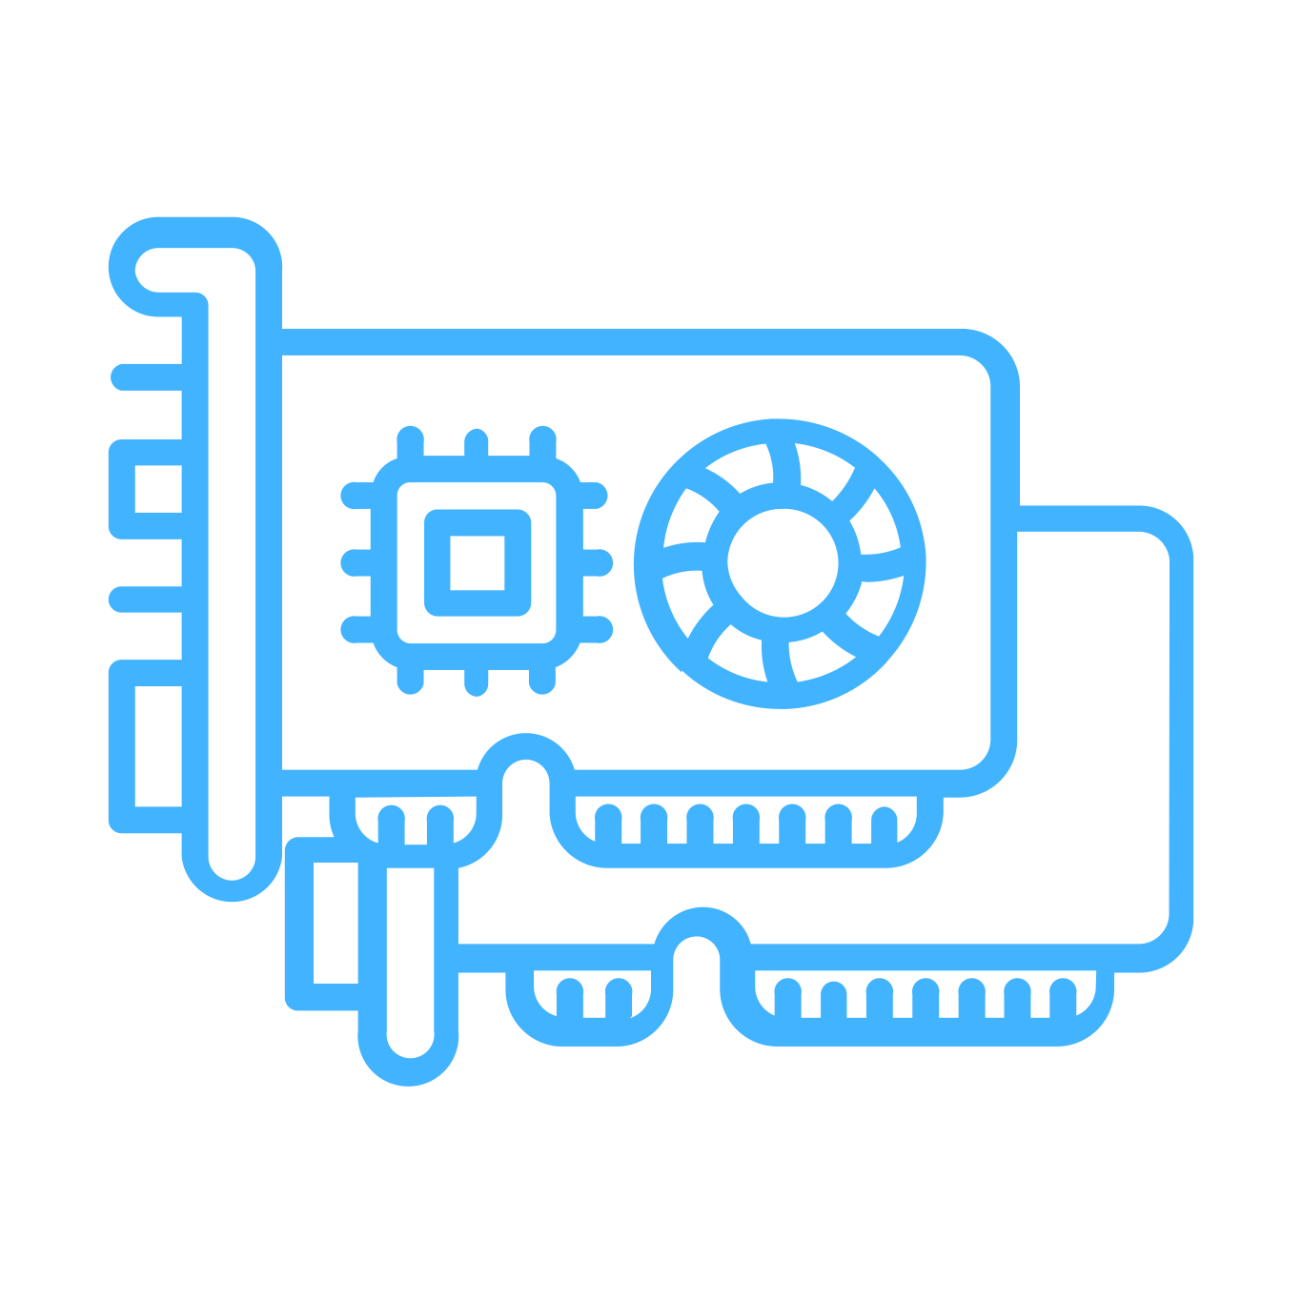
Optimized recipes for HyperPod get you started to fine-tune publicly available FMs in minutes
Business value
How it works
Reduce FM training setup time and get started in minutes
Pre-tested training stack configurations for fine-tuning and pre-training publicly available FMs
Recipes for GPU or AWS Trainium
Open-source and customizable, with a growing list of recipes
Specify directories for training and validation data
Select from over 30 curated model training recipes
Run the recipe on SageMaker HyperPod
Notes:
For those working with today’s most popular models, HyperPod also offers over 30 curated model training recipes, including support for OpenAI GPT-OSS, DeepSeek R1, Llama, Mistral, and Mixtral. These recipes automate key steps like loading training datasets, applying distributed training techniques, and configuring systems for checkpointing and recovery from infrastructure failures.

Slide 14
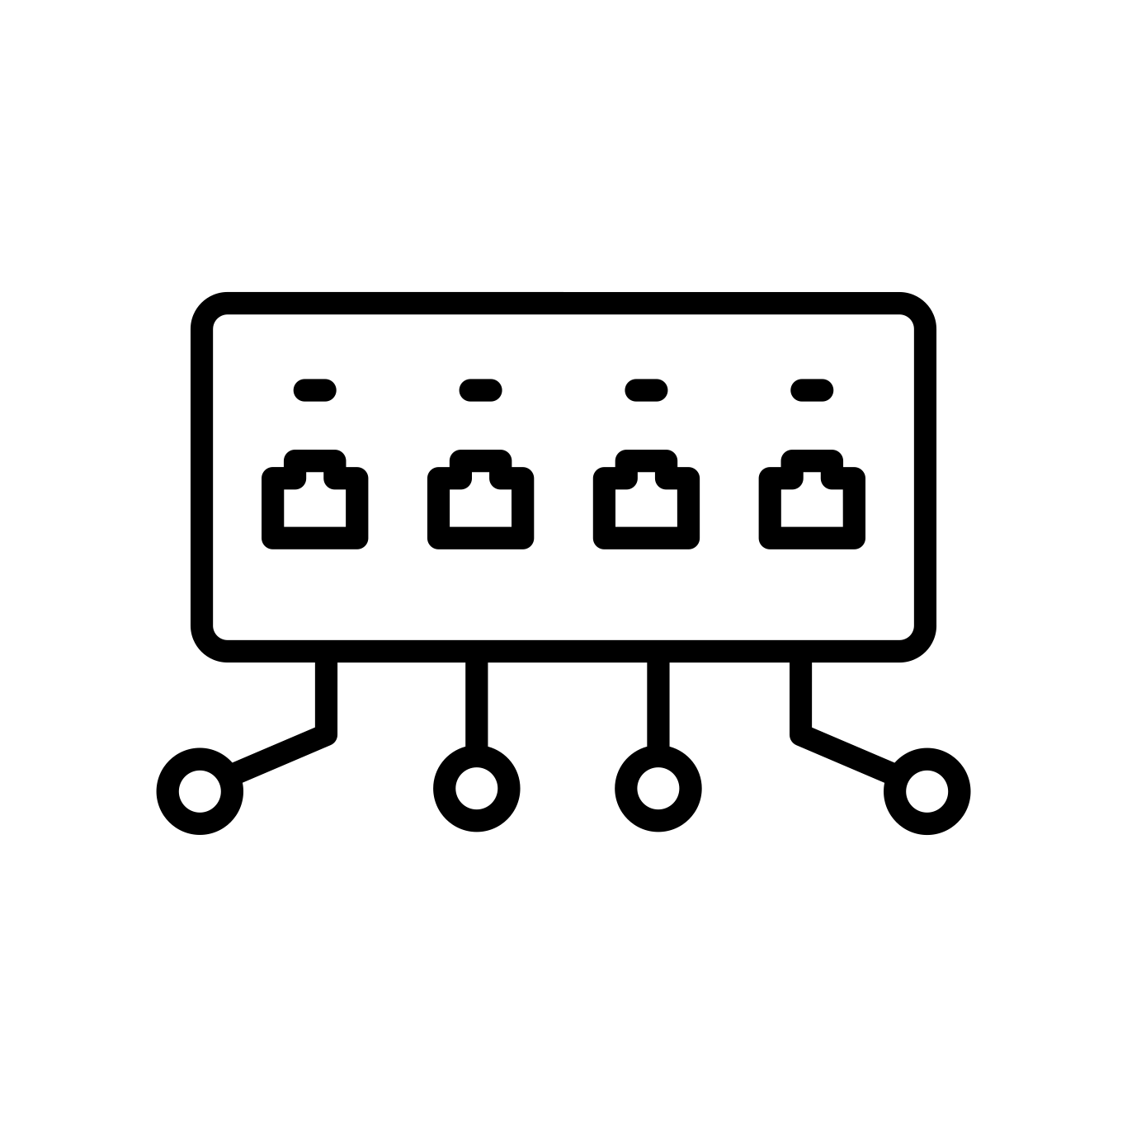



HyperPod provides a scalable infrastructure
Resilient
Versatile
Scalable
Efficient
Single network switch
Nodes are co-located on a single network spine, reducing network hops for inter-node communication
Cluster instance groups
Rapidly scale-up cluster to tens of thousands of accelerator instances for the most demanding FM training
Elastic Fabric Adapter (EFA) ensures fastest inter-node communication, optimized for AWS infrastructure
NODE 1

Slide 15
HyperPod’s resilient features help reduce training time by up to 40%
Proactively prevent node failures
Quickly detect hardware issues
Automatically repair nodes and resume training
Deep health checks screen and replace potentially problematic instances during cluster creation and updates
Monitor in-flight clusters for hardware failures and initiate automatic rapid node replacement if detected
Draws from spare capacity to restore the cluster and automatically resumes training from the last saved checkpoint
Notes:
H100s: ~3.4 failures per 1000 node hours
A100s: ~6.5 failures per 1000 node hours

Slide 16
GPU failures for continuously running training workloads are inevitable and bring everything to a halt.
Without SM HyperPod
~3hrs up to 3 days downtime!
Manually Investigate Root Cause
Manually restart
Long-running model training workload
With SM HyperPod
~20 minutes downtime!
Self-Healing
NO Manual Intervention
Each of these failures occur unpredictably and without Hyperpod would require several hours or even days to diagnose and repair.
With the built-in resiliency of HyperPod, you get a self-healing cluster to automatically resume training in < 20 minutes
This results in major savings in model development costs, faster time to market, and increased productivity
On a 16,000-chip cluster, for instance, every 0.1% decrease in daily node failure rate improves cluster productivity by 4.2% —translating to potential savings of up to $200,000 per day for a 16,000 H100 GPU cluster.

Slide 17
End-To-End FM Training Plan - Phases
Research and Planning
Data Preparation
Training – Experimentation
Training –
Hero Run
Evaluation
Post-Training for Downstream Tasks
Deployment - Inference

Slide 18
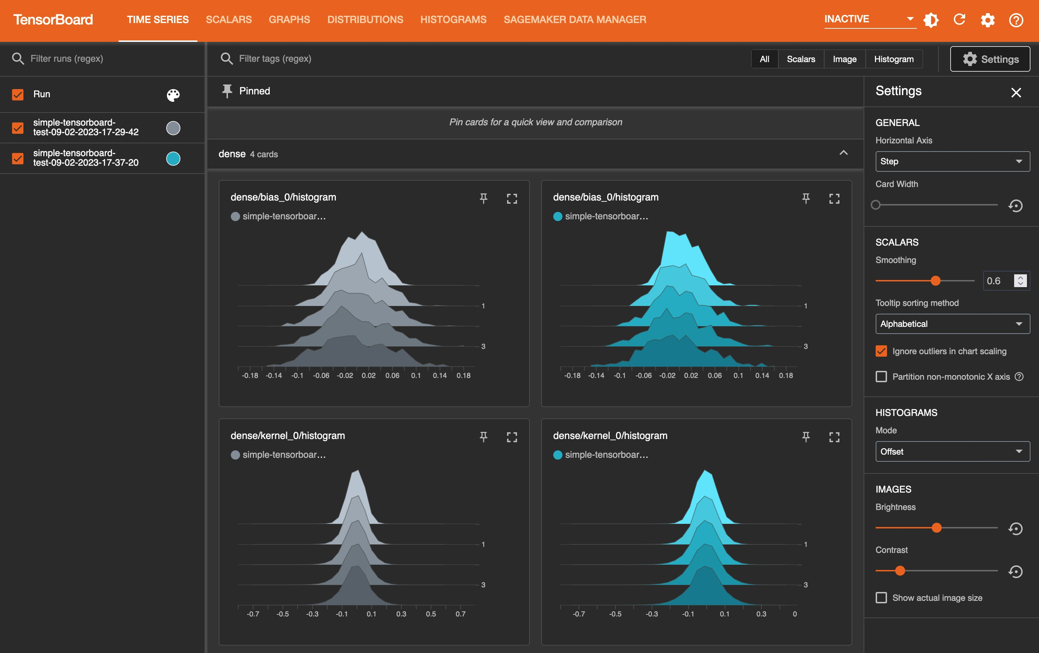
HyperPod provides advanced observability and experimental tools to increase accuracy and efficiency
Managed TensorBoard on SageMaker provides visualization of model architecture to identify and remediate convergence issues
Amazon CloudWatch Container Insights provides deeper understanding of cluster performance
Managed MLflow on SageMaker enables efficient model experimentations at scale
Notes:
You can use purpose-built ML tools in SageMaker HyperPod to improve training performance. For example, Amazon SageMaker with TensorBoard helps you to save development time by visualizing the model architecture to identify and remediate convergence issues, such as validation loss not converging or vanishing gradients. Amazon SageMaker Debugger provides built-in rules for detecting model convergence issues, such as overfitting, saturated activation functions, vanishing gradients, and more.

Slide 19
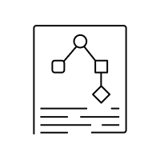
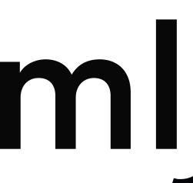

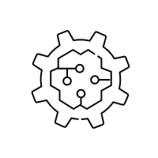


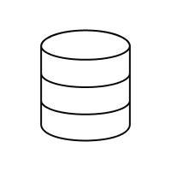

HyperPod and managed MLflow integration helps efficiently manage model experimentation
SageMaker HyperPod
Auto-create Model Card
SageMaker Jobs: JumpStart, Training, Pipelines
Track ML experiments as runs
Compare runs, evaluate models
Register model
Auto-register models in SageMaker Model Registry
Deploy model on SageMaker
Preferred training infrastructure
Notes:
Customers can use MLflow from their preferred ML platform – SageMaker, EC2, EKS etc.
Customers can use MLflow to log metrics, compare their runs on the MLflow UI and register models.
Customers can have multiple MLflow Tracking Servers in an account, typically one per team or business problem. Models across these MLflow Model Registries can be mirrored in the SageMaker Model Registry for simplified management, automatic Model Card creation, and an approval system.
Once approved, customers can deploy MLflow Models to SageMaker
Auto register model to SageMaker Model Registry for centralized model management
Auto create model card for centralized model documentation
- Experiment using MLflow with fully managed infrastructure – Q2 2024
In 2024, we will launch the next generation of SageMaker Experiments using a fully managed MLflow service.
This will include all features that are available in Open Source MLflow (SDK and UI) with added AWS benefits of fully managed infrastructure and integration with AWS IAM so customers can write IAM policies to manage access to their MLflow Tracking Servers. Customers can access the MLflow UI directly through a pre-signed URL or via Studio v2.
- Deploy models from MLflow to SageMaker Inference
SageMaker Inference will natively support models in the MLflow Model format so customers do not need to build customer containers to host MLflow Models and can take advantage of SageMaker DLCs.
- Evaluate model performance in an experiment
Customers can use MLflow’s model evaluation capabilities to evaluate both classical ML models, Deep Learning models, and GenAI models. Additionally, in H2 we will offer customers the option to use SageMaker Clarify to evaluate their models logged in an MLflow Run and view the results of the Clarify job on the MLflow UI.
- Track fine-tuning jobs from LLMs from JumpStart in an experiment
JumpStart will be integrated with MLflow so that customers who choose to use JumpStart’s fine-tuning capabilities can view their fine-tuning metrics in MLflow Runs and Experiments. They can use the MLflow UI to compare different fine-tuning attempts and Register the best fine-tuned model to the MLflow Model Registry.

Slide 20
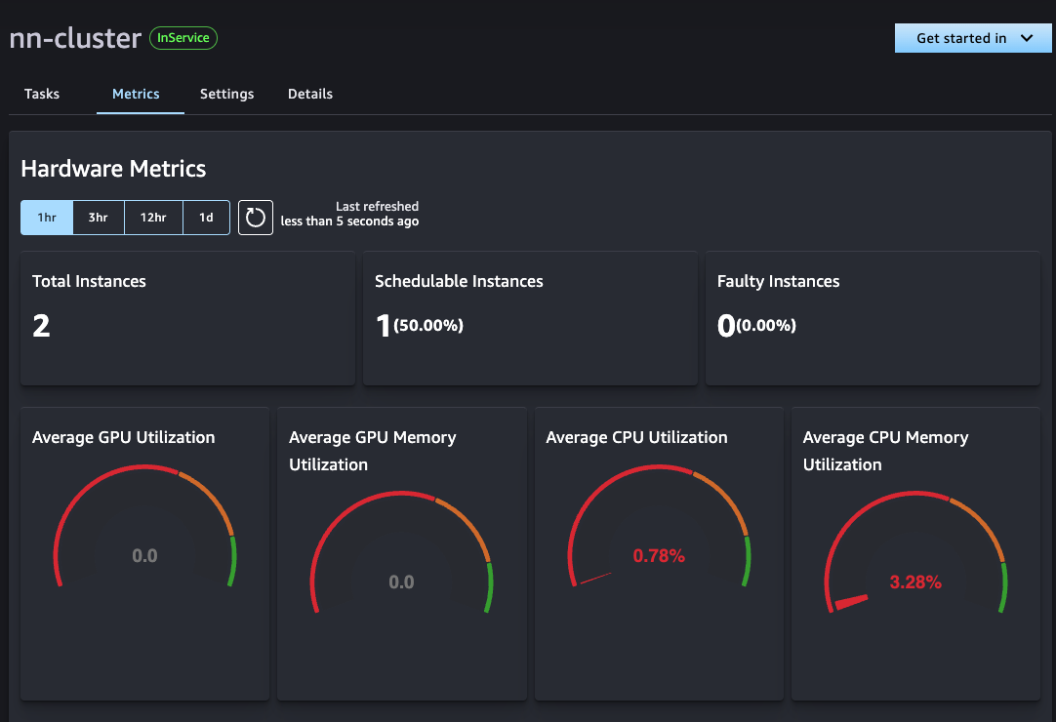
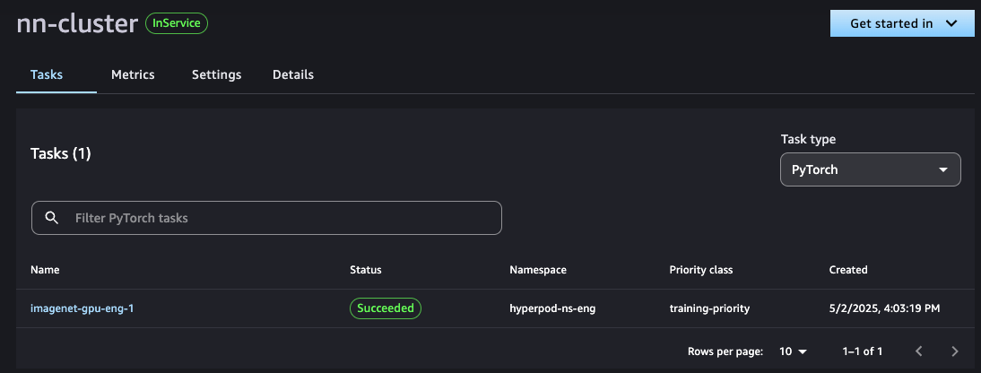
HyperPod integrates with SageMaker Studio to streamline the data science experience
Cluster monitoring and resource utilization Monitor metrics such as GPU/memory utilization, wait times, node availability, and more
Flexible interfaces for Data Scientists Build in familiar IDEs and then easily containerize and submit those to your preferred job scheduler
Task Governance UI access Interface for defining allocation policies, dynamic scheduling with workload priorities, and more
FSx for Lustre mounting to shared Spaces Consistent, collaborative access to your cluster’s high-speed file system from an IDE
Notes:
Key Message: Amazon SageMaker offers purpose-built tools for end-to-end foundation model development and experimentation.
Talking Points:
To help customers prepare massive amounts of training datasets with high relevance and accuracy, SageMaker offers scalable tools to for data cleansing, data enrichment, error detection, and data formatting.
That's why we offer purpose built tooling specifically for building foundation models.
Build models with the broadest selection of IDEs in SageMaker Studio. You can pick whichever notebook environment you like best - Jupyter, VSCode, RStudio - whatever makes you most productive.
And you won't be stuck trying to move data around from one system to the next either. Customers can also connect, access, and query data from a wide variety of popular AWS and third-party data sources. Query data sources, process with EMR & Glue, Redshift, etc to train your models, all within SageMaker.
You can even collaborate live with your team in-notebook so you're not constantly merging changes from different copies.
The key advantage here is that we handle all the infrastructure, integration, and tooling so you can actually focus on building better foundation models rather than fighting with notebooks and clusters. I think you'll be surprised at how much faster your experiments and FM development will move.
Transition: Now that I've covered the development tools, let's talk about how we can assist training and tuning best practices as you prepare these foundation models for production use.

Slide 21
Rise of inferencing compute demand
Frontier LLMs utilize chain-of-thought (CoT) reasoning across multiple nodes to facilitate complex problem-solving
CoT significantly increases inferencing compute due to pre-fill text and inflated context windows
Agentic systems utilizing both RAG and reasoning models in tandem further amplify test-time compute requirements
Inferencing compute demands
Zero-shot prompting
RAG
Reasoning Models
Agentic systems with RAG + Reasoning

Slide 22
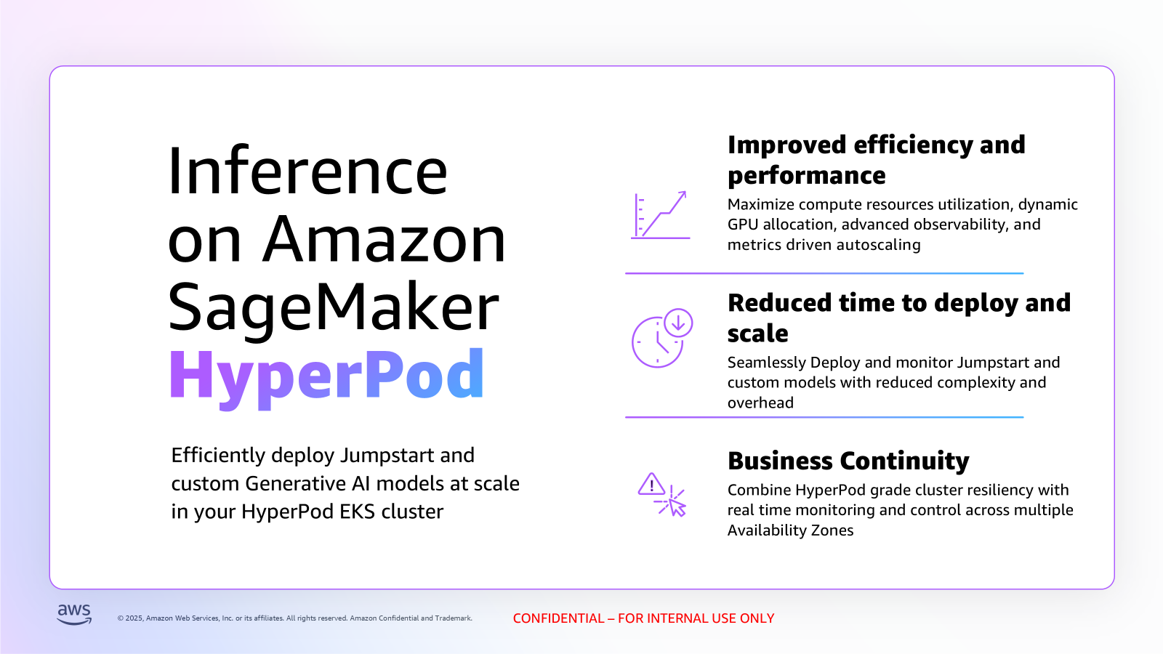

Slide 23
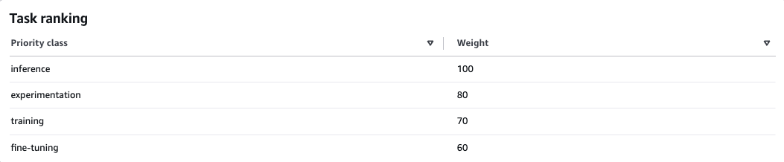
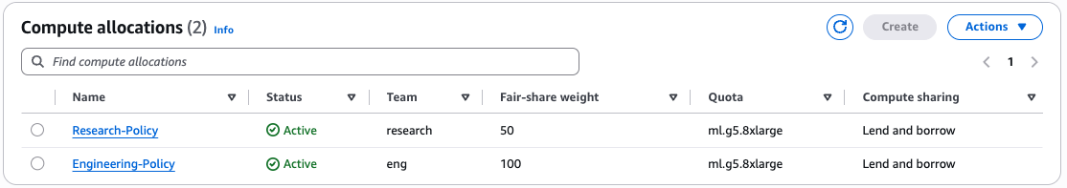
HyperPod task governance helps efficiently utilize compute resources
Maximize compute resources utilization and reduce FM development costs by up to 40%
Advanced task prioritization and preemption policies
Adaptive allocation across large and diverse teams
Deep insights into resource utilization, task health, and allocations

Slide 24
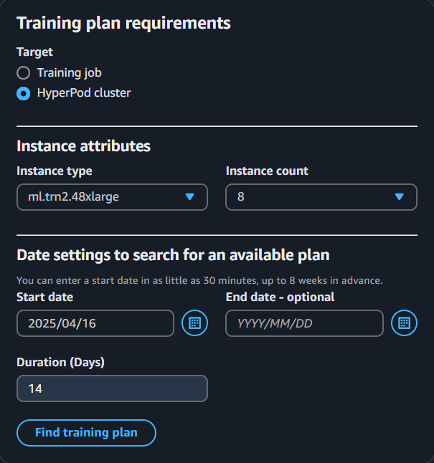
HyperPod flexible training plans help meet timelines and budgets by efficiently securing compute capacity
Business value
How it works
Easily secure future capacity for core training, inference, or bursting workloads
Self-service and simple
Reserves capacity for up to 6 months
Lower cost (up to 68% savings vs. on-demand pricing)
Specify…
Instance type (p5, p5e, p5en, trn1, trn2, p4d)
Number of instances (1-64)
Duration of plan (1-182 days)
Start date (within 8 weeks)
Review available segments
Confirm selections
Use the plan when creating HyperPod clusters

Slide 25
Benefits of Amazon SageMaker HyperPod
Develop and train FMs continuously for weeks and months
Faster Time to Value
Resilient AI Infrastructure
Optimize Cluster Utilization
Ease of Use
Scale Model Development
25
Notes:
So there are three main areas of SageMaker Hyper Pod um that provides benefits to customers training foundation models.
One is that we provide a resilient training environment. So the clusters that you can provision with Hyper Pod are self healing. If there is a hardware failure, Hyper Pod will automatically recover from that failure reload from the last checkpoint and resume training all without any customer intervention required at scale. This can reduce training time by up to 20%.
In addition, we also provide access to Sage makers distributed training libraries which are optimized for AWS networking infrastructure and can provide an improvement on training or reduced training time again by another 20%.
And lastly, the user experience around the need to iterate and control multiple layers of the tech stack. When you're in the training environment is really critical for rapid iterations on model design, the ability to start and stop jobs with low latency SSH to any cluster instance, install whatever frameworks debugging tools, software libraries, custom optimizations are needed for training those models are really critical for a lot of the customers developing these.

Slide 26

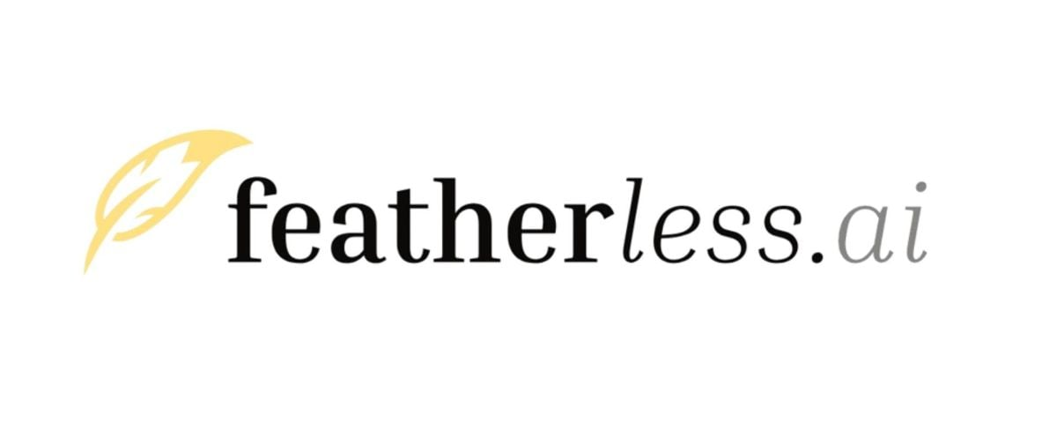
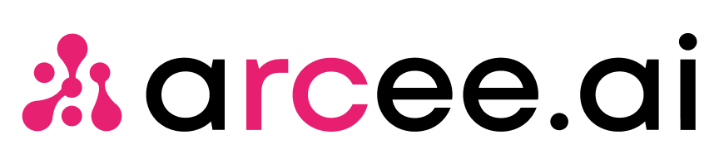




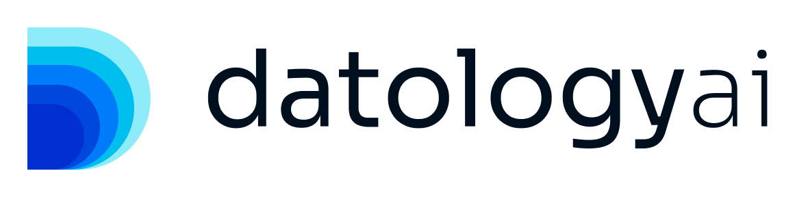

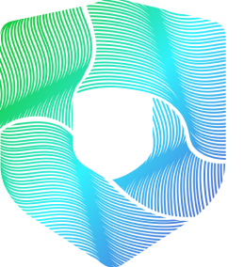

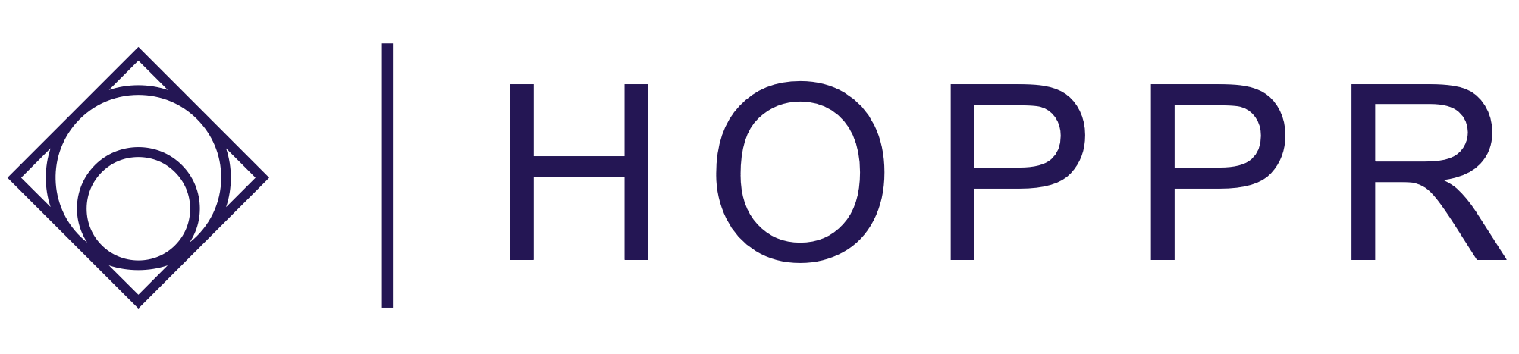

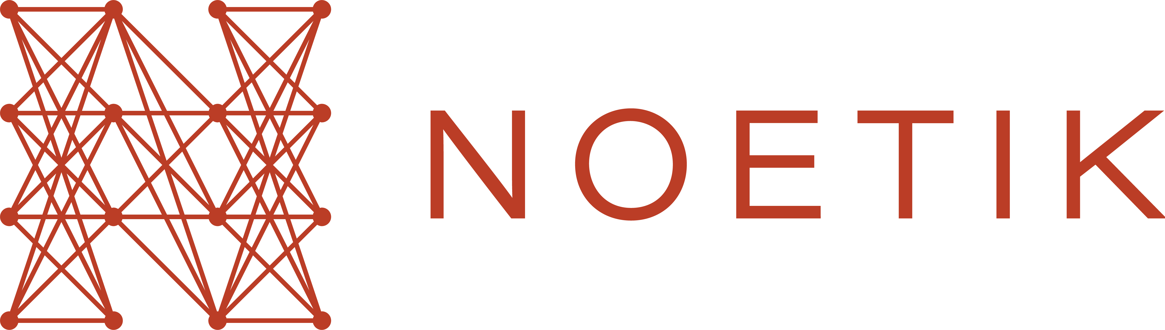



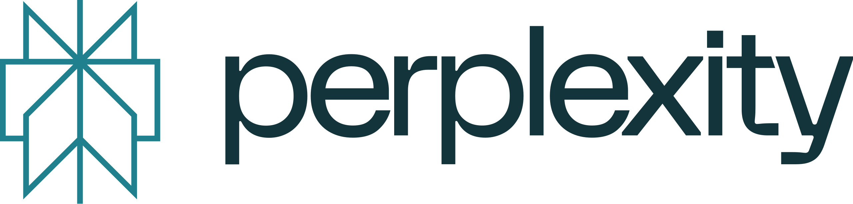

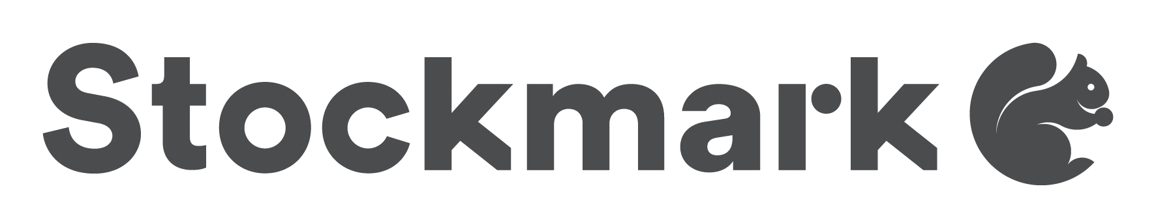
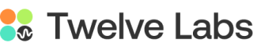

Top AI companies use HyperPod to train and deploy models

Slide 27

SageMaker HyperPod’s distributed training libraries helps us improve large scale model training performance. And its resiliency feature saves time as we monitor and manage infrastructure. Training our foundation models on SageMaker HyperPod will increase our speed to market and help us provide quality solutions for our customers at pace.
Joel Hron
Head of AI and Labs, Thomson Reuters

Slide 28
SageMaker HyperPod greatly streamlined the setup, configuration, and administration of our GPU SLURM cluster. Several of our research teams now run large, distributed training jobs daily, and the SageMaker team has significantly boosted our training efficiency by 20% due to reduced operational overhead contributed by hardware resiliency features and highly responsive support.

Slide 29
SageMaker HyperPod’s purpose-built resiliency and performance capabilities have enabled our open science team to focus on innovating and publishing important improvements to the ways foundation models are built, rather than managing infrastructure. This automated job recovery feature helped us minimize disruption during the foundation model training process, helping us save hundreds of hours of training time in just a year.
Jeff Boudier
Head of Product, Hugging Face

Slide 30

SageMaker HyperPod’s built-in data and model parallel libraries helped us optimize training time on GPUs and double the training throughput. As a result, our training experiments can now run twice as fast, which means our developers can iterate more quickly, accelerating the development of new generative AI experiences for our customers.
Aravind Srinivas
Co-founder and CEO, Perplexity AI

Slide 31

Hippocratic AI, an AI company that develops the first safety-focused Large Language Model (LLM) for healthcare. To train its primary LLM and the supervisor models, Hippocratic AI required powerful compute resources, which were in high demand and difficult to obtain. Amazon SageMaker HyperPod flexible training plans made it easier for them to gain access to Amazon Elastic Compute Cloud (Amazon EC2) P5 Instances. HippocraticAI is also leveraging AWS services such as Grafana to track important GPU utilization metrics. Using Amazon EC2 P5 Instances, Hippocratic AI has increased model training speed by four times and scales its solution to accommodate hundreds of use cases. It helped them to secure the required compute resources and train models quickly.

Slide 32
Developers and data scientists at OpenBabylon, an AI company that customizes large language models for underrepresented languages, has been using SageMaker HyperPod flexible training plans for a few months to streamline their access to GPU resources to run large scale experiments. Using the multi-node SageMaker HyperPod’s distributed training capabilities, they conducted 100 large scale model training experiments, achieving state-of-the-art results in English-to-Ukrainian translation. This breakthrough was achieved on time and cost-effectively, demonstrating SageMaker HyperPod’s ability to successfully deliver complex projects on time and at budget.

Slide 33
Training
Accelerate training: Shorten training time using more nodes and better parallelism
Multi-node scaling and more powerful nodes
Optimized data parallelism
Efficient model parallelism
Pipeline parallelism techniques
ZeRO
1
Sample Framework Tools
PyTorch DDP
Megatron-LM
DeepSpeed
NxDT
Scale model size: Train bigger context windows or larger models
Memory optimization techniques
Gradient checkpointing
Model sharding strategies
Mixed precision training
AWS Infrastructure
2
SageMaker HyperPod
Sagemaker Training Jobs
Parallel Cluster
G5/G6e/P4d/P5
Inf2/ Trn1/Trn2
33

Slide 34
Inference
3
Reduce Inference costs: Lower production costs while maintaining performance
Optimized serving infrastructure
Caching and batching techniques
Kernel customization
Sample Framework Tools
vLLM – Paged Attention
TensorRT
NxDI
Faster Transformer
GPTQ/AWQ Quantization
Custom Kernels
Triton/Dynamo
4
Smaller models but just as powerful: Deliver cost efficient small models without minimal performance degradation
Pruning and distillation
Quantization (INT8, FP16)
AWS Infrastructure
SageMaker Endpoints
Bedrock Custom Model Import
EKS/ECS
34

