Slide 1
Cora Z7-10
Dashboard demonstration
Unified sensing, navigation and acoustic communications
Investor meeting · October 2026
Notes:
Opening: the combined Cora Z7-10 image puts the control dashboard and all feature packages on one SD card. Demonstrate features one at a time. Source: docs/cora-combined-demo.md.

Slide 2
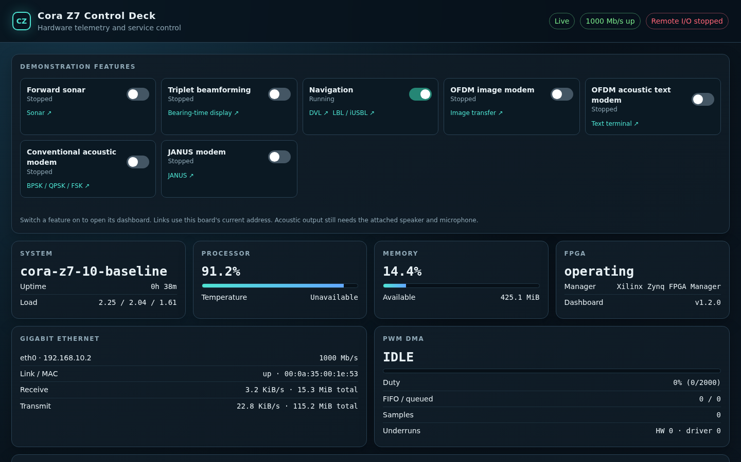
Unified control dashboard
One page controls seven services
Eight direct views open from the same board. System, network and FPGA health remain visible.
Live Cora capture | 8080
02 / 11
Notes:
Open http://192.168.10.2:8080/. Use the Demonstration features switches. Navigation has two links, DVL and LBL/iUSBL. Screenshot captured from the running Cora on October 6, 2026.

Slide 3
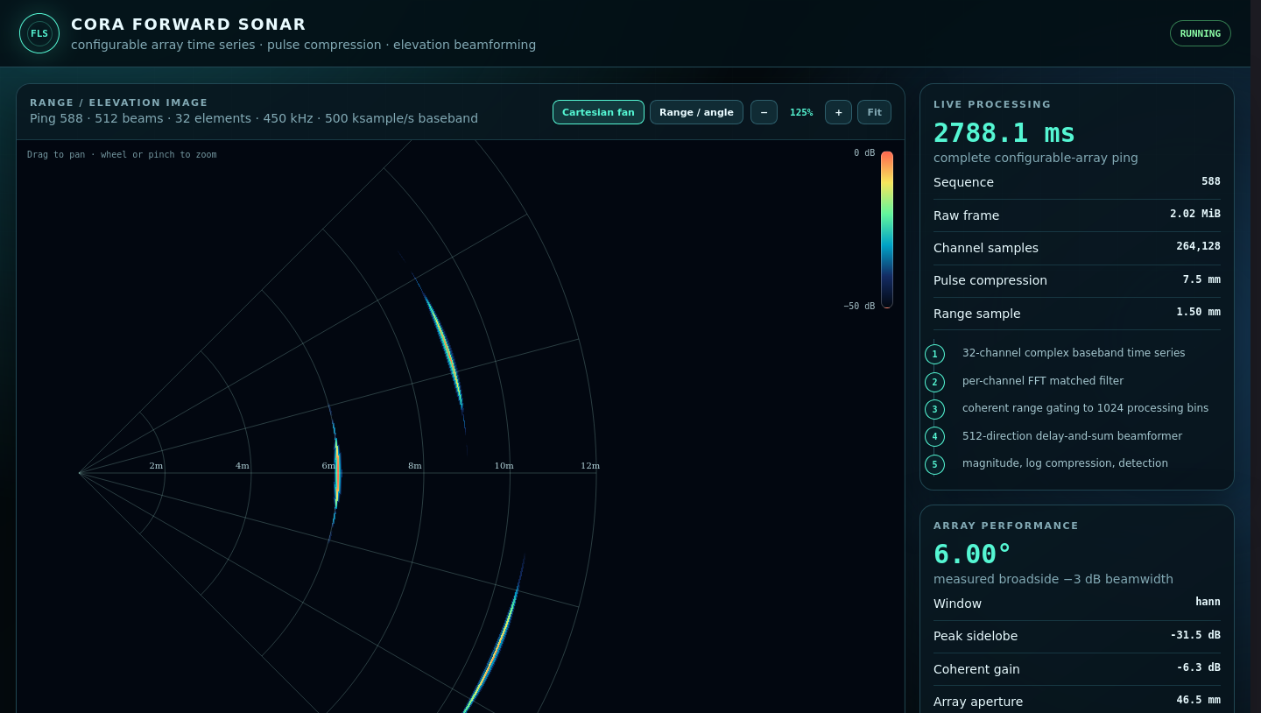
Forward sonar
Three targets in a range and elevation view
32-channel simulated array, pulse compression and a 512-beam display.
Synthetic scene | 8085
03 / 11
Notes:
Enable Forward sonar on the control dashboard, then open port 8085. The screenshot is a prior live board capture. The sonar scene is simulated, and the October 5 smoke test detected all three targets. Source: docs/cora-combined-demo.md.

Slide 4
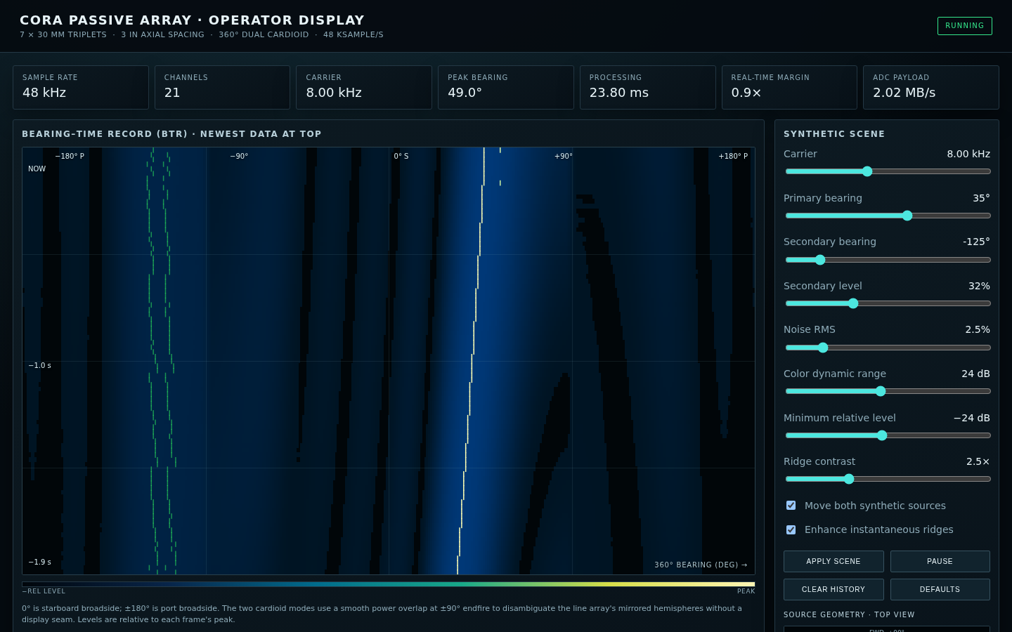
Triplet beamforming
Bearing over time reveals moving sources
Seven triplets provide 21 synthetic channels for a 360° dual-cardioid display.
Synthetic input | 8088
04 / 11
Notes:
Enable Triplet beamforming and open port 8088. The synthetic scene shows two moving bearing ridges. Real 21-channel input requires the external ADC and DMA device. Turn triplet off after this page to preserve navigation CPU capacity. Screenshot captured October 6, 2026.

Slide 5
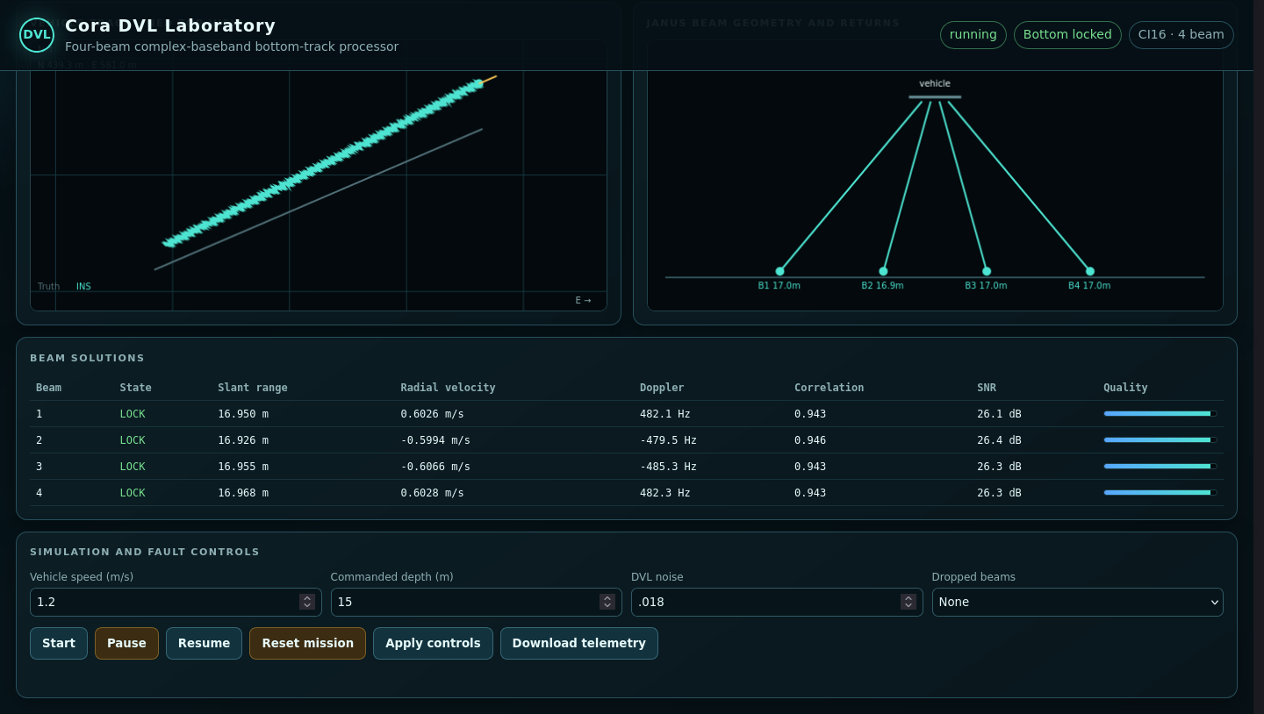
DVL navigation
Bottom lock feeds a live vehicle track
Four beam solutions, an INS trajectory and position error update in the same view.
Simulated mission | 8083
05 / 11
Notes:
Enable Navigation and open port 8083. The NED graph was repaired on October 6 to fit live positions; it now moves as telemetry arrives. Show the bottom-lock indicator and beam table. Screenshot captured from the live board.

Slide 6
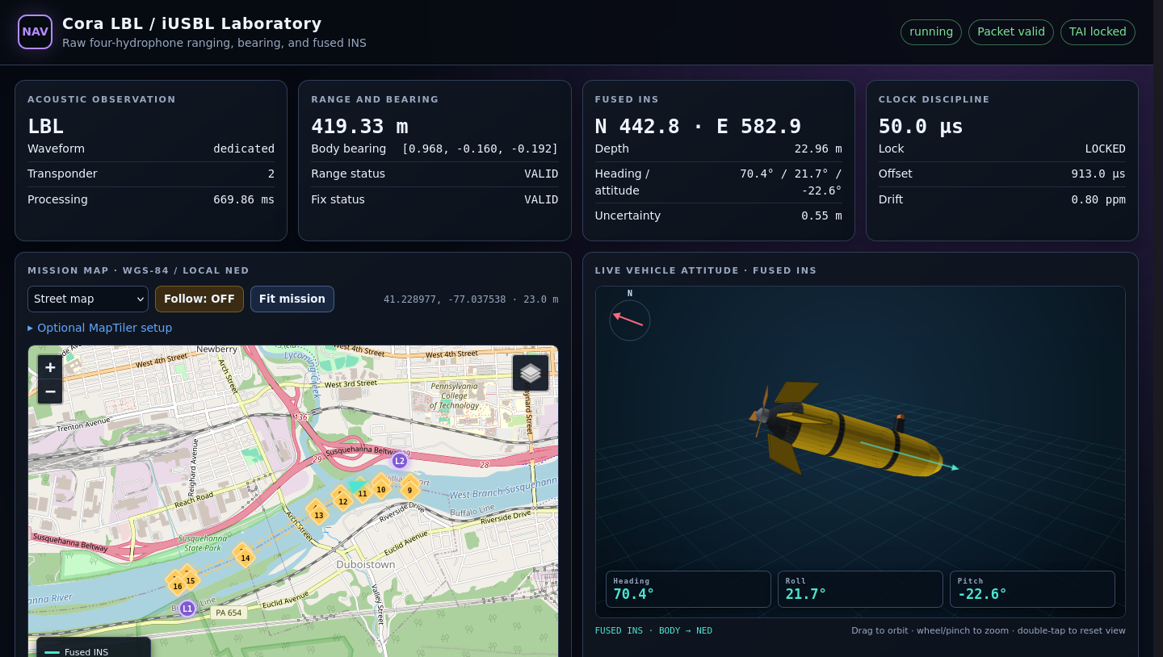
Acoustic positioning and INS
LBL fixes update the fused vehicle state
Range, bearing, map, clock discipline and vehicle attitude remain visible together.
Simulated mission | 8087
06 / 11
Notes:
Keep Navigation enabled and open port 8087. The same service supports LBL and iUSBL modes. Isolated smoke tests passed at 100 Hz with valid positions and zero drops. This dashboard screenshot shows LBL. Source: docs/cora-combined-demo.md.

Slide 7
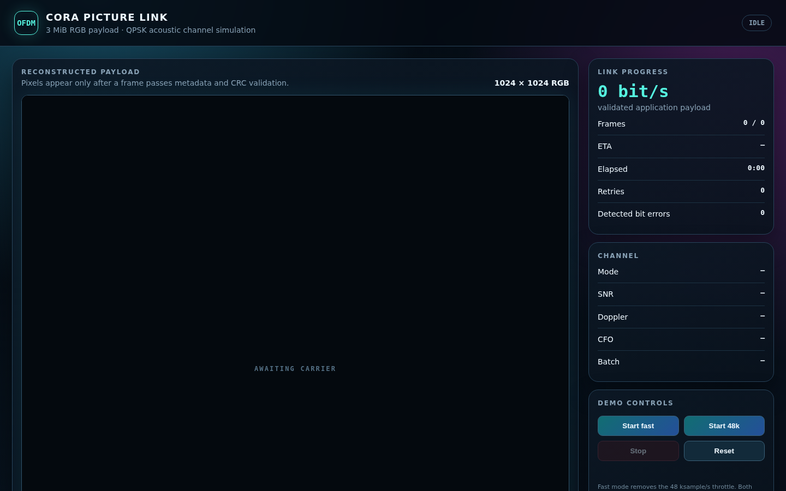
OFDM image link
Validated frames reconstruct a 3 MiB image
The transfer controller tracks CRC checks, retries, progress and final SHA-256 integrity.
Idle dashboard capture | 8081
07 / 11
Notes:
Enable OFDM image modem and open port 8081. This screenshot shows the controller ready before transfer. Do not present it as a completed full-image run. A 768-byte board smoke transfer completed with matching source and output SHA-256. The full 1024x1024 RGB demo is time-consuming. Source: docs/cora-combined-demo.md.

Slide 8
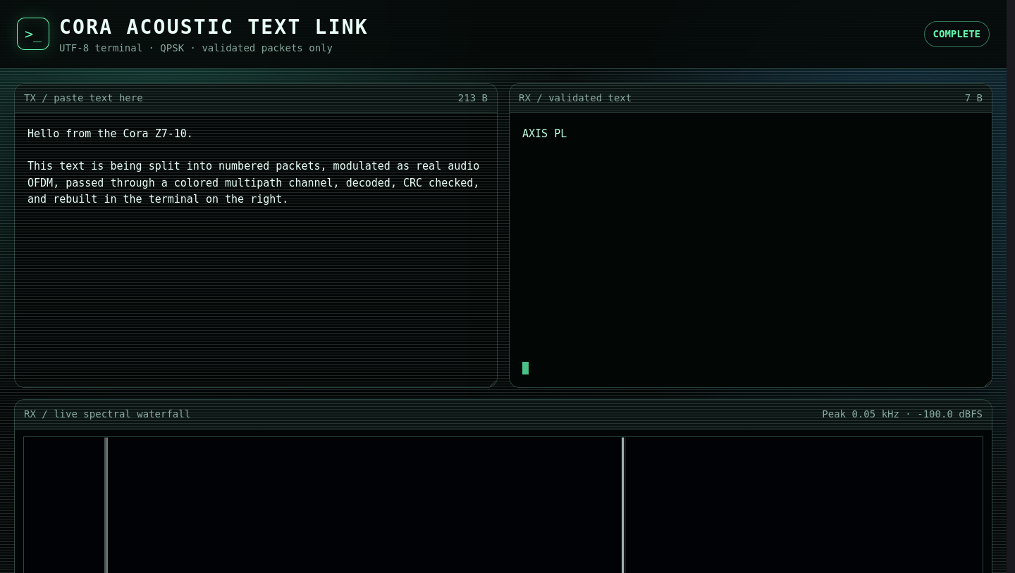
OFDM acoustic text
Text appears after packet validation
QPSK symbols pass through the selectable loopback, FPGA AXIS or acoustic path.
FPGA AXIS capture | 8082
08 / 11
Notes:
Enable OFDM acoustic text and open port 8082. This prior capture shows a completed AXIS PL run. The board offline acoustic OFDM text loopback passed. Speaker-to-microphone SNR remains for the amplified-speaker test. Source: docs/cora-combined-demo.md.

Slide 9
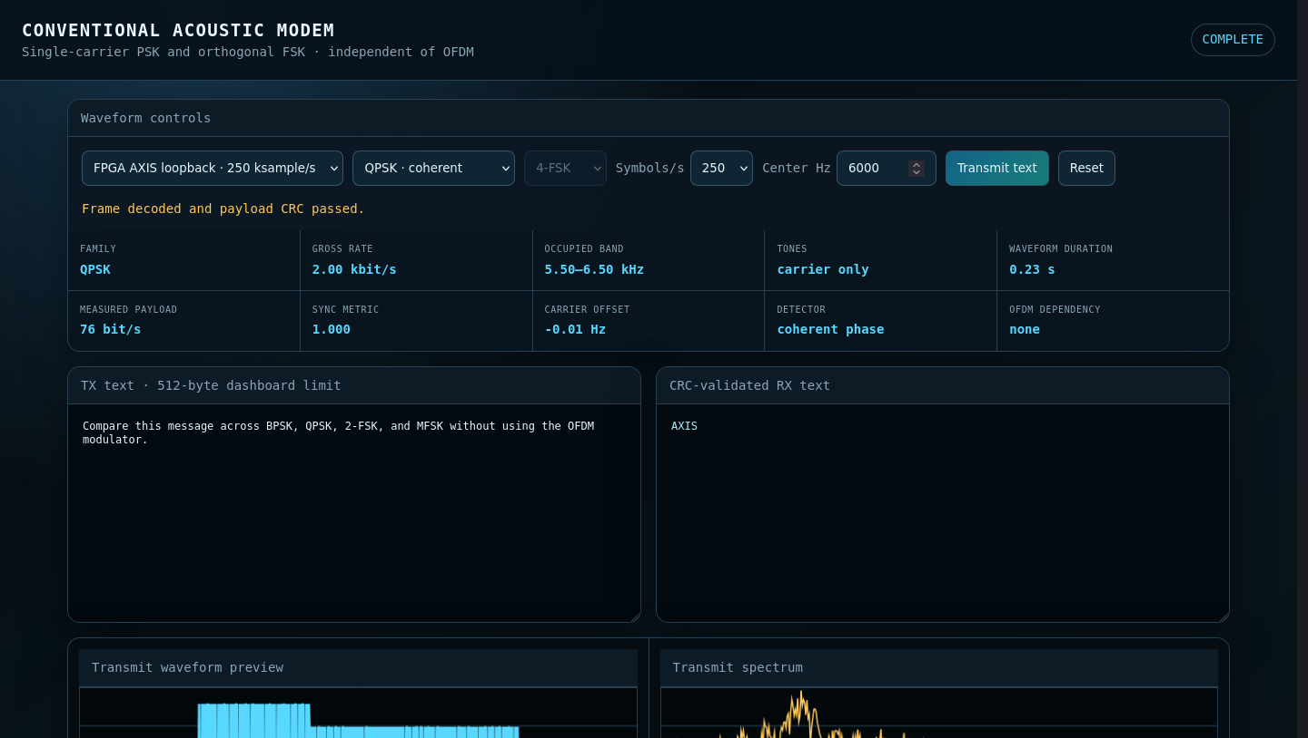
Conventional acoustic modem
Independent PSK and FSK waveforms
BPSK, QPSK, FSK and 4-FSK modes share one dashboard. This capture shows a CRC-valid QPSK loopback.
FPGA AXIS capture | 8084
09 / 11
Notes:
Enable Conventional acoustic modem and open port 8084. The prior board capture shows QPSK through FPGA AXIS loopback. BPSK, QPSK, FSK and 4-FSK colored-channel tests passed on the combined image. Source: docs/cora-combined-demo.md.

Slide 10
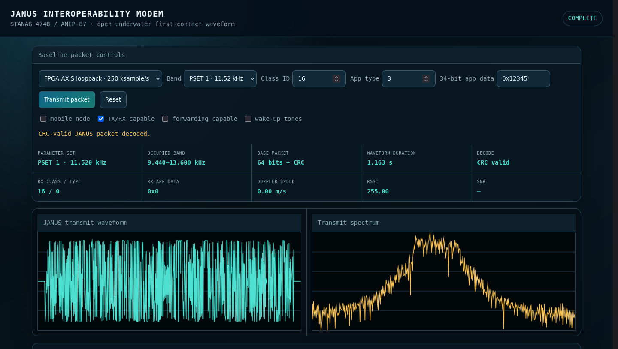
JANUS interoperability modem
A first-contact packet decodes with valid CRC
The JANUS view exposes the parameter set, packet fields, waveform and receive result.
FPGA AXIS capture | 8086
10 / 11
Notes:
Enable JANUS modem and open port 8086. This prior capture shows a CRC-valid packet through AXIS loopback. The JANUS offline loopback passed on the combined image. Physical acoustic SNR is not measured in this screenshot. Source: docs/cora-combined-demo.md.

Slide 11
What the board demonstrates today
Integrated control
Board checks
Physical next step
Seven selectable services
Eight linked web views
Sonar target detection
100 Hz isolated navigation
CRC and hash loopbacks
Byte-exact FPGA AXIS path
Measure speaker-to-microphone SNR. Real array input needs the external ADC hardware.
11 / 11
Notes:
Close with demonstrated board checks and the planned amplified-speaker test. The sensor scenes in this deck are simulated; modem captures use offline or FPGA AXIS loopback. The USB sound device is visible, but air-path SNR has not been measured. Sources: docs/cora-combined-demo.md and the board smoke results in the current project.

