Slide 1
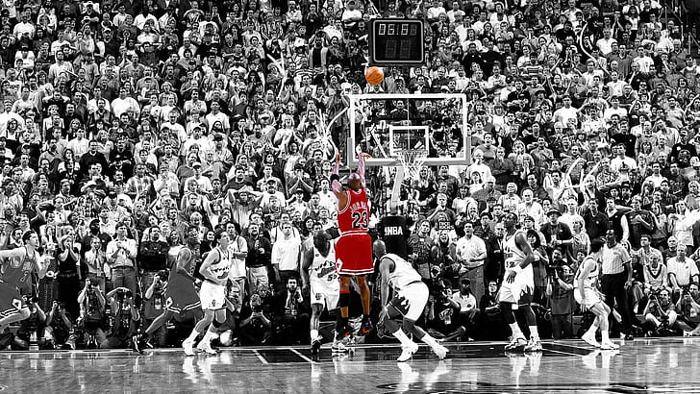
Storyboard
Background
Growing up, I have always been exposed to the game of basketball. My father always mentioned how Michael Jordan was the greatest basketball player in his era. With this, I decided to research the different factors that contributed to the title given to him, and what makes him stand out from the rest.
Problem statement
We need to find out the different factors and achievements that attributes to being the greatest basketball player of all time so that we can prove Michael Jordan is truly indeed the greatest basketball player of all time.
Data
UNC College career statistics
Awards won during college at UNC
NBA Chicago Bulls’ career statistics from 1984-1993
Awards won during NBA career
Awards won from international games such as the Olympics
Findings
Points per game average is 30.1, highest in NBA history
Only player to be named Defensive player of the year, lead the league in scoring and won Most Valuable Player trophy
Playoff career average 33.4 points per game, best in NBA history
won NBA record of 6 Finals MVP awards every time he appeared in finals
Analysis
Michael Jordan still holds many of the records set by him in the NBA
Given the period that Michael Jordan played in the NBA, no one would be able to surpass him
Though records have been broken by other players who are still in the league, holistically, no player other than Kobe Bryant comes close to beating Michael Jordan
Michael Jordan was a jack of all trades, master of none
Recommendations

