Slide 1

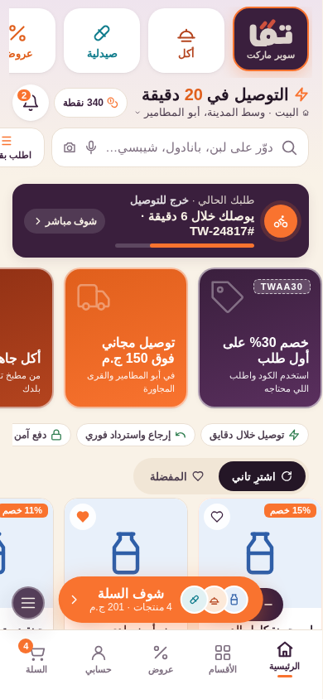
Hyperlocal quick commerce
for Abu El Matamir
Project overview & delivery plan
من هنا لك.. توّا · September 2026 · Based on BRD v1.1
Customer app prototype · 26 screens · Arabic-first
Notes:
Twaa is a hyperlocal quick-commerce platform. Launch market: Abu El Matamir city and its villages, Beheira. This deck covers the project and the delivery plan to launch.

Slide 2



Executive summary
Where we are and what it takes to launch
The everyday digital convenience store for Egypt's secondary cities and villages.
Status today
BRD v1.1 complete (94 sections)
Supermarket, hot food and pharmacy in 20–60 minutes, cash or digital.
Deep coverage where national players are weak: one city, nine villages, one dark store.
Edge: local products, village addressing, Egyptian-Arabic UX, instant returns.
Brand identity and logo
Customer app designed: 26 screens, responsive, AR/EN
Design system and engineering handoff notes
20–60
9
Backend, admin, picker and rider apps: to build
min delivery per zone
villages in the first service area
Store, stock, riders and payments: to set up
3
26
Target: pilot January 2027, public launch February 2027
verticals: supermarket, food, pharmacy
app screens designed & prototyped
توّا · Twaa
Notes:
Design phase is complete. Engineering build and operational setup start in October.

Slide 3



Why now, why here
Secondary cities and villages are under-served by national quick-commerce players
Coverage gap
High-frequency need
Local advantage
National apps concentrate on Cairo and Alexandria. Abu El Matamir and its villages have weak or no on-demand delivery.
Milk, bread, water, diapers, medicine: bought several times a week, often urgently. Frequency is the engine of quick commerce.
Local dairy, bakeries and produce that national assortments miss, plus village addressing that maps and couriers get wrong.
Desired customer behaviour
محتاج حاجة؟ هاتها توّا.
"Need something? Get it now." Twaa becomes the default whenever a household needs an essential, fast.
توّا · Twaa
Notes:
BRD sections 1-3 and 92: the strategic position is the fastest and easiest local way to get what you need now.

Slide 4




How Twaa wins
Not another grocery app: the fastest, easiest local way to get what you need now
Reliable speed
Village coverage
Local products
Zone-based ETAs customers can trust; capacity controls so promises hold.
Live GPS + draggable pin + village picker; polygons per village with their own fee and minimum.
Farm milk, baladi bread, local honey and produce alongside national brands.
Egyptian-Arabic UX
Instant returns
Loyalty that pays
Colloquial copy, RTL-native, works on cheap Android and weak networks.
Missing, wrong or damaged: refund to wallet immediately, 24-hour policy.
نقط توّا on every order, tiers, challenges, referral, later توّا+.
توّا · Twaa

Slide 5








Business model
Controlled quick-commerce retailer: we own the stock, the picking and the delivery
Customer
Twaa store / dark store
Picker
Rider
Customer
Revenue streams
Contribution margin per order
Product margin
Core
Net sales − COGS = Gross profit
− picking · packaging · delivery · payment · promotion · refunds · shrinkage
= Contribution margin
Delivery & service fees
Core
Supplier-funded promotions & placement
Growth
Reported by order, zone, customer, category and store (BRD §55). Promotions are approved against this number, not GMV.
Twaa+ subscription
Phase 2
توّا · Twaa
Notes:
Single-store fulfilment per order in MVP; no basket splitting.

Slide 6



Who we serve
Five segments in the launch market, one app
Families
Young adults
Emergency buyers
Village customers
Small businesses
Weekly groceries, cleaning, baby products, beverages. Biggest basket.
Snacks, drinks, frozen, personal care, hot meals. Highest frequency.
Milk, bread, diapers, water, medicine: needed now, price-insensitive.
Outside the city centre where national delivery does not reach.
Offices, cafés, salons, workshops. Phase 2 B2B ordering.
Journeys designed: first order in ~6 taps after OTP · returning customer reorders in under a minute · village customer sees the right ETA, fee and minimum the moment the pin lands.
توّا · Twaa

Slide 7
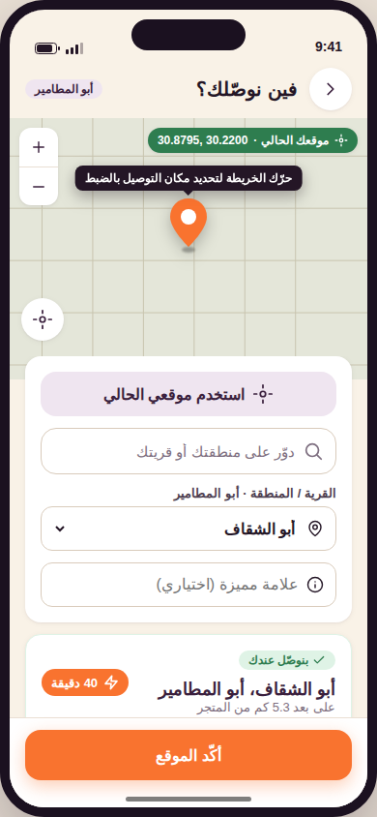
Launch service area: Abu El Matamir
One dark store, nine zones with their own ETA, fee and minimum basket
Zone | ETA | Fee | Min. | Status
وسط المدينة · City Center | 20 min | 10 | 60 | Live
شارع الجيش والمحطة | 25 min | 10 | 60 | Live
أبو الشقاف | 40 min | 15 | 80 | Live
زاوية صقر | 45 min | 20 | 90 | Live
الطيرية | 45 min | 20 | 90 | Live
الحدين | 55 min | 25 | 100 | Live
بولين | 55 min | 25 | 100 | Live
الوفائية | 60 min | 30 | 120 | Coming soon
كوم البركة | 70 min | 30 | 120 | Coming soon
Fees and minimums in EGP. Prototype uses approximate centroids and radii; production uses surveyed delivery polygons managed in the admin (BRD §6–7). Unsupported pins capture demand instead of blocking: "لسه موصلناش عندك، بس جايين توّا."
Live location: device GPS, draggable map with a fixed pin, instant zone detection.
توّا · Twaa

Slide 8









The full platform
Twelve systems, one operating company (BRD §9, §94)
Customer mobile app
Responsive web app
Admin portal
Operations portal
Designed
Designed
To build
To build
Inventory management
Picker app
Rider app
Dispatch platform
To build
To build
To build
To build
Support console
Promotion & CRM engine
Payment & wallet
Analytics & reporting
To build
To build
To build
To build
Customer-facing surfaces are designed and prototyped. The nine operational systems are the engineering scope of the MVP build.
توّا · Twaa

Slide 9
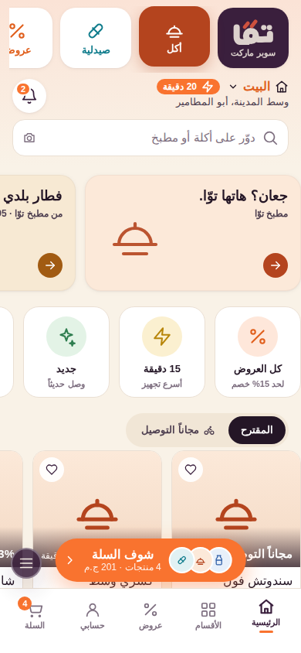
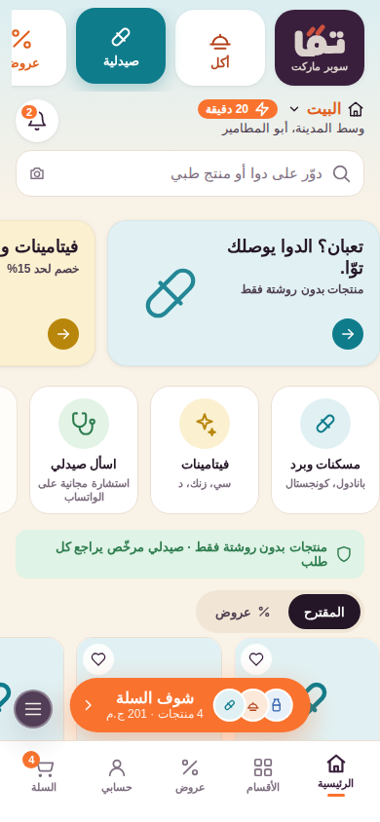
Customer app: three verticals, one basket
Structured like noon: a strip of verticals on top, each with its own home
Supermarket
Food (أكل)
Pharmacy (صيدلية)
Minutes headline, promo tiles, reorder, circular categories, + on every product
Twaa kitchen and local kitchens: promo cards, quick tiles, image cards with prep time
OTC only, pharmacist review, ask-a-pharmacist, prescription upload coming soon
توّا · Twaa
Notes:
Bottom nav follows noon order: Home, Categories, Deals, Account, Cart. Deals and Local are also verticals.

Slide 10
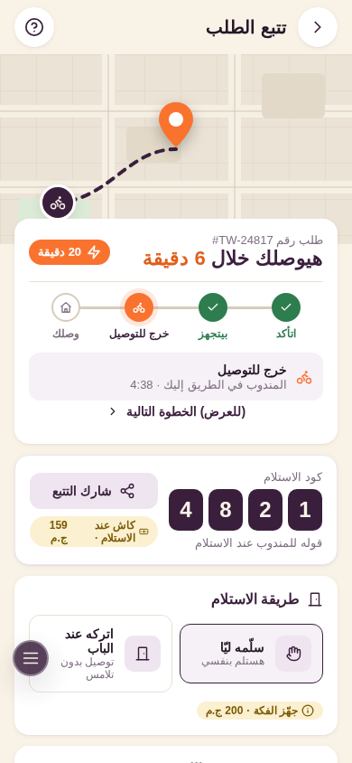
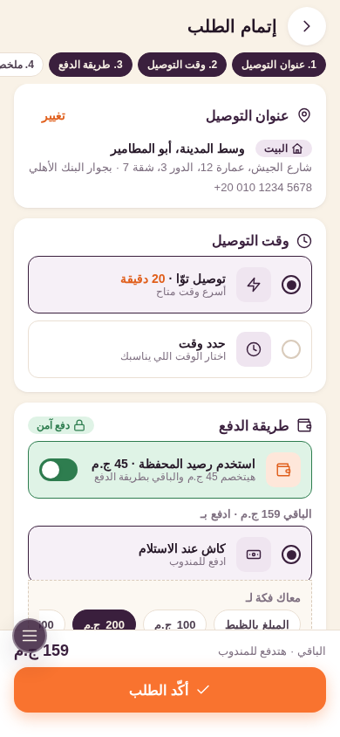
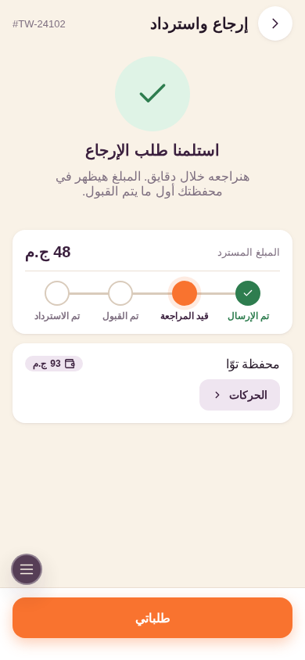
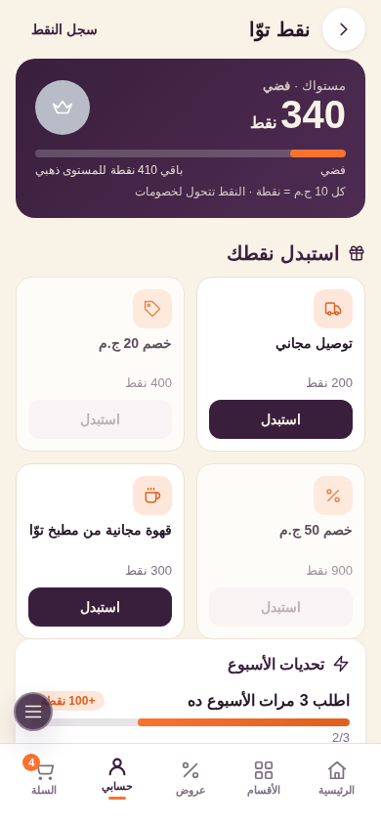
Built for trust: track, pay, return, earn
The parts that make customers come back, modelled on noon and Amazon
Live tracking
Payment
Returns & refunds
نقط توّا
Map, rider distance, delivery code, handover choice, cash-change reminder, proof of delivery
Wallet balance toggle, cash with change selector, saved cards, mobile wallets, secure badge
4-step wizard by item and reason; instant wallet refund with a status tracker
Points, tiers, rewards, weekly challenges, referral, Twaa+ teaser
توّا · Twaa

Slide 11

Brand & design system
Every screen derives from one token set, ready to port to the mobile theme
Aubergine
Cream
Mandarin
Food
Pharmacy
#3A1F3D · structure, prices, nav
#F9F2E7 · page background
#F9732F · one action per screen
#B4441E · vertical tint
#0F7C8C · vertical tint
Typography
Principles
Deliverables in repo
Display: Baloo Bhaijaan 2 (rounded, echoes the logo) for headings, prices, buttons
Body: Cairo, Arabic and Latin in one voice
Tabular numerals for prices, timers and codes
Body 15–16px, nothing under 11px
Arabic first, RTL native; English is a direction flip, not a second layout
One Mandarin action per screen, always in the bottom bar with the total
Availability and status stated in words, never colour alone
44px targets, reserved image space, motion under 320ms
index.html: interactive prototype, 26 screens
design-system.html: tokens and components
DESIGN.md: screen-by-screen guideline mapped to BRD sections
Container-query responsive: phone, tablet, desktop web
توّا · Twaa

Slide 12
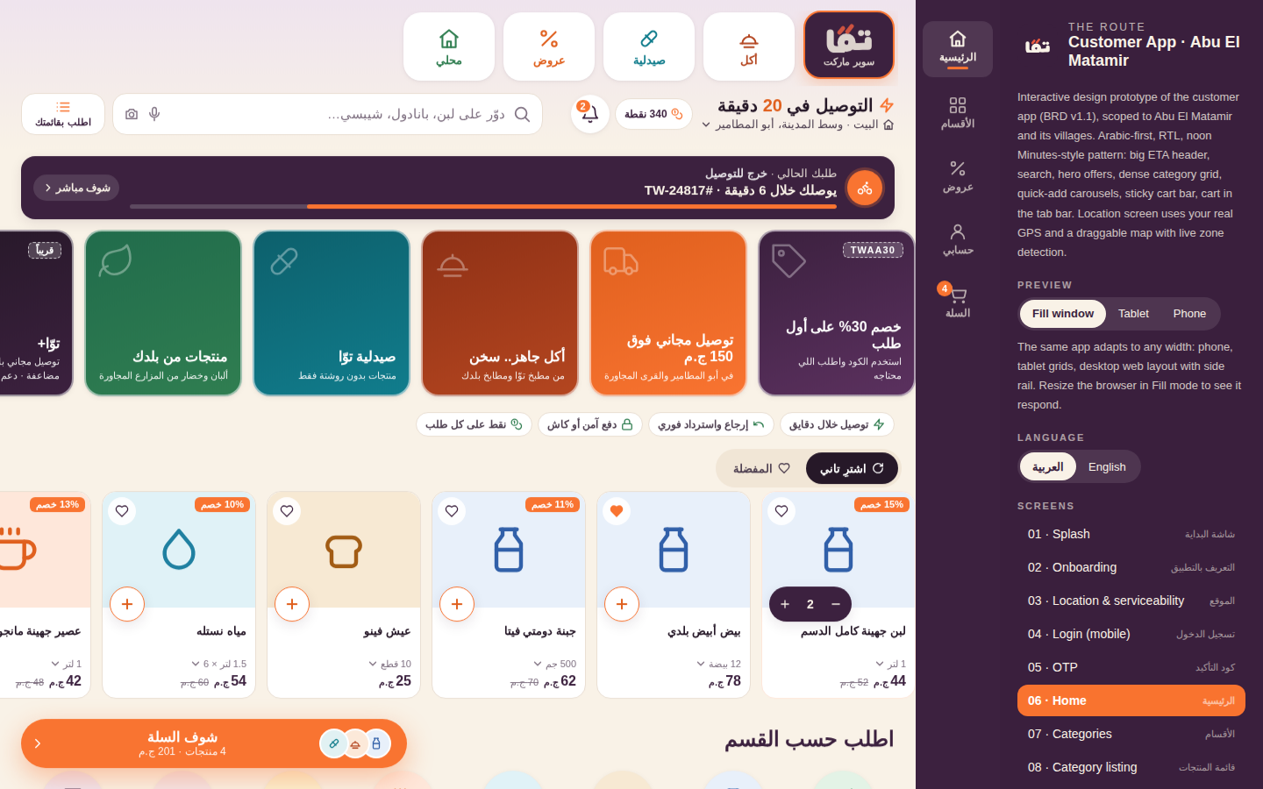
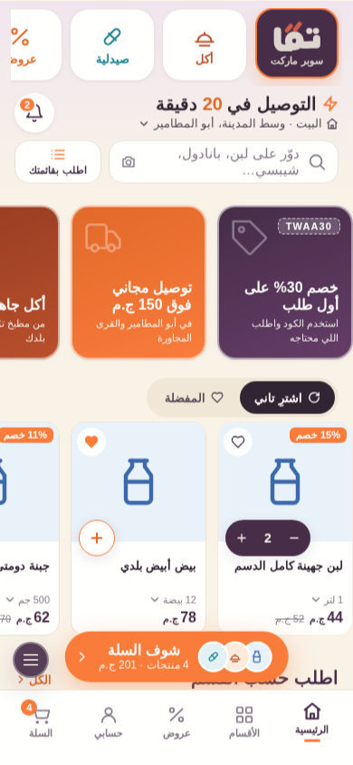
One app, every screen size
Fills a phone, adapts on tablets, becomes a web layout with a side rail on desktop
Phone: full-screen, safe-area aware, installable as a PWA
Tablet: centred column, auto-fill grids, 2-up banners
Desktop: side rail, two-column cart and checkout, map beside details, product modal
توّا · Twaa

Slide 13
MVP scope
What must exist before the first zone launches (BRD §83)
Customer app
Admin & operations
Fulfilment
Rider
OTP login, live location, saved addresses
Home verticals, categories, search, product pages, quick add
Cart, promo codes, checkout, COD + digital payment
Tracking, order history, reorder, favourites
Returns & refunds, wallet, notifications, support
Dashboard, products, categories, pricing
Inventory per location with reservations
Orders, customers, promotions, refunds
Stores, delivery zones, riders, pickers
Reports, users, roles, audit log
Order queue and acceptance
Guided picking with shelf locations
Substitutions per customer preference
Packing and handover
Picker KPIs
Login, online/offline status
Assignment, navigation, customer contact
Status updates and delivery code
COD collection and cash balance
Proof of delivery, problem reporting
Out of scope for MVP: marketplace sellers, restaurant marketplace, prescription delivery, multi-store basket splitting, advanced AI forecasting (BRD §86).
توّا · Twaa

Slide 14
Product roadmap
Launch focused, then deepen, then expand
MVP
Q4 2026 – Q1 2027
Phase 2
Q2 – Q3 2027
Phase 3
2028
Supermarket, food and pharmacy in Abu El Matamir
COD, cards, mobile wallets, Twaa wallet refunds
Live tracking, returns, basic points
Manual / semi-automatic dispatch
1,500–3,000 SKUs from one dark store
Scheduled delivery, Twaa+ subscription
Full loyalty (tiers, challenges), referral programme
Automated dispatch and ETA model
Personalisation: مخصوص ليك, ممكن تحتاج معاهم
Supplier portal, B2B ordering, advanced CRM
Additional Beheira markazes and governorates
More dark stores, dynamic fulfilment allocation
Private label, sponsored placement, ads platform
Third-party sellers
Demand forecasting and auto-replenishment
توّا · Twaa

Slide 15
Delivery plan: design to launch
Proposed 7-month plan, October 2026 to April 2027
Sep 26
Oct
Nov
Dec
Jan 27
Feb
Mar
Apr
Discovery, BRD, brand & app design
✓ complete
Backend, admin & inventory
Customer app (iOS, Android, web)
Picker & rider apps, dispatch
Integrations: payments, SMS, maps, WhatsApp
Store setup, assortment, suppliers, hiring
QA, RTL, payments & real-store testing
Pilot: city centre, friendly users
Public launch: Abu El Matamir city
Village rollout, zone by zone
Phase 2 features start
Milestones
Design sign-off
Code complete
All villages live
Public launch
توّا · Twaa
Notes:
Dates are a proposal to be confirmed with the engineering vendor or in-house team. A zone launches only when the readiness checklist passes (BRD §89).

Slide 16
Workstreams and team
Who owns what through launch
Workstream | Owner | Key deliverables | Size
Product & design | Product lead + designer | Backlog, admin/picker/rider designs, acceptance tests, copy deck | 2
Engineering: backend & admin | Tech lead + 3 devs | APIs, inventory, orders, promotions, roles, audit, reporting | 4
Engineering: apps | 2 mobile devs + 1 web | Customer app iOS/Android/web, picker and rider apps | 3
QA | 1 QA engineer | Functional, RTL, payments, maps, load, security, real-store tests | 1
Operations | Ops manager + store manager | Dark store, shelving, receiving, picking SLA, cash controls | 2 + staff
Supply & assortment | Buyer | 1,500–3,000 launch SKUs, local suppliers, pricing, safety stock | 1
Delivery | Rider manager | Rider hiring and training, zones, capacity, COD reconciliation | 1 + riders
Marketing & CRM | Growth lead | Launch campaign, first-order offer, referral, notifications, content | 1
Finance & support | Finance + 2 agents | Payment gateway, reconciliation, refunds policy, support console | 3
Core build team of about 10 plus operations staff. Engineering can be in-house or a vendor; either way the BRD and the prototype are the contract.
توّا · Twaa

Slide 17




How we measure success
Operational targets for the pilot, validated before expansion (BRD §54, §91)
KPI | Initial target
Order completion | >95%
Inventory accuracy | >97%
Picking accuracy | >99%
Urban delivery time | 25–40 min
Outer-zone delivery time | 45–75 min
Cancellation rate | <5%
Customer rating | >4.5 / 5
Stock availability | >93%
North-star metric
Successful repeat orders per active customer
Downloads do not count. Reliable, repeated deliveries do.
Supporting metrics
Retention, repeat rate, DAU/MAU
Orders/day, AOV, items/order
Pick, pack, dispatch, delivery times
Gross and contribution margin, promo cost/order
Refund rate, substitution rate
توّا · Twaa

Slide 18





Key risks and how we contain them
From BRD §90, with the design and plan decisions that address each
Low order density
Stock inaccuracy
Delivery delay
Too few orders per zone makes delivery uneconomical.
Customers order what is not on the shelf.
Missed ETAs destroy trust fast.
Mitigation: Launch zone by zone from the city centre; a zone goes live only when riders and stock are ready.
Mitigation: Reservations on confirmation, cycle counts, substitution preference captured in the cart.
Mitigation: Zone-based ETAs, capacity caps, live tracking so customers always know where the order is.
Promotion overspend
Excess inventory
COD leakage
Discounts lift GMV and kill margin.
Too many SKUs tie up cash and expire.
Cash collection without reconciliation.
Mitigation: Every promotion reported against contribution margin; caps on usage and value.
Mitigation: Focused 1,500–3,000 SKU launch range weighted to high-frequency essentials.
Mitigation: Rider cash balance, deposit tracking and variance reports from day one; wallet nudges digital payment.
توّا · Twaa

Slide 19
Launch readiness and next steps
A zone opens only when every box is ticked (BRD §89)
Readiness checklist
Decisions needed now
Fulfilment location ready, stock loaded, prices verified
1
Approve the plan and dates
Zones, hours and ETAs configured; riders and pickers trained
Confirm October start and the January pilot.
Payments, COD workflow and refunds tested end to end
2
Choose the build route
In-house team vs. vendor; both work from the BRD and prototype.
Support operational; escalation procedures in place
Secure the dark store
3
Promotions validated, analytics verified
Location in the city centre, shelving, cold chain, capacity.
4
Confirm payment partners
Order created once only; inventory reserved; audit log on
Gateway for cards and Meeza; Vodafone Cash / InstaPay; SMS provider.
5
Start assortment and supplier deals
Launch range and local suppliers; pricing and safety stock.
6
Provide brand assets
Official logo files and final brand package for the build.
توّا · Twaa

Slide 20
Same places. Brighter together.
Local roots. Closer days.
Interactive prototype, design system and guideline: repo eldeniney/abbas, folder twaa/ · branch claude/twaa-quick-commerce-design-tfgzjq

