Slide 1
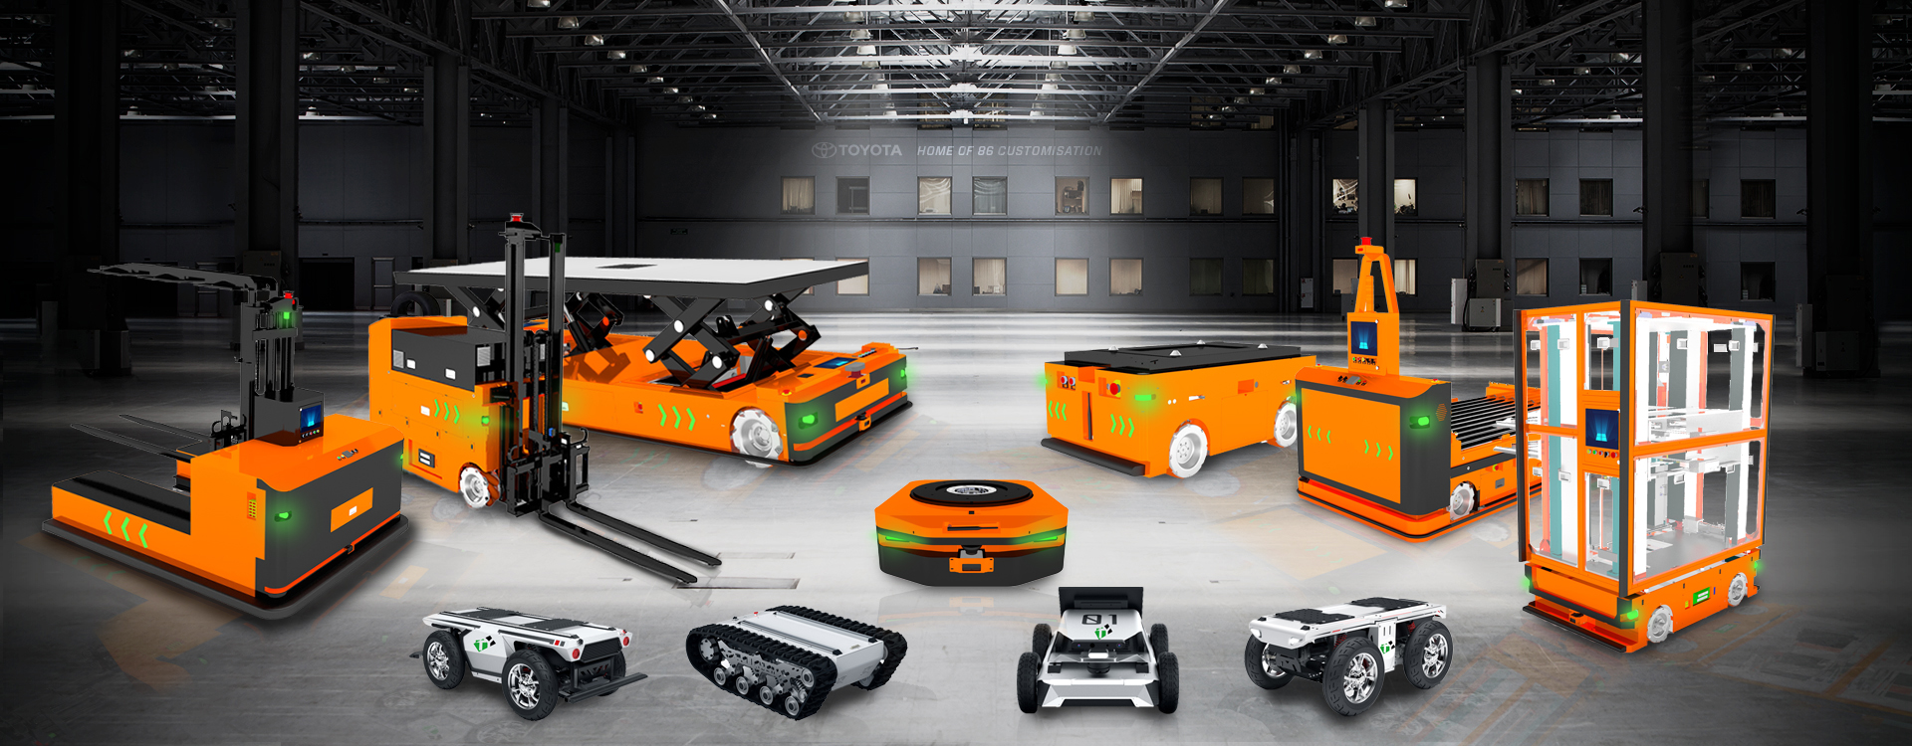

Guangzhou Tanyue Automation Technology Co., Ltd.
Guangzhou Xinyue Zhixing Robot Technology Co., Ltd.
Our goal is to help more customers achieve digital transformation of their factories.

Slide 2
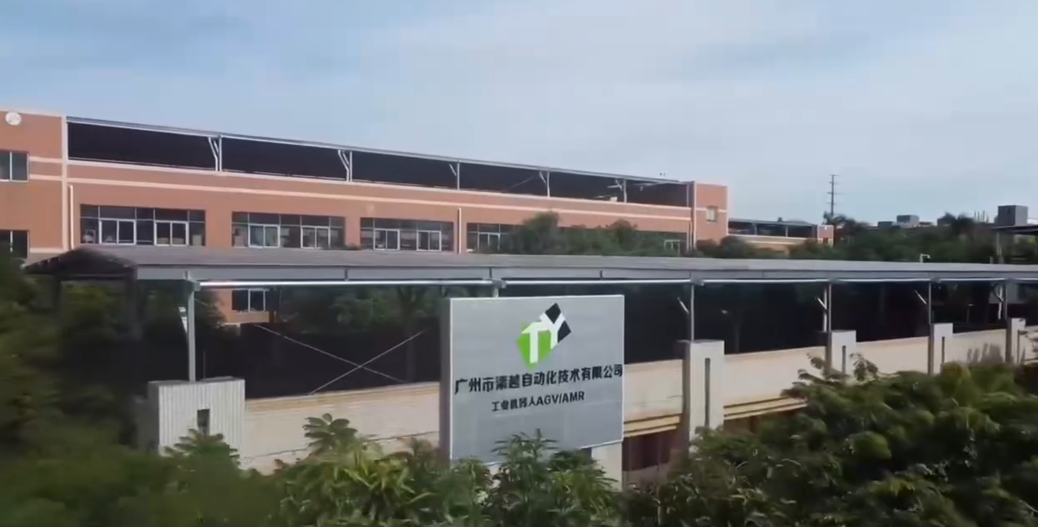
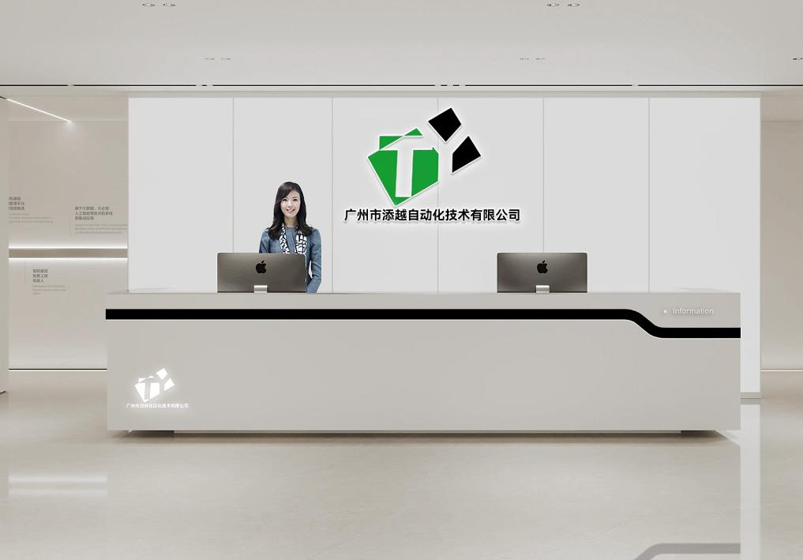
About Our Company
Our AGV team traces its roots back to 2012. Guangzhou Tanyue Automation Technology Co., Ltd. was founded in 2018, with Guangzhou Xinyue Robot Technology Co., Ltd. as its subsidiary. We continuously optimize our product structure and improve our multi-tier product portfolio through sustained AGV/AMR technological innovation. We are also committed to R&D and manufacturing of heavy-duty customized mobile equipment to meet market demands.
As a pioneer in building custom intelligent mobile chassis with solutions at the core, we deliver market-oriented customization services. Meanwhile, we adhere to technological and service innovation to support material handling across diverse industries. Our mission is to develop intelligent and cost-effective transfer platforms, providing our clients with more efficient, safe, intelligent and reliable services.

Slide 3












Case Studies & Clients

Slide 4
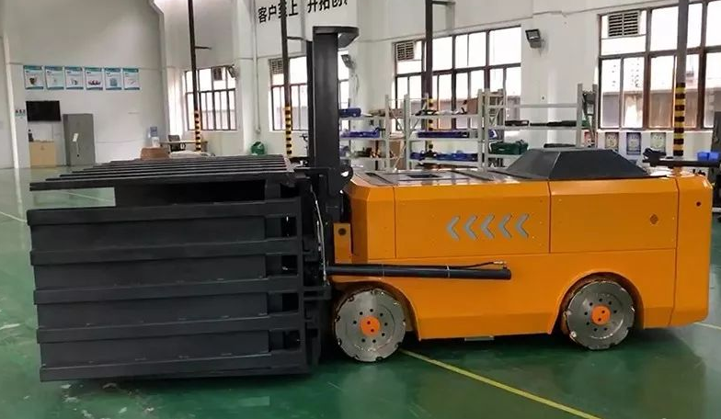
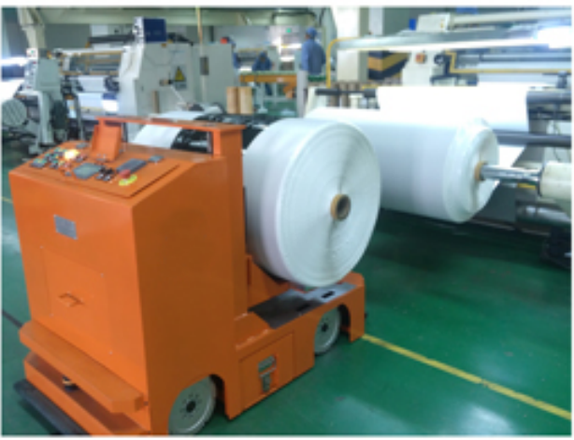
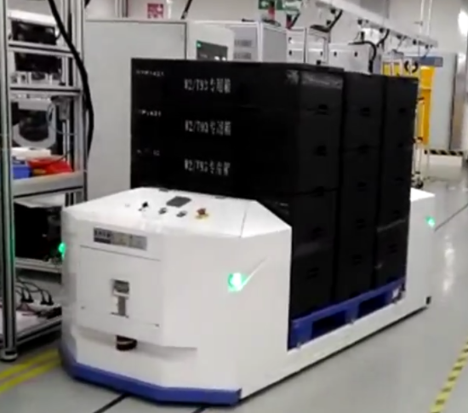
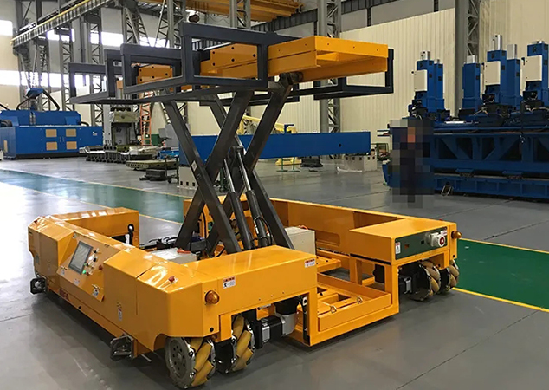
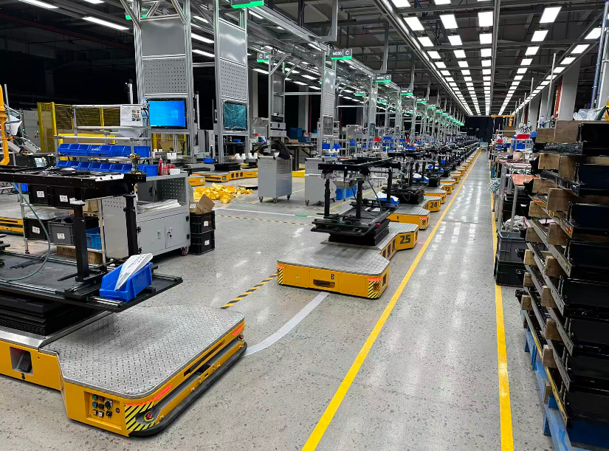
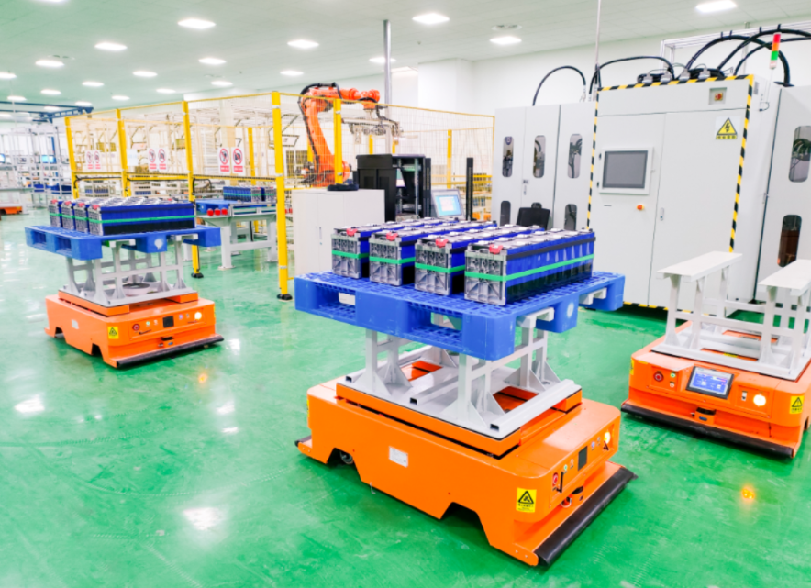
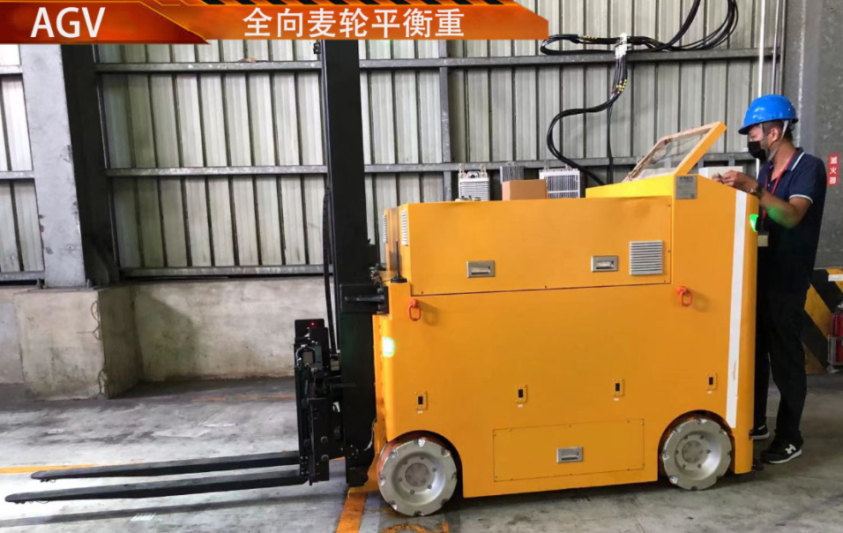
Case Studies & Clients

Slide 5
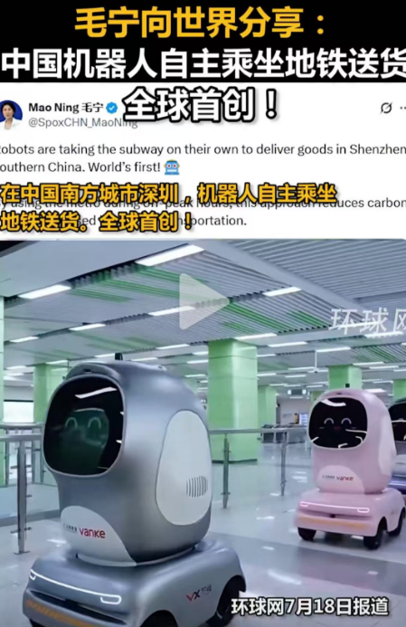
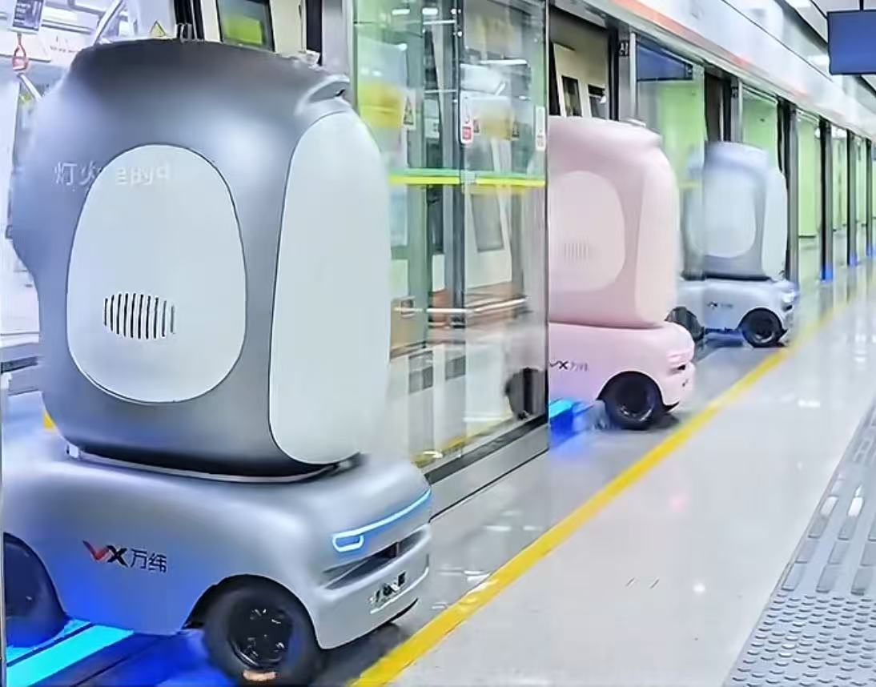
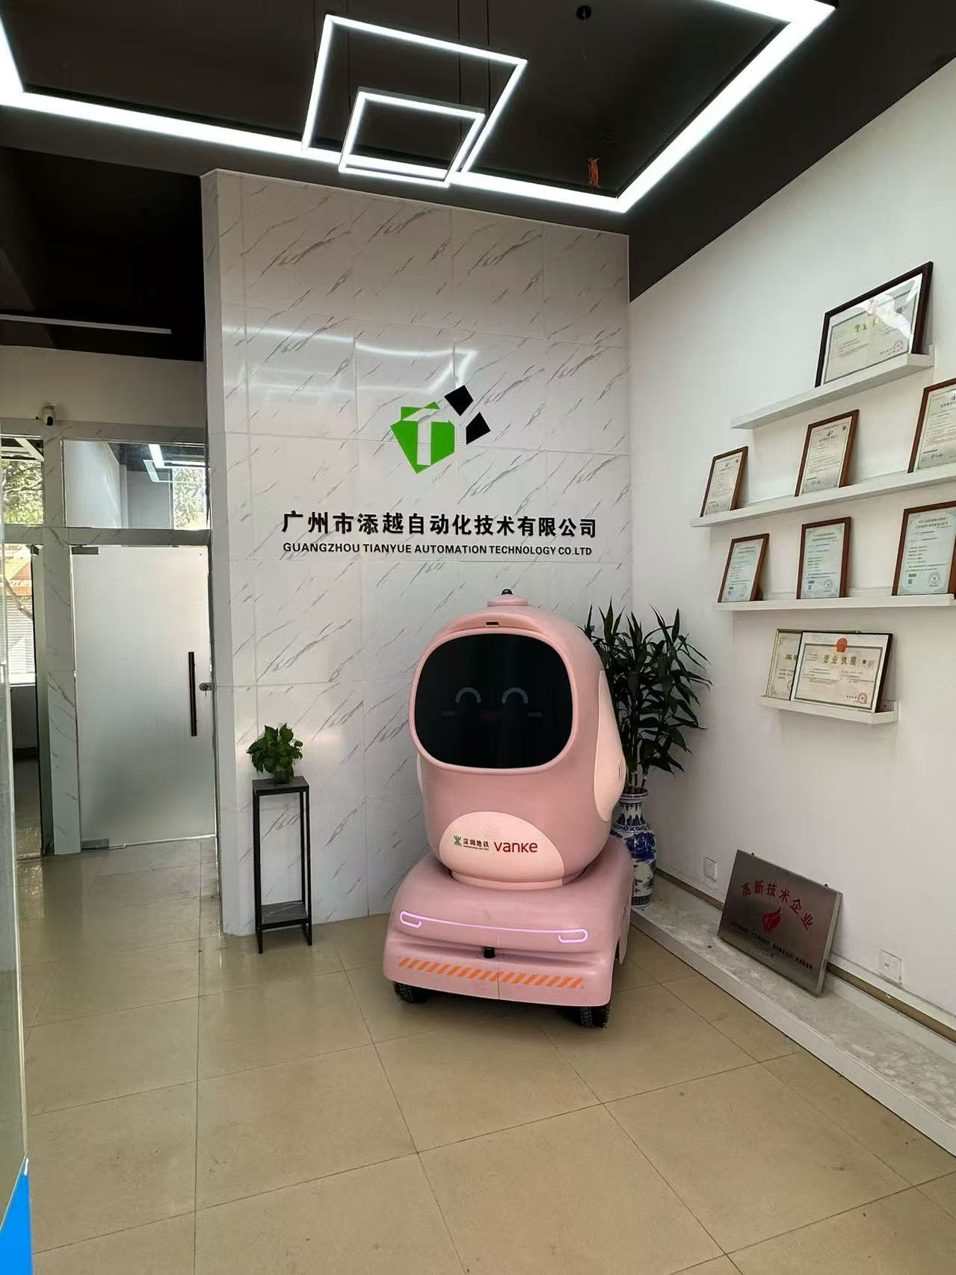
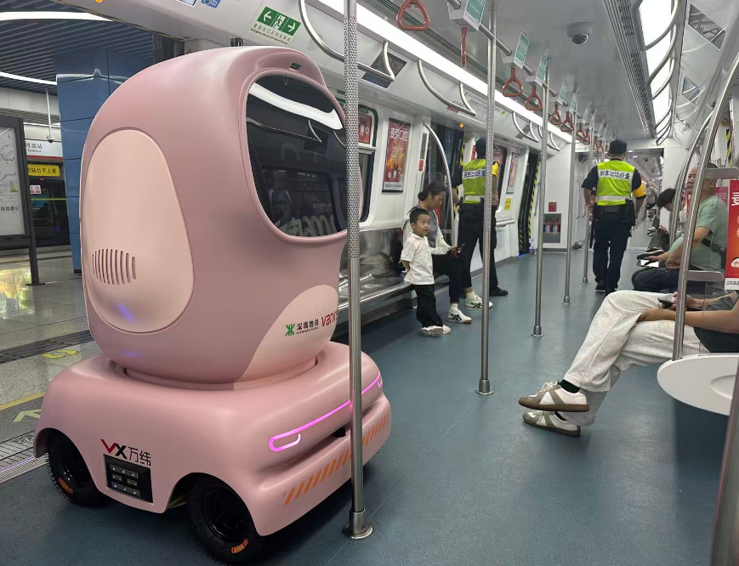
Case Studies & Clients

Slide 6
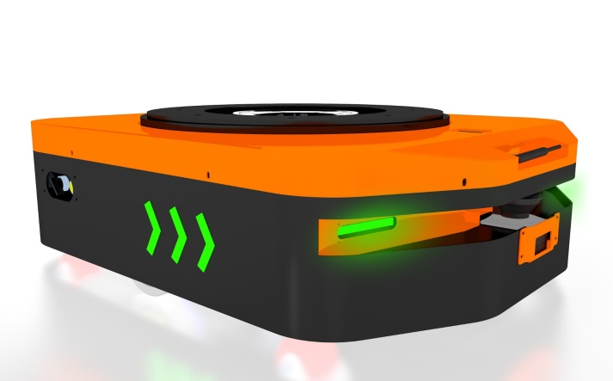
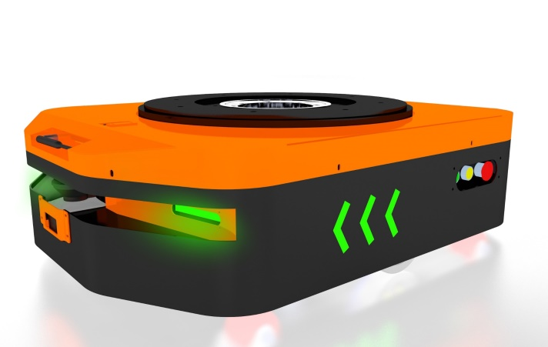
Our Products
Storage AGV
Dimensions: L1060*W750*H290 (mm)
Lifting capacity: 1000kg-3000kg
Drive type: Differential drive
Loading method: Lifting
Navigation method: Laser navigation
Travel speed: 0-50 mm/min
Lifting height: 50mm
Power supply: DC48V
Inclination climbing capability: ≤2°

Slide 7
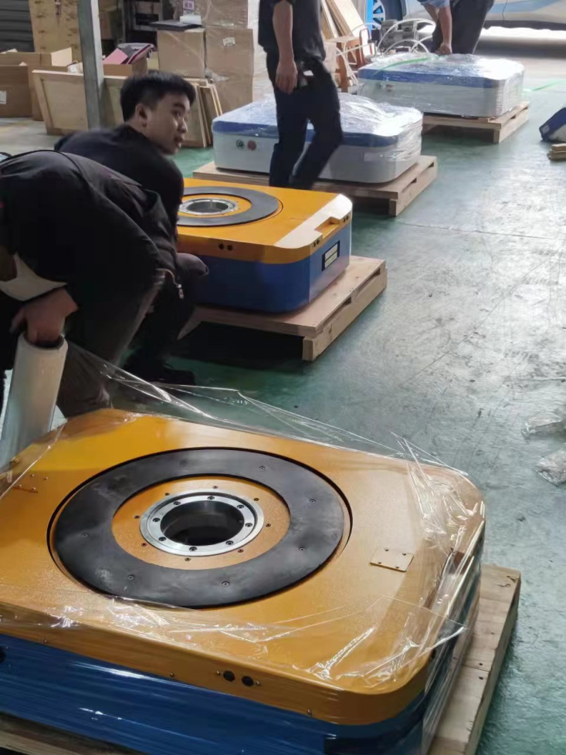
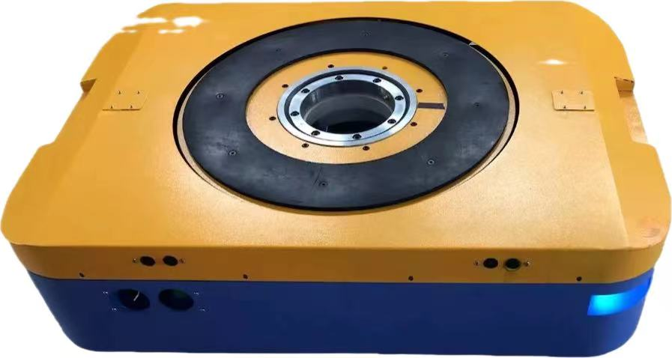
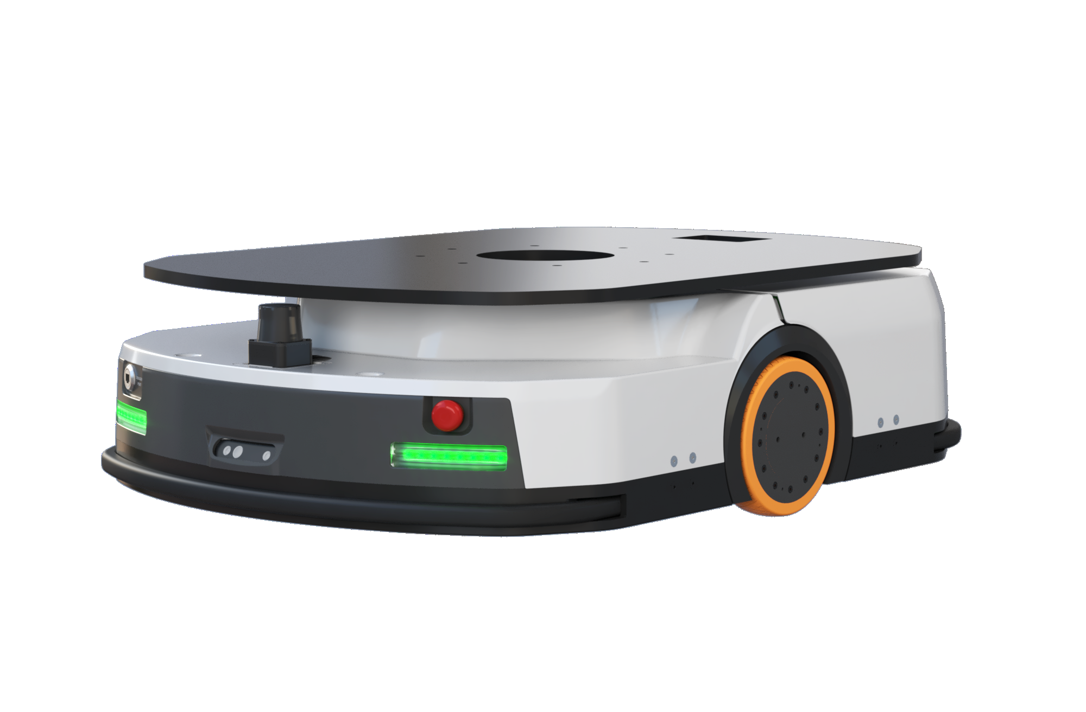
Our Products

Slide 8
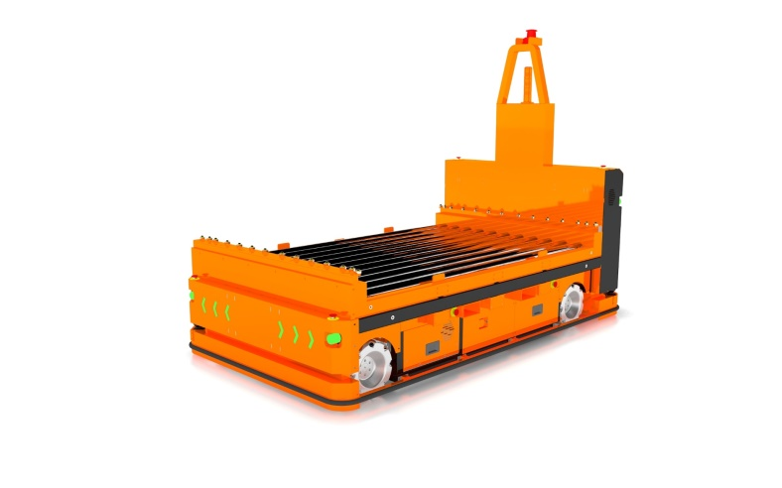
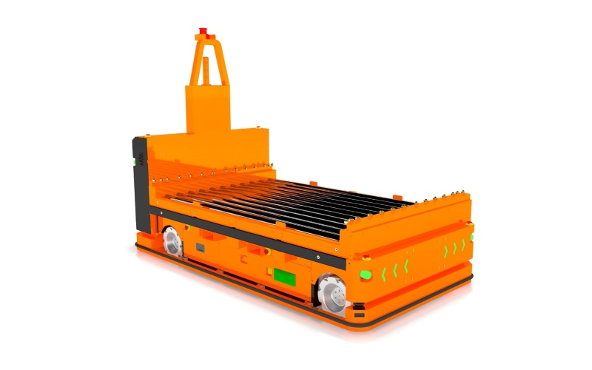
Our Products
omnidirectional drum AGV
Dimensions: L3210*W1500*H2000 (mm) Drum interface: 500mm (custom)
Drive mechanism: MacNam wheel drive / steering wheel
Load-bearing type: load-bearing drum
Load capacity: 1000kg-3000kg
Navigation method: Laser navigation/QR code/magnetic strip
Travel speed: 0-50mm/min
Lifting height: 1000mm
Power supply: DC48V
Inclination climbing capability: ≤2°

Slide 9
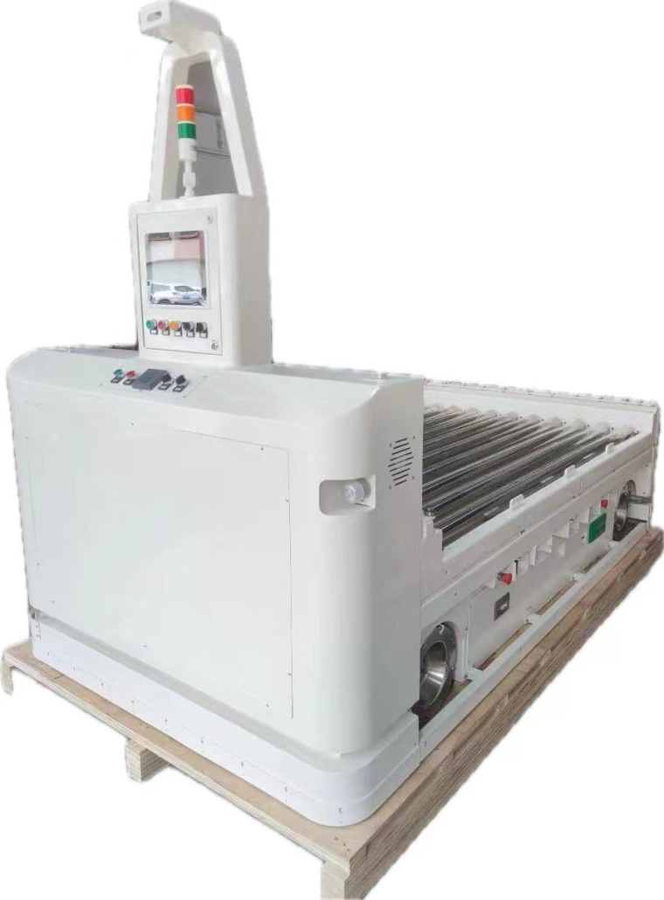
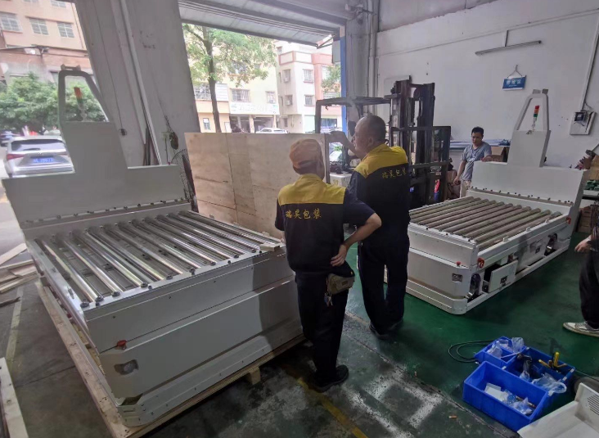
Our Products

Slide 10
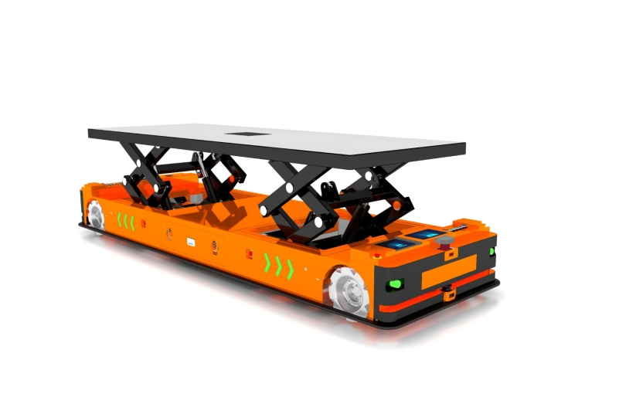
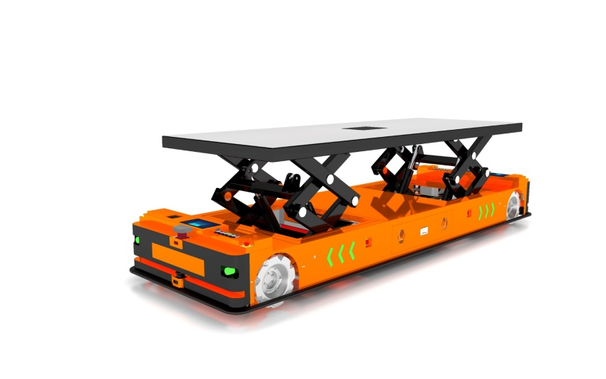
Our Products
omnidirectional lifting AGV
Dimensions: L4500*W1400*H500 (mm) Minimum lifting height: 500mm (customizable)
Drive system: MacNam wheel drive Loading mechanism: Double scissor lift
Load capacity: 4000kg-10000kg Navigation methods: Laser guidance/QR code/magnetic strip
Travel speed: 0-50mm/min
Lifting height: 1000mm (customizable) Power supply: DC48V
Inclination climbing capability: ≤2°

Slide 11
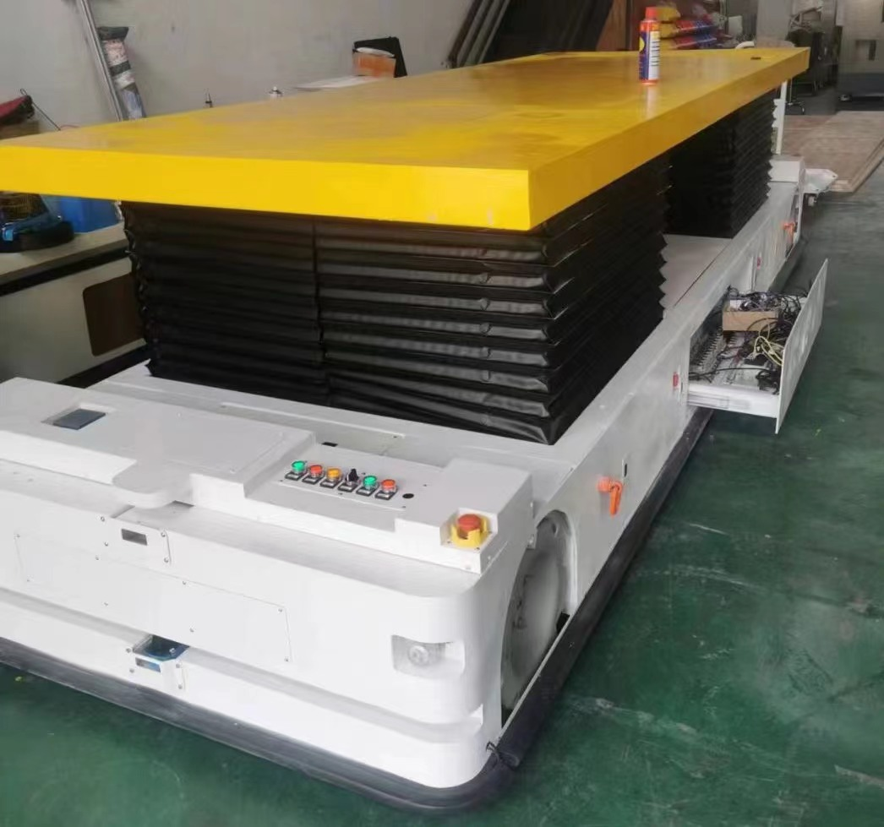
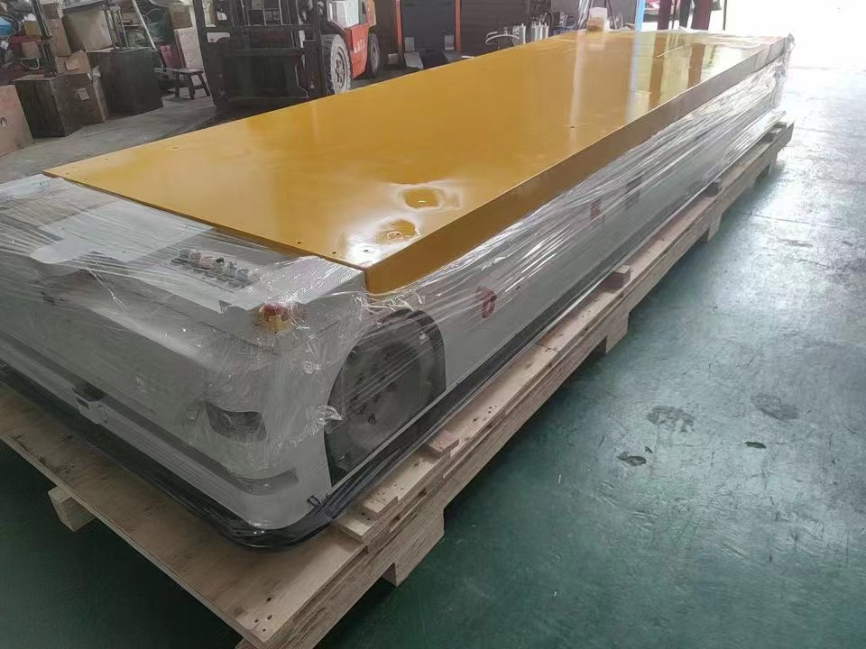
Our Products

Slide 12
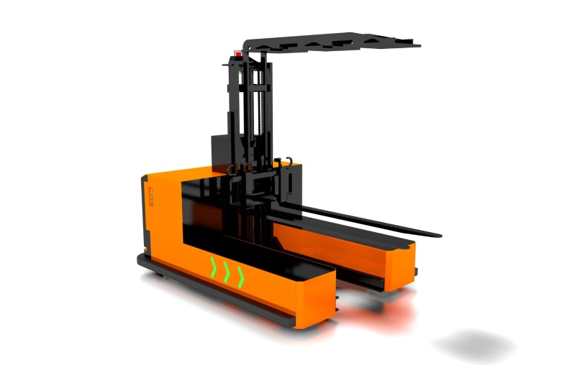
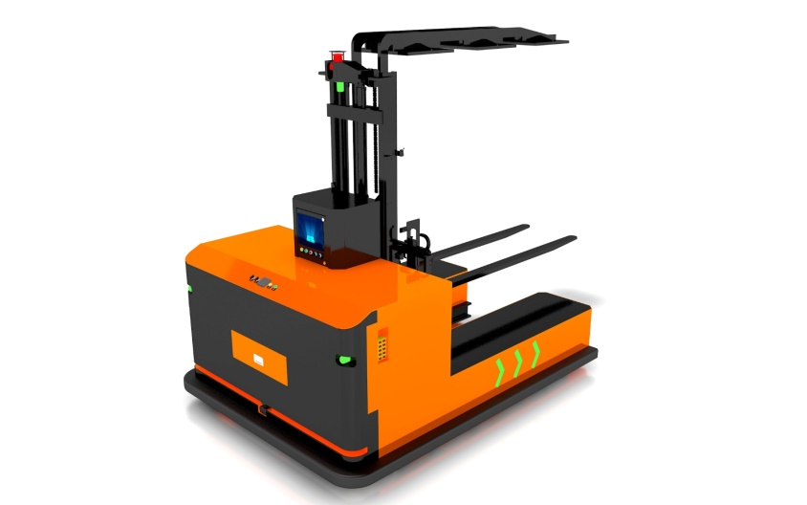
Our Products
All-Front Forklift Lift AGV
Dimensions: L3000*W2100*H2000 (mm) Lifting capacity: 2000kg
Drive system: Dual steering wheel drive/MacNamah wheel
Loading method: Lift
Navigation method: Laser navigation Travel speed: 0-50mm/min
Lifting height: 1000mm-10000mm (customizable)
Power supply: DC48V
Inclination climbing capability: ≤2°

Slide 13
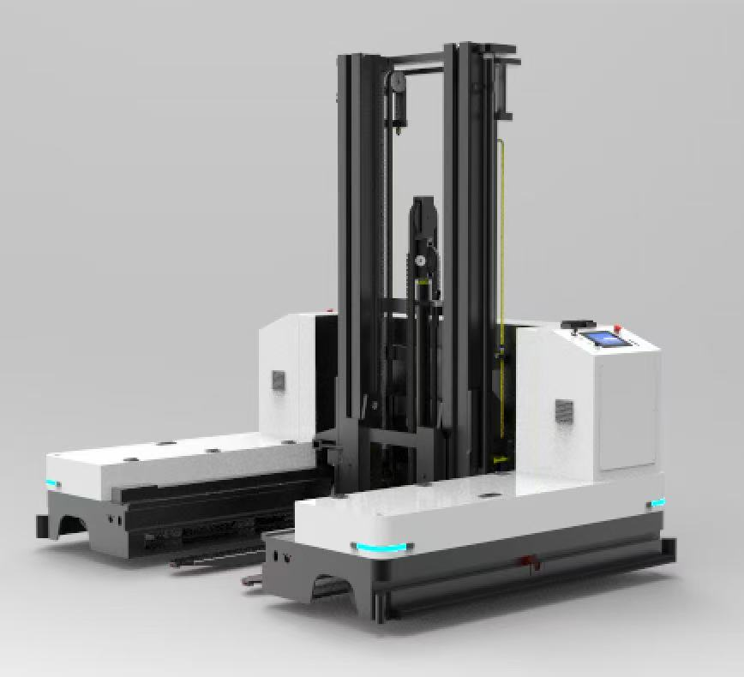
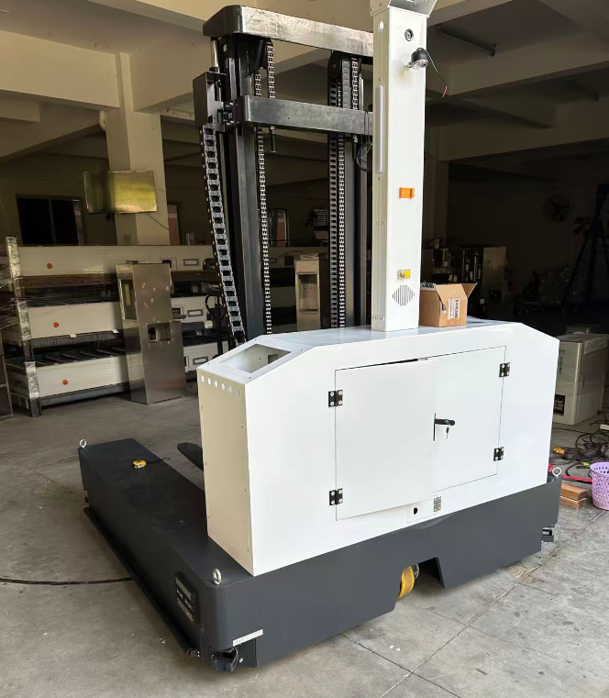
Our Products

Slide 14
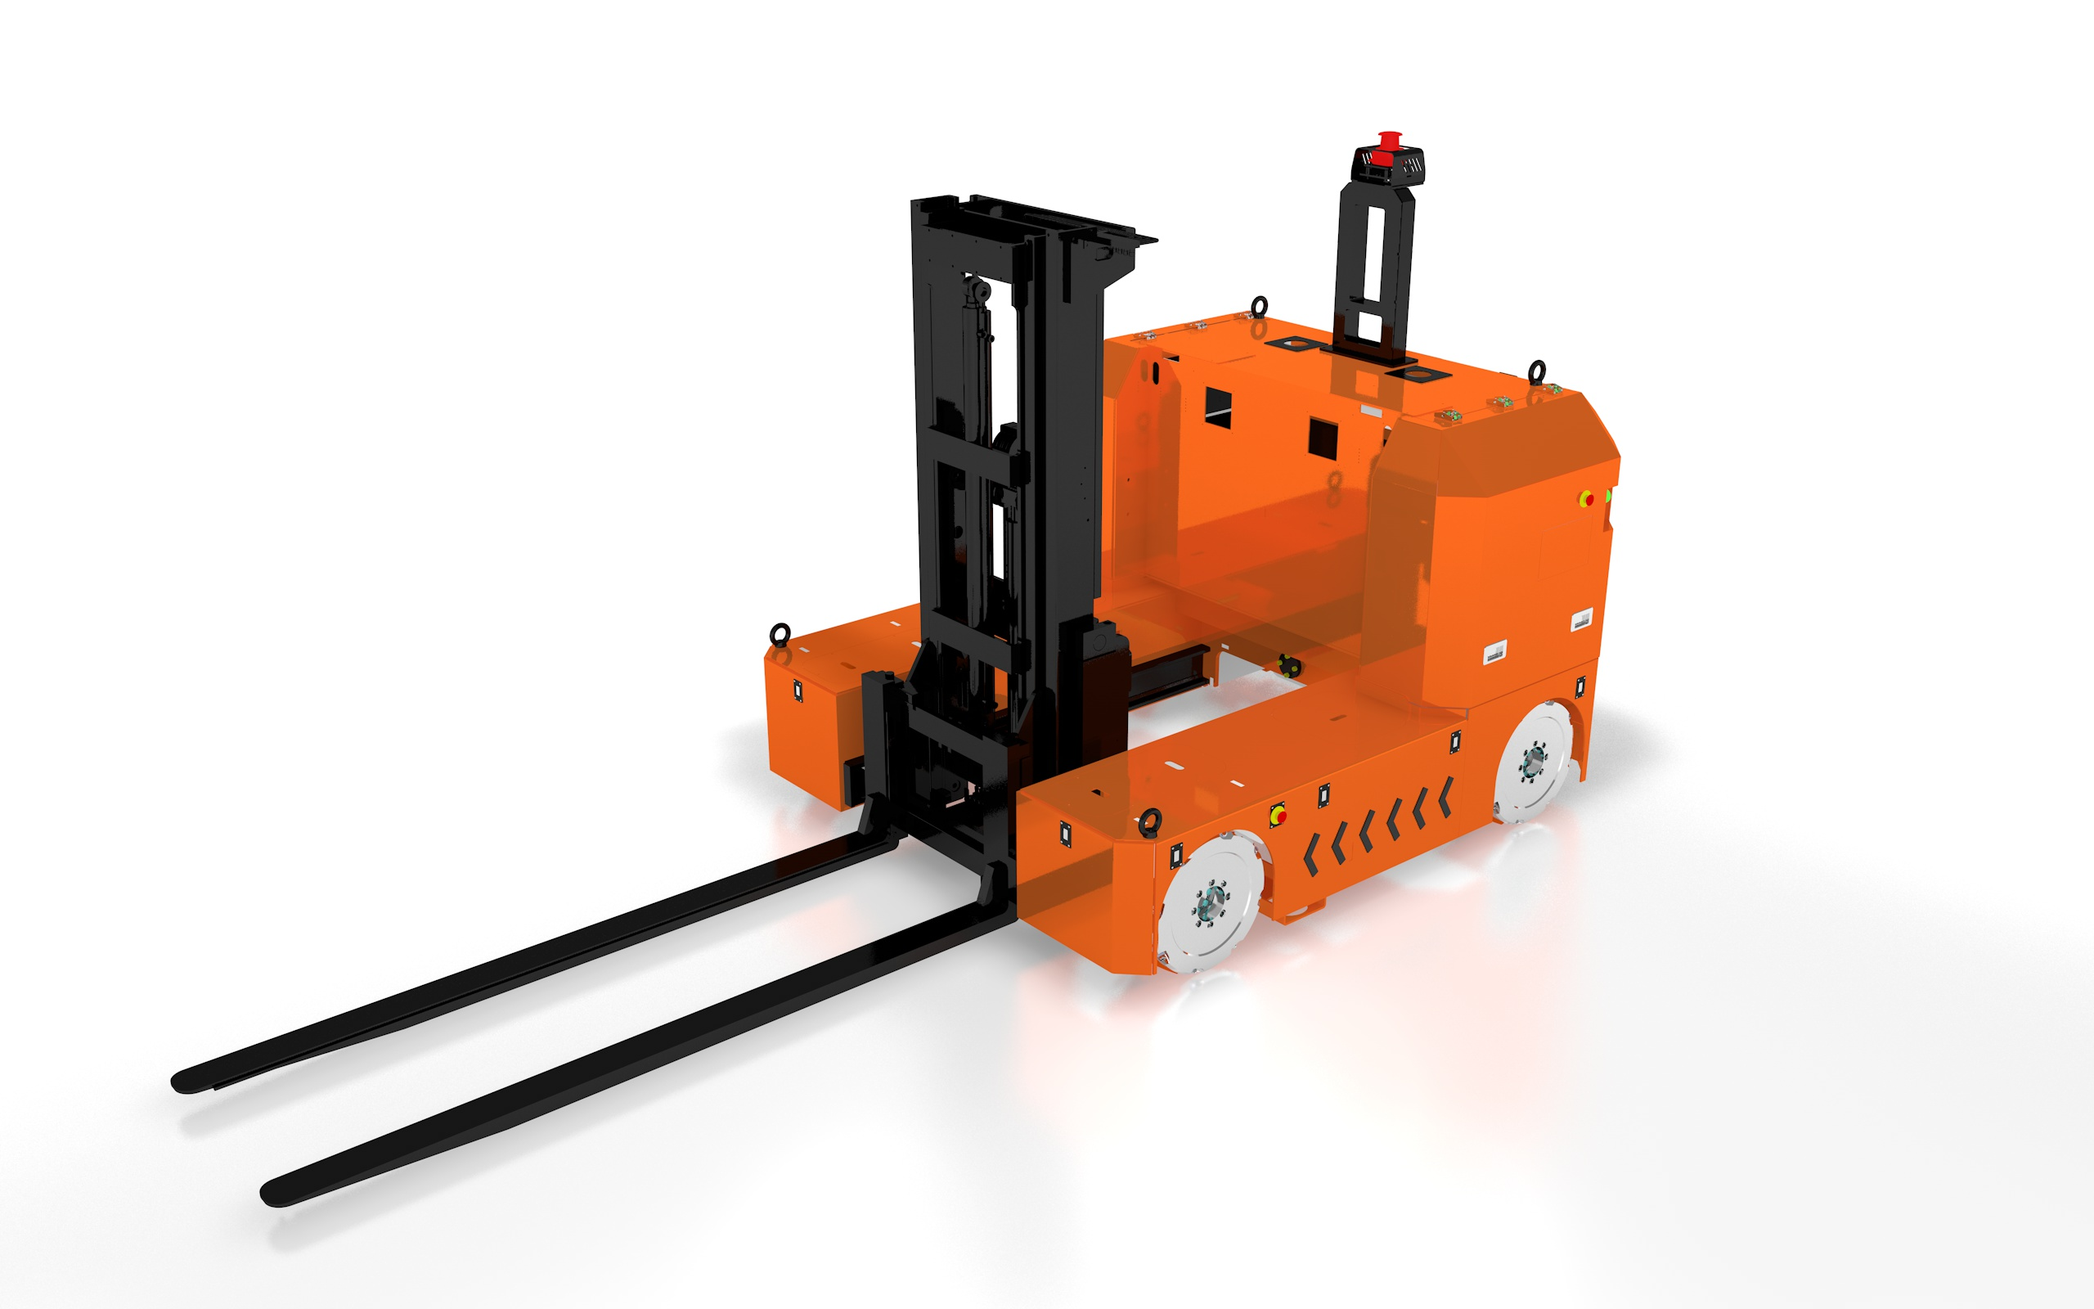
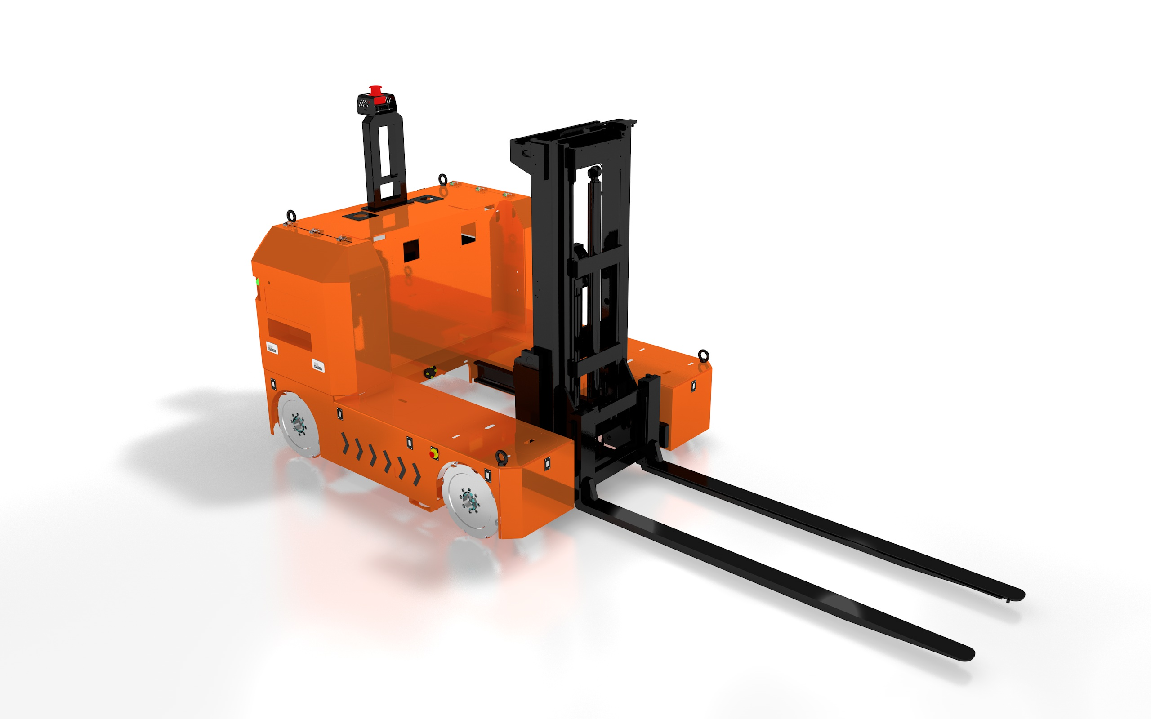
Our Products
All-direction forklift AGV
Dimensions: L3500*W1100*H2433 (mm) Drive type: MacNam wheel drive
Load-bearing method: Front fork lift
Working mode: 24-hour operation
Load capacity: 1500kg
Navigation method: Laser guidance
Travel speed: 0-50mm/min
Maximum lifting height: 3000mm
Power supply: DC48V
Inclination tolerance: ≤4°

Slide 15
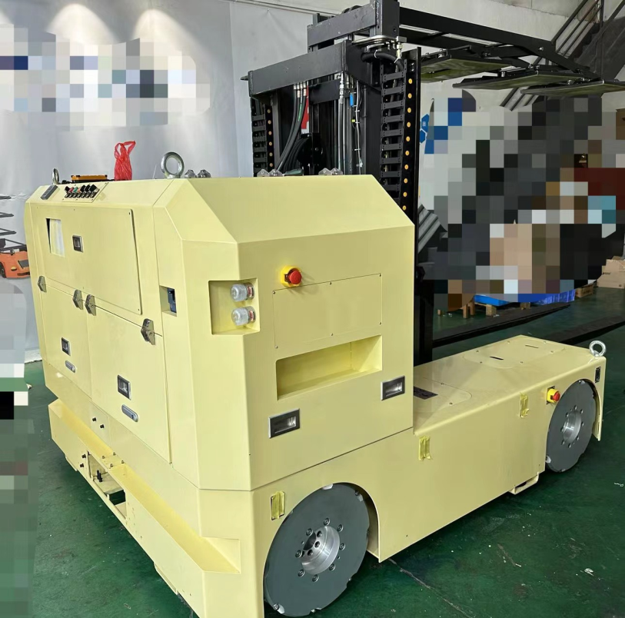
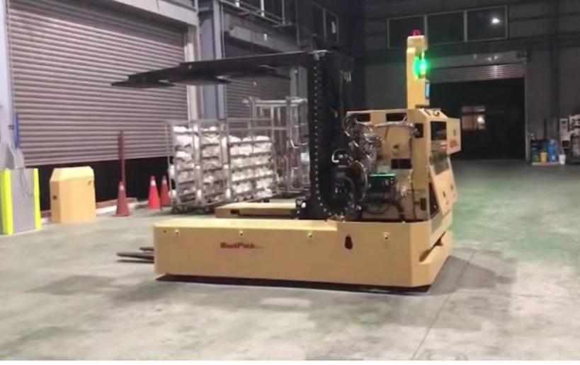
Our Products

Slide 16
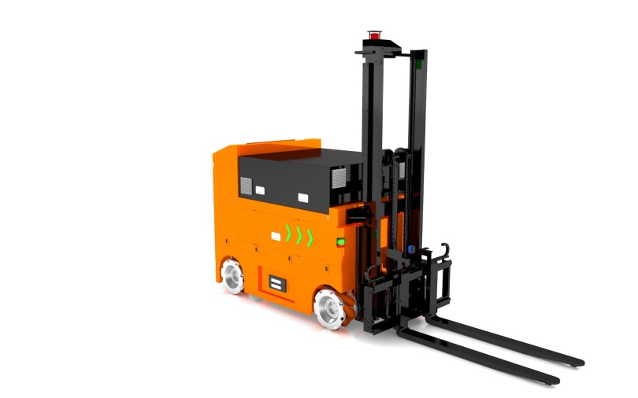
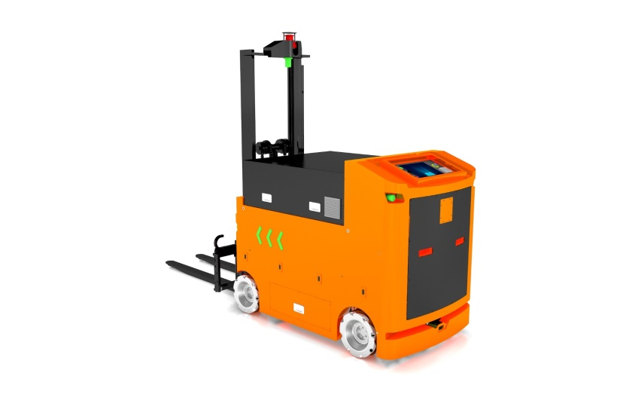
Our Products
All-direction forklift AGV
Dimensions: L3500*W1100*H2433 (mm) Drive type: MacNam wheel drive
Load-bearing method: Front fork lift Working mode: 24-hour operation
Load capacity: 1500kg
Navigation method: Laser guidance
Travel speed: 0-50mm/min
Maximum lifting height: 2000mm
Power supply: DC48V
Inclination tolerance: ≤4°

Slide 17
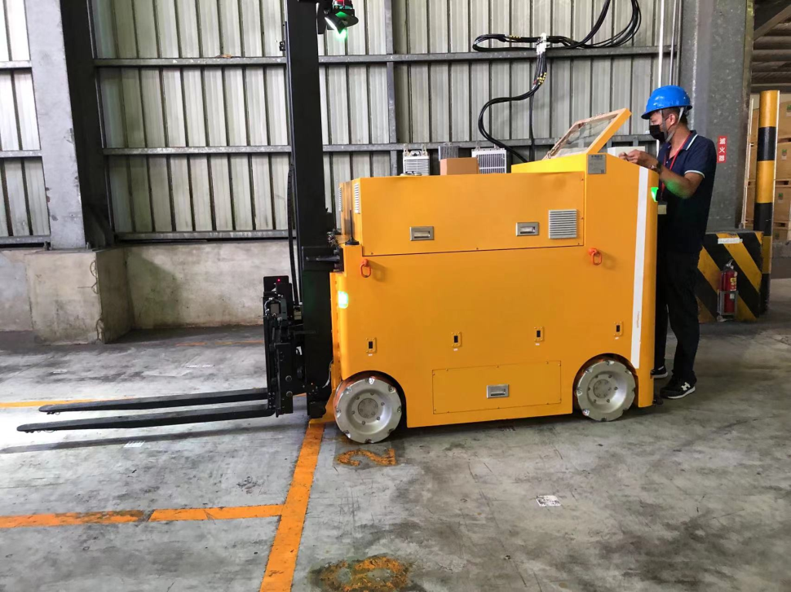
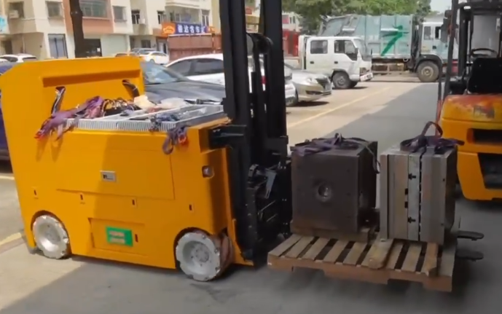
Our Products

Slide 18
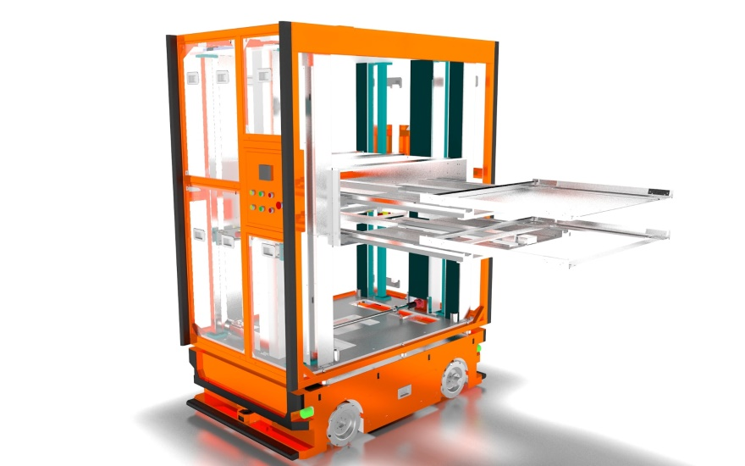
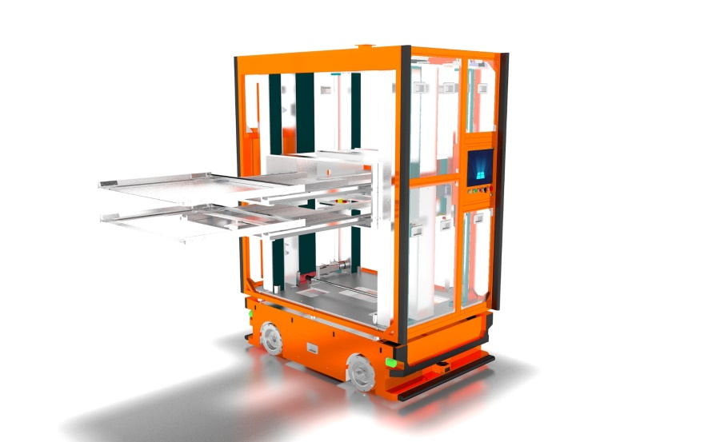
Our Products
Unidirectional balanced dual fork AGV
Dimensions: L1600×W1100×H2230 (mm)
Drive Type: Mecanum Wheel Drive
Load-Bearing Method: Side Fork Lifting
Operation Mode: 24/7 Continuous Operation
Load capacity: 100kg*2
Guidance method: Laser navigation Travel speed: 0-50mm/min
Maximum lifting height: 1500mm Power supply: DC48V
Inclination climbing capability: ≤2°

Slide 19
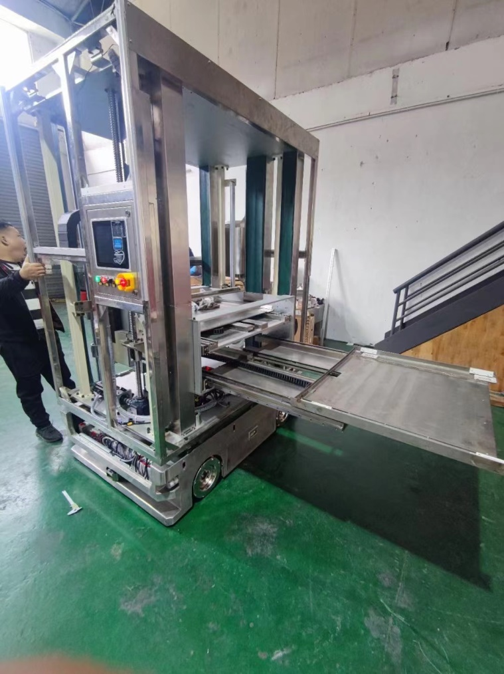
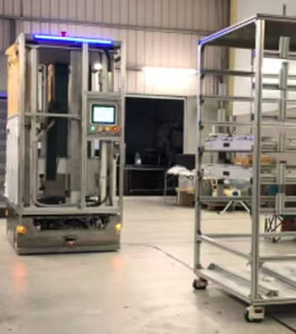
Our Products

Slide 20
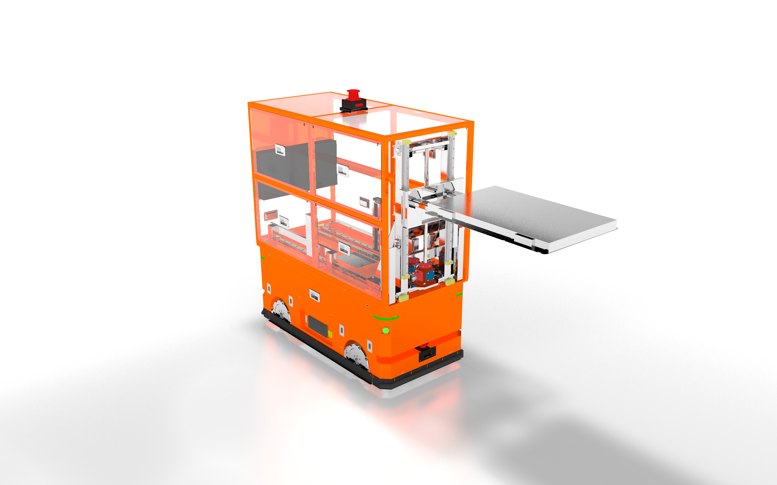
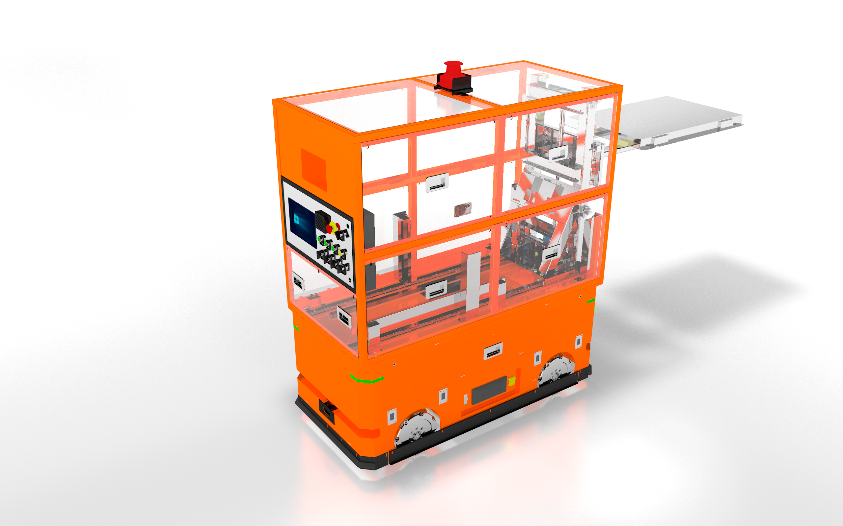
Our Products
All-direction forklift AGV
Dimensions: L3500*W1100*H2433 (mm) Drive type: MacNam wheel drive
Load-bearing method: Front fork lift Working mode: 24-hour operation
Load capacity: 1500kg
Navigation method: Laser guidance
Travel speed: 0-50mm/min
Maximum lifting height: 1500mm
Power supply: DC48V
Inclination tolerance: ≤4°

Slide 21
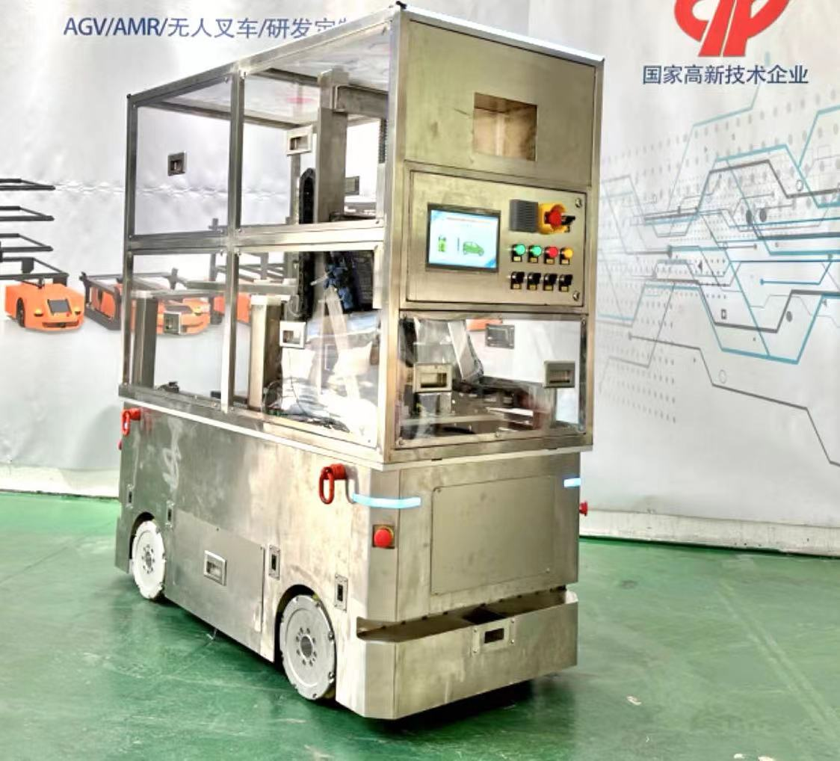
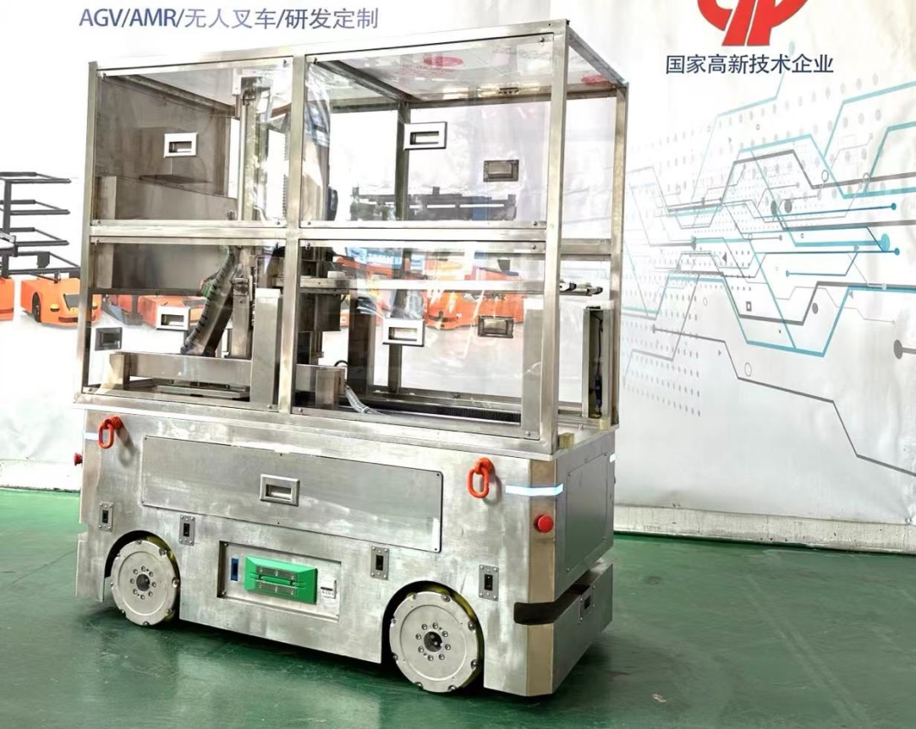
Our Products

Slide 22
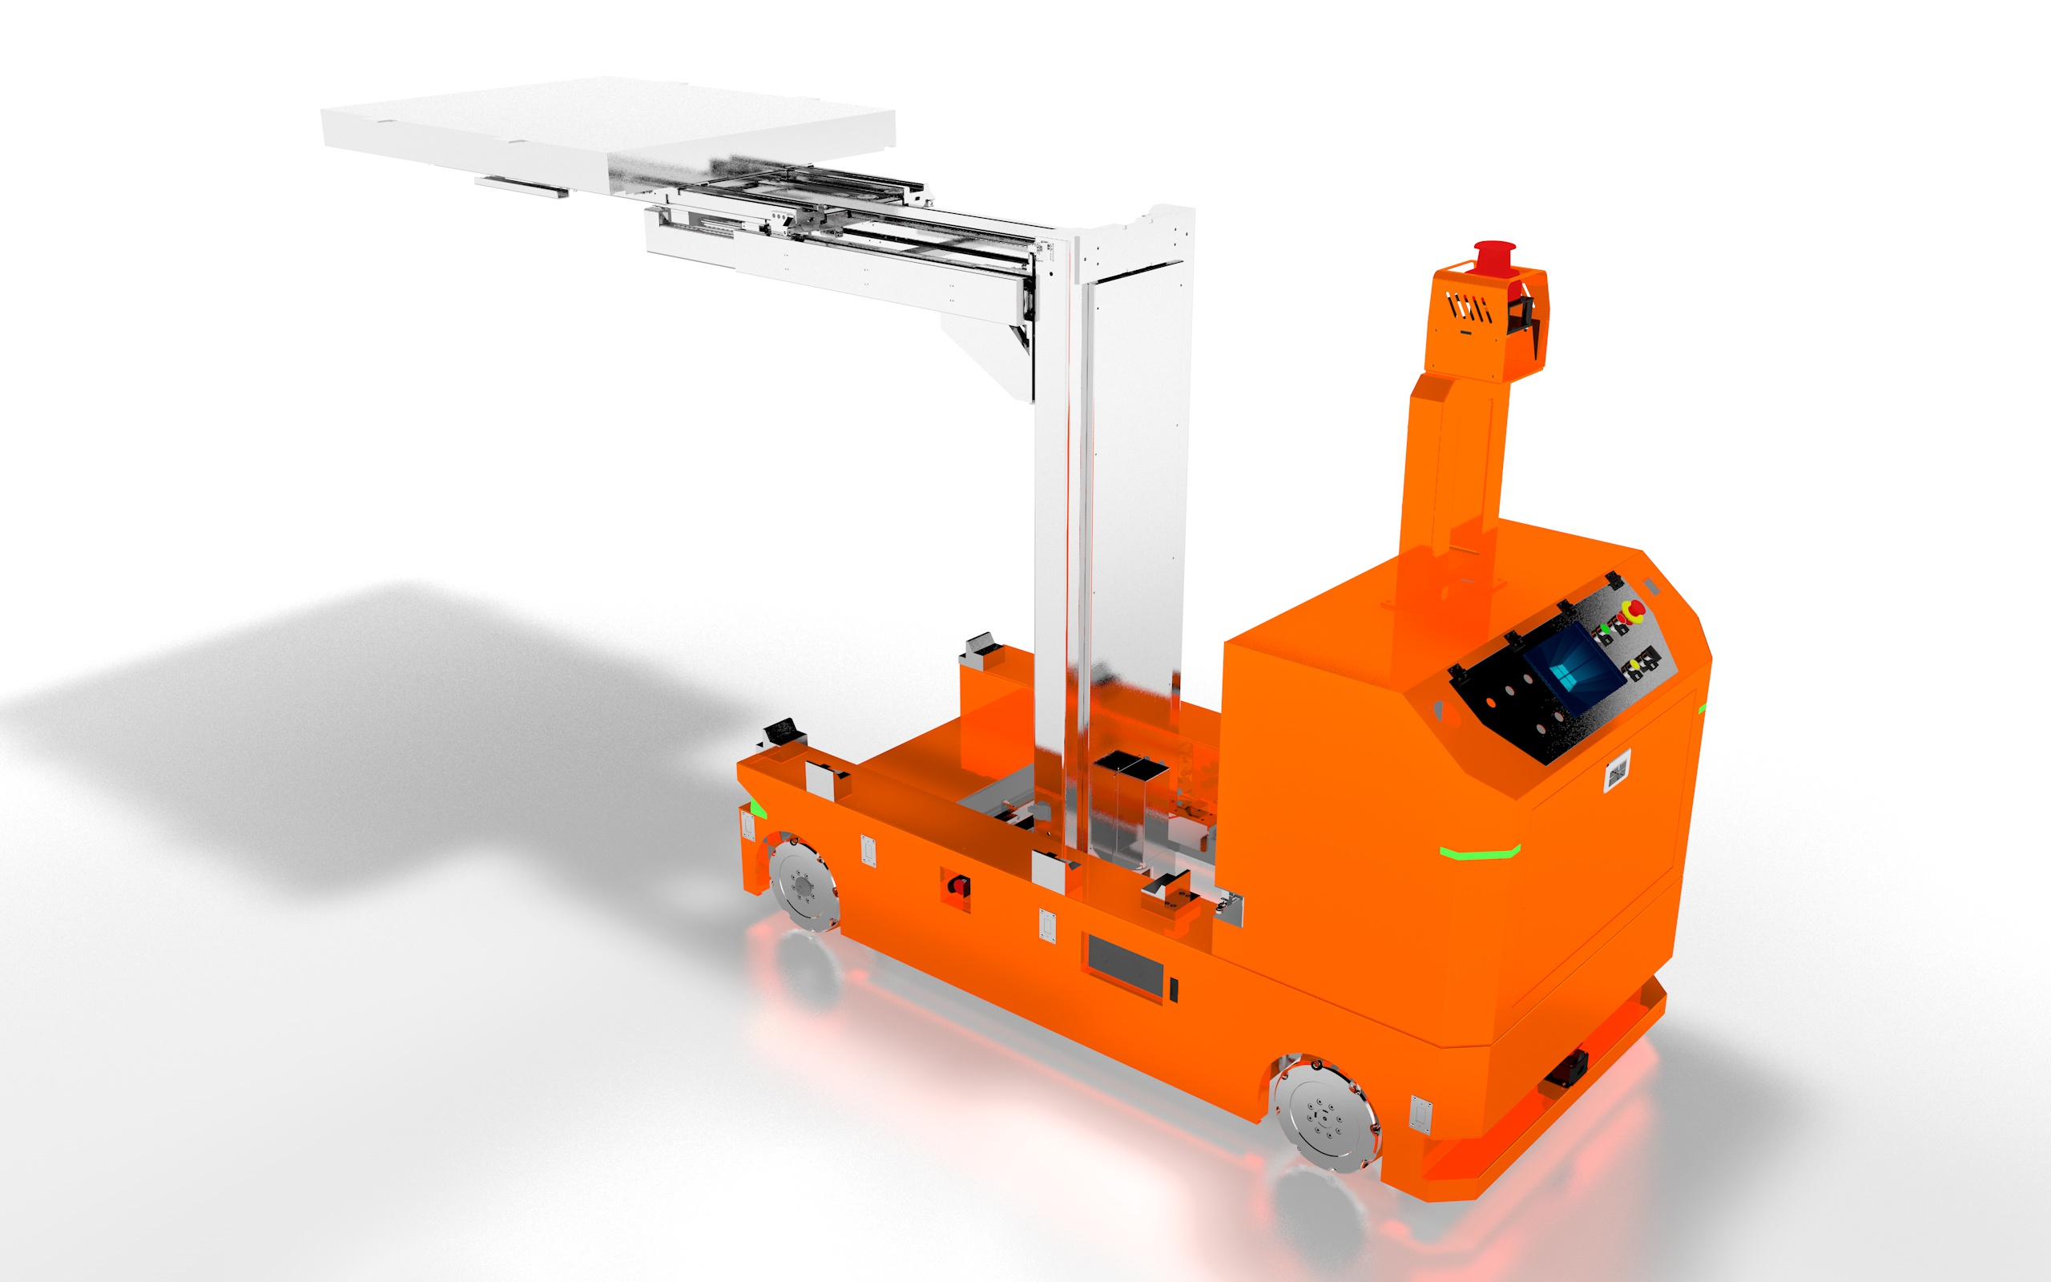
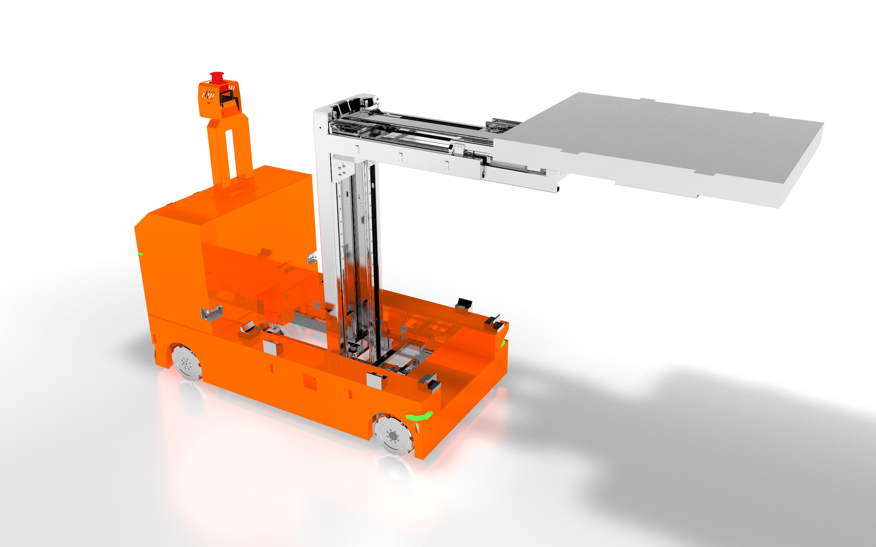
Our Products
All-direction forklift AGV
Dimensions: L3500*W1100*H2433 (mm) Drive type: MacNam wheel drive
Load-bearing method: Front fork lift Working mode: 24-hour operation
Load capacity: 1500kg
Navigation method: Laser guidance
Travel speed: 0-50mm/min
Maximum lifting height: 1500mm
Power supply: DC48V
Inclination tolerance: ≤4°

Slide 23
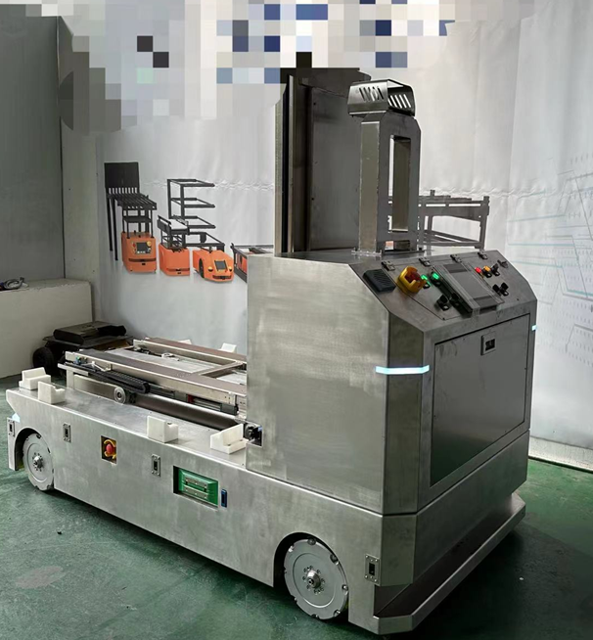

Our Products

Slide 24


Our Products
omnidirectional lifting AGV
Dimensions: L3500*W1100*H2433 (mm) Drive: Dual differential drive
Load-bearing: Front fork lift
Operating: 24/7
Load capacity: 1500kg
Navigation method: Laser guidance
Travel speed: 0-50mm/min
Maximum lifting height: 1500mm
Power supply: DC48V
Inclination tolerance: ≤4°

Slide 25


Our Products

Slide 26


Our Products
Load capacity: 1000kg-2000kg
Guidance method: RFID
Travel speed: 0-50m/min
Power supply: DC48V
Inclination tolerance: ≤0°

Slide 27

Our Products
All-direction side fork AGV
Load capacity: 300kg
Dimensions: L1518*W823*H2480mm
Navigation: Laser guidance
Travel speed: 1-1.5m/min
Lifting height: 4m
Power supply: DC24V
Inclination tolerance: ≤2°
Positioning accuracy: ±10mm
Integrated functions: Side-shift loading, lifting, etc.
Stacking channel width: 975mm
Minimum turning radius: 1130mm

Slide 28

Our Products
Stacker Forklift AGV
Load capacity: 2000kg
Dimensions: L1630*W945*H2180mm
Navigation: Laser guidance
Travel speed: 1-1.3m/min
Maximum lifting height: 3300mm
Power supply: DC24V
Inclination tolerance: ≤2°
Positioning accuracy: ±10mm
Integrated functions: Rotation, lateral movement, lifting, etc.
Stacking channel width: 1888mm+300mm

Slide 29


Our Products

Slide 30

Our Products
omni-directional flat handling forklift
Load capacity: 2000kg
Dimensions: L1620*W945*H1410mm
Navigation: Laser guidance
Travel speed: 1-1.5m/min
Lift height: 205mm | Power supply: DC24V Inclination tolerance: ≤2°
Positioning accuracy: ±10mm
Integrated functions: Side-shift loading, lifting, etc.
Stacking channel width: 1825mm+300mm

Slide 31


Our Products

Slide 32

Our Products
counterbalanced lift truck
Load capacity: 1000-2000kg
Dimensions: L2767*W1180mm Navigation: Laser guidance
Travel speed: 1-1.5m/min
Maximum lifting height: 2000mm Power supply: DC24V
Inclination tolerance: ≤2°
Positioning accuracy: ±10mm
Composite function: Lifting
Stacker aisle width: 2850mm+300mm

Slide 33


Our Products

Slide 34

Our Achievements

Slide 35

Our Achievements

Slide 36

Our Achievements

Slide 37


Our Achievements

Slide 38


Guangzhou Tianyue Automation Technology Co., Ltd.
Guangzhou Xinyue Zhixing Robot Technology Co., Ltd.
Address: No.2 Daguan Garden Road, Jewelry City, Huadu District, Guangzhou City, Stone Story Jewelry Co., Ltd. self-compiled 7 building, 8 building
Corporate Website：WWW.ROBOTICSAGV.COM

