Slide 1
Particle Filter/Monte Carlo Localization
Slides from D. Fox. W. Burgard, C. Stachniss,
M. Bennewitz, K. Arras, S. Thrun, J. Xiao

Slide 2
Particle Filter
Definition:
Particle filter is a Bayesian based filter that sample the whole robot work space by a weight function derived from the belief distribution of previous stage.
Basic principle:
Set of state hypotheses (“particles”)
Survival-of-the-fittest

Slide 3
Why Particle Filters
Represent belief by random samples
Estimation of non-Gaussian, nonlinear processes
Particle filtering ➔ non-parametric inference algorithm
- suited to track non-linear dynamics.
- efficiently represent non-Gaussian distributions

Slide 4
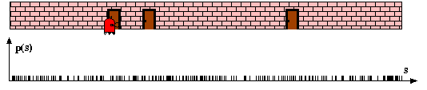
Particle Filters
Pose particles drawn at random and uniformly over the entire pose space

Slide 5
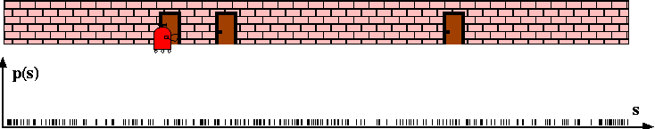
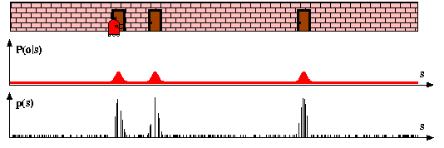
Sensor Information: Importance Sampling
After robot senses the door, MCL Assigns importance factors to each particle

Slide 6
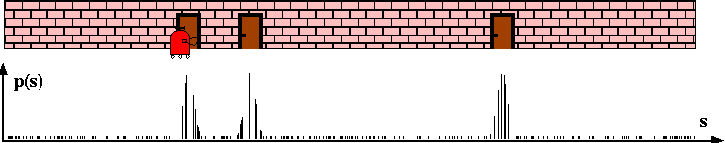
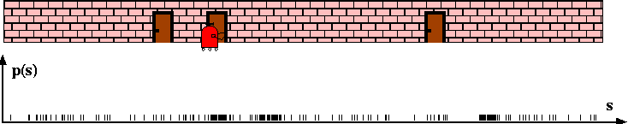
Robot Motion
After incorporating the robot motion and after resampling, leads to new particle set with uniform importance weights, but with an increased number of particles near the three likely places

Slide 7
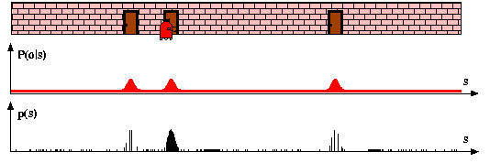
Sensor Information: Importance Sampling
New measurement assigns non-uniform importance weights to the particle sets, most of the cumulative probability mass is centered on the second door

Slide 8
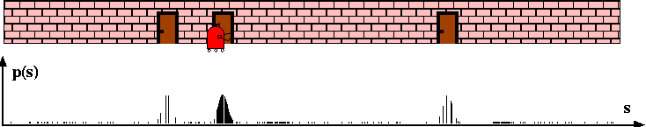
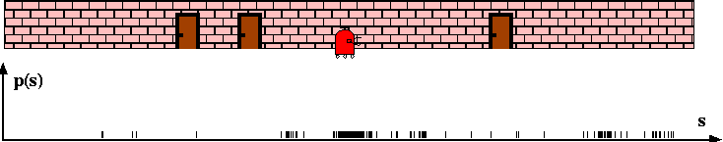
Robot Motion
Further motion leads to another re-sampling step, and a step in which a new particle set is generated according to the motion model

Slide 9
Particle Filter Basics
Known map of the world (2D in our case). Location of objects of interest (i.e. obstacles, walls, beacons/cones) is also known
How can we localize ourselves given an arbitrary starting position?
Idea: populate the space with random samples of where we might be
See if the random samples are consistent with sensor and movement readings
Keep samples that are consistent over samples that are not consistent
Sample: Randomly select M particles based on weights (same particle may be picked multiple times)
Predict: Move all particles according to movement model with noise
Measure: Integrate sensor readings into a “weight” for each sample by making a prediction about the sensor readings likelihood given this particle’s location. Update weight on the particle accordingly

Slide 10
Particle Filter Basics
Particle filters represent a distribution by a set of samples drawn from the posterior distribution.
The denser a sub-region of the state space is populated by samples, the more likely it is that true state falls into this region.
Such a representation is approximate, but it is nonparametric, and therefore can represent a much broader space of distributions than Gaussians.
Weight of particle are given through the measurement model.
Re-sampling allows to redistribute particles approximately according to the posterior .
The re-sampling step is a probabilistic implementation of the Darwinian idea of survival of the fittest: it refocuses the particle set to regions in state space with high posterior probability
By doing so, it focuses the computational resources of the filter algorithm to regions in the state space where they matter the most.

Slide 11
Properties of Particle Filters
Sampling Variance
Variation due to random sampling
The sampling variance decreases with the number of samples
Higher number of samples result in accurate approximations with less variability
If enough samples are chosen, the observations made by a robot – sample based belief “close enough” to the true belief.

Slide 12
Mobile Robot Particle Filter Video

Slide 13
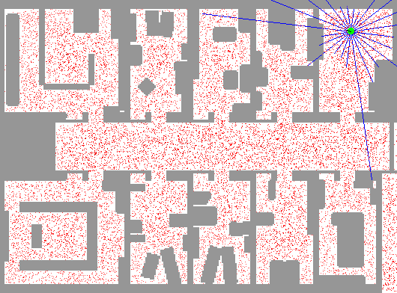
Sample-based Localization (sonar)

Slide 14
MCL in action
“Monte Carlo” Localization -- refers to the resampling of the distribution each time a new observation is integrated

Slide 15
2-D Mobile Robot Particle Filter Algorithm
Define a map of the scene, with features that can be sensed by the robot
Choose N random particle locations (X,Y,θ) to cover the scene
Place mobile robot in scene (unknown location).
Until robot is localized do:
Move robot according to known motion model with noise.
Move each particle with similar motion using known motion model with noise.
Compare real sensor readings with simulated sensor readings from each particle, given:
We know each Particle’s location
We have a noise model of the sensor (i.e. ultrasound)
We have a known map with feature locations (walls/obstacles/beacons)
Use comparison in (3) above to generate an “importance weight” for each particle – how close it’s measurements are to the sampled measurement
Resample the particles (with replacement) according to the new weighted distribution above. Higher weights mean more agreement with the sensor measurement, and a more likely location for the robot.
Repeat steps 1-5 above with the newly sampled particle set until robot is localized – particles converge
After each movement update, particles that are close to the actual robot location will have their sensor measurements be consistent with the real readings, reinforcing these particles.
Particles that were not close to the actual robot location after the movement update will not be consistent with sensor measurements, and will be less likely to survive during resampling

Slide 16
Particle Filter in Python
p=[]
for i in range(N): #p is initial particle array with random location of particle (X,Y,ϴ)
p.append(p[i].location(X,Y,ϴ))
p2=[]
myrobot=myrobot.move(dX,dY, dϴ)
for i in range(N):
p2.append(p[i].move(dX,dY, dϴ)) #update particle position with movement (rotation, translation)
p = p2
w = []
for i in range(N): #w is importance weight for each particle: P(Z |p[i])
w.append(p[i].measurement_prob(Z)) #importance weight is how close sensor measurement
#at particle location is to actual sensor values
p3 = [] # now resample according to new importance weights
….insert resampling code here to get a new set of particles weighted by their importance
p = p3
# now do this again (starting with myrobot.move() )with the new particle set……

Slide 17
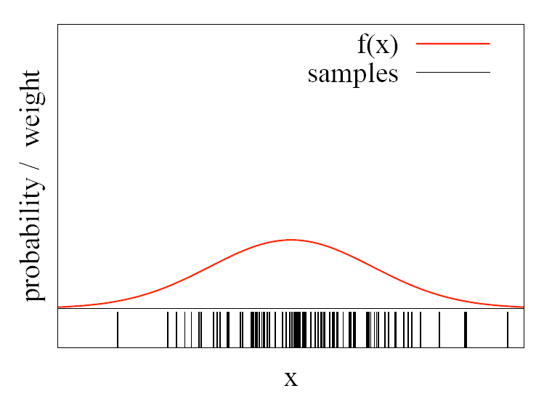
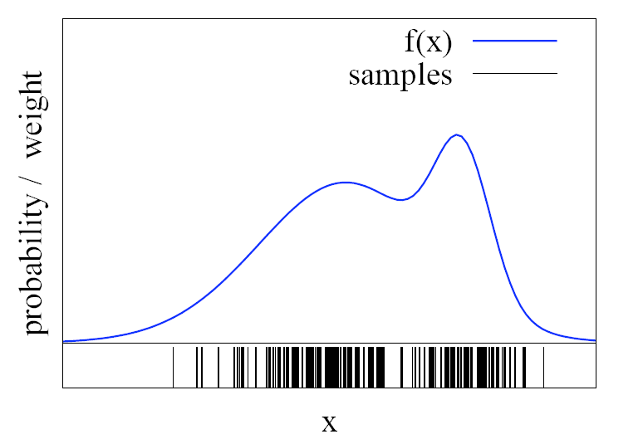
Function Approximation
Particle sets can be used to approximate functions
The more particles fall into an interval, the higher
the probability of that interval

Slide 18
Importance Sampling Principle
After we update the particles with the sensor readings, we have a set of particles with new “importance weights”
We want to resample the particles (with replacements – duplicates) based on the new importance weightings.
Essentially: sample from an arbitrary prob. Distribution
Methods ( each with different efficiency/complexity)
Rejection sampling
Cumulative Distribution Function buckets
Stochastic sampling
Importance sampling makes sure “good” particles survive

Slide 19
Rejection Sampling
Let us assume that f(x)<1 for all x
Sample x from a uniform distribution
Sample c from [0,1]
if f(x) > c keep the sample
otherwise reject the sample

Slide 20
#rejection sampling
# pick a random particle from 1 to N. Then see if its weight (i.e. probability)
# is greater or less than a random probability from [0,1].
# if it is greater, then accept this particle, otherwise reject
import math
import random
N=5 #number of particles
w=[.1,.1,.6,.1,.1] #probability of each particle
print 'initial particle probabilities',w
freq=[0,0,0,0,0] #resampling frequency (histogram buckets)
accepted=0
iteration=0
while (accepted<1000):
iteration=iteration+1
index = int(random.random() * N)
c=random.random() * 1
if w[index]>=c:
freq[index]=freq[index]+1
accepted=accepted+1
print '# of iterations', iteration, ' # accepted', accepted
print 'resampled frequencies are', freq
Test execution to generate 1000 new particles:
initial particle probabilities [0.1, 0.1, 0.6, 0.1, 0.1]
# of iterations 4900 # accepted 1000
resampled frequencies are [92, 105, 598, 98, 107]
initial particle probabilities [0.1, 0.1, 0.6, 0.1, 0.1]
# of iterations 5266 # accepted 1000
resampled frequencies are [88, 103, 592, 118, 99]
initial particle probabilities [0.2, 0.2, 0.2, 0.2, 0.2]
# of iterations 4892 # accepted 1000
resampled frequencies are [195, 209, 185, 198, 213]
initial particle probabilities [0.47, 0.02, 0.02, 0.02, 0.47]
# of iterations 5009 # accepted 1000
resampled frequencies are [464, 20, 17, 25, 474]

Slide 21
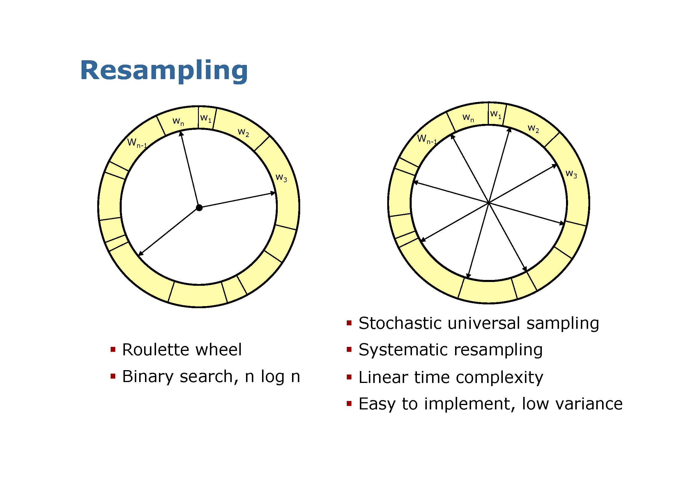
Importance Sampling

Slide 22
Roulette Wheel: Cumulative Dist. Function (CDF)
Particle # | weight | Cumulative weight
3 | 0.1 | 0.1
5 | 0.1 | 0.2
1 | 0.1 | 0.3
4 | 0.1 | 0.4
5 | 0.6 | 1
Choose random number [0,…,1]
Find which bin in the CDF the number falls into
Choose that particle
Binary Search on the Cumulative Weight to find the right bin – Log N complexity
For N samples, overall complexity is N Log N

Slide 23
Stochastic Resampling: see sample code
Why choose 2*max(weight) for sampling wheel?
Problem : resampling a uniform distribution.
Need to resample P particles, each of 1/P weight
Beta is the amount we “walk” around the sampling
wheel each time. If weights are probabilities, a full
walk around the wheel has distance = 1.0.
If Beta is chosen between [0,…, (1.0 *max(weight)]
we sample between [0,.., 1/P] each time
On average, resampling P particles, Beta has average
value of 1/(2P). If we sample P times, expected
total distance of a walk around the wheel is:
Expected_walk_distance = P * 1/(2P) =0.5
Using 1* max(weight) cannot guarantee a full “walk” around the wheel. But using 2*max(weight) can, since now average value of Beta is 1/P.
Expected_walk_distance = P * 1/P = 1.0
You could use a larger value (e.g. 3*max(weight)) but this will just cause you to do more computation.
#choose random particle index
index = int(random.random() * N)
beta = 0.0
# mw =max. particle weight
mw = max(w)
for i in range(N):
beta += random.random() * 2.0 * mw
while beta > w[index]:
beta -= w[index]
index = (index + 1) % N
print' accept particle = ',index
p3.append(p[index])
freq[index]+=1
p = p3

Slide 24
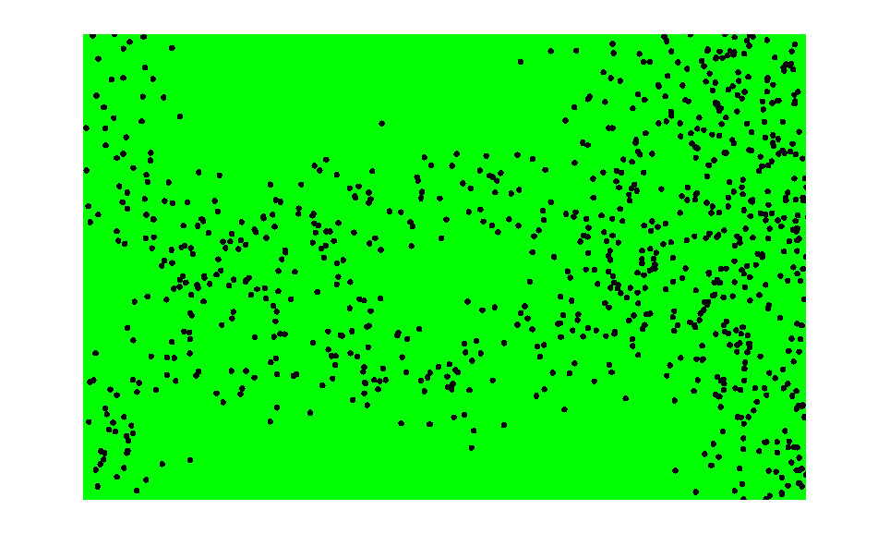
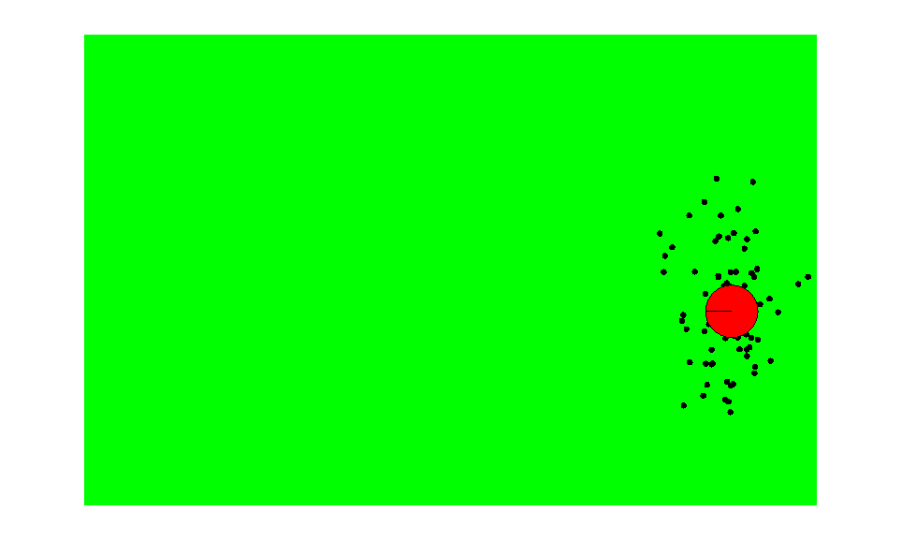
Importance Sampling with Resampling
Weighted samples
After resampling

Slide 25
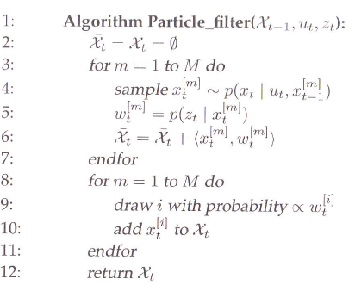
Particle Filter Algorithm
Each particle is a hypothesis as to what the true world state may be at time t
Sampling from the state transition distribution
Importance factor, incorporates the measurement into particle set
Re-sampling, importance sampling

Slide 26
Particle Filter Algorithm
Line 4 – hypothetical state
- sampling from the state transition distribution
- set of particles obtained after M iterations is the filter’s representation of the posterior
Line 5 – importance factor
- incorporate measurement into the particle set
- set of weighted particles represents Bayes filter posterior
Line 8 to 11 – Importance sampling
Particle distribution changes - incorporating importance weights into the re-sampling process.
Survival of the fittest: After resampling step, refocuses particle set to the regions in state space with higher posterior probability, distributed according to
Notes:
Darwins theory – resampling

Slide 27
Simple Particle Filter in Python

Slide 28
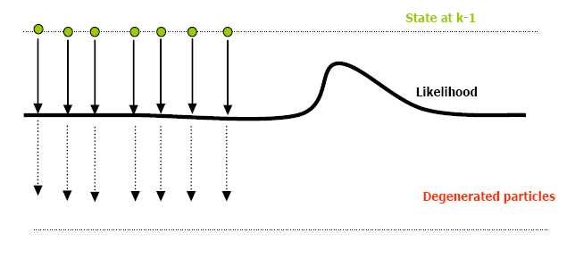
Drawbacks
In order to explore a significant part of the state space, the number of particles should be very large which induces complexity problems not adapted to a real-time implementation.
PF methods are very sensitive to non consistent measures or high measurement errors.
Notes:
More particles ) Better approximation (and more
expensive), but there’s no formula for the “right amount

Slide 29

Importance Sampling with Resampling
Reducing sampling error
1. Variance reduction
Reduce the frequency of resampling
Maintains importance weight in memory & updates them as follows:
Resampling too often increases the risk of losing diversity. Too infrequently many samples might be wasted in regions of low probability,

Slide 30
Advantages of Particle Filters:
can deal with non-linearities
can deal with non-Gaussian noise
mostly parallelizable
easy to implement
PFs focus adaptively on probable regions of state-space
Parallel implementation possible
Can deal with kidnapped robot problem

Slide 31
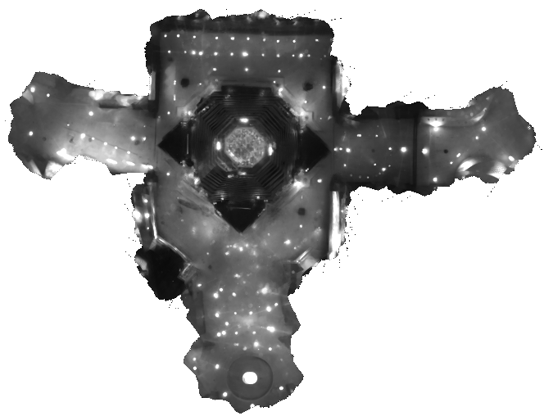
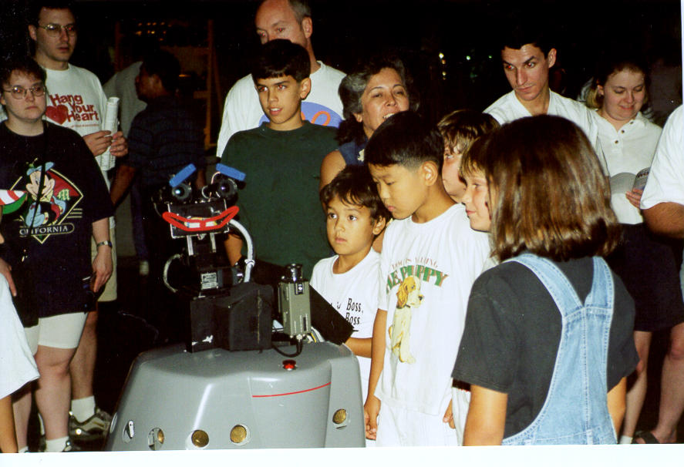
Using Ceiling Maps for Localization

Slide 32
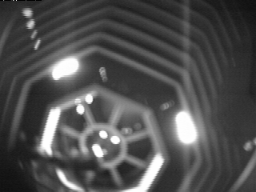
Vision-based Localization
P(z|x)
z
h(x)

Slide 33

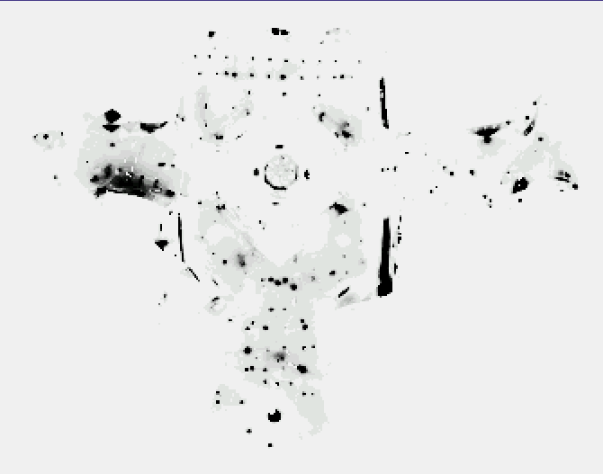
Under a Light
Measurement z:
P(z|x):

Slide 34

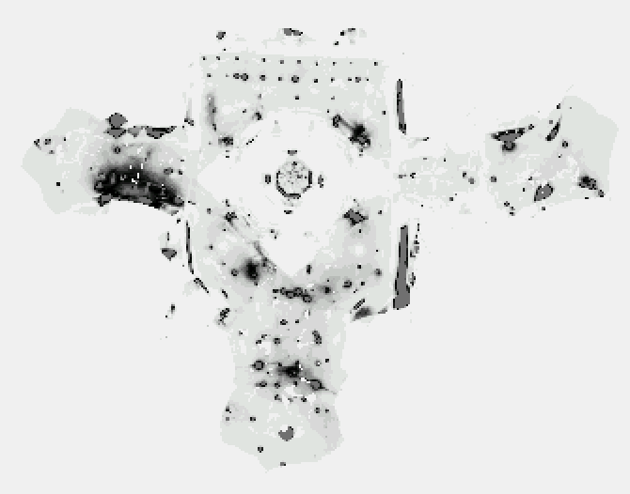
Next to a Light
Measurement z:
P(z|x):

Slide 35
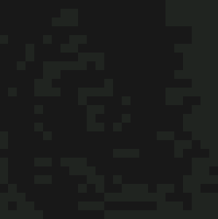
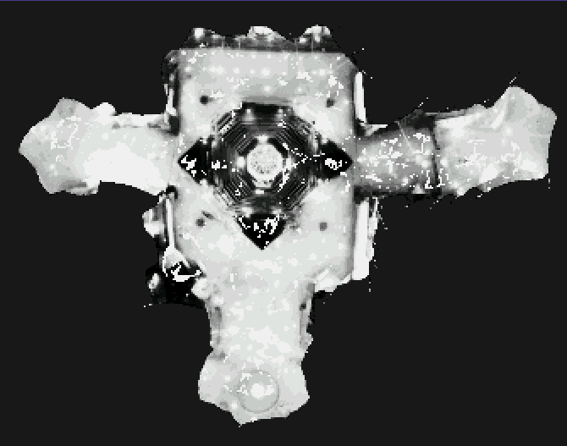
Elsewhere
Measurement z:
P(z|x):

Slide 36
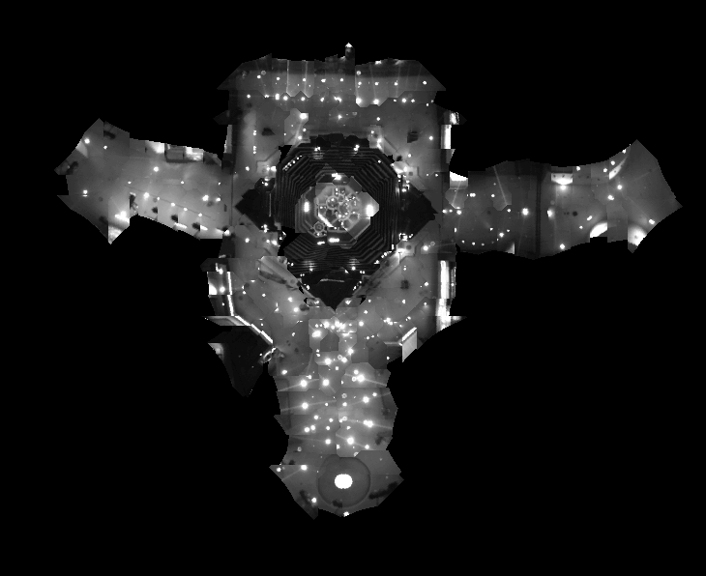
Global Localization Using Vision

Slide 37
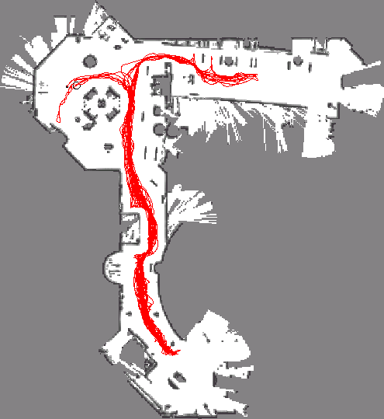
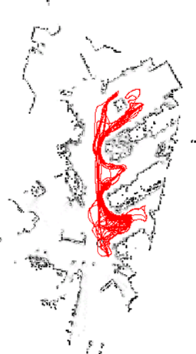
Application: Rhino and Albert Synchronized in Munich and Bonn
[Robotics And Automation Magazine, to appear]

Slide 38
Summary
Particle filters are an implementation of recursive Bayesian filtering
They represent the posterior by a set of weighted samples.
In the context of localization, the particles are propagated according to the motion model.
They are then weighted according to the likelihood of the observations.
In a re-sampling step, new particles are drawn with a probability proportional to the likelihood of the observation.

Slide 39
References
Dieter Fox, Wolfram Burgard, Frank Dellaert, Sebastian Thrun, “Monte Carlo Localization: Efficient Position Estimation for Mobile Robots”, Proc. 16th National Conference on Artificial Intelligence, AAAI’99, July 1999
Dieter Fox, Wolfram Burgard, Sebastian Thrun, “Markov Localization for Mobile Robots in Dynamic Environments”, J. of Artificial Intelligence Research 11 (1999) 391-427
Sebastian Thrun, “Probabilistic Algorithms in Robotics”, Technical Report CMU-CS-00-126, School of Computer Science, Carnegie Mellon University, Pittsburgh, USA, 2000

