Slide 1
Efficient Snapshot Differential Algorithms for Data Warehousing
By
Wilburt Juan Labio
Hector Garcia-Molina

Slide 2
The Presentation
1. Introduction
2. Problem Formulation
3. Optimization
  Compression Techniques
  Windows Algorithm
4. Conclusion

Slide 3
Introduction
What is Differential Algorithms?
  Detect and extract the modification to the information source by comparsion
What can it do?
  Use the extracted information to update the data in the others warehouse efficientaly

Slide 4
The 3 common ways to detect and extract modification
  Application running on top of the source is altered to send the modification to the warehouse => Require existing code be altered, that may be problematic!
  A system log file is parsed to obtain the relevant modifications
  => DBA privileges are required to access the log. files.

Slide 5
The 3 common ways to detect and extract modification
  Comparing the current source snapshot with an earlier one(Differential Algorithms)
  => Does not scale well. We need to perform it as efficiently as possible.
    Compression Techniques
    Window Algorithm

Slide 6
Problem Formulation
A source snapshot as a file containing a set of distinct records.
<K, B>
    K is the key field(s)
    B is the rest field(s) of the record
  We have 2 snapshots, F1 and F2(the later snapshot)

Slide 7
Problem Formulation
Goal: Produce a file F_{out} that contain records which has one of the forms below:
  <Update, Ki, Bj> produced when a record <Ki, Bi> in file Fi is updated to <Ki, Bj> in file F2
  <Delete, Ki> Produced when a record <Ki, Bi> does not appear in F2
  <Insert, Ki, Bi> Produced when a record present in F2 does not appear in F1

Slide 8
Problem Formulation
The Algorithm can take place at:
  Source site – performs the snapshot differential periodically and sends the detected modification to the warehouse.
  Intermediate site – the source sends the full snapshots to an intermediate site, send the result to the warehouse.

Slide 9
Problem Formulation
Method to use:
  Outerjoin F1 and F2 on their common K attribute, join condition on their B attribute differ.
Characteristic of the problem that we can make use:
  Snapshot differentials are an on-going process running at a source. This make it possible to save some of the information used in one differential to improve the next iteration.
  Acceptable to miss a few of the modification. For some data warehousing application, miss a few of the records is not a problem.

Slide 10
Problem Formulation
Continue Characteristic of the problem
3. Useless delete-insert pair are acceptable. Allow algorithms that are “sloppy” but efficient in matching records.
Delete-insert pair: <Delete, Ki> and <Insert, Ki, Bi> with the same Ki value appear at the same time in the output file. It is a redundant because they both can be removed or replaced by a single <Update Ki, Bi>

Slide 11
Optimization
multi-way mergesort on file F
  |F| is the file size
  |M| is the memory size
Step
  1. Read |M| record from the file each time, sort it internally, and write to intermedium files, called ‘run’. -> 2*|F| disk I/O
  2. Read from the head of all the run, compare them and merge them together to produce the sorted file. -> 2*|F| disk I/O
  4*|F| disk I/O in Total

Slide 12
Optimization
Basic Outer Join Algorithms(sort merge ):
Sort the 2nd input files F2 -> cost 4*|F2| disk I/O (It is a on-going process, F1 is already sort in the last phase)
Scan the files only and any pair of records that satisfy the join condition are produced as output. -> cost |F1| + |F2| disk I/O
10
12
14
15
20
30
10
11
12
15
20
30

Slide 13
Optimization
Improve the Basic Outer Join Algorithms
1. Use the run files created in the first phase directly to merge with F1. Then, output the sorted F2 file and the output at the same time. -> Total Cost: |F1| + 4*|F2|
2. Use partitioned hashed join algorithm. The input files are partitioned into buckets by computing a hash function on the join attribute. Records are matched by considering each pair of corresponding buckets. The IO cost incurred is |F1| + 3*|F2|
([LGM96] )

Slide 14
Optimization : Compression Techniques
Instead of read in all the field in a record for comparison, we use lossy compression on the non-key field(s).
  For each record in the snapshot of form <Ki, Bi>
  Lossy Compress Bi to bi
  Assume Bi is of size n bit, bi is of size b bit
  Each record is become <Ki, bi>

Slide 15
Optimization : Compression Techniques
Advantage:
  The compressed intermediate file(in disk or memory) are smaller, so the algorithm can perform faster and use less space
Disadvantage:
  The compression is a many-to-1 mapping. 2 different Bi value can compress to the same bi.
  Analyis
  For each given value, the probability that another value maps to the same compressed value is:
  (2^{b}/2^{n} – 1)/ 2^{b} ~ 2^{-n} for large value of b

Slide 16
Optimization : Compression Techniques
Using the probability
  |F| is 256Mb
  |Bi| is 150 bytes
  |bi| is 4 bytes
  If we perform a differential algorithm daily
  The about 2,430 days in average is needed for a missing error

Slide 17
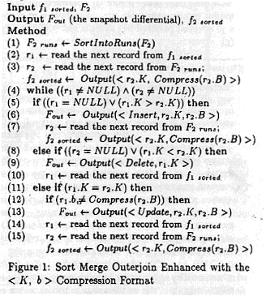
Optimization : Compression Techniques
Analyis
  Sorting phase of the algorithm incurs 2*|F2| I/O
  Matching phase incurs |F2| + |f1| since the 2 files are scanned once.
  Saving phase for next differential as f1_{sort} cost |f2|
  Total Cost
  |f1| + 3*|F2| + |f2|

Slide 18
Optimization : Compression Techniques
Greater improve by pointer to record
  As we need to product the <Update, Ki, Bi>, the Bi field in F2, F2 need to remain uncompress in matching phase.
  Now, we introduce a pointer p in the compressed record
  <K, b, p>, p is the disk pointer to the record with key K
  We can use the compressed files in both phase, use p to find out the uncompress Bi when a Update or Insert are detected.

Slide 19
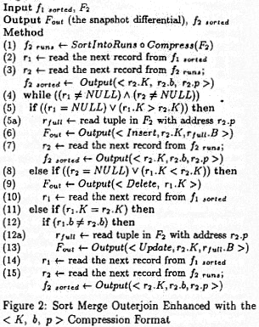
Optimization : Compression Techniques
Analyis
  Sorting and compression phase of the algorithm incurs |F2| + |f2| I/O
  Matching phase incurs |f1| + |f2| + U + I, where U and I are the no. of updates and insertions found.
  Saving phase for next differential as f1_{sort} cost |f2|
  Total Cost
  |f1| + F2| + 3*|f2| + U + I
  -> The savings in IO is significant reduced if few updates and inserts

Slide 20
Optimization : Compression Techniques
Use partitioned hashed join algorithm as before.
  The buckets are compressed before the matching phase, we also show in [LGM96] that the overall cost is |f1| + |F2| + 2*|f2| + I + U
  If the compression factor is high enough such that all of the buckets of f1 can fit in memory. Then, scanned F2 are compare the record one by one into the hash table. And also construct the compressed f2 for next differential during the probe.
  Total cost is only |f1| + |F2| + |f2|

Slide 21
Optimization : Window Algorithm
Fact: Matching records cannot be expected in the same position in the two snapshots, we may still expect a record to remain in a relatively small area.
Aim: We can process the snapshot in a small part only at a time, we call it the moving window.
Method: Only the records within the windows are compared. Unmatched records are reported as either insert or delete.

Slide 22
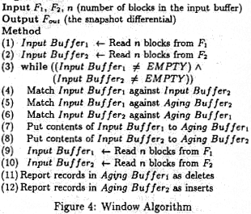
Optimization : Window Algorithm
Step 1-2, 9-10 At each turn, the input buffers for F1 and F2 read in n records from the files
Step 4-6 Match the records in Input buffer and aging buffer, remove those matched pair.
Step 7-8 push all the remain unmatched records in the input buffers to the aging buffers. If the aging buffers is full, remove the oldest records in it and report as delete or insert(FIFO).
Step 11-12 Clean up those unmatched records in aging buffers at last.

Slide 23
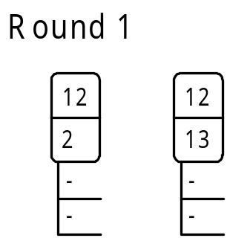
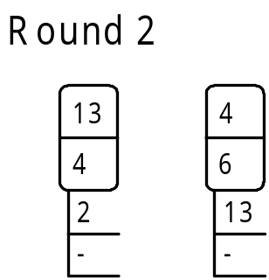
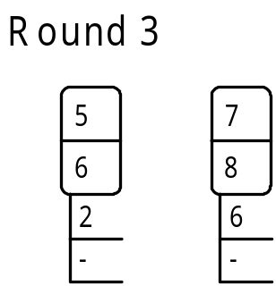
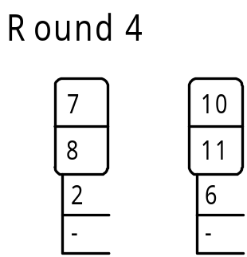
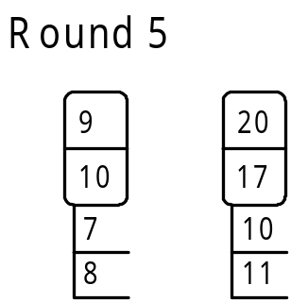
Optimization : Window Algorithm
F1: 12, 2, 13, 4, 5, 6, 7, 8, 9, 10
F2: 12, 3, 4, 6, 7, 8, 10, 11, 20, 17
Size of input & aging buffer = 2
Record with key 2 is output as Delete, key 6 is output as Insert

Slide 24
Optimization : Window Algorithm
Analyis:
  IO cost for the window algorithm is only|F1|+|F2|
  It may produce useless delete-insert pair
  -> the efficiencies depends on how physically different the 2 snapshots are.

Slide 25
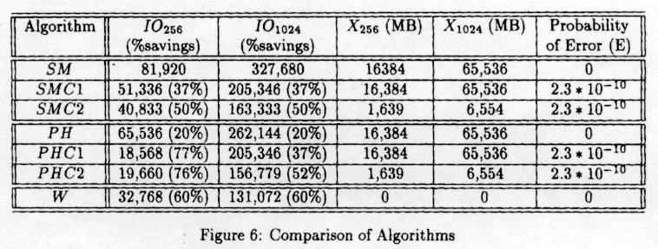
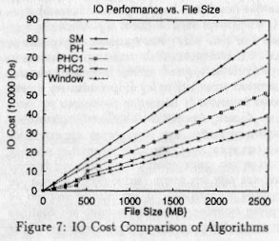
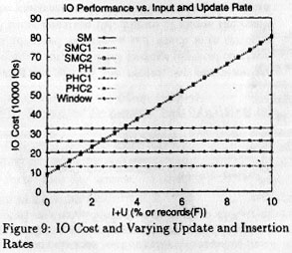
Conclusion
The algorithm with pointer work extremely well if the snapshots are not different.
By augmenting the outerjoin algorithms with record compression, we have that very significant savings in I/O cost

Slide 26
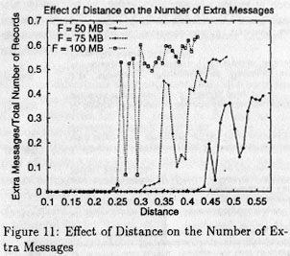
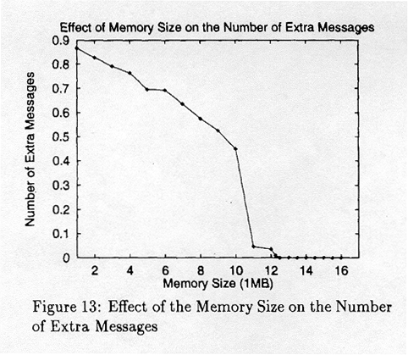
Conclusion
The windows algorithm work extremely well if the snapshots are not different. But degrade after a certain threshold in average displacement of records.
The window algorithm depend a lot on the memory available.

