Slide 1


0m 30s
Neo4j Label Property Graph
and
Scott Wardlaw Chief Engineer BR&T - Huntsville

Slide 2
















Who else uses Neo4j?
1m 0s
Neo4j is the top ranked Label Property Graph Database

Slide 3

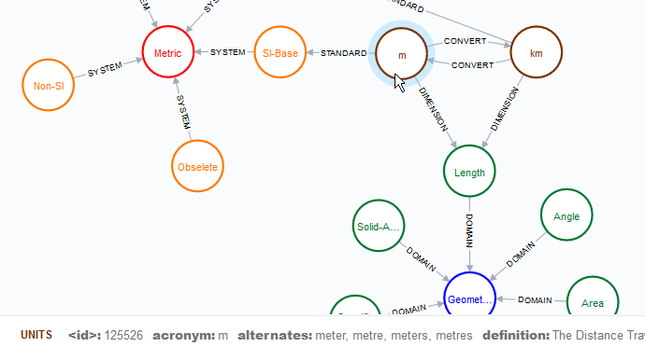
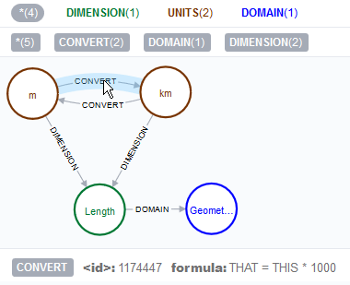
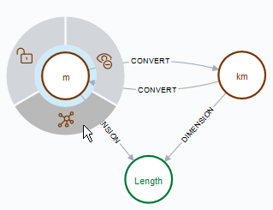
What is a Label Property Graph (LPG)?
3m 0s
Nodes are data entities that can have zero or more Properties
Properties are key-value pairs
Name: Metric System of Units, Acronym: Metric, Definition: International standard for measurement
Relationships link two Nodes and can have zero or more Properties
Labels can provide identifier(s) to Nodes and Relationships
Data is visually organized with Labeled Nodes and Relationships

Slide 4
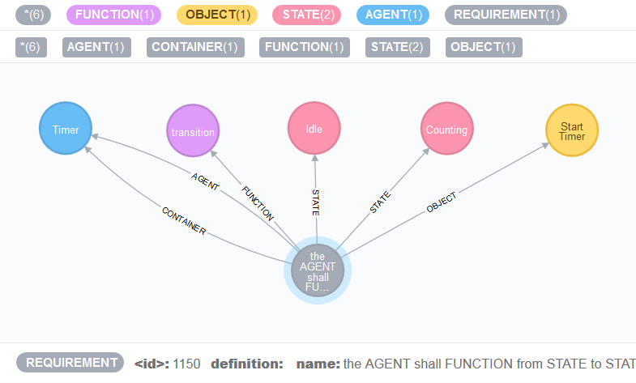
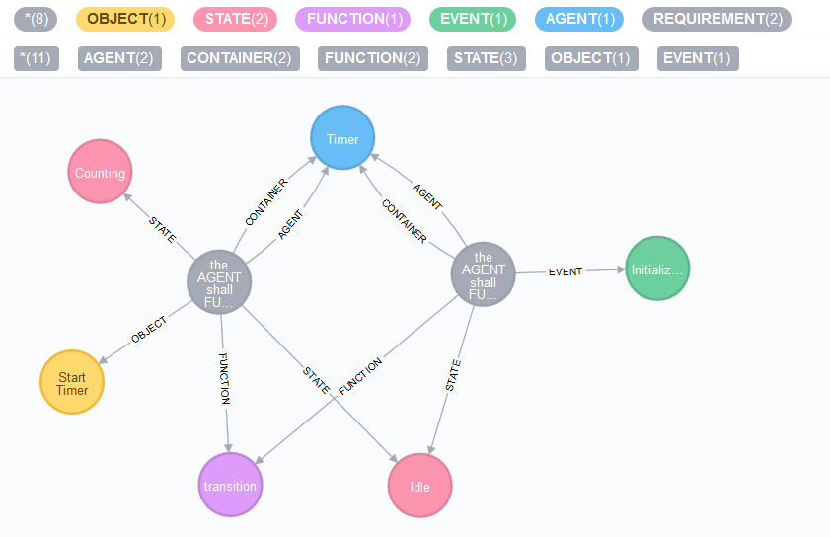
Why Neo4j for ReqFoundry?
2m 30s
ReqFoundry needed:
Highly scalable, high-performance storage solution
tens of thousands of requirements * avg. 5 components
Store requirement components with attributes
Key-Value Properties stored with specific data types
Store relationships with attributes
Labeled Relationships w/ Properties is very powerful
Differentiate component types (visually & retrieve performance)
Labels are used as custom data types
It was also free and approved for use
In the beginning, we needed to prove our concept quickly
The Timer shall transition from Idle to Counting Down upon Start Timer.
Two requirements with the same subject (Timer), the same action (transition) and the same term (Idle)
Requirements are stored as models that reference single instance components

Slide 5
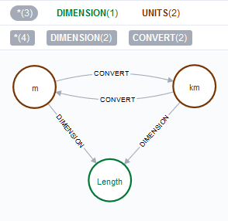
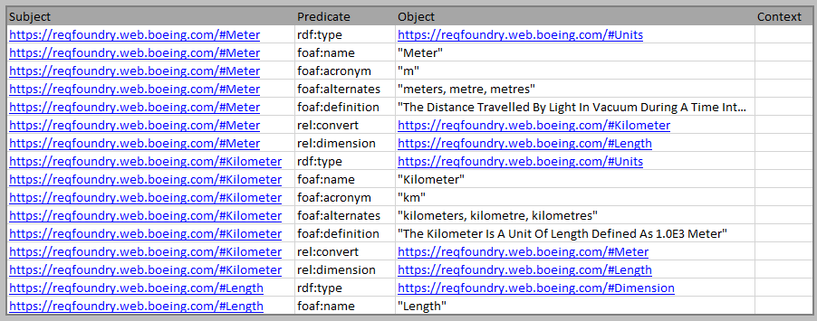



How does Neo4j compare to other storage solutions?
2m 30s
Most databases have:
ACID (Atomicity, Consistency, Isolation, Durability) Transactions - Guarantee validity even if errors, power failures, etc.
Parameter-Based Transactions – Enforce data types and prevent rogue arguments (SQL injection, etc.)
Ability to migrate “schema” from prior version to current – data organization evolves… your database should too
Distribute across multiple servers in a cluster – faster reads & writes amongst high-volume traffic
Neo4j
RDF4j
MySQL
Units Table
Dimensions Table
Conversion Table
With the Neo4j Browser, you can quickly, visually discover how your data relates and operates

Slide 6
What have we learned?
2m 0s
Should it be a Node or Property?
Nodes should be named items with attributes that can have relationships
Properties should be data that is fixed to one item or relationship
Labels should not change on nodes/relationships, unlike properties
Customize the browser label, color, and size of nodes / relationships with ‘grass stylesheet’
Keep all of your queries together in the same class
Use the browser to create queries for your code – neo4j browser has syntax and timing feedback
Consult the neo4j website for online documentation on Cypher Query Manual
Loop over Array, Loop over Map, If Statements using Case in For Each, Collect and Sort Distinct results,
Optional vs. required data, Merge to only create if not exists, Call fast proceedures
Learn more about ReqFoundry: https://reqfoundry.web.boeing.com
Getting started project: https://insite.web.boeing.com/culture/viewArticle.do?id=630264

Slide 7
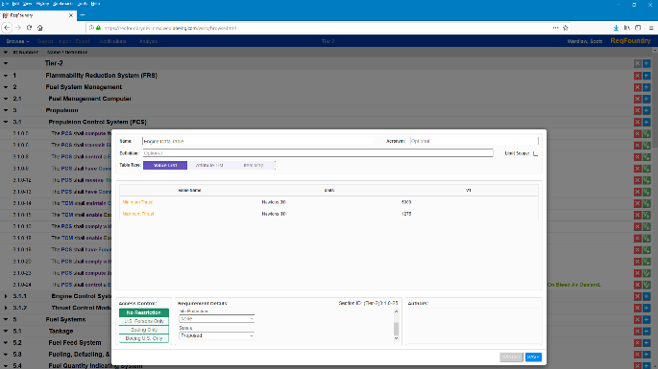
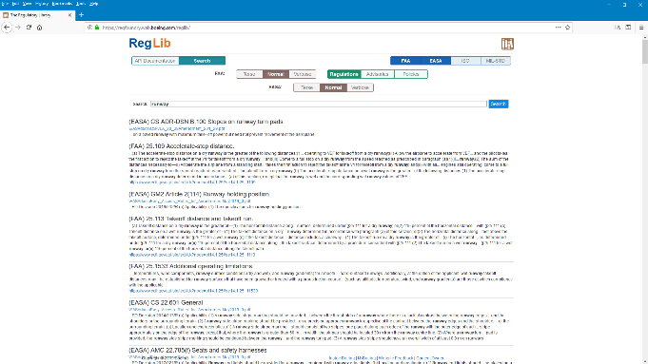
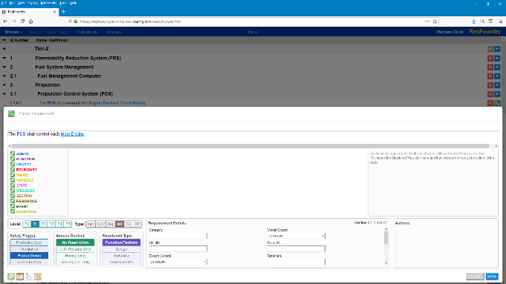
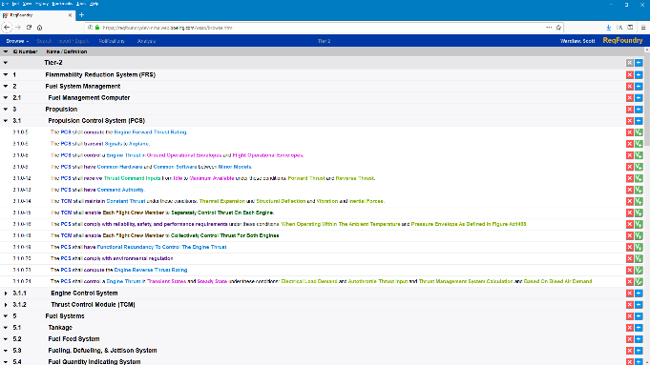

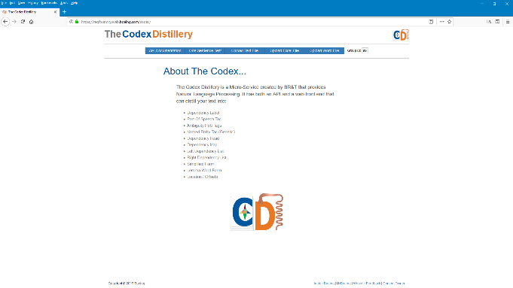
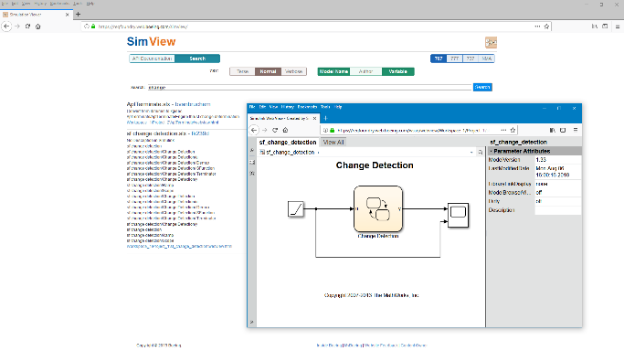
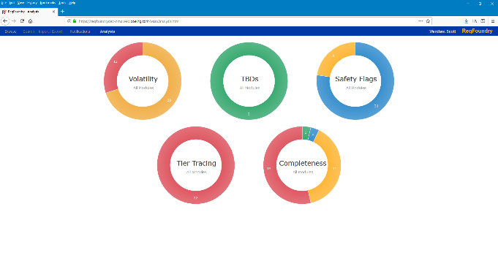
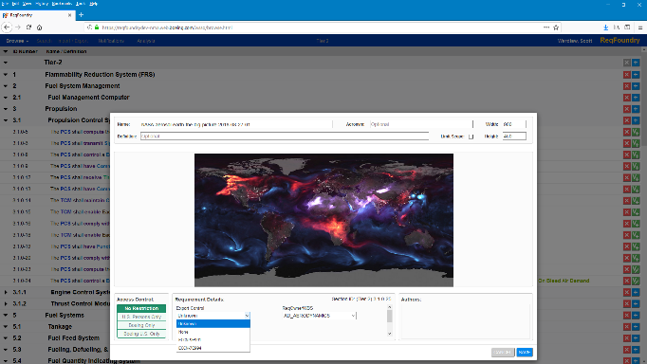
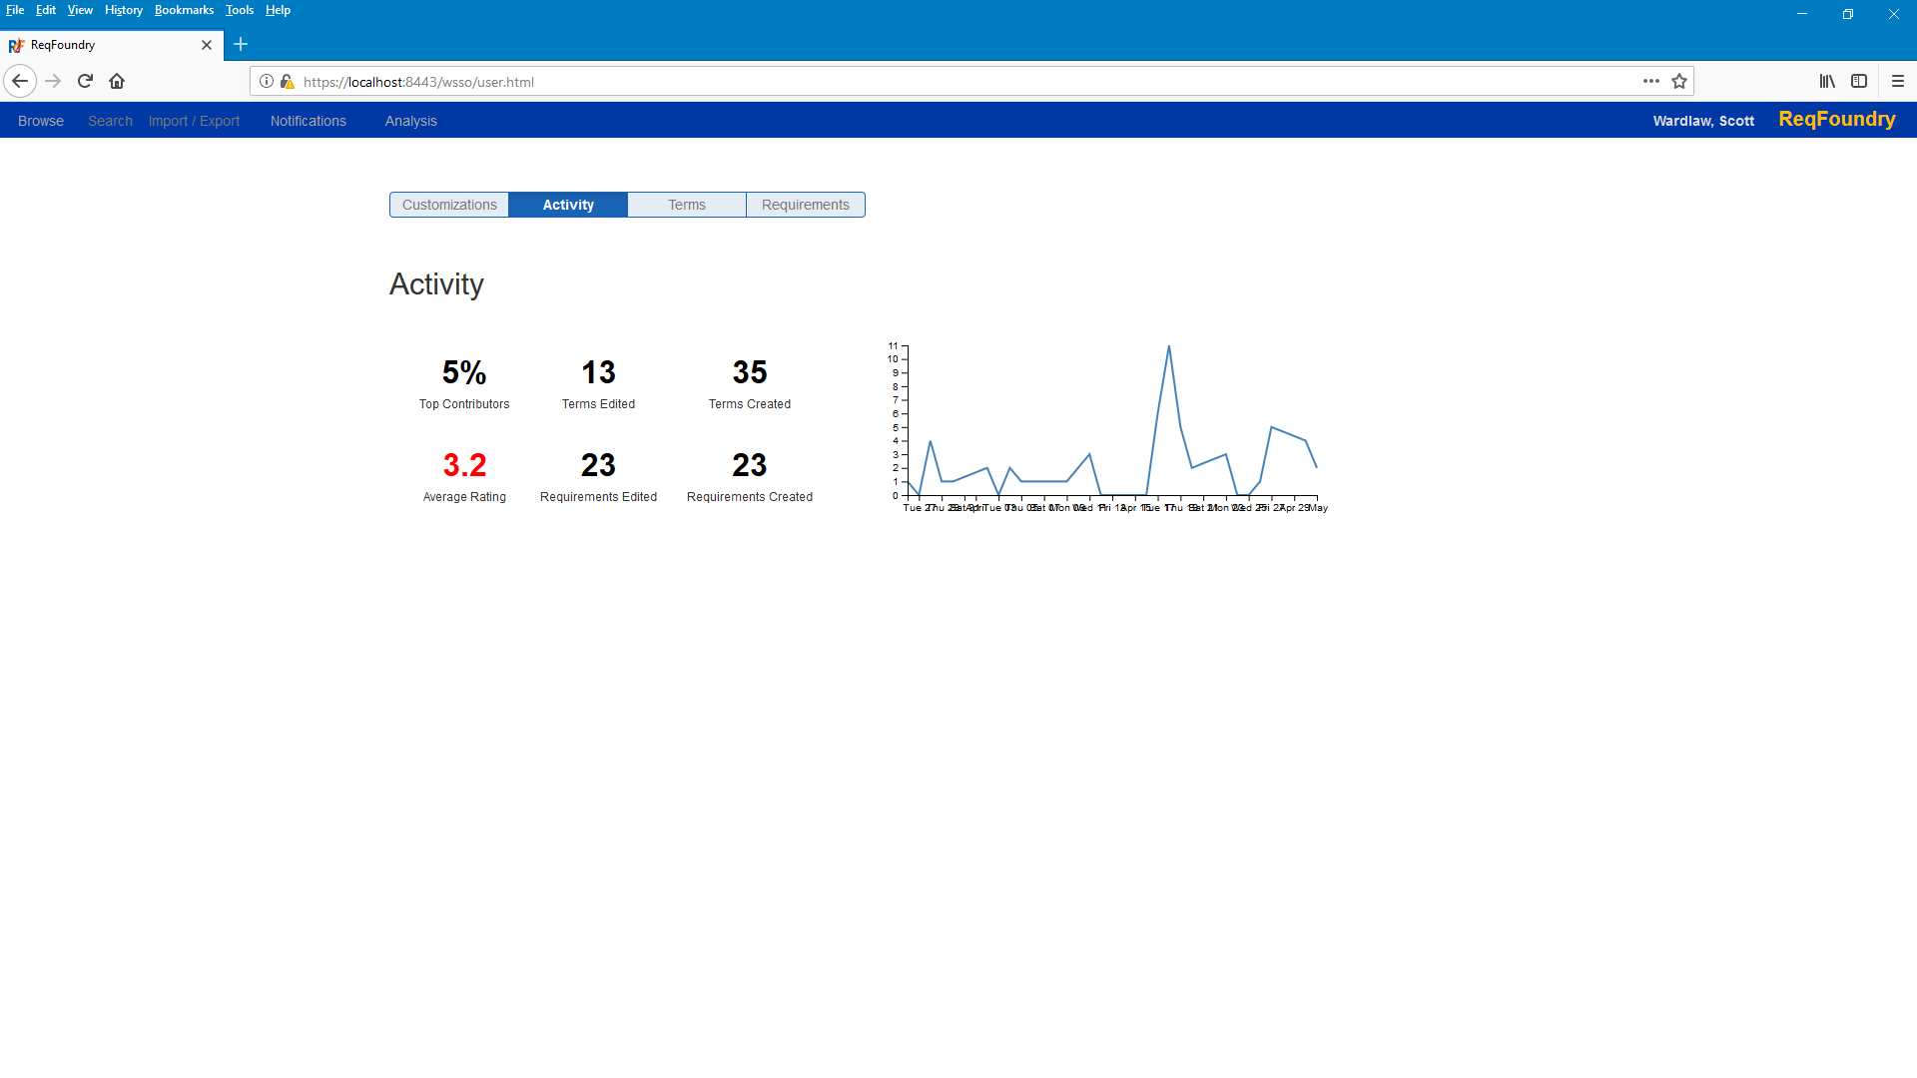
Notes:
Team Name – Arial Bold 18

