Slide 1
Ontologies, Triple Stores and Graph DBs
Alek Przybylo

Slide 2

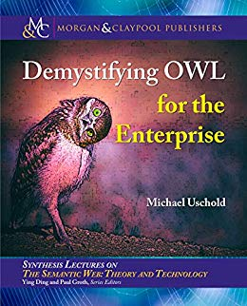
Why am I listening to this presentation?
Demystifying OWL for the Enterprise
by Michael Uschold
American computer scientist
Leading researcher and consultant in knowledge representation and ontology
Ex-Boeing guy!
Semantics Technology Workshop
Semantics-Based Virtual Product Models: Unifying Knowledge and Product Data
Notes:
Playing a game. Who can guess who’s on the picture?
I was confused about ontologies and read this book
There will be a LOT of black and white pictures during this presentation

Slide 3
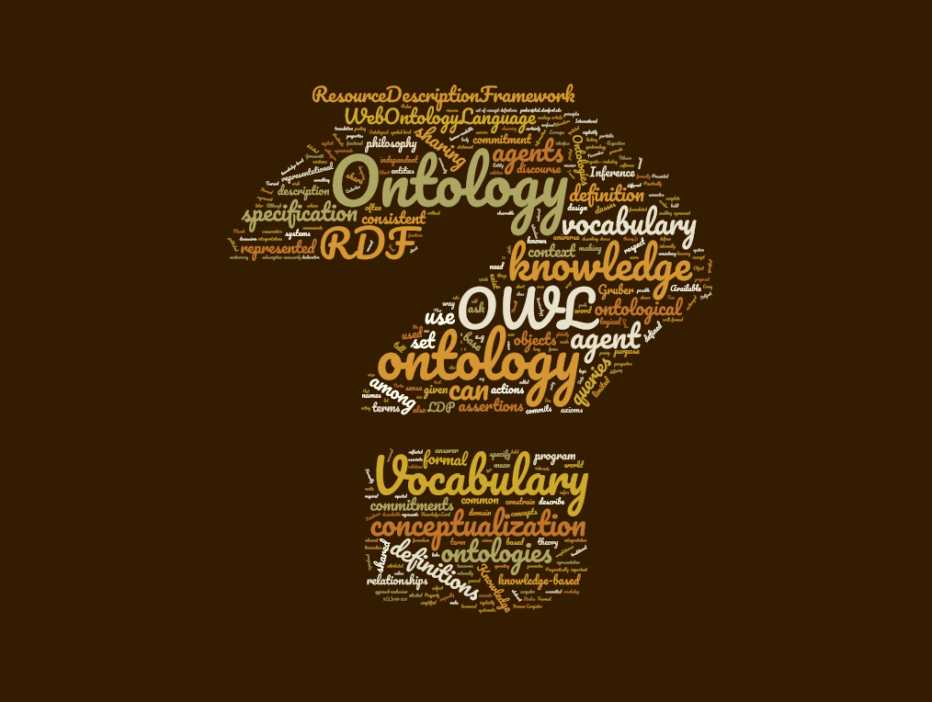

Slide 4
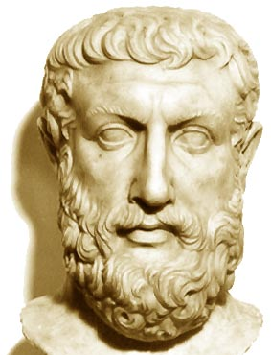
What is an ontology?
Ontology is the philosophical study of being.

Slide 5
What is an ontology?
Ontology is the philosophical study of being.
More broadly, it studies concepts that directly relate to being, in particular becoming, existence, reality, as well as the basic categories of being and their relations.
Clear?
Parmenides
Notes:
Pre-socratic philosopher. Founder of ontology and metaphysics

Slide 6
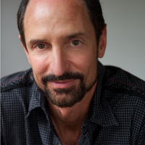
What is an ontology?
Then how about this?
“An ontology is an explicit specification of a conceptualization. The term is borrowed from philosophy, where an ontology is a systematic account of Existence. For knowledge-based systems, what “exists” is exactly that which can be represented.
When the knowledge of a domain is represented in a declarative formalism, the set of objects that can be represented is called the universe of discourse. This set of objects, and the describable relationships among them, are reflected in the representational vocabulary with which a knowledge-based program represents knowledge.”
Gruber, Tom (1993); "A Translation Approach to Portable Ontology Specifications", in Knowledge Acquisition, 5: 199-199
Notes:
The Tom Grubers of this world are why ontologies are obscure!
Co-founder of Siri

Slide 7
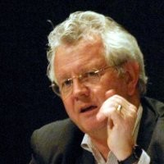
What is an ontology?
On why early adopters abandoned the Semantic Web:
“It almost seemed as if the authors intentionally wanted to encourage the perception of a high priesthood, only able to be fathomed by the chosen few.”
Dave McComb, Foreword for: Michael Uschold (2018), “Demystifying OWL for the Enterprise”
Notes:
Partner at Semantic Arts

Slide 8
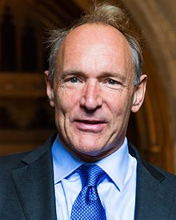
What is an ontology?
In computer science, ontologies have their roots in the concept of the semantic web.

Slide 9
What is an ontology?
In computer science, ontologies have their roots in the concept of the semantic web.
“I have a dream for the Web [in which computers] become capable of analyzing all the data on the Web – the content, links, and transactions between people and computers. A "Semantic Web", which makes this possible, has yet to emerge, but when it does, the day-to-day mechanisms of trade, bureaucracy and our daily lives will be handled by machines talking to machines. The "intelligent agents" people have touted for ages will finally materialize.”
Berners-Lee, Tim; Fischetti, Mark (1999). Weaving the Web. HarperSanFrancisco. chapter 12. ISBN 978-0-06-251587-2.

Slide 10
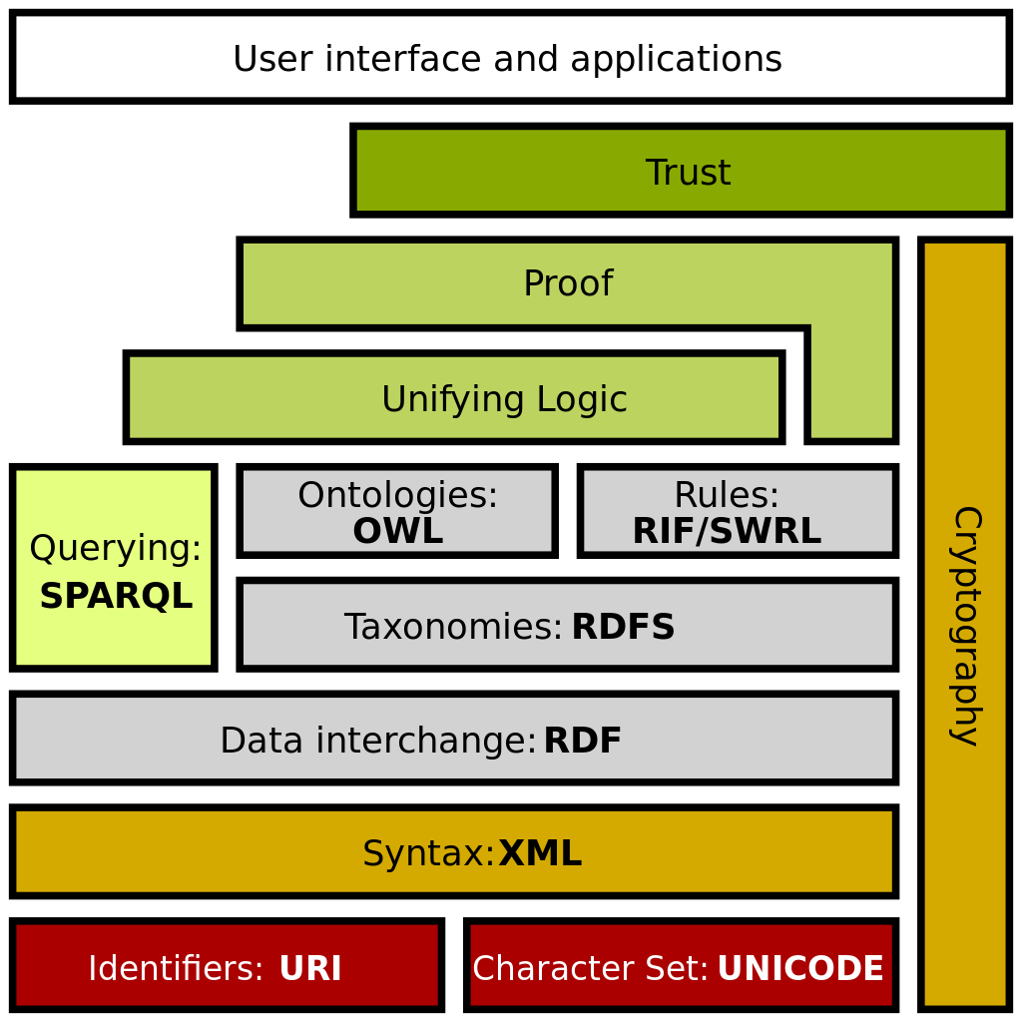
What is an ontology?
OWL: Web Ontology Language

Slide 11

What is an ontology?
OWL: Web Ontology Language
Why OWL and not WOL?
“Why not be inconsistent in at least one aspect of a language which is all about consistency?”
Herman, Iván. "Why OWL and not WOL?". Tutorial on Semantic Web Technologies. World Wide Web Consortium.
Notes:
Key member of W3C

Slide 12

A little bit of DBMS history
Charles Bachman, 1973
IDS and CODASYL
Ted Codd, 1981
Relational model
Carlo Strozzi, 1988
NoSQL
Google BigTable (2005), MongoDB (2009), Amazon DynamoDB (2012)
Notes:
A little bit of history to explain the distinctions between different DBMS
IDS designed in 1960s at GE, Bachman receives Turing Award in 1973 (essentially a network of records/nodes)
Strozzi NoSQL is still relational but doesn’t expose SQL
NoSQL uses data stores optimized for specific purposes. Normally, NoSQL stores data in one of four categories:
- Key-Value storage
- Document storage
- Wide Column storage
- Graph database

Slide 13
OWL vs. other data models
Scope
Relational: Domain
Document: ?
Ontology: Ontology
UML/SysML: Project
Classification
Relational: Table
Document: ?
Ontology: Entity
UML/SysML: Class
Instantiation
Relational: Row
Document: json/xml/… file
Ontology: Thing
UML/SysML: Element
Description
Relational: Schema
Document: xsd file
Ontology: Vocabulary
UML/SysML: Profile
Notes:
In document DBs such as Mongo, most of these don’t exist. A document is an instance and that’s it.

Slide 14
OWL vs. other data models
Person
ID | firstName | lastName | livesIn | employer
0x628346 | Alek | Przybylo | 0x234645 | 0x213464
0x228246 | Al | Capone | 0x743262 | NULL
Company
ID | name | headquarters | field
0x213464 | Boeing | 0x743262 | A&D
0x732632 | Amazon | 0x234645 | Sales
City
ID | name | country | population
0x234645 | Seattle | 0x834762 | 744955
0x743262 | Chicago | 0x834762 | 2705994

Slide 15
OWL vs. other data models
{
“id”: “0x628346”,
“firstName”: “Alek”,
“lastName”: “Przybylo”
“livesIn”: “Seattle”
“employer”: “0x213464”,
“type”: “Person
}
{
“id”: “0x234645”,
“name”: “Seattle”,
“population”: 744955,
“type”: “City”
“nativeName”: “dᶻidᶻəlal̓ič”,
“country”: “0x834762”
}
{
“id”: “0x234645”,
“name”: “Chicago”,
“population”: 2705994,
“type”: “City”,
“country”: “USA”
}
Notes:
Most document databases are schema-less. Notice two things?

Slide 16
OWL vs. other data models
Why URIs?
Tim Berner’s Lee:
1. All kinds of conceptual things, they have names now that start with HTTP.
2. If I take one of these HTTP names and I look it up...I will get back some data in a standard format which is kind of useful data that somebody might like to know about that thing, about that event.
3. When I get back that information it's not just got somebody's height and weight and when they were born, it's got relationships. And when it has relationships, whenever it expresses a relationship then the other thing that it's related to is given one of those names that starts with HTTP.
https://www.ted.com/talks/tim_berners_lee_on_the_next_web
http://example.com/livesIn
Seattle
https://www.seattle.gov
http://example.com/worksFor
Alek
http://example.com/AlekPrzybylo
Boeing
http://www.boeing.com
Al
https://www.fbi.gov/history/famous-cases/al-capone
http://example.com/isHeadquarteredIn
http://example.com/livedIn
Chicago
https://www.chicago.gov
Notes:
Colors show type
The predicates have URIs because they are described in a vocabulary

Slide 17
OWL vs. other data models
Crucial difference #1
In a relational database, the atom is the row.
In a document database, the atom is the document. Its contents can be indexed at more granular levels, but if we delete the document, all information disappears.
In an ontology (triple store), the atom is the triple (equivalent to a single key-value pair in a document or a single column in a row in a RDBMS)
Crucial difference #2
In a relational database, if the data doesn’t conform to the schema, it cannot be inserted.
In a document database, we can insert whatever we want. Schema can be validated as an option.
In an ontology (triple store), we can insert whatever we want. Ontology reasoners can validate whether an ontology is valid.
Caveat: if the triple store is populated from other sources, often those sources have their own schema validations (this is our case: SysML data from Cameo)
Notes:
Caveat: in our case, the schema is validated in advance since it is valid SysML data

Slide 18
OWL vs. other data models
Crucial difference #3
In a relational database, type is inferred by the table name
In a document database, type can but doesn’t have to be declared
In an ontology (triple store), type can be declared or inferred

Slide 19
Inferrence
Class: mbse:System
Class: mbse:PowerSupply
ObjectProperty: mbse:powers
Domain: mbse:PowerSupply
Range: mbse:System
ObjectProperty: mbse:isPoweredBy
InverseOf: mbse:powers
Class: mbse:ElectrifiedSystem
EquivalentTo:
mbse:System and
mbse:isPoweredBy some mbse:PowerSupply
Individual: mbse:_sys543
Annotations: rdfs:label “Entertainment system”
Types: mbse:System
Individual: mbse:_ps123
Annotations: rdfs:label “some power supply”
Types: mbse:PowerSupply
Facts: mbse:powers mbse:_sys543
Notes:
Simplified Manchester syntax

Slide 20
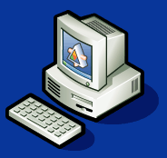

Inferrence
Query: show me individuals of type: “electrified system”
Class: mbse:System
Class: mbse:PowerSupply
ObjectProperty: mbse:powers
Domain: mbse:PowerSupply
Range: mbse:System
ObjectProperty: mbse:isPoweredBy
InverseOf: mbse:powers
Class: mbse:ElectrifiedSystem
EquivalentTo:
mbse:System and
mbse:isPoweredBy some mbse:PowerSupply
Individual: mbse:_sys543
Annotations: rdfs:label “Entertainment system”
Types: mbse:System
Individual: mbse:_ps123
Annotations: rdfs:label “some power supply”
Types: mbse:PowerSupply
Facts: mbse:powers mbse:_sys543

Slide 21
Inferrence
Query: show me individuals of type: “electrified system”
Class: mbse:System
Class: mbse:PowerSupply
ObjectProperty: mbse:powers
Domain: mbse:PowerSupply
Range: mbse:System
ObjectProperty: mbse:isPoweredBy
InverseOf: mbse:powers
Class: mbse:ElectrifiedSystem
EquivalentTo:
mbse:System and
mbse:isPoweredBy some mbse:PowerSupply
Individual: mbse:_sys543
Annotations: rdfs:label “Entertainment system”
Types: mbse:System
Individual: mbse:_ps123
Annotations: rdfs:label “some power supply”
Types: mbse:PowerSupply
Facts: mbse:powers mbse:_sys543
_sys543

Slide 22
Inferrence
Can we do this with RDBMS? Of course we can
System
CREATE VIEW ELECTRIFIEDSYSTEM AS
SELECT SYSTEM.* FROM SYSTEM
INNER JOIN POWERS ON
SYSTEM.ID=POWERS.SYSTEMID
ID | name
1 | Entertainment system
2 | Hydraulic brakes
PowerSupply
ElectrifiedSystem
ID | name | type
1 | PS1 | Battery
2 | PS2 | Alternator
ID | name
1 | Entertainment system
Powers
ID | powerSupplyID | systemID | port
1 | 1 | 1 | 1
Notes:
The difference is in the expression. Ontologies make it more “declarative”

Slide 23
Inferrence pitfalls
Query: show me individuals of type: “Bicycle”
An ill-defined ontology can produce nonsensical results
Class: Bicycle
EquivalentTo:
Vehicle and
hasPart exactly 2 Wheel
hasPart exactly 0 Engine

Slide 24

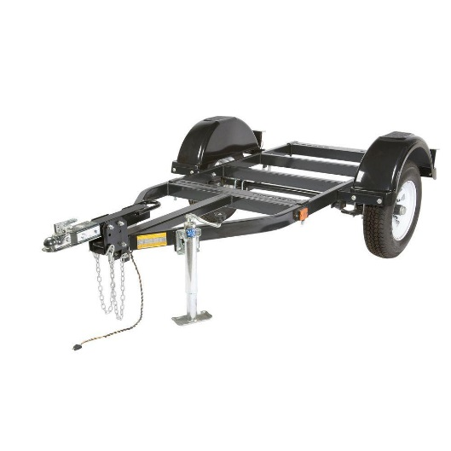

Inferrence pitfalls
Query: show me individuals of type: “Bicycle”
An ill-defined ontology can produce nonsensical results
Class: Bicycle
EquivalentTo:
Vehicle and
hasPart exactly 2 Wheel
hasPart exactly 0 Engine
Hand truck
Trailer
Dufour yacht

Slide 25
Some final comments
Ontologies are still very rarely used in practice
Outside of academia and researchers with expendable budgets
Mainly used in medical research
Inference has exponential complexity
Each new found fact can act as source for other inferences (example: inverseOf then subClass)
All facts are found where no inference produces new facts
Those are typically evaluated at query time
We are not really implementing an ontology but rather a triple store
We take advantage of the powerful capabilities of a graph database without getting lost in the intellectual exercise
Pure Triple Stores are not well suited for transactional data stores with strict configuration control rules
CAUTION!!!
Alek’s opinion
Notes:
Caveat: in our case, the schema is validated in advance since it is valid SysML data
About the last item: This is the reason we use MarkLogic. DocumentDB with triple indexing capability

