Slide 1
SysML data in RDF/SPARQL Tutorial
Alek Przybylo

Slide 2
Contents
RDF/SPARQL fundamentals
MBSE ontology
Query examples
BISQUIT User Interface
Tableau data connector

Slide 3
The anatomy of a triple
A triple is composed of three components: a subject, a predicate and an object, just like a basic sentence:
The Seattle bus #5 stops at the corner of Greenwood Ave and NW 85th Street
The subject is always a “thing”, or rather a URI (Unique Resource Identifier) of the thing. Think of it as an instance of some type that can be uniquely identified. In Cameo, it could be the id of a SysML block.
The predicate is usually described by a verb such as “belongsTo”, “isDescribedBy” etc. Think of it as the name of a property that describes the thing. In Cameo, it could be the name of a property such as “name”.
The object can be a literal (a primitive value like an integer or a string) or a URI of (reference to) another thing. In Cameo, it could be the actual value of the name property, such as “Engine”.
subject
predicate
object

Slide 4
The anatomy of a triple store
A triple store is simply a collection of triples that represents the entire dataset
RDF Triple stores are a type of graph database because the chaining of objects and subjects forms a graph where objects and subjects are nodes and predicates are edges
The following two triples:
airplane hasPart wing
wing hasPart leading edge
where the wing plays the role of the object in one triple but subject in the other forms the following graph:
hasPart
hasPart
leading
edge
airplane
wing

Slide 5
The anatomy of a graph
2345
787 Wing
Integration
mbse:hasPart
8901
787 Wing
mms_id:1234 rdf:type sysml:Block
mms_id:1234 rdfs:label “787”
mms_id:1234 mbse:hasPart mms_id:5678
mms_id:1234 mbse:hasPart mms_id:2345
mms_id:5678 rdf:type sysml:Block
mms_id:5678 rdfs:label “787 Fuselage”
mms_id:5678 mbse:hasPart mms_id:9012
mms_id:2345 rdf:type sysml:Block
mms_id:2345 rdfs:label “787 Wing Integration”
mms_id:2345 mbse:hasPart mms_id:9012
mms_id:9012 rdf:type sysml:Block
mms_id:9012 rdfs:label “787 Fuselage Section 41”
mms_id:9012 sm:isBuiltBy mms_id:3456
mms_id:8901 rdf:type sysml:Block
mms_id:8901 rdfs:label “787 Wing”
mms_id:8901 sm:isBuiltBy mms_id:4567
mms_id:3456 rdf:type sm:Company
mms_id:3456 rdfs:label “Spirit AeroSystems”
mms_id:3456 sm:isHeadquarteredIn mms_id:7890
mms_id:7890 rdf:type sm:City
mms_id:7890 rdfs:label “Kasnas”
mms_id:4567 rdf:type sm:Company
mms_id:4567 rdfs:label “Mitsubishi Heavy Industries”
mms_id:4567 sm:isHeadquarteredIn mms_id:6789
mms_id:6789 rdf:type sm:City
mms_id:6789 rdfs:label “Tokyo”
mbse:hasPart
sm:isBuiltBy
1234
787
6789
Tokyo
sm:isHeadquarteredIn
4567
Mitsubishi
Heavy Industries
mbse:hasPart
5678
787
Fuselage
mbse:hasPart
9012
787 Fuselage
Section 41
sm:isBuiltBy
3456
Spirit
AeroSystems
sm:isHeadquarteredIn
7890
Kansas

Slide 6
The anatomy of a query
mms_id:1234 rdf:type sysml:Block
mms_id:1234 rdfs:label “787”
mms_id:1234 mbse:hasPart mms_id:5678
mms_id:1234 mbse:hasPart mms_id:2345
mms_id:5678 rdf:type sysml:Block
mms_id:5678 rdfs:label “787 Fuselage”
mms_id:5678 mbse:hasPart mms_id:9012
mms_id:2345 rdf:type sysml:Block
mms_id:2345 rdfs:label “787 Wing Integration”
mms_id:2345 mbse:hasPart mms_id:9012
mms_id:9012 rdf:type sysml:Block
mms_id:9012 rdfs:label “787 Fuselage Section 41”
mms_id:9012 sm:isBuiltBy mms_id:3456
mms_id:8901 rdf:type sysml:Block
mms_id:8901 rdfs:label “787 Wing”
mms_id:8901 sm:isBuiltBy mms_id:4567
mms_id:3456 rdf:type sm:Company
mms_id:3456 rdfs:label “Spirit AeroSystems”
mms_id:3456 sm:isHeadquarteredIn mms_id:7890
mms_id:7890 rdf:type sm:City
mms_id:7890 rdfs:label “Kasnas”
mms_id:4567 rdf:type sm:Company
mms_id:4567 rdfs:label “Mitsubishi Heavy Industries”
mms_id:4567 sm:isHeadquarteredIn mms_id:6789
mms_id:6789 rdf:type sm:City
mms_id:6789 rdfs:label “Tokyo”
Notes:
SPARQL Queries essentially find patterns in the triple store

Slide 7
The anatomy of a query
mms_id:1234 rdf:type sysml:Block
mms_id:1234 rdfs:label “787”
mms_id:1234 mbse:hasPart mms_id:5678
mms_id:1234 mbse:hasPart mms_id:2345
mms_id:5678 rdf:type sysml:Block
mms_id:5678 rdfs:label “787 Fuselage”
mms_id:5678 mbse:hasPart mms_id:9012
mms_id:2345 rdf:type sysml:Block
mms_id:2345 rdfs:label “787 Wing Integration”
mms_id:2345 mbse:hasPart mms_id:9012
mms_id:9012 rdf:type sysml:Block
mms_id:9012 rdfs:label “787 Fuselage Section 41”
mms_id:9012 sm:isBuiltBy mms_id:3456
mms_id:8901 rdf:type sysml:Block
mms_id:8901 rdfs:label “787 Wing”
mms_id:8901 sm:isBuiltBy mms_id:4567
mms_id:3456 rdf:type sm:Company
mms_id:3456 rdfs:label “Spirit AeroSystems”
mms_id:3456 sm:isHeadquarteredIn mms_id:7890
mms_id:7890 rdf:type sm:City
mms_id:7890 rdfs:label “Kasnas”
mms_id:4567 rdf:type sm:Company
mms_id:4567 rdfs:label “Mitsubishi Heavy Industries”
mms_id:4567 sm:isHeadquarteredIn mms_id:6789
mms_id:6789 rdf:type sm:City
mms_id:6789 rdfs:label “Tokyo”
?s ?p ?o
Notes:
SPARQL Queries essentially find patterns in the triple store

Slide 8
The anatomy of a query
mms_id:1234 rdf:type sysml:Block
mms_id:1234 rdfs:label “787”
mms_id:1234 mbse:hasPart mms_id:5678
mms_id:1234 mbse:hasPart mms_id:2345
mms_id:5678 rdf:type sysml:Block
mms_id:5678 rdfs:label “787 Fuselage”
mms_id:5678 mbse:hasPart mms_id:9012
mms_id:2345 rdf:type sysml:Block
mms_id:2345 rdfs:label “787 Wing Integration”
mms_id:2345 mbse:hasPart mms_id:9012
mms_id:9012 rdf:type sysml:Block
mms_id:9012 rdfs:label “787 Fuselage Section 41”
mms_id:9012 sm:isBuiltBy mms_id:3456
mms_id:8901 rdf:type sysml:Block
mms_id:8901 rdfs:label “787 Wing”
mms_id:8901 sm:isBuiltBy mms_id:4567
mms_id:3456 rdf:type sm:Company
mms_id:3456 rdfs:label “Spirit AeroSystems”
mms_id:3456 sm:isHeadquarteredIn mms_id:7890
mms_id:7890 rdf:type sm:City
mms_id:7890 rdfs:label “Kasnas”
mms_id:4567 rdf:type sm:Company
mms_id:4567 rdfs:label “Mitsubishi Heavy Industries”
mms_id:4567 sm:isHeadquarteredIn mms_id:6789
mms_id:6789 rdf:type sm:City
mms_id:6789 rdfs:label “Tokyo”
mms_id:1234 ?p ?o
Notes:
SPARQL Queries essentially find patterns in the triple store

Slide 9
The anatomy of a query
mms_id:1234 rdf:type sysml:Block
mms_id:1234 rdfs:label “787”
mms_id:1234 mbse:hasPart mms_id:5678
mms_id:1234 mbse:hasPart mms_id:2345
mms_id:5678 rdf:type sysml:Block
mms_id:5678 rdfs:label “787 Fuselage”
mms_id:5678 mbse:hasPart mms_id:9012
mms_id:2345 rdf:type sysml:Block
mms_id:2345 rdfs:label “787 Wing Integration”
mms_id:2345 mbse:hasPart mms_id:9012
mms_id:9012 rdf:type sysml:Block
mms_id:9012 rdfs:label “787 Fuselage Section 41”
mms_id:9012 sm:isBuiltBy mms_id:3456
mms_id:8901 rdf:type sysml:Block
mms_id:8901 rdfs:label “787 Wing”
mms_id:8901 sm:isBuiltBy mms_id:4567
mms_id:3456 rdf:type sm:Company
mms_id:3456 rdfs:label “Spirit AeroSystems”
mms_id:3456 sm:isHeadquarteredIn mms_id:7890
mms_id:7890 rdf:type sm:City
mms_id:7890 rdfs:label “Kasnas”
mms_id:4567 rdf:type sm:Company
mms_id:4567 rdfs:label “Mitsubishi Heavy Industries”
mms_id:4567 sm:isHeadquarteredIn mms_id:6789
mms_id:6789 rdf:type sm:City
mms_id:6789 rdfs:label “Tokyo”
?s rdfs:label ?o
Notes:
SPARQL Queries essentially find patterns in the triple store

Slide 10
The anatomy of a query
mms_id:1234 rdf:type sysml:Block
mms_id:1234 rdfs:label “787”
mms_id:1234 mbse:hasPart mms_id:5678
mms_id:1234 mbse:hasPart mms_id:2345
mms_id:5678 rdf:type sysml:Block
mms_id:5678 rdfs:label “787 Fuselage”
mms_id:5678 mbse:hasPart mms_id:9012
mms_id:2345 rdf:type sysml:Block
mms_id:2345 rdfs:label “787 Wing Integration”
mms_id:2345 mbse:hasPart mms_id:9012
mms_id:9012 rdf:type sysml:Block
mms_id:9012 rdfs:label “787 Fuselage Section 41”
mms_id:9012 sm:isBuiltBy mms_id:3456
mms_id:8901 rdf:type sysml:Block
mms_id:8901 rdfs:label “787 Wing”
mms_id:8901 sm:isBuiltBy mms_id:4567
mms_id:3456 rdf:type sm:Company
mms_id:3456 rdfs:label “Spirit AeroSystems”
mms_id:3456 sm:isHeadquarteredIn mms_id:7890
mms_id:7890 rdf:type sm:City
mms_id:7890 rdfs:label “Kasnas”
mms_id:4567 rdf:type sm:Company
mms_id:4567 rdfs:label “Mitsubishi Heavy Industries”
mms_id:4567 sm:isHeadquarteredIn mms_id:6789
mms_id:6789 rdf:type sm:City
mms_id:6789 rdfs:label “Tokyo”
?s rdf:type sm:Company
Notes:
SPARQL Queries essentially find patterns in the triple store

Slide 11
The anatomy of a query
?s rdf:type sm:Company ;
rdfs:label ?o .
Notes:
SPARQL Queries essentially find patterns in the triple store

Slide 12
The anatomy of a query
?s rdf:type sm:Company ; Equivalent to:
rdfs:label ?o .
?s rdf:type sm:Company .
?s rdfs:label ?o .
Notes:
SPARQL Queries essentially find patterns in the triple store

Slide 13
The anatomy of a query
?s rdf:type sm:Company ; Equivalent to:
rdfs:label ?o .
Query: ?s rdf:type sm:Company
Matching triples:
mms_id:3456 rdf:type sm:Company
mms_id:4567 rdf:type sm:Company
?s rdf:type sm:Company .
?s rdfs:label ?o .
Notes:
SPARQL Queries essentially find patterns in the triple store

Slide 14
The anatomy of a query
?s rdf:type sm:Company ; Equivalent to:
rdfs:label ?o .
Query: ?s rdf:type sm:Company
Matching triples:
mms_id:3456 rdf:type sm:Company
mms_id:4567 rdf:type sm:Company
Solutions:
?s
mms_id:3456
mms_id:4567
?s rdf:type sm:Company .
?s rdfs:label ?o .
Notes:
SPARQL Queries essentially find patterns in the triple store

Slide 15
The anatomy of a query
?s rdf:type sm:Company ; Equivalent to:
rdfs:label ?o .
Query: ?s rdf:type sm:Company
Matching triples:
mms_id:3456 rdf:type sm:Company
mms_id:4567 rdf:type sm:Company
Solutions:
?s
mms_id:3456
mms_id:4567
?s rdf:type sm:Company .
?s rdfs:label ?o .
Query:?s rdfs:label ?o
Matching triples:
mms_id:1234 rdfs:label “787”
mms_id:5678 rdfs:label “787 Fuselage”
mms_id:2345 rdfs:label “787 Wing Integration”
mms_id:9012 rdfs:label “787 Fuselage Section 41”
mms_id:8901 rdfs:label “787 Wing”
mms_id:3456 rdfs:label “Spirit AeroSystems”
mms_id:7890 rdfs:label “Kasnas”
mms_id:4567 rdfs:label “Mitsubishi Heavy Industries”
mms_id:6789 rdfs:label “Tokyo”
Notes:
SPARQL Queries essentially find patterns in the triple store

Slide 16
The anatomy of a query
?s rdf:type sm:Company ; Equivalent to:
rdfs:label ?o .
Query: ?s rdf:type sm:Company
Matching triples:
mms_id:3456 rdf:type sm:Company
mms_id:4567 rdf:type sm:Company
Solutions:
?s
mms_id:3456
mms_id:4567
?s rdf:type sm:Company .
?s rdfs:label ?o .
Query:?s rdfs:label ?o
Matching triples:
mms_id:1234 rdfs:label “787”
mms_id:5678 rdfs:label “787 Fuselage”
mms_id:2345 rdfs:label “787 Wing Integration”
mms_id:9012 rdfs:label “787 Fuselage Section 41”
mms_id:8901 rdfs:label “787 Wing”
mms_id:3456 rdfs:label “Spirit AeroSystems”
mms_id:7890 rdfs:label “Kasnas”
mms_id:4567 rdfs:label “Mitsubishi Heavy Industries”
mms_id:6789 rdfs:label “Tokyo”
Solutions:
?s ?o
mms_id:1234 “787”
mms_id:5678 “787 Fuselage”
mms_id:2345 “787 Wing Integration”
mms_id:9012 “787 Fuselage Section 41”
mms_id:8901 “787 Wing”
mms_id:3456 “Spirit AeroSystems”
mms_id:7890 “Kasnas”
mms_id:4567 “Mitsubishi Heavy Industries”
mms_id:6789 “Tokyo”
Notes:
SPARQL Queries essentially find patterns in the triple store

Slide 17
The anatomy of a query
?s rdf:type sm:Company ; Equivalent to:
rdfs:label ?o .
Query: ?s rdf:type sm:Company
Matching triples:
mms_id:3456 rdf:type sm:Company
mms_id:4567 rdf:type sm:Company
Solutions:
?s
mms_id:3456
mms_id:4567
?s rdf:type sm:Company .
?s rdfs:label ?o .
Query:?s rdfs:label ?o
Matching triples:
mms_id:1234 rdfs:label “787”
mms_id:5678 rdfs:label “787 Fuselage”
mms_id:2345 rdfs:label “787 Wing Integration”
mms_id:9012 rdfs:label “787 Fuselage Section 41”
mms_id:8901 rdfs:label “787 Wing”
mms_id:3456 rdfs:label “Spirit AeroSystems”
mms_id:7890 rdfs:label “Kasnas”
mms_id:4567 rdfs:label “Mitsubishi Heavy Industries”
mms_id:6789 rdfs:label “Tokyo”
Solutions:
?s ?o
mms_id:1234 “787”
mms_id:5678 “787 Fuselage”
mms_id:2345 “787 Wing Integration”
mms_id:9012 “787 Fuselage Section 41”
mms_id:8901 “787 Wing”
mms_id:3456 “Spirit AeroSystems”
mms_id:7890 “Kasnas”
mms_id:4567 “Mitsubishi Heavy Industries”
mms_id:6789 “Tokyo”
Notes:
SPARQL Queries essentially find patterns in the triple store

Slide 18
The anatomy of a query
?s rdf:type sm:Company ; Equivalent to:
rdfs:label ?o .
Query: ?s rdf:type sm:Company
Matching triples:
mms_id:3456 rdf:type sm:Company
mms_id:4567 rdf:type sm:Company
Solutions:
?s
mms_id:3456
mms_id:4567
?s rdf:type sm:Company .
?s rdfs:label ?o .
Query:?s rdfs:label ?o
Matching triples:
mms_id:1234 rdfs:label “787”
mms_id:5678 rdfs:label “787 Fuselage”
mms_id:2345 rdfs:label “787 Wing Integration”
mms_id:9012 rdfs:label “787 Fuselage Section 41”
mms_id:8901 rdfs:label “787 Wing”
mms_id:3456 rdfs:label “Spirit AeroSystems”
mms_id:7890 rdfs:label “Kasnas”
mms_id:4567 rdfs:label “Mitsubishi Heavy Industries”
mms_id:6789 rdfs:label “Tokyo”
Solutions:
?s ?o
mms_id:1234 “787”
mms_id:5678 “787 Fuselage”
mms_id:2345 “787 Wing Integration”
mms_id:9012 “787 Fuselage Section 41”
mms_id:8901 “787 Wing”
mms_id:3456 “Spirit AeroSystems”
mms_id:7890 “Kasnas”
mms_id:4567 “Mitsubishi Heavy Industries”
mms_id:6789 “Tokyo”
Query solutions:
?s ?o
mms_id:3456 “Spirit AeroSystems”
mms_id:4567 “Mitsubishi Heavy Industries”
Notes:
SPARQL Queries essentially find patterns in the triple store

Slide 19
What are all the parts on the 787 program, built in Tokyo?
2345
787 Wing
Integration
mbse:hasPart
8901
787 Wing
We first need to locate the nodes whose type is Block and name is 787
Then we need to find all parts
Make it recursive to find parts of parts
Then find the supplier that builds the part
And the city it’s headquartered in
mbse:hasPart
sm:isBuiltBy
1234
787
6789
Tokyo
sm:isHeadquarteredIn
4567
Mitsubishi
Heavy Industries
mbse:hasPart
5678
787
Fuselage
SELECT *
WHERE
{
?787node rdfs:label “787 ;
rdf:type sysml:Block ;
mbse:hasPart ?part .
?part sm:isBuiltBy ?supplier .
?supplier sm:isHeadquarteredIn ?city .
}
mbse:hasPart
9012
787 Fuselage
Section 41
+
sm:isBuiltBy
3456
Spirit
AeroSystems
sm:isHeadquarteredIn
7890
Kansas

Slide 20
What are all the parts on the 787 program, built in Tokyo?
2345
787 Wing
Integration
mbse:hasPart
8901
787 Wing
We first need to locate the nodes whose type is Block and name is 787
Then we need to find all parts
Make it recursive to find parts of parts
Then find the supplier that builds the part
And the city it’s headquartered in
Finally, the city’s name needs to be Tokyo
mbse:hasPart
sm:isBuiltBy
1234
787
6789
Tokyo
sm:isHeadquarteredIn
4567
Mitsubishi
Heavy Industries
mbse:hasPart
5678
787
Fuselage
SELECT *
WHERE
{
?787node rdfs:label “787 ;
rdf:type sysml:Block ;
mbse:hasPart+ ?part .
?part sm:isBuiltBy ?supplier .
?supplier sm:isHeadquarteredIn ?city .
?city rdfs:label “Tokyo” .
}
mbse:hasPart
9012
787 Fuselage
Section 41
sm:isBuiltBy
3456
Spirit
AeroSystems
sm:isHeadquarteredIn
7890
Kansas

Slide 21
What are all the parts on the 787 program, built in Tokyo?
2345
787 Wing
Integration
mbse:hasPart
8901
787 Wing
We first need to locate the nodes whose type is Block and name is 787
Then we need to find all parts
Make it recursive to find parts of parts
Then find the supplier that builds the part
And the city it’s headquartered in
Finally, the city’s name needs to be Tokyo
mbse:hasPart
sm:isBuiltBy
1234
787
6789
Tokyo
sm:isHeadquarteredIn
4567
Mitsubishi
Heavy Industries
mbse:hasPart
5678
787
Fuselage
SELECT *
WHERE
{
?787node rdfs:label “787 ;
rdf:type sysml:Block ;
mbse:hasPart+ ?part .
?part sm:isBuiltBy ?supplier .
?supplier sm:isHeadquarteredIn/ rdfs:label “Tokyo” .
}
mbse:hasPart
9012
787 Fuselage
Section 41
sm:isBuiltBy
3456
Spirit
AeroSystems
sm:isHeadquarteredIn
7890
Kansas

Slide 22
What are all the parts on the 787 program, built in Tokyo?
2345
787 Wing
Integration
mbse:hasPart
8901
787 Wing
We first need to locate the nodes whose type is Block and name is 787
Then we need to find all parts
Make it recursive to find parts of parts
Then find the supplier that builds the part
And the city it’s headquartered in
Finally, the city’s name needs to be Tokyo
mbse:hasPart
sm:isBuiltBy
1234
787
6789
Tokyo
sm:isHeadquarteredIn
4567
Mitsubishi
Heavy Industries
mbse:hasPart
5678
787
Fuselage
SELECT *
WHERE
{
?787node rdfs:label “787 ;
rdf:type sysml:Block ;
mbse:hasPart+ ?part .
?part sm:isBuiltBy ?supplier .
?supplier sm:isHeadquarteredIn/ rdfs:label ?cityName .
FILTER (?cityName = “Tokyo”)
}
mbse:hasPart
9012
787 Fuselage
Section 41
sm:isBuiltBy
3456
Spirit
AeroSystems
sm:isHeadquarteredIn
7890
Kansas

Slide 23
What are all the parts on the 787 program, built in Tokyo?
2345
787 Wing
Integration
mbse:hasPart
8901
787 Wing
SELECT *
WHERE
{
?787node rdfs:label “787 ;
rdf:type sysml:Block ;
mbse:hasPart+ ?part .
?part sm:isBuiltBy ?supplier .
?supplier sm:isHeadquarteredIn/rdfs:label ?cityName .
FILTER (?cityName = “Tokyo”)
}
mbse:hasPart
sm:isBuiltBy
1234
787
6789
Tokyo
sm:isHeadquarteredIn
4567
Mitsubishi
Heavy Industries
mbse:hasPart
5678
787
Fuselage
mbse:hasPart
?787node | ?part | ?supplier | ?cityName
1234 | 8901 | 4567 | Tokyo
9012
787 Fuselage
Section 41
sm:isBuiltBy
3456
Spirit
AeroSystems
sm:isHeadquarteredIn
7890
Kansas

Slide 24
What are all the parts on the 787 program, built in Tokyo?
2345
787 Wing
Integration
mbse:hasPart
8901
787 Wing
SELECT *
WHERE
{
?787node rdfs:label “787 ;
rdf:type sysml:Block ;
mbse:hasPart+ ?part .
?part rdfs:label ?partName ;
sm:isBuiltBy ?supplier .
?supplier rdfs:label ?supplierName ;
sm:isHeadquarteredIn/rdfs:label ?cityName .
FILTER (?cityName = “Tokyo”)
}
mbse:hasPart
sm:isBuiltBy
1234
787
6789
Tokyo
sm:isHeadquarteredIn
4567
Mitsubishi
Heavy Industries
mbse:hasPart
5678
787
Fuselage
mbse:hasPart
?787node | ?part | ?part Name | ?supplier | ?supplier Name | ?city Name
1234 | 8901 | 787 Wing | 4567 | Mitsubishi Heavy Industries | Tokyo
9012
787 Fuselage
Section 41
sm:isBuiltBy
3456
Spirit
AeroSystems
sm:isHeadquarteredIn
7890
Kansas

Slide 25
What are all the parts on the 787 program, built in Tokyo?
2345
787 Wing
Integration
mbse:hasPart
8901
787 Wing
SELECT ?partName
WHERE
{
?787node rdfs:label “787 ;
rdf:type sysml:Block ;
mbse:hasPart+ ?part .
?part rdfs:label ?partName ;
sm:isBuiltBy ?supplier .
?supplier rdfs:label ?supplierName ;
sm:isHeadquarteredIn/rdfs:label ?cityName .
FILTER (?cityName = “Tokyo”)
}
mbse:hasPart
sm:isBuiltBy
1234
787
6789
Tokyo
sm:isHeadquarteredIn
4567
Mitsubishi
Heavy Industries
mbse:hasPart
5678
787
Fuselage
mbse:hasPart
?partName
787 Wing
9012
787 Fuselage
Section 41
sm:isBuiltBy
3456
Spirit
AeroSystems
sm:isHeadquarteredIn
7890
Kansas

Slide 26
What we learned so far?
SELECT and WHERE statements
The where defines the graph pattern that we are looking for and the variables to which specific values will be bound
The select statement chooses the variables that should be returned
FILTER statement
Limits the results returned to only those that satisfy some condition
Property paths
Provide ability to traverse multiple edges at once:
{?s p1/p2 ?o} first traverses p1 to an anonymous object, then traverses p2 from the anonymous subject to the final object ?o
{?s p+ ?o} traverses the predicate p once, then as many more times as it is found
See https://www.w3.org/TR/sparql11-property-paths for more info on property paths

Slide 27
MBSE Ontology
mms thing namespace: <http://mbse.web.boeing.com/mms/>
used for URIs of RDF things. Generated by appending element sysml ids.
mbse namespace: <http://mbse.web.boeing.com/ontologies/2019/05/mbse#>
isPartOf, isConnectedTo, isSatisfiedBy, isDecomposedBy, …
uml namespace: <http://mbse.web.boeing.com/ontologies/2019/05/uml#>
id, name, type, description, sourceId, targetId, …
mms namespace: <http://mbse.web.boeing.com/ontologies/2019/05/mms#>
appliedStereotypeId, projectId, commitId, …
rdf namespaces: <http://www.w3.org/1999/02/22-rdf-syntax-ns#>
type
rdfs namespace: <http://www.w3.org/2000/01/rdf-schema#>
label, subclass
dc namespace: <http://purl.org/dc/terms/>
created, modified, creator
Example: <http://mbse.web.boeing.com/ontologies/2019/05/mbse#isPartOf>

Slide 28
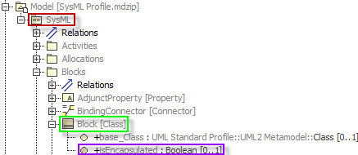
MBSE Ontology
Each profile (standard or custom) is mapped to an additional namespace
Properties defined under Stereotypes define additional predicates within the profile namespace
Example:
<http://mbse.web.boeing.com/ontologies/2019/05/ sysml # isEncapsulated >
NOTE: The stereotype name is not used in the construction of the predicate
Profile
Stereotype
Property

Slide 29
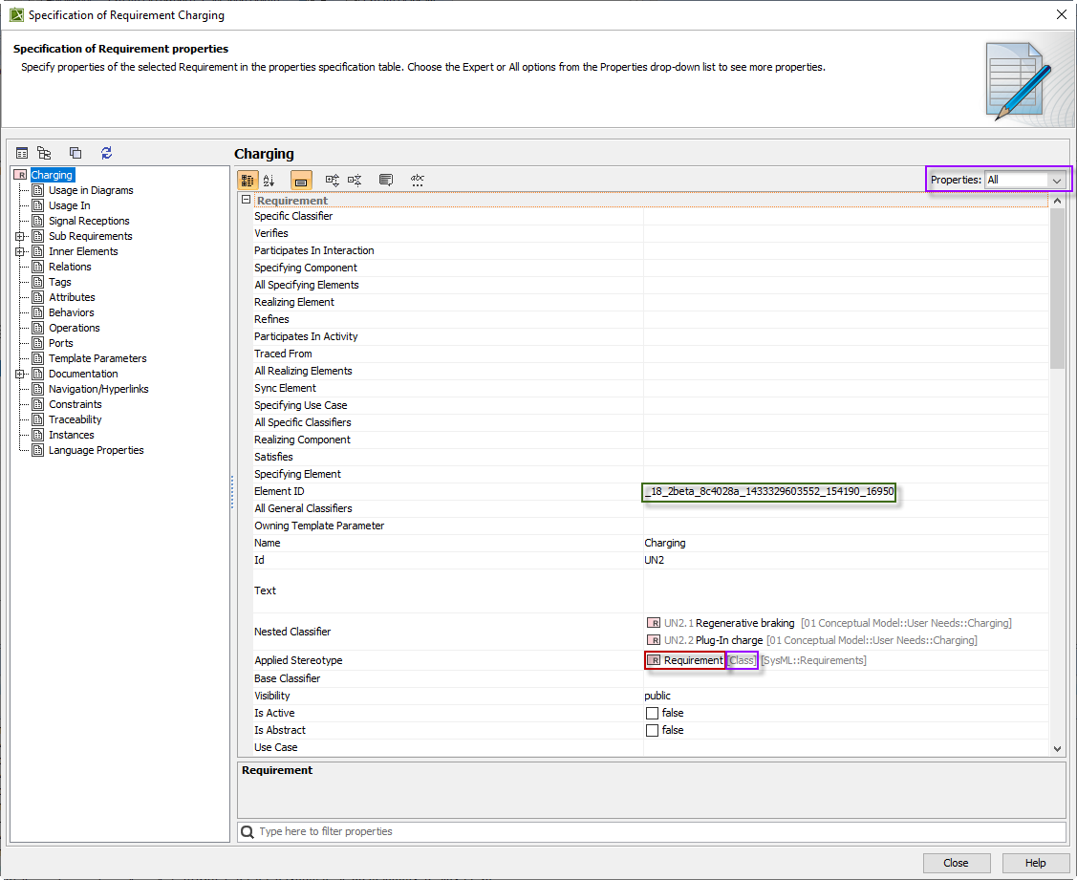
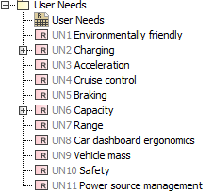
Example 1: Element type
Query for types of an element in the “Implied Relations” sample Cameo project
Properties must be set to “All” in order to see the Element ID
Element ID used to construct the URI
Applied Stereotype
UML Metatype

Slide 30
Example 1: Element type
Use the mms thing (mms_id) namespace and the element id to get all triples where the Element is the object
PREFIX mms_id: <http://mbse.web.boeing.com/mms/>
select *
where {
mms_id:_18_2beta_8c4028a_1433329603552_154190_16950 ?p ?o .
}

Slide 31
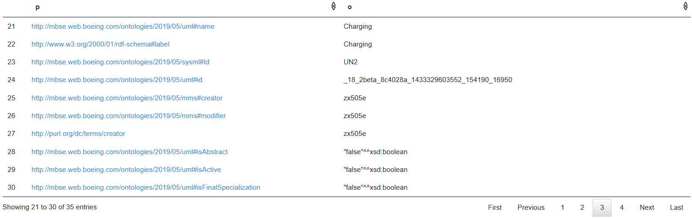
Example 1: Element type

Slide 32

Example 1: Element type
Use the mms thing (mms_id) namespace and the element id to get all triples where the Element is the object
Use the uml type predicate to get all the Metatype types
PREFIX mms_id: <http://mbse.web.boeing.com/mms/>
PREFIX uml: <http://mbse.web.boeing.com/ontologies/2019/05/uml#>
select *
where {
mms_id:_18_2beta_8c4028a_1433329603552_154190_16950 uml:type ?type .
}

Slide 33
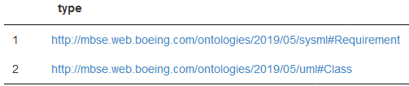
Example 1: Element type
Use the mms thing (mms_id) namespace and the element id to get all triples where the Element is the object
Use the rdf type predicate to get all types including stereotypes
PREFIX mms_id: <http://mbse.web.boeing.com/mms/>
PREFIX rdf: <http://www.w3.org/1999/02/22-rdf-syntax-ns#>
select *
where {
mms_id:_18_2beta_8c4028a_1433329603552_154190_16950 rdf:type ?type .
}

Slide 34
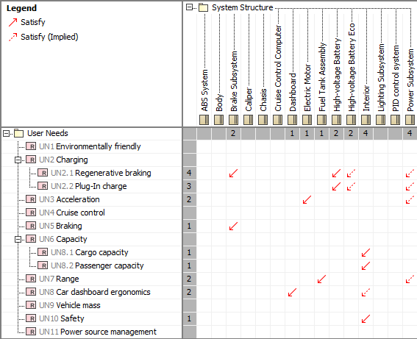
Example 2: Satisfy links
Find subsystems satisfying requirements (user needs) in the “Implied Relations” sample Cameo project. Report the requirement ID.

Slide 35
Example 2: Satisfy links
First, find the requirements
Filter the requirements to only those present under the “User Needs” package
PREFIX rdf: <http://www.w3.org/1999/02/22-rdf-syntax-ns#>
PREFIX sysml: <http://mbse.web.boeing.com/ontologies/2019/05/sysml#>
PREFIX mbse: <http://mbse.web.boeing.com/ontologies/2019/05/mbse#>
PREFIX rdfs: <http://www.w3.org/2000/01/rdf-schema#>
select *
where {
?req rdf:type sysml:Requirement ;
mbse:isHeldBy*/rdfs:label "User Needs" .
}

Slide 36
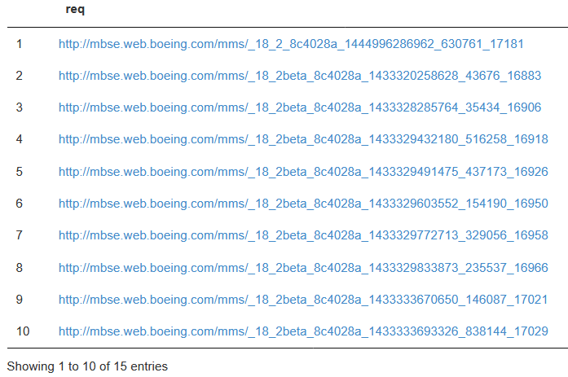
Example 2: Satisfy links

Slide 37
Example 2: Satisfy links
First, find the requirements
Filter the requirements to only those present under the “User Needs” package
Fetch the requirement ID
PREFIX rdf: <http://www.w3.org/1999/02/22-rdf-syntax-ns#>
PREFIX sysml: <http://mbse.web.boeing.com/ontologies/2019/05/sysml#>
PREFIX mbse: <http://mbse.web.boeing.com/ontologies/2019/05/mbse#>
PREFIX rdfs: <http://www.w3.org/2000/01/rdf-schema#>
select *
where {
?req rdf:type sysml:Requirement ;
mbse:isHeldBy*/rdfs:label "User Needs" ;
sysml:Id ?Id .
}

Slide 38
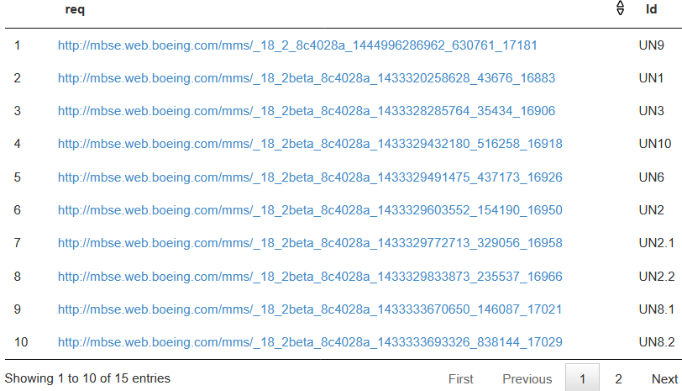
Example 2: Satisfy links

Slide 39
Example 2: Satisfy links
First, find the requirements
Filter the requirements to only those present under the “User Needs” package
Fetch the requirement ID
Find all objects pointing to the requirements through Satisfy links
PREFIX rdf: <http://www.w3.org/1999/02/22-rdf-syntax-ns#>
PREFIX sysml: <http://mbse.web.boeing.com/ontologies/2019/05/sysml#>
PREFIX mbse: <http://mbse.web.boeing.com/ontologies/2019/05/mbse#>
PREFIX rdfs: <http://www.w3.org/2000/01/rdf-schema#>
select *
where {
?req rdf:type sysml:Requirement ;
mbse:isHeldBy*/rdfs:label "User Needs" ;
sysml:Id ?Id .
?subsystem sysml:Satisfy ?req .
}

Slide 40
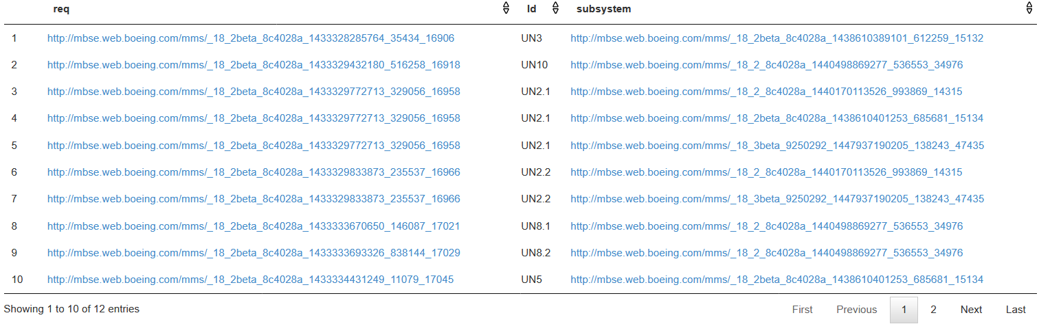
Example 2: Satisfy links

Slide 41
Example 2: Satisfy links
First, find the requirements
Filter the requirements to only those present under the “User Needs” package
Fetch the requirement ID
Find all objects pointing to the requirements through Satisfy links
Replace the ids with names
PREFIX rdf: <http://www.w3.org/1999/02/22-rdf-syntax-ns#>
PREFIX sysml: <http://mbse.web.boeing.com/ontologies/2019/05/sysml#>
PREFIX mbse: <http://mbse.web.boeing.com/ontologies/2019/05/mbse#>
PREFIX rdfs: <http://www.w3.org/2000/01/rdf-schema#>
select ?reqName ?Id ?subSystemName
where {
?req rdf:type sysml:Requirement ;
mbse:isHeldBy*/rdfs:label "User Needs" ;
sysml:Id ?Id ;
rdfs:label ?reqName .
?subsystem sysml:Satisfy ?req ;
rdfs:label ?subSystemName .
}

Slide 42
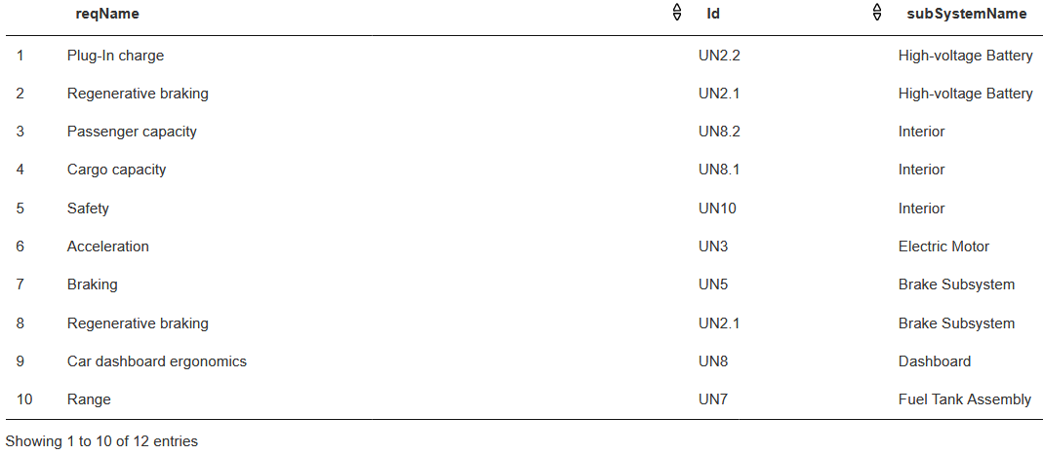
Example 2: Satisfy links

Slide 43
What we learned so far?
UML metatypes and stereotype names can both be used to filter elements by type
UML types are in the uml namespace
<http://mbse.web.boeing.com/ontologies/2019/05/uml#Class>
Profile specific types are in the corresponding profile namespace
<http://mbse.web.boeing.com/ontologies/2019/05/sysml#Requirement>
The profile namespaces can be applied to tag names and relationships in the predicate or to types in the object portion of the triple
Relationships can be directly traversed using the metatype or stereotype of the link element

